Slide 1
Recent progress in understanding breakdown

Slide 2
I would like to start my presentation with what I believe are some of the essential questions which motivate and direct our study of breakdown.
I will then describe some recent progress in answering those questions.
Why bother understanding? Breakdowns happen anyway.
What features on, or near, a surface cause a breakdown to occur at a particular place? How do these features form? What causes the features to begin the run-away process we detect as breakdown? Which leads to the question,
Where does the breakdown rate come from? What gives the principle dependencies – breakdown rate on gradient and pulse length?

Slide 3
Why bother understanding? Breakdowns happen anyway.
We observe a very strong dependence of achievable accelerating gradient on the rf geometry. Linac parameters are also a strong function of rf geometry: wakefields, shunt impedance, rf to beam efficiency etc.
Being able to predict the gradient a given structure will achieve (based on a specific technology) allows us to optimize the overall design of the accelerator. This dependence is not simply the surface electric field…
Parameter Routine
Luminosity, …
CLIC re-baselining exercise currently underway.
I_{drive}
E_{drive}
τ_{RF}
N_{sector}
N_{combine}
f_{r}
N
n_{b}
n_{cycle}
E₀
f_{r}
E_{cms,} G, L_{structure}
Two-Beam Acceleration Complex
L_{module}, Δ_{structure}, …
Drive Beam Generation Complex
P_{klystron}, N_{klystron}, L_{DBA}, …
Main Beam Generation Complex
P_{klystron}, …

Slide 4
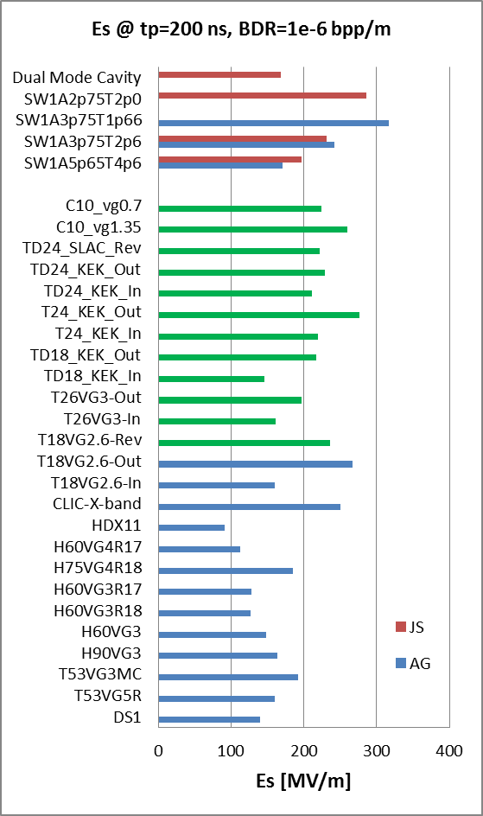
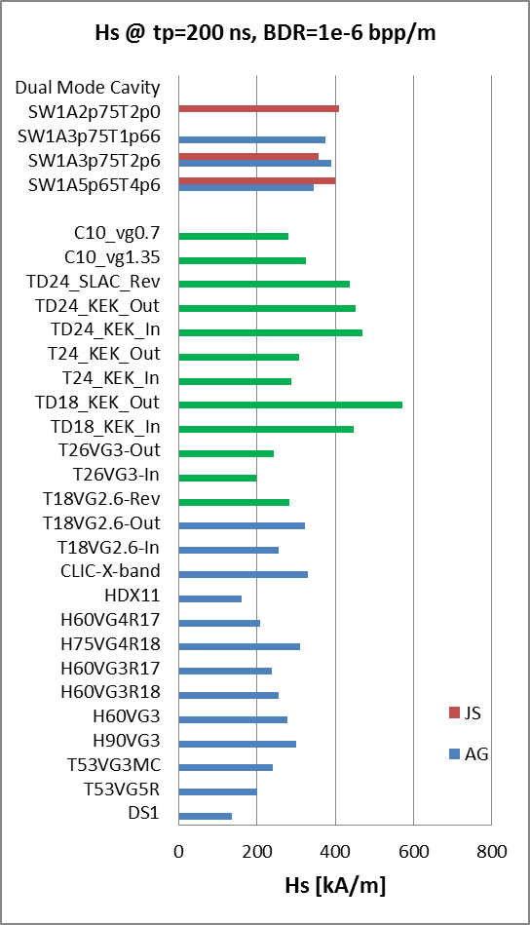
Maximum surface electric and magnetic fields
Waveguide
damped
Es = 220 - 250 MW/mm²

Slide 5
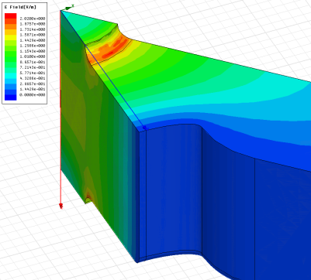
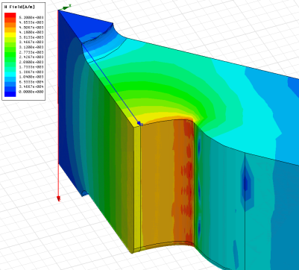
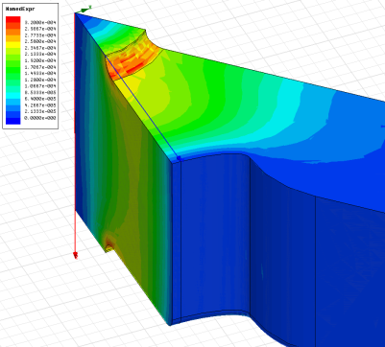
High-power design laws
The functions which, along with surface electric and magnetic field (pulsed surface heating), give the high-gradient performance of the structures are:
E_{s}/E_{a}
global power flow
local complex power flow
New local field quantity describing the high gradient limit of accelerating structures.
A. Grudiev, S. Calatroni, W. Wuensch (CERN). 2009. 9 pp.
Published in Phys.Rev.ST Accel.Beams 12 (2009) 102001
H_{s}/E_{a}
S_{c}/E_{a}²

Slide 6
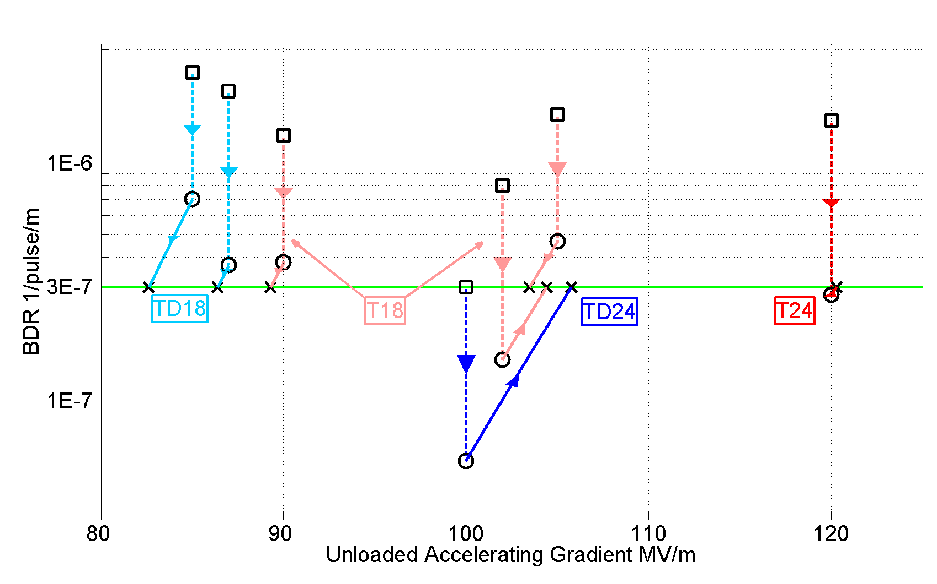
Accelerating gradients achieved in tests.
Status: 4-9-2012
HOM damped

Slide 7
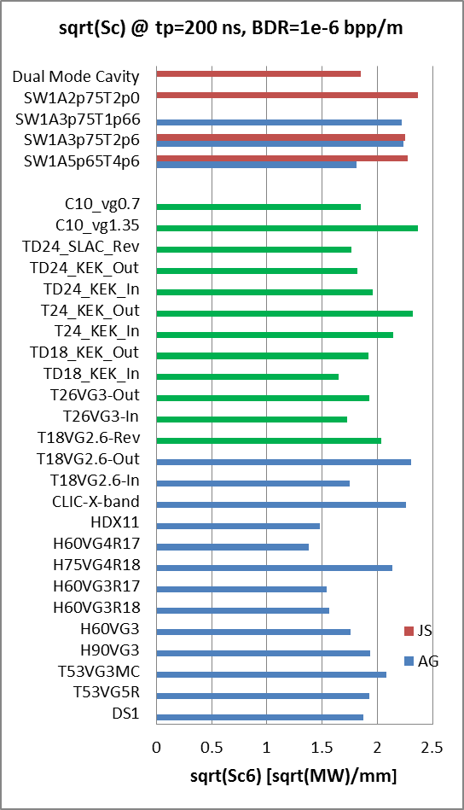
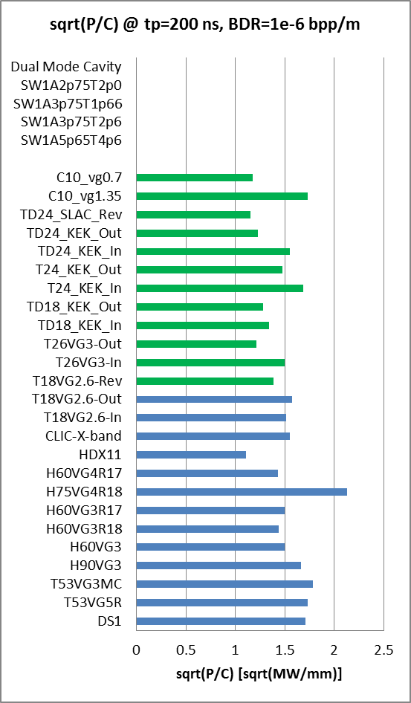
Power flow related quantities: Sc and P/C
Sc = 4 - 5 MW/mm²
P/C = 2.3 – 2.9 MW/mm

Slide 8
What features on, or near, a surface cause a breakdown to occur at a particular place?
Our field has depended on the proverbial field emission “tip” with the corresponding field enhancement factor β in order to reconcile observed field emission with the Fowler-Norheim equation.
We keep talking about these tips even though no-one has ever taken pictures of them nor can anyone predict the β a surface will have except through field emission.
Typical values of β in our high gradient accelerating structures are in the range of 50-100.
But there can be more than geometrical field enhancement…
Surface-Emission Studies in a High-Field RF Gun based on Measurements of Field Emission and Schottky-Enabled Photoemission H. Chen, Y. Du, W. Gai, A. Grudiev, J. Hua, W. Huang, J. G. Power, E. E. Wisniewski, W. Wuensch, C. Tang, L. Yan, and Y. You
Phys. Rev. Lett. 109, 204802 – Published 14 November 2012

Slide 9
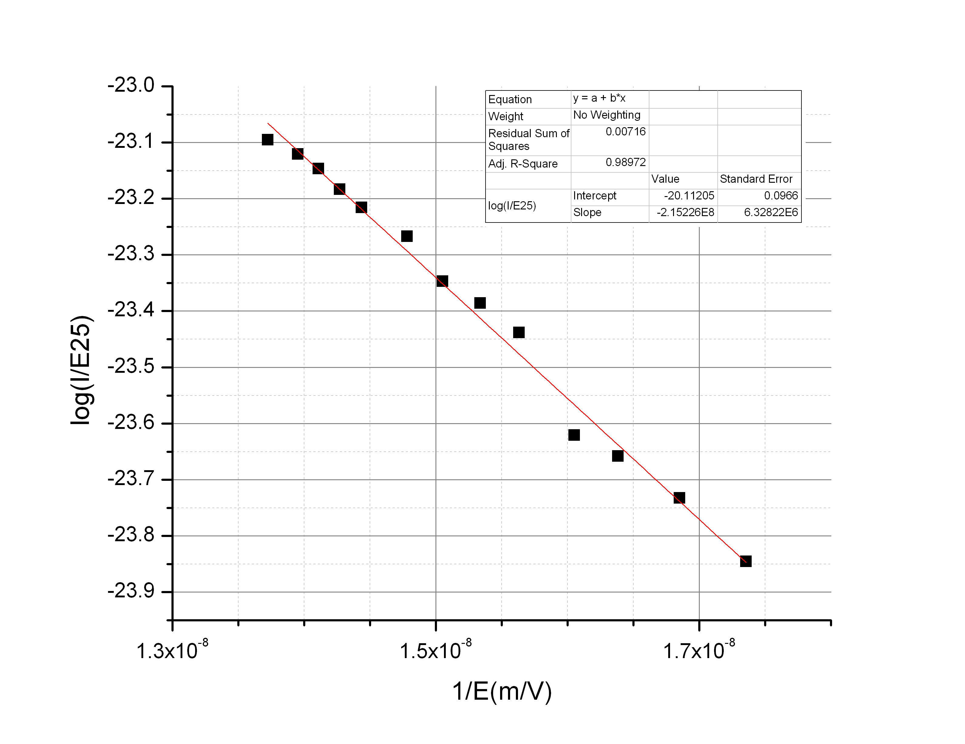
Electron emission
Fowler Nordheim Law (RF fields):
I_{FN}
(β, φ₀, A_{e}, E₀)
High field enhancements (β) can field emission.
Low work function (φ₀) in small areas can cause field emission.
typical picture ➔
geometric perturbations (β)
alternate picture ➔
material perturbations (φ₀)
grain
boundaries
peaks
oxides
cracks
Copper surface
inclusions
(suggested by Wuensch and colleagues)

Slide 10
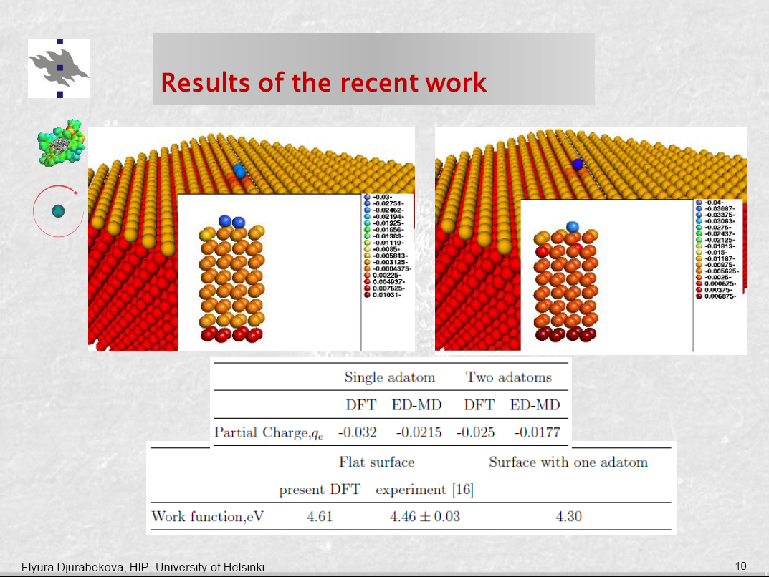

Slide 11
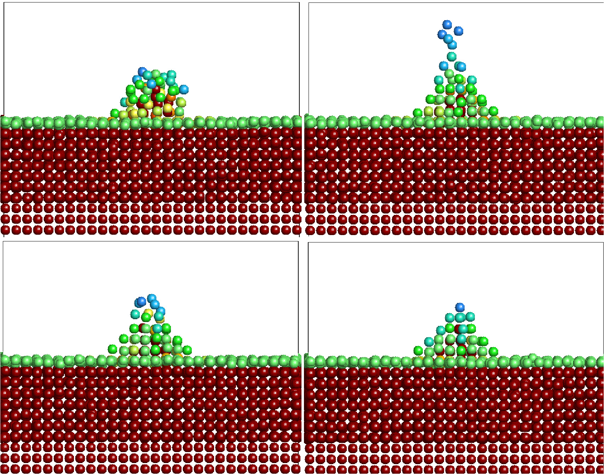
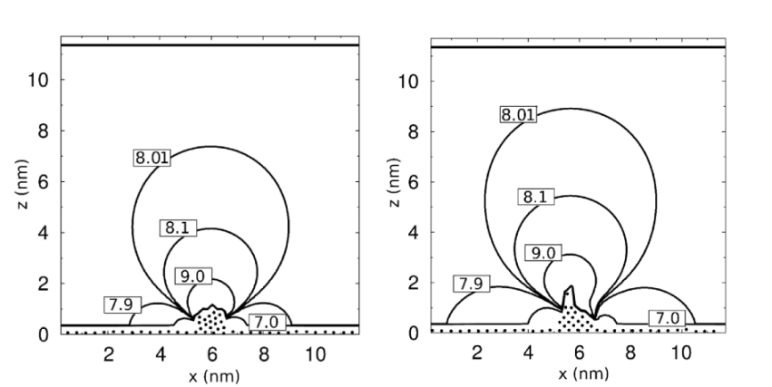
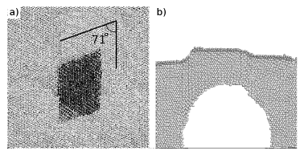
Electrodynamics-molecular dynamic model+ study of a void under tensile stress
Details in F. Djurabekova, S. Parviainen, A. Pohjonen and K. Nordlund, PRE 83, 026704 (2011).
ED-MD model follows the evolution of the charged surface.
The dynamics of atom charges follows the shape of electric field distortion on tips on the surface
We also studies the dislocation dynamics on a void burrowed near the surface in Cu held under unilater tensile stress.
A. Pohjonen, F. Djurabekova, et al., Jour. Appl. Phys. 110, 023509 (2011).

Slide 12
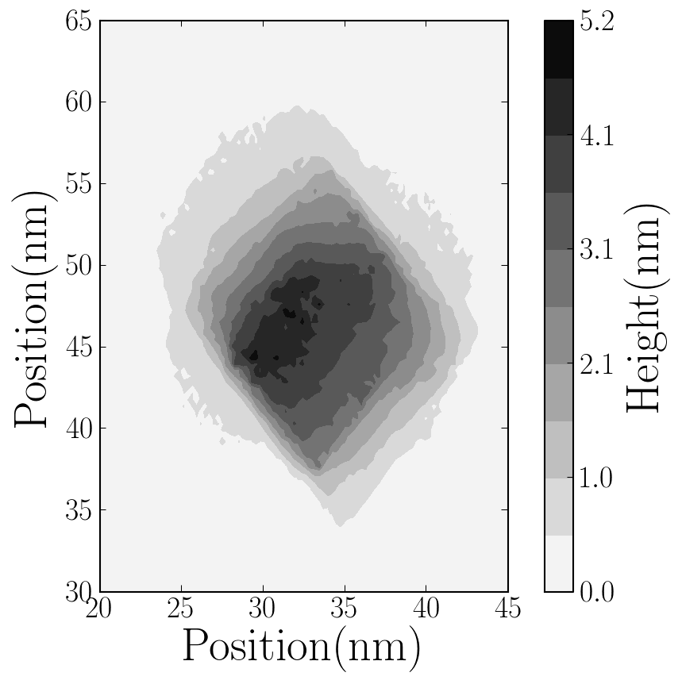
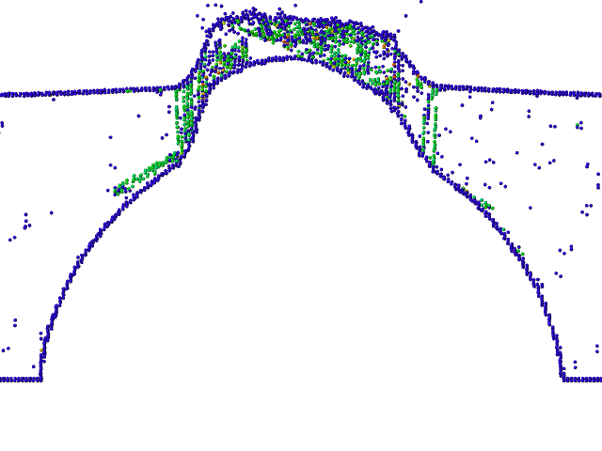
“Catastrophic”growth of a protrusion at the void
. the top view and a slice of the system at time t = 130 ps when the fully developed protrusion is clearly visible.

Slide 13


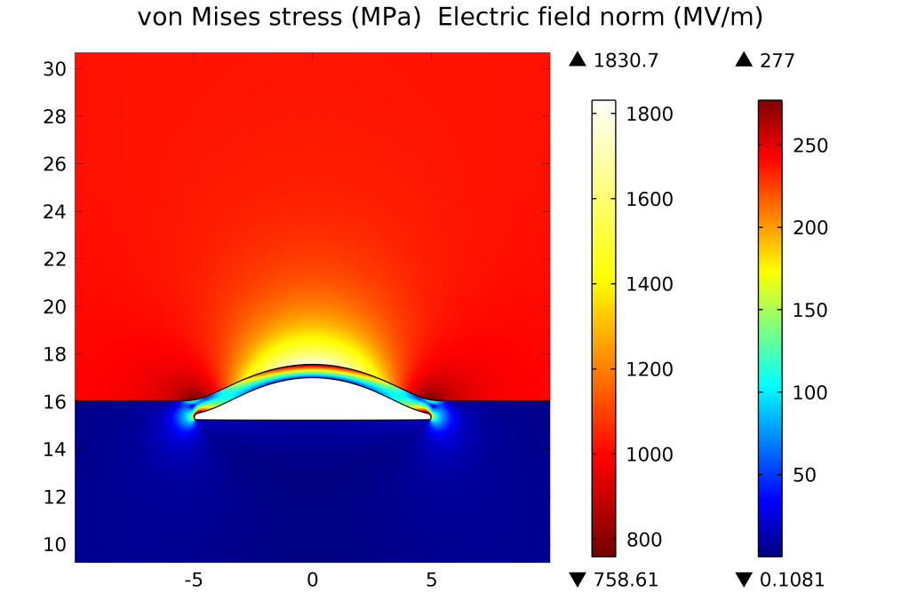
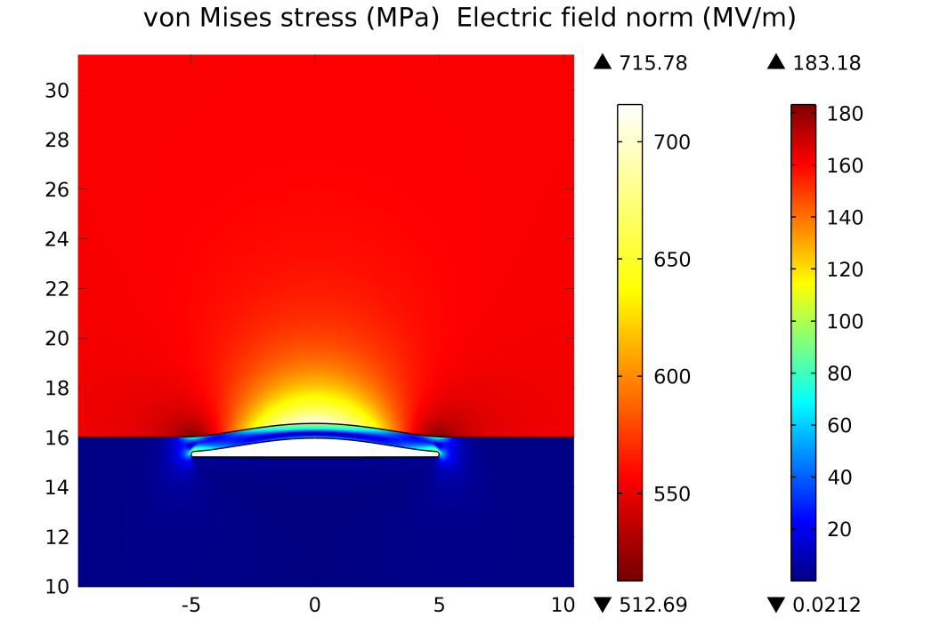
Deformation at realistic electric field strength
Void formation starts at fields > 400 MV/m
Material is plastic only in the vicinity of the defect
Thin slit may be formed by combination of voids or by a layer of fragile impurities
Field enhancement factor ~2.4
Thin material layer over the void acts like a lever, decreasing the pressure needed for protrusion formation
Vahur Zahdin

Slide 14
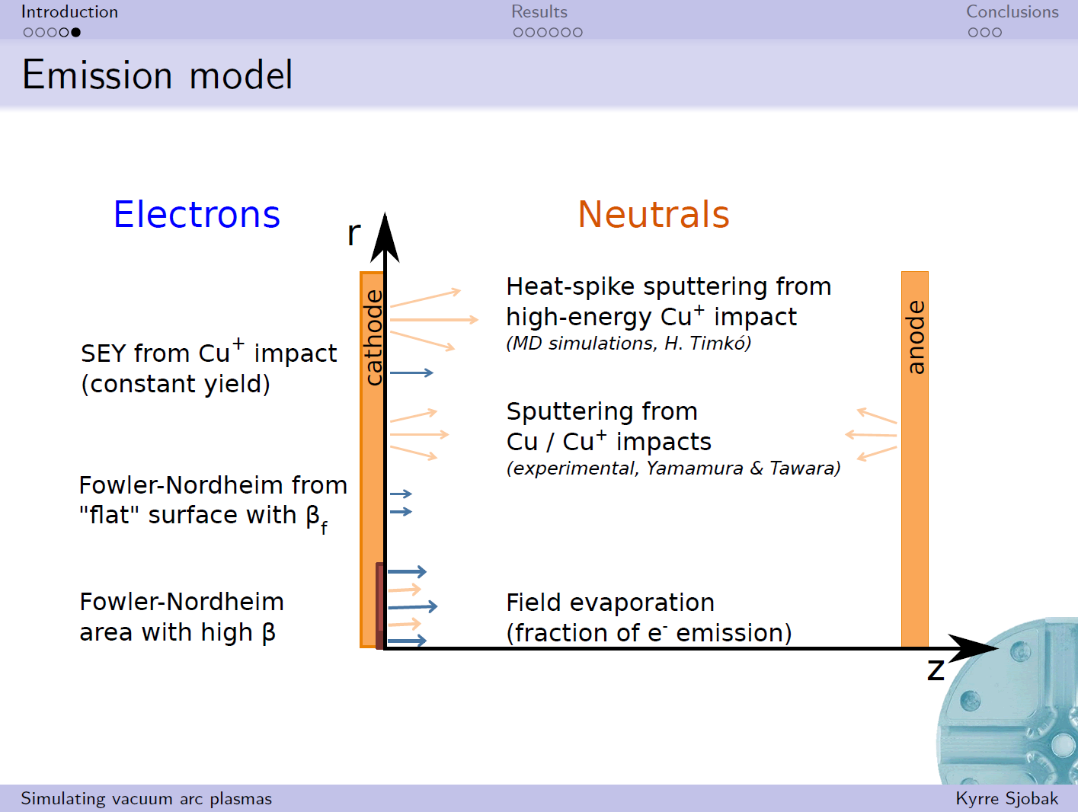

Slide 15
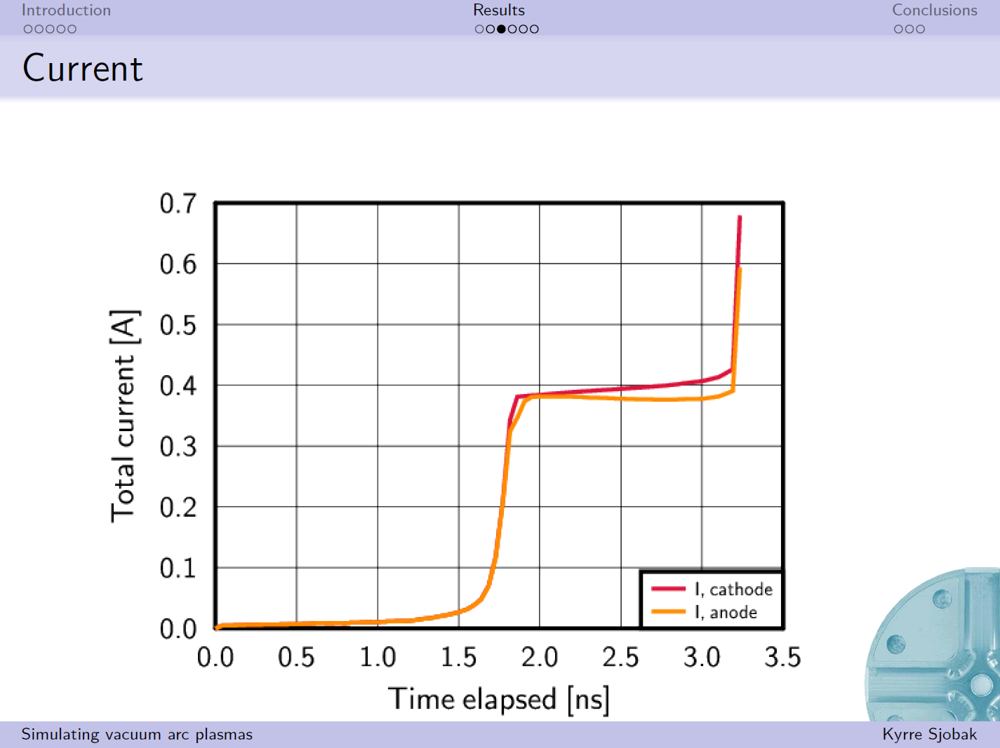

Slide 16
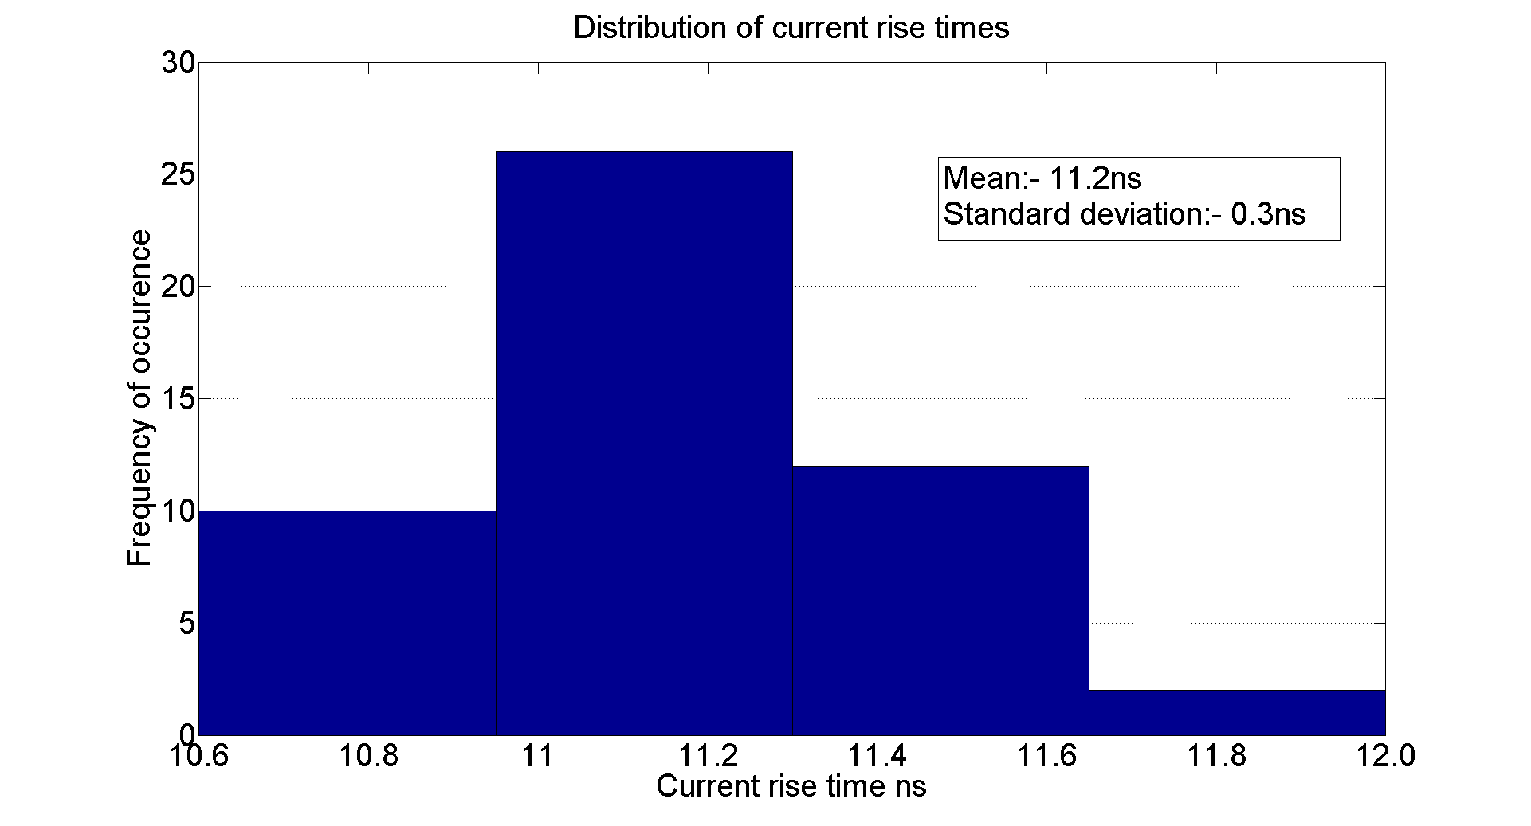
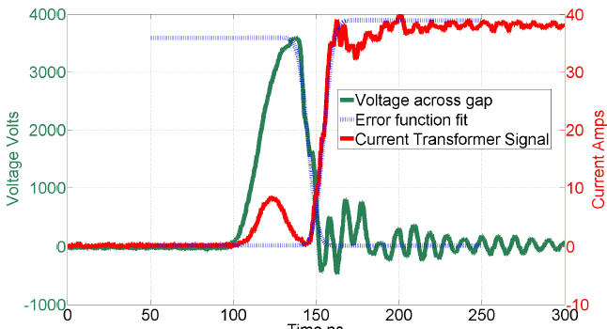
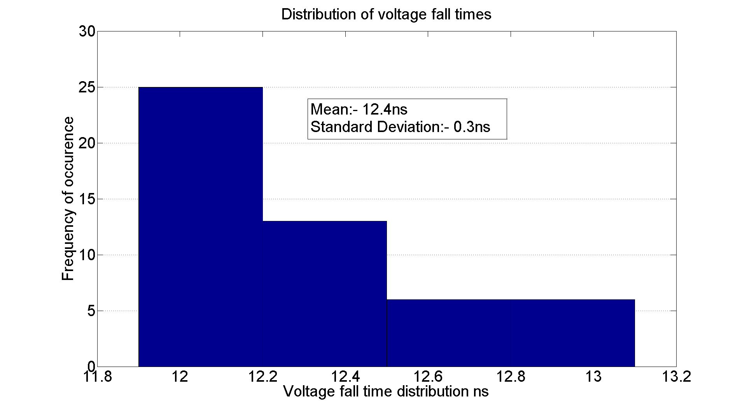
DC Spark System Turn on Time
Sample size = 50
The spread in voltage fall times (and current rise times) is extremely small compared to the RF case.
The measured current rise time always shorter than voltage fall time due to initial charging current overlap.

Slide 17
Summary of turn on times
Test | Frequency | Measurement | Result
Simulation |  |  | 0.25ns
New DC System | DC | Voltage Fall Time | 12-13ns
Swiss FEL (C-Band) | 5.7GHz | Transmitted Power Fall Time | 110 - 140ns
KEK T24 (X-Band) | 12GHz | Transmitted Power Fall Time | 20-40ns
CTF/TBTS TD24 (X-Band) | 12GHz | Transmitted Power Fall Time | 20-40ns
CTF SICA (S-Band) | 3GHz | Transmitted Power | 60-140ns
The turn on time does not seem to be related to the bandwidth of the structures but to the frequency or possibly the intrinsic size.

Slide 18
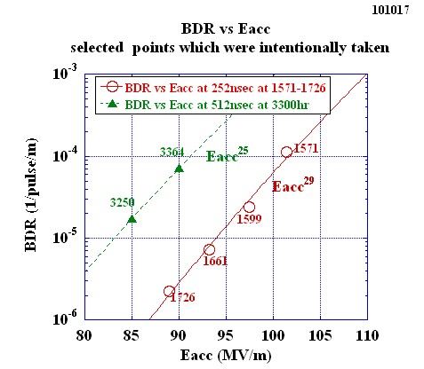
Relevant data points of BDR vs Eacc
TD18
Steep rise as Eacc, 10 times per 10 MV/m, less steep than T18
T. Higo, KEK

Slide 19
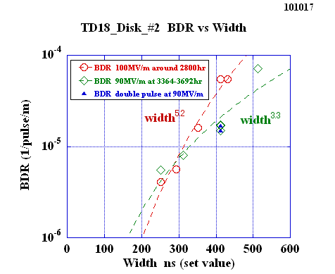
TD18_#2 BDR versus width at 100MV/m around 2800hr and at 90MV/m around 3500hr
TD18
Similar dependence at 90 and 100 if take usual single pulse?
T. Higo, KEK

Slide 20
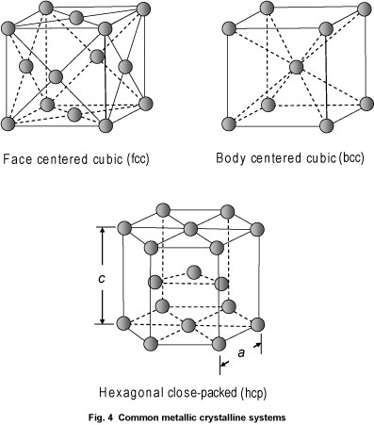
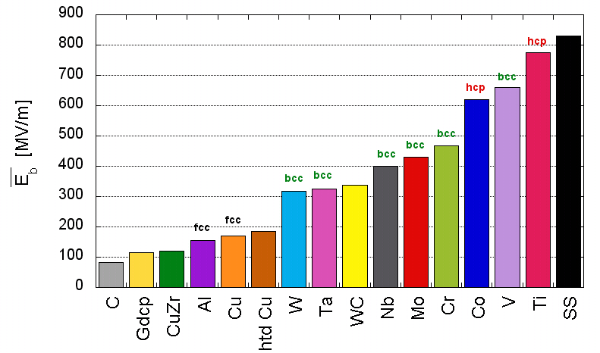
What are the field emitters? Why do we look for dislocations?
The dislocation motion is strongly bound to the atomic structure of metals. In FCC (face-centered cubic) the dislocation are the most mobile and HCP (hexagonal close-packed) are the hardest for dislocation mobility.
A. Descoeudres, F. Djurabekova, and K. Nordlund, DC Breakdown experiments with
cobalt electrodes, CLIC-Note XXX, 1 (2010).

Slide 21
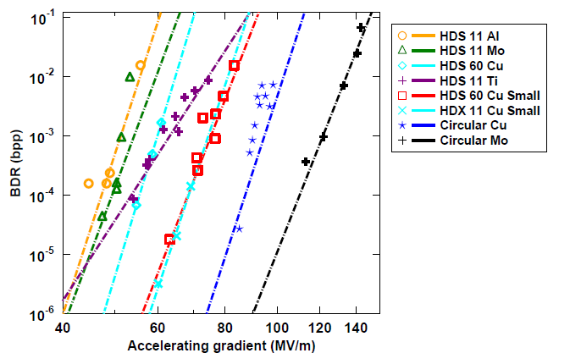
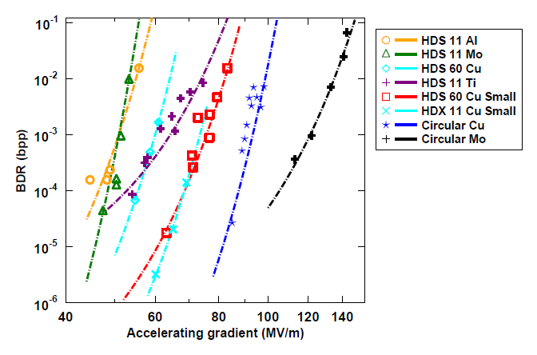
Dislocation-based model for electric field dependence
Now to test the relevance of this, we fit the experimental data
The result is:
Power law fit
Stress model fit
[W. Wuensch, public presentation at the CTF3, available online at http://indico.cern.ch/conferenceDisplay.py?confId=8831.] with the model.]

Slide 22
Pulsed surface heating limit
TD24
Last
regular
cell: 19
Cell # (cell #1 is a input matching cell):
4
?16?
5
6
7
8
9
10
11
12
13
14
15
17
18
It seems that cell #10 (regular cell #9 ~ middle cell) exhibits the level of damage which could be considered as a limit.
A. Grudiev
Images courtesy of M. Aicheler: http://indico.cern.ch/getFile.py/access?contribId=0&resId=1&materialId=slides&confId=106251

Slide 23
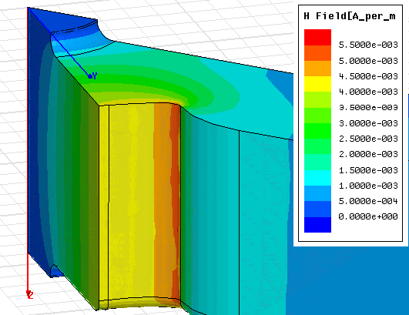
Features in high current region of TD18
Current density around 2x10⁸A/cm² during test
Damping waveguide
Inner cell

Slide 24
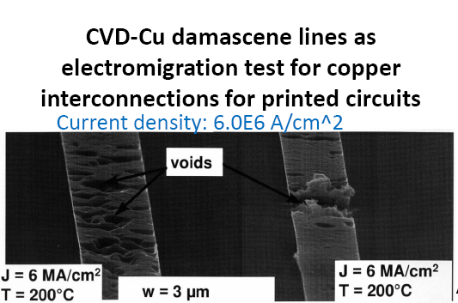
Electromigration
Our current(!) explaination is that these features are due to electromigration. Electromigration is the transport of atoms in a conductor due to momentum transfer from the current.
This can cause the formation of voids and breakup of the material.
The effect has been a problem in semiconductor interconnects – at current densities of

Slide 25
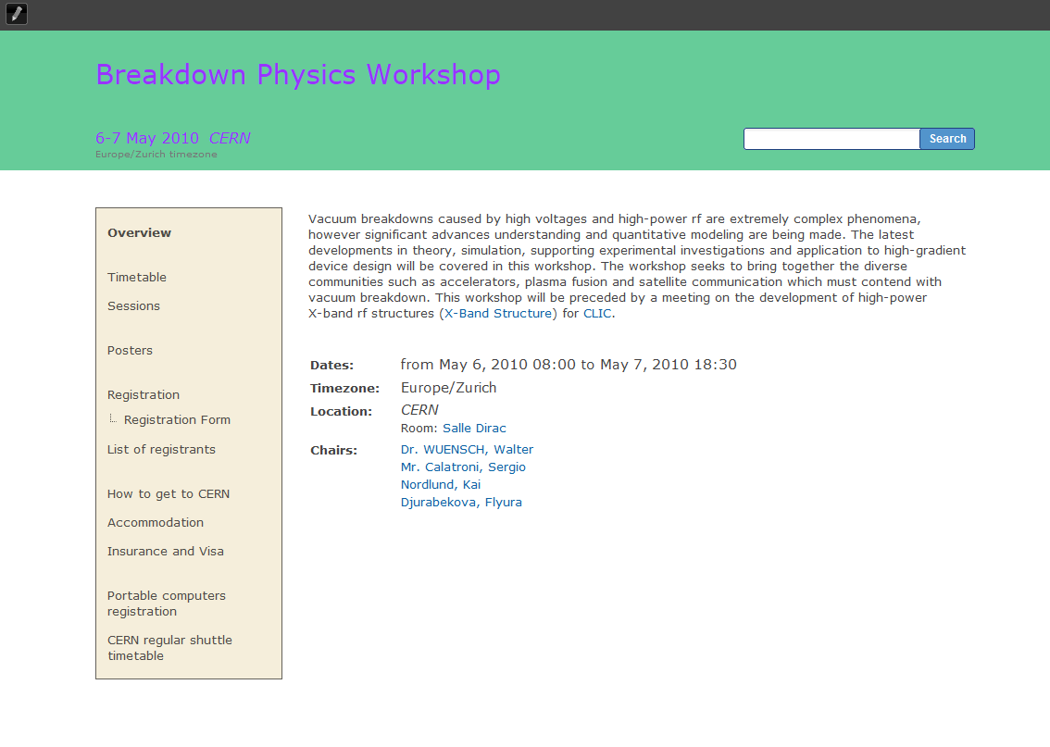


MeVArc – Multidisciplinary and multi-application workshop dedicated to breakdown physics
http://www.regonline.com/builder/site/default.aspx?EventID=1065351
This year 5-7 November – hosted by CERN.
http://indico.cern.ch/conferenceDisplay.py?confId=246618

