Slide 1
On the single bunch linac optimization
Alexej Grudiev
29/05/2013
CLIC RF Structure Development Meeting

Slide 2
Linac layout and energy ugrading
Motivation
from
Gerardo D’Auria
Present machine layout
E_{beam} up to 1.5 GeV
FEL-1 at 80-20 nm and FEL-2 at 20-4 nm
Seeded schemes
Long e-beam pulse (up to 700 fs), with “fresh bunch technique”
FEL-1 & FEL-2
beamlines
Beam input energy
≥ 750 MeV
New FEL
beamline λ < 1 nm
Energy upgrade
Space available for acceleration 40 m
Accelerating gradient @12 GHz 60 MV/m
X-band linac energy gain 2.4 GeV
Injection energy .75 GeV
Linac output energy 3.15 GeV
~50 m available
40 m (80%)
available for acceleration
For short bunch (< 100 fs)
and low charge (< 100pC)
operation

Slide 3
Aperture scaling and BBU
Growth rate of the BBU due to wakefield kick from head to tail:
 | Present | Upgrade | Scaling factor γ’/γ
L_{t} [m] | 40 | 40
<β> [m] | ~10 | ~10
E₀ [GeV] | 0.75 | 0.75
E_{L} [GeV] | 1.5 | 3.15 | 1/2
σ_{z} [fs] | 700 | 100 | 1/7
eN [pC] | 500 | 100 | 1/5
 |  |  | ↓
a [mm] | 5 | 5*0.35=1.75 ← | 1/(2*7*5)
γ | 0.02 | 0.02 | Keep const
* Alex Chao, “Physics of collective beam instabilities in high energy accelerators”, 1993
** Karl Bane, “Short-range Dipole Wakefields in Accelerating structures for the NLC”, SLAC-PUB-9663, 2003

Slide 4
Transient in a cavity -> pulse compression
V
Short-Circuit
Boundary
Condition:
P₀
W
P_{in}
I_{in}
I_{ref}
V_{in}
V_{ref}
·
V_{rad}
P_{out}
I_{rad}
P_{in}
P_{out}
t_{p}
t_{k}
Analytical expression for the pulse shape

Slide 5
Pulse compression: example
Example at 12 GHz:
Q₀ = 180000; Q_{e} = 20000
t_{k} = 1500 ns klystron pulse length
t_{p} = 100 ns compressed pulse length
Average power gain =
= average power in compressed pulse / input power = 5.6
Average power efficiency =
= compressed pulse energy
/ input pulse energy = 34.7 %

Slide 6
Effective shunt impedance of
Acc. Structure + Pulse Compressor
* i.e. A. Lunin, V. Yakovlev, A. Grudiev, PRST-AB 14, 052001, (2011)
** R. B. Neal, Journal of Applied Physics, V.29, pp. 1019-1024, (1958)

Slide 7
Effective Shunt impedance in Const Impedance (CI) AS
No pulse compression
With pulse compression
R_{s0}/R
R_{s}/R
R_{s}/R
R_{s}/R
R_{s}/R
τ_{s0}
τ_{s0} = 1.2564 => R_{s0} /R = 0.8145
For Q = 8128; Q₀ = 180000; Q_{e} = 20000
τ_{s0} = 0.6078 => R_{s0} /R = 3.3538
But in general it is function all 3 Qs: Q, Q₀, Q_{e}

Slide 8
Undamped cell parameters for dphi=150º

Slide 9
CIAS pulse compression optimum
Q₀ = 180000 – Q-factor of the pulse compressor cavity(s)
t_{k} = 1500 ns – klystron pulse length
Optimum attenuation: τ_{s0}
Averaged Shunt Impedance R_{s0}/R
R_{s0}/R
Point from slide above
Point from slide above
Optimum value of Q_{e} ~ const: ranges from 20000 for Q=6000 up to 21000 for Q=8000

Slide 10
CIAS Effective Shunt Impedance: w/o and with pulse compression
R_{s0}
No pulse compression
R_{s0}
With pulse compression
As expected ~ 4 times higher effective shunt impedance with pulse compression
Optimum pulse length is ~ two times longer no pulse compression is used, still it is much shorter than the klystron total pulse length

Slide 11
CIAS linac 40 m long, <G>=60MV/m : w/o and with PC
Total klystron power
Optimum structure length
Klystron power per structure
~# of structures per 0.8x50 MW klystron
2 -> 1/5
~20 -> ~2

Slide 12
CIAS high gradient related parameters: w/o and with PC
AS Pin(t=0)
AS Esurf(z=0,t=0)
AS Sc(z=0,t=0)
Typical Pulse length
Flat pulse: 230-290 ns
Above the HG limits for larger apertures
Peaked pulse:
122-136 ns
60-70 ns
Assamption:
Effective pulse length for breakdowns is ~ half of the compressed pulse
Breakdown limits are very close for large a/λ and thin irises
A dedicated BDR measurements are needed for compressed pulse shape

Slide 13
CIAS with PC: max. Lstruct < 1m
R_{s0}
For high vg corner
Shorter tp
Lower Qe
More Ptotal
Less Pin/klyst.
Lower field and power quantities

Slide 14
Const Gradient (CG) AS
No pulse compression
With pulse compression
R_{s}/R
R_{s}/R
R_{s}/R
R_{s}
R_{s}/R
If the last cell ohmic and diffraction losses are equal => minimum vg.
For 12 GHz, Q=8000, l_{c} = 10mm: τ_{s0} = 0.96;
min(vg/c) = 0.032 - very low vg at the end
BUT CGAS can reach higher R_{s}/R than CIAS
Q = 8128; Q0 = 180000; Qe = 20000
τ_{s0} = 0.5366 => R_{s0} /R = 3.328 – function Q-factors
Roughly the same as for CIAS with pulse compression
vg_max = vg(1+0.5366); vg_min = vg(1-0.5366)
Optimum vg variation is about factor 3.3
Lowest group velocity limits the CGAS performance

Slide 15
CIAS pulse compression optimum
Q₀ = 180000 – Q-factor of the pulse compressor cavity(s)
t_{k} = 1500 ns – klystron pulse length
Optimum attenuation: τ_{s0}
Averaged Shunt Impedance R_{s0}/R
R_{s0}/R
Point from slide above
Point from slide above
Optimum value of Q_{e} ~ const: ranges from 21000 for Q=6000 up to 22000 for Q=8000

Slide 16
CGAS Effective Shunt Impedance: w/o and with pulse compression
R_{s0}
No pulse compression
R_{s0}
With pulse compression
CGAS has higher R_{s} compared to CIAS if no pulse compression is used and the same R_{s} with pulse compression
Optimum pulse length is ~ 4.5 times longer if no pulse compression is used, still it is significantly shorter than the klystron total pulse length

Slide 17
CGAS linac 40 m long, <G>=60MV/m : w/o and with PC
Total klystron power
Optimum structure length
Klystron power per structure
~# of structures per 0.8x50 MW klystron
2 -> 1/3
~20 -> ~2
Optimum structure length and input power per structure are very similar to the CIAS

Slide 18
CGAS high gradient related parameters: w/o and with PC
AS Pin(t=0)
AS Esurf(z=0,t=0)
AS Sc(z=0,t=0)
Typical Pulse length
Flat pulse: 250-650 ns
Above the HG limits for larger apertures
Peaked pulse:
122-138 ns
60-70 ns
Due to much shorter compressed pulse the CGAS with PC is safer in terms of high gradient related parameters than w/o PC
Also due to CG profile it is significantly safer than CIAS with PC

Slide 19
CGAS with PC: max. Lstruct < 1m
R_{s0}
For high vg corner
Shorter tp
Higher vg_min
More Ptotal
Less Pin/klyst.
A little bit lower field and power quantities

Slide 20
CIAS and CGAS with PC, different RF phase advance, no constraints
CLIC_G_undamped: τ_{s}=0.31 < τ_{s0}=0.54; Ls=0.25m; Qe=15700; Pt = 400MW
H75 : τ_{s}=0.50 ~ τ_{s0}=0.54; Ls=0.75m; Qe=20200; Pt = 613MW

Slide 21
CIAS and CGAS with PC, different RF phase advance, Ls < 1m

Slide 22
Small aperture linac, 2.4 GeV, 40m
RF phase advance | 2π/3
a/lambda | 0.118
d/h | 0.1
Pt | 322 MW
Ls | 0.833 m
# klystrons | 8
# structures | 8 x 6 = 48
a | 2.95 mm
d | 0.833 mm
vg/c | 2.22 %
tp | 125 ns
Qe | 20700
Constant Impedance Accelerating Structure
with input power coupler only
Klystron
RF load
P
C
Pulse compressor
Hybrid

Slide 23
Middle aperture linac, 2.4 GeV, 40m
RF phase advance | 2π/3 | 3π/4
a/lambda | 0.145 | 0.145
d/h | 0.1313 | 0.1
Pt | 401 MW | 401 MW
Ls | 1 m | 1 m
# klystrons | 10 | 10
# structures | 10 x 4 = 40 | 10 x 4 = 40
a | 3.62 mm | 3.62 mm
d | 1.09 mm | 0.937 mm
vg/c | 3.75 % | 3.29%
tp | 90 ns | 102 ns
Qe | 18000 | 19000
Constant Impedance Accelerating Structure
with input power coupler only
Klystron
RF load
P
C
Pulse compressor
Hybrid

Slide 24
Large aperture linac, 2.4 GeV, 40m
RF phase advance | 5π/6
a/lambda | 0.195
d/h | 0.183
Pt | 602 MW
Ls | 1.333 m
# klystrons | 15
# structures | 15 x 2 = 30
a | 4.87 mm
d | 1.90mm
vg/c | 4.425 %
tp | 101 ns
Qe | 18500
Constant Impedance Accelerating Structure
with input power coupler only
Klystron
P
C
Pulse compressor
RF load
Hybrid

Slide 25
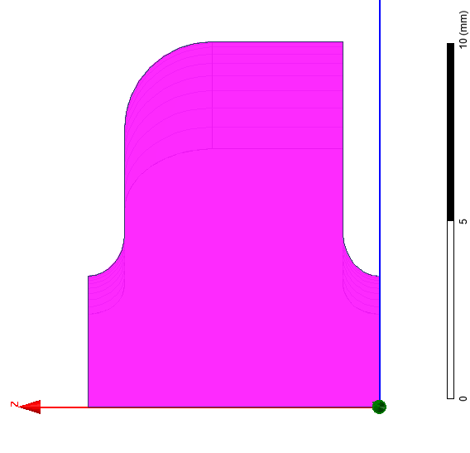
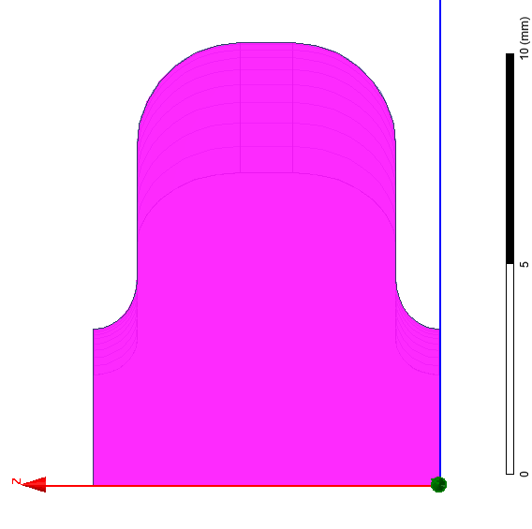
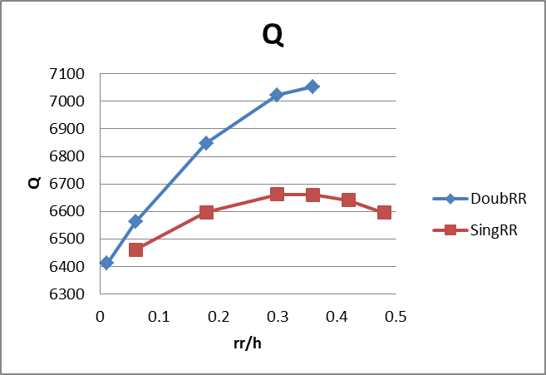
Single- versus Double-rounded cells
By doing double rounded cells instead of single rounded cells Q-factor is increased by 6% and the total linac power is reduced by 3.7%
No tuning will be possible
~6%

Slide 26
Conclusions
An analytical expression for effective shunt impedance of the CI and CG AS without and with pulse compression have been derived.
Maximizing effective shunt impedance for every average aperture gives the optimum structure design of a single bunch linac
Different constraints have been applied to find practical solutions for a FERMI energy upgrade based on the X-band 2.4 GeV, 60 MV/m linac

