Slide 1
Multipoles of the accelerating field and the beam distortion in TBTS
Alexej Grudiev
29/05/2013
CLIC RF Structure Development Meeting

Slide 2
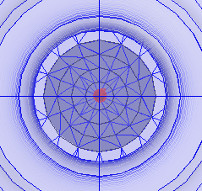
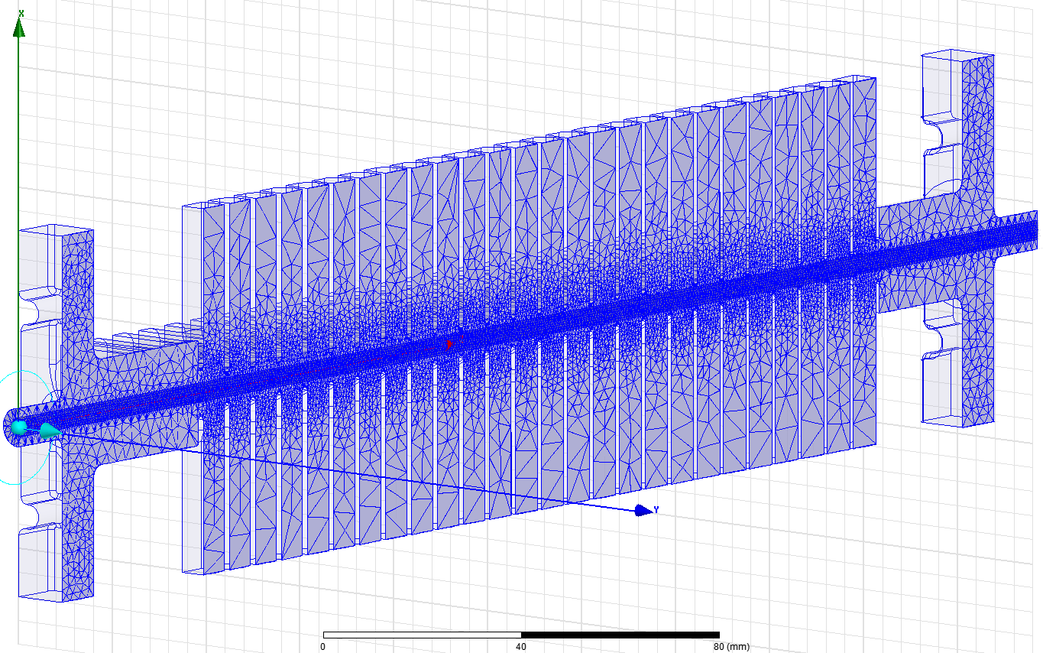
Mesh
TD24_vg1p8
Ntetr = 1188991;
dxyz ~ 0.5 mm near axis

Slide 3
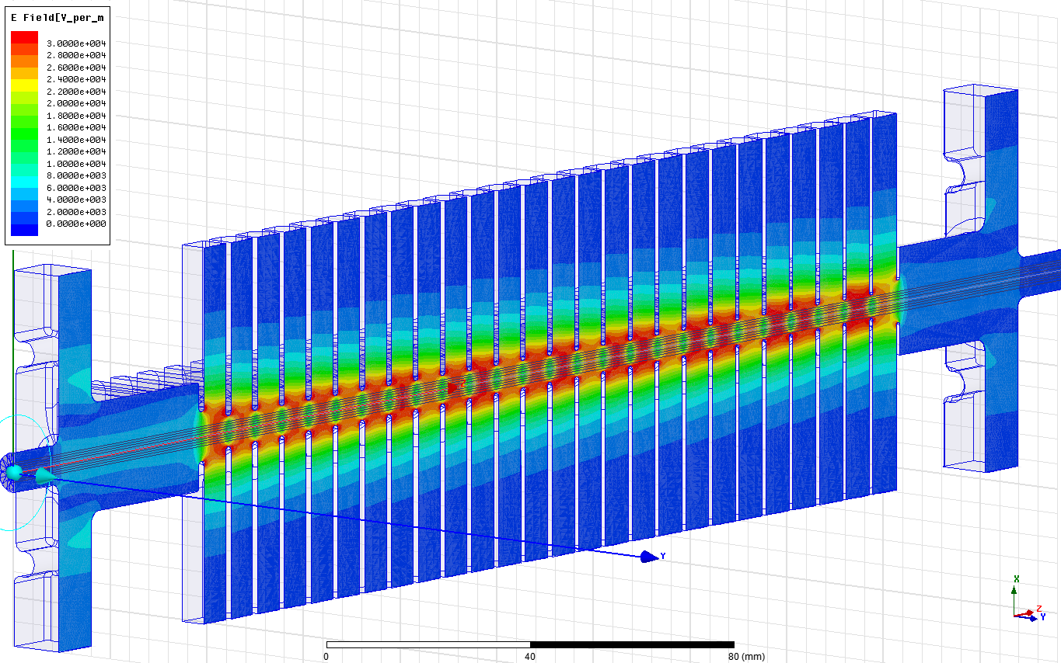
Electric field

Slide 4
Multipole expansion of E_{z}
Accelerating gradient:
Accelerating voltage:
Multipole expansion in vacuum only:
Skew components = 0 due to the symmetry
Panofsky-Wenzel (PW) theorem:
Gives an expression for multipolar RF kicks:
Lorenz Force (LF):
Gives an expression for kick directly from the RF EM fields:
Which can be decomposed into multipoles:
Equating the RF and magnetic kicks, RF kick strength can be expressed in magnetic units:

Slide 5
TD24_vg1p8: multipoles of E_{acc} at V_{z}=1V;

Slide 6
TD24_vg1p8: quadrupolar kick; LF versus PW
Quadrupolar kick strength F_{x} and corresponding multipole of E_{acc}⁽²⁾ have very different dependence along the beam axis but the integrals are equal.
Comparison b⁽²⁾ @V_{z}=1V
LF: 0.10 - 0.91i [nTm/m²]
PW: 0.02 - 0.65i [nTm/m²]

Slide 7
TD24_vg1p8: octupolar kick; LF versus PW
Octupolar kick is maximum for particle on zero crossing.
Comparison b⁽⁴⁾ @V_{x}=1V
LF: 0.17 +3.23i [mTm/m²]
PW: 0.22 +3.22i [mTm/m²]

Slide 8
Summary table for V_{z} = 22.8 MV; P_{in} = 46.5 MW
ΔV_{y}@Δx=2mm/structure | Δx after 5m for 180 MeV beam
18 V
176000 V | ~5 mm
 | TD24_vg1p8
f [GHz] | 11.994
Vz(x=0) [MV] | 22.8 +0i
Vx [MV] | 0
b⁽²⁾ [mTm/m] | 0 - 15i
b⁽³⁾ [Tm/m² ] | 0
b⁽⁴⁾ [kTm/m³] | -4.6 +73.4i
NB: the b^{(n)}‘s B-field : B_{y}^{(n)}(y=0,x=x₀) = b^{(n)}x₀^{n-1}. This is not MAD convention for multipolar strength.
There is the following dependences of the multipolar kick on the RF phase, where δφ_{s} is the deviation of the (macro)particle RF phase from the crest

Slide 9
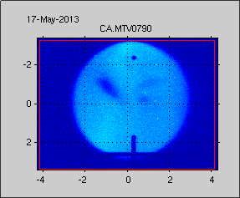
Beam spot distortion due to Octupole
Beam spot: in the structure on the screen
Wilfred Farabolini

Slide 10
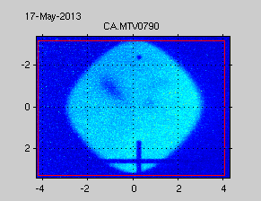
Beam spot distortion due to Octupole
Beam spot: in the structure on the screen
Wilfred Farabolini

Slide 11
Beam spot distortion due to Octupole
Beam spot: in the structure on the screen

Slide 12
Beam spot distortion due to Octupole
Beam spot: in the structure on the screen

Slide 13
Beam spot distortion due to Octupole
Beam spot: in the structure on the screen

Slide 14
Beam spot distortion due to Octupole
Beam spot: in the structure on the screen

Slide 15
Beam spot distortion due to Octupole
Beam spot: in the structure on the screen

Slide 16
Beam spot distortion due to Octupole
Beam spot: in the structure on the screen

Slide 17
Beam spot distortion due to Octupole
Beam spot: in the structure on the screen

Slide 18
Beam spot distortion due to Octupole
Beam spot: in the structure on the screen

Slide 19
Beam spot distortion due to Octupole
Beam spot: in the structure on the screen

Slide 20
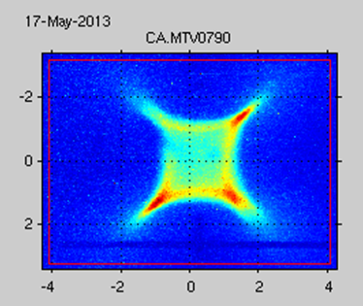
Beam spot distortion due to Octupole
Beam spot: in the structure on the screen
Wilfred Farabolini

Slide 21

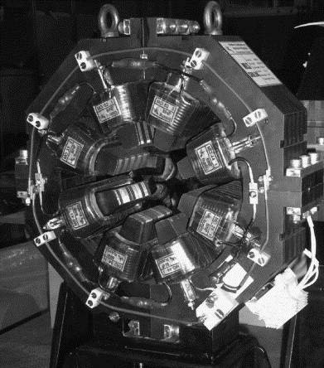
Thanks for your attention
Probe beam distortion in TBTS is due to octupolar component of the 12 GHz accelerating field
RF octupole is 90 degree out of phase with respect to the accelerating field. Maximum octupolar kick at 0-crossing of the main RF
8-star shape of the beam near the on crest acceleration (0-crossing for RF octupole) is probably due to multi-bunch RF phase spread

