Slide 1
Probe beam distortion in TBTS due to high gradient RF acceleration (first part: observations)
CTF3/TBTS Logbook
17 May 2013
Wilfrid Farabolini – Alexej Grudiev

Slide 2
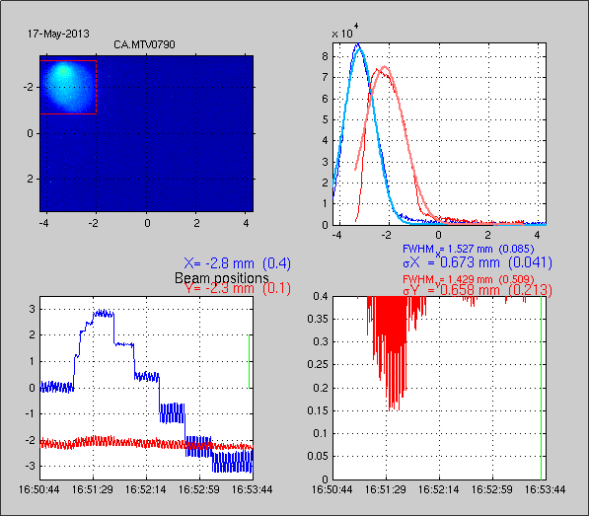
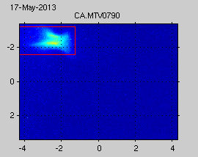
Beam observed on MTV0790
Beam kicks during acceleration have been observed from a long time, especially when the beam is passing off-axis through the 12 GHz structures.
In addition of beam kick it appears that the beam shape can also be distorted after the 12 GHz structure when powered.
accelerated
Hor. Position [mm]
non accelerated
Vert. Pos.
[mm]
Horizontal beam kick when scanning the horizontal positions within the ACSs
Non-accelerated (left) and accelerated (right) beam shapes observed on the straight line screen, 4.75 m downstream the ACS

Slide 3
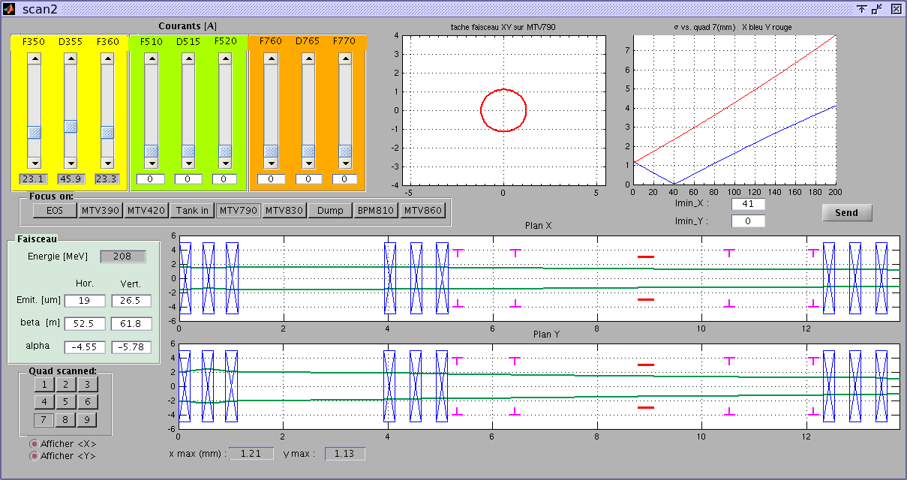
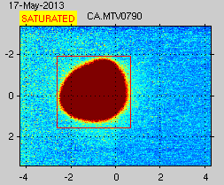
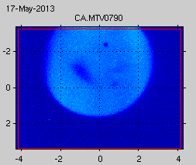
Beam transport settings
Beam size check
7.6 m
4.7 m
The only used triplet
Structures position
Screen position
Transverse envelope model
With all quads off: structure shadowed beam
(here not perfectly aligned)

Slide 4
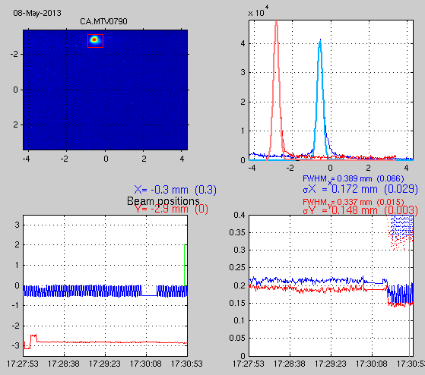
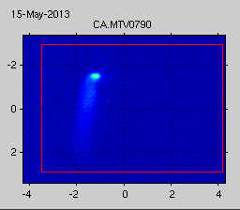
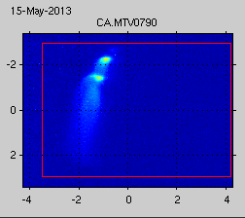
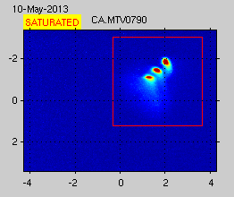
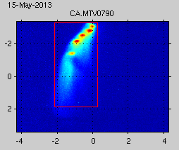
For transverse kick measurements beam can off course be much better focused
And also beam loading evidence with high bunch charge

Slide 5
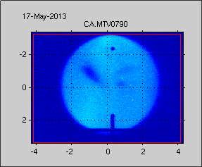
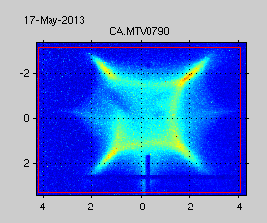
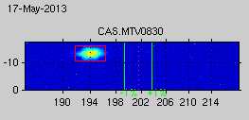
Beam shape observation
To fully observe beam shape distortion we have used a non focused beam that covers the full structure aperture (4.7 mm bore diameter on the output side).
Large beam shadowed by the structure, non accelerated (left) and accelerated (right)
Similar shape can be observed in the spectrum line on MTV830 when energy spread is low (here on deceleration crest)

Slide 6
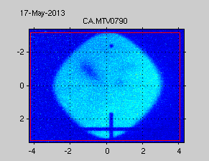
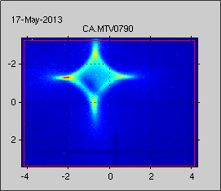
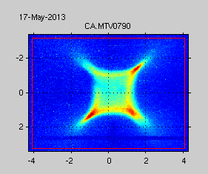
Beam shape characterization
The octupolar-like beam shape evolves with the accelerating gradient but also with the accelerating phase (phase between probe beam and 12 GHz RF)
For very weak RF power (few MWs, uncertain phase)
At zero-crossing (rising RF power side), 25 MW
At zero-crossing (falling RF power side), 25 MW

Slide 7
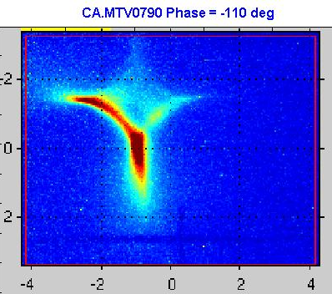
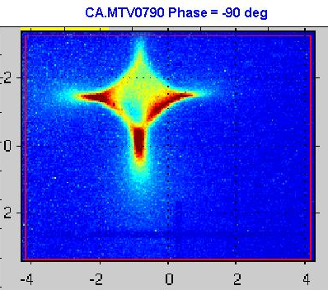
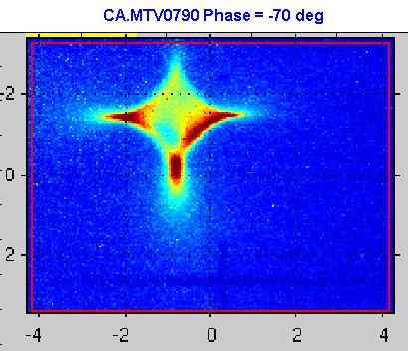
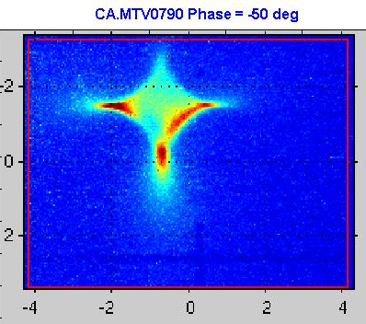
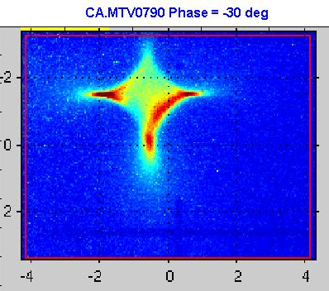
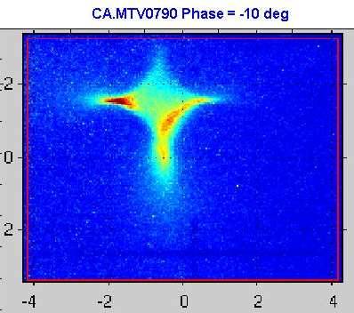
Phase scan from -110 to -10 deg (poor linearity of the phase shifter in this range)
Close to decelerating crest

Slide 8
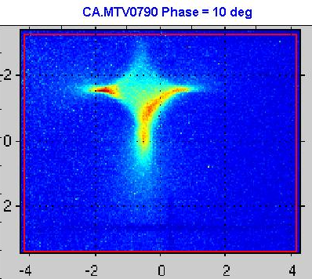
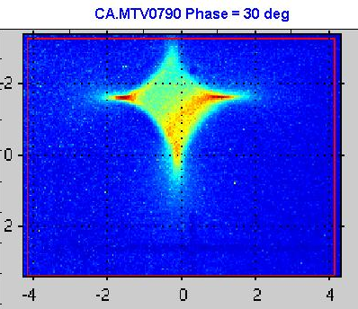
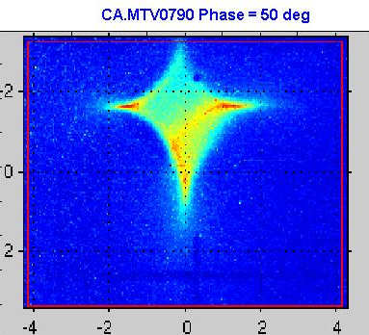
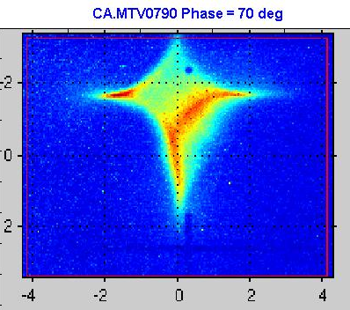
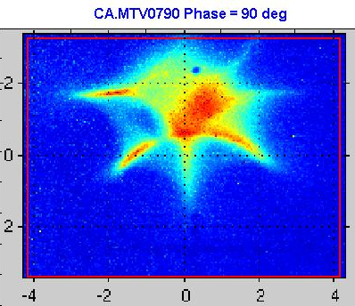
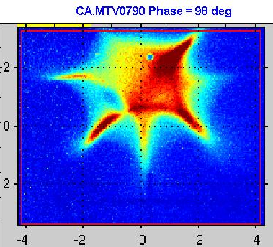
For accelerating phase from 10 to 98 deg
Close to zero-crossing
(left side of accelerating crest)
On accelerating crest

Slide 9
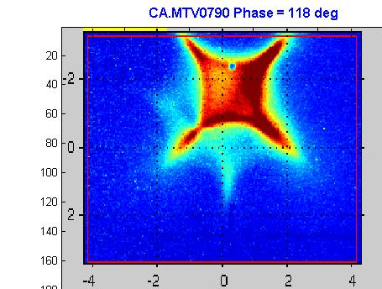
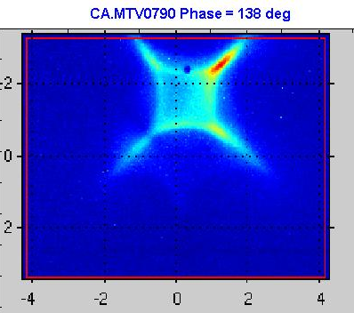
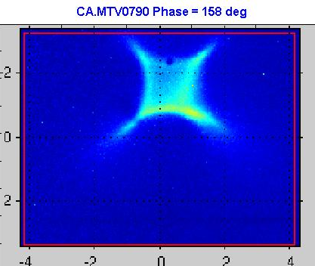
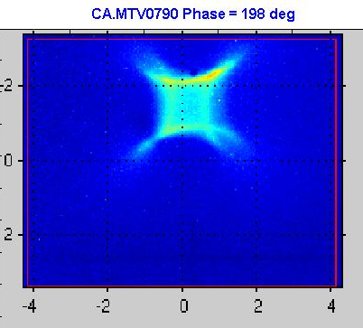
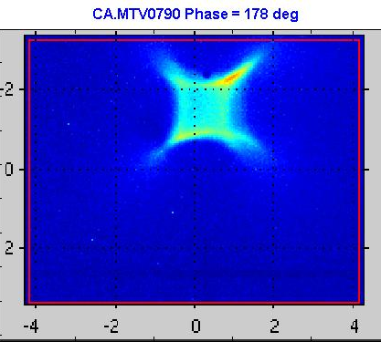
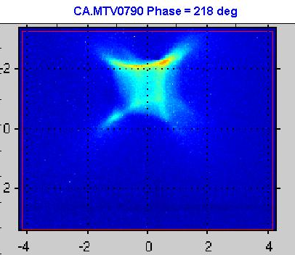
For accelerating phase from 118 to 218 deg
On zero-crossing
(right side of accelerating crest)

Slide 10
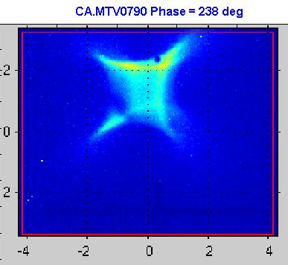
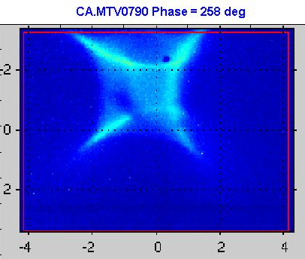
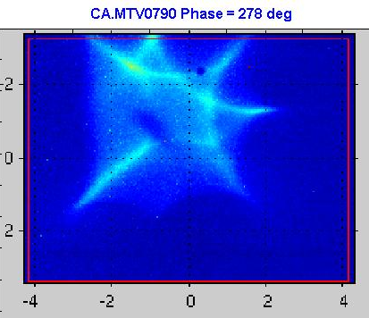
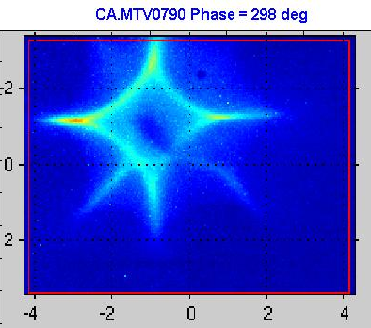
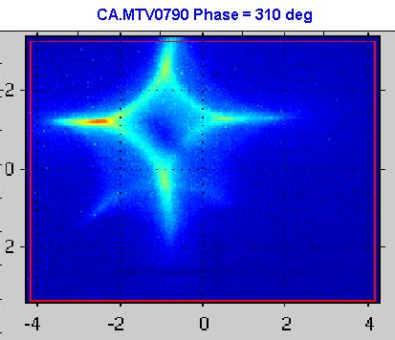
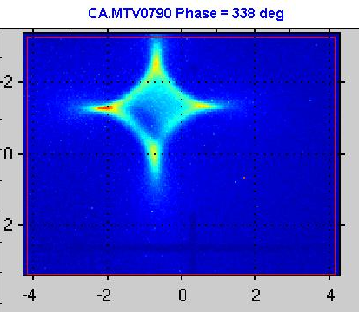
For accelerating phase from 238 to 318 deg
On decelerating crest
Close to zero-crossing
(left side of accelerating crest)

Slide 11
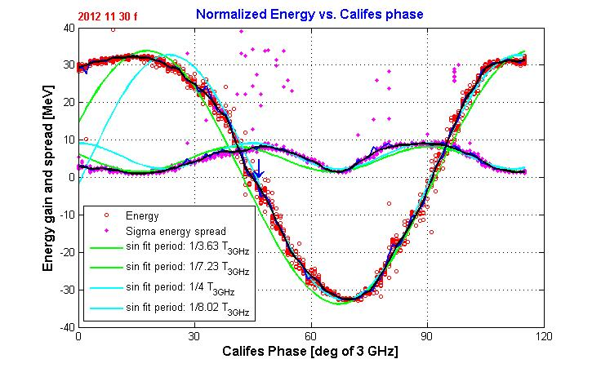
Energy gain and beam shape as function of accelerating phase
The octupolar beam shape changes from positive to negative at the RF crest phases.
Note: phase shifter is not linear in the lower 20 deg range (at 3 GHz) corresponding to 80 deg range at 12 GHz.

Slide 12
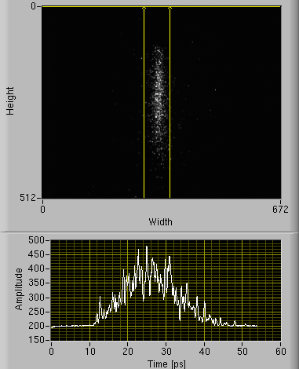
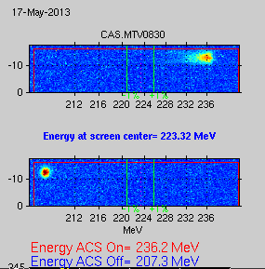
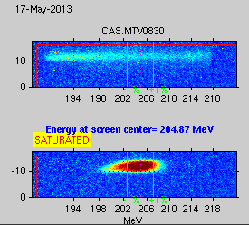
Problem of the octopus shape on crests
On crest phases, octupolar components should compensated one each other, so why we observe their addition on the screen ?
Possible effect of multi bunch with phase jitter or of the bunch length (15 ps FWHM: 61 deg) ?
15 ps
On crest energy spectrum
At zero crossing energy spectrum

Slide 13
Summary and follow-up
We have observed an octupolar transverse effect on the beam during 12 GHz acceleration that should be explained with model (achieved by Alexej, see following talk).
We have shown that this transverse effect evolves with the accelerating phase and is a fundamental mode of the structure (12 GHz).
Many other parameters should also be investigated during a next run (bunch number, bunch length, phase between the 2 accelerating structures, RF power).

