Slide 1
TOPLHCWG
THIRD open session
18-19th APRIL 2013

Slide 2
Introduction and coordinates
Third open session of the TOPLHCWG
  Forum for public discussions (ATLAS+CMS+TH) on combination and interpretation of top physics measurements at the LHC
  Plan is to have two open sessions per year
Documentation and coordinates
  Integrated into the LPCC structure at CERN
  Agendas available at https://indico.cern.ch/categoryDisplay.py?categId=4463
  Twiki page available at http://lpcc.web.cern.ch/LPCC/index.php?page=top_wg
    Public notes produced so far also available from that page
  Please make sure you subscribe to the main open list lhc-toplhcwg@cern.ch
Welcome !

Slide 3
Recent activities
Combination activities
  The W helicity fractions has recently been approved by the Collaborations
    See presentations today
  Towards the first top mass world average
  Working on cross section combinations (top-pair, single top) at 8 TeV
  Towards finalization of pseudo-tops and common acceptances
    See presentation today
“Tools”
  JetMET
    A cross ATLAS-CMS effort is formed
      Coordinators: C.Doglioni, B.Malescu (ATLAS), H.Kirschenmann , M.Voutilainen (CMS)
    Mandate: present a proposal for common conventions and classification.
      Today a summary of the discussions so far
  B-tag
    Subgroup is being formed, same mandate as for JetMET
  Theory systematic errors
    Discussion about the inclusion of fragmentation in our analyses
      Presentation today
    Several other contributions, today and tomorrow, on specific theory issues

Slide 4
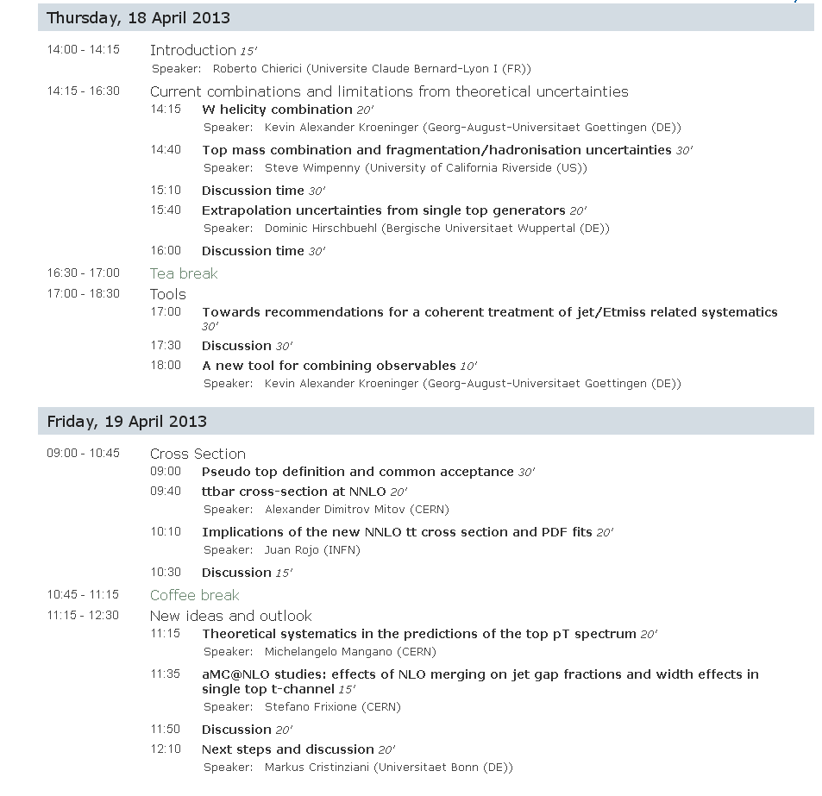
Combination
activities
Tools
Cross
section
Theory
feedback
Future

