Slide 1
Next steps
Markus Cristinziani
Open TOPLHCWG workshop
April 19th, 2013

Slide 2
Ongoing work
Combination results released so far (see this URL)
  Top quark mass, 02-Jul-12
  tt̄ cross-section, 17-Sep-12
  W helicity in top decays, 12-Mar-13
Hope to converge soon on
  single top cross section at 8 TeV
  top mass

Slide 3
From discussions yesterday
Top mass/hadronisation
  CMS is checking the differences Pythia/Herwig beyond JES
  Need to work on further common treatment of systematics
Single top extrapolation uncertainty
  Confirmed that 2→3 NLO (4FS) is best, and available in aMC@NLO
  Propose to unify „generator“ uncertainty
    ATLAS: evaluate parton level, pT (2nd b))
    CMS: compare to generators at reconstruction level
    could quote the largest of the two?

Slide 4
From discussions yesterday
Jet/E_{T}^{miss}
  Concrete first proposal presented on how to map and join categories which have similar correlations
  CMS is evaluating effct of close-by jets
  Finalise and document in a Twiki and in a public document
  (Strongly) encourage its usage for EPS timescale results?

Slide 5
From discussions today
Common input definition for pseudo-top
  progress report on common definitions
  lepton definition
    isolation (brings experimental problems)
    no isolation: need good definition of b‘s
    tau‘s as background? not optimal in dilepton channe
  include neutrinos in jet definition or not?
  need common jet radius (0.5)
    ATLAS working in this direction but will take time
Complete NNLO calculation available
  uncertainty now ~5% for NNLO+NNLL
  implemented in Top++ („you cannot get a better deal“)

Slide 6
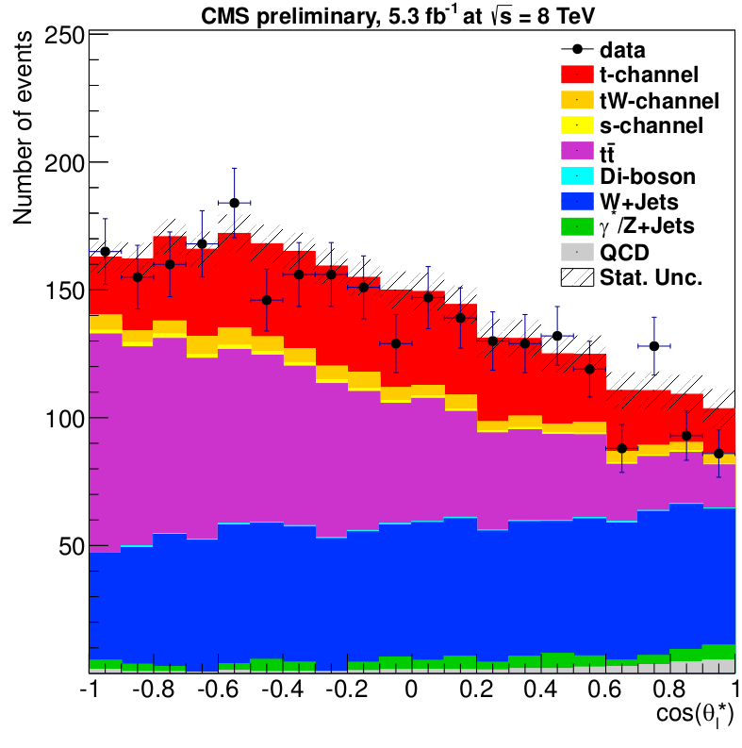
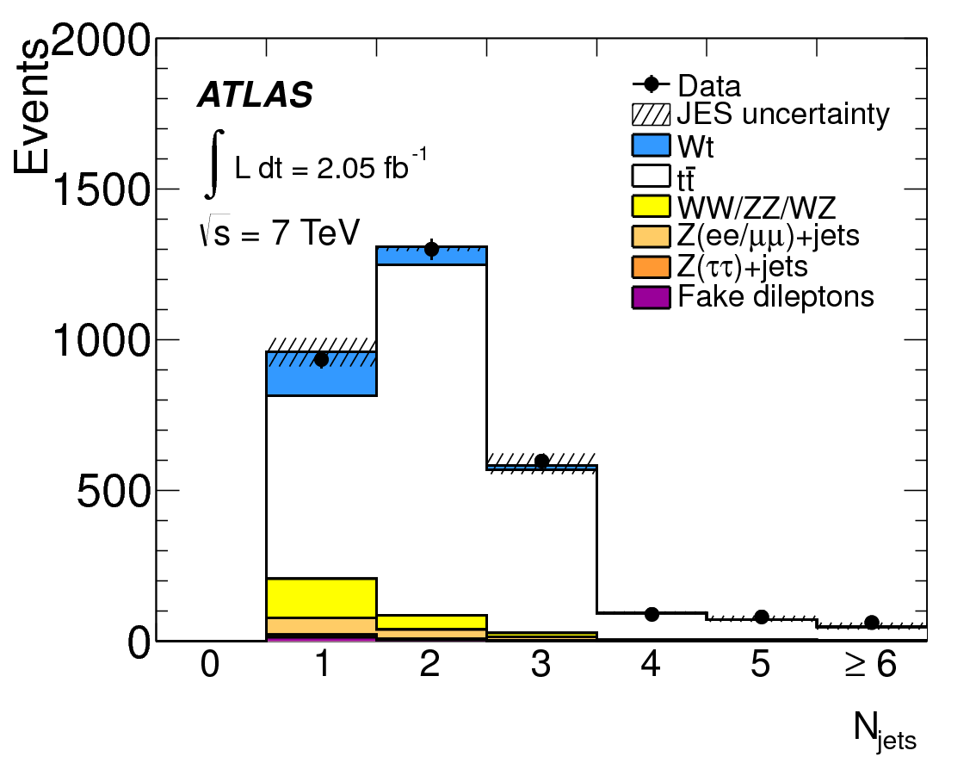
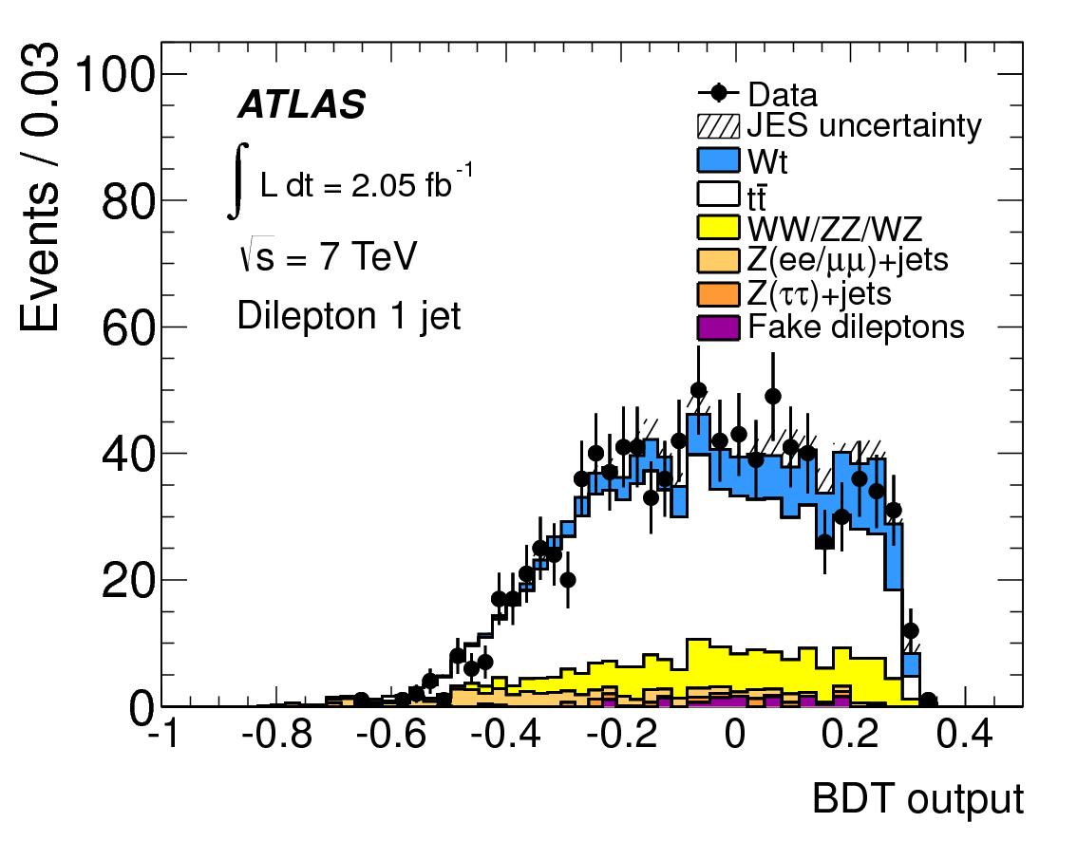
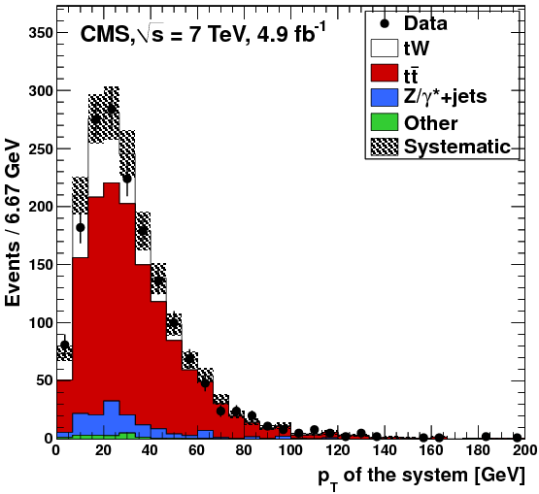
Possible combinations
PAS TOP-12-020
Single top measurements
  include single top cosϑ in Wtb structure
  Wt production?
  R_{t} at 8 TeV (once ATLAS measurement is available)?
σ_{Wt} = 16.8 ± 2.9 ± 4.9 pb (ATLAS) 3.3σ
σ_{Wt} = 16 ⁺⁵₋₄ pb (CMS) 4.0σ
Phys. Lett. B 716 (2012) 142-159
Phys. Rev. Lett. 110 (2013) 022003

Slide 7
Possible combinations: angular distributions
Spin correlations (7 TeV)
  ATLAS: Phys. Rev. Lett. 108 (2012) 212001
    first observation in dilepton channel (2.1/fb) using Δφ in Lab
    A_{hel} = 0.40 ± 0.04 ± 0.08 (SM NLO is 0.31)
  CMS: PAS TOP-12-004
    similarly, using 5/fb A_{hel} = 0.24 ± 0.02 ± 0.08
    also measure asymmetries A_{Δφ} and A_{cosϑcosϑ} and with m_{tt} cut
    finally unfolded to parton level and compared to generators
Charge asymmetry (7 TeV)
  ATLAS: Eur.Phys.J. C72 (2012) 2039 + ATLAS-CONF-2012-057
    combined lepton+jets (1.04/fb) and dilepton (4.7/fb) channel
    A_{C} = 0.029 ± 0.018 ± 0.014
  CMS: Phys.Lett.B 717 (2012) 129 + CMS PAS TOP-12-010
    A_{C} = 0.004 ± 0.010 ± 0.011 (lepton+jets)
    A_{C} = 0.050 ± 0.043^{+0.010}_{-0.037} (dilepton)
  Could combine also differential distributions (m_{tt,} etc.)

Slide 8
Possible combinations
Other ideas? What could be interesting?
  tt̄Z?
  Search for FCNC in decay and production?
  ...

Slide 9
Next meetings
Closed with participation of experts
  track progress of ongoing combinations
  start new combinations
  b-tagging discussion (similar to jet/E_{T}^{miss})
  generator uncertainties (single top, NLO vs multileg)
Open meetings
  so far:
    First meeting on 19-Jul-12, see this URL
    Second meeting on 29-Nov-12, see this URL
    This meeting 18-19-Apr-2013
  shall agree on a date for this year
  probably after TOP2013 ~Oct/Nov

