Slide 1
The “Flat-Sample-Holder” (Flats) Method for
Material Measurement
Motivation/ History…
Material parameters as relative permeability µ_{r} and/or relative permittivity ɛ_{r} are crucial for RF calculations and simulations ,
Equally for loss and heat estimates, absorption calculations, etc.
but typically these data are not available, because
Material suppliers measure at selected frequencies, but the material is highly dispersive,
Material parameters depend on external magnetic bias, but the material supplier cannot measure in this condition, etc.
Material suppliers are no RF-measurement experts; these expertise is costly and not available in house.

Slide 2
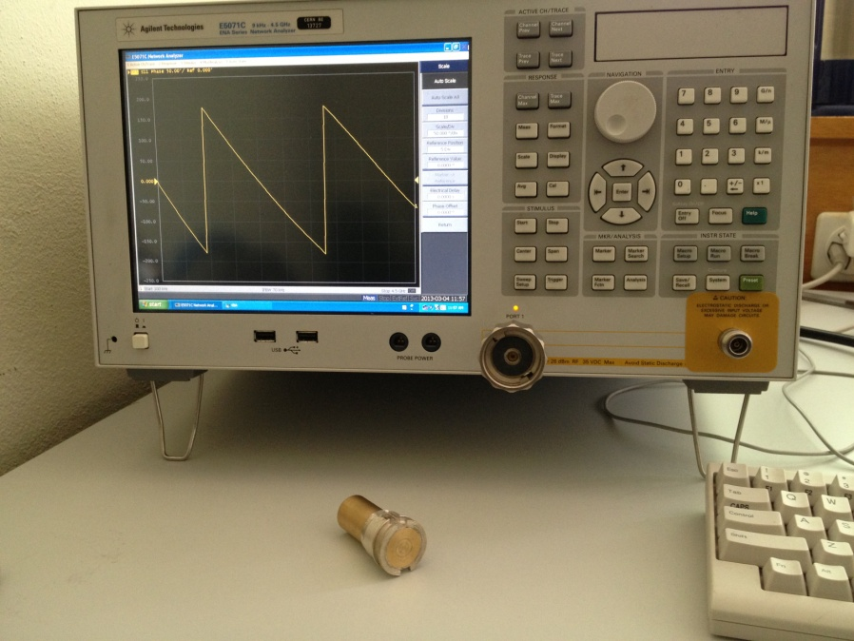
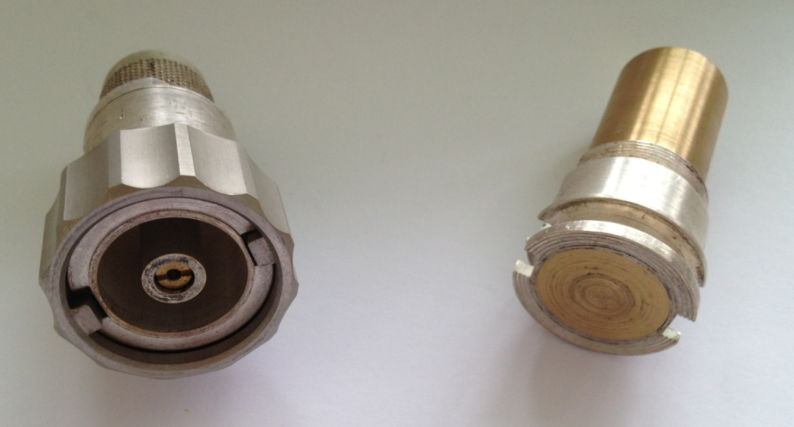
“Old” Method for Material Measurement (Coax-type)
Material measurements itself are not new…
Typical method is with coaxial sample holder (similar to picture);
Requires toroidal-cut sample with tight tolerances;
Tolerances are challenging to achieve for absorbers as ferrites or foams.

Slide 3
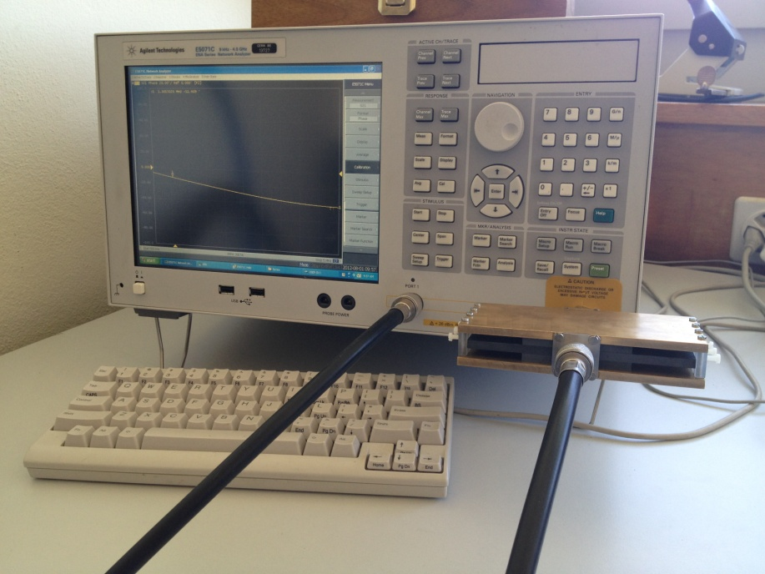
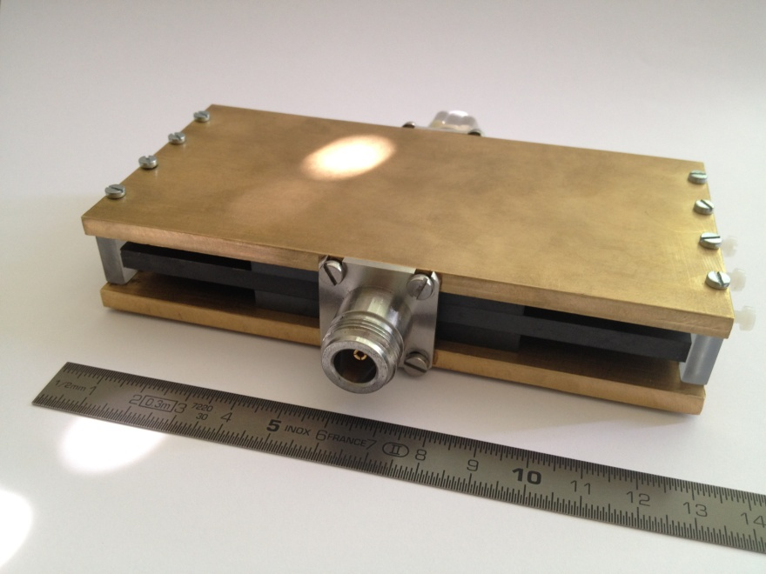
Example: Flats-Measurement of Ferrite Material
This ferrite is readily available in tiles of 6 cm x 6 cm and 5 mm
thickness;
Material samples are “wrapped” around an inner conductor;
this allows a non-destructive measurement,
without any machining of the ferrite.

Slide 4
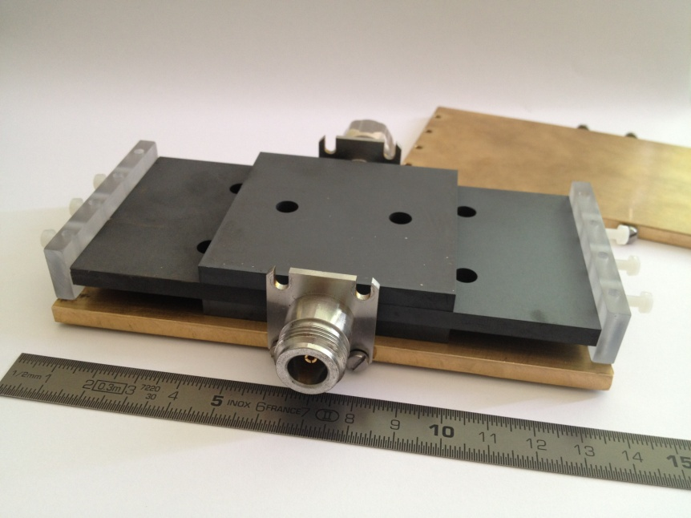
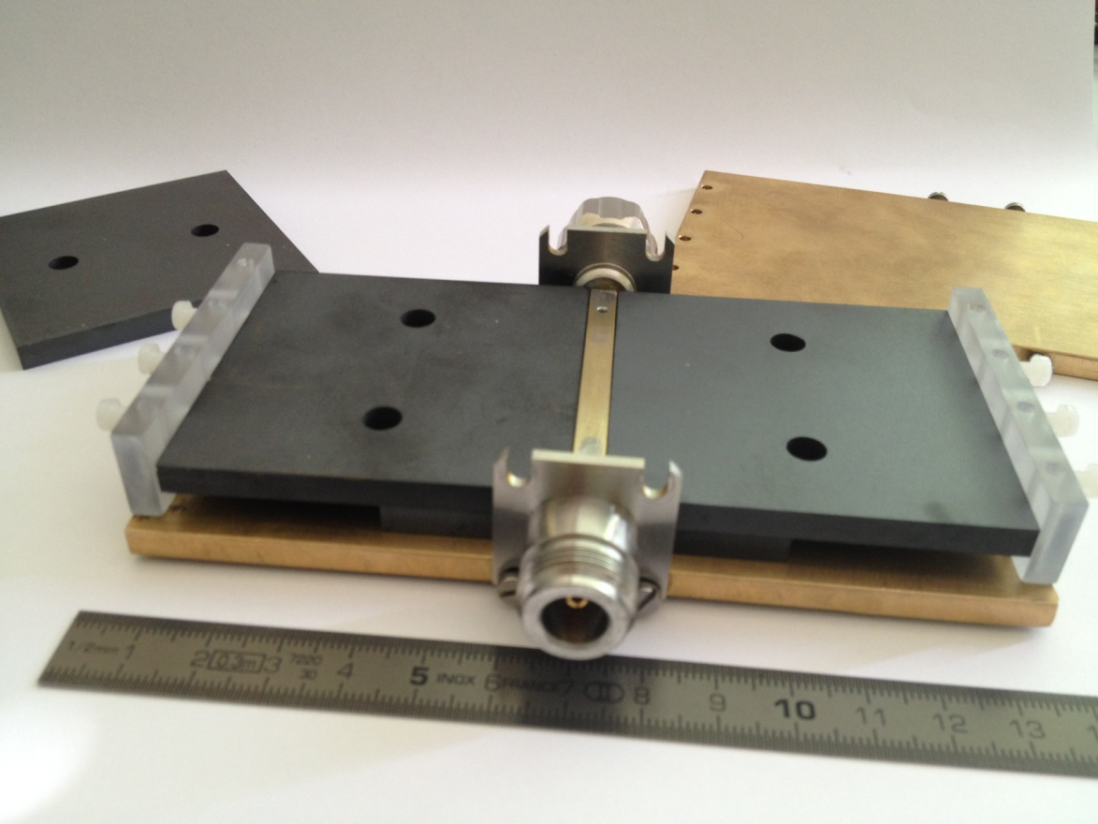
Material Measurement of TT2-111R
sample holder
Side walls made of Plexiglas to allow “wave leakage”
(no unwanted HO modes).
It is much simpler to machine metal and acrylic glass than ceramics with adequate accuracy…
Embedded conductor (brass)

Slide 5
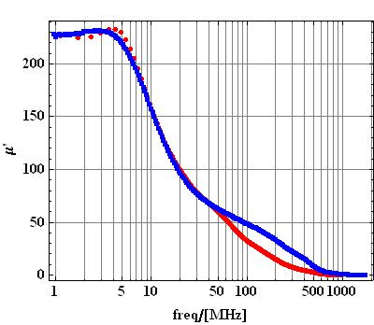
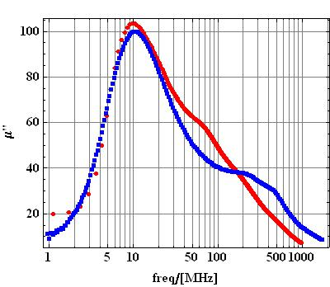
Flats Measurement of TT2-111R /Permeability
Red= Measurement in SH-sample holder;
Blue= Measurement provided by TT.

Slide 6
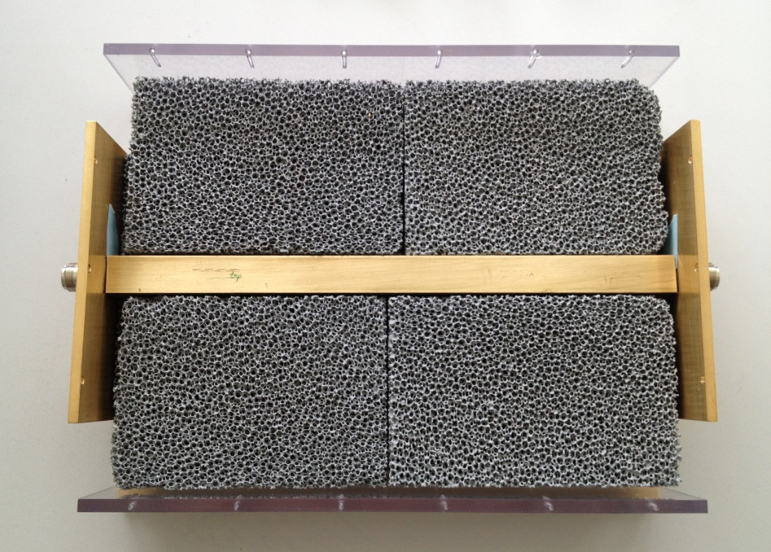
A number of obstacles had to be solved in the algorithm, e.g.:
The sample size determines the
cross-section of the inner conductor, so the characteristic impedance differs from that of the 50 Ω measurement system.
(here: 2 cm x 2 cm)
The inner conductor produces a parasitic capacitance
with the N connectors.

Slide 7
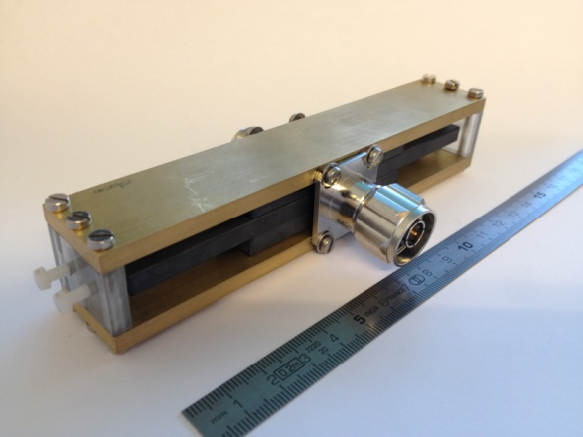
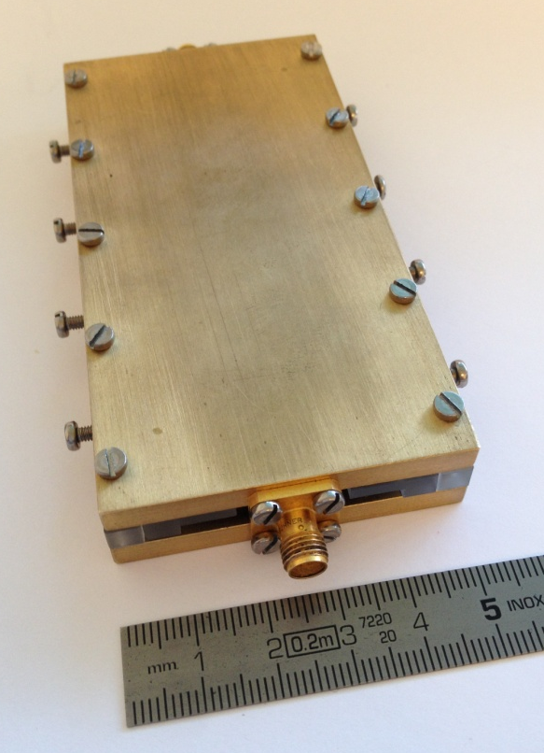
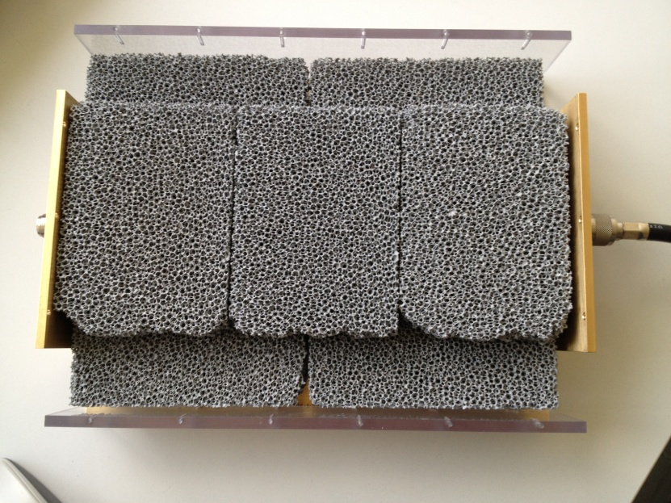
Flats Measurement is now used at CERN…
Absorber measured f=1 MHz… 4.5 GHz
Absorber measured f=10… 20 GHz
Absorber measured f=0.5… 2 GHz
approx. 30 cm

Slide 8
Flats Measurements has some other advantages!
Flats works both as transmission measurement and one-port reflection;
Relative permeability µ_{r} and/or relative permittivity ɛ_{r} are measured simultaneously;
Sample holder is adapted to material shape;
Non-destructive measurement.
Material sample stays untouched and defines flats size;
The method can be used for quality assurance since flats allows reception tests of material batches!
No machining of the material!
The tight tolerance requirements are shifted from the sample (ferrite or foam) to materials that are “easy” to handle as brass and acrylic glass.
Sample holder as closed box IS POSSIBLE (no HOM!)

Slide 9
Thank you for your attention!

