Slide 2
Technology Transfer Introduction
Enrico Chesta
Head of CERN Technology Transfer and
Intellectual Property Management Section
Knowledge Transfer Group – FP Department

Slide 3
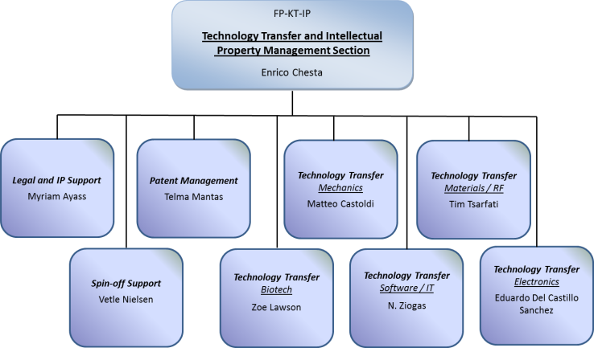
CERN FP/KT/IP
Organization
Chart

Slide 4
Dual-mode service-oriented operation
Legal advice on IP issues
Patentability studies
Market assessments
Industrial needs monitoring
Contract negotiation
Promotional activities
Technology scouting
Financial support to KT projects
Assistance to spin-off creation
Intellectual Property Management
Services for CERN Community
Collaborative R&D model: set-up partnerships with industry to use CERN competences in support of innovative applications and creation of joint IP
Technology Transfer Support
to External Partners
Licensing Approach: give access to CERN technology portfolio for scientific and commercial use

Slide 5
BE-KT: How can we do Technology Transfer together?
1- Identifying innovative technology => Disclosure Process
2- Deciding best dissemination model => Open vs. Protected
3- Taking it closer to the market => KT Fund
4- Setting-up exploitation partnerships with:
- Industry => Whole spectrum
- Partner research organizations => e.g. Easy Access IP
- Start-up companies => CERN BIA

Slide 6
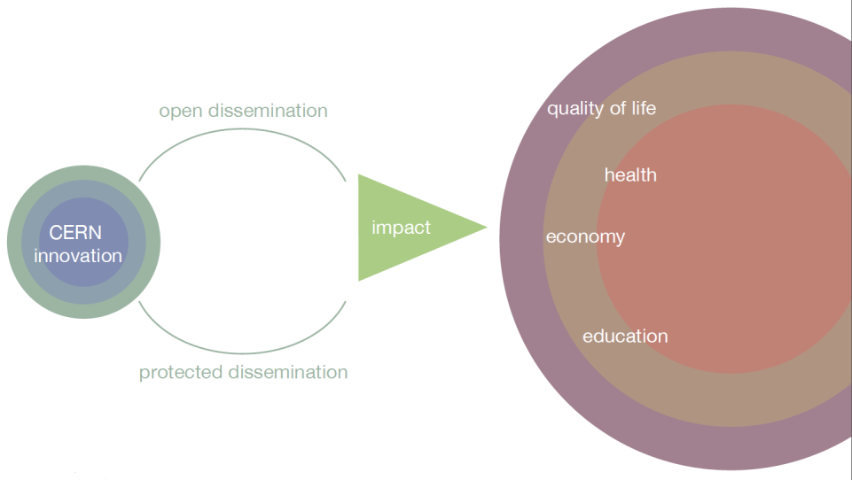
Impact-driven Innovation Approach

Slide 7
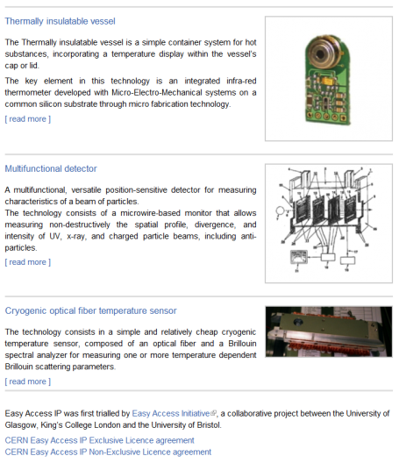
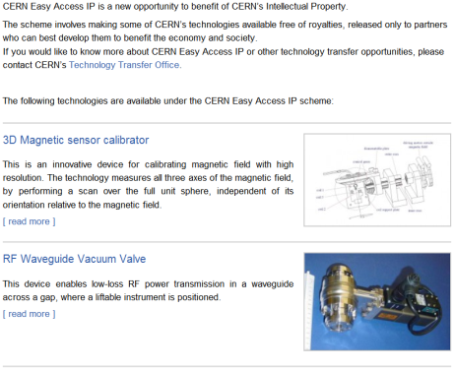
CERN Easy Access IP
Notes:
This is a screenshot of our website.
We have implemented the scheme pioneered by the University of Glasgow. We are ready to give a free license (for some of our technologies) to companies who will demonstrate that they can turn it into a product.

Slide 8
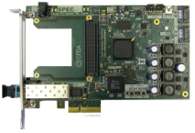

CERN Open Hardware License
A legal framework to facilitate knowledge exchange across the electronic design community.
In the spirit of knowledge and technology dissemination, the CERN OHL was created to govern the use, copying, modification and distribution of hardware design documentation, and the manufacture and distribution of products.
Hardware design documentation includes schematic diagrams, designs, circuit or circuit-board layouts, mechanical drawings, flow charts and descriptive texts, as well as other explanatory material.
CERN OHL v1.1 Launched in 2011, great interest from the worldwide community
More than 50 hardware designs licensed under CERN OHL
16 companies involved!
The license is being used by people outside our community as well (and for any kind of hardware)
Thanks to the interactions with the community, we are improving the license and preparing v1.2
Visit: http://www.ohwr.org

Slide 9
Patents are taken in order to:
Increase the probability of having the technology transferred (justify development investments from industry)
Significantly enhance the commercial value of the technology
Ensure CERN’s recognition as the originator of an invention

Slide 10
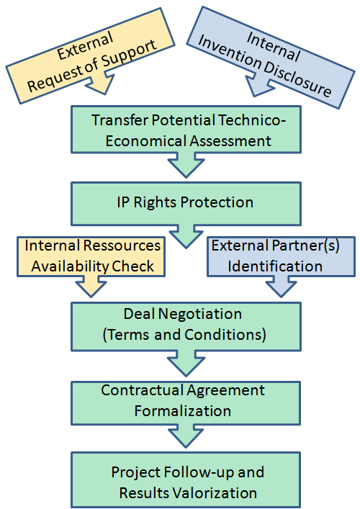
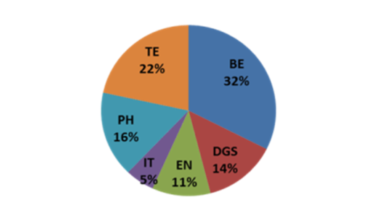
Typical Technology Transfer Process Steps
In 2012…

Slide 11
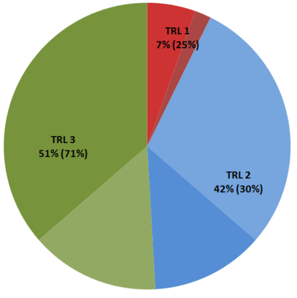
Technology Portfolio
Some approximate numbers:
200 TT cases (30% open)
  20 invention disclosures per year
  40 patent families (50% exploited)
Technology Readiness Levels | Simplified Definition
1 | Technology application formulated and basic concept demonstrated
2 | Functional validation in laboratory environment
3 | Representative prototype fully qualified (technology ready to transfer)
Technology Readiness and “Exploitation” Levels

Slide 12
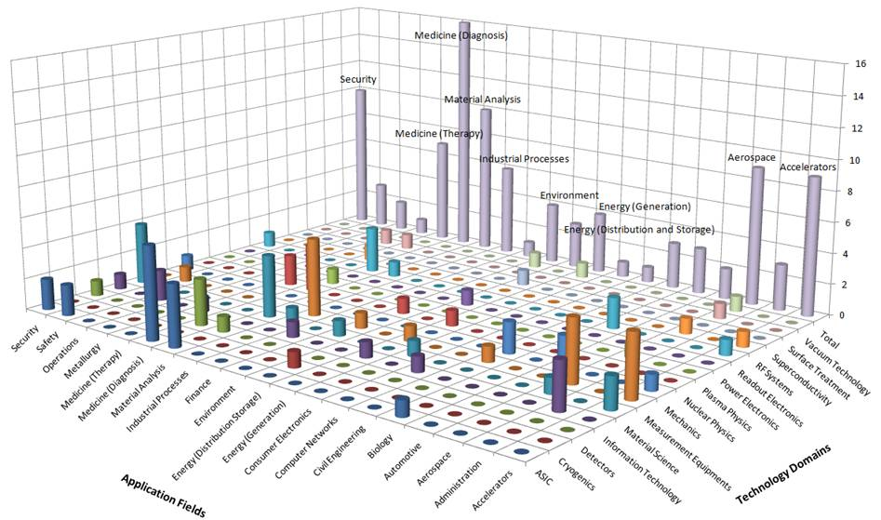
Technology Portfolio

Slide 13
The KT Fund
The KT Fund is a tool introduced 2 years ago, using resources generated by the exploitation of CERN IP portfolio complemented by DG budget.
Typically, it can be used to fund projects to build proof of concepts or prototypes; overall target: bringing CERN technologies closer to the market
The requests are evaluated by a Committee composed by all the Department Heads and members of the KT Group
6 projects were approved and financed in 2011, 6 more in 2012
For 2013, 500 kCHF are available
Requests can be submitted anytime, the selection committee usually meets in Autumn
More information can be found on the KT Group web site

Slide 14
CERN Business Ideas Accelerator (BIA) Concept
Network of European Universities providing technical students
Individual entrepreneurs including staff from CERN or partner organizations
BIA Admission Conditions:
-1 year max
-no revenue generation
-pre-incubation contract
BIA Outcome:
-Business Plan
-Demonstrators
CERN pre-incubator
Part-time support from CERN inventors
Use of Lab facilities and CERN infrastructure
Business Creation and IP support
National Innovation Funds
Projects
flow
National incubator 1
UK-STFC
National incubator 2
?
National incubator n
Investors
Spin-off companies

Slide 16

A whole spectrum of opportunities to collaborate with industry
Service and Consultancy
Licensing
R&D collaborations

Slide 18
Development of ultra-low phase gradient X-band resonators for continuous beam Cs clocks
W. Wuensch and Igor Syratchev
BE-KT day
3-6-2013

Slide 19
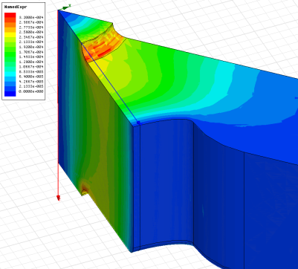
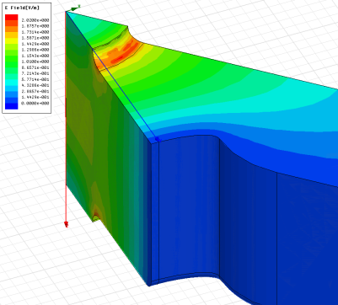
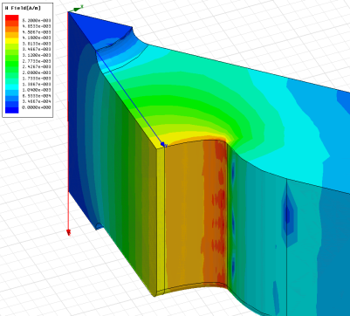
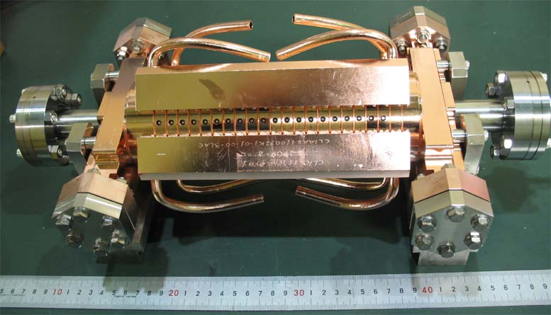
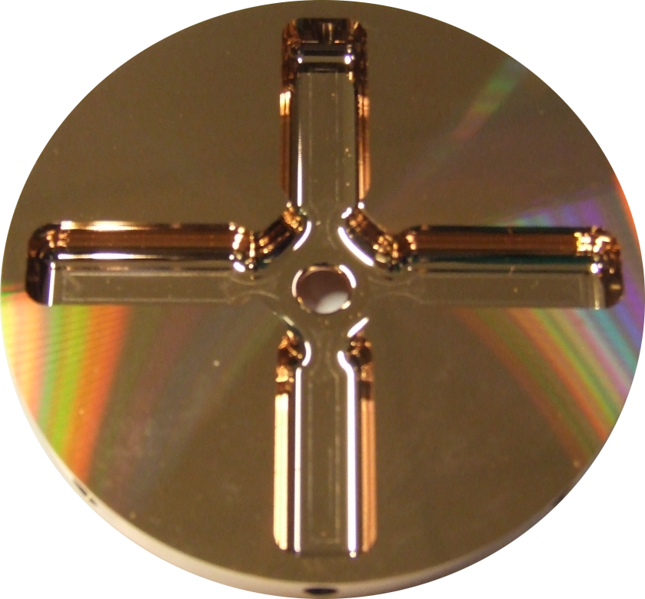
CLIC accelerating structure development
In the context of the study of a TeV-range linear colliders – NLC/JLC and CLIC - we have developed advanced rf design techniques combined with advanced rf component and accelerating structure assembly techniques.

Slide 20

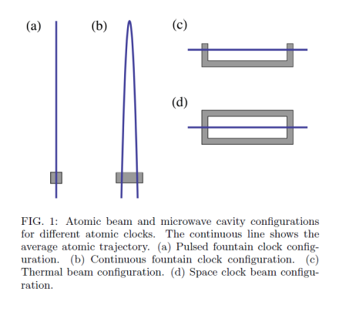
Collaboration with METAS
METAS is the national standards laboratory for Switzerland. They have an on-going continuous beam Cs clock development project. Cs clocks are the current standard for the second, so of crucial importance all throughout society and industry
Through a series of visits we have realized that we could make a significant contribution to their continuous-beam Cs clock project.
A critical component which is limiting their performance is the X-band resonator, in which the atomic interaction occurs. In particular they require extreme phase flatness – micro-radians.

Slide 21
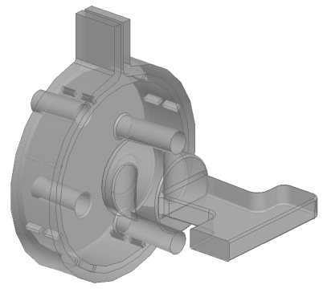
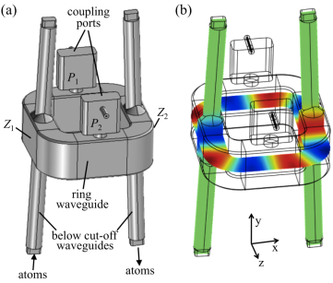
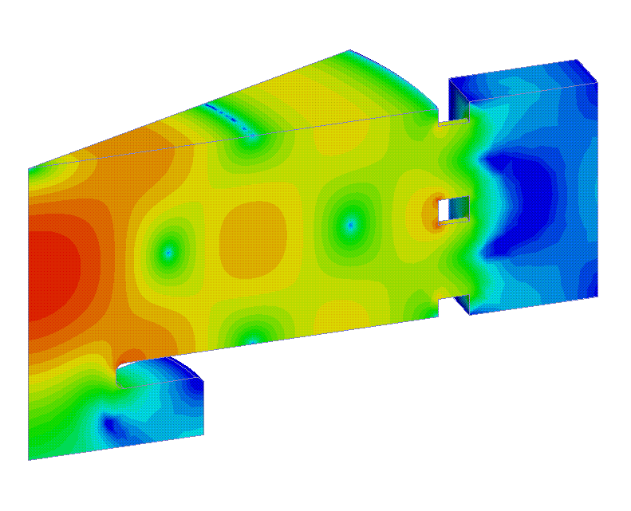
Our potential contribution in innovative rf design
Current design
Possible improvement
Beam trajectory
Notes:
An ideal resonator has perfect phase flatness. A real one, even one made out of a good conductor like copper, has losses which inevitably results in phase variations because a cavity is fed from a particular point or points. The losses basically cause a change in the magnetic field different from the electric - hence a phase shift. The trick we found is to feed as symmetrically as possible with respect to where their beams go by using coupling structures topologies we have developed for high-power rf components.

Slide 22
Design Summary
The TE_{0,N(N>1)} cavity with opposite RF power flow can provide “flat-phase” zones with RF phase variation < 1microradian in the area of ~ 7x7 mm².
This cavity can host multiple beam lines.
We have designed (built already) all the specific components like TE₁₁-> TE₀₁ mode converter.
The presented results mostly illustrate the concept, more detailed evaluation will certainly be needed (TE₀₃?, more then 8 coupling slots?, sensitivity analysis…etc. )

Slide 23
Our proposal
Design study of ultra-low phase gradient resonator configurations.
Realization of a prototype resonator.
Electrical characterization of the prototype using rf techniques and test with Cs beam in the clock at METAS.
By means of a PhD student jointly supervised by the Laboratoire Temps-Fréquence (LTF) of the University of Neuchatel and CERN.
We plan to apply for KT funding for partial support of the student. METAS will manufacture/supply the prototype cavity and measurements will occur at both laboratories.

Slide 24

An ns-FFAG for Medical Applications
Particle Accelerators Corporation and FNAL (US)
and
Huddersfield University
STFC (UK)
^{99m}Tc and ⁹⁹Mo production using accelerators
Introduction to our FFAG accelerator
Benefits for medical applications
Use for radioisotope production
Status and plans
Rob Edgecock

Slide 25
FFAGs
Our solution: novel type of non-scaling FFAG
Fixed Field Alternating Gradient accelerator
Important feature of cyclotrons:
Ease of operation
Rapid cycling
High beam current potential
Important feature of synchrotrons:
Better beam control
Smaller losses
Easier beam extraction
Smaller magnets

Slide 26
FFAGs
Non-scaling FFAGs:
  Invented at PAC 97/99 for muon acceleration in a Neutrino Factory
  Do not obey scaling law → more flexibility → ~unique
  Necessary to build proof-of-principle machine
  EMMA construction started in 2007 at DL, Cheshire
  Completed and commissioned in 2011
  Experimental programme still on-going

Slide 27
Our ns-FFAG
Cyclotrons are the current standard for: - radioisotope production - proton therapy - SC cyclotrons being developed for carbon therapy
Our ns-FFAG is more cyclotron-like: - fixed magnetic fields - ~isochronous to ~2 GeV → fixed RF frequency, CW operation - easy, reliable operation
But with stronger focussing: - ring of individual, smaller magnets - smaller emittance beams - smaller beam loss - smaller orbit excursion (usually) - variable beam energy extraction - multiple extractions

Slide 28
Next Steps
(1) Extension of existing design to 14 MeV:
  Conceptual design
  Engineering design if this looks OK
(2) Prototyping, in particular, ring magnet
(3) Construction of accelerator
We are seeking funding for the conceptual design
For more details, come to the EuCARD2 Accelerator Applications Network meeting on Friday 14th June in the Council Chamber, see:
http://indico.cern.ch/conferenceDisplay.py?confId=247757

