Slide 1
LHC schedule status
K. Foraz
EN-MEF

Slide 2
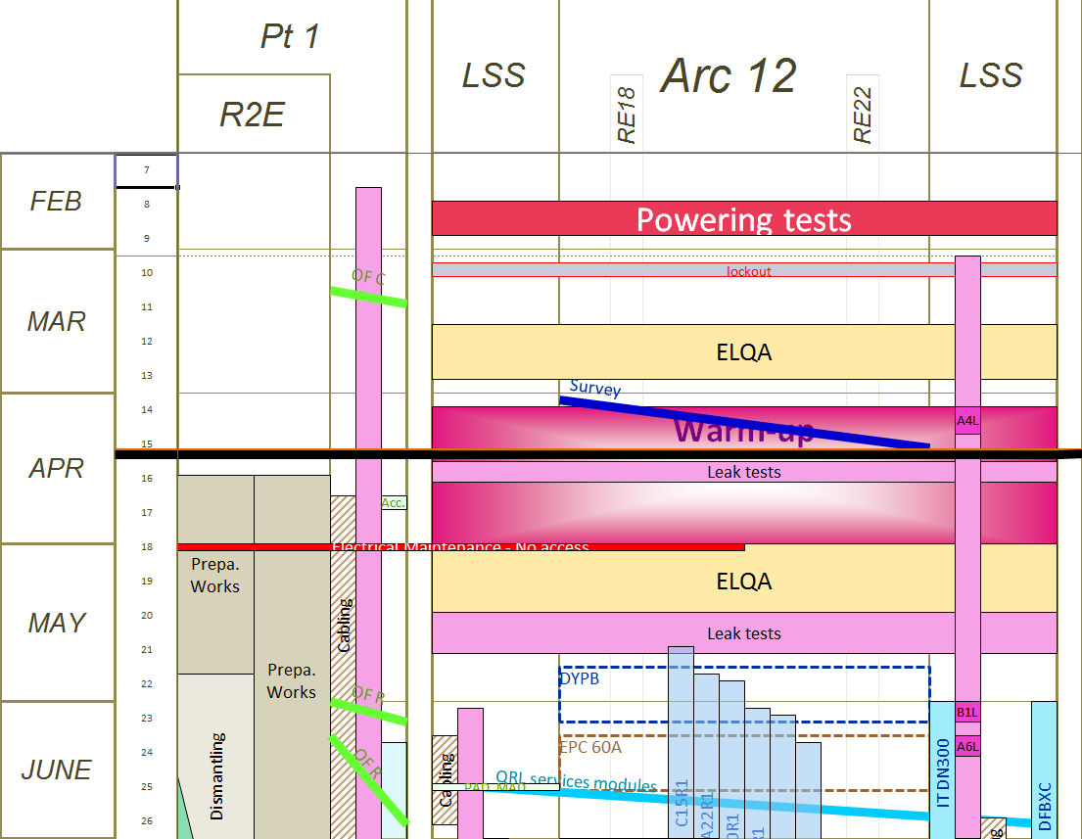
Progress & forecast – P1 & Sec. 12
Point 1 & LSS1
  In progress: R2E preparatory works
  Forecast :
    R2E - PAD-MAD removal wk. 17-18
    R2E - Shielding removal wk.18..
    ATLAS ZDC decabling wk. 17
    Scaffolding installation for cabling campaign
Sector 12
  In progress
    Warm-up - T~ 140K
  Forecast
    Leak detection @cold next week
Today

Slide 3
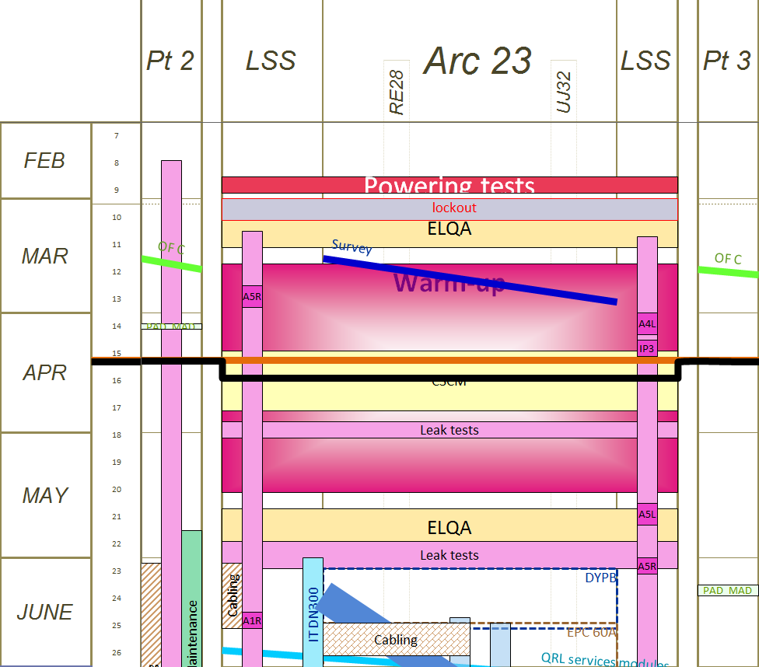
Progress & forecast – P2 & Sec. 23 & P3
Point 2 & LSS
  In progress
    Improvement of the MKI cooling oil circuit
    Vacuum activities A4L2 (TDI resect.)
    NEG activation finishing
Sector 23
  CSCM tests
  [80-300K] ~ wk18-19
Point 3 & LSS
  blocked for CSCM tests
Today

Slide 4
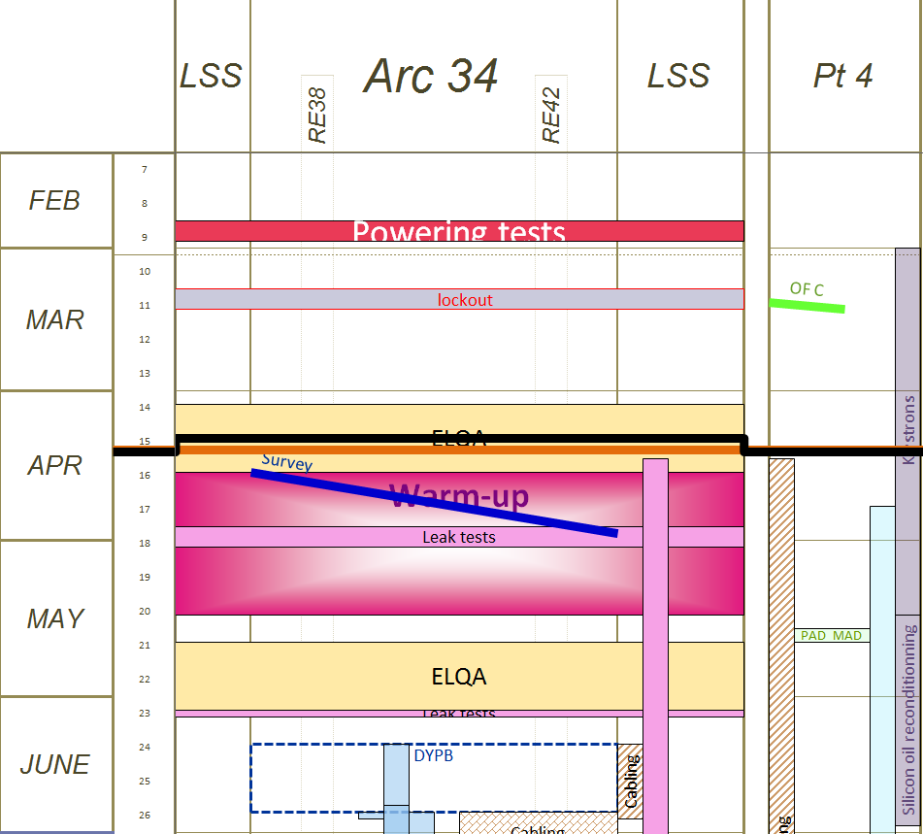
Progress & forecast –Sec. 34 & P4
Sector 34
  In progress: ELQA @ cold
  Forecast
    Warm up will start wk. 17
Point 4 & LSS
  In progress
    RF activities
  Forecast
    Cabling campaign from wk.16
    Survey and realignment of D & Q (-> Q12)
    wk. 16-17
    Vacuum activities
      E5L4 - BWS removal (wk.17)
      D5L4 - BGI detectors removal (wk. 16)
      E5R4 & D5R4 opening of beam vacuum
Today

Slide 5
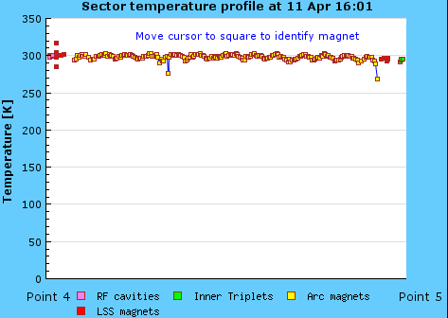
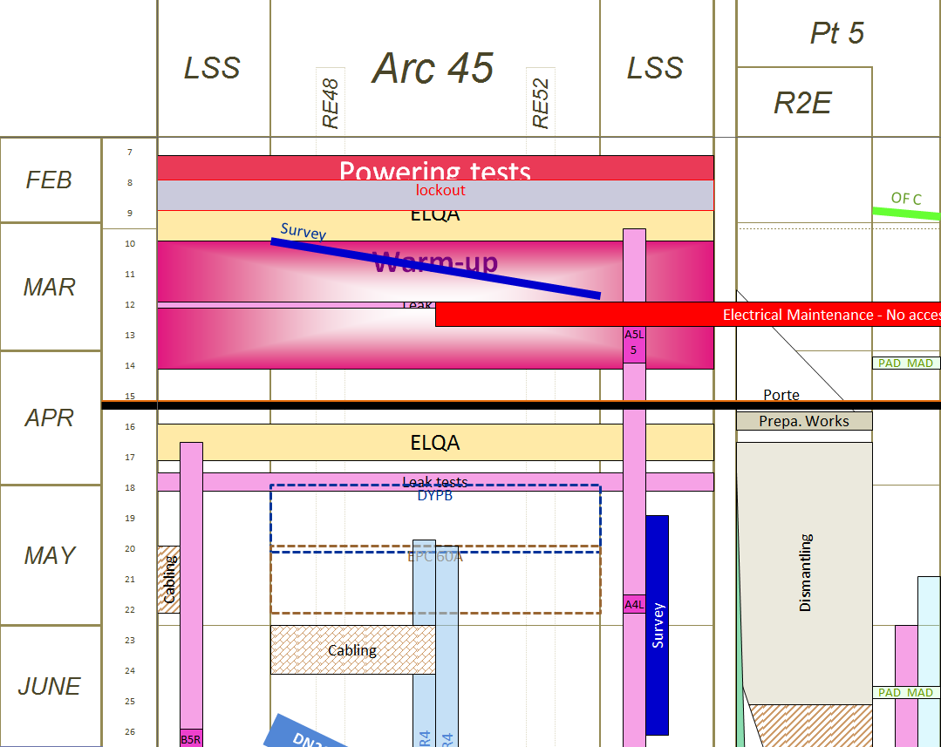
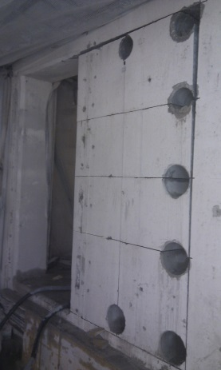
Progress & forecast –Sec. 45 & P5
Sector 45
  Venting of the arc done
  Almost warm
  ELQA @ warm on Monday
Point 5 & LSS5
  In progress
    UL55 door enlargement
    R2E is getting ahead (cable trays..)
    TOTEM & CMS-ZDC activities
    Vacuum : A5R5 (VM repair) NEG activation
  Forecast
    R2E rack disconnection wk 17
    Vacuum activities B4L5 (XRPT-> TCL4 - wk. 17
    CMS evacuation test on Friday 26th of April – 12:00- 14:00
      Alarms will sound from RR53-Pt5-RR57
      All the persons in this area will evacuate
Today
Courtesy J. Crespo GS-SE

Slide 6
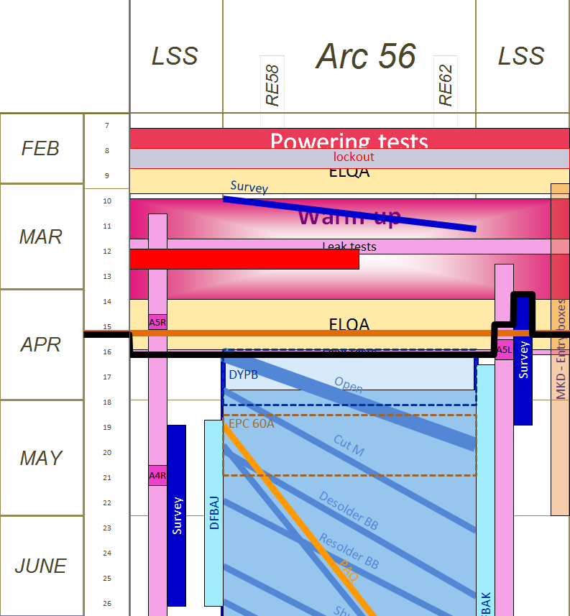
Progress & forecast –Sec. 56
Sector 56
  22 positions defined by VSC & MSC
    BLM removed & QPS cable trays displaced
    W bellows opened (See J.-P. Tock presentation)
  ELQA finished tonight
  Cryo depressurization this week-end
  Cryogenic “consignation” on Monday morning
  PIMs
    1st ball test: 16th-18th April
    PIMs repairing (after ball test): 19th - 25th April
    PIMs repairing (after W bellows open.): up to 13th May.
  IC train
    Open W: April 16th
    Cutting M: April 23rd
    Desolder BB: May 13th
    Solder BB: May 24th
    Shunt: June 11th
  DFBA consolidation from wk. 17
Today

Slide 7
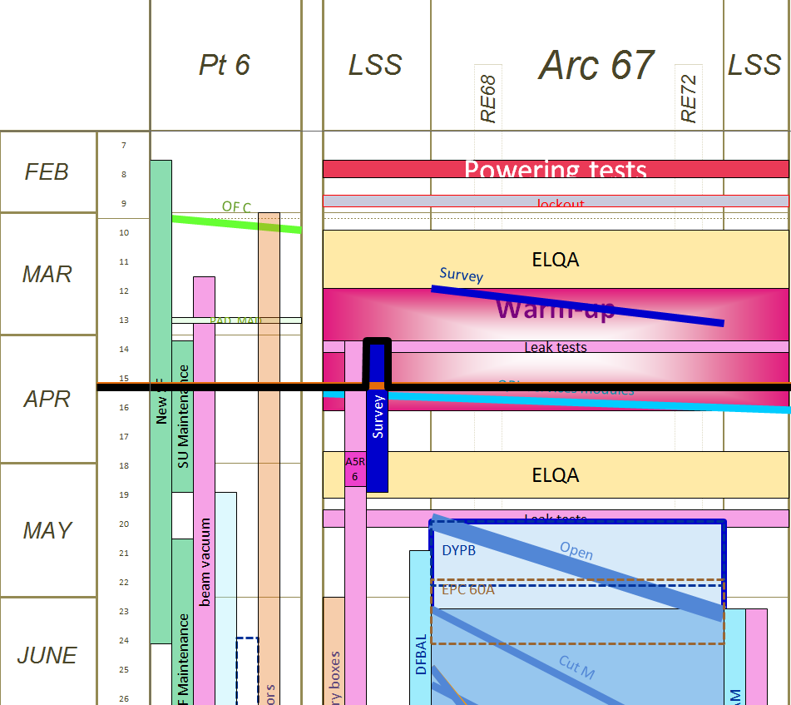
Progress & forecast – P6 & Sec. 67
Point 6 & LSS6
  LBDS tests: synchronic dump successful
  In progress
    Addition cooling tower installation
    SU maintenance
    MKD generator maintenance
    Vacuum activities
      A4L6 &A4R6 for TCDQ displacement
      A5R6 (NC)
  Forecast
    MKB completion of staged installation (wk.16)
Sector 67
  Warm-up in progress T~ 270K
  Forecast
    Wk. 16: 300K + vacuum degradation
    Wk.17: ELQA@ warm
Today

Slide 8
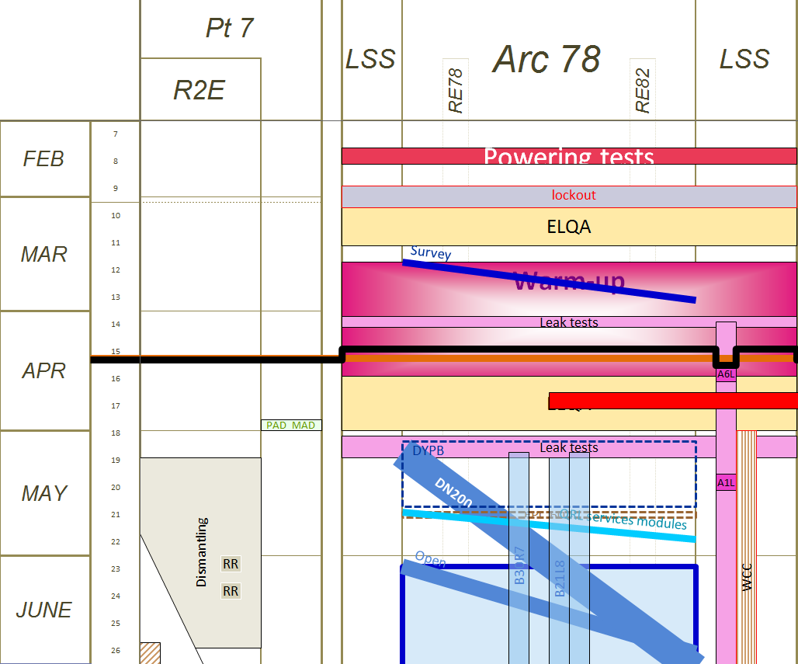
Progress & forecast – P7 & Sec. 78
Point 7
  R2E is getting ahead: cable trays
Sector 78
  In progress
    Warm up - T ~ 200K
  Forecast:
    nQPS type test @cold - wk. 16
    ELQA wk ~18-19
Today

Slide 9
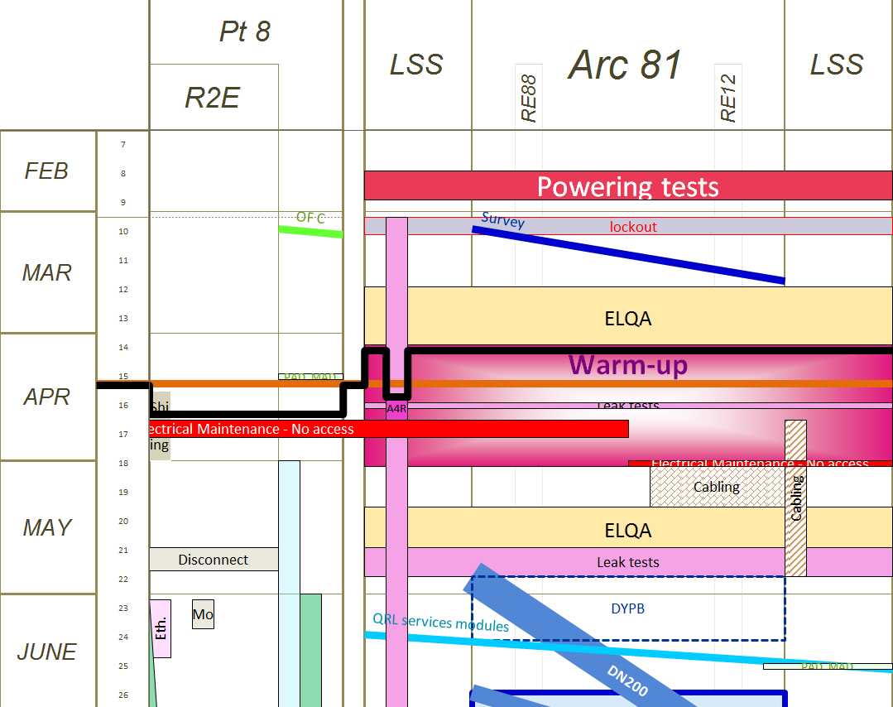
Progress & forecast – P8 & Sec. 81
Point 8 & LSS8
  In progress
    R2E shielding
    A6L8, A4R8, MKI vacuum activities
    Upgrade and maintenance of collimator
    control systems
  Forecast
    Electrical maintenance wk. 17
      No access except for authorized
      persons to the site & in underground
      Night Wed. to Thur. – NO safety network
      = NO ACESS (procedure being edited)
Sector 81
  Warm-up just started T~5K
  Leak tests at cold wk. 16
  [80-300K] ~ Wk.17-18-19
Today

Slide 10
LS1 Leak Testing - Phase 1
VSC consolidation – leak tests of arc cryomagnets prior to SMACC
Global leak tests – Tightness check prior to W opening
Longitudinal localization of known internal He leaks
4 arcs completed
Local leak tests – Open priority interconnects (MSC), apply 6 bar (CRG)
Localization of He leak to component level
* LHC = 18’000 elastomer joints, 250’000 welds
 | 5-6 | 4-5 | 6-7 | 7-8 | 1-2 | 2-3 | 8-1 | 3-4 | Comments
Air leaks found* | 4 | 7 | 2 | 4 |  |  |  |  | No systematics
Helium leaks present* | 4 | 2 | 5 | 1
Helium leaks found | 3 |  |  |  |  |  |  |  | Good start !
Courtesy: P. Cruikshank TE-VSC

Slide 11
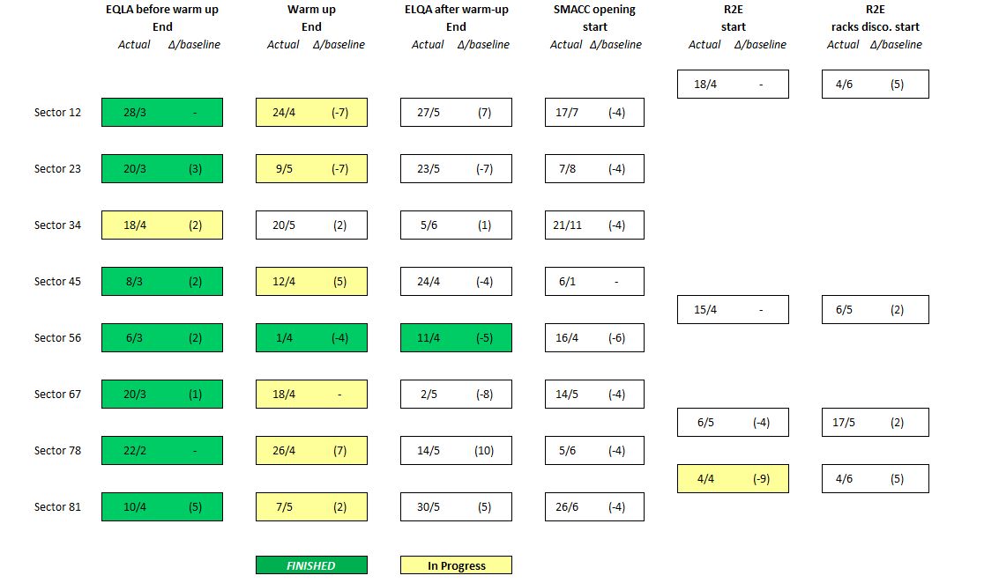
General Progress

Slide 12
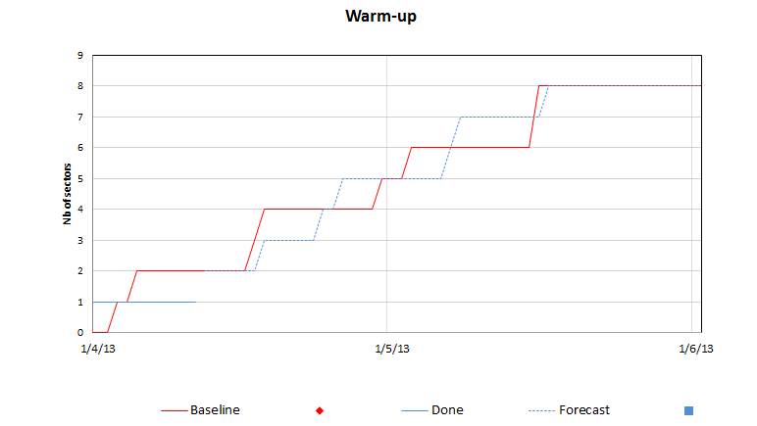
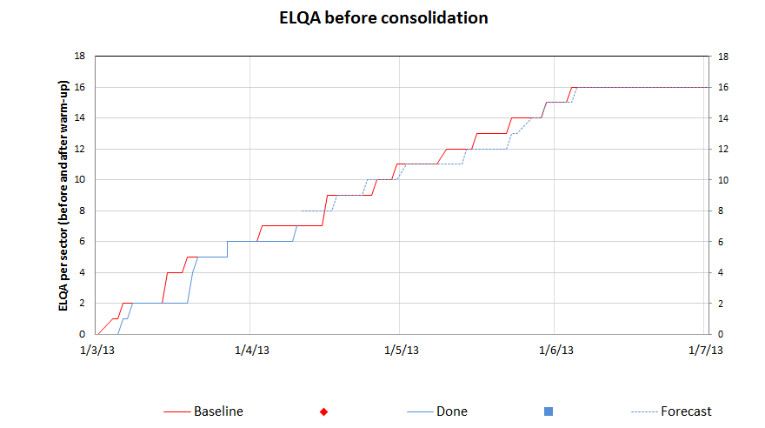
Dashboards

Slide 13
Organisation & Reminders
Phone numbers
  LHC coordination phone = 16 1669
  MAD problems: 6 2511
EPIs are not required for the equipment protection, but for the person protection !!!
No access means NO ACCESS
  For this reason, during electrical maintenance the access to the site will be filtered !!
  Proposal: anyone not respecting access restriction will go straight to sanction n°2

Slide 14
Conclusions
So far ..so Good
SMACC starting 1 week ahead of schedule
Some minor delays for R2E
Please do remind your colleagues: safety 1st !!!

