Slide 1
Shutdown of the 400 & 66kV
LSC 12/04/2013
F Duval, on behalf of EN/EL

Slide 2
Why a shutdown?
Maintenance of the CERN 400 & 66 kV
Maintenance of « Bois Tollot » 400 kV substation
Maintenance of the Genissiat/Bois Tollot 400 kV OHL
Various maintenance operations on F + CH network
Consolidation of the CERN 66 kV protection system
4 weeks needed
8 weeks needed
Last time in 2009

Slide 3
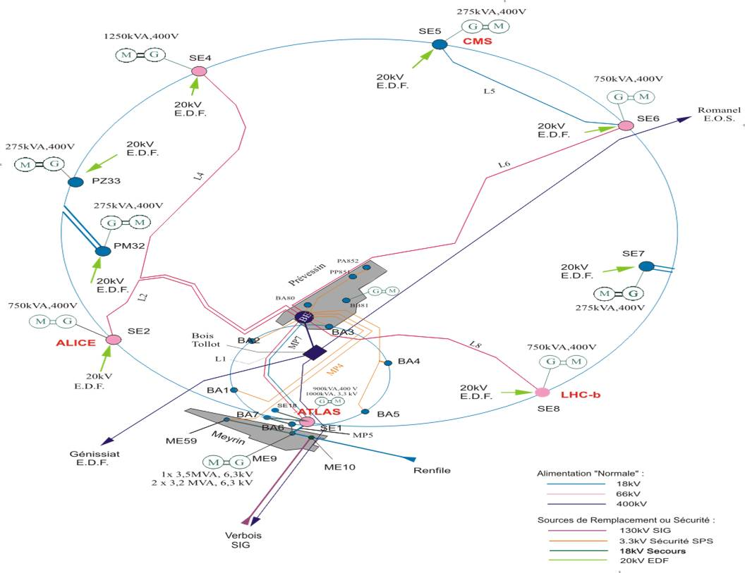
Why a shutdown?

Slide 4
Shutdown Schedule
Max power during shutdown = 60MW
  Limitation from the Swiss grid
  Insert in the LS1 Schedule after Cryo warm up
400 kV shut down from June 3rd to July 1st
  Include 66 kV shutdown
  All CERN fed from the Swiss network ( High energy prices: Over cost estimate = 500 000 CHF depending on CERN consumption and cost of energy from the open market)
66kV shutdown from July 1st to July 29th
  Max power still limited to 60 MW (CERN limitation)
  All CERN fed from French side (18 kV only)

Slide 5
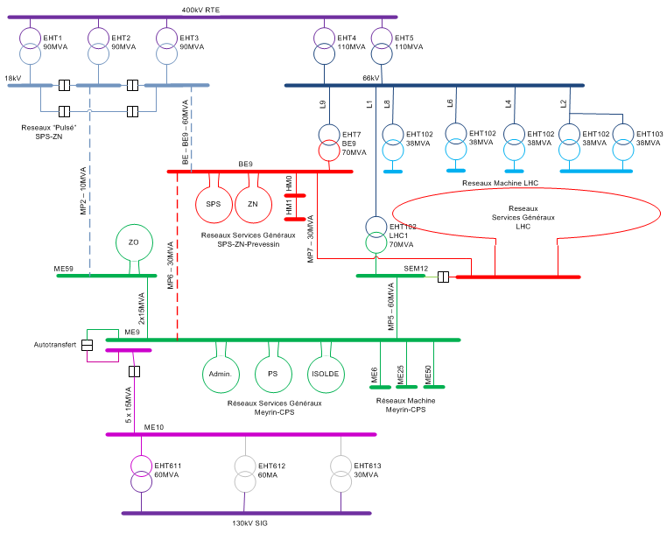
network configuration until June 3rd

Slide 6
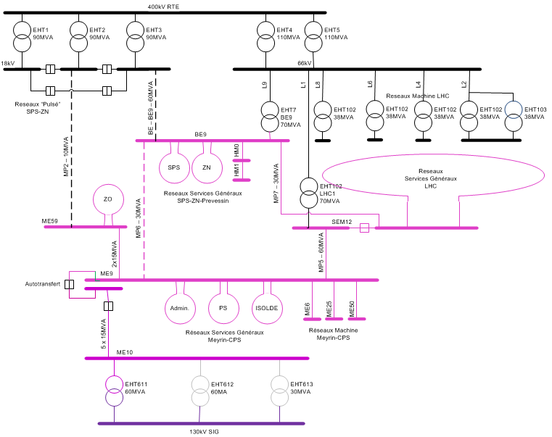
network configuration from June 3rd to July 1st

Slide 7
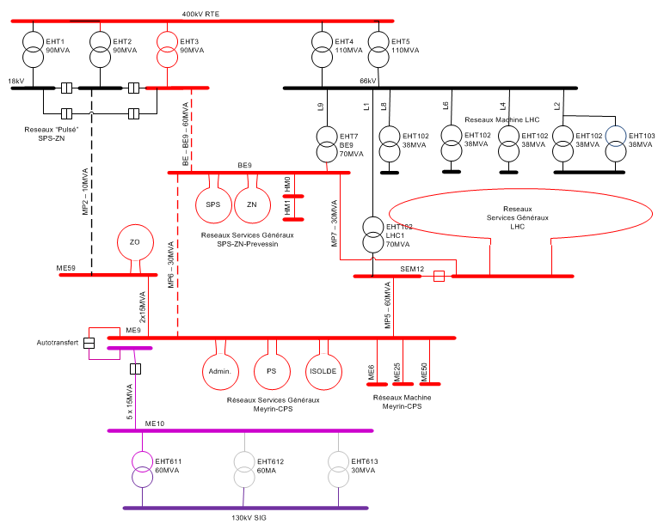
network configuration from July 1st to July 29th

