Slide 2
SMACC firt report
(of a long series…)
[10 min ++]
Jean-Philippe Tock (TE-MSC)
On behalf of the SMACC project …
Courtesy ….

Slide 3
SMACC (Superconducting Magnets And Circuits Consolidation)
  Scope of work
  Timeframe
SMACC organization
  Organization chart
  Meetings
  WISh
Progress report
  Activities since the start of the interventions
  Activities for the next 2 weeks
  Dashboards
Issues
Conclusions

Slide 4
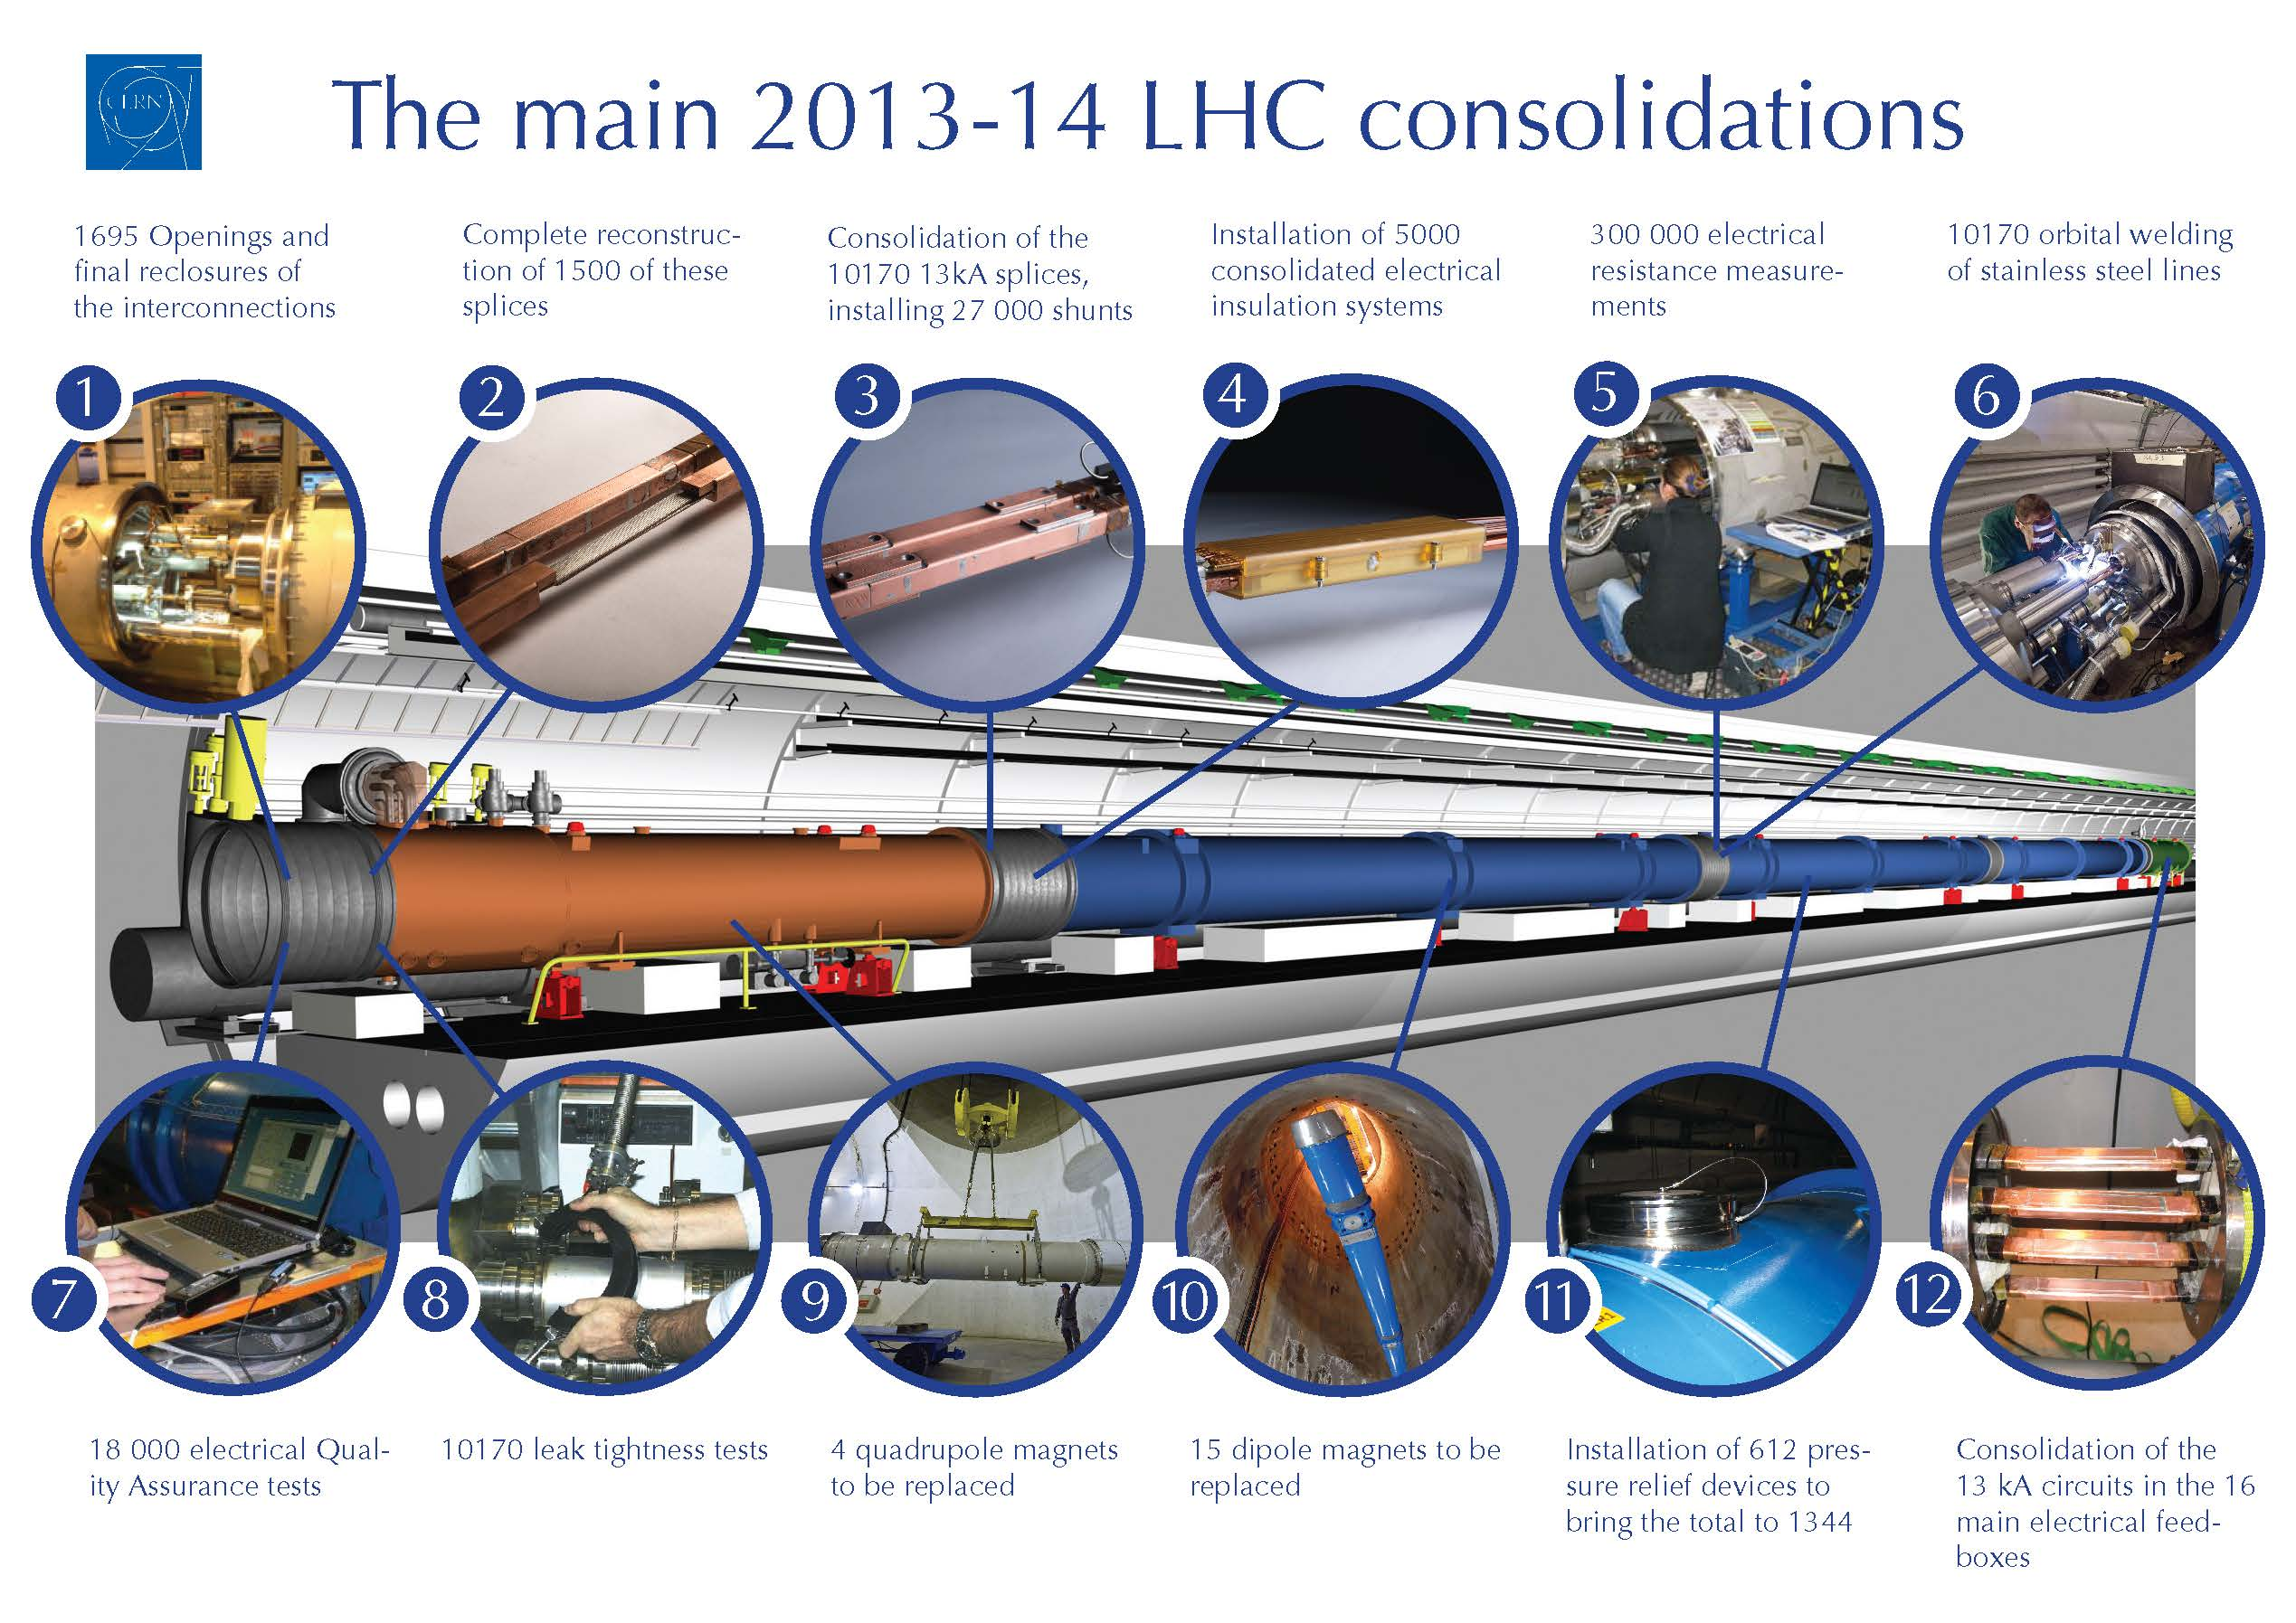
SMACC : Scope of work

Slide 5
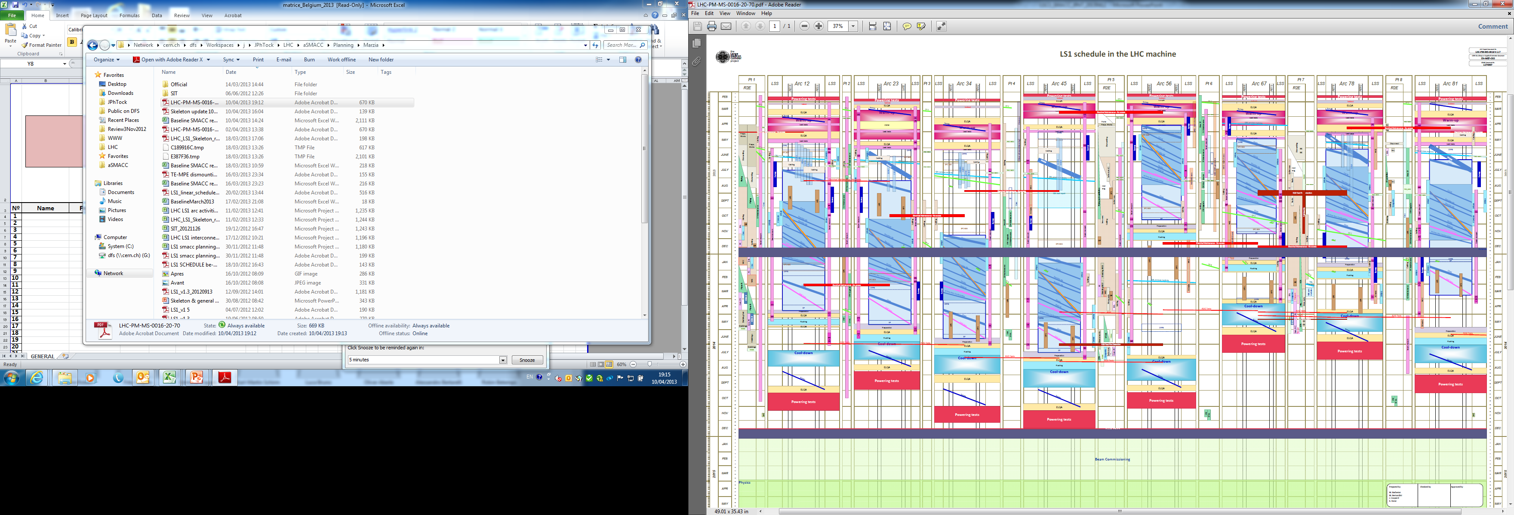
SMACC : Timeframe
1st opening on the 8th of April 2013 Start of the train on 15-16th of April
Consolidation of main splices in 4 sectors in parallel (13 km)
Last closure in Summer 2014

Slide 6
SMACC Organization Chart
Long Shutdown 1
F. Bordry
SMACC J.Ph. Tock (# 257)
Superconducting Magnets And Circuits Consolidation
Open/Close IC [DN200]
A Musso (A Chrul) #36
Main arc splices cons.
F Savary (H Prin) #77
Quality Assurance
R Ostojic #39
Opening/ Closure of IC
Partial and complete
W bellows & ther. shields
Installation of DN200
Sleeves cutting
BB surfacing
Shunt installation
Insulation
Splice de- & resoldering [15%]
Quadrupole diodes connection
Experts
Electrical QC: #16: C.Scheuerlein (P.Thonet)
-Welding QC: # 6 : JM Dalin
ICIT: : #11 : C Garion/D Bodart
[Beam vacuum & Open/Close QC]
QA manager support: #2
Audits: #3
TIG welding [EN-MME]
S Atieh (D Rey) #18 (+5)
- Orbital & manual
Special interventions “SIT”
N Bourcey (G Maury) #18
ELQA [TE-MPE]
K Dahlerup
(G D’Angelo) #28
Leak Test [TE-VSC]
P Cruikshank
(C Garion) #19
DFBA [TE-CRG]
A Perin (O Pirotte) [#10]
Cryomagnets exchange
Connect. Cryostat cons.
PIMs
Specific issues
Heavy NCs
Continuity
HV test
Beam lines
Cryogenics lines
Insulation vacuum
Splices and BB
SMACC CSI (Coordination, Support, Infrastructure) M Pojer (R Giachino) #11
Radiation protection
Safety, Access
General logistics
Pressure test
Link to visits, media
Coordination with
Survey, BLM, Instrumentation, Transport, planning, QPS, cryogenics, VSC, MPE, CRG, …
Test teams on a chain of IC
Reporting tools
Administrative support (Budget, human resources, scientific secretary)
SMACC Overview

Slide 7
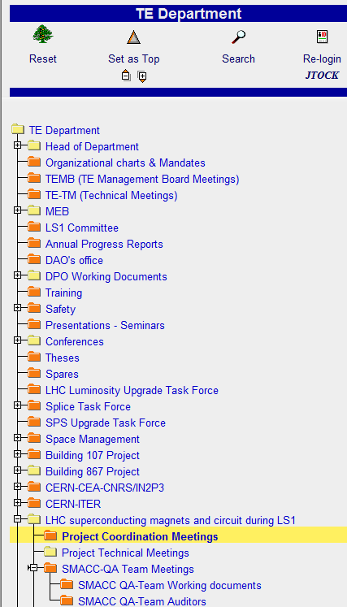
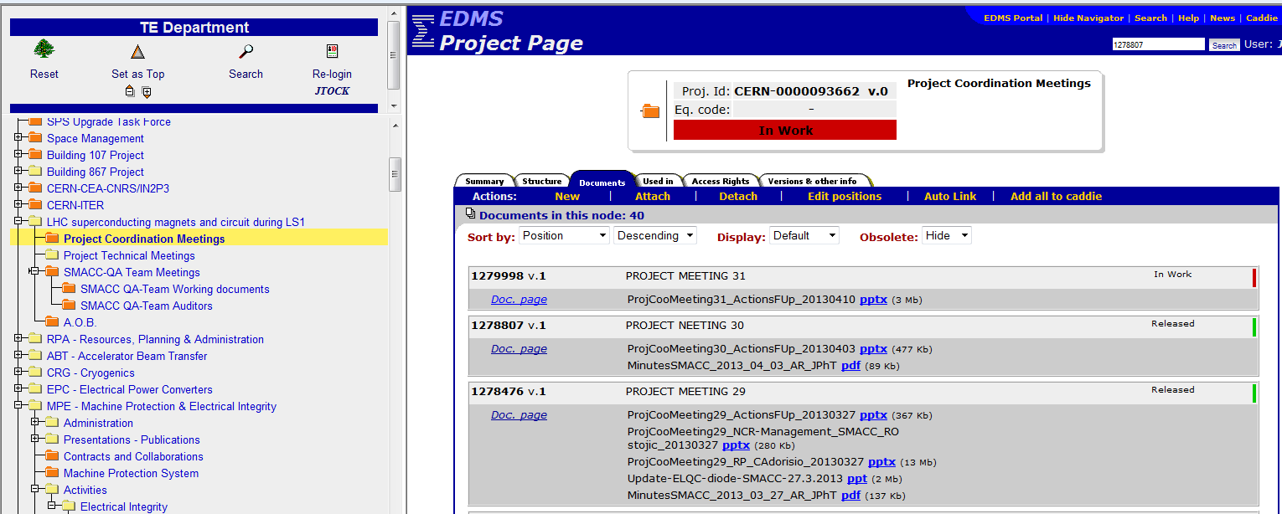
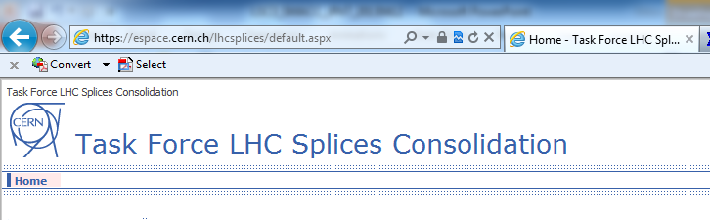
SMACC organization Meetings
SMACC Coordination meetings
  Wednesday 9:00
  Chair : JPh Tock
SMACC QA meetings
  Thursday 10:00 also Tuesday if required
  Chair : R Ostojic
LHC splices TF
  On request for technical issues
  Chair : JPh Tock
Local coordination meeetings
  (Bi)daily if required
  Chair : M Pojer – CSI
Participation to:
  LS1 Coordination meetings (Thursday 9:15)
  LSC (Friday 10:00) with a reporting every 2 weeks
Thanks to TE-RPA support

Slide 8
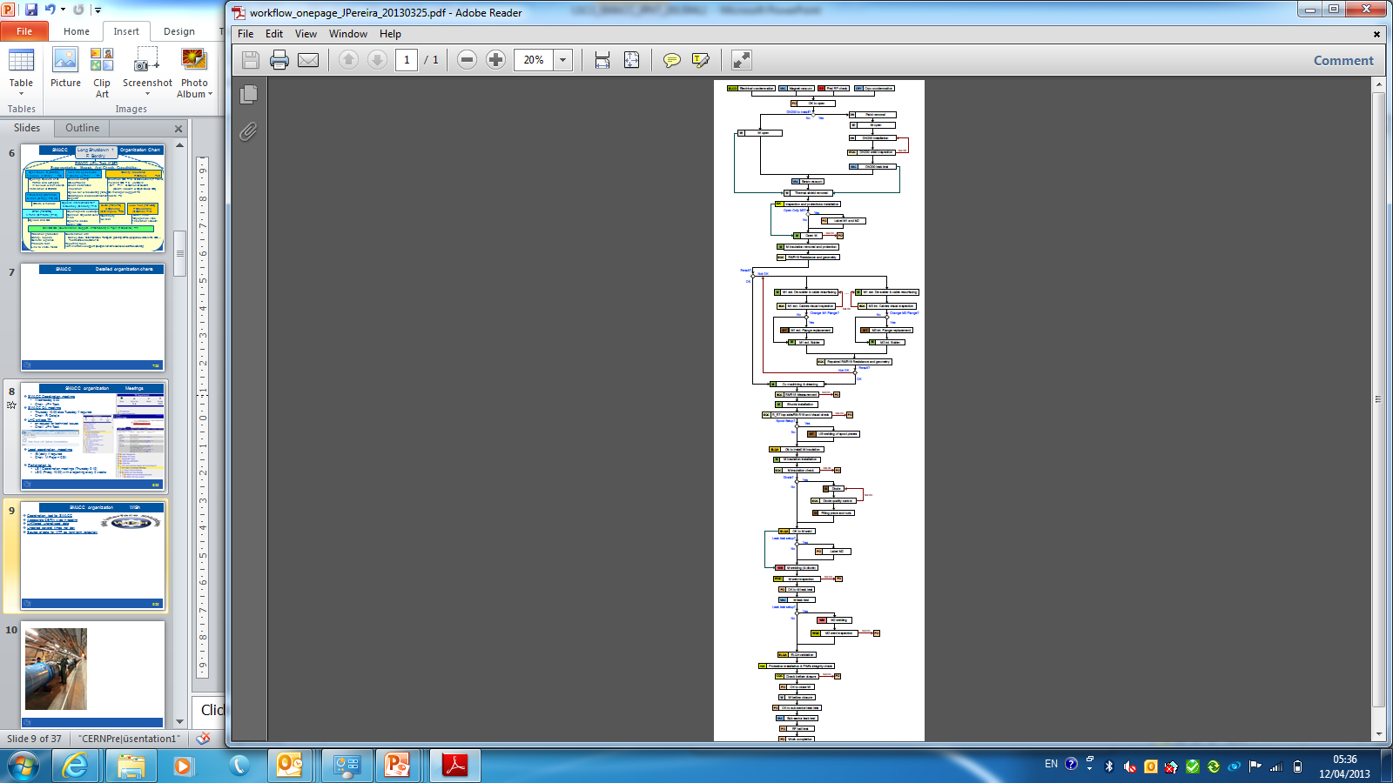

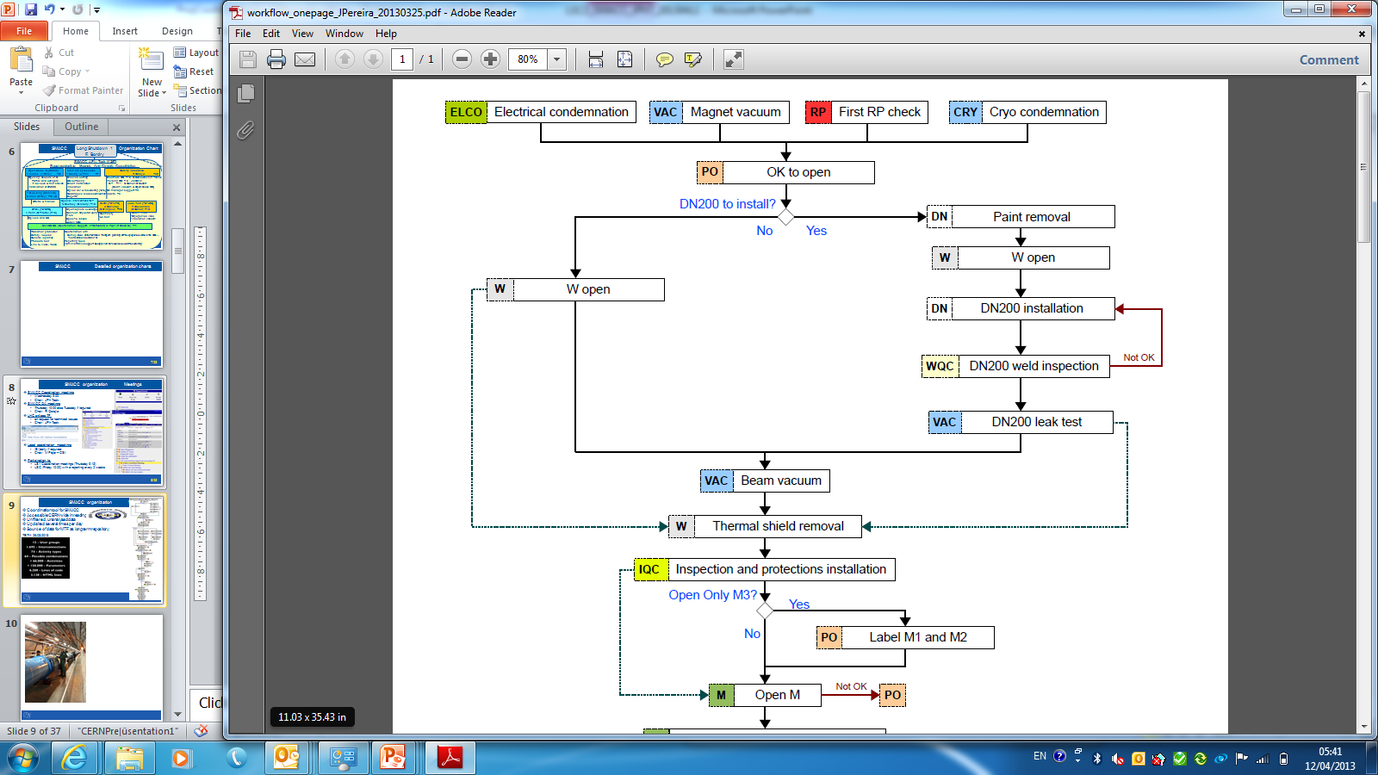
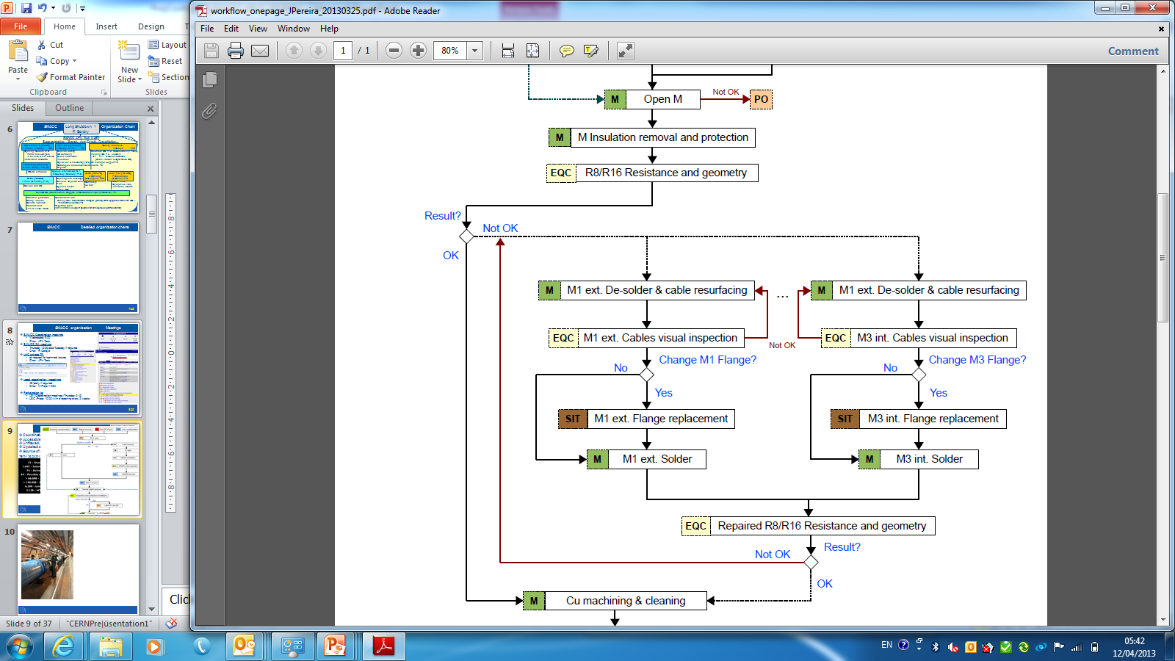
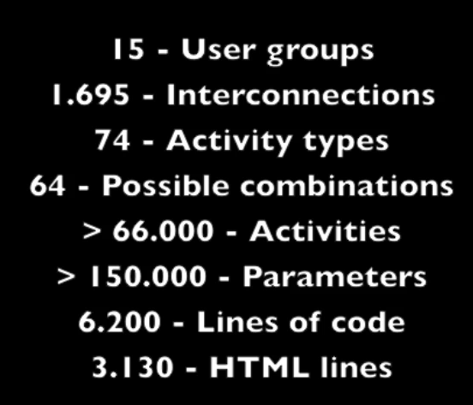
SMACC organization WISh
Coordination tool for SMACC
Accessible CERN wide in reading
Unfiltered, unanalysed data
Updated several times per day (1 hour typ)
Source of data for MTF as long term repository
TETM 26.03.2013
Courtesy J Pereira Lopes

Slide 9
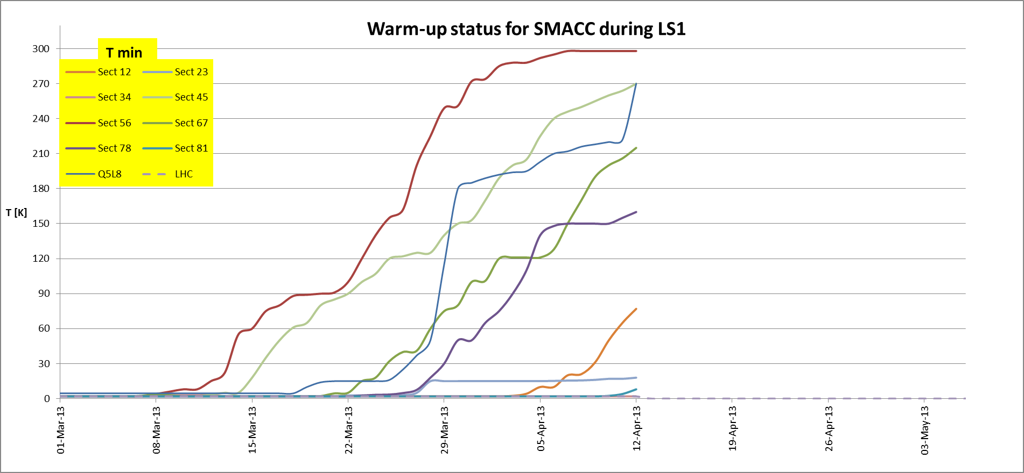
SMACC Progress report Activities in the last 2 weeks
Sector 56
Sector 45
Q5L8
Sector 67

Slide 10
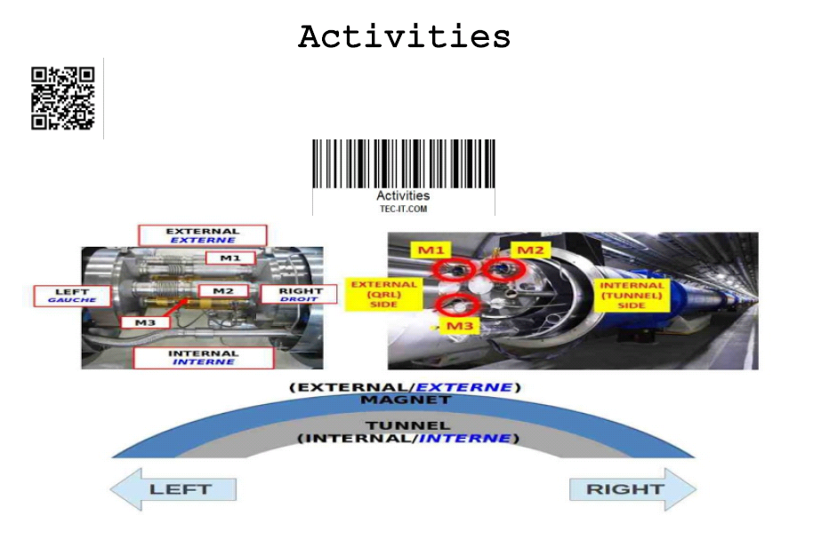
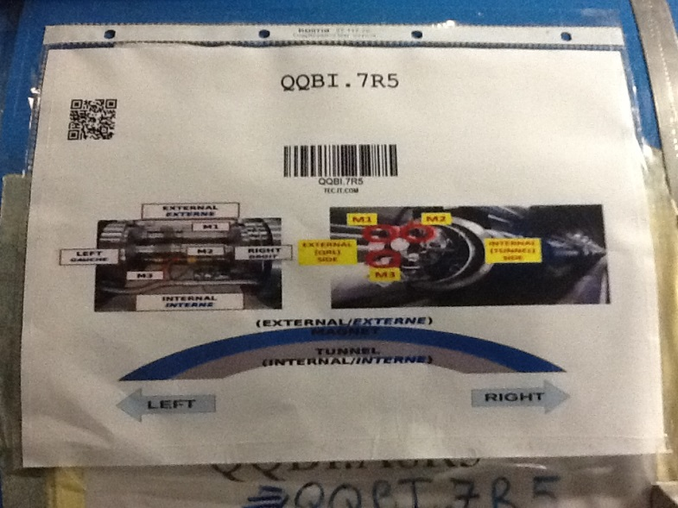
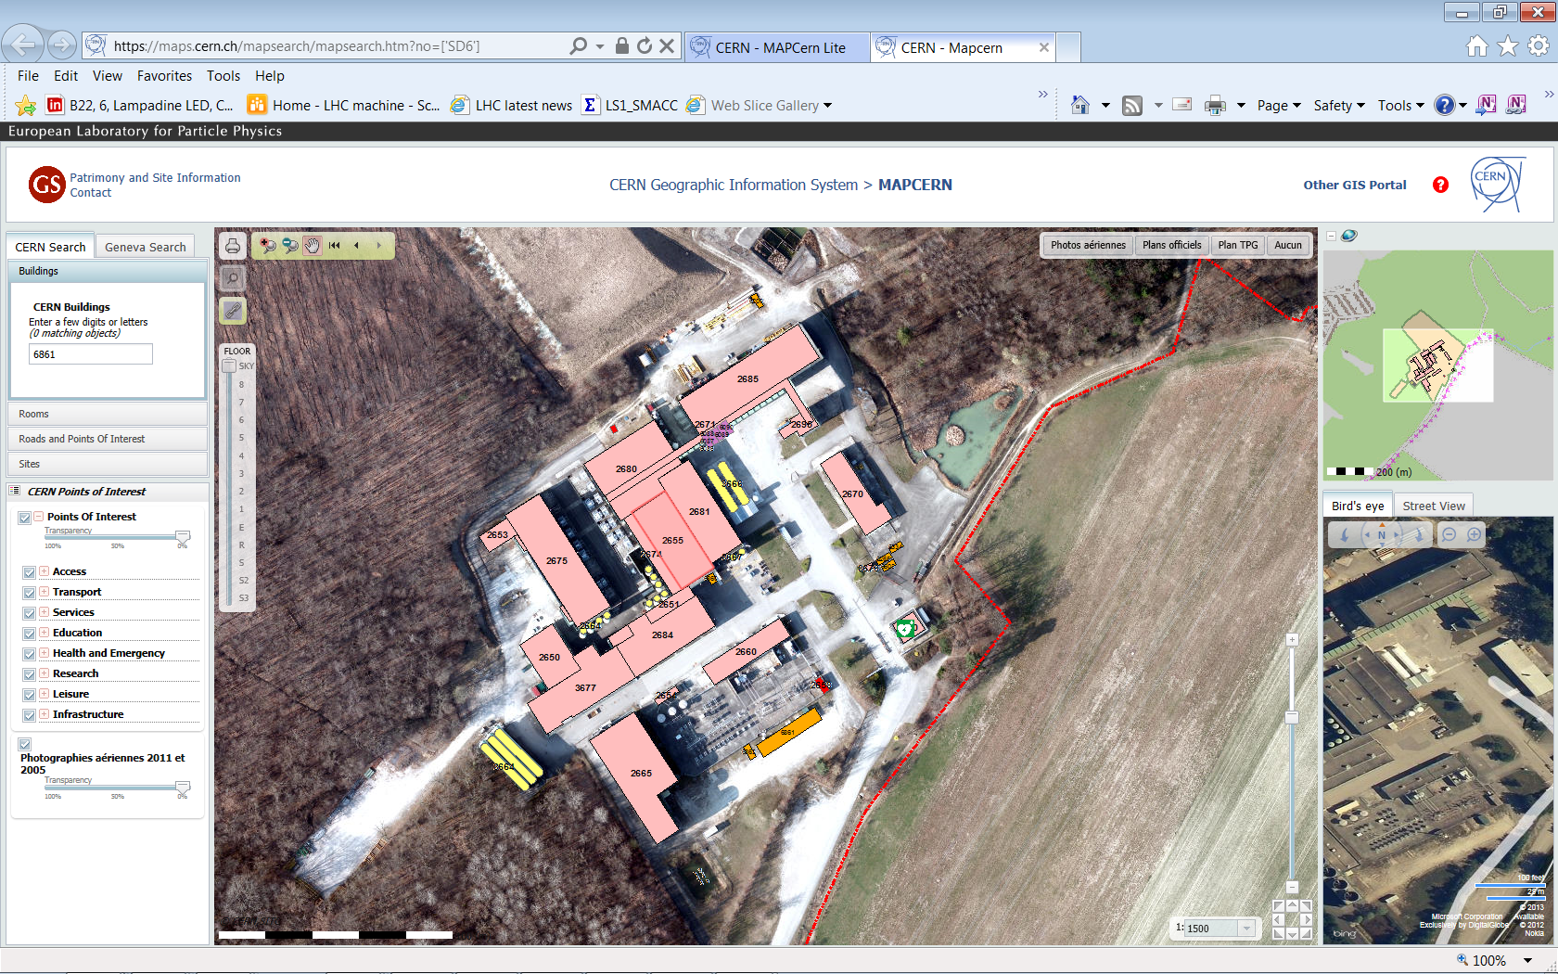
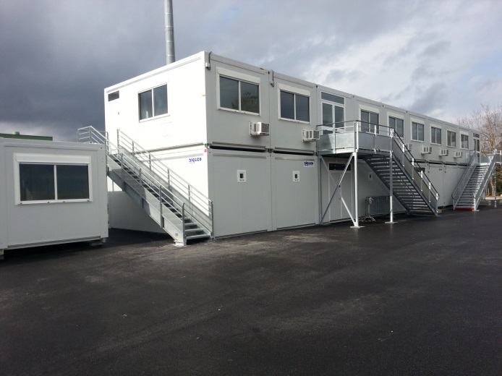

SMACC Progress report Activities in the last 2 weeks
Focused on tunnel activities
2 days of work in sector 56 for
  CSI
  (Coordination Support & Infrastructure)
  α ω team (DN200)
  ICIT
  RP
Lift
Base chantier
Courtesy M Pojer, Ph Canard, R Faes

Slide 11
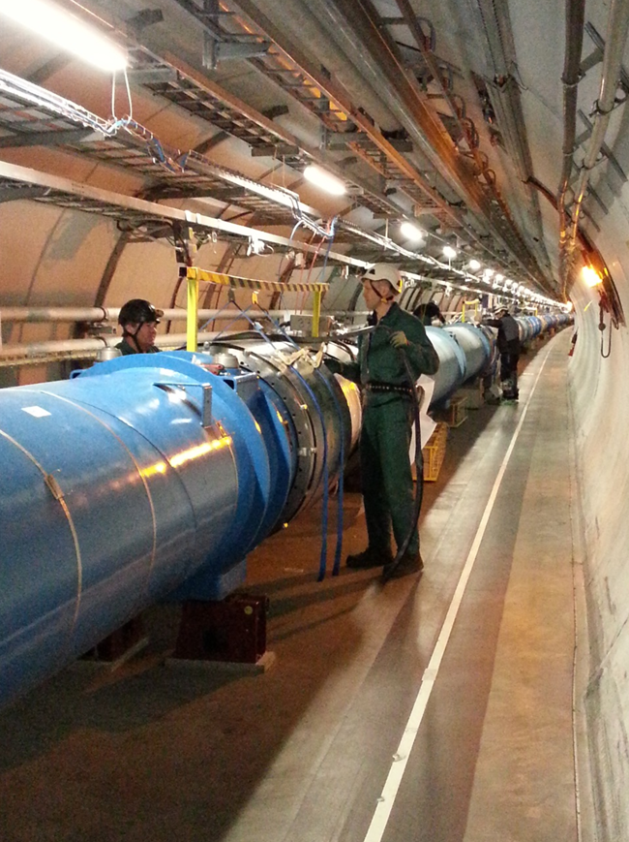
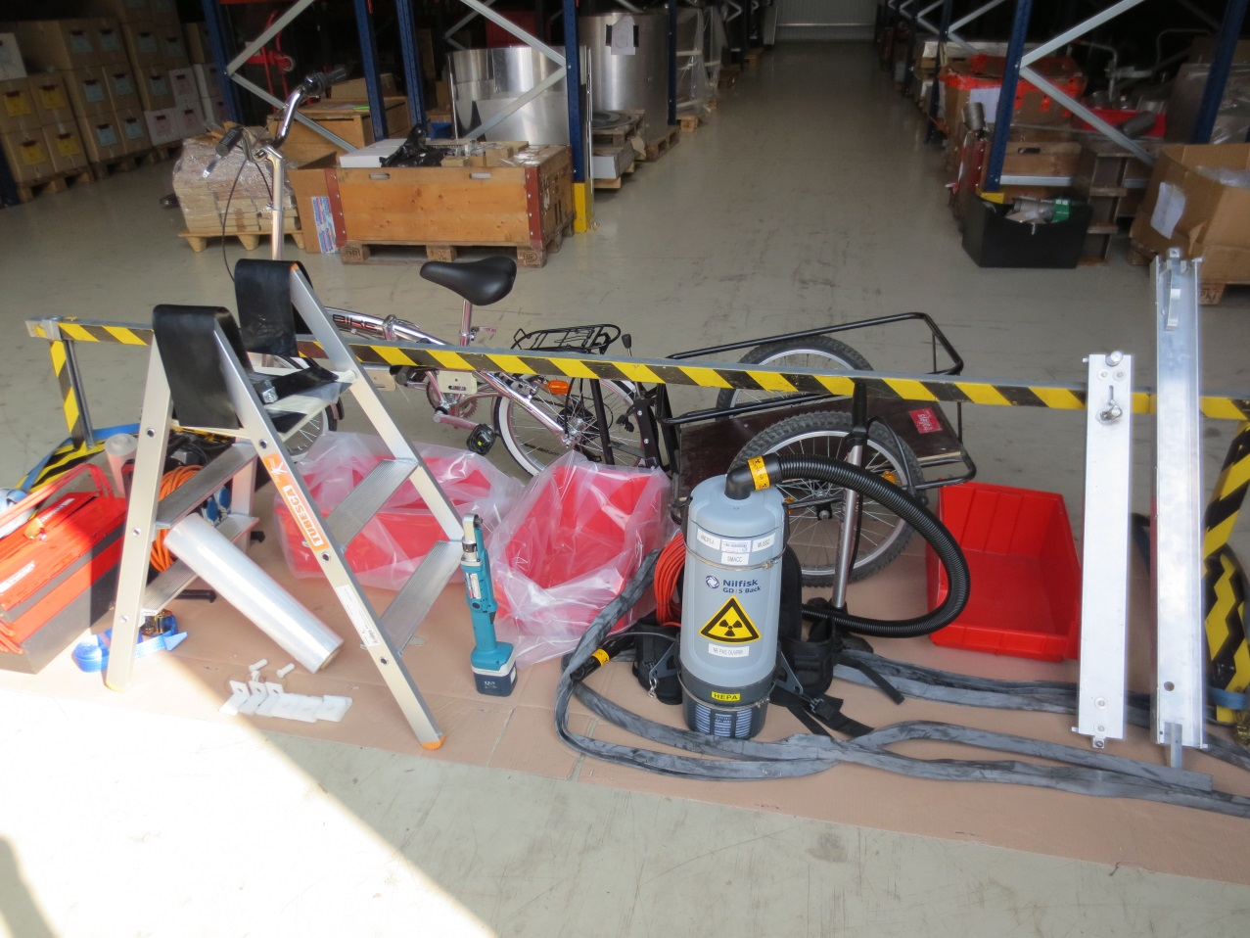
SMACC Progress report Activities in the last 2 weeks
Focused on tunnel activities
2 days of work in sector 56 for
  CSI
  α ω team (DN200)
  ICIT
  RP
Courtesy A Chrul, A Bastard

Slide 12
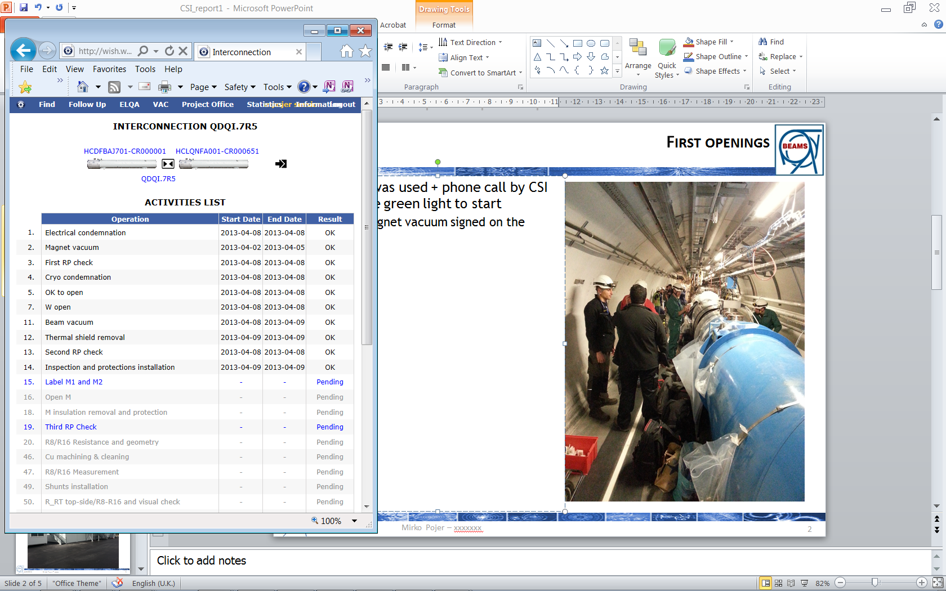
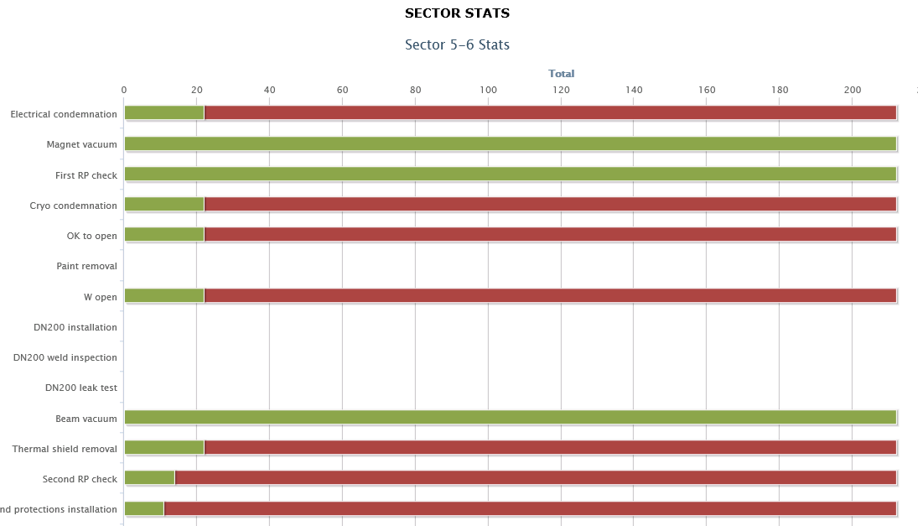
SMACC Progress report Activities in the last 2 weeks
Focused on tunnel activities
2 days of work in sector 56 for
  CSI
  α ω team (DN200)
  ICIT
  RP
Objective : Opening 22 interconnections
Achieved
Courtesy A Chrul, M Pojer

Slide 13
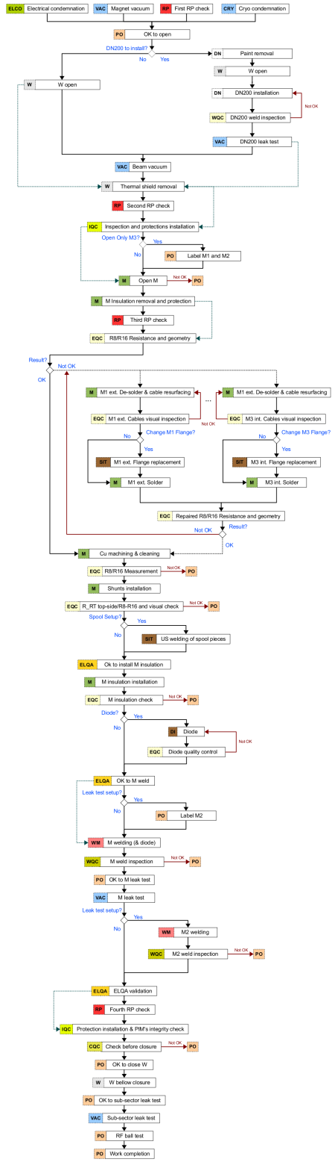
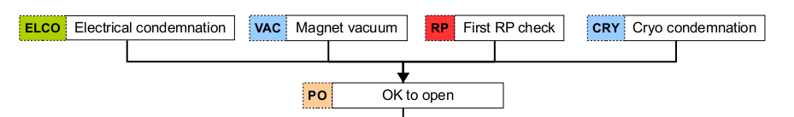
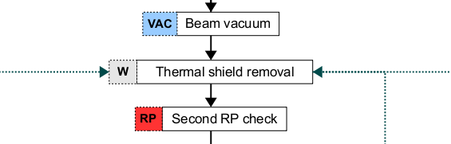
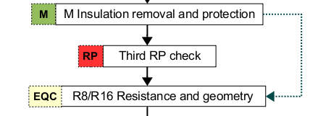
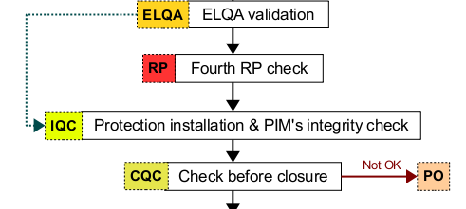
SMACC Progress report Activities in the last 2 weeks
Focused on tunnel activities
2 days of work in sector 56 for
  CSI
  α ω team (DN200)
  ICIT
  RP
    Checks
Courtesy C Adorisio, Y Pira

Slide 14
SMACC Progress report Activities in the last 2 weeks
Focused on tunnel activities
2 days of work in sector 56 for
  CSI
  α ω team (DN200)
  ICIT
  RP
    Checks
Second RP check measurements – Sect. 5-6
IC | M1 |  | M2 |  | M3
 | cps | uSv/h | cps | uSv/h | cps | uSv/h
QDQI.7R5 | 120 | - | 120 | - | 300 | -
QQBI.7R5 | 70 | - | 70 | - | 100 | -
QBBI.8R5 | 180 | - | 230 | - | 170 | -
QBQI.8R5 | 1200 | 1.0 | 800 | 0.7 | 1500 | 1.2
QQBI.8R5 | - | 1.0 | - | 0.5 | - | 0.6
QEQI.11R5 | - | 0.5 | 430 | 0.6 | - | 0.8
QQBI.17R5 | - | - | - | - | - | -
QBBI.A18R5 | - | - | - | - | - | -
QBBI.B18R5 | - | - | - | - | - | -
QBQI.18R5 | - | - | - | - | - | -
QQBI.18R5 | - | - | - | - | - | -
QBBI.B27R5 | - | - | - | - | - | -
IC | M1 |  | M2 |  | M3
 | cps | uSv/h | cps | uSv/h | cps | uSv/h
QBQI.9L6
QQBI.8L6
QBBI.8L6
QBEI.5L6
QEDI.5L6
QBBI.A14L6 | - | - | - | - | - | -
QBQI.14L6 | - | - | - | - | - | -
QQBI.13L6
QBBI.B13L6
QBBI.A13L6
Only background noise
Courtesy C Adorisio, Y Pira

Slide 15
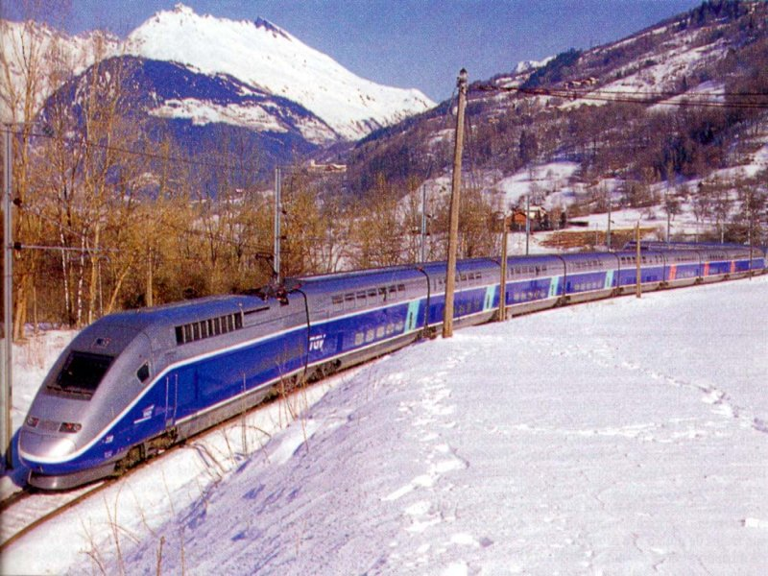
SMACC Progress report Activities for the next 2 weeks
Sector 56 : From 15.04.2013:
  Lowering of tooling
  Opening of interconnections systematically starting from P5
  Staged starting time of various activitites:
    M line cutting, insulation removal, ELQCs, splices redoing, shunt installation
  Special interventions : PIMs consolidation, RF ball test, cuts for ELQA, Q11 short, CC inspections,…
Sector 45 (26.04.2013)
  Start opening for leak test localisation and preparation of special interventions (#23+ ICs)

Slide 16
SMACC Progress report Activities for the next 2 weeks
Sector 56
Sector 45
Sector 67

Slide 17
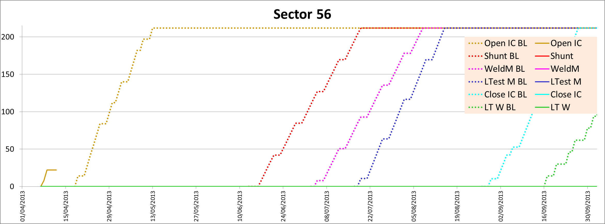
SMACC Progress report : Dashboards

Slide 18
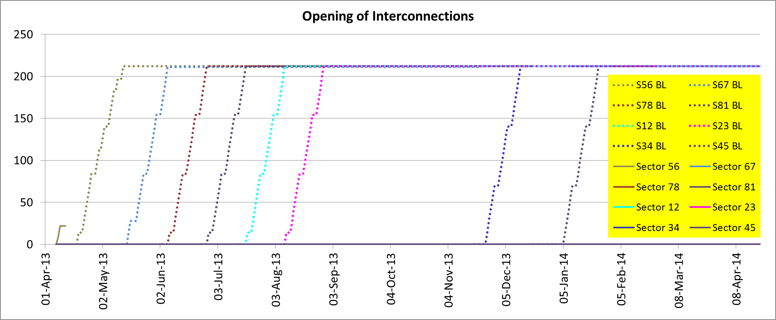
SMACC Progress report : Dashboards

Slide 19
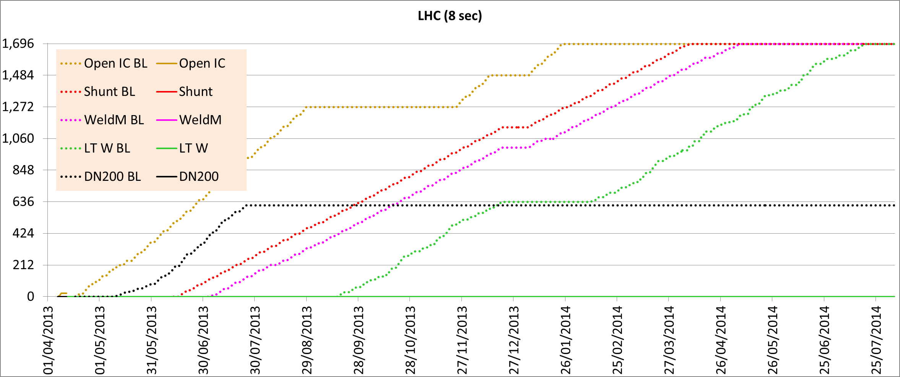
SMACC Progress report : Dashboards

Slide 20
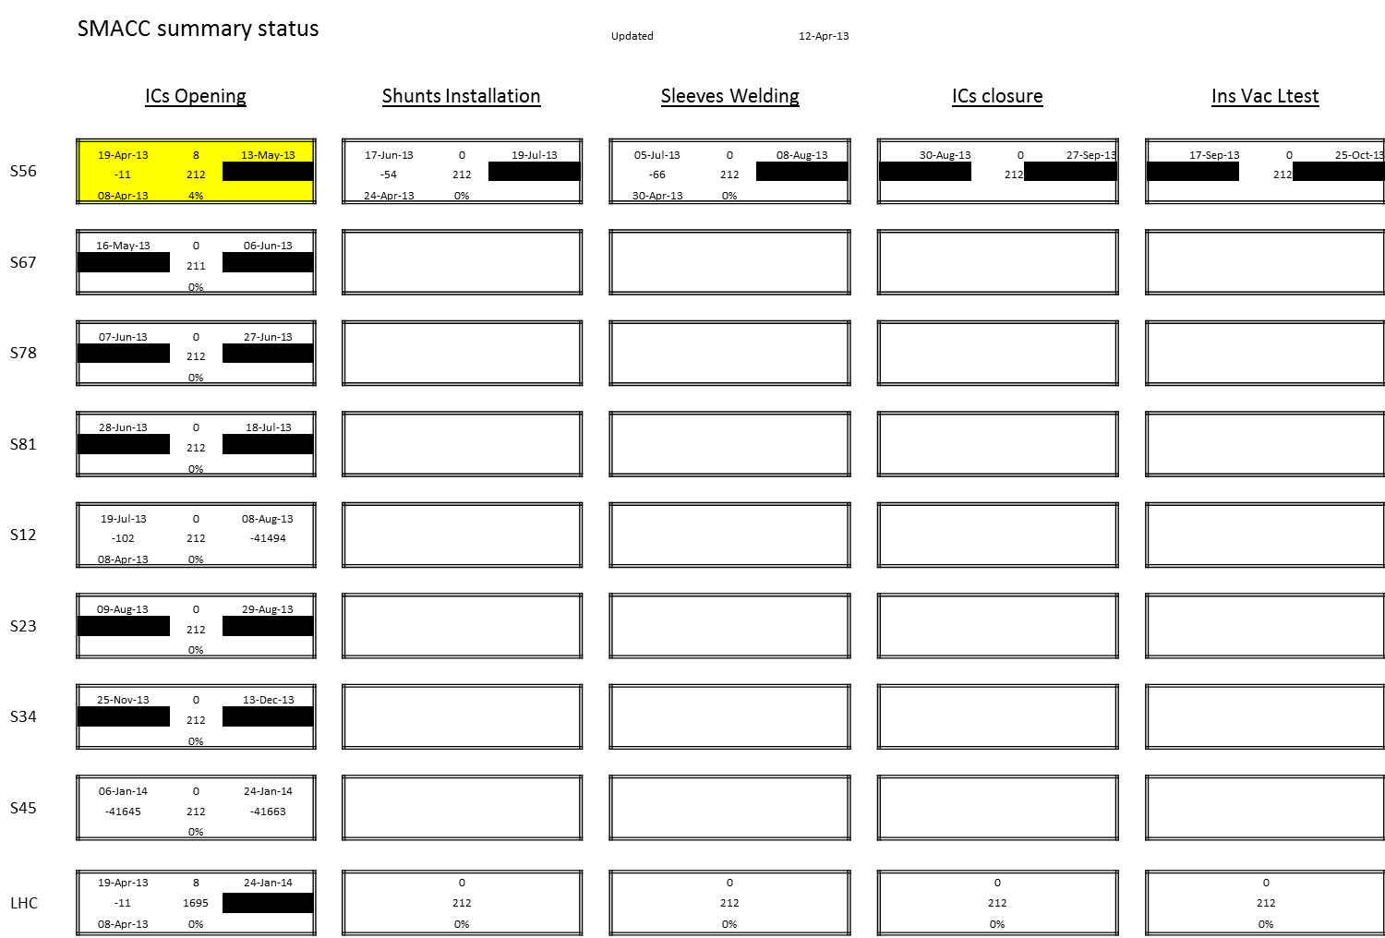

SMACC Progress report : One page summary

Slide 21
SMACC Issues
☺ WiFi in the tunnel. Very efficient +++
    😐 Weakness at the surface, coverage map will be provided by IT
☹ Access : Difficulties (Just few examples)
    1.45 h to have 22 persons through the M/PAD at P5 on 8.04.2013
    3 opening/closure cycles of MAD at P6 on the 9.04.2013
    Procedure for remote control of MAD by CSA is not known
    ☺ : Bikes and tooling will remain in the tunnel later
    ☺ : Guards will be available for a parallel access
      ☹ But only starting from 22.04.2013
    GS/EN … are working on it. Thanks in advance. [ 62511 / 161669]
    ☹ Gradually up to 150 persons accessing
    ☹ «Newcomers» have to be trained
    Let’s be prepared, patient, understanding..
        There will be blockages to be handled
        It is a learning phase for many teams

Slide 22
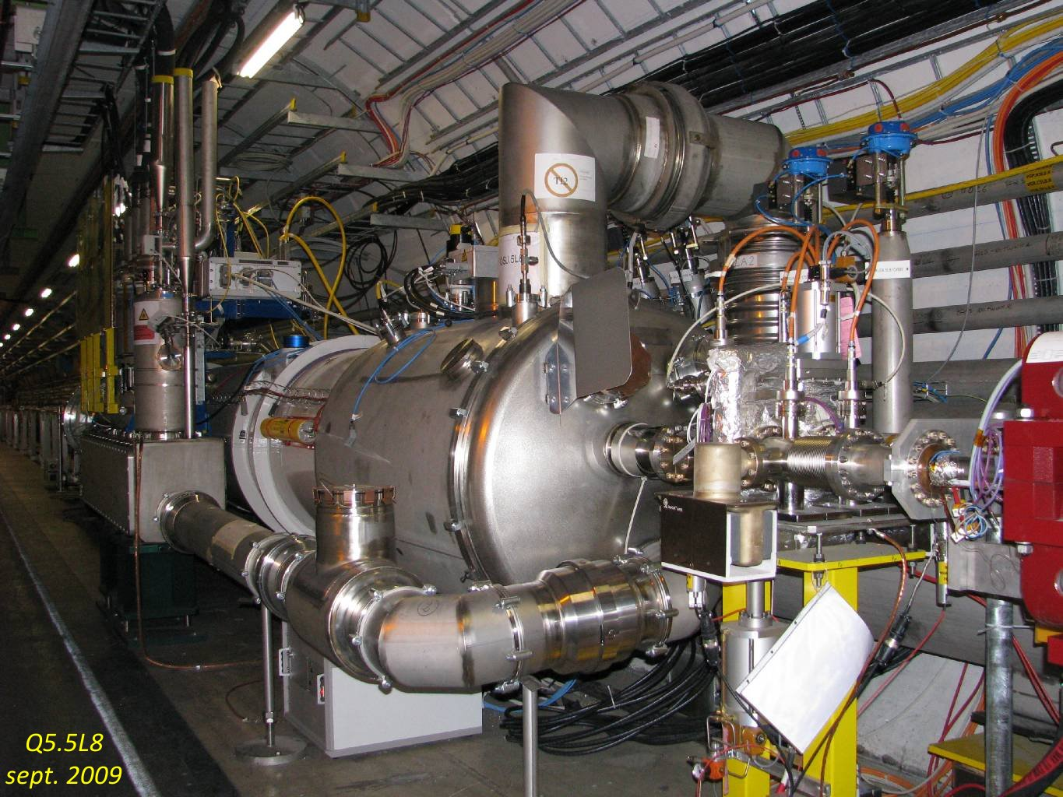
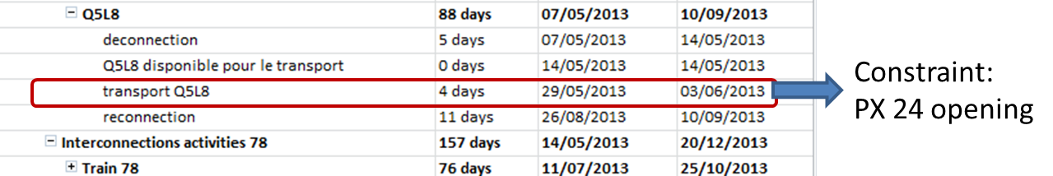
SMACC Issues
😐 Q5 L8
Critical from the schedule point of view
5 working days to disconnect with no one having assembled it !
Was foreseen 7.05.2013 so margin of 2 weeks
Now start of disconnection 21.05.2013 so no more margin !
Closely followed by EN-MEF-OSS, TE-CRG,…

Slide 23
SMACC Progress report Activities for the next 2 weeks
Sector 56
Sector 45
Q5L8
Sector 67

Slide 24
Conclusions
The work has started with a good spirit, ahead of schedule
Main issues :
  Make the accesses as fluid as possible
  Q5L8 to be closely monitored
  Dashboards to be finalised with EN-ICE

Slide 25
