Slide 2
LS1 Safety Issues
4th LSC, 12.4.2013
- Accidents
- Personal protective equipment
- Measures against breach of Safety Rules
Thomas Otto, Safety Officer, TE Dept.

Slide 3
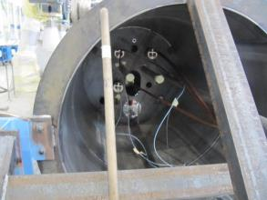
Inappropriate Safety Glasses - 1
Two accidents on the Mockups in Bld. 180 (on 24.1. and 19. 3.)
In spite of wearing Safety Glasses, operators received projections of metal fragments in the eye during
work with a Dremel minia-
ture mill
Imposed working position,
tool lateral to face

Slide 4
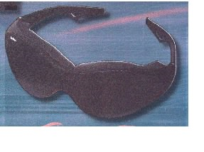
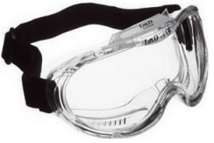
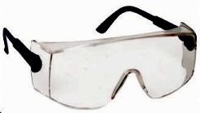
Inappropriate Safety Glasses - 2
The Safety Glasses worn did not have lateral protection, and the workers were awkwardly positioned
Use safety glasses offering lateral protection
SCEM 50.49.10.040.0
SCEM 50.49.10.025.9
SCEM 50.49.10.250.2
The models now sold in CERN stores all have lateral protection

Slide 5
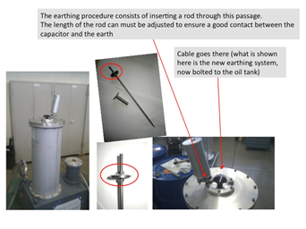
Electrical Accident - 1
Beginning of March:
4 μF capacitor disconnected from RF powering network and connected to ground, following standard procedure
(Ground connection had bad electrical contact)
Capacitor vessel is not connected to ground

Slide 6
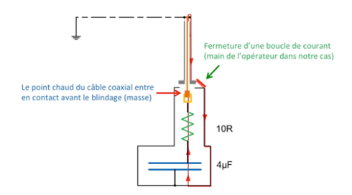
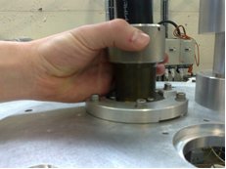
Electrical Accident - 2
19.3. :
Reconnection of the 4μF capacitor to the the RF installation
Capacitor has inadvertently charged
Operator’s hand made contact, discharging capacitor to ground

Slide 7
Electrical Accident - 3
The connection had already been identified as not ergonomic and is being redesigned, including a more reliable ground connection
Analyse the possibility to have the capacitor vessel connected to ground
Develop procedure on how to deal with stored capacitors, which may have a bad ground connection and be charged

Slide 8




Mandatory
Personal Protective Equipment
Accelerators, Experimental Halls
Underground Areas
At a fixed work station, the self-rescue mask container can be taken off.
At a fixed work station without risk of head injuries, the helmet can be taken off.
The PPEs have to be in the immediate vicinity (< 5 metres) and must be always reachable.

Slide 9

Measures against Breach of Safety Rules
An A&T Safety Procedure is under approval
Safety coordinators, TSOs and other SOs will control compliance with CERN Safety Rules

Slide 10

Measures against Breach of Safety Rules
1st breach: invitation to immediate corrective action (this may include leaving the premises to get the missing PPE)
2nd breach: repetition of relevant safety courses within
2 weeks
3rd breach: revocation of access rights until safety courses have been repeated
Any further breach:
action at the discretion of the Department Head.

Slide 11
Have a safe workday

