Slide 1
LS1 Progress Monitoring
B.Copy, Ph.Gayet, A.Rijllart, V.Vasilyev
EN-ICE

Slide 2
Objectives
Aggregate in a common place the relevant information on the progress of LS1
Broadcast it to a wide audience

Slide 3
Requirements
Information must be accurate and validated
Information on projects must be synthetic, self explaining
Navigation to/from/through the dashboard must be obvious
All projects should use a homogenous look and feel
The LS1 Dashboard must be available 24/7
The LS1 Dashboard must be available on mobile devices

Slide 4
Site organization
Main
Cabling
LHC
SPS
SMACC
DFBA
Home page : overall advancement
Main projects page
Sub project page
R2E
Injectors
Shunt
Other?
One or more graphs or images can be associated to each node

Slide 5
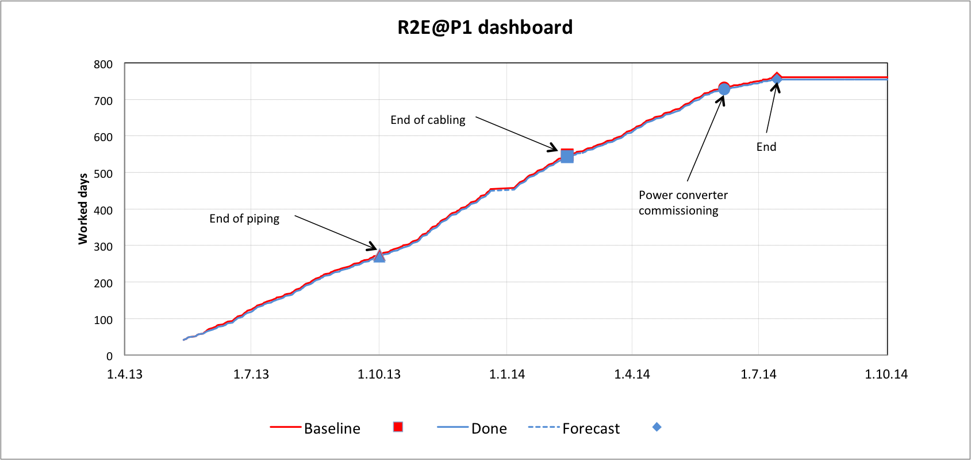
Typical Progress Report
X : time
Y : % Completion

Slide 6
Overview Picture

Slide 7
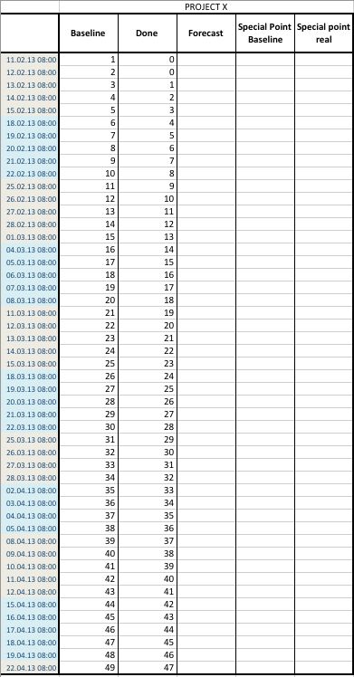
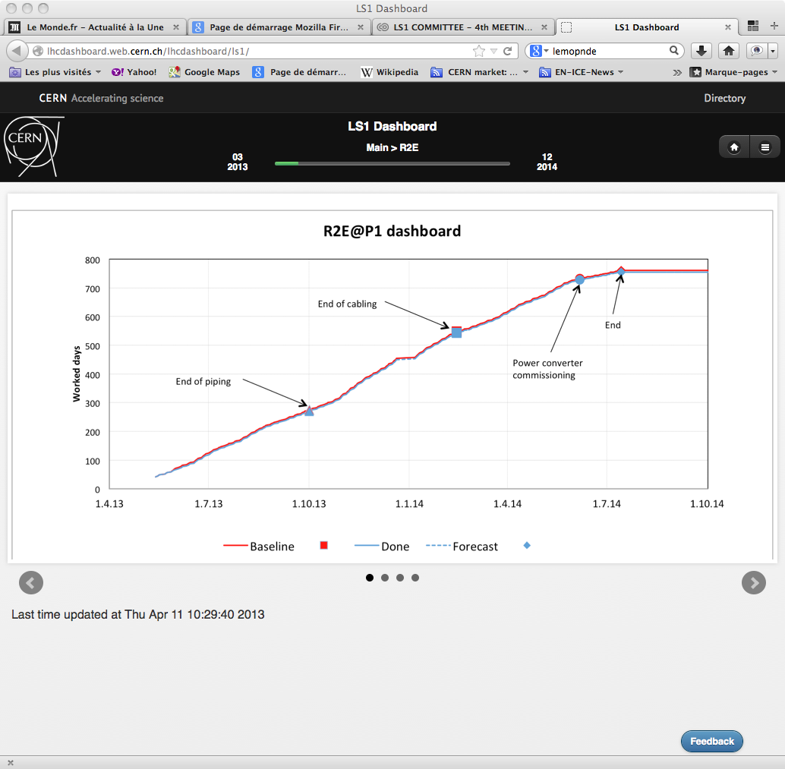
Workflow
Projects
LS1 Coordination
EN-ICE
Project Leaders
Update weekly their data in a agreed format for graph or prepare new pictures
LS1 coordination
Validate the evolution and put the updated/validated files into a repository
Automated scripts update the website

Slide 8
Identified Projects
LHC
  SMACC
  Cabling
    LHC
    SPS
  R2E
  ELQA
  Cryo
Injectors
  SPS
  PS
  LEAR
  AD
Infrastructure ?
  Maintenance ?
  Consolidation?
IF you want to present information in the LS1Dashboard
Contact : ls1.dashboard@cern.ch

Slide 9
ON-AIR
http://lhcdashboard.web.cern.ch/lhcdashboard/ls1/

