Slide 1
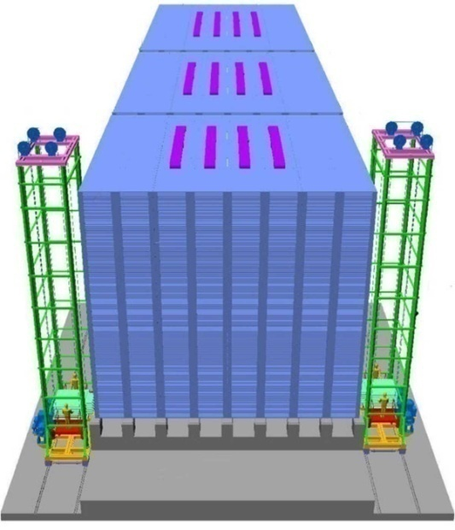
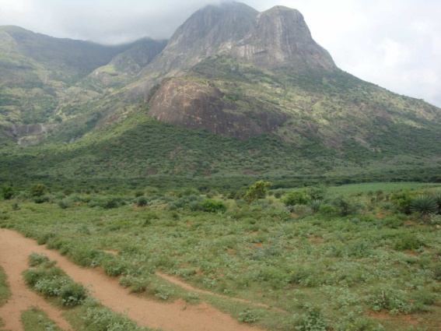
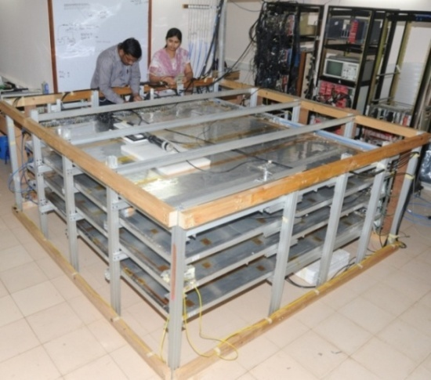
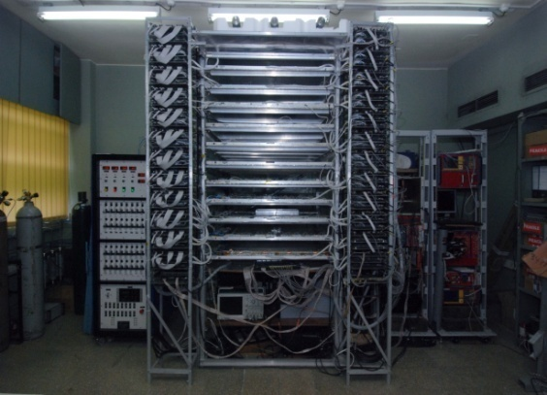
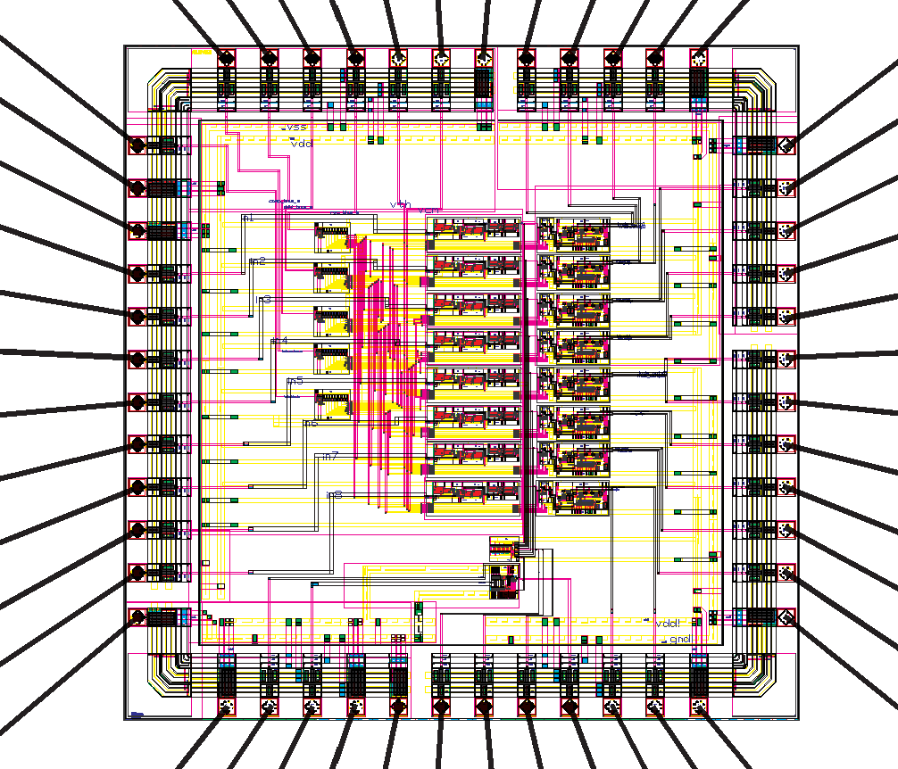
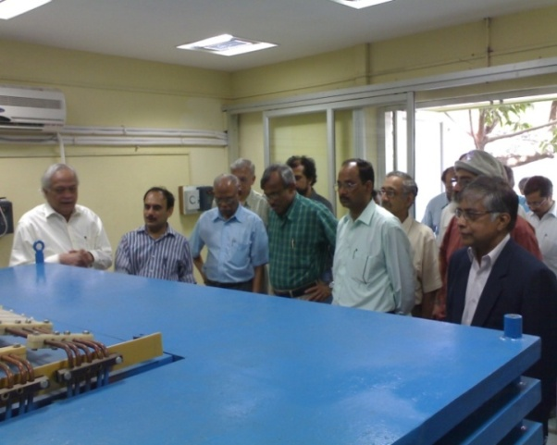
India-Based Neutrino Observatory
(INO)
ICAL
( conceptual)
INO Peak at
Bodi West Hills
Y.P. Viyogi
DAE Raja Ramanna Fellow
VECC Kolkata
for INO collaboration
RPC Test stand at TIFR
2mX2m RPC Test Stand at TIFR
Prototype ICAL at VECC
ASIC for RPC designed at BARC

Slide 2
INO: a brief history
MoU signed by Directors of seven DAE Institutions in 2002, for the exploration of sites, R&D on detectors and preparation of a detailed project report as part of the feasibility study.
DAE allocated funds for feasibility study and detector R &D. Disbursed through TIFR.
DST agreed to participate in the project and provided seed funding to 12 university groups.
Site selection : Two alternatives (a) PUSHEP near Masinagudi in Nilgiri mountains in Tamilnadu (b) Rammam in the Darjeelimng hills in West Bengal. Preferred PUSHEP.
Got trapped in environmental issues, lost four years of time, finally shifted to Bodi West Hills in Tamilnadu

Slide 3
INO : Salient Features
A unique facility for non-accelerator nuclear and particle physics in the country with multi-institutional initiative.
Underground laboratory with ~1 km all-round rock cover accessed through a 1.9 km long tunnel. A large and several smaller caverns to facilitate many experimental programs.
The magnetized Iron Calorimeter (ICAL) detector, with its charge identification ability, to address frontline neutrino issues e.g., mass parameters and other properties, in a manner complementary to ongoing efforts worldwide.
Will support several other experiments when operational. Neutrino-less Double Beta Decay and Dark Matter Search experiments foreseen in the immediate future.
Welcome International participation.

Slide 4
INO Project Components
Construction of an underground laboratory and surface facilities near Pottipuram village in Theni district of Tamil Nadu.
Construction of a massive 50 kton magnetised Iron Calorimeter (ICAL) detector to study properties of neutrinos.
Construction of the INO Centre- The Inter-Institutional Centre for High Energy Physics (IICHEP) at Madurai.
Human Resource Development (INO Graduate Training Program)

Slide 5
Financial Issues
Cost of the project : 1500 Crores
  Surface facilities, tunnel and cavern : ~500 Crores
  IICHEP at Madurai : ~ 50 Crores
  ICAL ~ 950 Crores
Status : AEC approved last month, now goes to Cabinet
Sharing between DAE and DST
  DAE funds civil infrastructure and 50% of ICAL, supports DAE groups
  DST funds 50% of ICAL, supports non-DAE groups
A 100 Crore project for development of site infrastructure (roads, water supply, electricity etc.) and construction of 1/8 size Engineering Module of ICAL already approved.

Slide 6
ICAL: The physics goals
Accurate determination of the atmospheric parameters (θ₂₃ octant, deviation of θ₂₃ from maximality)
Determination of neutrino mass hierarchy (large θ₁₃ is
good news !)
Nonstandard interactions, CPT violation, long range forces, ultrahigh-energy muon fluxes, ...
Far detector for a future neutrino factory
Physics goals to be complementary to other experiments worldwide. There is a growing realization that both atmospheric and accelerator experiments are needed to obtain best values of the parameters.
Accelerators : narrow range of L,E; high precision
Atmospheric : Large range of L,E, not-so-high precision

Slide 7
INO: the location

Slide 8
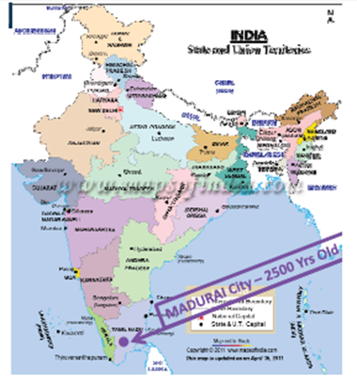
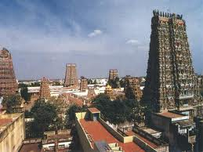
Madurai –the nearest major city
INO site is located 115 km west of the temple city
Madurai in the Theni district of Tamil Nadu close to
the border the between Tamil Nadu & Kerala.
Madurai has an international airport.
IICHEP to be setup at Madurai

Slide 9
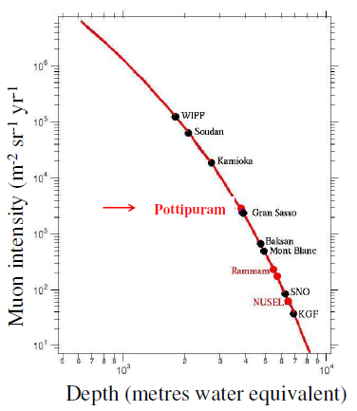
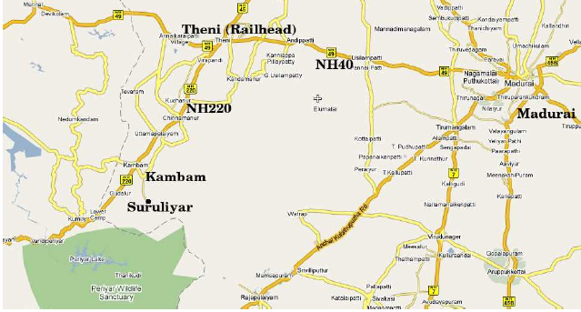

INO site : Bodi West Hills
Pottipuram
9⁰ 58’ N, 77⁰ 16’ E
Pottipuram Village
Theni District
Tamil Nadu State

Slide 10
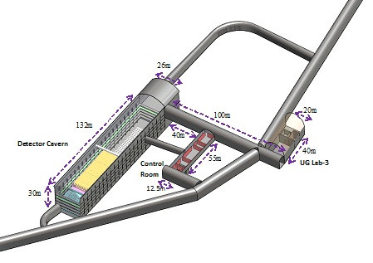
Underground Laboratory Layout
Cavern 1
132m X 26m X 30m
Cavern 3
40m X 20m X 10m
Cavern 2
55m X 12m X 8.5m
The cavern-1 is set under 1589 m peak with vertical rock cover of 1289 m.
Accessible through a 1.9 km long tunnel
Cavern -1 will host 50 kt ICAL detector. Space available for additional 50 kt.
Cavern-2 & 3 available for other experiments ( NDBD, Dark Matter ….).

Slide 11
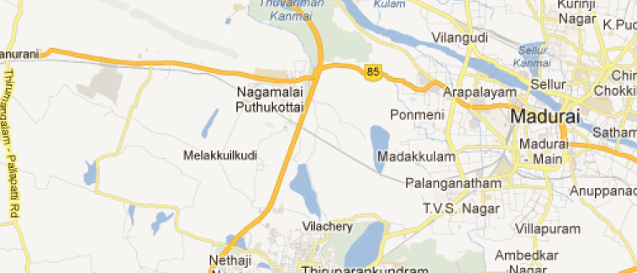
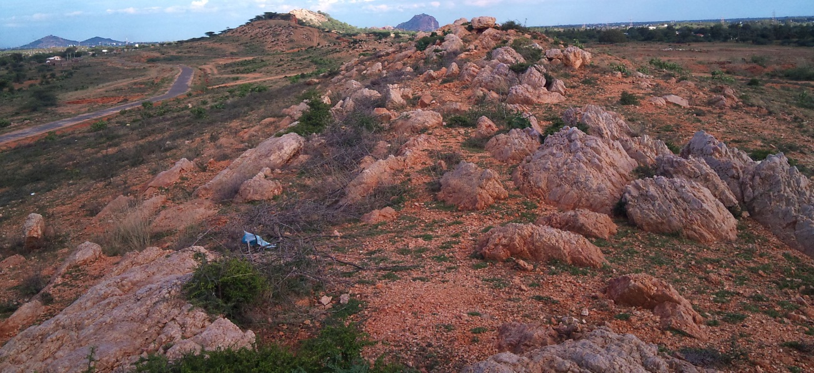
Inter-Institutional Centre for High Energy Physics (IICHEP)
To be located on a 13 Ha land very close to the Madurai Kamraj University in the city of Madurai.
Will act as the nodal centre for all INO activities.
Will have a major detector development laboratory.
INO Graduate Training program will move to IICHEP when ready.
MKU
IICHEP

Slide 12
Site and infrastructure development
26 hectares of land provided free by Tamil Nadu state government for setting up surface facilities near portal location at Pottipuram village.
13 hectares of land acquired at Madurai for IICHEP.
Survey work and fencing work at both sites in progress.
Water supply work by Tamilnadu Water and Drainage (TWAD) Board in progress
Master Plan for IICHEP site is ready.
Architectural design of the first building to house Detector hall and 1/8 Scale ICAL Engineering Module is ready
Tendering very soon

Slide 13
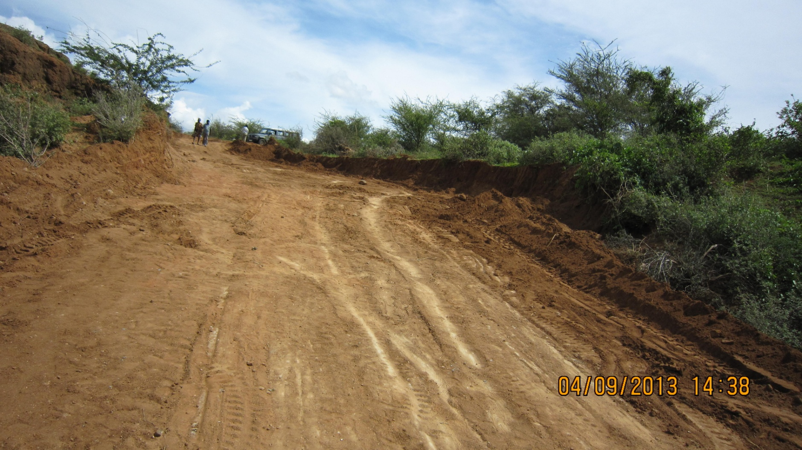
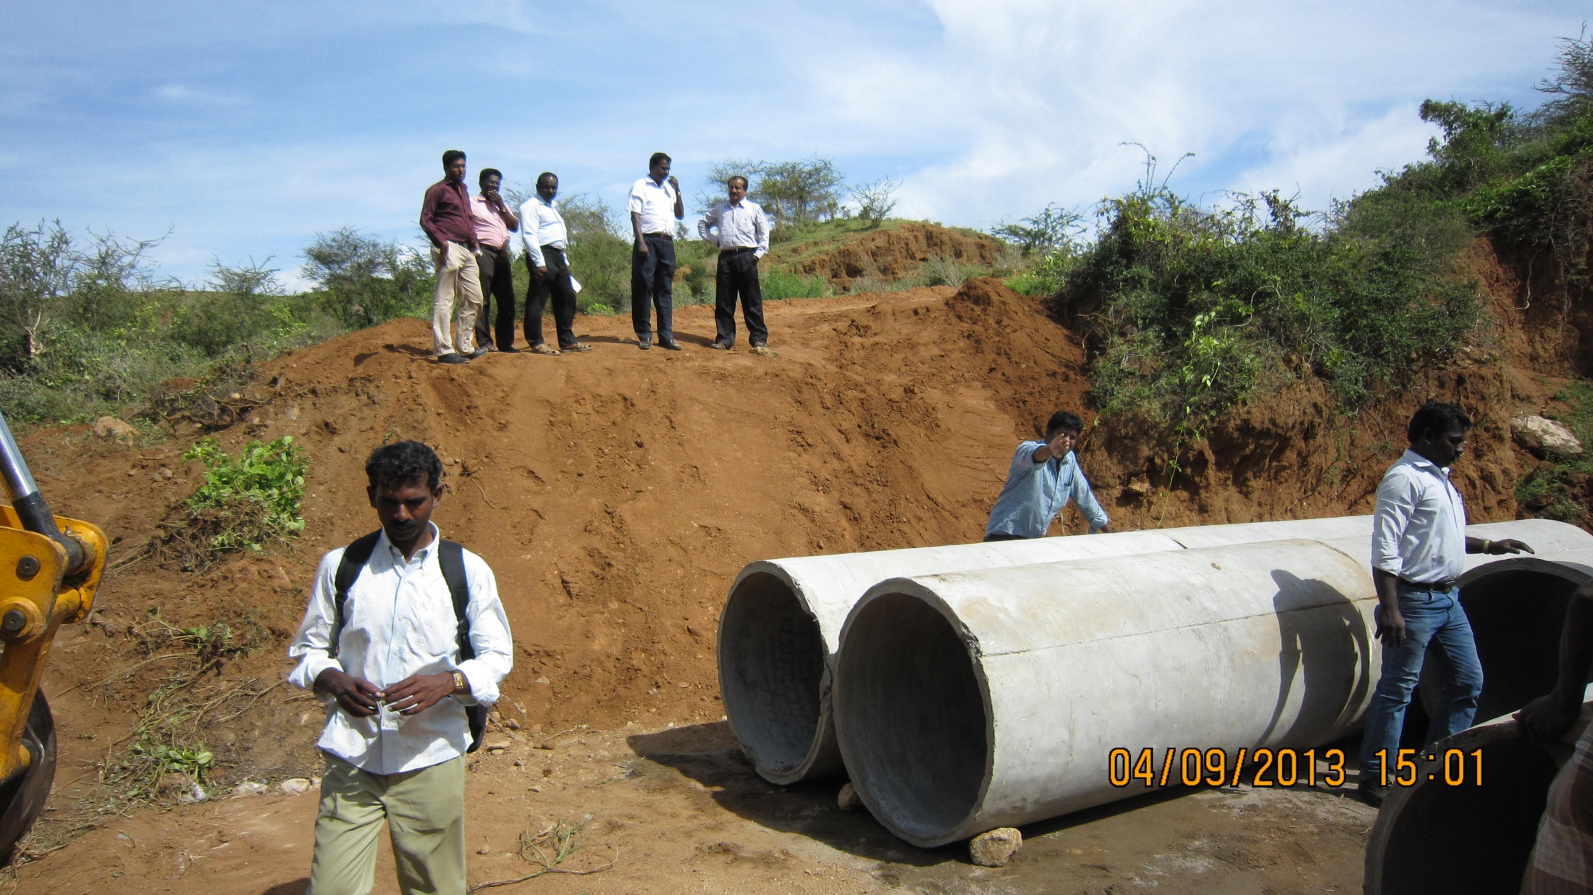
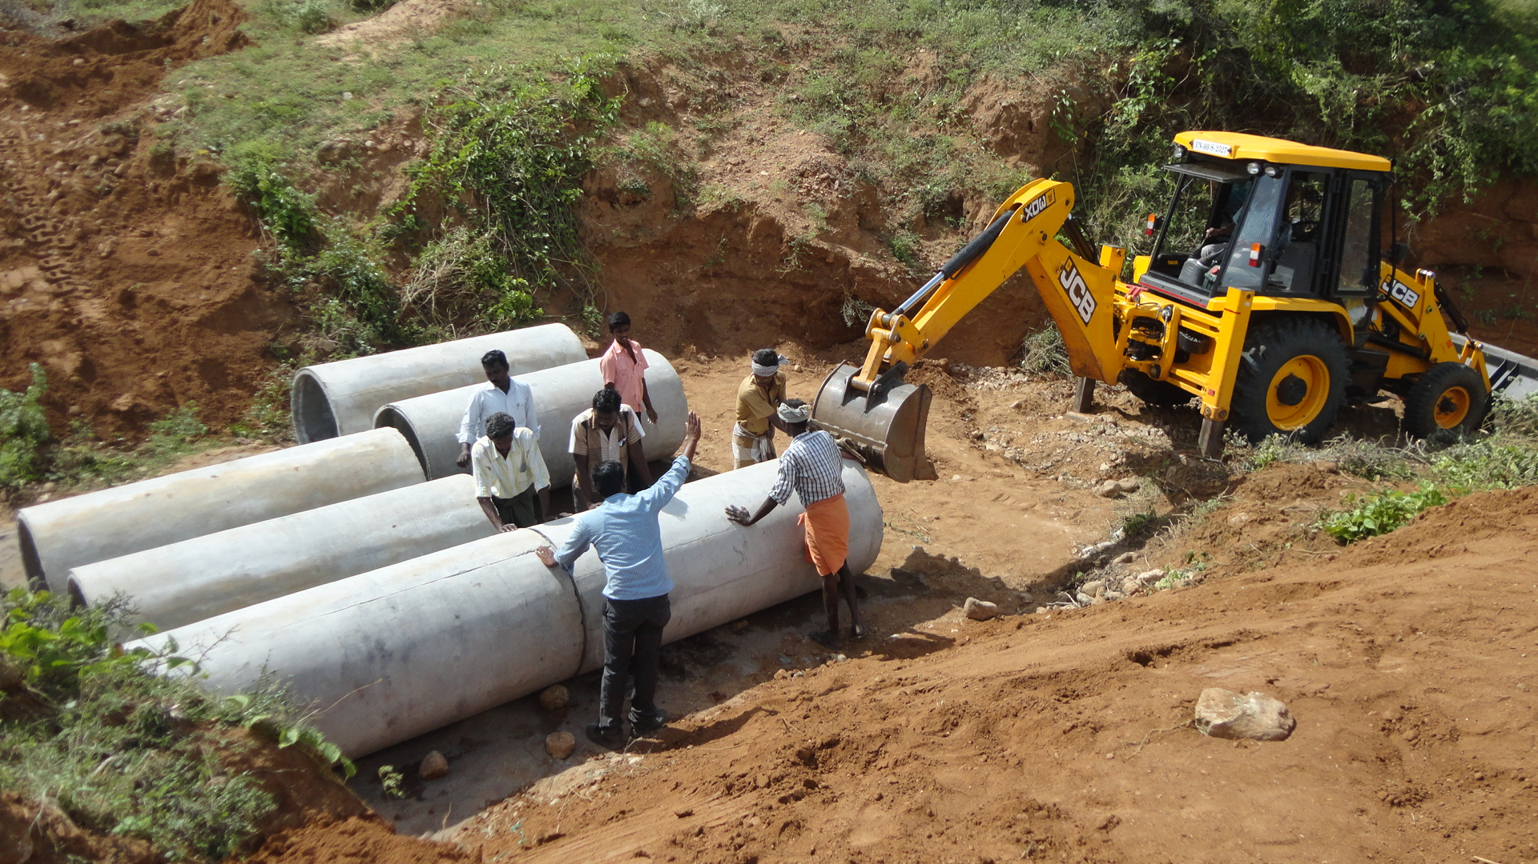
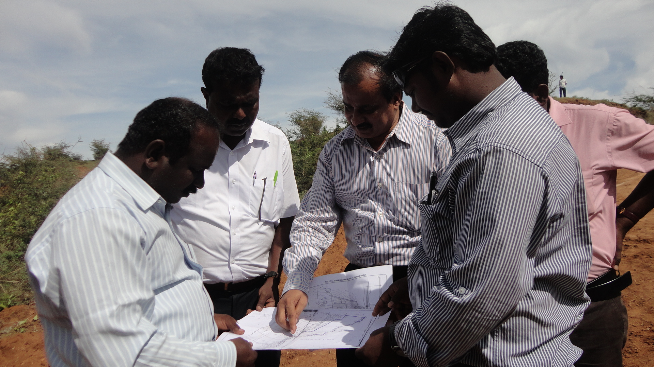
Activity at the INO site at Pottipuram : construction of a temporary bridge for carrying material

Slide 14
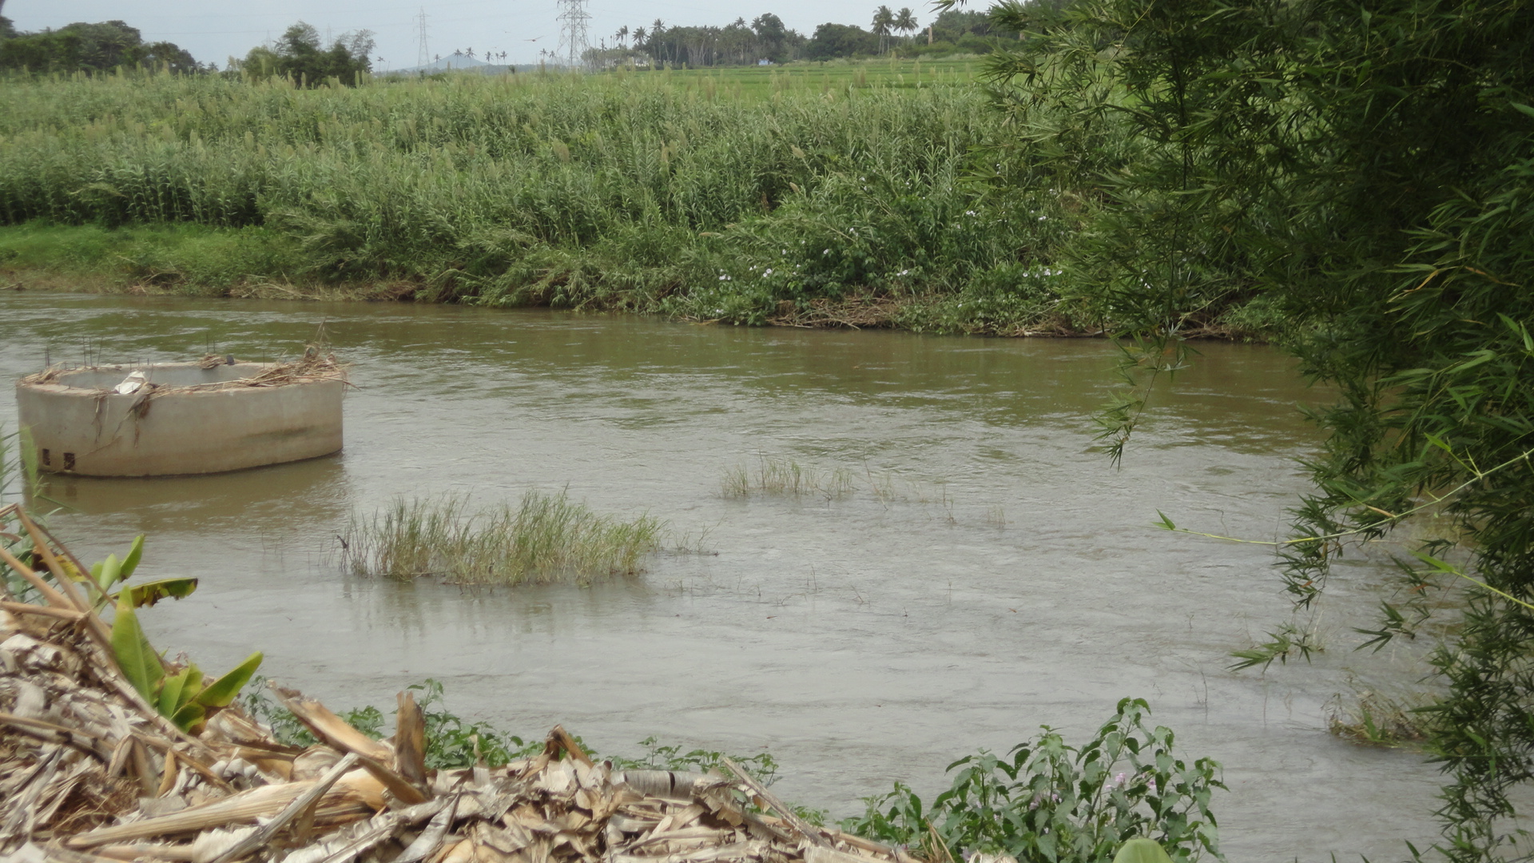
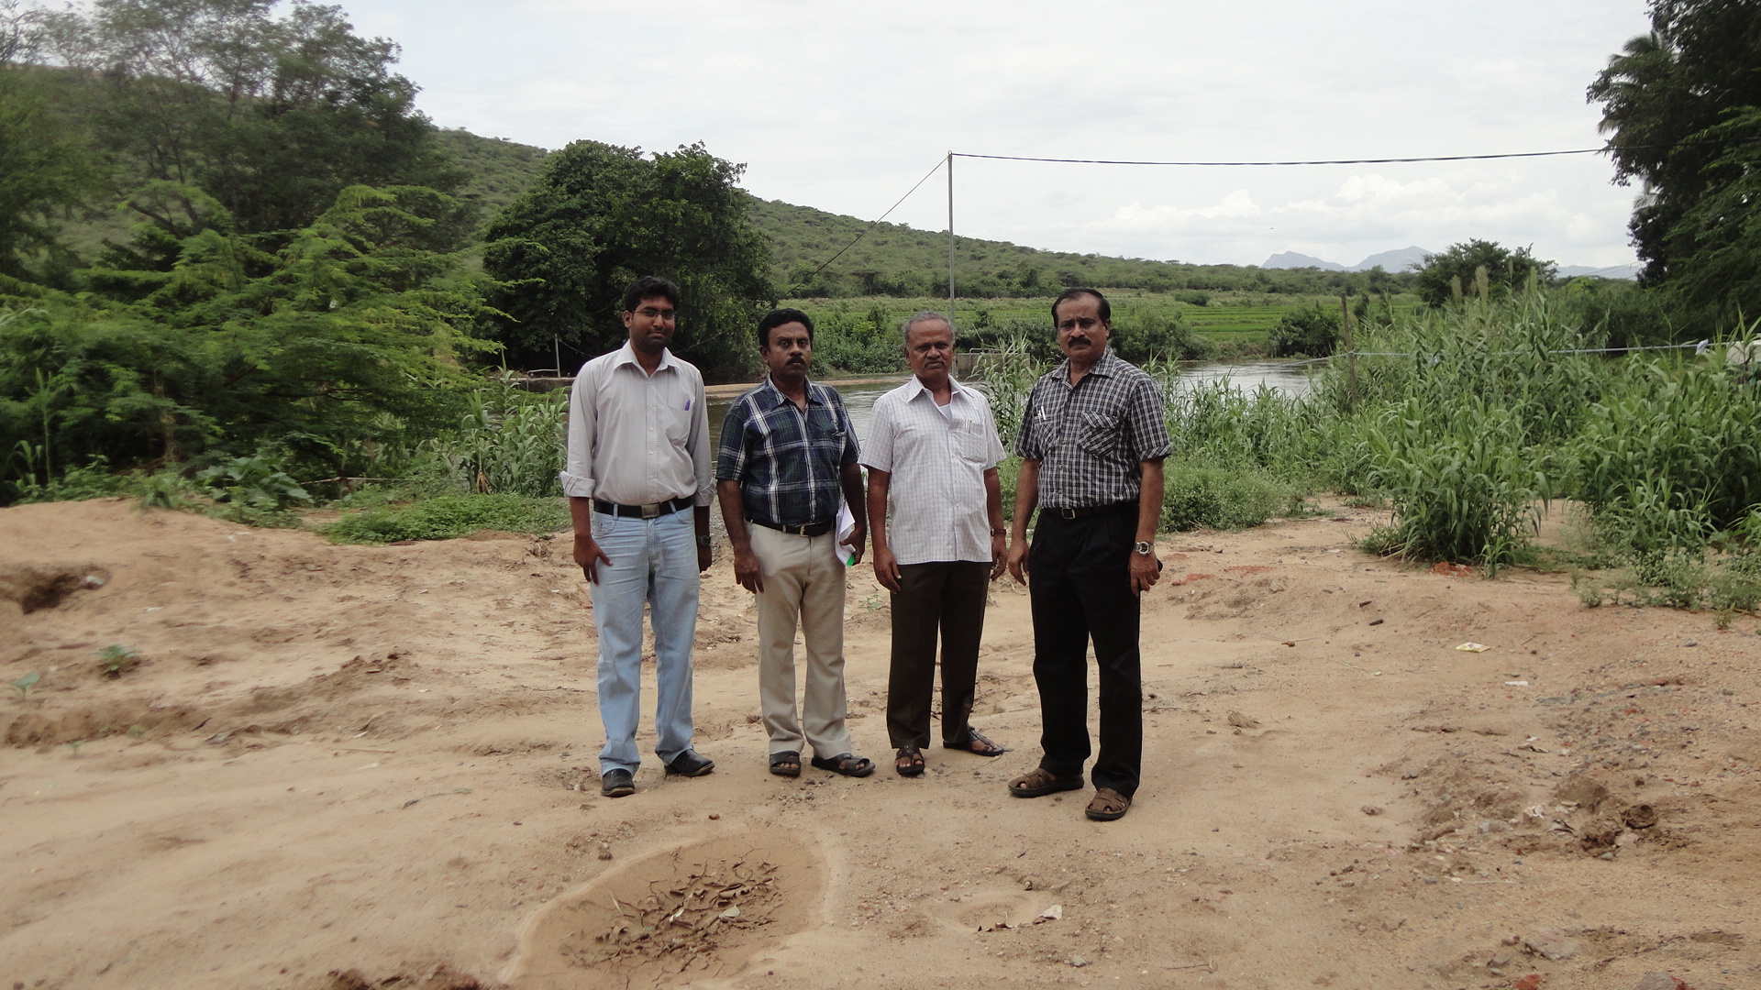
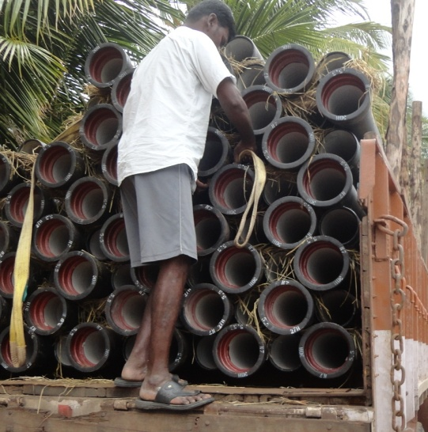
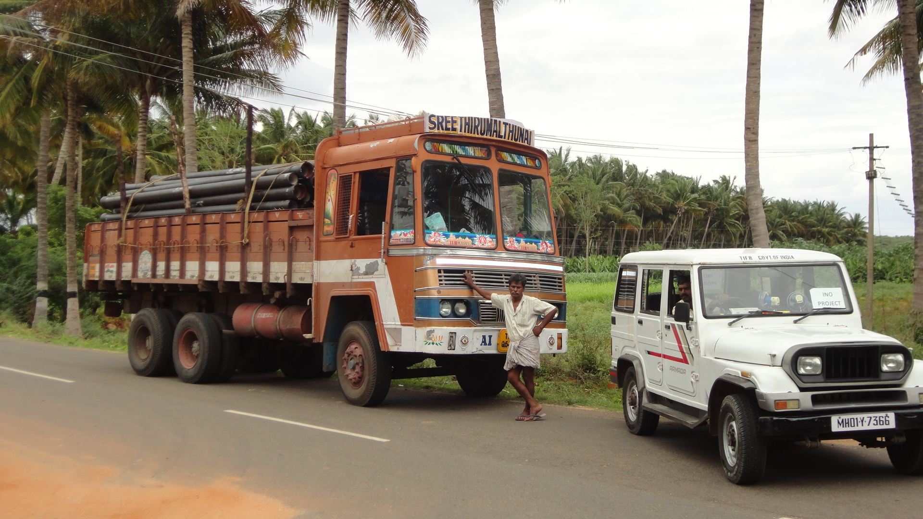
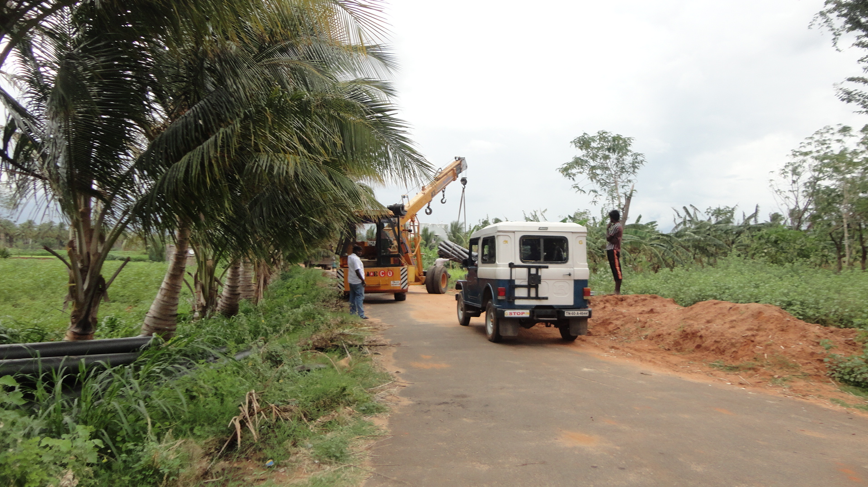
Supplying water to INO Project
TWAD engineers by the side of the river
River Mullaiperiyar
Unloading of water pipes near site
Transporting water supply pipes

Slide 15
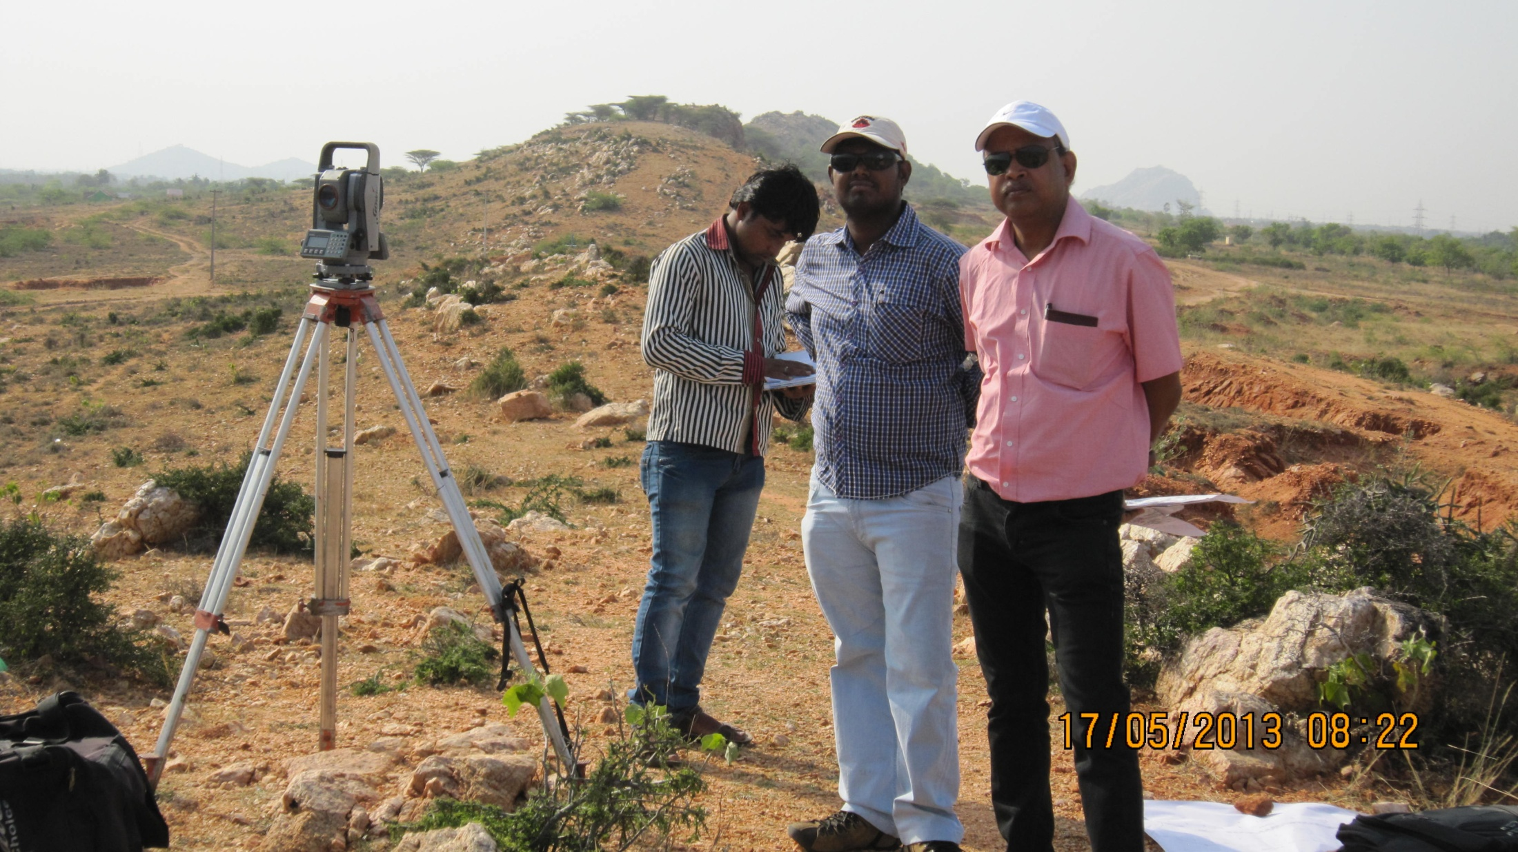
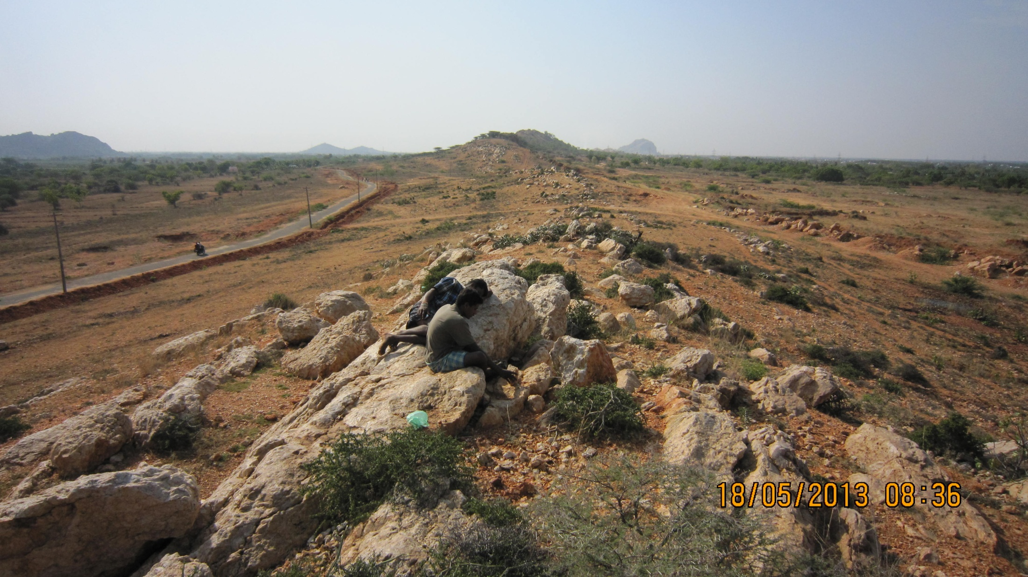
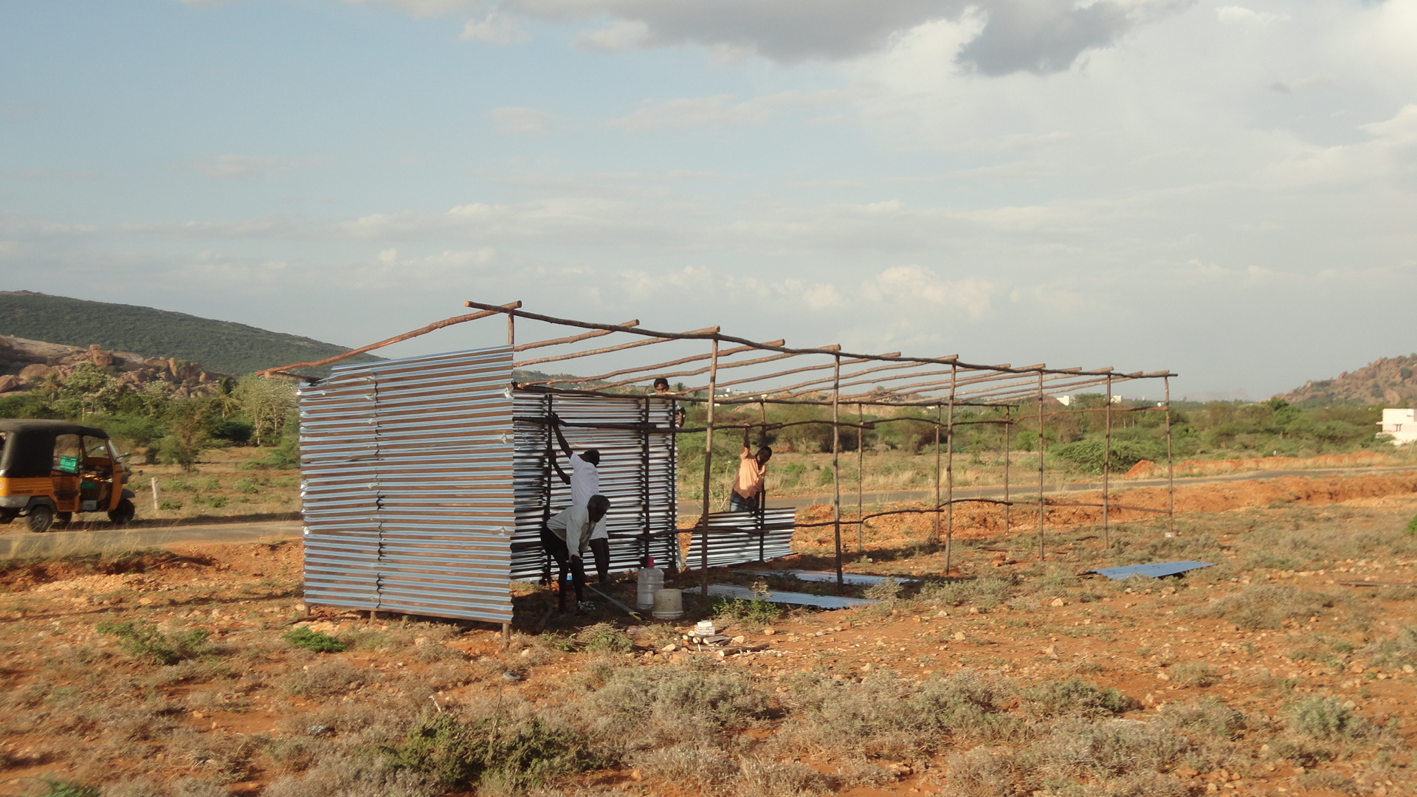
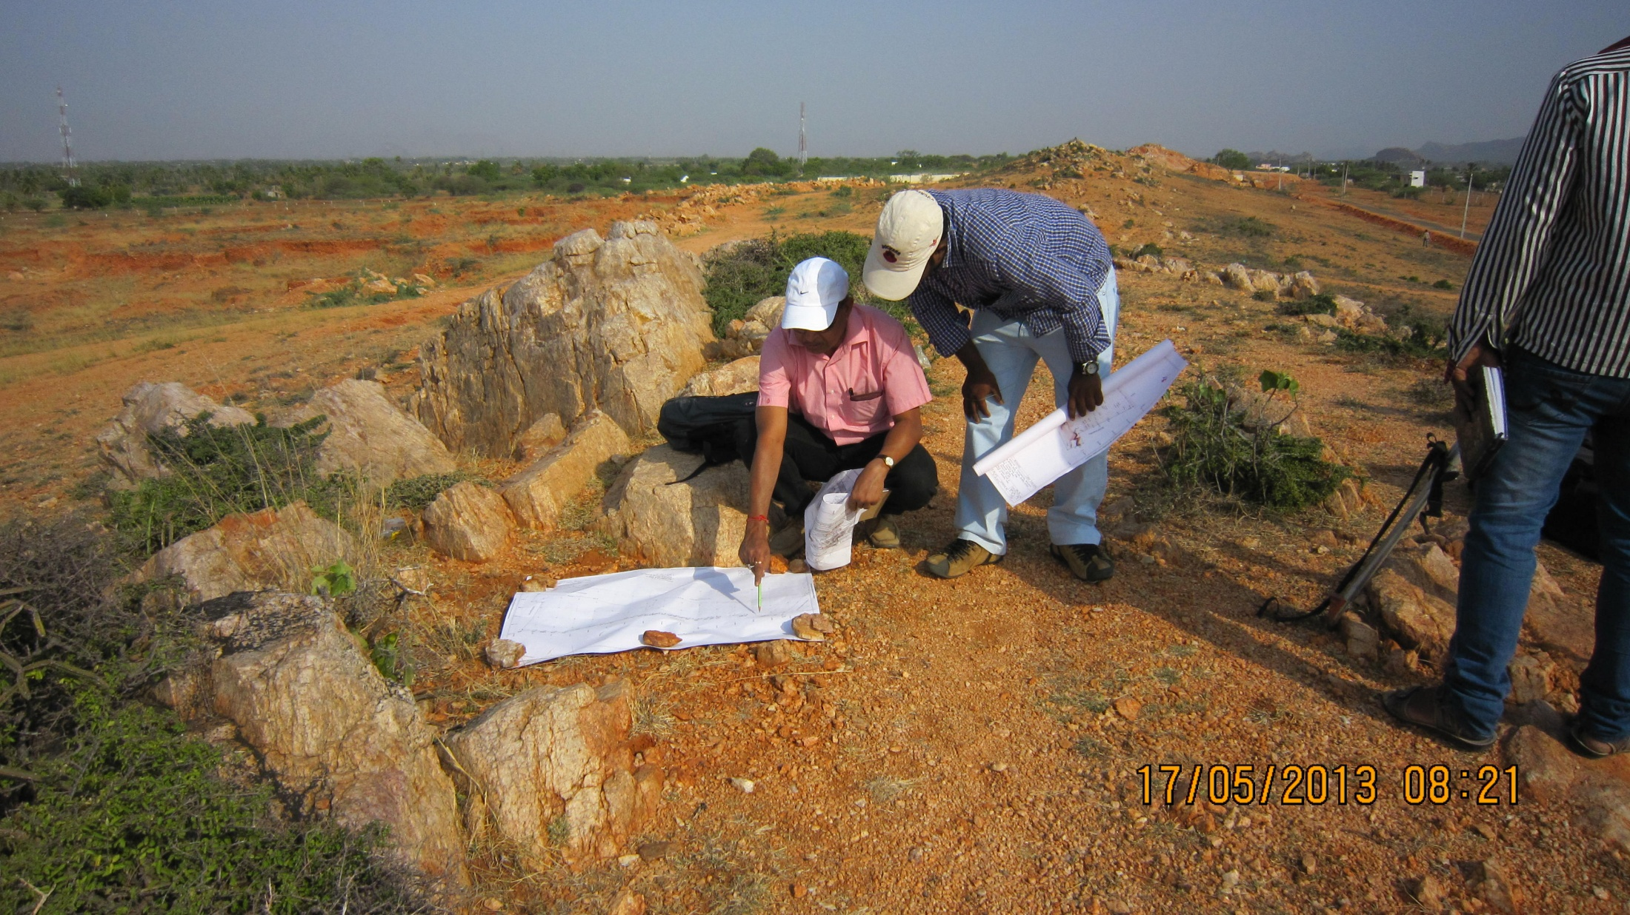
Survey work in progress at IICHEP site Madurai
The rocky site
Surveyors in action
Temporary shed being erected

Slide 16
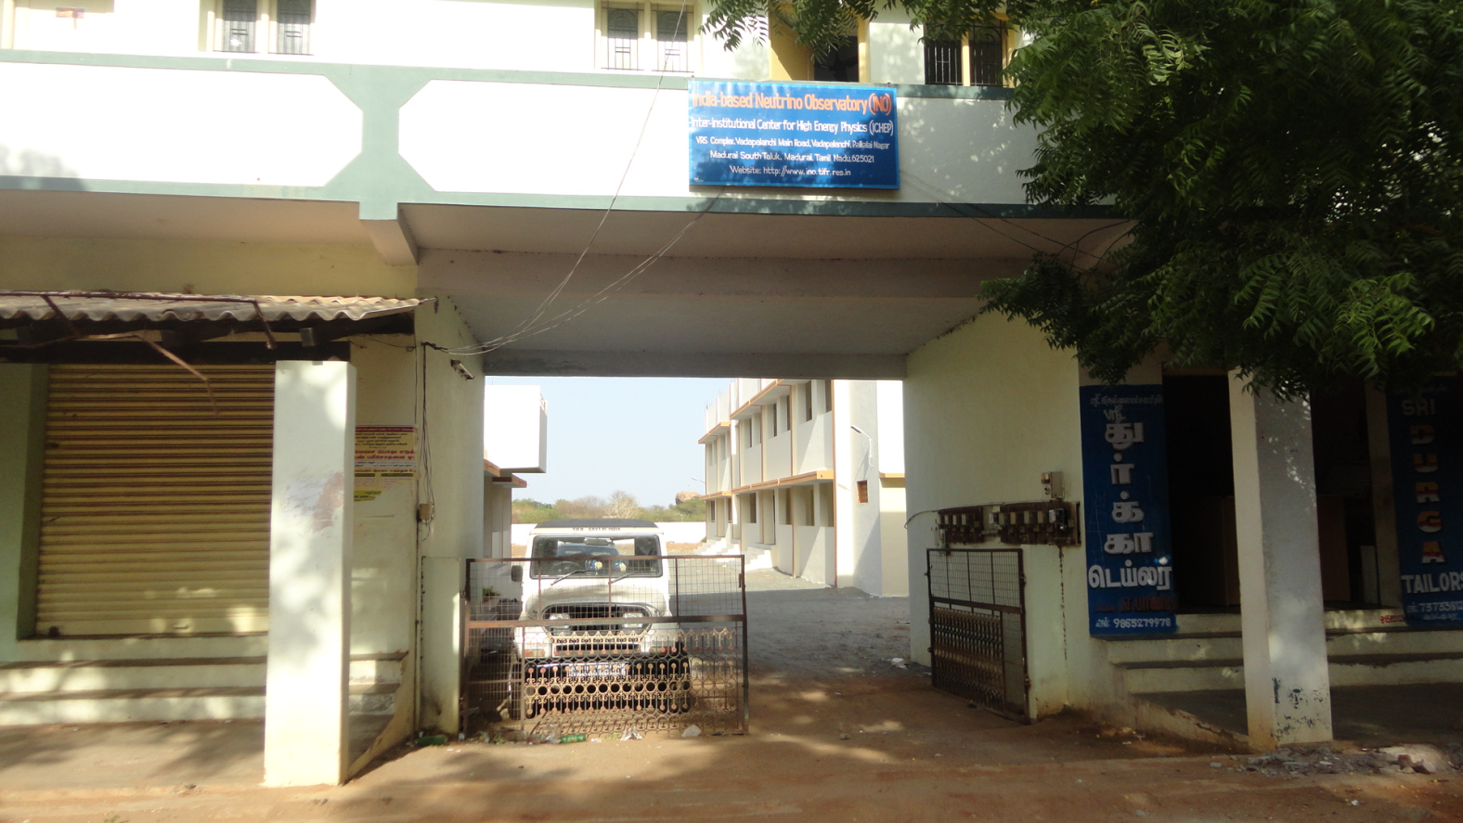
IICHEP@Madurai
Started operating from the rental building at Vadapalanchi, Madurai South.

Slide 17
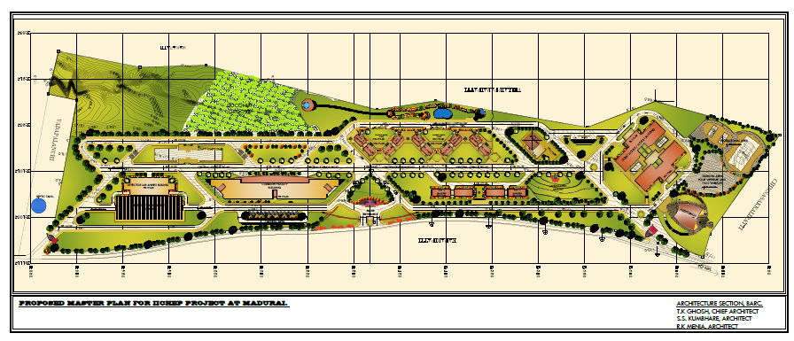
Master plan for IICHEP at Madurai

Slide 18
INO-ICAL : The detector
Steel stack with coils
Detector, electronics etc.

Slide 19
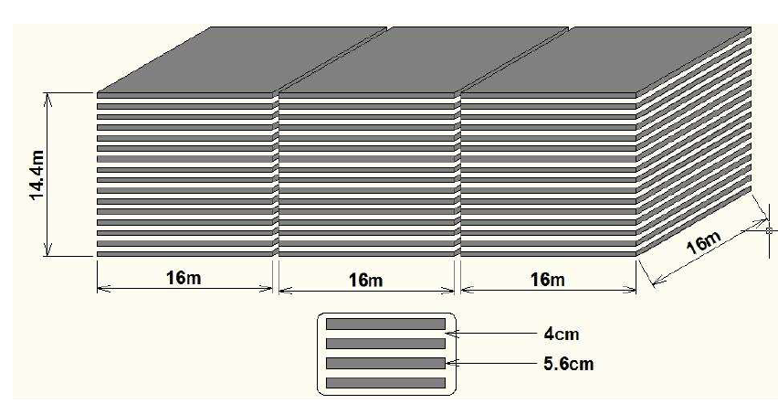
Magnetised Iron Calorimeter
No of modules | 3
Module dimension | 16 m X 16 m X 14.4m
Detector dimension | 48.4 m X 16 m X 14.4m
No of layers | 150
Iron plate thickness | 5.6cm
Gap for RPC trays | 4 cm
Magnetic field | 1.4 Tesla
RPC unit dimension | 195 cm x 184 cm x 2.4 cm
Readout strip width | 3 cm
No. of RPCs/Road/Layer | 8
No. of Roads/Layer/Module | 8
No. of RPC units/Layer | 192
Total no of RPC units | 28800
No of Electronic channels | 3.7 X 10⁶

Slide 20
Magnetized steel stack

Slide 21
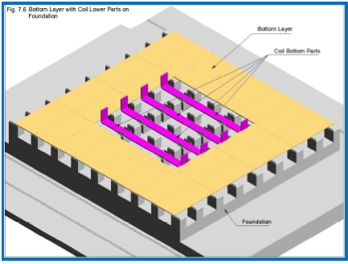
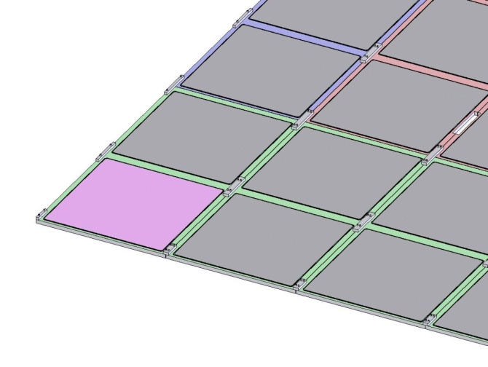
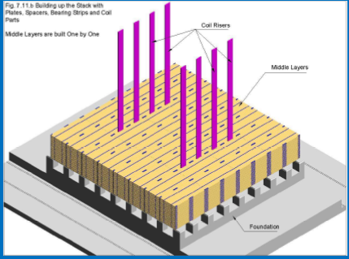
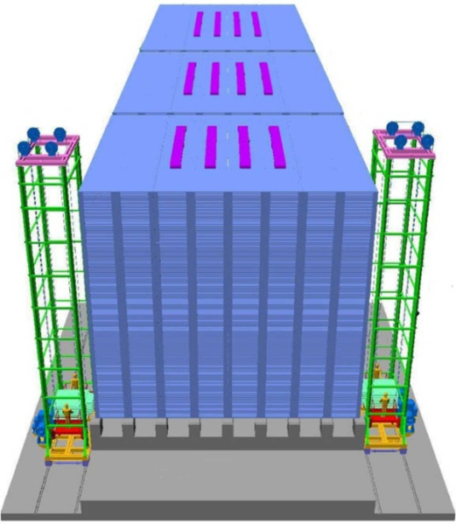
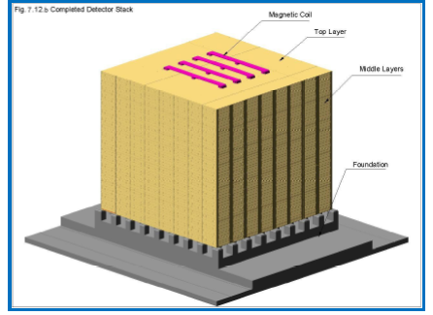
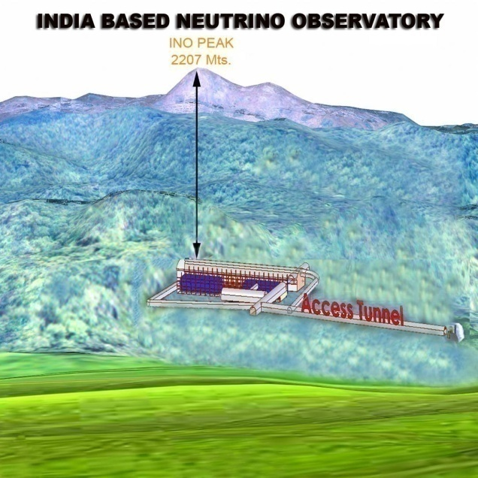
Construction of the ICAL detector
1/8 scale Engineering Module to be constructed first
Notes:
21

Slide 22
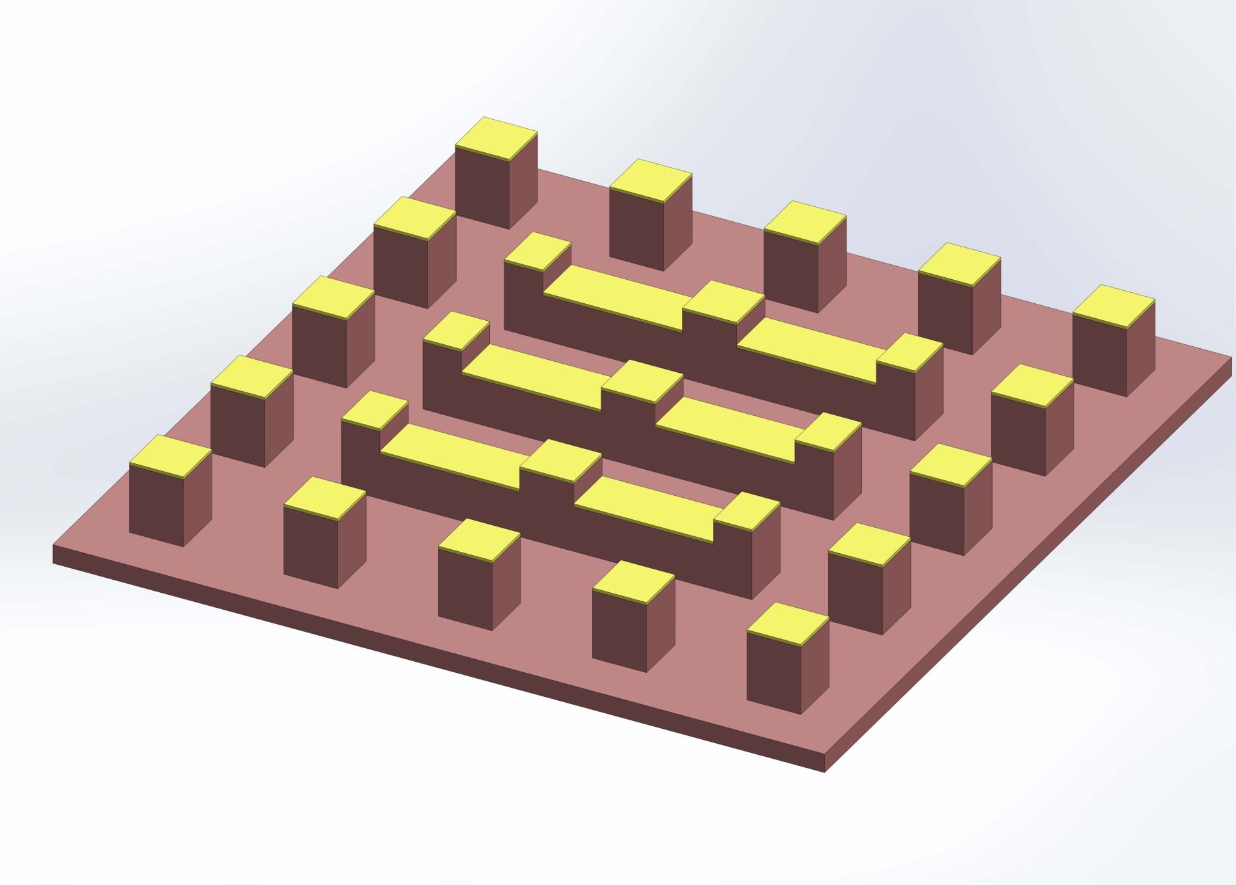
Concrete Pedestal for the 8m X 8m X 7m Engineering Module (1/8 scale)
Position of coils

Slide 23
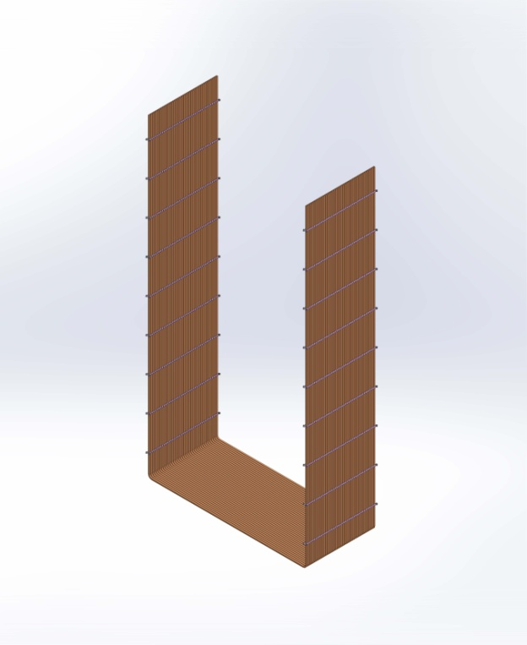

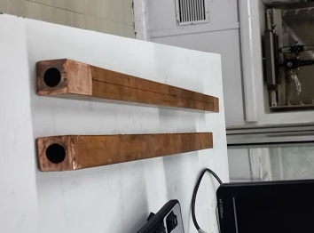
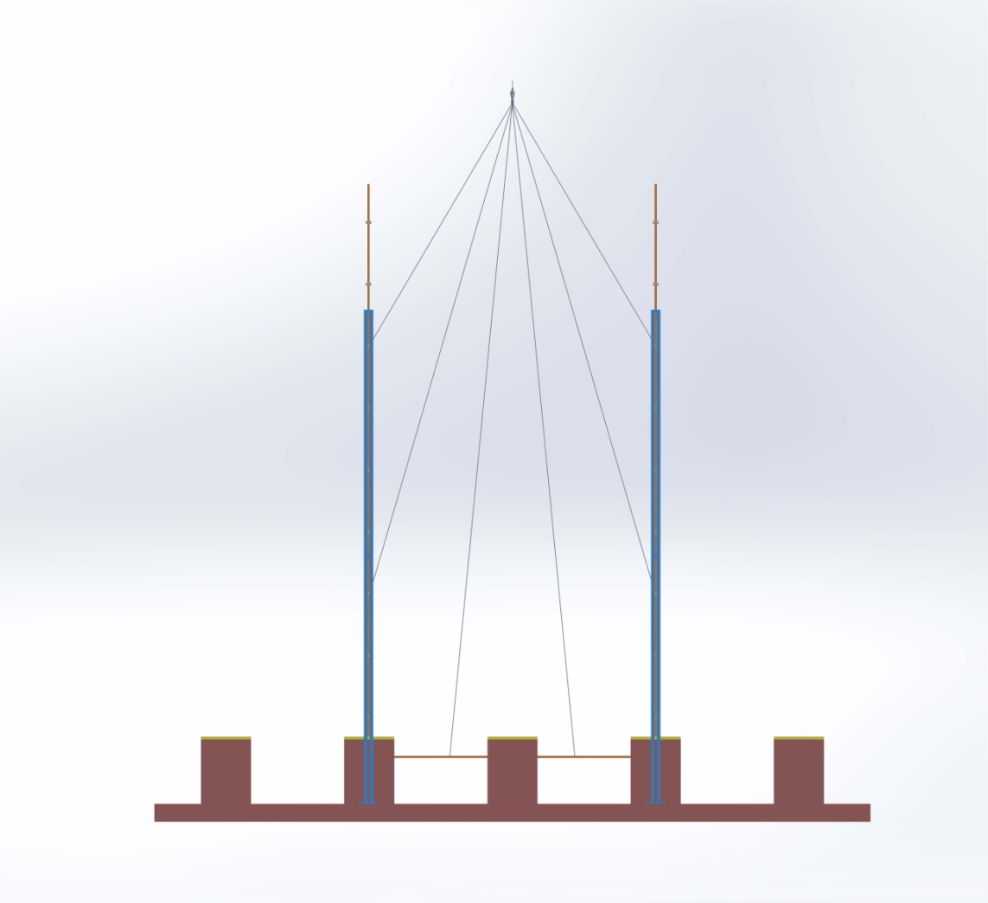
Copper conductor to U-shaped coil
One turn
The conductor
30mm cross-section
17 mm dia bore
Multiple turns
Avoid joints in the inaccessible region
Coil suspension during plate insertion

Slide 24
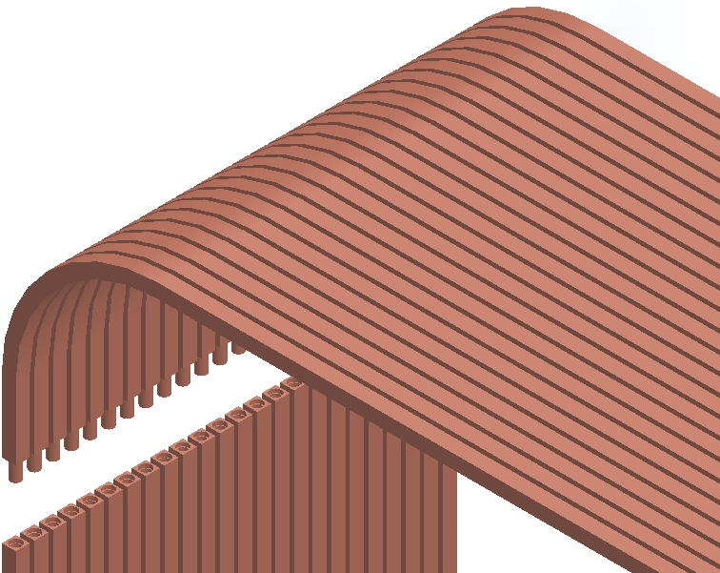
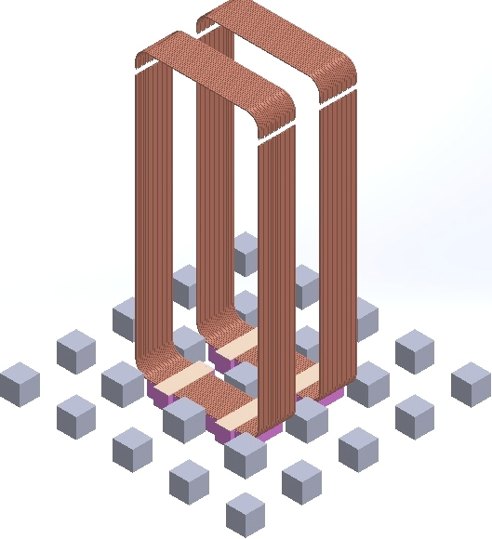
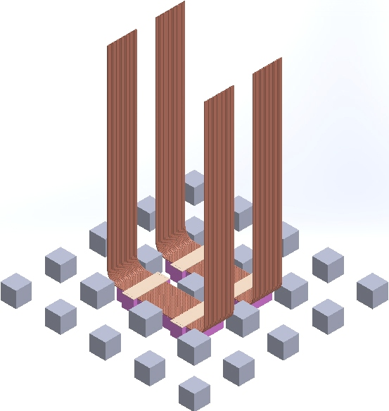
Connecting open ends of U-shaped coil

Slide 25
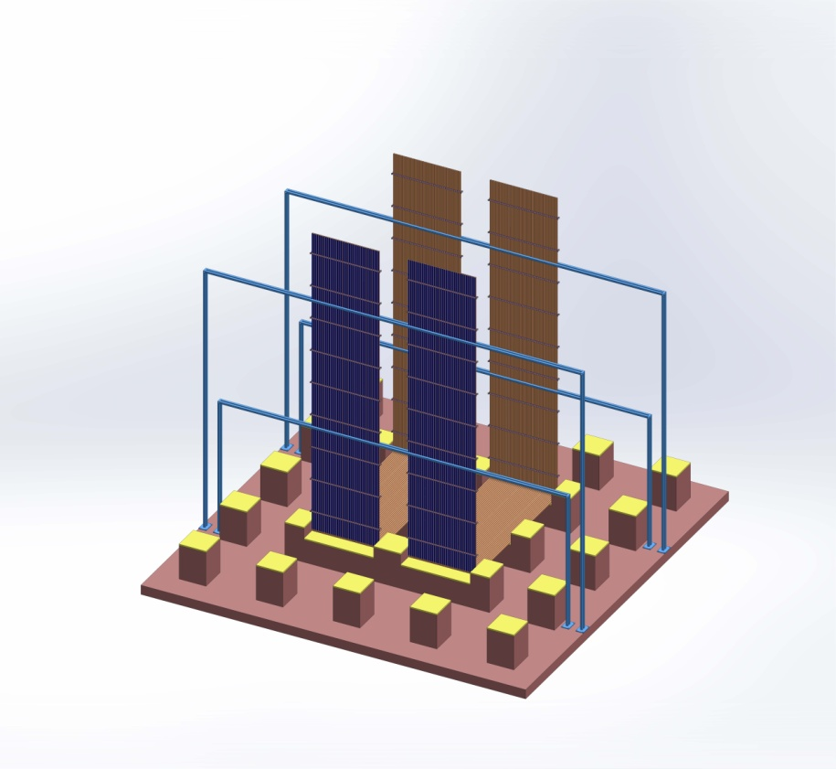
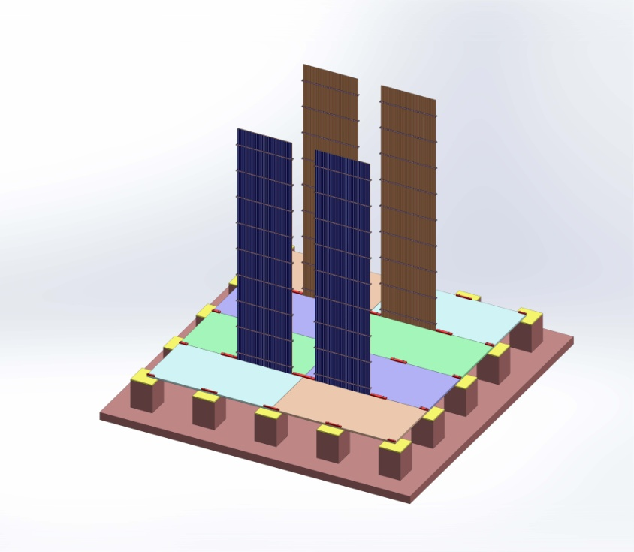
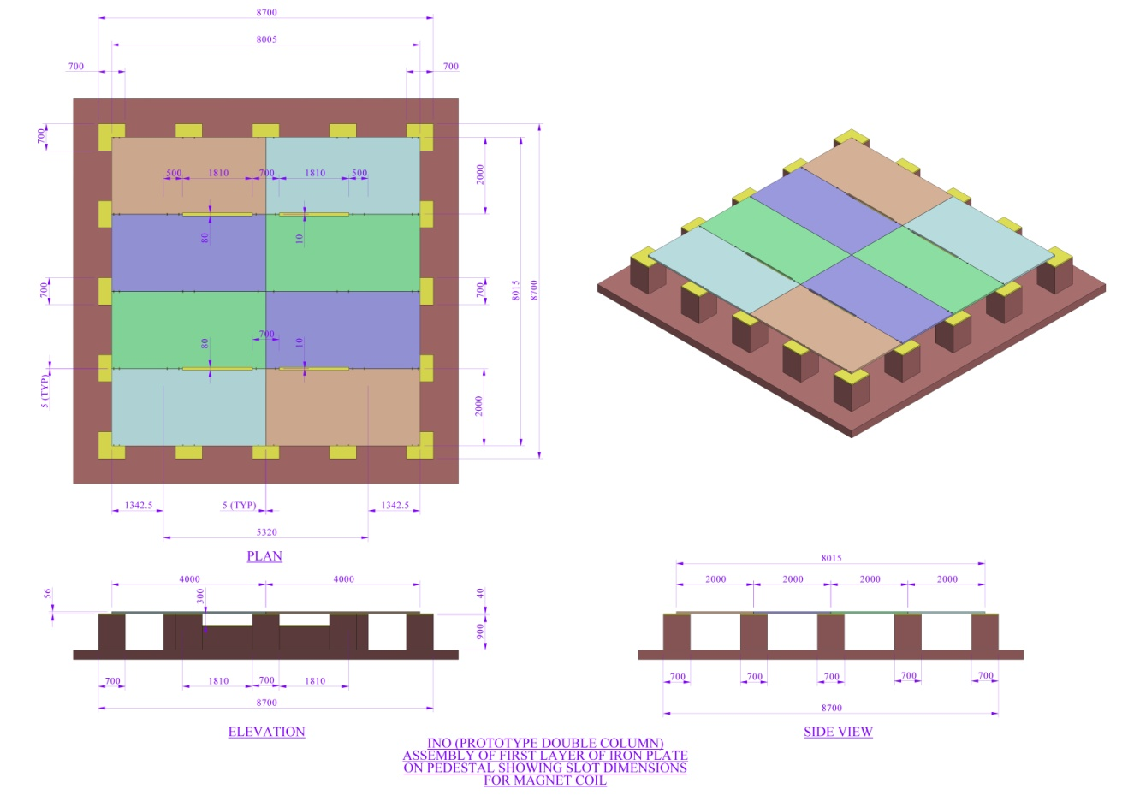
Laying out the steel plates after coil is erected

Slide 26
RPC Development, Electronics, Trigger and Daq

Slide 27
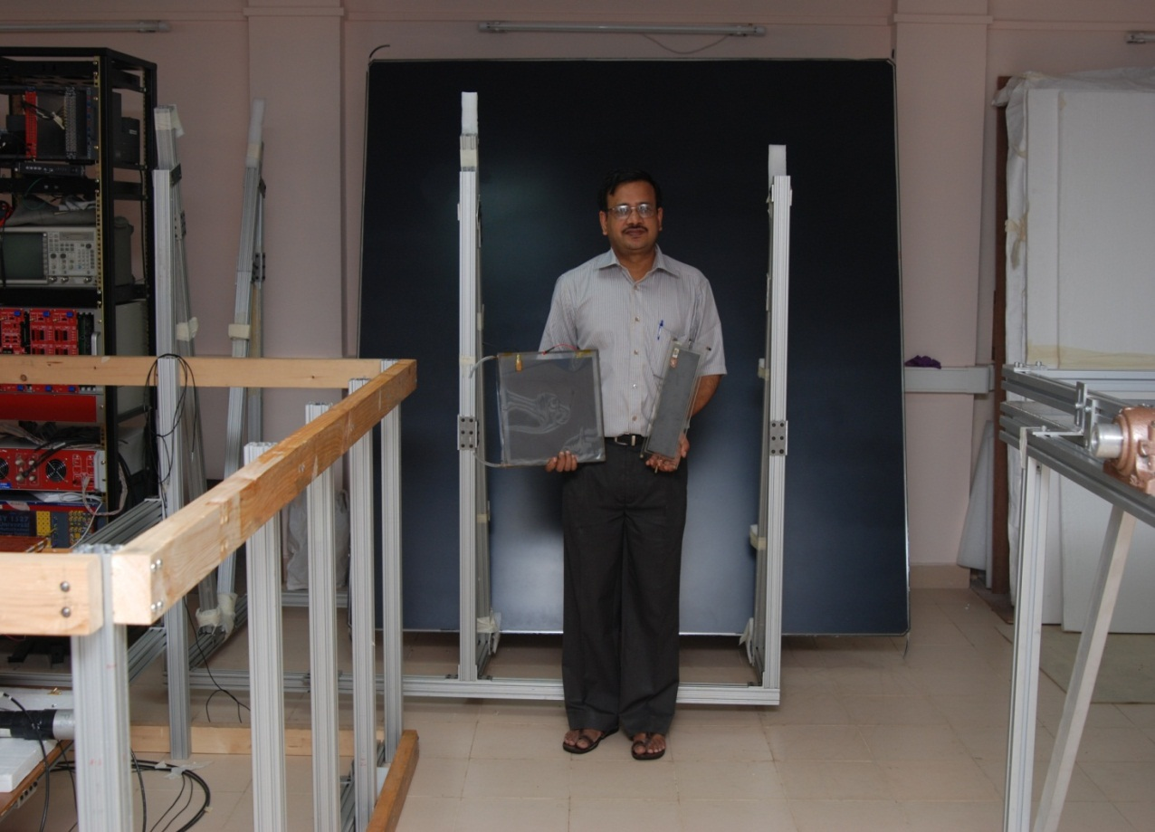
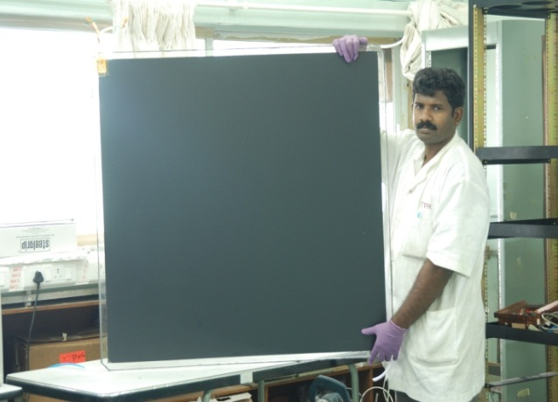
A journey through RPC road
200 cm x 200 cm glass RPC
RPC R&D
Glass RPCs : TIFR/BARC
Bakelite RPCs : VECC/SINP
30 cm x 30 cm
100 cm x 100 cm

Slide 28

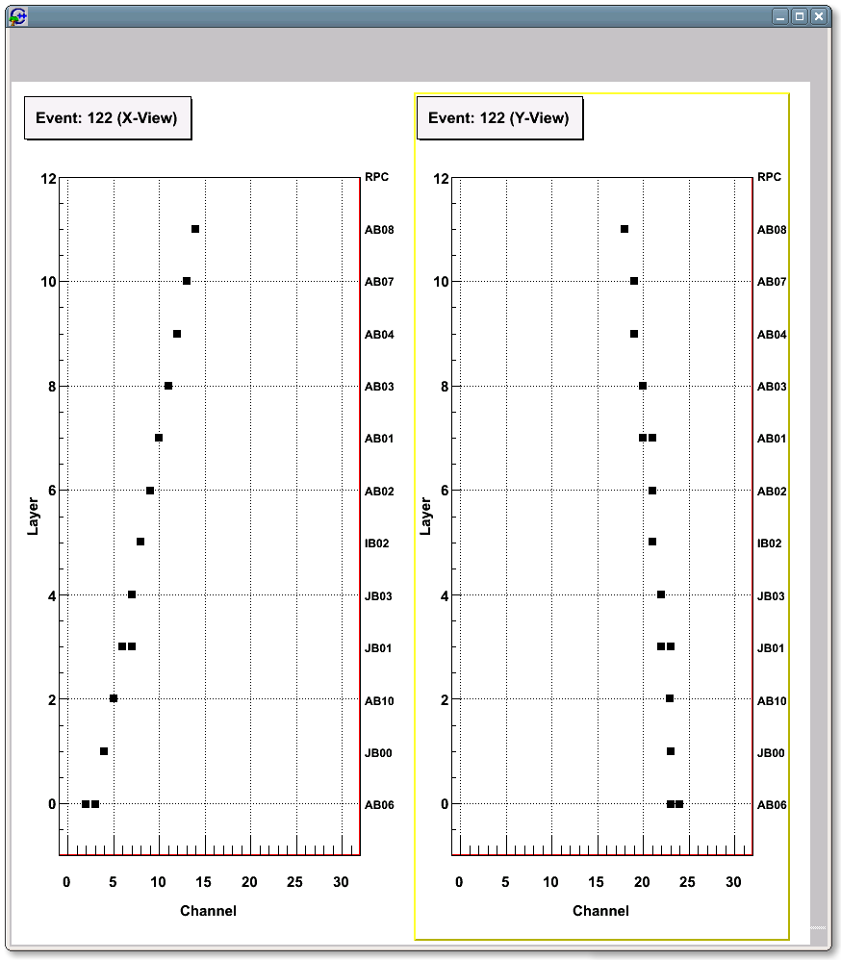
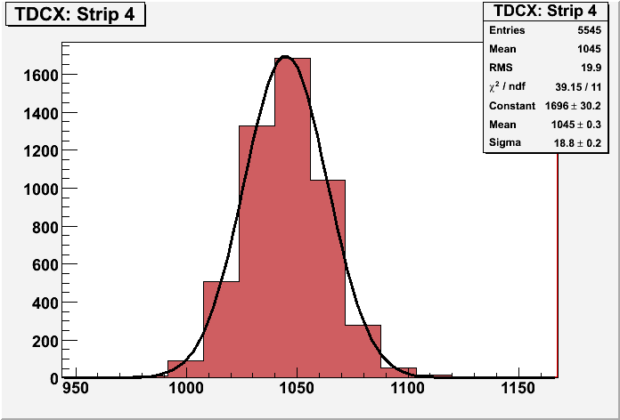
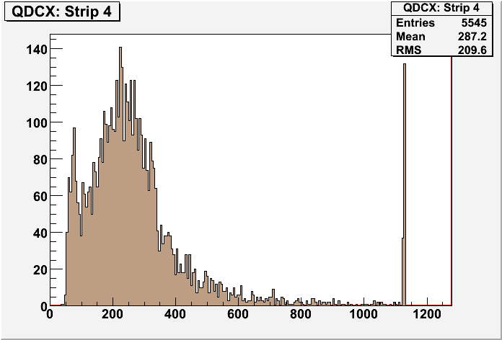

Prototype RPC Stack at TIFR tracking Muons
Cosmic ray tracks
Analog signal due to muon
Charge spectrum
Time resolution

Slide 29


Glass RPC : efficiencies and time resolution
Efficiency
Time resolution
Notes:
29

Slide 30



Bakelite RPC R&D at VECC/SINP Kolkata
Long term stability
Time spectra of RPC
Silicon coated P-120 grade Bakelite
30 cm X 30 cm and 1m X 1m RPCs
Running in streamer mode
Low counting rate ~0.1-0.2 Hz/cm²
Good time resolution ~ 2ns
Good efficiency > 90%
1m X 1m RPCs running in the mini-ICAL
R&D for large size chamber in progress

Slide 31


Electronics and Daq
Front end 8-in-1 Amplifier-discriminator ASIC developed by BARC, 2nd version tested, soon to be finalized
  Overall electronics and DAQ architecture under design, various prototypes are under test
  High performance FPGA (featuring a μC softcore), TDC and waveform sampler based RPC-DAQ board is being prototyped.
  Data network architecture and hardware being designed.
  Integration of electronics and DAQ hardware with the RPC detector is being finalized.
A TDC ASIC developed for
INO project by IIT, Madras

Slide 32



ICAL Trigger Scheme
Trigger criteria based on event topology alone.
Distributed and hierarchical architecture.
Detector module segmented to generate local trigger.
Combination of local triggers produces global trigger.
Global trigger latches event data.
NIM, A678, 105 (2012) & NIM, A694, 126 (2012)
First version of ICAL Trigger Scheme in place, several implementation aspects tested, integration issues being addressed

Slide 33

mini-ICAL : Prototype Magnet with RPC layers
Installed at VECC Kolkata
35 Ton prototype with 12 gaps to house 1m x 1m RPCs
Long term operational experience
Operate both glass & Bakelite RPCs
Muon track reconstruction with & without magnetic fields.
Lab environmental condition studies and student training

Slide 34

Cosmic muon tracks seen in the prototype
Hits and fitted points on a bent track for data taken with magnetic field ON condition

Slide 35

Magnetic field in the prototype
Comparisons of measured and simulated values
Good agreement with assuming 2mm gap between plates

Slide 36


Magnet simulation : 16m module
Realistic geometry with gaps between plates
Proper coil segments
~90% fiducial volume has B>1T
Field profile now in GEANT code also

Slide 37
Production of glass RPCs

Slide 38








Fabrication of 2m x 2m RPCs

Slide 39


2m x 2m glass RPC test stand

Slide 40




RPC fabrication at Asahi Float Glass

Slide 41



Painting/curing of glass plates

Slide 42




Automation of RPC gap making

Slide 43



Gas recirculation system
  Prototype close loop gas recirculation system is under test at TIFR RPC lab.
  Design of system required for Engineering Module in progress

Slide 44


Compact Design of RPC and Electronics
RPC Module
Hybrid Preamplifier
(What we have now)
RPC Module
ASIC
(Where we want to go)
A compact laptop-like design
Notes:
44

Slide 45


RPC Layout
1950
403 mm X 23 mm Preamp board
Preamp boards in side channel
Cut corner for Daq board
Preamp boards in side channel

Slide 46


DAQ Board in the RPC
RPC DAQ Board
Service lines
Prototyping in progress

Slide 47

ICAL Cavern : a closer look
Module 3
Services barrack
Module 2
Module 1
Electronics Racks
Tunnel End Side

Slide 48


Slide 49

Cable Trays
Attached to spacer steel blocks, depth same as thickness of steel plates

Slide 50


Populating the ICAL Cable tray
Gas Pipes
Φ 16mm
24 Digi I/O
Φ 11.2mm
24 Power
Φ 10.5mm
48 HV Lines
Φ 5mm

Slide 51



Human Resource Development & Training
INO Graduate Training Programme
Started in August 2008.
Affiliated to HBNI.
At present INO students are being trained for one year at TIFR, Mumbai in both experimental techniques and theory.
Being attached to Ph.D. guides at various collaborating institutions for a Ph. D. degree after completion of coursework
Theses completed 4, in the pipiline : 3
Many Short/long term visits to RPC labs ( Mumbai & Kolkata) of students and faculties from Universities in last several years.
2009
2013
2008
Notes:
51

Slide 52
INO Collaboration
Ahmedabad: Physical Research Laboratory
Aligarh: Aligarh Muslim University
Allahabad: HRI
Bhubaneswar : Utkal Univ.
Calicut : University of Calicut
Chandigarh: Panjab University
Chennai : IITM, IMSc
Delhi : Delhi University
Kalpakkam : IGCAR
Kolkata : SINP, CU, VECC
Lucknow : Lucknow University
Madurai : American College
Mumbai : BARC, IITB, TIFR
Mysore : University of Mysore
Srinagar : University of Kashmir
Varanasi : Banaras Hindu University
22 groups at present
Teams
Civil infrastructure : BARC
ICAL Engineering : BARC, TIFR, VECC
Detector and Physics : All groups
Invitation : Come and join either the INO-ICAL Collaboration or any other experimental collaboration at INO. Come if you have ideas to setup an experiment in an underground laboratory in any branch of science.

Slide 53
Summary
Project INO on firm footing
INO graduate training programme attracting bright minds
Work on site infrastructure and 1/8 scale Engineering Module in full swing
Industrial production of 2m X 2m glass RPCs
  Several vendors under development
  Initial stages of automation completed
  Order for first batch of large scale production soon
Electronics, Trigger, Daq in advanced stages of development
Work on Tunnel and cavern etc to be taken up after Cabinet approval of the main project

Slide 54

Thank You for your attention

