Slide 1



Stuff: What is it?
An Introduction to Particle Physics and Accelerators
Paul Newman bbb
Trigger Graduate School Jammu University
13 September 2013

Slide 2
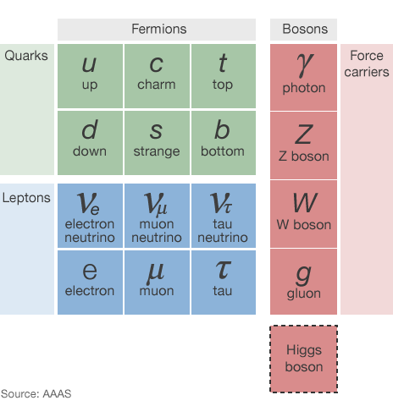
Contents
Highly selective whirlwind tour: 20 lectures → 1 lecture
In full: http://epweb2.ph.bham.ac.uk/user/newman/appt10/appt.html
Designed to give a feel for what we need to trigger on
116 Years of Accelerators
Electroweak Interactions
Flavour Physics
Strong Interaction
LHC Physics
Notes:
A very ordered world, which together with mechanics, gravity, thermodynamics and electromagnetism described just about everything

Slide 3
Contents
Highly selective whirlwind tour: 20 lectures → 1 lecture
In full: http://epweb2.ph.bham.ac.uk/user/newman/appt10/appt.html
Designed to give a feel for what we need to trigger on
116 Years of Accelerators
Electroweak Interactions
Flavour Physics
Strong Interaction
LHC Physics
Not covered at all:
Neutrinos
Dark Matter
All Experimental issues
Proper theory … just some data & outrageous claims
Notes:
A very ordered world, which together with mechanics, gravity, thermodynamics and electromagnetism described just about everything

Slide 4
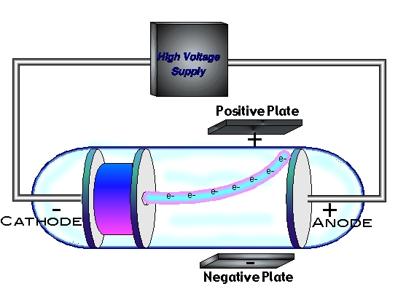
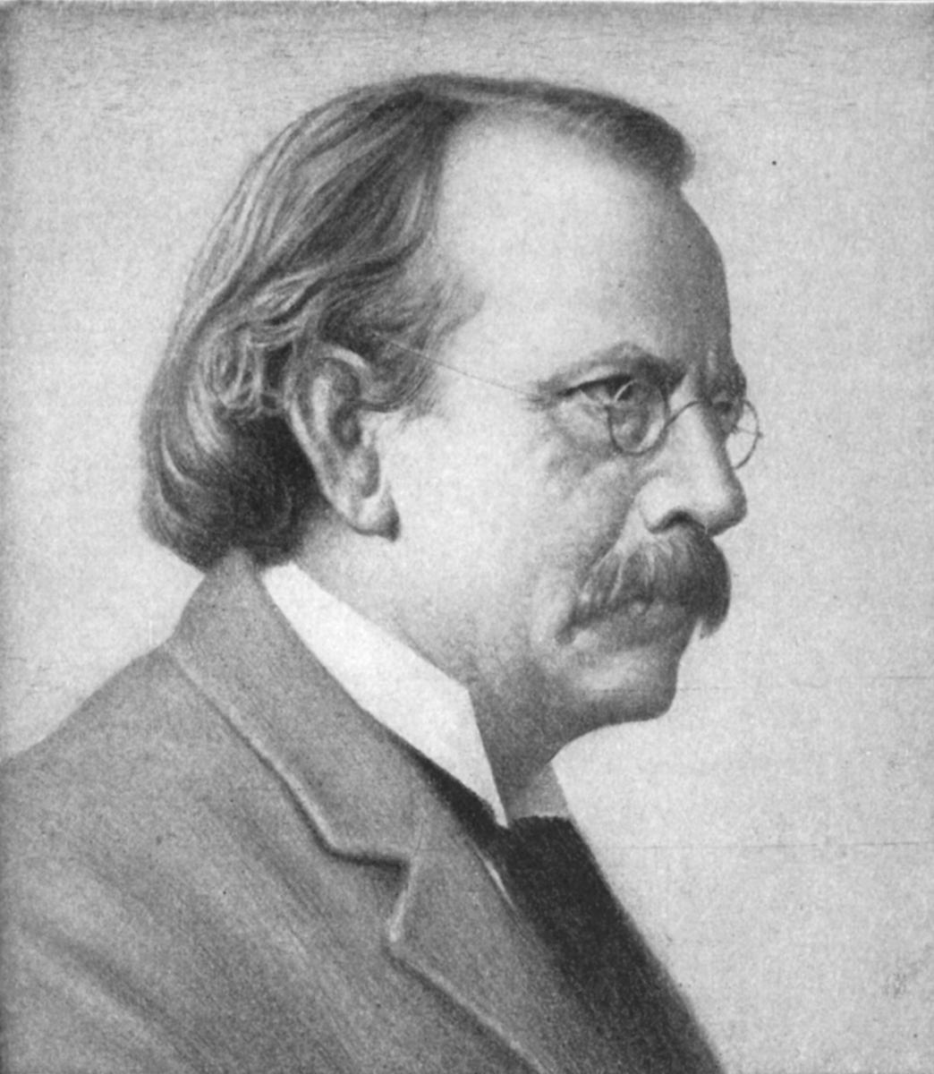
The first accelerators and the first fundamental particle
Cathode Ray Tubes: High
Voltage across low pressure gas
Mysterious charged particles
emitted from cathode
1897: JJ Thompson measured cathode
ray mass from bending in electric field
… 1/1000th of mass of Hydrogen
… there are smaller things than atoms!
… we now know them as ‘electrons’
Notes:
CAN YOU SAY HE MEASURED Q/M? wikipedia says it was a magnetic field?

Slide 5
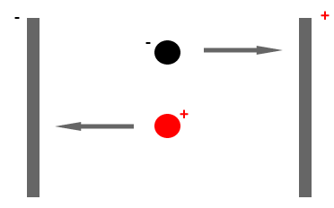
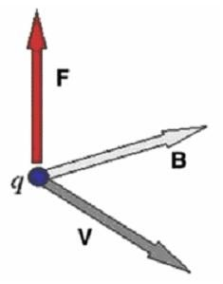
How does a Cathode Ray Tube work?
We can accelerate charged
particles by applying an
electric field to them
q
E
We can also change the
direction of the particle by
applying magnetic fields
… acting perpendicular to the
B field and the particle’s motion
Modern particle accelerators work on the same principle …
Notes:
CAN YOU SAY HE MEASURED Q/M?
REPLACE WITH OTHER PIC OF TELLY AND INTRODUCE ELECTRON-VOLT

Slide 6
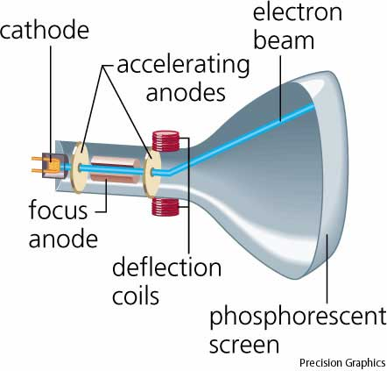
More Cathode Ray Tubes
(Old fashioned) TVs accelerate electrons through ~20keV, bend them using magnets and image on light-emitting screen
Notes:
Nobel prize
Redo diagrams

Slide 7
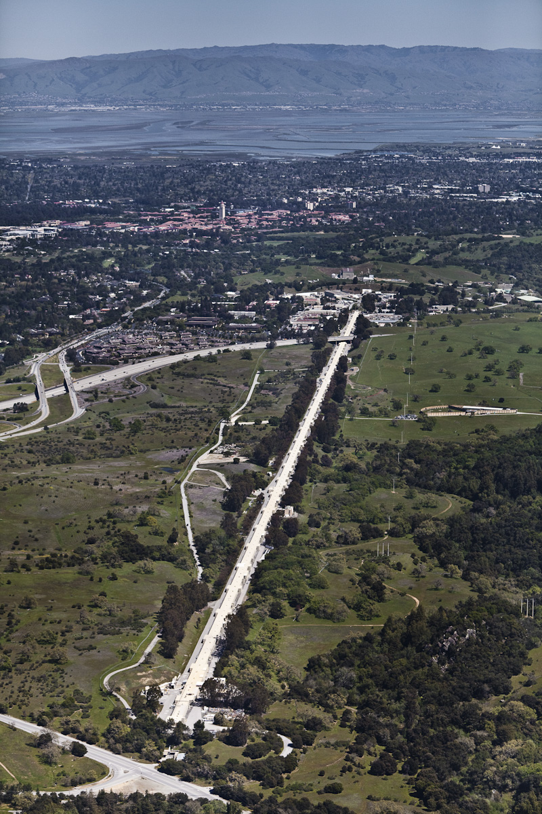
More Cathode Ray Tubes
(Old fashioned) TVs accelerate electrons through ~20keV, bend them using magnets and image on light-emitting screen
1969: SLAC 2-mile 20 GeV electron accelerator showed that protons have structure → quarks
Notes:
Nobel prize
Redo diagrams

Slide 8
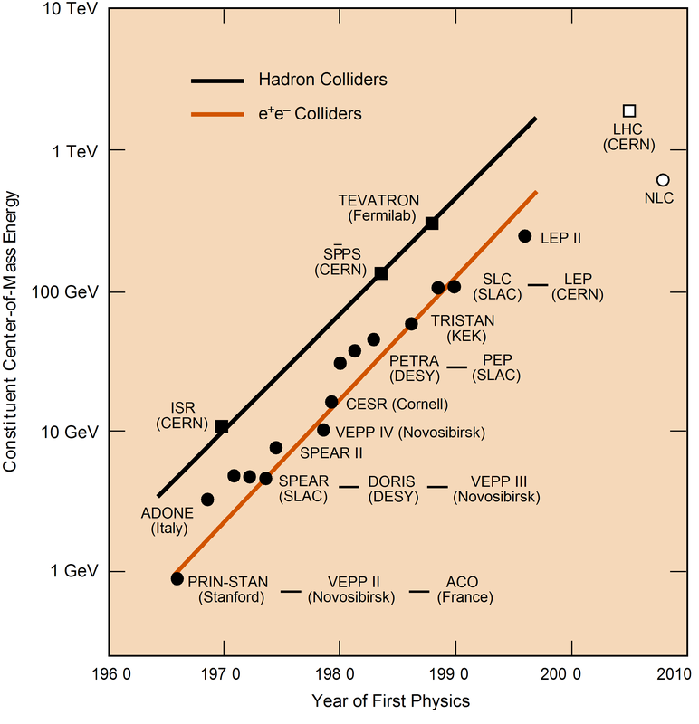
The ‘Livingstone’ Plot
Energy of machines grew exponentially from 1950s to 1990s.

Slide 9
The ‘Livingstone’ Plot
Energy of machines grew exponentially from 1950s to 1990s.
Current state of the art:
e⁺e⁻: E_{cms}=209 GeV
(LEP, CERN)
pp: E_{cms}=7 - 14 TeV
(LHC, CERN)
ep: E_{cms}=318 GeV
(HERA, DESY)
AA: E_{cms}=200 GeV for
nucleons in Au-Au
(RHIC, BNL)
E_{cms}=2.7-5.4 TeV per
nucleon Pb-Pb (LHC)

Slide 10
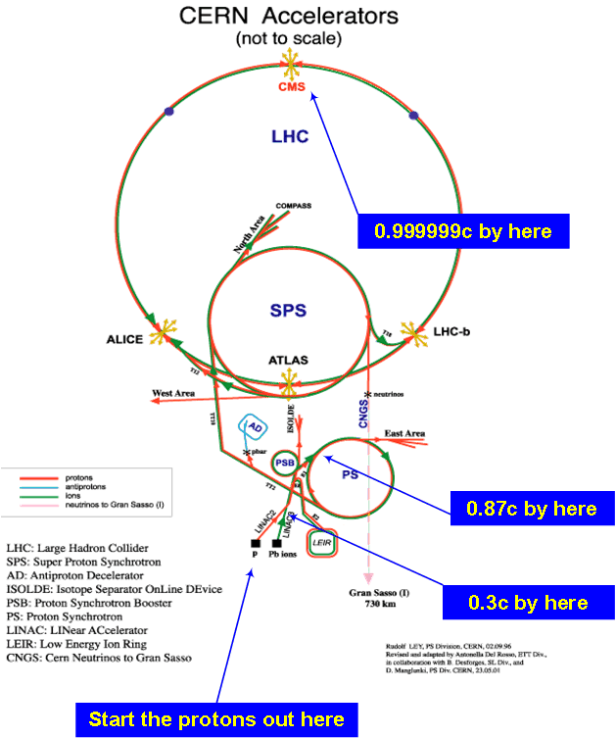
CERN Accelerators
Little wastage!…
Accelerators recycled and re-used often as
injectors, but also to
run other experiments
simultaneously with the
big one.
In parallel detection techniques have developed!
… bubble / spark /
cloud chambers →
complex multi-layer
detectors with many
sub-components

Slide 11
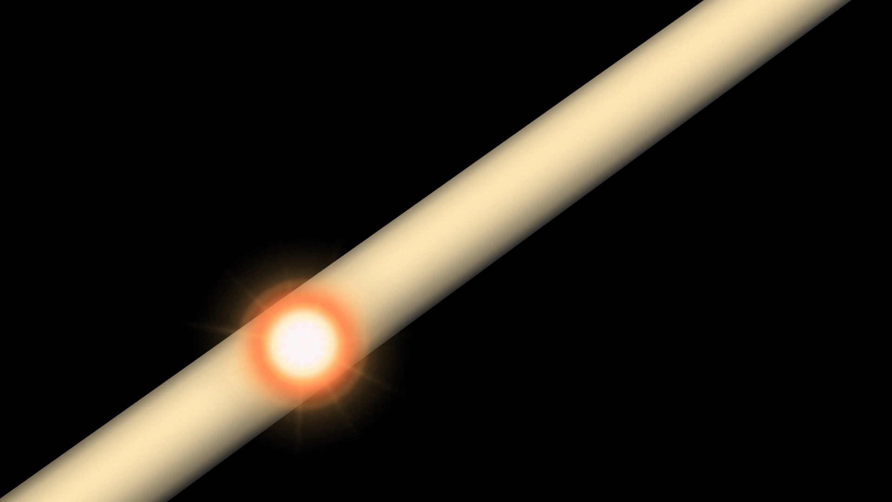

Slide 12
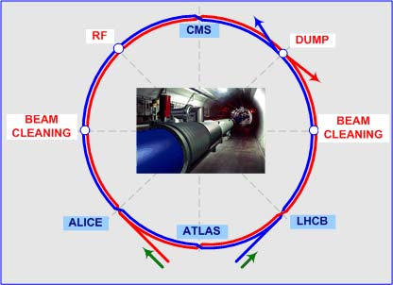
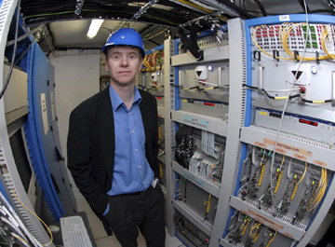
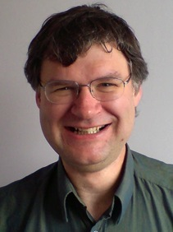
Birmingham’s
Current Work
Birmingham has large
groups, playing important
roles in three of the
four LHC experiments
[ALICE, ALTAS & LHCb] and
one SPS experiment [NA62]
Dave Charlton,
ATLAS
Spokesperson
David Evans,
UK ALICE
Spokesman

Slide 13

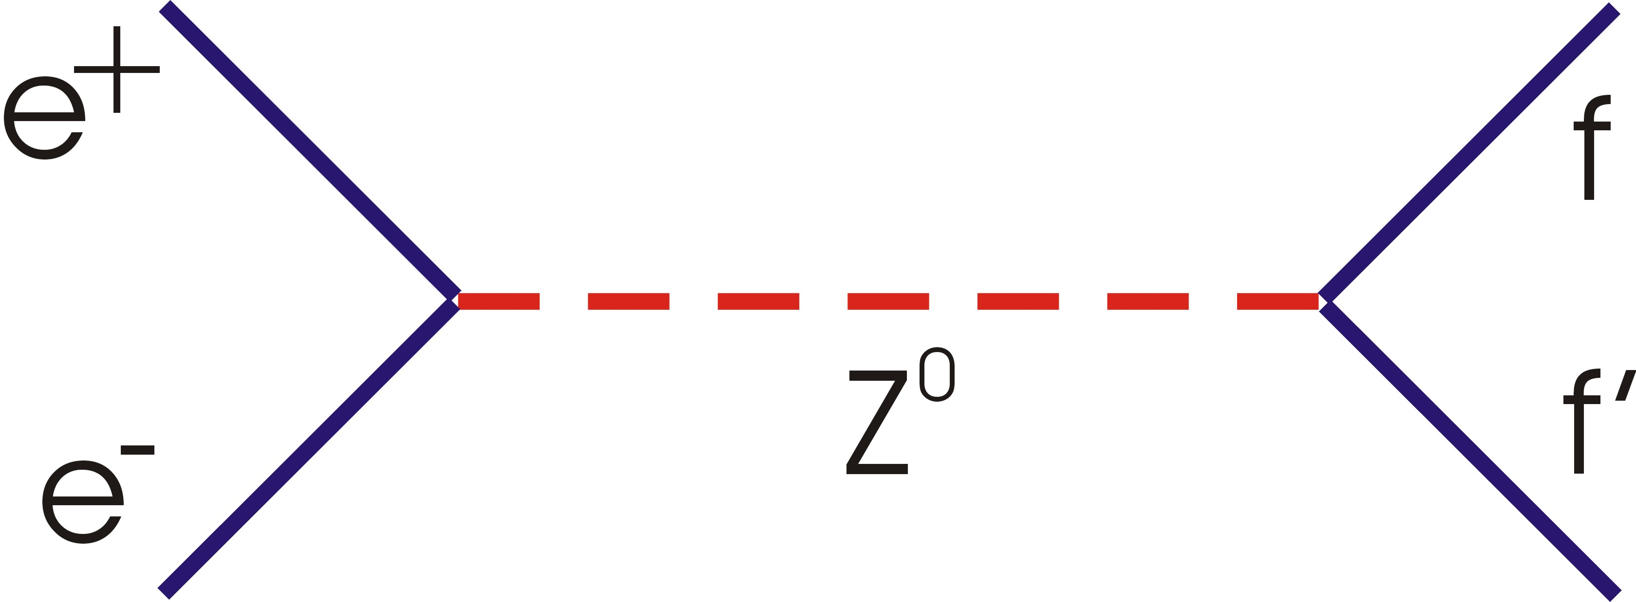
e+ e- Scattering at Z Pole: LEP1 (1989-1995)
f = quark (u,d,s,c,b)
lepton (e, μ, τ)
neutrino (ν_{e}, ν_{μ}, ν_{τ})
CMS energy √s=91.2 GeV
→ Many millions of Z bosons
Notes:
Nobel prize
Redo diagrams

Slide 14
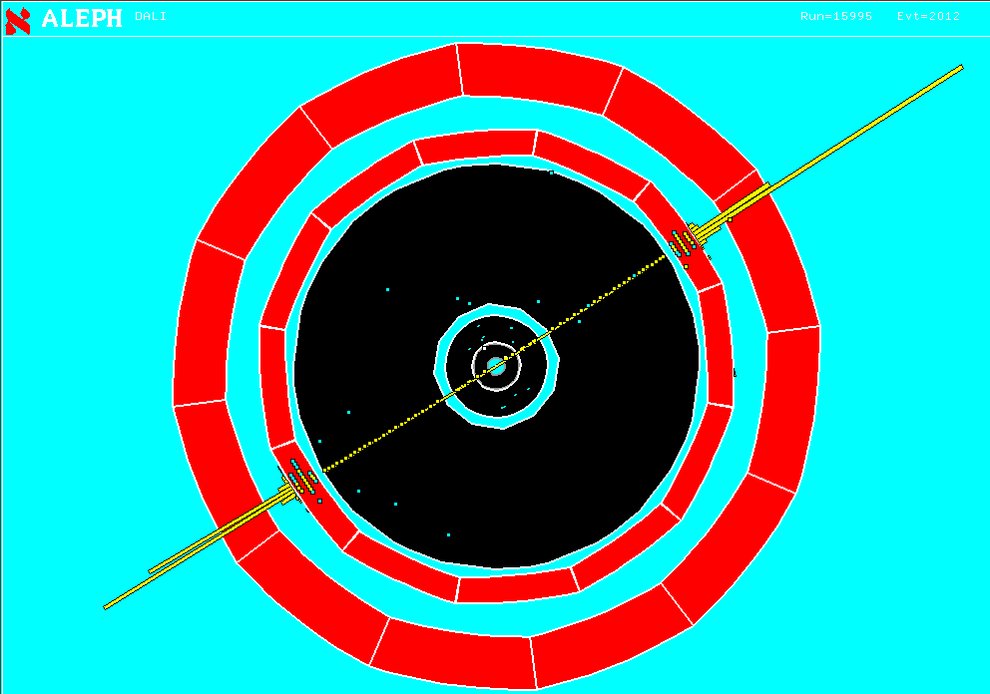
e+ e- Scattering at Z Pole: LEP1 (1989-1995)
f = quark (u,d,s,c,b)
lepton (e, μ, τ)
neutrino (ν_{e}, ν_{μ}, ν_{τ})
CMS energy √s=91.2 GeV
→ Many millions of Z bosons
Unprecedented precision in
testing the Standard Model
and constraining new physics
Notes:
Nobel prize
Redo diagrams

Slide 15
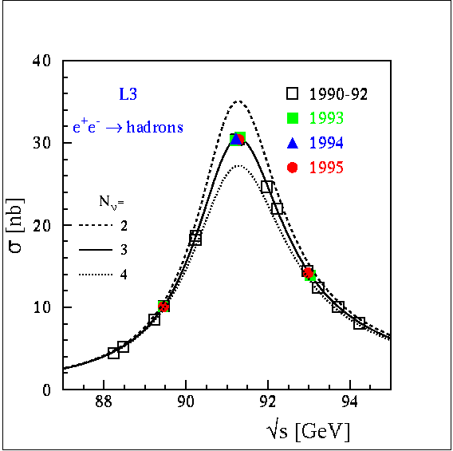
(Very) selected LEP Results
20M Z⁰ decays at LEP-I 40k W⁺W⁻ events at LEP-II.
There are 3 families of
leptons
They all feel the electroweak
force equally (lepton
universality)
Standard Model established
in detail and its parameters
measured very precisely (e.g.
m_{Z} to 0.002%, m_{W} to 0.05%)
Many limits on physics beyond the Standard Model
Indirect constraints on Higgs and other new physics (loops!)

Slide 16
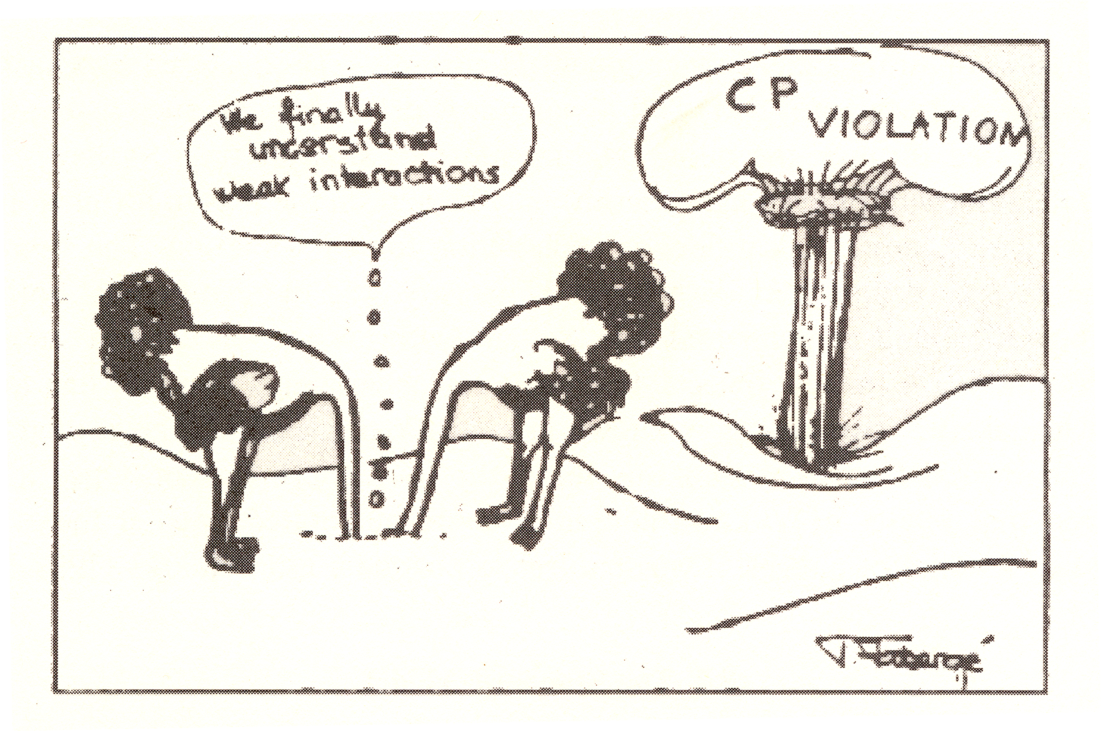
Flavour Physics & the Weak Interaction
Cartoon shown by N Cabbibo, 1966, after Cronin & Fitch
discovered CP violation in K⁰ (s-dbar / d-sbar) decays, 1964
… implies
asymmetry
between
matter and
antimatter …

Slide 17
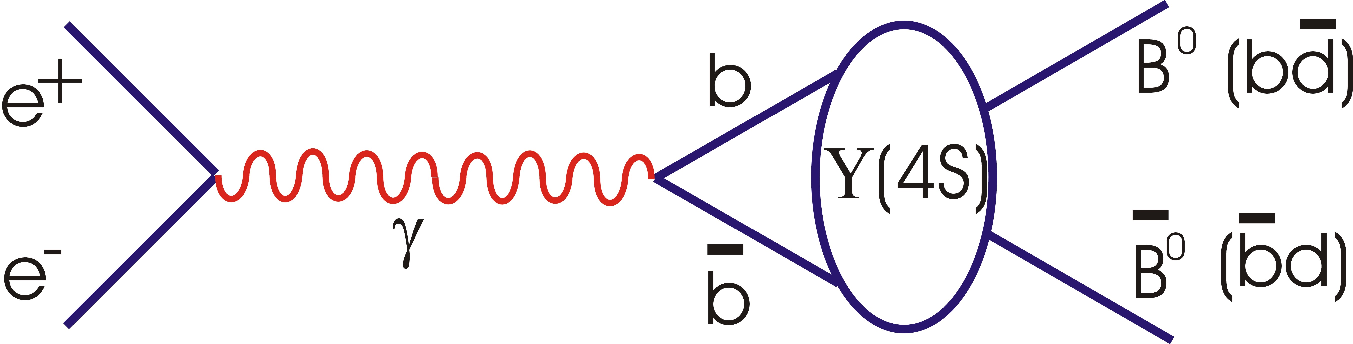
CP Violation and e⁺e⁻ B Factories
− Υ(4S) just above B Bbar
threshold

Slide 18
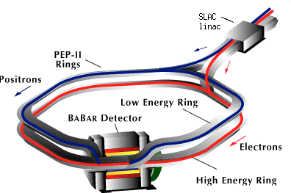
CP Violation and e⁺e⁻ B Factories
− Υ(4S) just above B Bbar
threshold
- Asymmetric e+ e- beams
e.g. BaBar (SLAC, California, 1999-2008)
- 9 GeV electrons
- 3.1 GeV positrons
- Lumi > 10³⁴ cm⁻² s⁻¹

Slide 19
CP Violation and e⁺e⁻ B Factories
− Υ(4S) just above B Bbar
threshold
- Asymmetric e+ e- beams
e.g. BaBar (SLAC, California, 1999-2008)
- 9 GeV electrons
- 3.1 GeV positrons
- Lumi > 10³⁴ cm⁻² s⁻¹
10⁹ co-moving B⁰ (b+dbar)& B⁰bar (bbar+d)
pairs to study differences in well controlled way

Slide 20
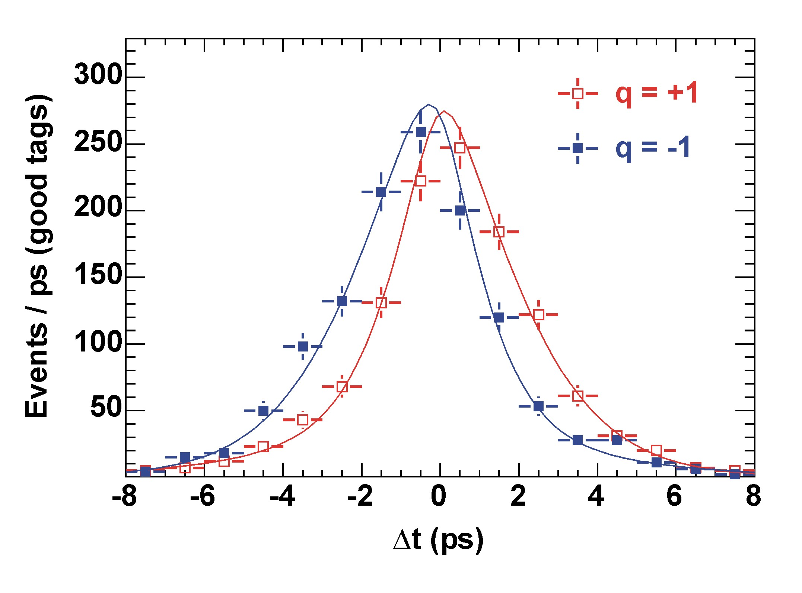
An Important Result from B Factories
Tiny difference between lifetimes of B⁰ (q=+1) and B⁰bar (q=-1):
A `time dependent CP asymmetry’ measurement

Slide 21
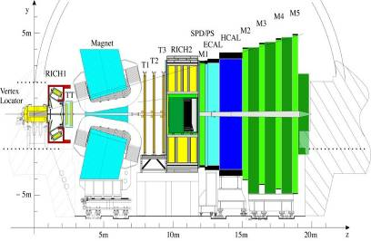
LHCb: A B Factory at the LHC
Looks more like a fixed target configuration, with detectors
stacked transverse to the beam direction
Pairs of B hadrons tend to have similar momentum & emerge close to the beam-pipe ...not so very different from BaBar!...

Slide 22
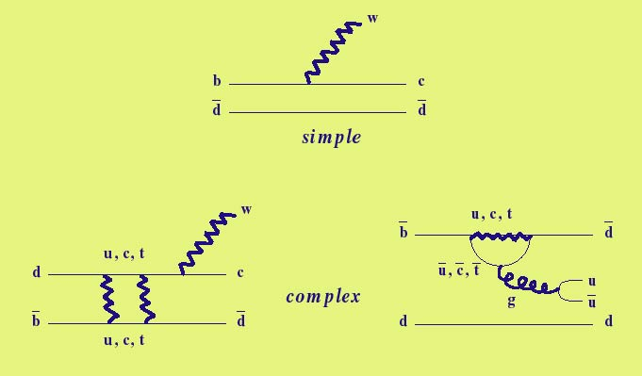
Types of B Decay
Most common: B⁰ → D⁰ W (Tree)
CP violation via mixing:
B⁰bar → B⁰ → D⁰ W (Box)
b
W
W
Flavour Changing Neutral Current:
B0bar → π+π- (Penguin)
W
Virtual Loop processes are very rare
and some Penguins are very rare
indeed → loops are sensitive to new
particles with mass well beyond √s

Slide 23
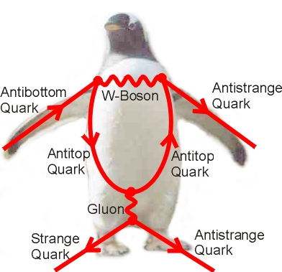

Slide 24
Rare Kaon Decays: NA48 and NA62
Strangeness (K mesons) represented most of the history
and development of flavour phsics and CP violation ...

Slide 25
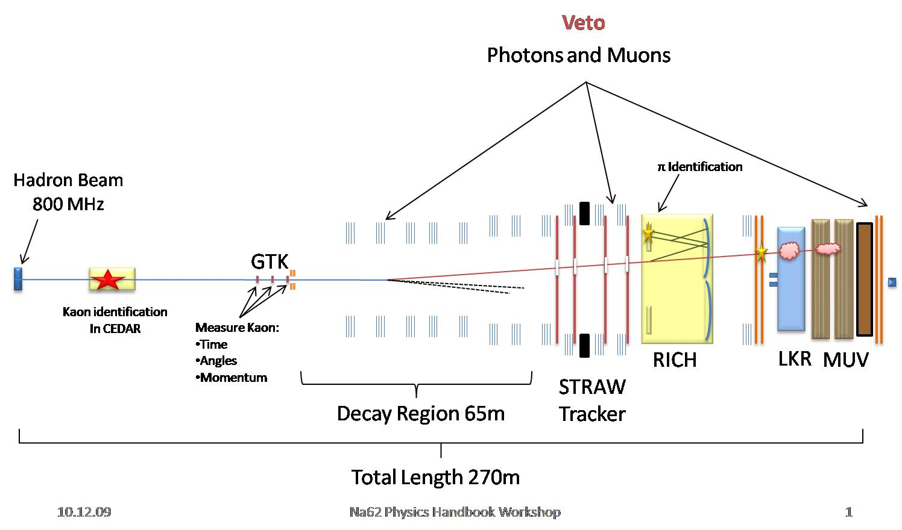
Rare Kaon Decays: NA48 and NA62
Strangeness (K mesons) represented most of the history
and development of flavour phsics and CP violation ...
Next plan at CERN:
NA62 (2015-)
… to study
K→ π ν νbar
decays in flight

Slide 26

Rare Kaon Decays: NA48 and NA62
Strangeness (K mesons) represented most of the history
and development of flavour phsics and CP violation ...
Next plan at CERN:
NA62 (2015-)
… to study
K→ π ν νbar
decays in flight
<10⁻¹⁰ branching ratio …
~100 events expected with low background after running for 2 years!... Clear exotic signal if there are many more events …

Slide 27
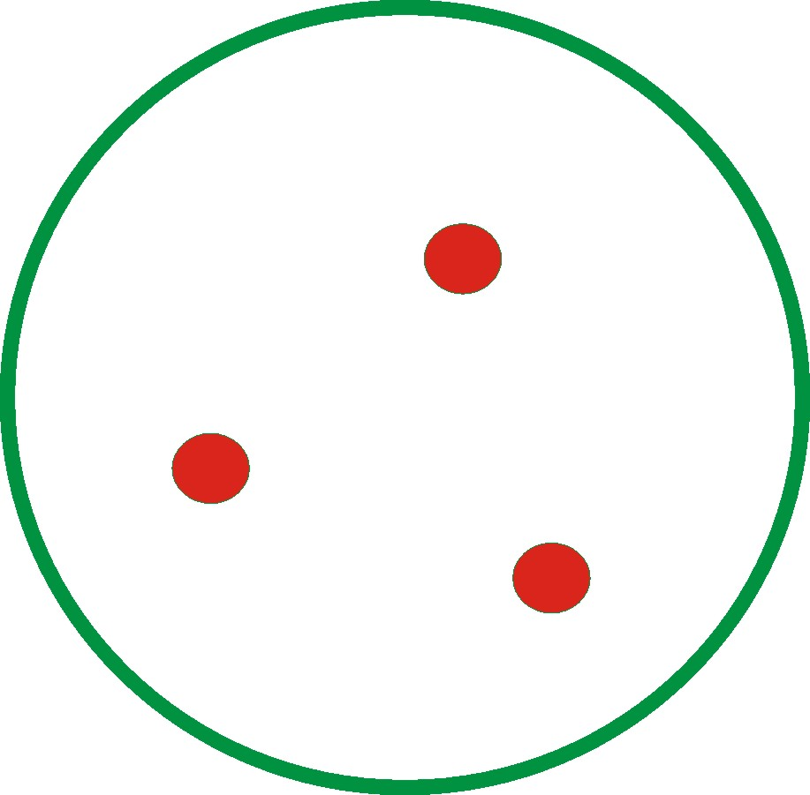
Proton “Structure”?
u
Proton constituents …
2 up and 1 down valence quarks
u
d

Slide 28
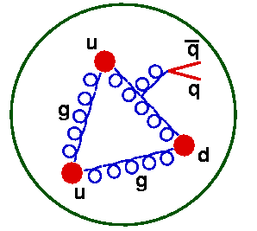
Proton “Structure”?
u
Proton constituents …
2 up and 1 down valence quarks
… and some gluons
… and some sea quarks
u
d

Slide 29
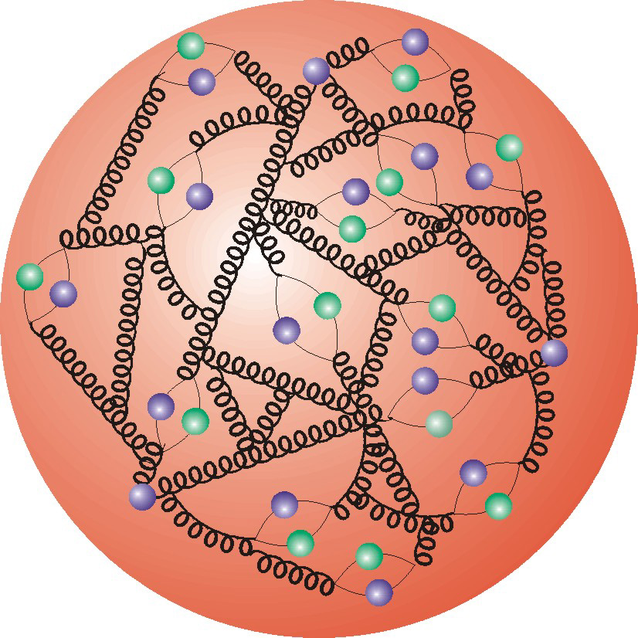
Proton “Structure”?
u
u
Proton constituents …
2 up and 1 down valence quarks
… and some gluons
… and some sea quarks
… and lots more gluons and sea quarks …
strong interactions induce rich and complex
`structure’ of high energy proton interactions!
d

Slide 30
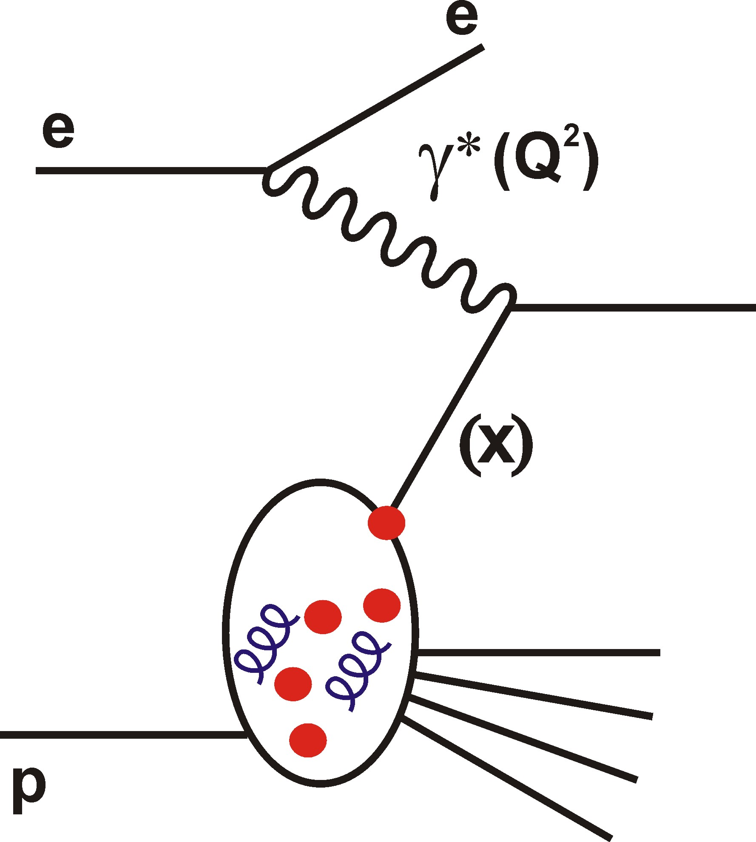
Proton “Structure”?
u
u
Proton constituents …
2 up and 1 down valence quarks
… and some gluons
… and some sea quarks
… and lots more gluons and sea quarks …
strong interactions induce rich and complex
`structure’ of high energy proton interactions!
Scattering electrons from
protons at √s > 300GeV at
HERA established detailed
proton structure & provided
a testing ground for QCD
over a huge kinematic range
… parton density functions
d

Slide 31
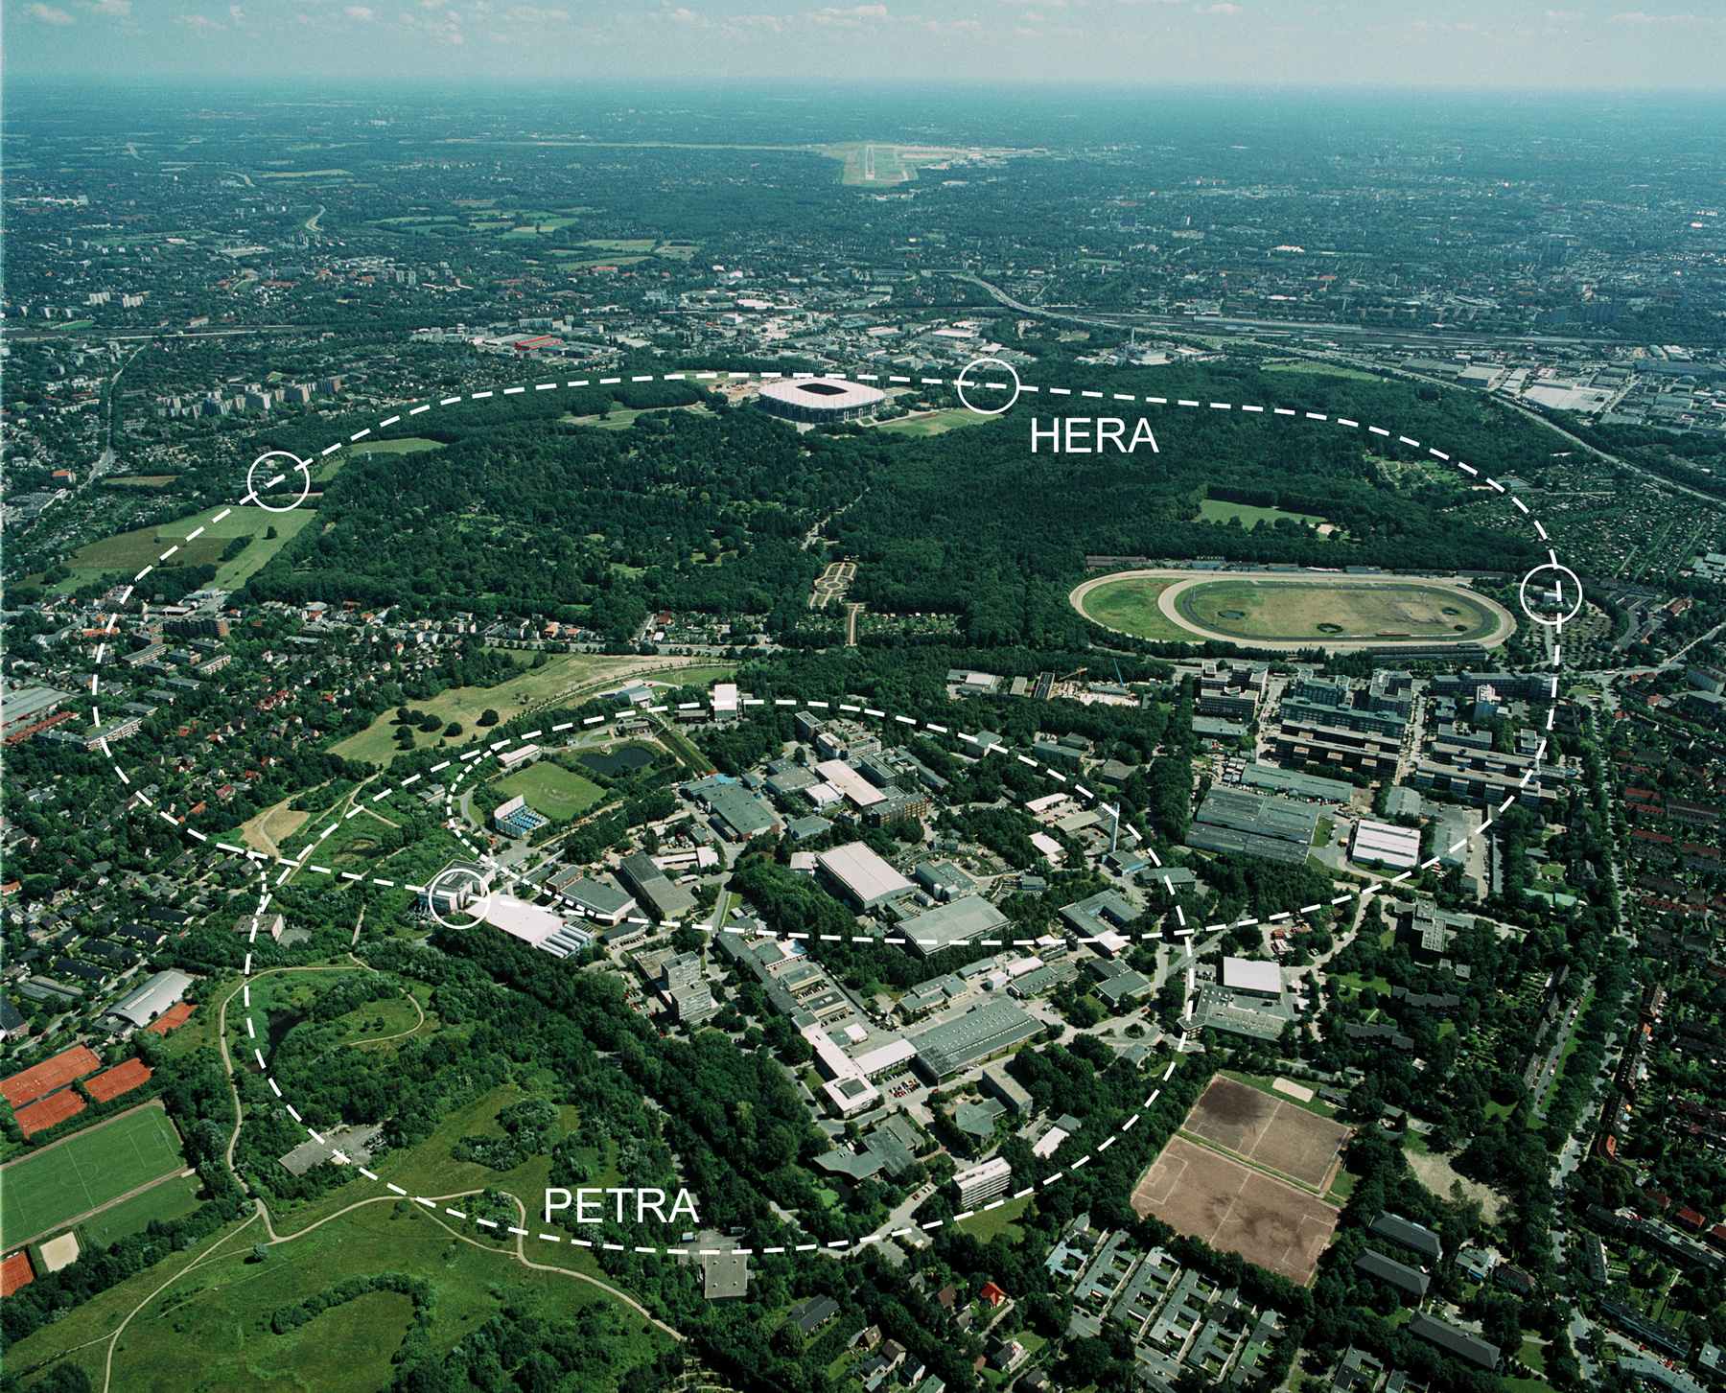


DESY, Hamburg
P (920 GeV)
P (920 GeV)
HERA (1992-2007)
… the only ever collider of electron and proton beams
ZEUS
e (27.5 GeV)
e (27.5 GeV)
Equivalent to a 50 TeV beam on
a fixed target proton
~2500 times more than SLAC!
Notes:
WORLD’S MOST POWERFUL MICROSCOPE!!!

Slide 32
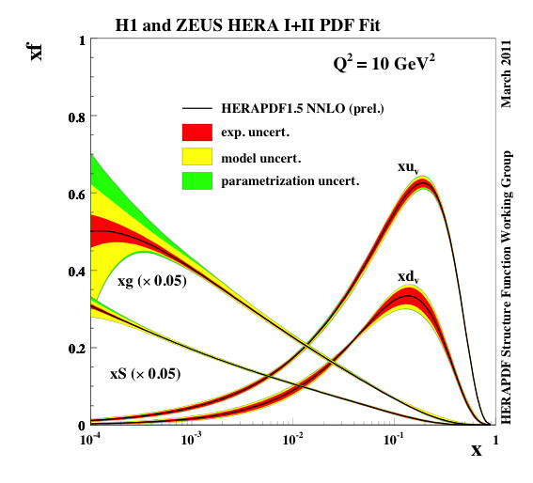
DESY, Hamburg
P (920 GeV)
P (920 GeV)
HERA (1992-2007)
… the only ever collider of electron and proton beams
ZEUS
e (27.5 GeV)
e (27.5 GeV)
Parton densities of the
proton from HERA data
Notes:
WORLD’S MOST POWERFUL MICROSCOPE!!!

Slide 33
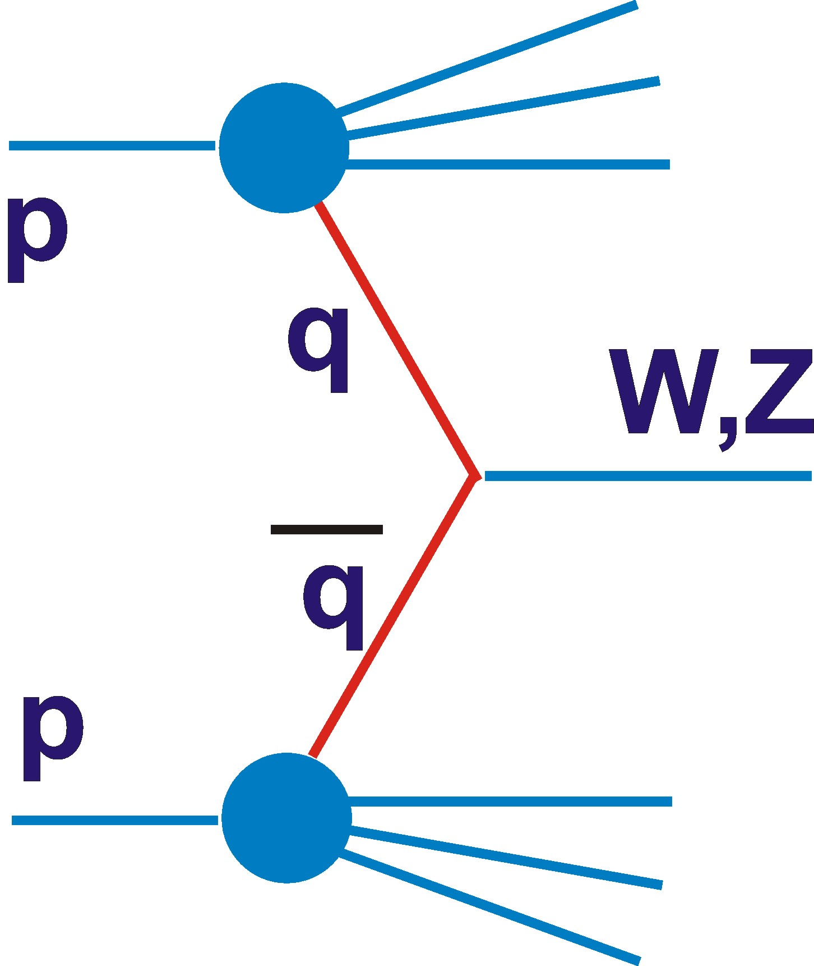
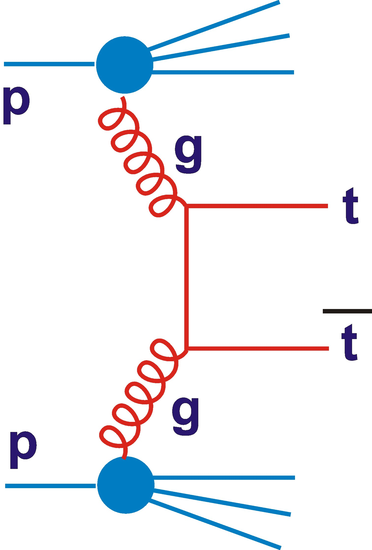
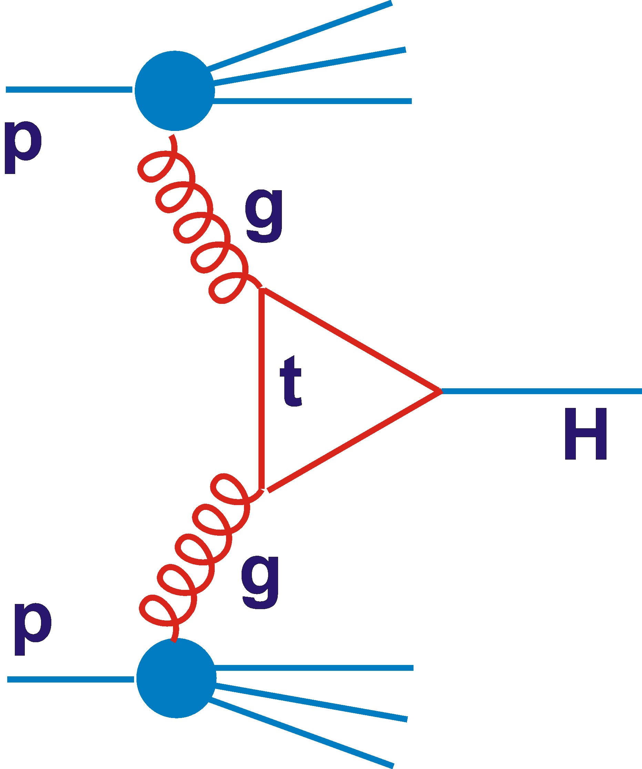
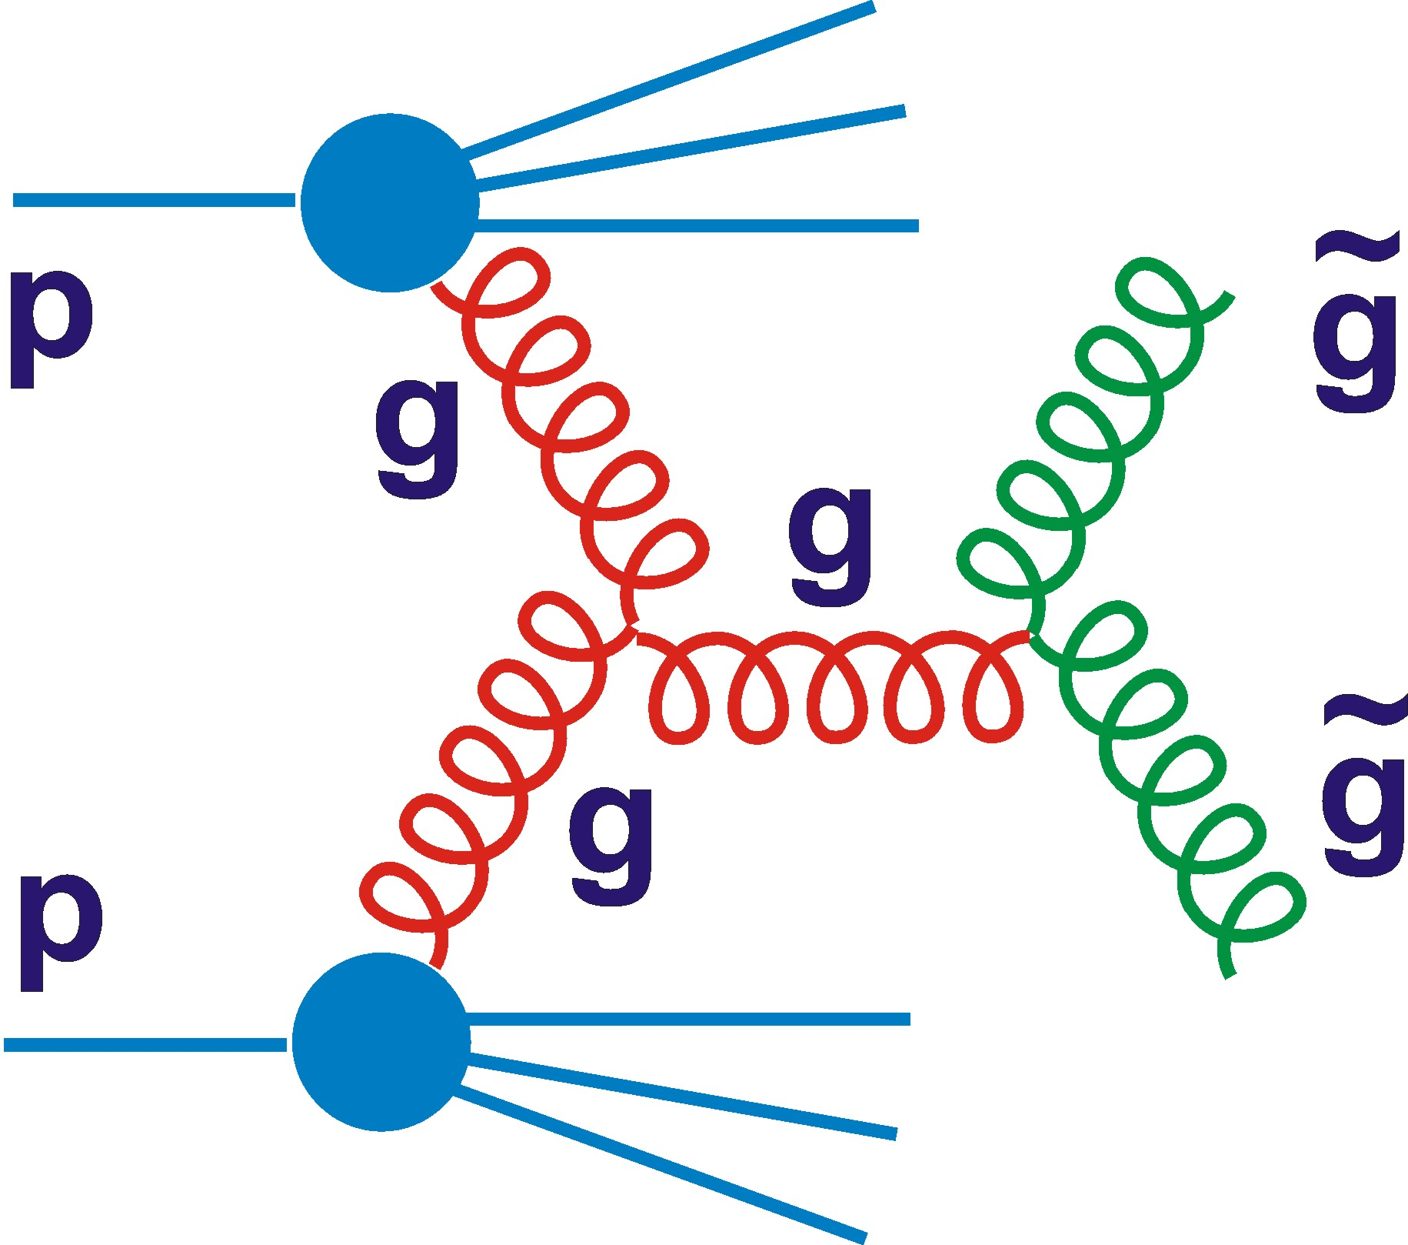
Partons and the LHC
All pp physics starts from partons (i.e. quarks and gluons)

Slide 34
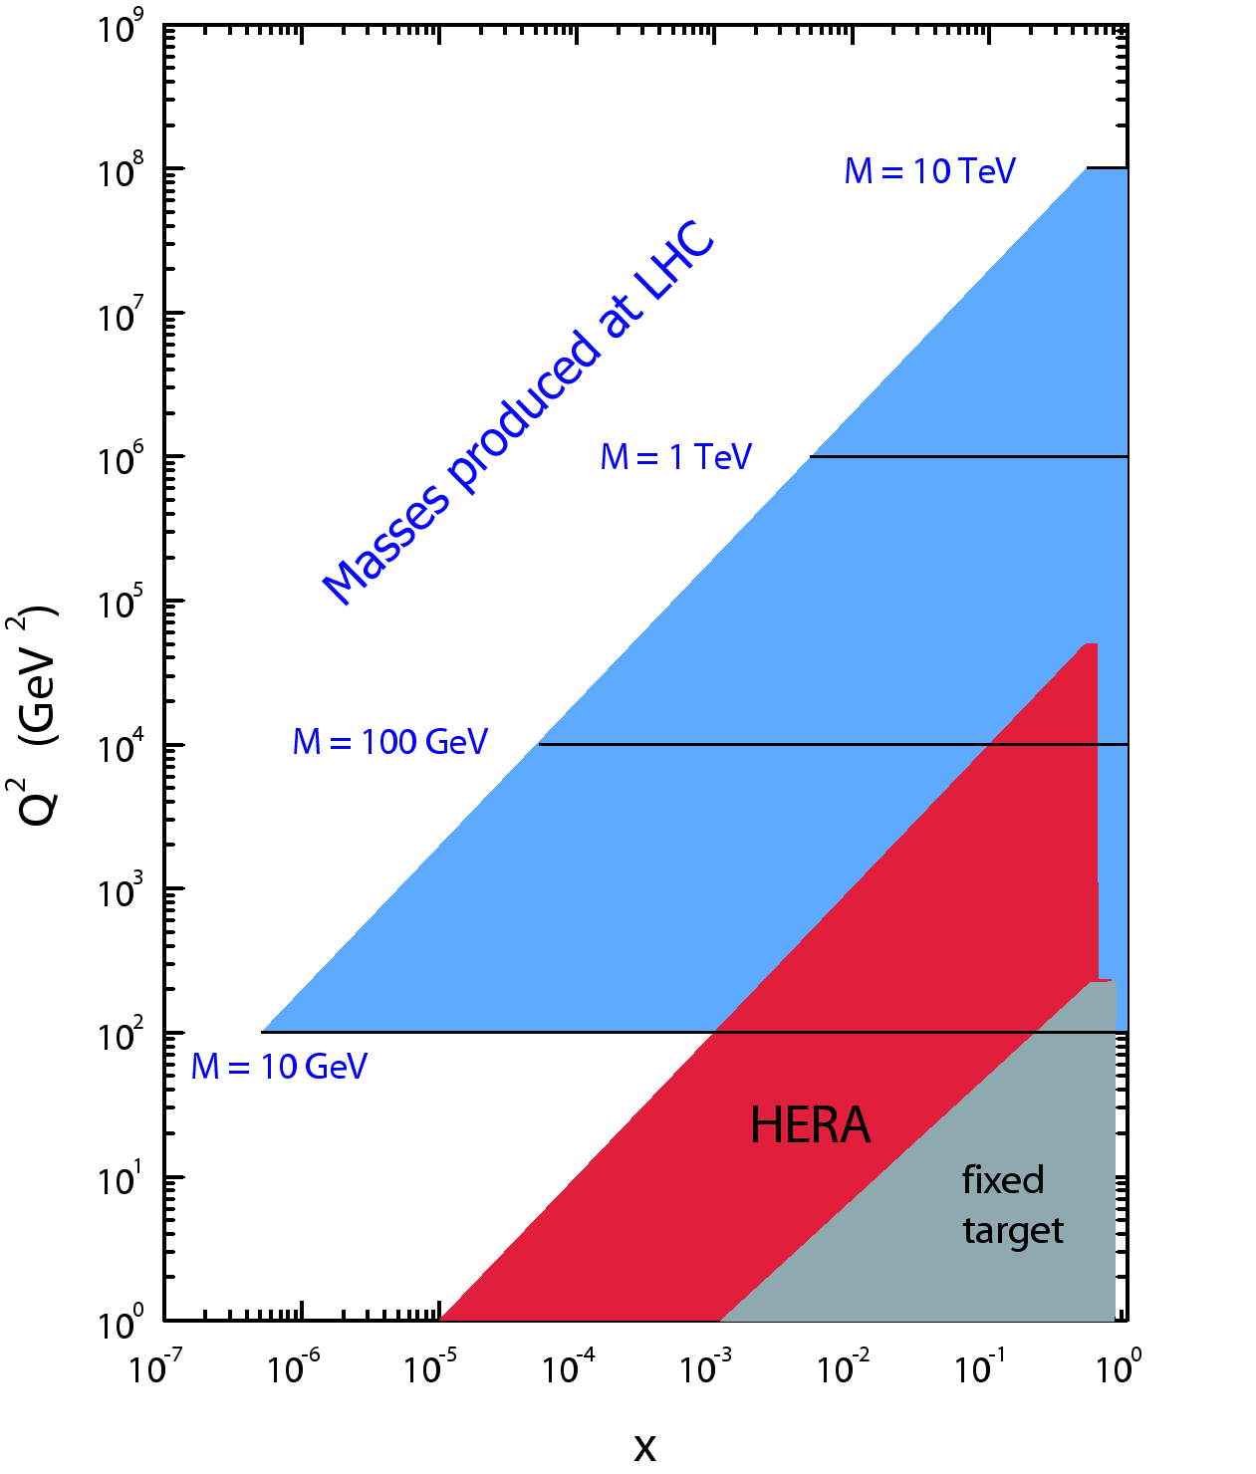
Partons and the LHC
DGLAP
All pp physics starts from partons (i.e. quarks and gluons)
LHC uses partons over very similar range in x to HERA!
QCD (DGLAP equations) tells us the parton densities at all Q² if we know them at one value of Q²

Slide 35
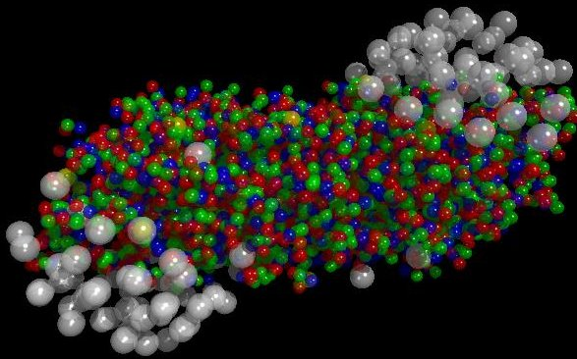
Melting Hadrons: High Denstity QCD
Relativistic Heavy Ion Collisions
place as much baryonic matter
in one place as possible →
the QCD phase diagram and
the Quark Gluon Plasma
Notes:
35

Slide 36
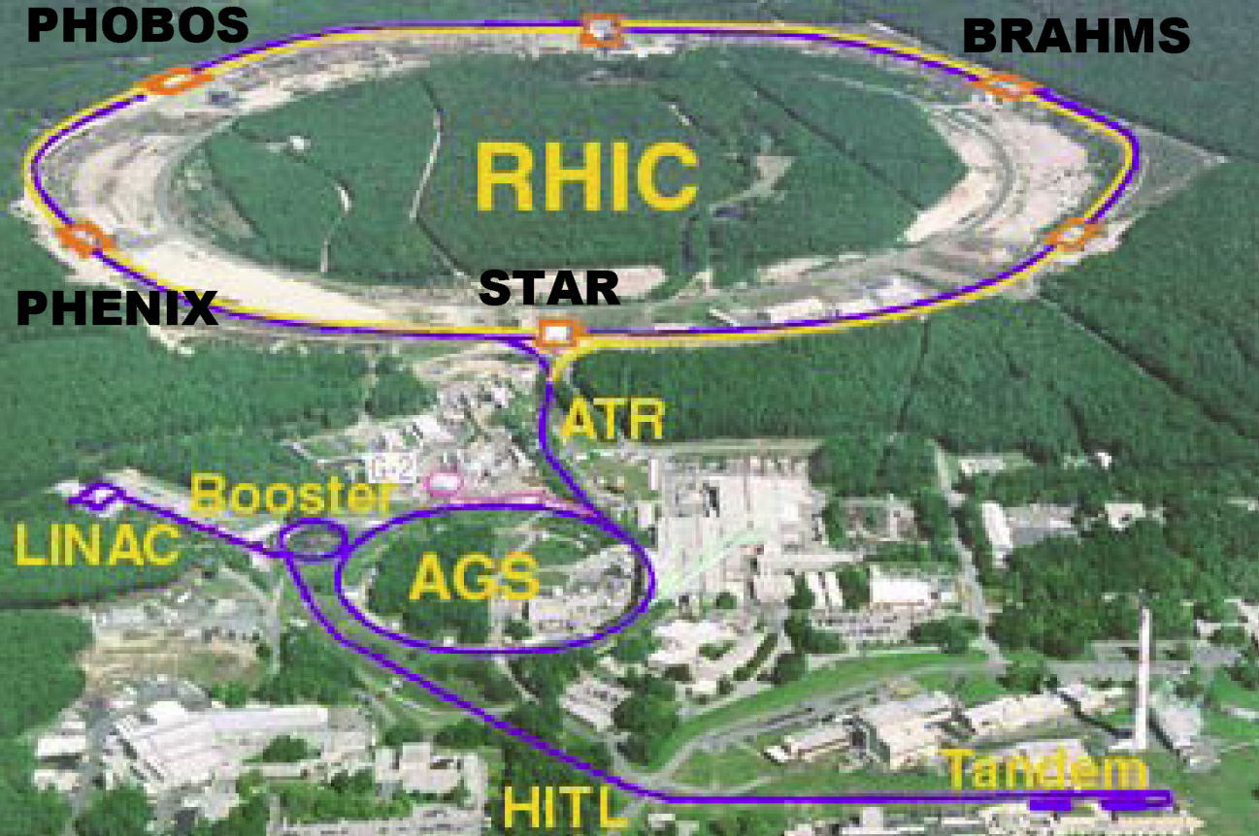
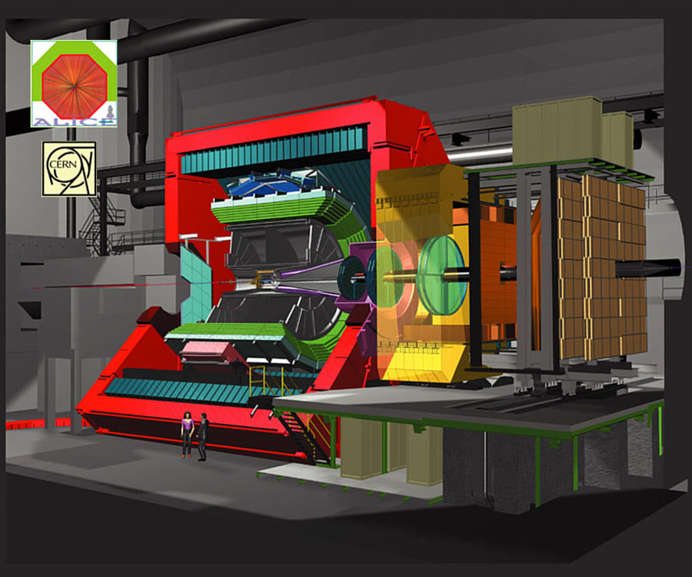
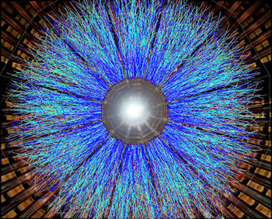
Melting Hadrons: High Denstity QCD
Relativistic Heavy Ion Collisions
place as much baryonic matter
in one place as possible →
the QCD phase diagram and
the Quark Gluon Plasma
AuAu @ RHIC
PbPb @ LHC
Notes:
36

Slide 37
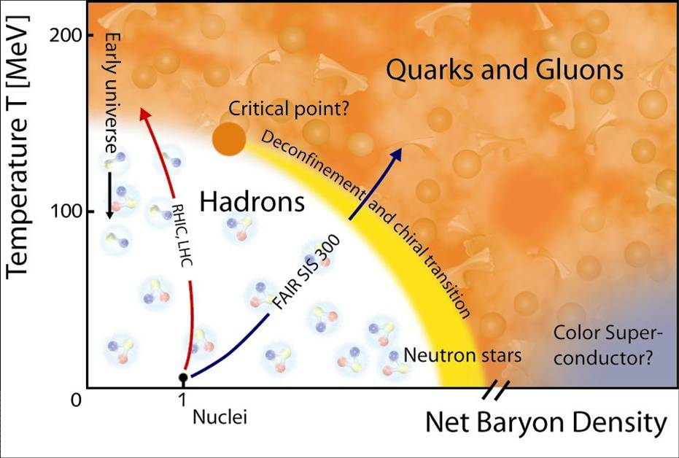
QCD Phase Diagram
& Evidence for QGP
Notes:
37

Slide 38
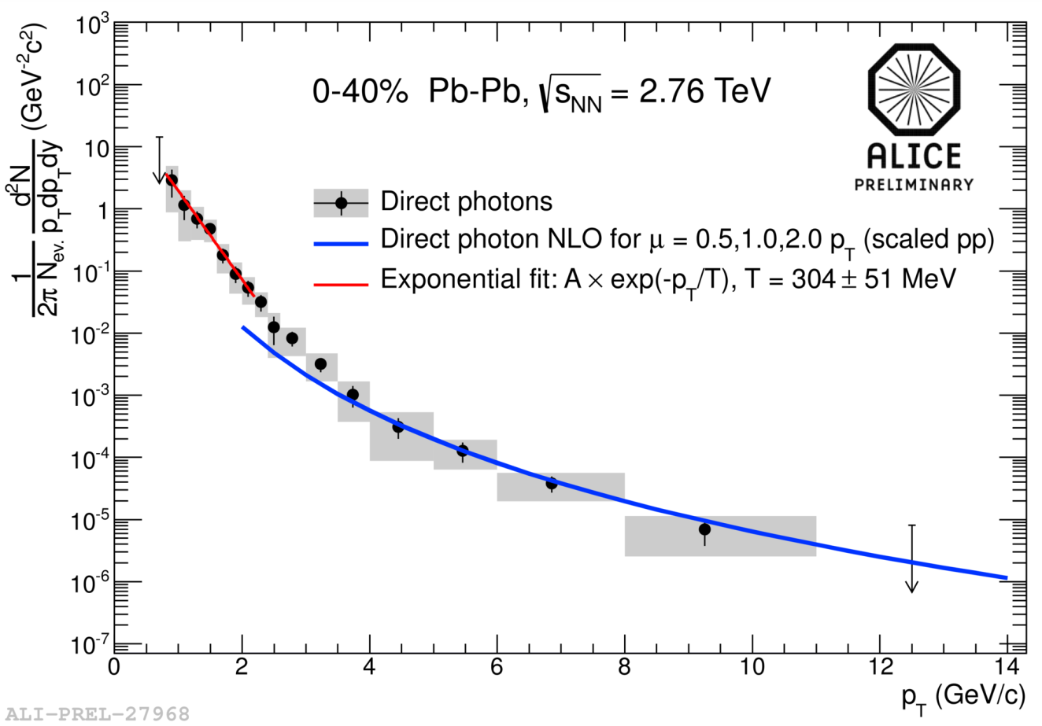
QCD Phase Diagram
& Evidence for QGP
Inverse p_{T} slopes give
kT ~ 300 MeV at LHC
Notes:
38

Slide 39
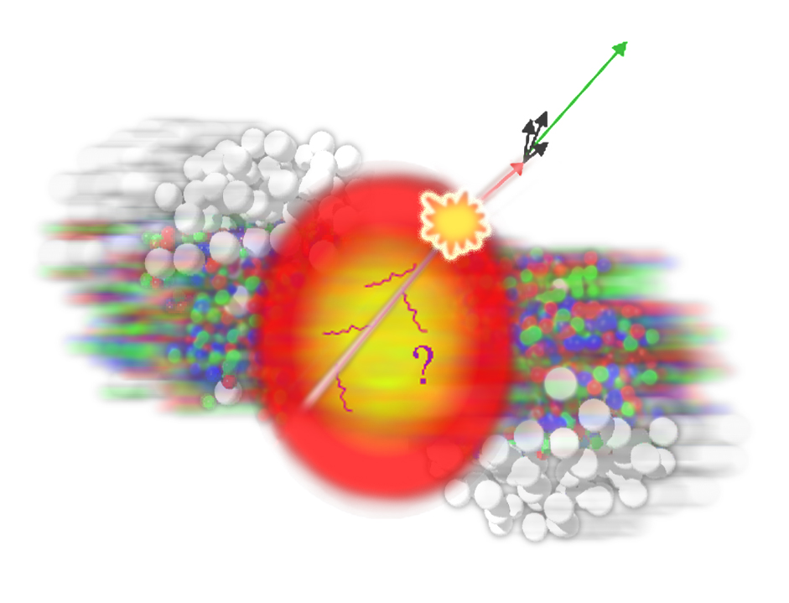
QCD Phase Diagram
& Evidence for QGP
Inverse p_{T} slopes give
kT ~ 300 MeV at LHC
Many QGP signatures:
e.g. jet quenching …
Notes:
39

Slide 40
Why do we need a Higgs Field?
… it generates mass for the particles in the Standard Model …
… Couples to other particles in a way that depends on their
mass, giving them inertia relative to massless particles
travelling at the speed of light.

Slide 41
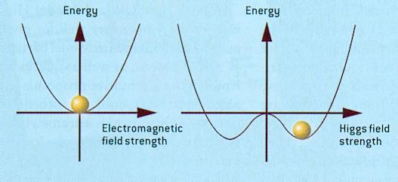
Why do we need a Higgs Field?
… it generates mass for the particles in the Standard Model …
… Couples to other particles in a way that depends on their
mass, giving them inertia relative to massless particles
travelling at the speed of light.
… a field with a non-zero
vacuum expectation value
… with no preferred direction

Slide 42
Why do we need a Higgs Field?
… it generates mass for the particles in the Standard Model …
… Couples to other particles in a way that depends on their
mass, giving them inertia relative to massless particles
travelling at the speed of light.
… a field with a non-zero
vacuum expectation value
… with no preferred direction
Consequence: Unlike force fields such as gravity:
→ No need for a source … equally strong in vacuum of
inter-galactic space as it is in this room … Weird!!!

Slide 43
Why do we need a Higgs Field?
An analogy:
What happens when a (light)
Mr Nobody and a (heavy)
Mrs Thatcher try to walk
quickly through a room full of
Conservative party workers?…

Slide 44
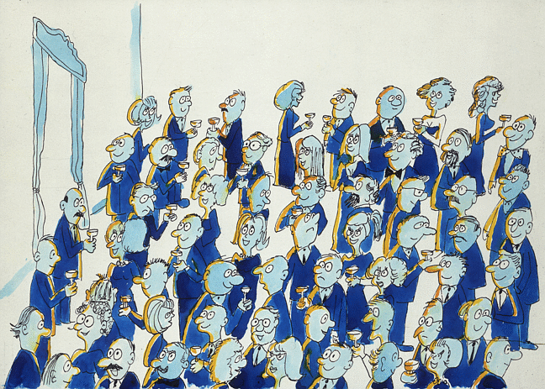
Why do we need a Higgs Field?
An analogy:
What happens when a (light)
Mr Nobody and a (heavy)
Mrs Thatcher try to walk
quickly through a room full of
Conservative party workers?…

Slide 45
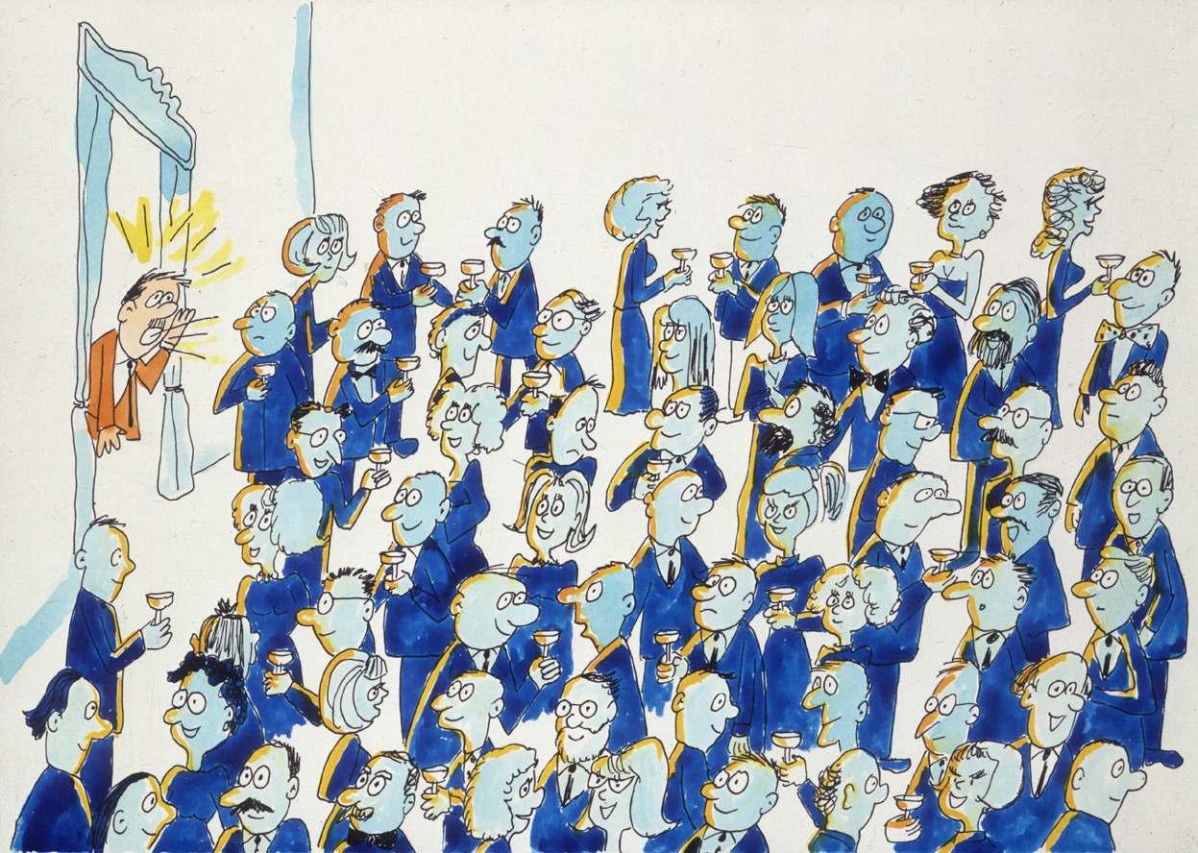
Why do we need a Higgs Field?
An analogy:
What happens when a (light)
Mr Nobody and a (heavy)
Mrs Thatcher try to walk
quickly through a room full of
Conservative party workers?…

Slide 46
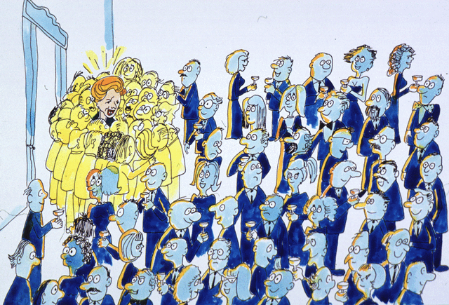
Why do we need a Higgs Field?
An analogy:
What happens when a (light)
Mr Nobody and a (heavy)
Mrs Thatcher try to walk
quickly through a room full of
Conservative party workers?…

Slide 47
Why do we need a Higgs Boson?

Slide 48
Why do we need a Higgs Boson?
The Higgs boson is a consequence (radial excitation) of the
Higgs field.

Slide 49
Why do we need a Higgs Boson?
The Higgs boson is a consequence (radial excitation) of the
Higgs field.
Avoids a high energy catastrophe: perfectly cancels a high
energy WW scattering diagram that violates unitarity on
~TeV scale

Slide 50
Why do we need a Higgs Boson?
The Higgs boson is a consequence (radial excitation) of the
Higgs field.
Avoids a high energy catastrophe: perfectly cancels a high
energy WW scattering diagram that violates unitarity on
~TeV scale

Slide 51
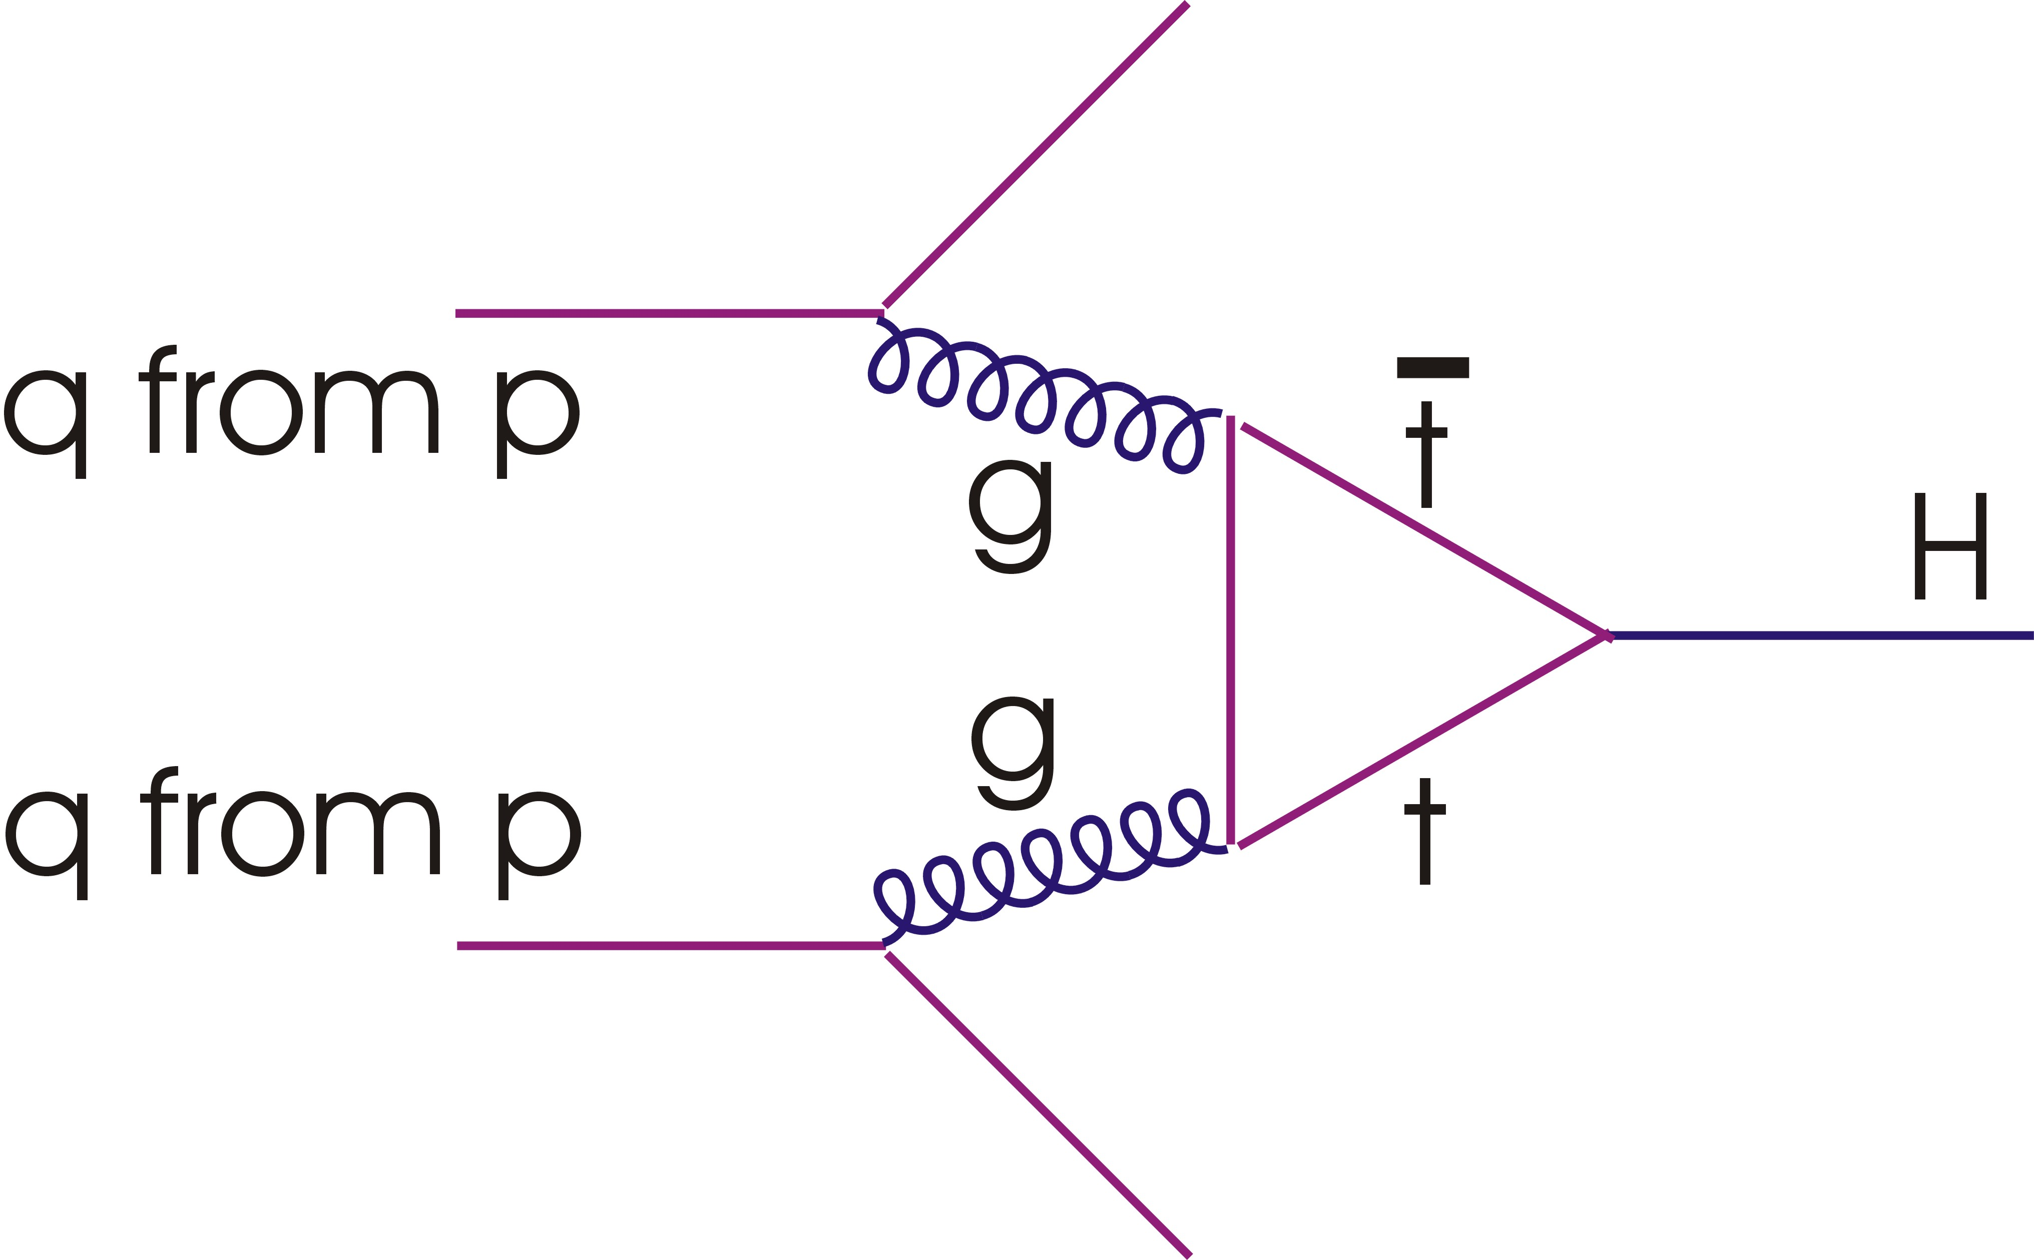
LHC: Higgs Production & Decay
Higgs boson couples to mass …
Dominant production mechanism
is gg fusion via a top quark loop

Slide 52
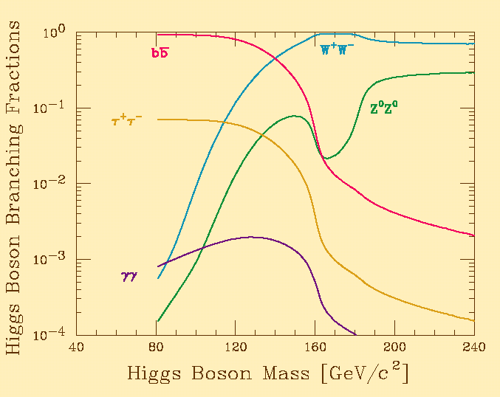
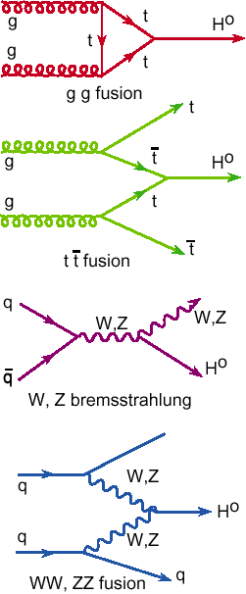
LHC: Higgs Production & Decay
Higgs boson couples to mass …
Dominant production mechanism
is gg fusion via a top quark loop
At m_{H} ~ 125 GeV, dominant decay is to b bbar … huge
background at LHC → tough,
but not impossible …

Slide 53
LHC: Higgs Production & Decay
Higgs boson couples to mass …
Dominant production mechanism
is gg fusion via a top quark loop
At m_{H} ~ 125 GeV, dominant decay is to b bbar … huge
background at LHC → tough,
but not impossible …
γγ, ZZ, WW and ττ have all
shown signals …

Slide 54
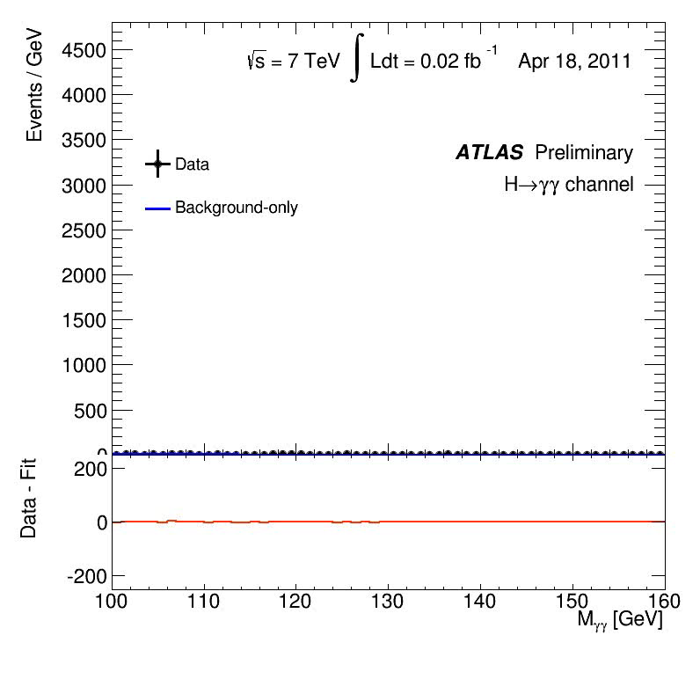
Looking for Higgs decaying to 2 photons

Slide 55

… and Higgs decaying to two Z bosons …

Slide 56

July 4 2012: The world went Higgs-crazy

Slide 57

July 4 2012: The world went Higgs-crazy

Slide 58

July 4 2012: The world went Higgs-crazy

Slide 59

July 4 2012: The world went Higgs-crazy

Slide 60
July 4 2012: The world went Higgs-crazy

Slide 61
July 4 2012: The world went Higgs-crazy

Slide 62


How Discoveries Change 1:
W, Z bosons (1983) p-pbar collisions at √s=540 GeV in
CERN SPS [UA1]

Slide 63


How
Discoveries Change 2:
Higgs bosons,
(2012) pp Collisions at √s = 8 TeV in CERN LHC
[ATLAS, CMS]

Slide 64



Slide 65



Slide 66



Slide 67



Slide 68


Slide 69


~3000 physicists from 174 institutes in 38 countries

Slide 70



Higgs Coupling Strength
In all measurements of Higgs properies
To date, it is compatible with the
Standard Model version

Slide 71

Physics Beyond Standard Model
Intense work by ATLAS, CMS, LHCb and many other
experiments searching for Supersymmetry
Many other scenarios for physics beyond our current knowledge
also investigated
Notes:
71

Slide 72


Slide 73
No signal up to masses ~ 1 TeV
… SUSY’s not dead, but she’s poorly

Slide 74

Many More Searches … without success

Slide 75


Slide 76
It’s way too early to give up hope! So far at LHC:
                Half design beam energy
→ 1% of planned collisions
The LHC will run for another 15-20 years …
… and it’s certainly not the only show in town ☺

Slide 77

Thank you for your Attention!

