Slide 1
Physics of B-mesons
Sanjay K. Swain
NISER
Outline
B-factories
CP violation in Standard Model
CPV results from B factories
Other Rare Decays
Need for Super B-factory
Summary and outlook

Slide 2
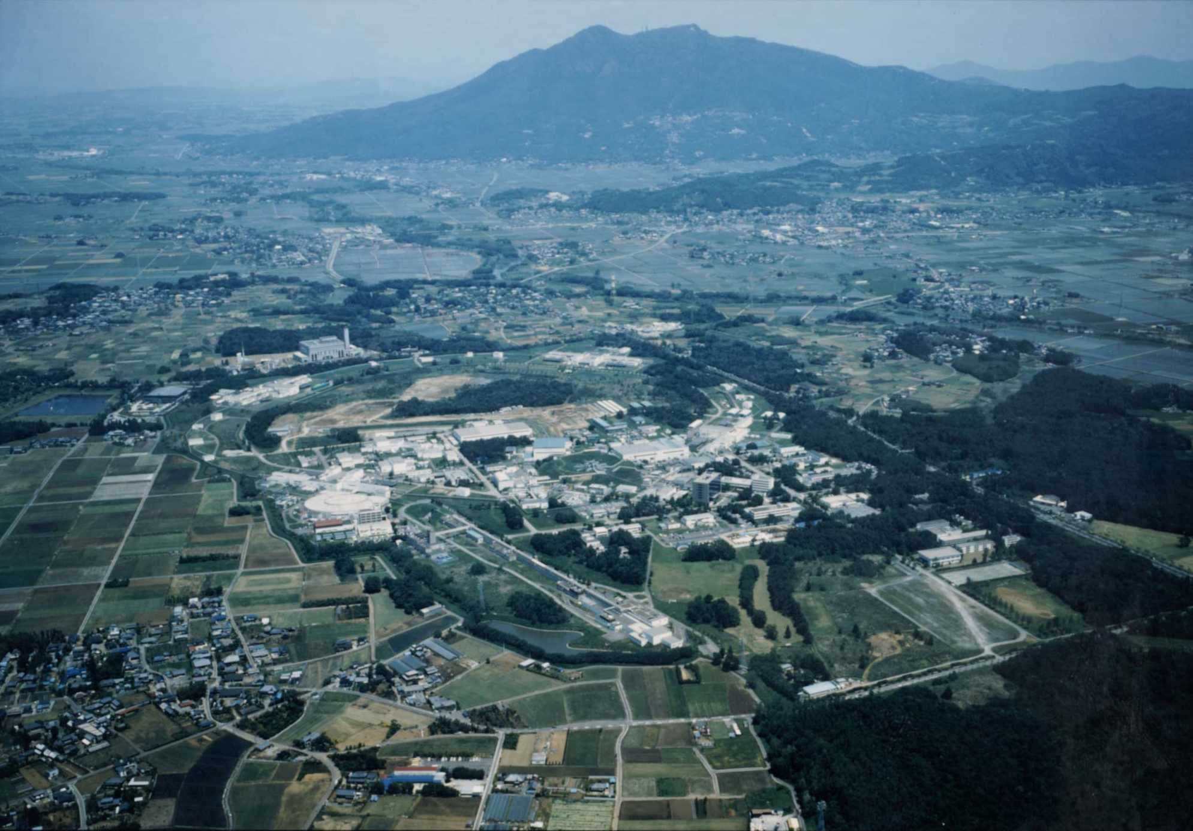
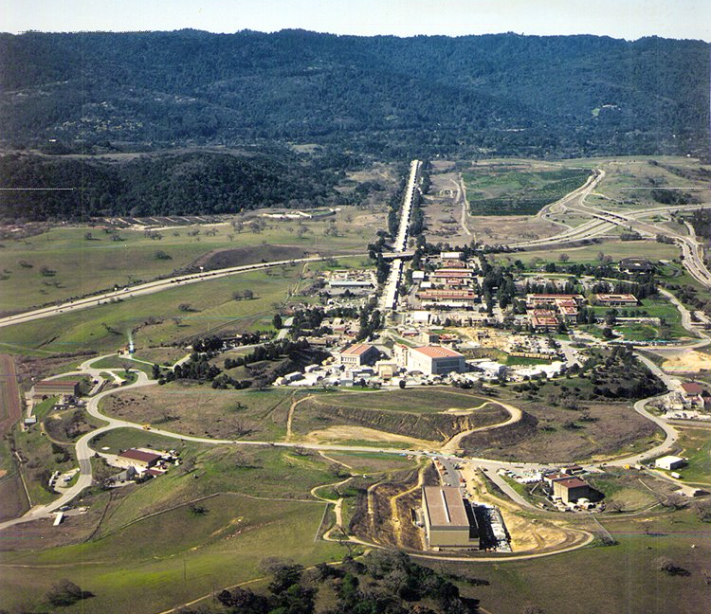
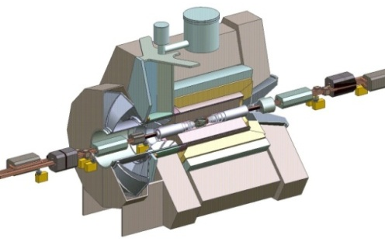
B-factory experiments (@KEK and @SLAC)
e⁺e⁻ −> ϒ4s (10.58GeV) −> B⁰B⁰ or B⁺B⁻
For KEKB: E_{electron} = 8.0 GeV For PEP-II: E_{electron} = 9.0 GeV
E_{positron} = 3.5 GeV E_{positron} = 3.1 GeV
ϒ4s (and B’s moving in lab frame)
−> B decay time measurements (why ? )
Belle detector
BABAR detector
KEKB
PEP-II

Slide 3
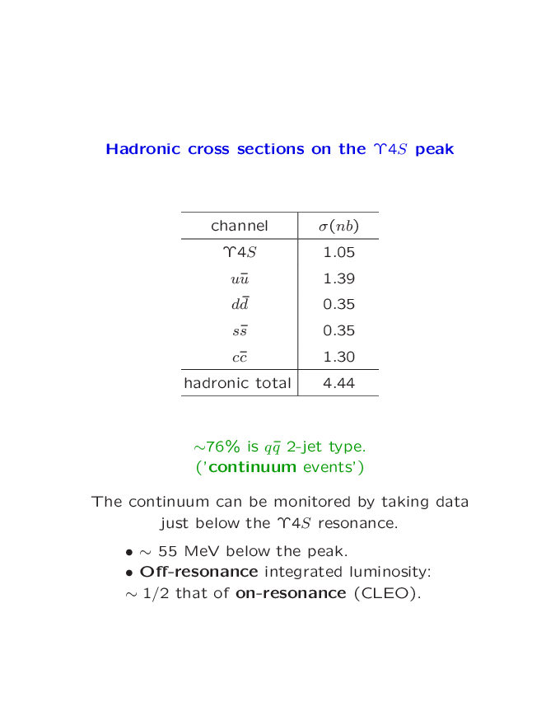
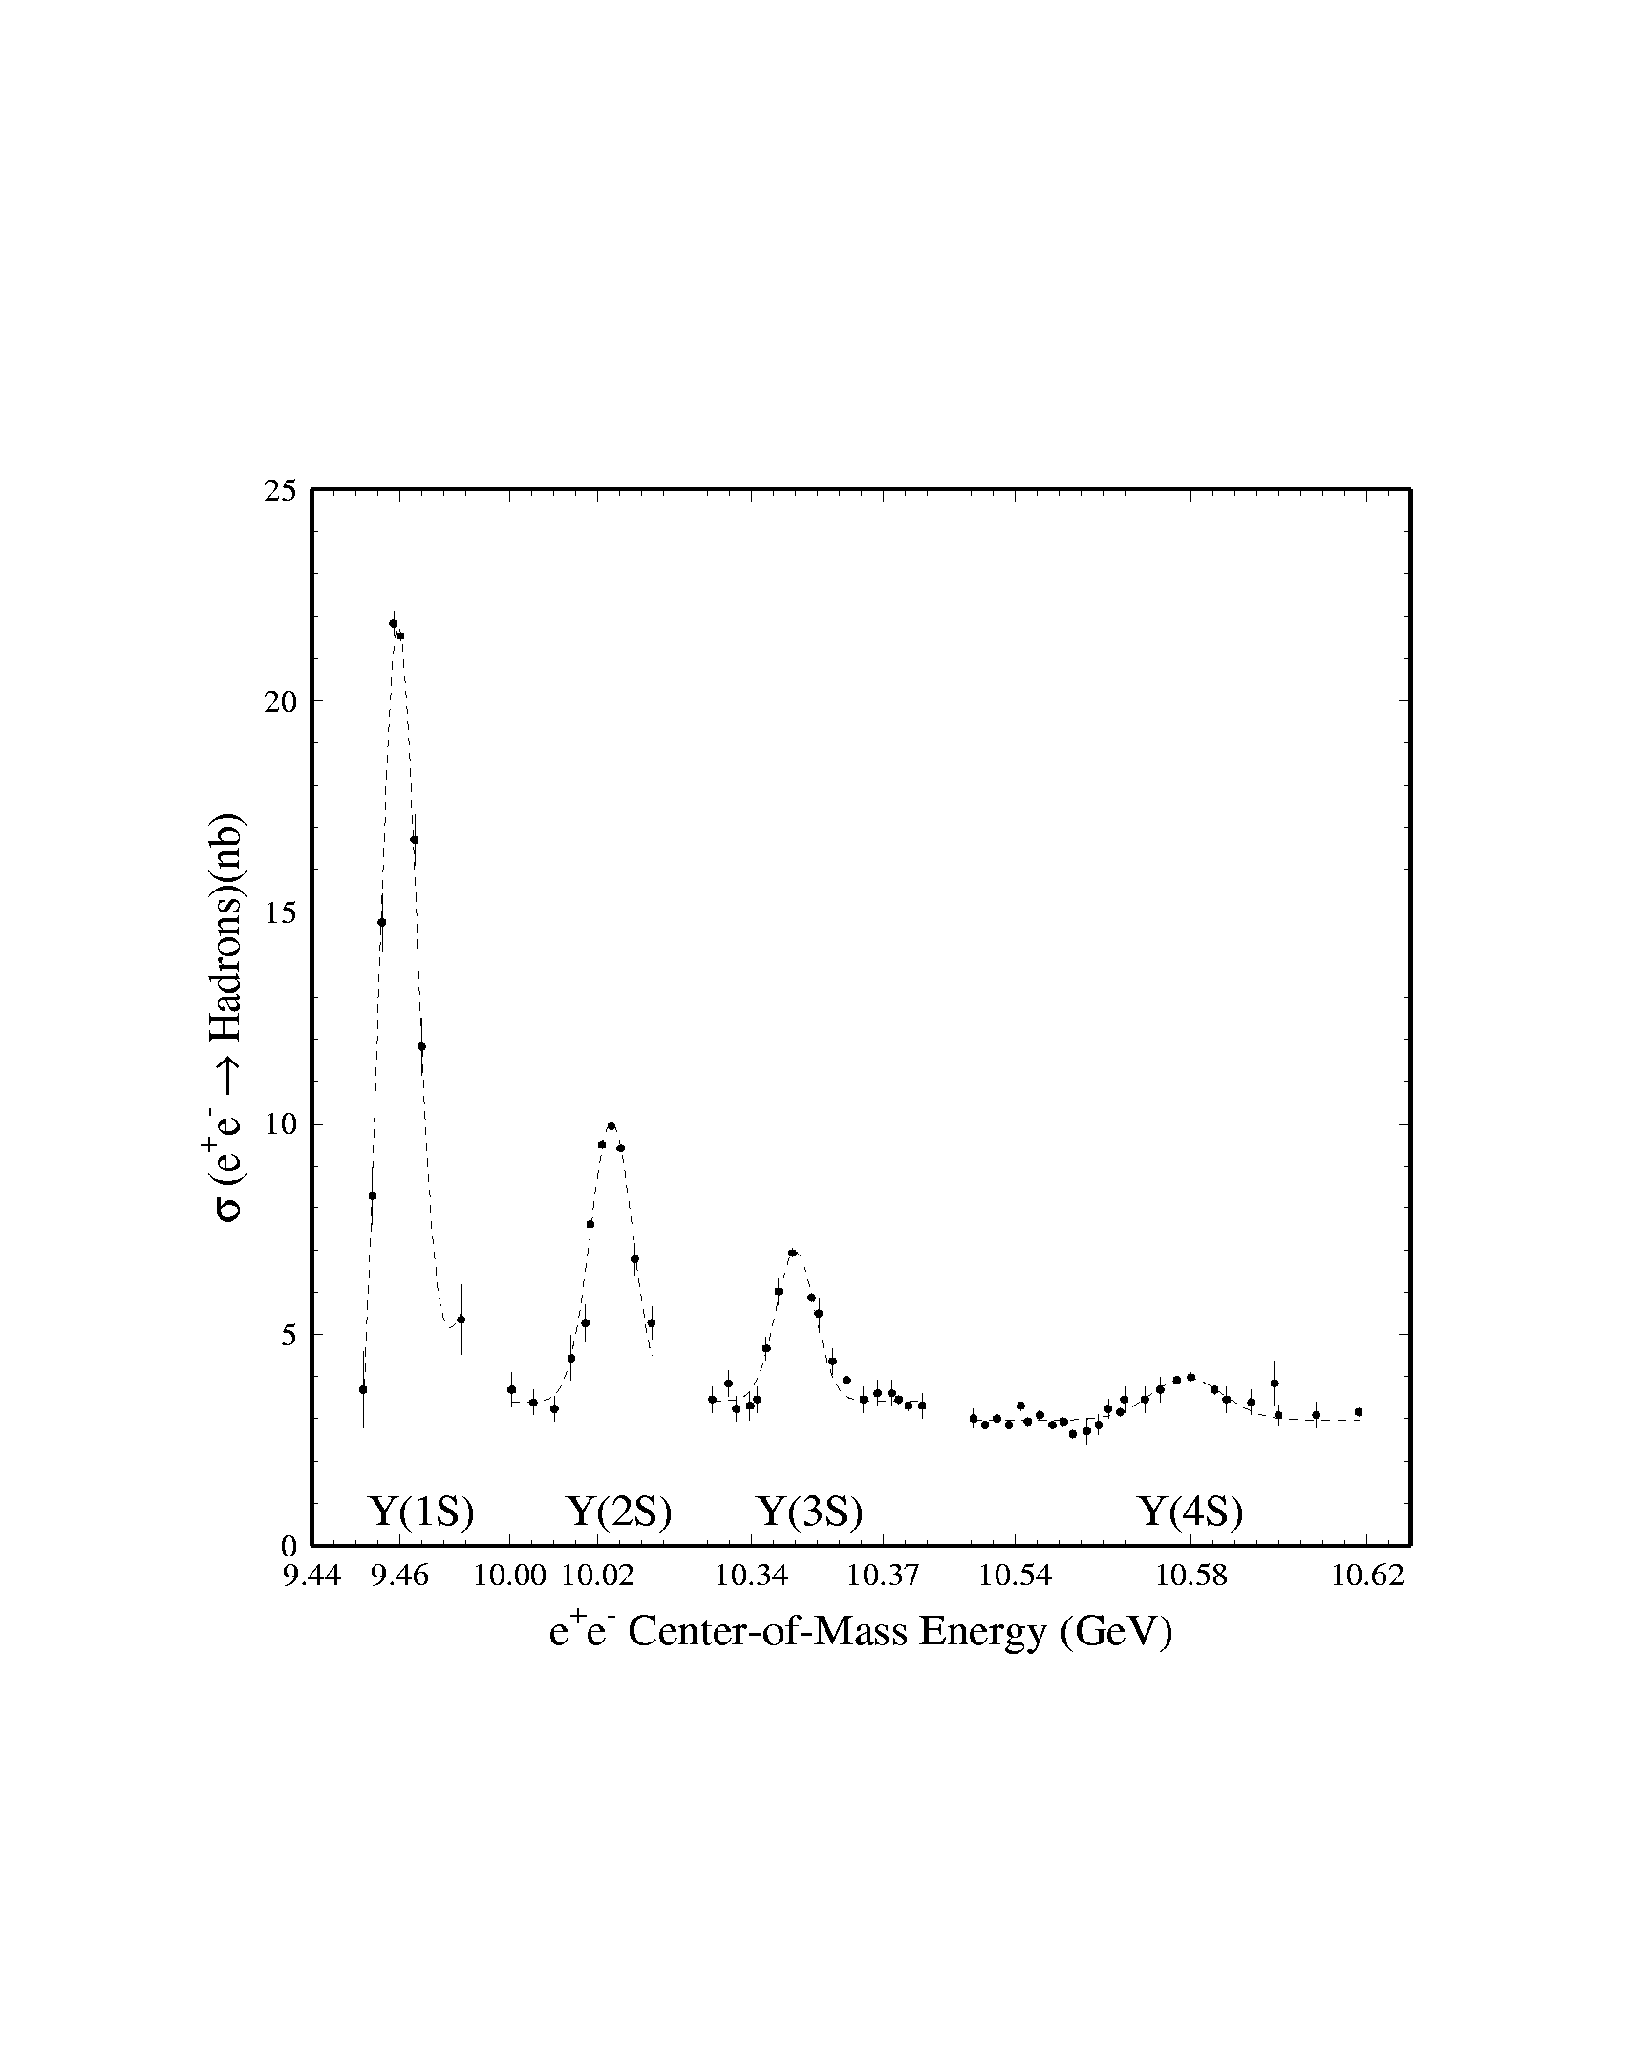
e⁺e⁻ multi-hadron cross-section
~ 76% is q q 2 jet-type (“ continuum events”)
The continuum is monitored
by taking data just below the
ϒ(4S) resonance (60 MeV)
off ϒ(4S) ≅ x on ϒ(4S)
BABAR & BELLE
operates here
Rare decay background
is usually dominated by
continuum
qq
3

Slide 4
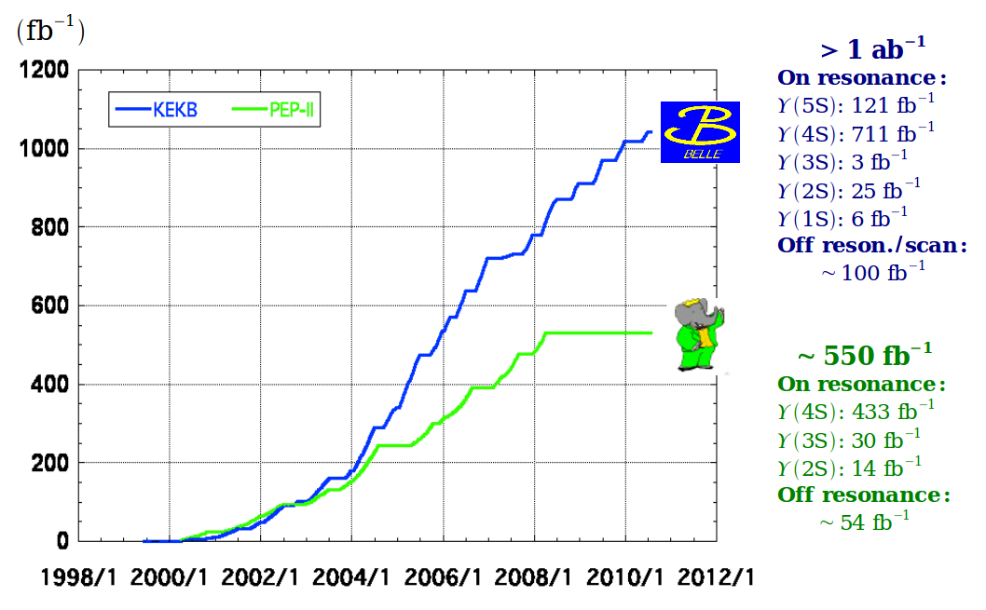
The amount of data collected

Slide 5
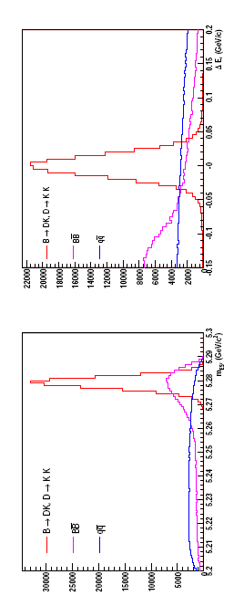
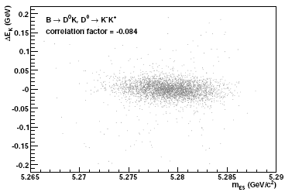
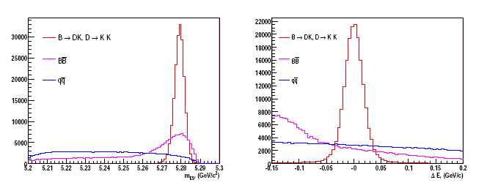
Variables to identify signals
B -> f₁, f₂,…..f_{n}
Energy and absolute value of momentum is known:
→
E_{B} = E_{beam} = 5.29 GeV
P_{B} =
= 0.34 GeV (for Belle)
Requires that the candidates satisfy
ΔE
→
→
E_{B} = |P_{B}| =| |
→
Instead of E_{B} and P_{B} , we often use
Energy difference
Peaks at:
0.0 GeV
5.279 GeV
→
M_{ES}
Beam constrained mass
But why collect B-mesons, to study what ?
-> To study CP violation
-> Indirect probe to New Physics through any significant
deviation from SM expectation ( How ?)
By the way how CP violation is predicted in SM ?

Slide 6
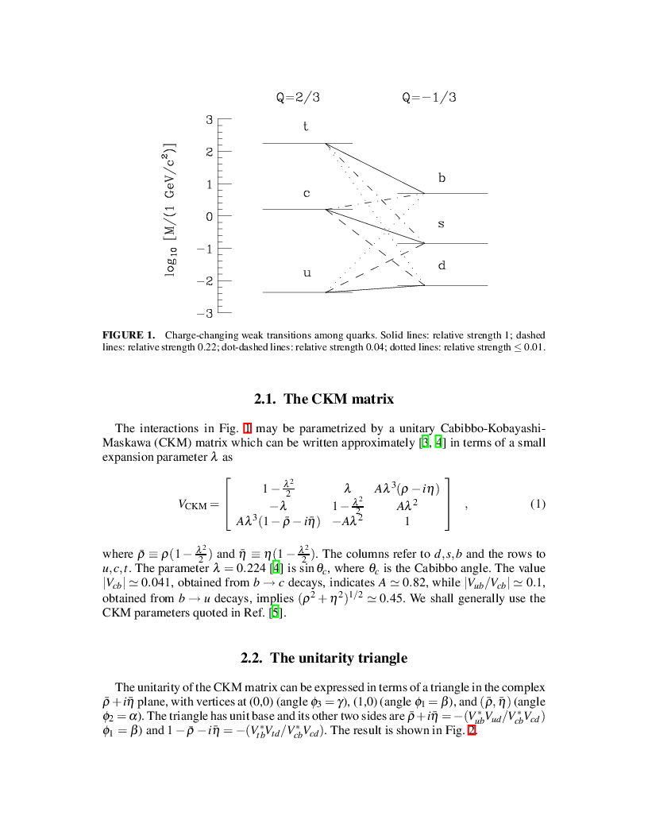
Standard Model quark-W interaction
The left-handed q-W interaction lagrangian
L_{int}(t) = ∫ d³x (L_{qW}(x) + L†_{qW}(x))
W⁻
d
V_{ud}
u
where the lagrangian density is
d
d
L_{qW}(x)= ∑ V_{ij} U_{i} γ_{μ} ( 1- γ₅) D_{j} W^{μ}
u
n
u
p
d
u
w⁻
D_{j} (x ) =
e⁻
U_{i} (x ) =
ν_{e}
n −> p + e⁻ + ν_{e}
Experimentally, V has a hierarchical structure.
V=
~
(CKM matrix)
(λ = 0.22)

Slide 7
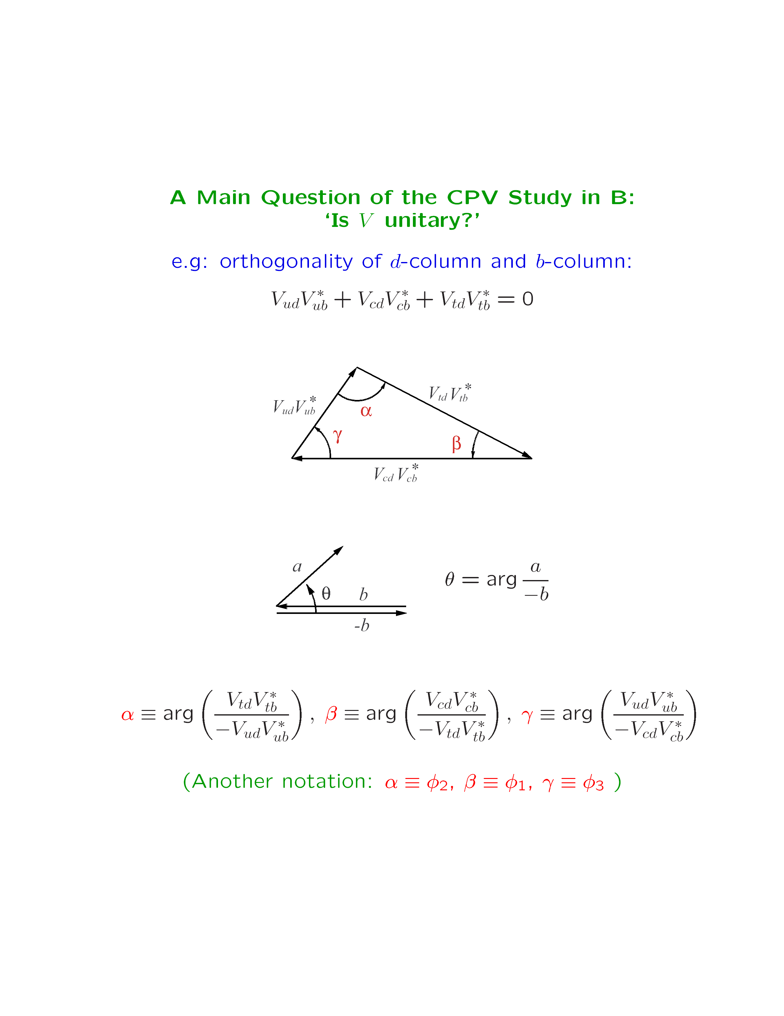
Unitarity of V_{CKM}
CP L_{qW}(x) (CP)⁺ = η_{ui}η_{Dj}* V_{ij} [U_{i}(x’)γ^{μ}(1-γ₅)D_{j}(x’)W_{μ}(x’)]⁺
If η_{Ui}η_{Dj}* can be chosen such that
then, CPL_{qW}(x) (CP)⁺ = L_{qW}(x)⁺
→ L_{int}(t) becomes invariant under CP
→ S matrix is invariant under CP
Orthogonality of d-column and b-column:
V_{ud}V_{ub}* + V_{cd}V_{cb}* + V_{td}V_{tb}* = 0
Following the standard notation:
(Another notation: α = φ₂ , β = φ₁ , γ= φ₃ )
If the CKM matrix is real, the triangle is a line

Slide 8
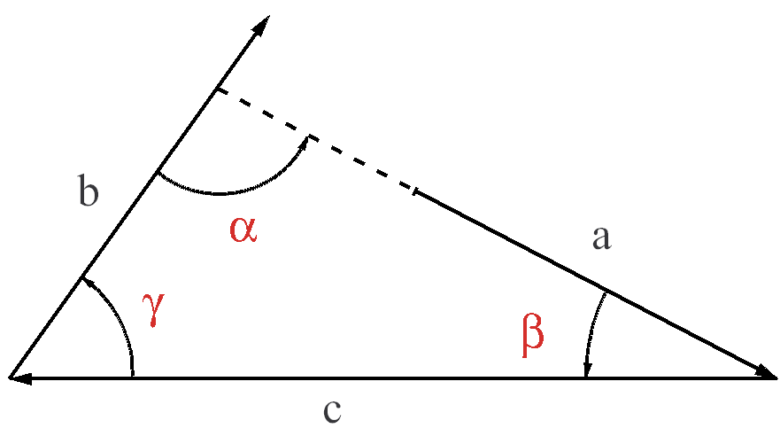
Unitarity of CKM matrix
For any complex number a,b,c, trivially
α + β + γ = π (mod 2π)
The condition α + β + γ = π hold even if the triangle doesn’t close
It does not test the Unitarity of V_{CKM}
It simply tests if the angle measured are as defined in
previous page In term of V_{CKM}
→ It is critical to measure the length of the sides

Slide 9
Large CP violation expected in B mesons
CKM matrix, V =
⇒
V_{ud}V_{us}* + V_{cd}V_{cs}* + V_{td}V_{ts}* = 0
In Complex plane:
ϑ (λ) + ϑ (λ) + ϑ (λ⁵)
Kaon-system
V_{us}V_{ub}* + V_{cs}V_{cb}* + V_{ts}V_{tb}* = 0
ϑ (λ⁴) + ϑ (λ²) + ϑ (λ²)
B_{S}-decays
V_{ud}V_{ub}* + V_{cd}V_{cb}* + V_{td}V_{tb}* = 0
Maximum CP
violation in
B-decays
ϑ (λ³) + ϑ (λ³) + ϑ (λ³)
B_{d}-decay

Slide 10
Different types of CP violation
1. CPV in decay (neutral and charged B)
Partial decay rate asymmetries,
Difficult to analyze
2. CPV by mixing-decay interference (neutral B)
When both B⁰ & B⁰ can decay to the same final state f:
B⁰
B⁰
B⁰
f
B⁰
f
the interference results in
Most Promising
3. CPV in mixing (neutral B)
Particle-antiparticle imbalance in physical neutral B-states (B_{a,b})
Expected to be small

Slide 11
CP violation in decays
Rate difference between two CP conjugate amplitudes -> Direct CP violation
This happens when two amplitudes contributing to the same process interfere with
one another with non-zero relative phases.
Lets the amplitude for the decay of interest:
A = A₁e^{iφ1}e^{iδ1} + A₂e^{iφ2}e^{iδ2}
A_{i} -> Real amplitudes φ₁, φ₂ -> weak phases and δ₁,δ₂ -> strong phases
The CP conjugate process would have amplitude:
A = A₁e^{−iφ1}e^{iδ1} + A₂e^{−iφ2}e^{iδ2}
The difference in decay rates is:
|A|² – |A|² = 2A₁A₂ sin(φ₁- φ₂)sin(δ₁-δ₂)
−> Requires both strong and weak phases are different for the two terms in amplitude

Slide 12
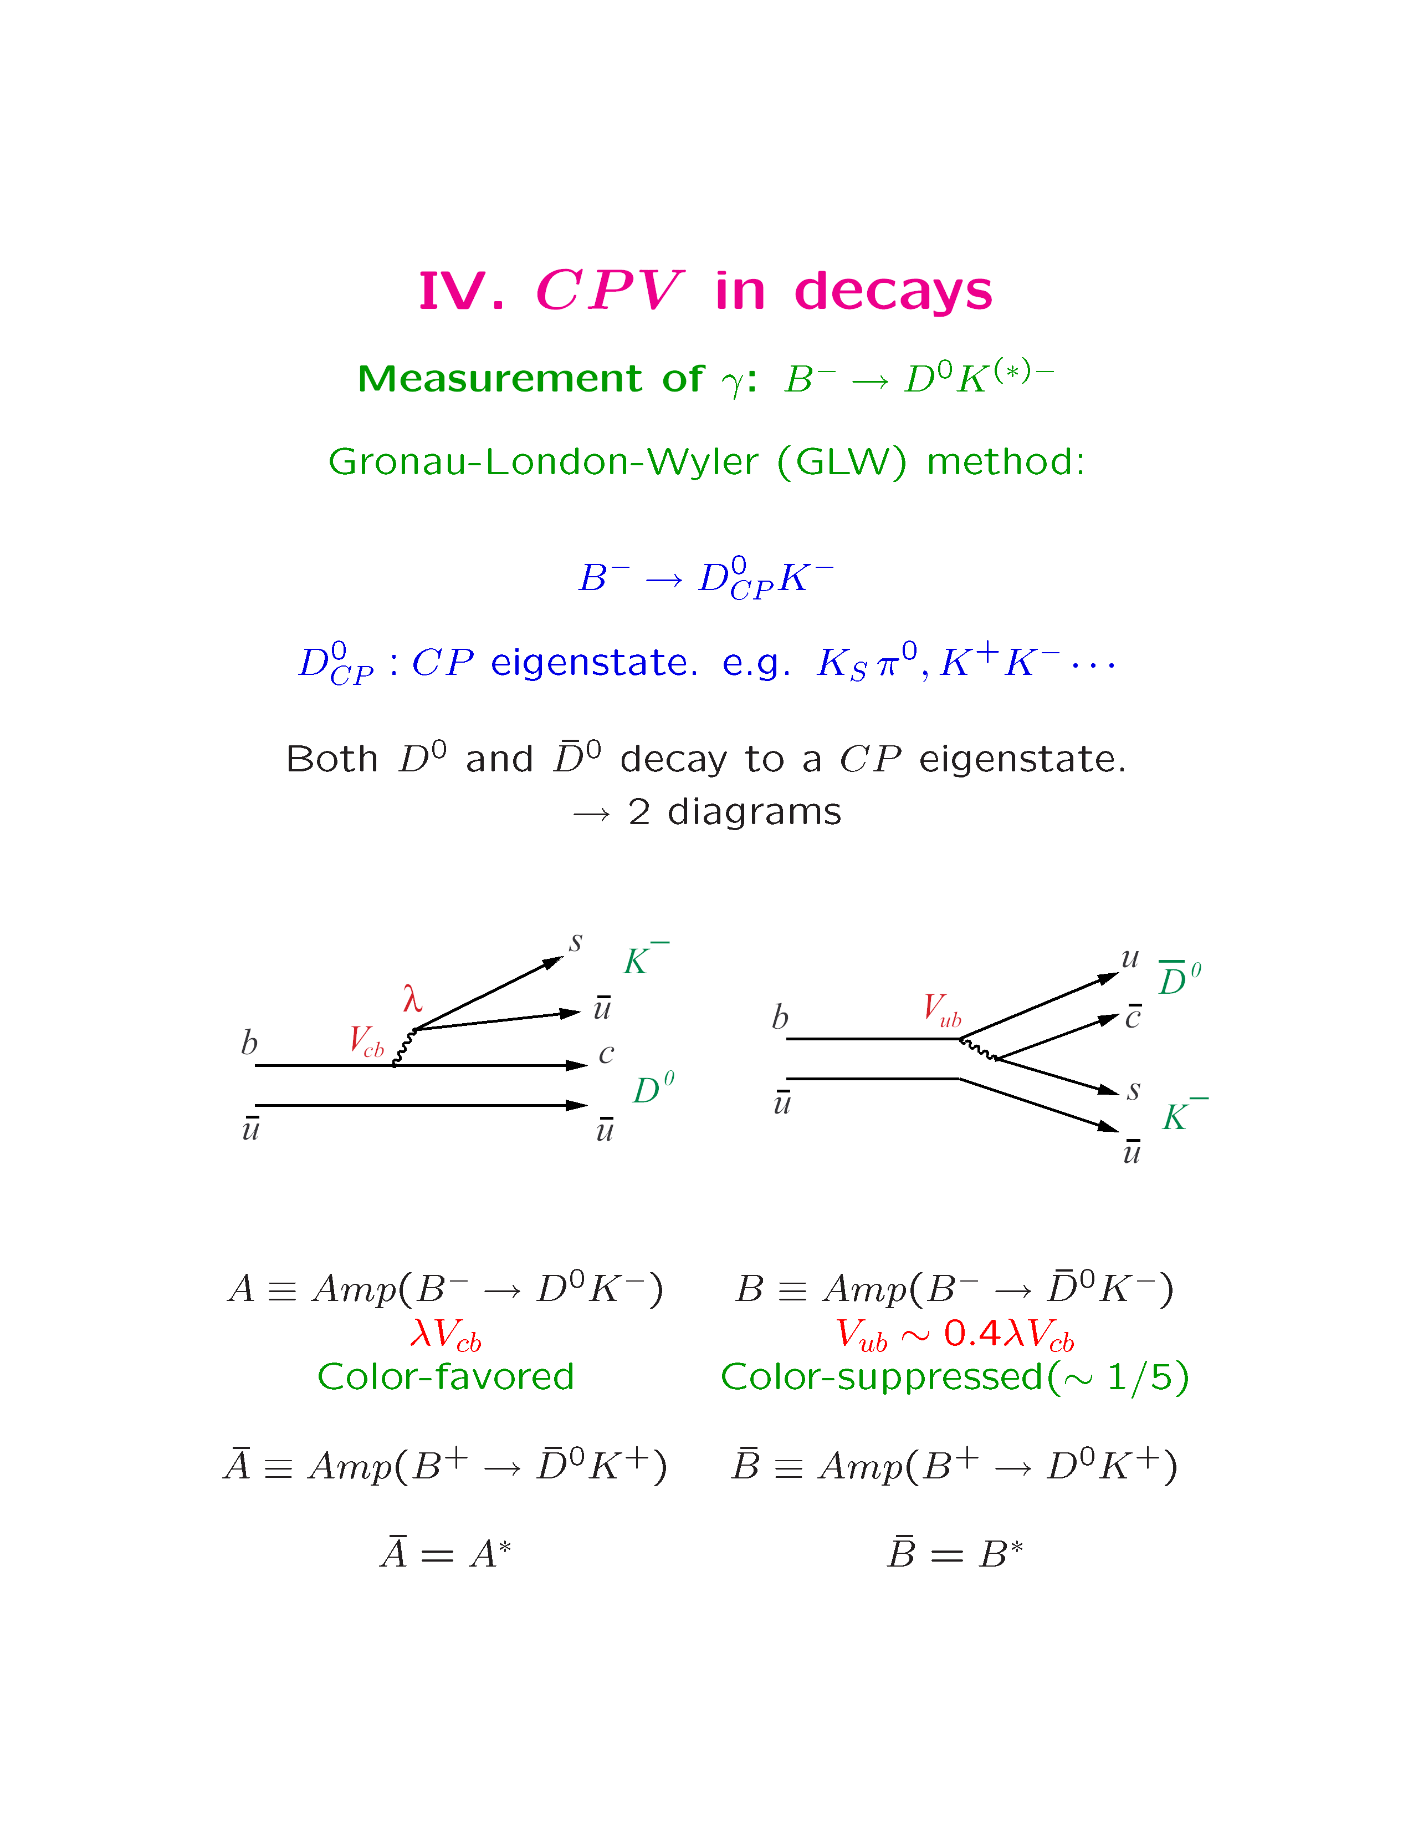
CP violation in decays
B⁻ → D_{CP}K⁻ where D_{cp} is CP eigenstate of D_{CP} ≅ (D⁰ ± D⁰ )
K⁺K⁻, π⁺π⁻ (CP + states)
K_{S}π⁰, K_{S}ω, K_{S}φ, K_{S}η, K_{S}η’ (CP – states)
Both D⁰ and D⁰ decay to a CP eigen-states → 2 diagrams
Color-favored B⁻ =D⁰K⁻
Color-suppressed B⁻ =D⁰K⁻
Assuming the strong final-state-interaction phase:
B⁻ → D⁰K⁻ relative to B⁻ → D⁰K⁻ is e^{iδ}

Slide 13
Measuring CKM angle gamma: γ
Amp(B⁻ → D_{CP}K⁻) = Amp(B⁻→ D⁰K⁻) + Amp(B⁻ → D⁰K⁻)
Rewriting same equation:
Amp(B⁻ → D_{CP}K⁻) = |Amp(B⁻ → D⁰K⁻)| + |Amp(B⁻ → D⁰K⁻)| e^{i(δ+γ)}
Amp(B⁺ → D_{CP}K⁺) = |Amp(B⁺ → D⁰K⁺)| + |Amp(B⁺ → D⁰K⁺)| e^{i(δ−γ)}
Without strong phase δ:
Due to non-zero strong phase (δ) → Direct CPV
Amp(B⁻→ D_{CP}K⁻)
Amp(B⁻→ D_{CP}K⁻)
Amp(B⁻→ D⁰K⁻)
Amp(B⁻→ D⁰K⁻)
γ
δ
Amp(B⁻ −> D⁰K⁻) = Amp(B⁺ −> D⁰K⁺)
Amp(B⁻ −> D⁰K⁻) = Amp(B⁺ −> D⁰K⁺)
Amp(B⁺→ D⁰K⁺)
Amp(B⁺→ D⁰K⁺)
δ
Amp(B⁺→ D_{CP}K⁺)
-γ
Amp(B⁺→ D_{CP}K⁺)
But even without strong phase one can still measure CKM angle γ
Reconstruct two triangles −> γ
Experimentally, its double ratio and the CP asymmetries are measured to constrain γ

Slide 14
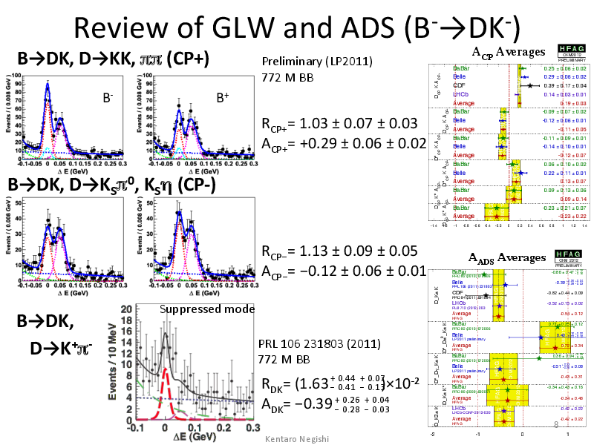
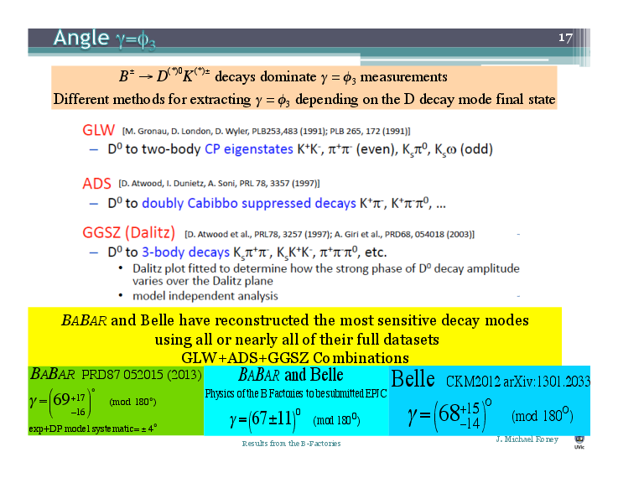
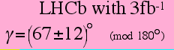
Results from BELLE & BABAR
Also One can look into D⁰ decaying to K⁺π⁻, K⁺π⁻π⁰,….
(Atwood, Dunietz, Soni PRL 78, 3357(1997))
D⁰ decaying to K_{S}π⁺π⁻, K_{S}K⁺K⁻, π⁺π⁻π⁰,… Dalitz analysis
(Atwood et al. PRL78, 3257(1997), A Giri et al. PRD68, 054018(2003))

Slide 15
CPV through decay-mixing interference
-> Occur when both B⁰ and B⁰ decay to the same final state
Eigen-states of mass & decay rate (assuming CPT):
(*)
B_{a} = pB⁰ + qB⁰ B_{a} (mass: m_{a}, decay rate: γa )
B_{b} = pB⁰ –qB⁰ B_{b} (mass: m_{b}, decay rate: γ_{b} )
In good approximation, γ_{a} = γ_{b} (≅ γ)
B⁰
B⁰
Time evolution:
B⁰
B⁰
f
f
B_{a} −> B_{a} e^{-imat}
B_{b} −> B_{b}e^{-imbt}
Solving (*) for B⁰ and B⁰, the time evolutions of pure B⁰ and B⁰ at t = 0 are
(δ m ≅ m_{a} – m_{b})

Slide 16
Decay-mixing interference (cont.)
Amplitude for pure B⁰ or B⁰ at t=0 to decay to f at t:
A = Amp (B⁰ → f ), A = Amp(B⁰ → f )
The probability that a pure B⁰ (B⁰) at t = 0 decays to a final state f at t:
(for f: CP eigen-state):
The time-dependent asymmetry is

Slide 17
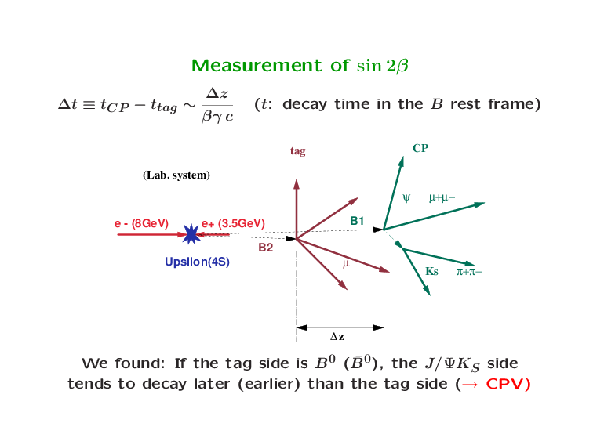
How to prepare (‘tag’) pure B⁰/B⁰ on ϒ4S
Since B⁰ decays to e⁻ + X but not e⁺ + X (X : something),
look the other side:
B⁰ −> f
B⁰ −> e⁻ X
ϒ4S →
If the other side decays to e⁻, then f came from B⁰ ?
If one finds one side to be B⁰ at t, then the
other side is pure B⁰ at the same time t, then it will evolve as before
−> Γ_{B}0_{(B}0_{) −> f} applies to ϒ4S with
t −> Δ t ≅ t(f) – t(tag)

Slide 18
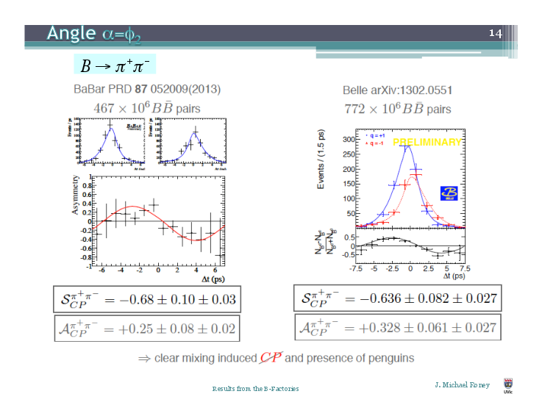
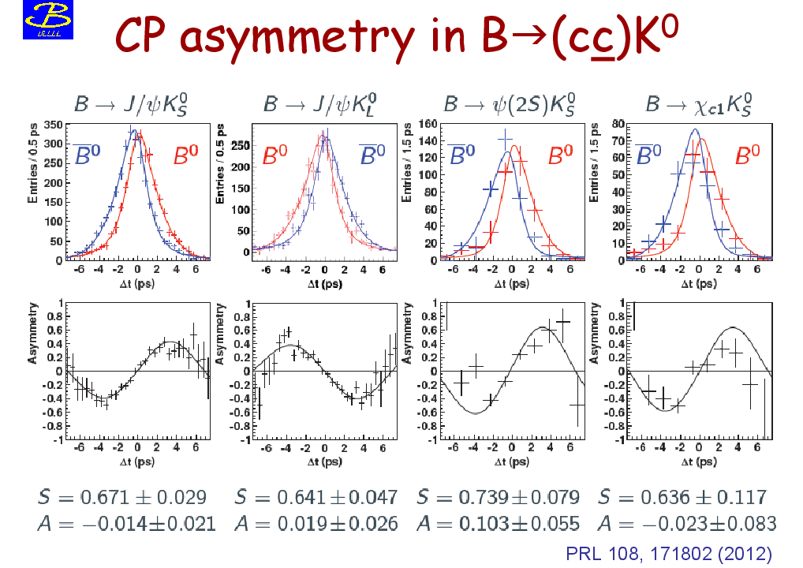
Measuring CKM angle α & β
B->π⁺π⁻
particle ↔ antiparticle (C)
A
B
mirror inversion (P)
If A & B occur at same rate (both true) then CP is conserved, else CP is violated
For CP ( ξ_{f} ) = -1 (e.g. ψK_{S} ), we observed:
A: If tag side is B⁰ (q = -1), the CP side tends to decay earlier than tag side
Particle −> antiparticle
Mirror inversion (on effect)
CP
B: If tag side is B⁰, the CP side tends to decay earlier than tag side
(inconsistent with observation)
→ CP violation

Slide 19
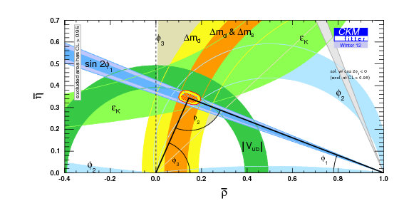
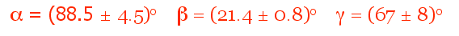
Current status of CKM triangle

Slide 20
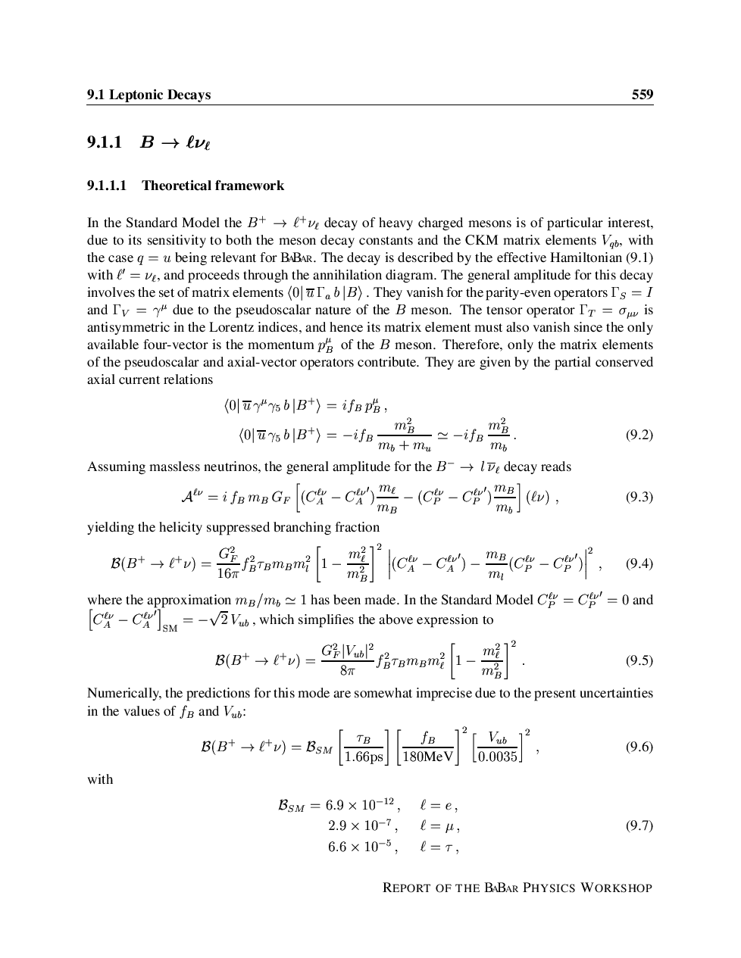
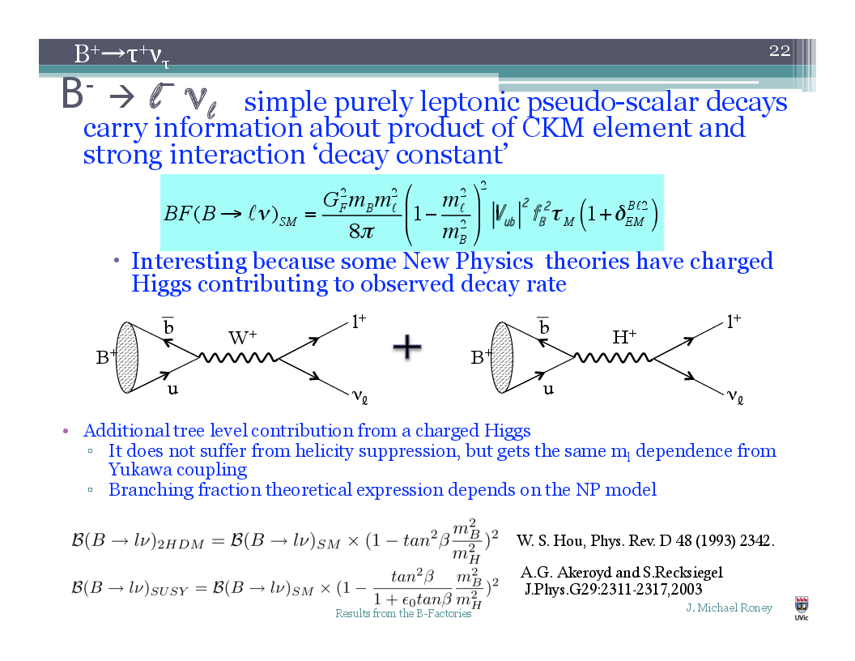
Leptonic rare decays from B-meson
Pure leptonic decays like B−>lν gives information about decay
constant as well as V_{CKM} (information on product)

Slide 21
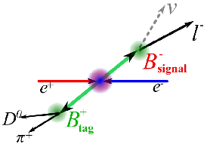
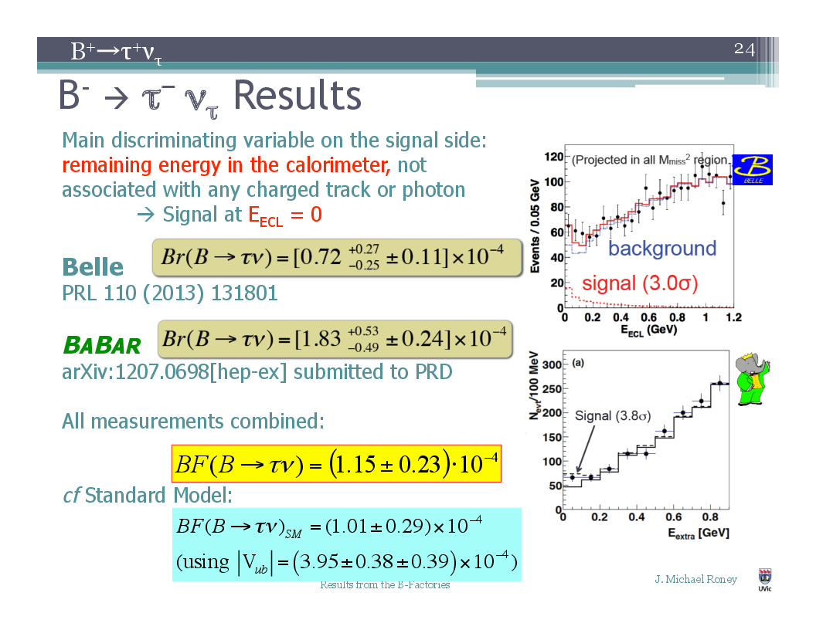
Results on B->τν
Look for the charged lepton on the
rest of that event (which should have
negative charge compared to tag B)
Then usage of the fact that for e⁺e⁻ the
total energy and momentum before
and after is know.
Fully reconstruct the tag side B through
many channels e.g. B->Dπ, DK, etc etc

Slide 22
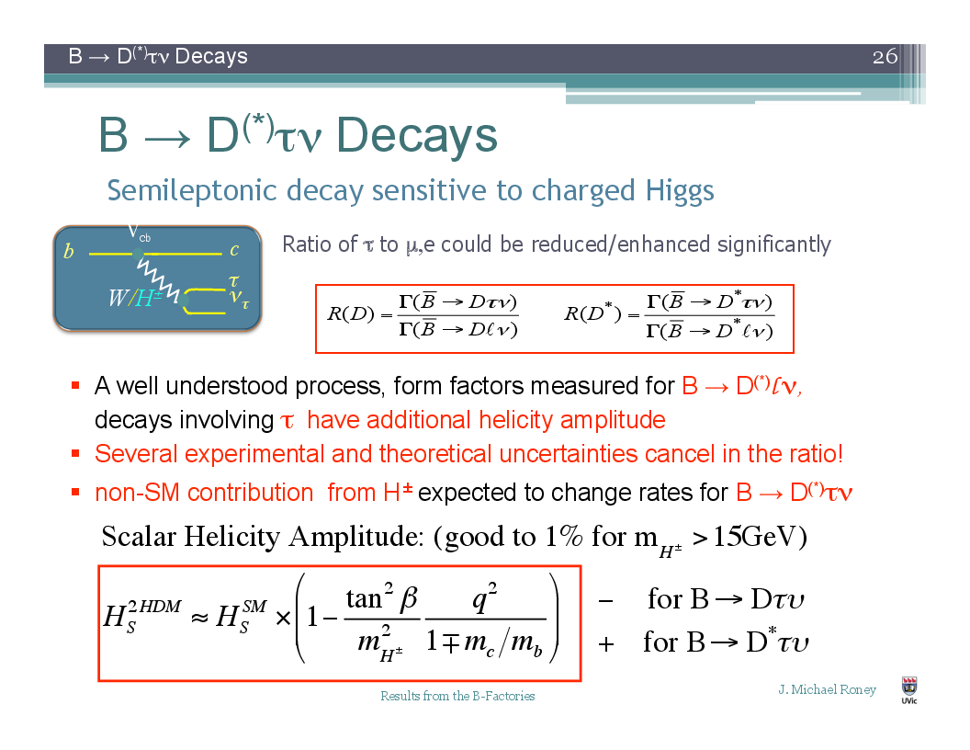
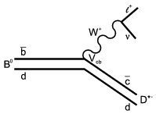
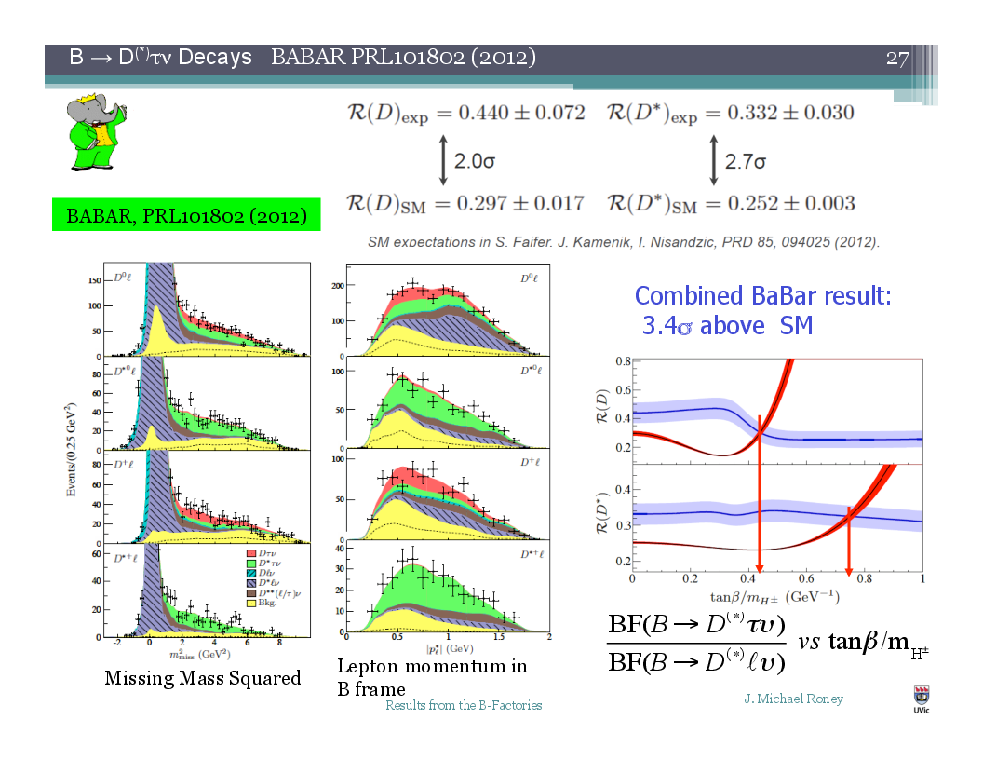
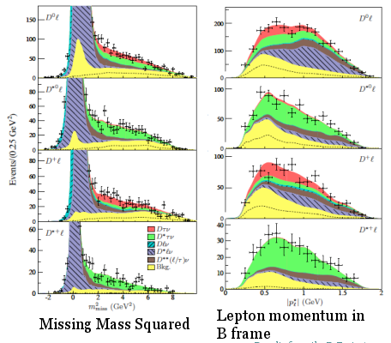
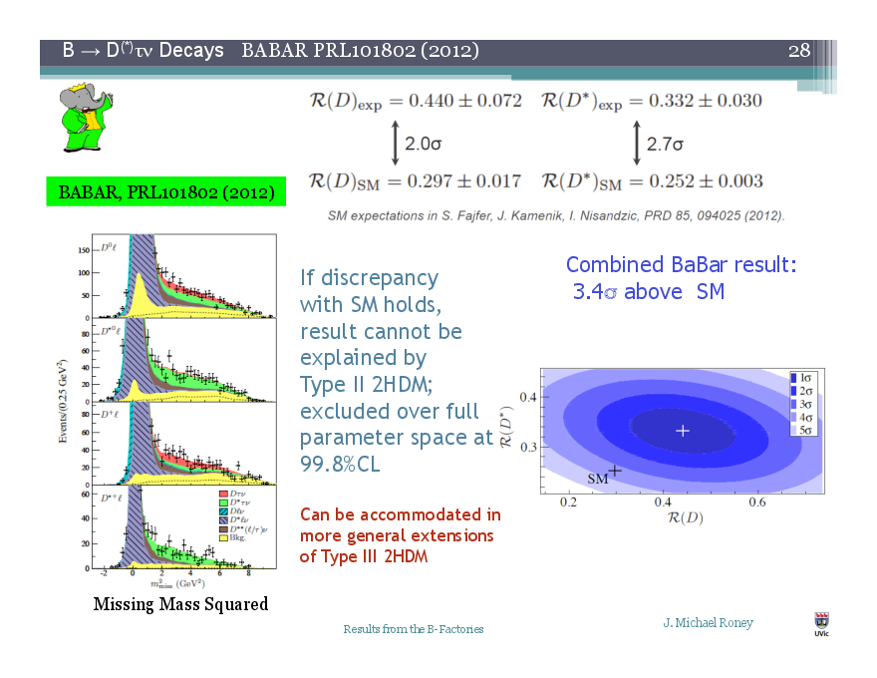
Decay of B->D^{(*)}τν
This semi-leptonic decay is sensitive to Charged Higgs
Can have any
BSM particle
like H⁺

Slide 23
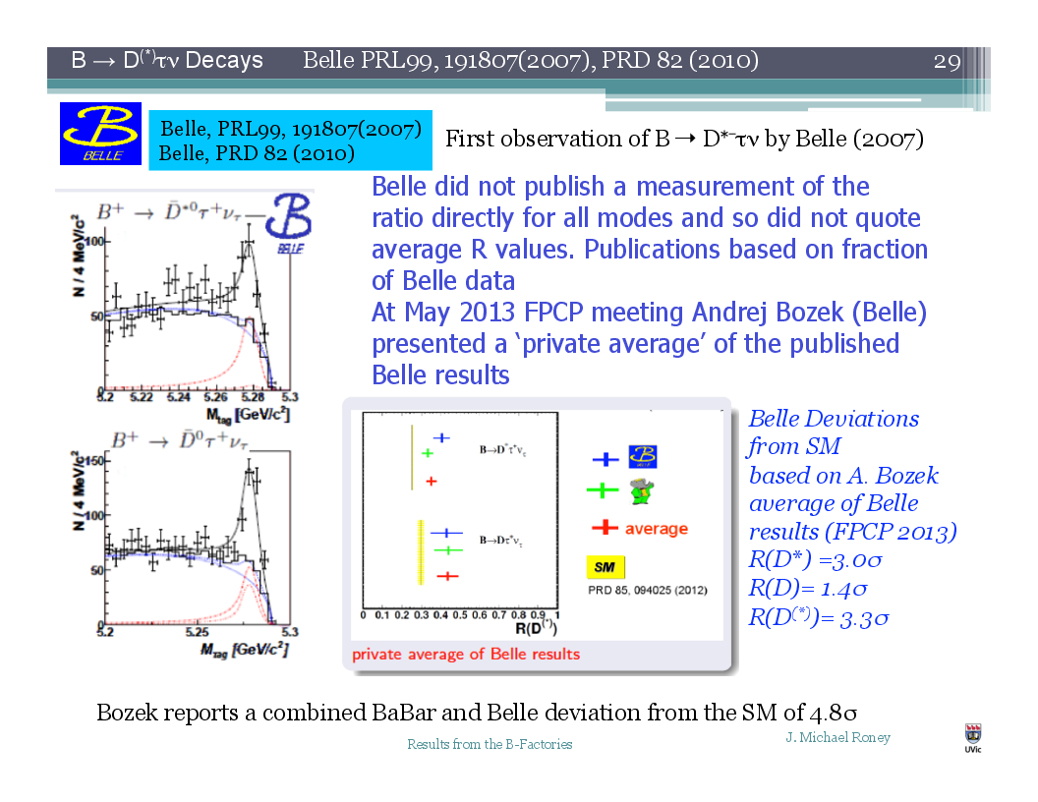
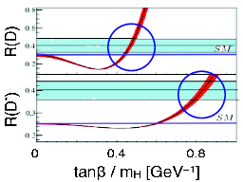
Decay of B->D^{(*)}τν
The current average includes small
fraction of Belle Data. However
including Belle’s result from FPCP,
2013, the combined deviation is
about 4.8 sigma away from
SM prediction

Slide 24
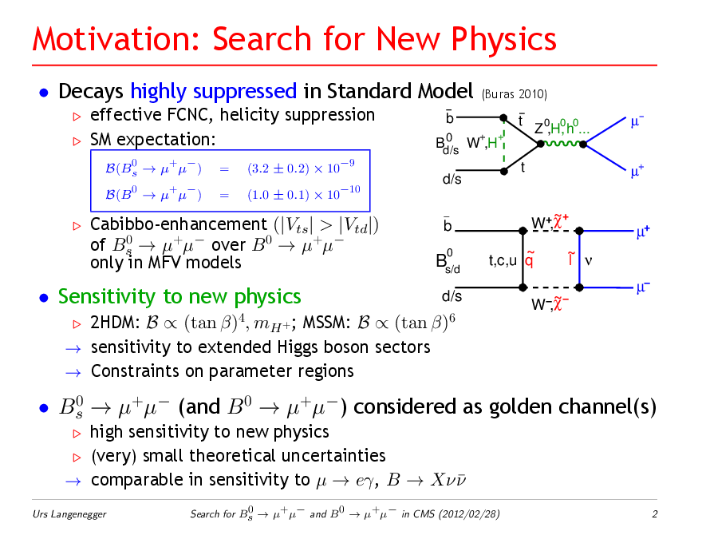
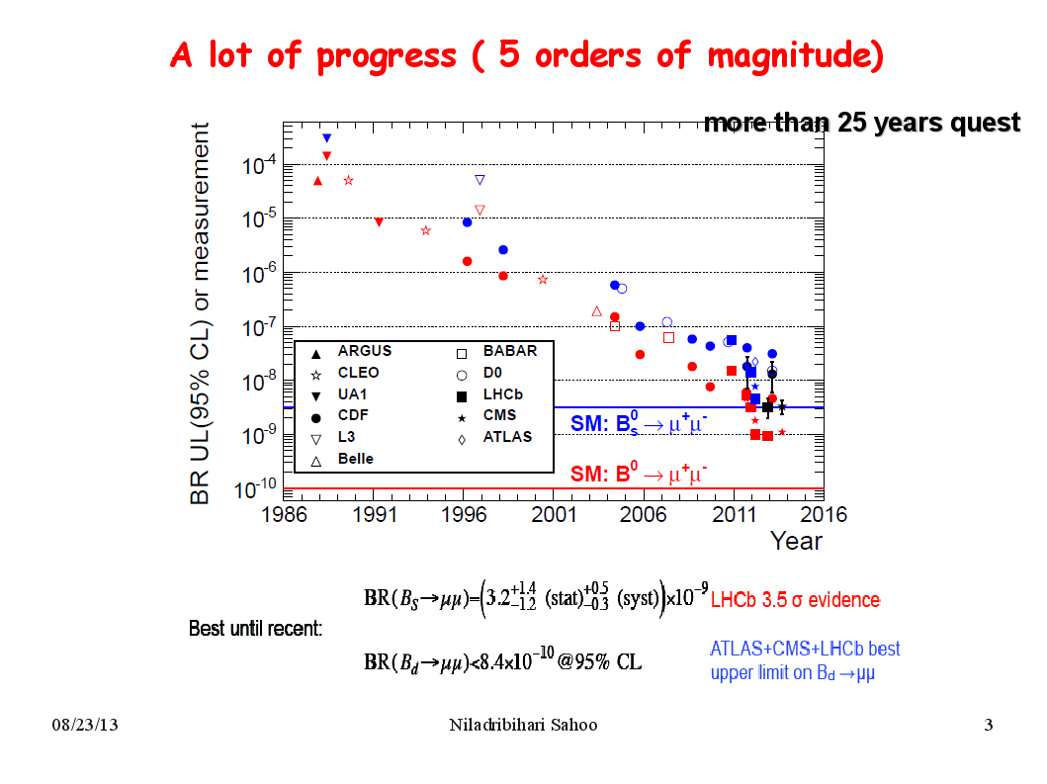
Search for NP through B_{s}->μ⁺μ⁻
Considered as golden channels
Decays highly suppressed in Standard Model
Sensitive to New Physics
Cabibbo enhancement (|V_{ts}| > |V_{td}| ) of
B_{s}->μ⁺μ⁻ over B_{d}->μ⁺μ⁻
2DHM: BF α (tanβ)⁴ , M_{H+} MSSM: BF α (tanβ)⁶
Constraints on parameter space

Slide 25
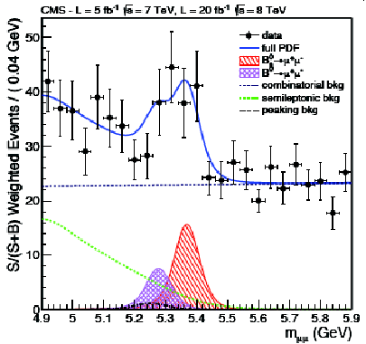
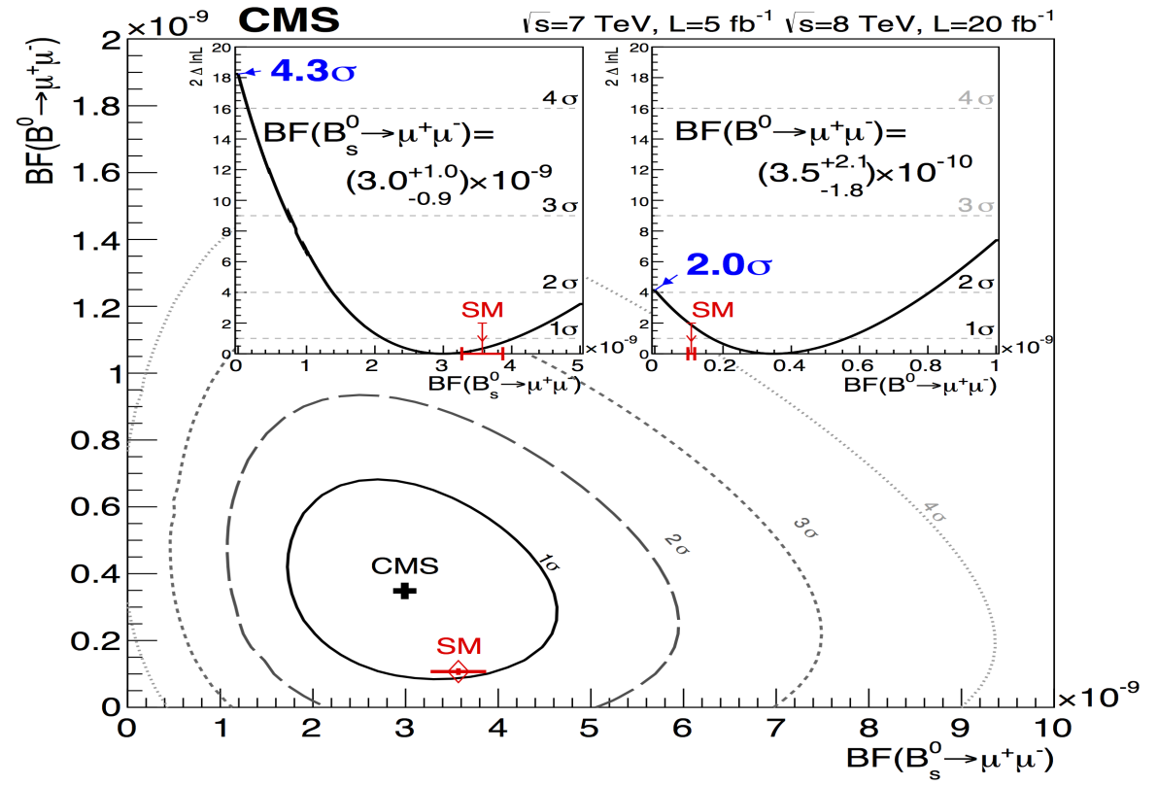
Search for NP through B_{s}->μ⁺μ⁻
4.3σ and 2σ signal significance for B_{s}->μ⁺μ⁻ and B_{d}->μ⁺μ⁻
The measured BFs are within Standard Model prediction
It will interesting to wait little more data and see the effect

Slide 26
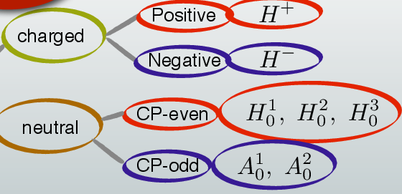
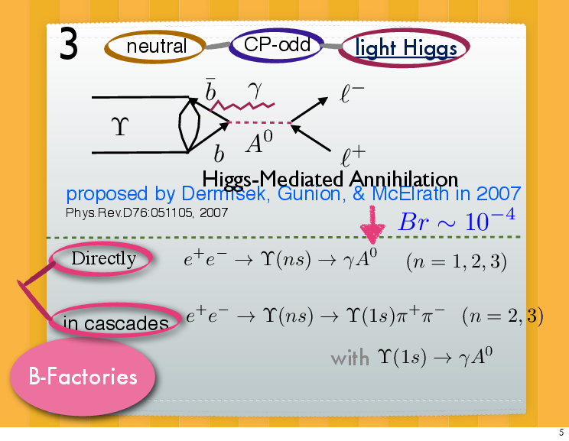
Search for Light Higgs
Next-to-Minimal Super Symmetric Standard Model (nMSSM)
(proposed by Dermisek, Gunion, Mcelrath: PRD76, 051105, 2007)
Predicted BF ~ 10⁻⁴
(depends on tanβ and
other parameters as well)
Lightest Higgs

Slide 27
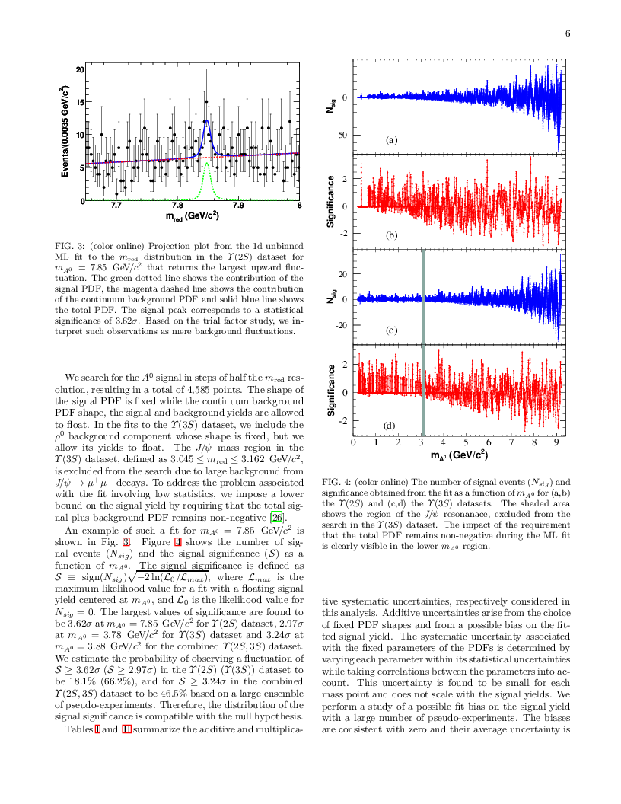
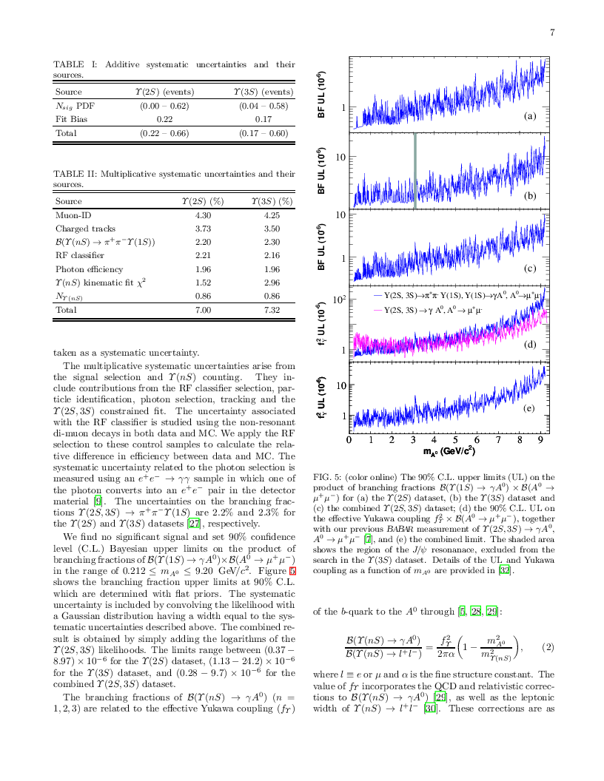
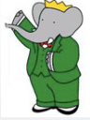
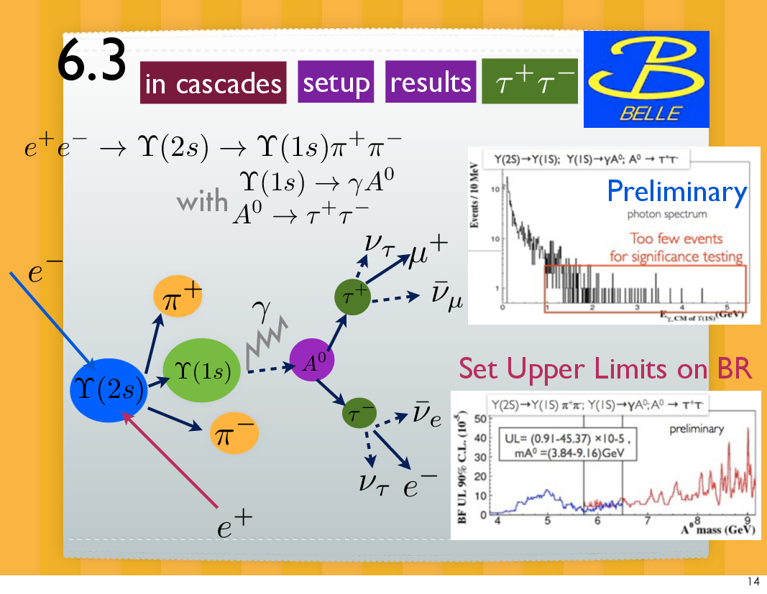
Search for Light Higgs (cont.)
No Significant excess
-> improve the limit

Slide 28
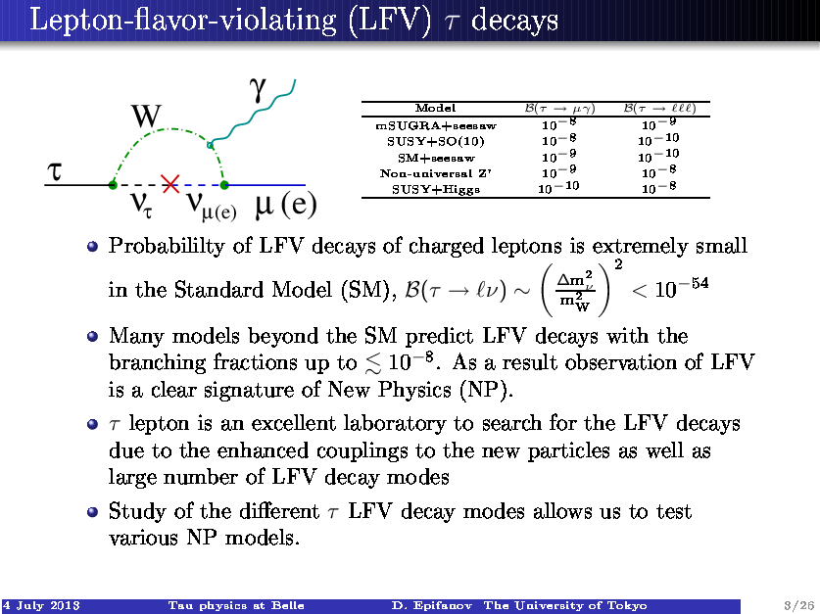
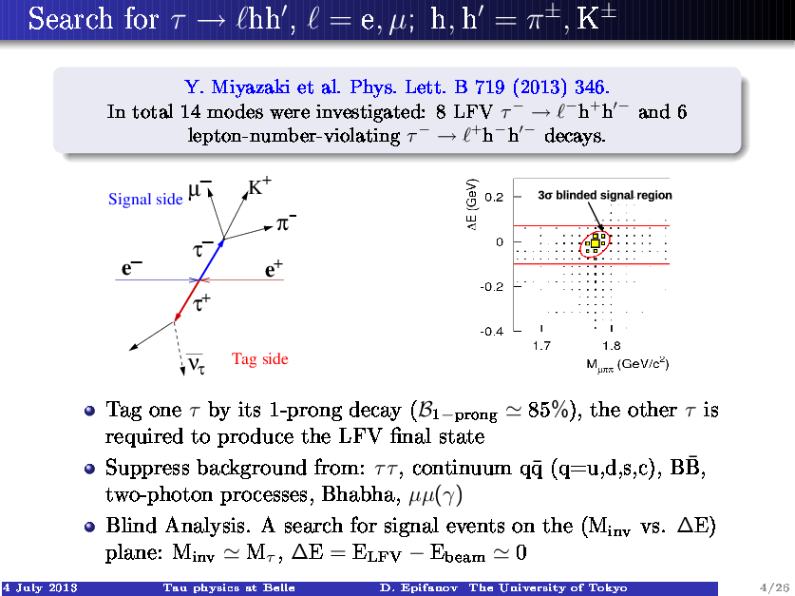
Search for Lepton flavor violation (LFV)
Probability of LFV decays of charged leptons is extremely small in the Standard
Model (SM),
Many Models beyond SM predict LFV decays with branching fractions up to
≤ 10⁻⁸ . So, observation of these LFV modes are clear indication of New Physics(NP)
Study of different LFV decays allows us to study different NP models, either
constraint or exclude them.

Slide 29
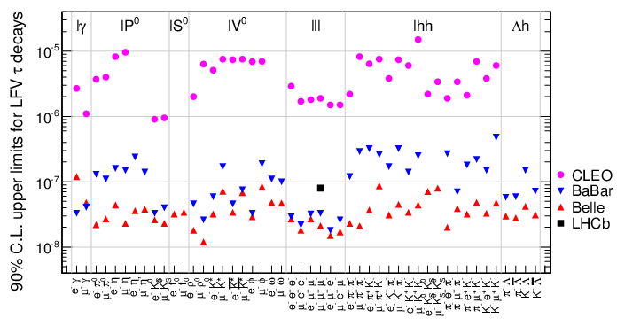
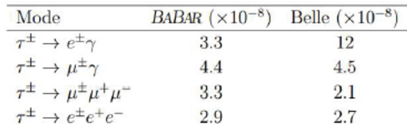
LFV process from B-factories
48 decay modes searched over last decade or so.
recently LHCb has joined the program to explore this phenomena

Slide 30

What’s next ? Need to high Luminosity….
Super B-factory

Slide 31
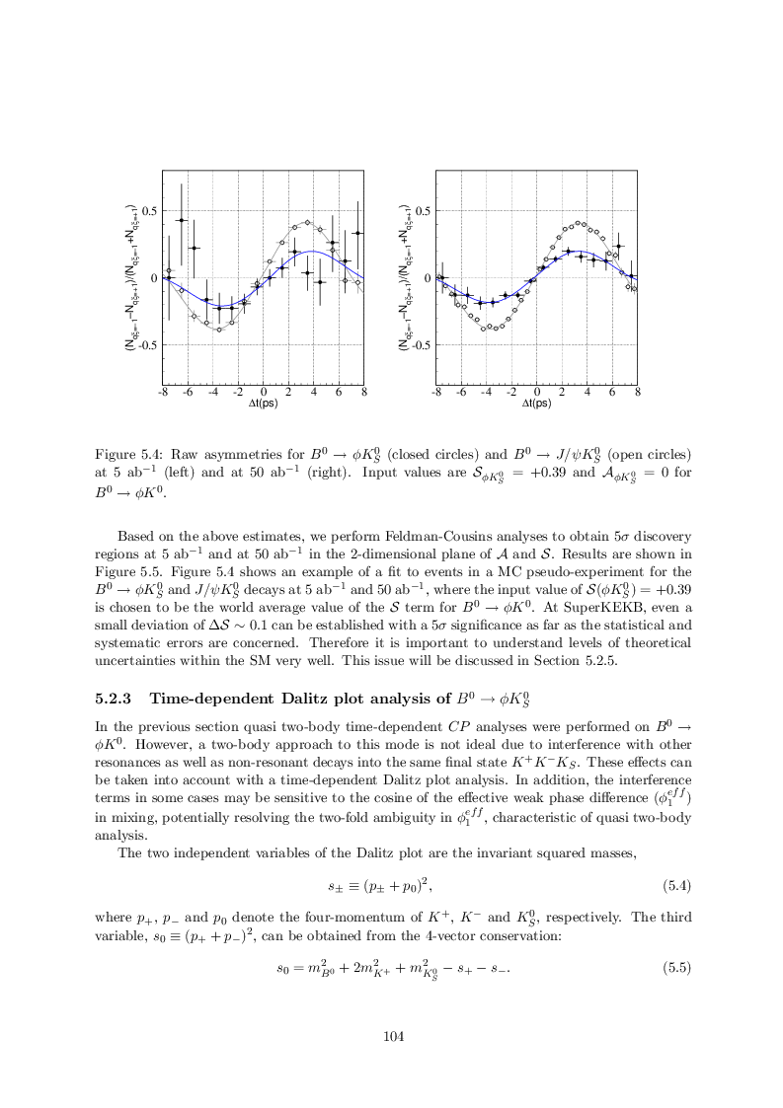
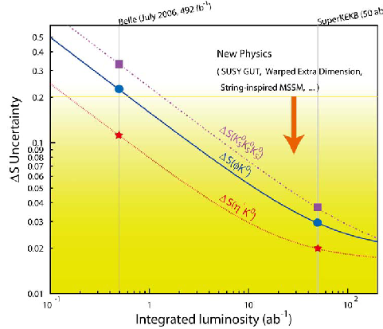
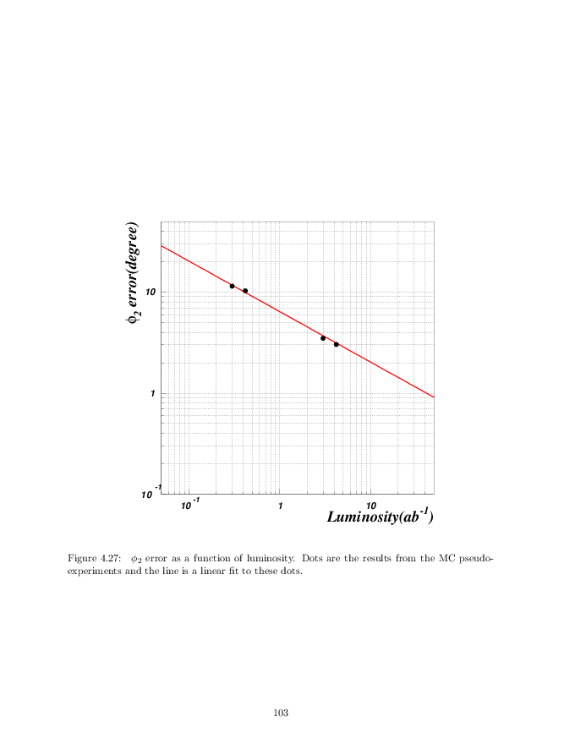
CKM triangle with large statistics (50 ab⁻¹)

Slide 32
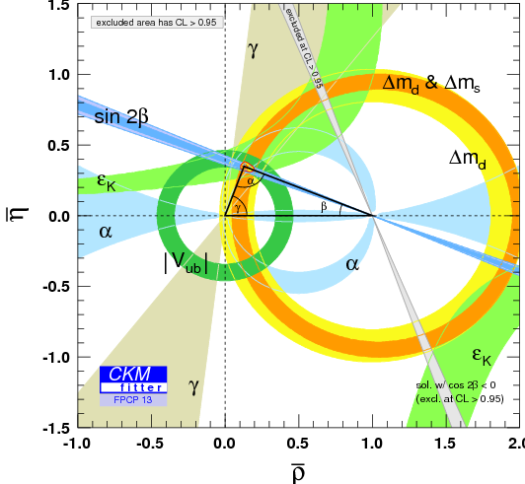


CKM triangle with large statistics (50 ab⁻¹)
It will be very easy to nail down any
deviation from SM prediction and find NP

Slide 33



B->K*ll FCNC decay
A_{FB} is sensitive to NP through Wilson
coefficients

Slide 34
Summary
B-factory results since last 15 years have been very successful in our
understanding in CP violation as well as search for New Physics beyond SM
The CKM triangle falls within SM prediction
Some of the rare decays needs more precision measurement
We have not found any hint of New Physics so far
However there are places where the experiments can look very closely to search
for any deviation from SM
The role of Super B-factory will be very crucial
Next decade or so will be very important to have more information from LHCb
as well as Belle-II
Thank you

Slide 35
Measuring through double ratios
How do you measure B=Amp(B⁻ −> D⁰K⁻) ?
B⁻ −> D⁰K⁻ but also B⁻ −> D⁰K⁻
K⁻π⁺
K⁻π⁺ (DCSD)
Ratio of two amplitudes R =
Solution:
where
3 independent measurements
→ 3 unknowns ( r , δ, γ)
(solve !)
A₁R₁ = -A₂R₂

Slide 36






BABAR detector at SLAC
DIRC: 144 quartz
bars &
11k PMT
EMC: 6580 CsI(TI)
crystals
3.1 GeV
40 layer DCH
9 GeV
IFR: RPC/LST
SVT: 5 layer
double-sided
si-strips

Slide 37

Belle detector at KEK, Japan
Aerogel Cherenkov cnt.
n=1.015~1.030
SC solenoid
1.5T
3.5GeV e⁺
CsI (Tl) 16X₀
TOF counters
8GeV e⁻
Tracking + dE/dx
small cell + He/C₂H₆
Si vtx. det.
4 lyr. DSSD
μ / K_{L} detection
14/15 lyr. RPC+Fe

Slide 38


Decay-mixing interference
What is for this mode ?
q/p is obtained by diagonalizing
<B⁰|H| B⁰>
<B⁰|H| B⁰>
Heff =
<B⁰|H| B⁰>
<B⁰|H| B⁰>
<B⁰|H| B⁰> :
<B⁰|H| B⁰>
V_{td}V_{tb}*
−> q/p = =
−
<B⁰|H| B⁰>
V_{td}*V_{tb}
With similar procedure to the B case,

Slide 39

Decay-mixing interference
Combing all,
With the definition of the angle β :
= -sin(2β)
Γ_{e}§_{,ψ KS} (Δ t) = N ( 1¨ sin2β sinδmΔt )
B⁰ = e⁻ tag, B⁰ = e⁺ tag
Total area is the same for B⁰/B⁰
−> need to measure Δt
Asymmetry B-factory
(moving B’s −> decay vertexes −> Δt)
[ At CLEO, B⁰B⁰ are nearly at rest]

Slide 40





Time Dependent CPV in B⁰ decays
e.g. for B→J/ψ Ks
S = −ξ_{CP}sin2φ₁ = +sin2φ₁
A ~ 0
(ξ_{CP} : CP eigenvalue ±1)
Mixing-induced CPV
Direct CPV
N.B. Time integrated mixing-induced asymmetries vanish

Slide 41
CP violation by mixing
Eigenstates of mass & decay rate (assuming CPT):
t=0
t
B_{a} = pB⁰ + qB⁰
B_{b} = pB⁰ –qB⁰
B_{a} (mass: m_{a}, decay rate: γa )
B_{b} (mass: m_{b}, decay rate: γ_{b}
Particle-antiparticle asymmetry in B_{a,b}:
gV_{cb}*
gV_{cb}

