Slide 1


Alice CTP upgrade
Marián Krivda on behalf of the ALICE trigger group
The University of Birmingham
Triggering Discoveries in High Energy Physics
9-14 September 2013 , Jammu, India

Slide 2
Plan of talk
Short overview of current CTP
Upgrade requirements for Run 2 (2015-2017)
  LM level
  Extension of classes
  Extension of clusters
  Second link to DAQ
  New L0 board
Ideas for upgrade for Run3 (2019-2021)

Slide 3
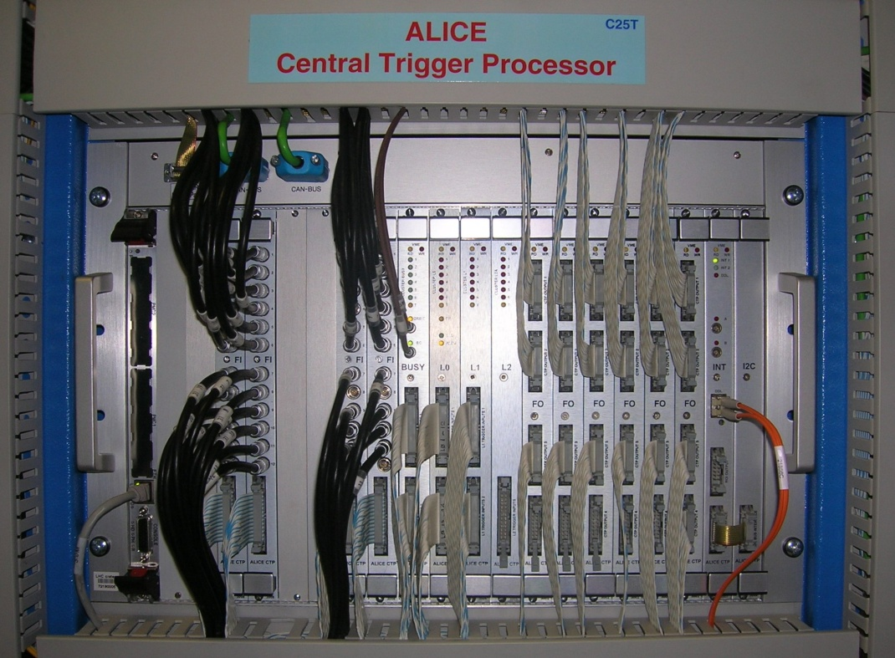
Current Alice trigger system
Central Trigger Processor (CTP):
receives trigger detector inputs, makes decision
Local Trigger Unit (LTU):
interface between CTP and readout detectors
Trigger and Time Control (TTC):
transmits LHC clock and delivers trigger signals to detectors
Due to short time for L0 latency the CTP is in the experimental cavern
6U VME boards
  L0, L1, L2 boards
  BUSY board
  FO boards
  INT board
  I2C board
LVDS Trigger inputs
Outputs are sent to Local Trigger Units (LTUs) where conversion to TTC format occurs

Slide 4
Current CTP
3 HW trigger levels:
    L0 inputs to CTP up to 800 ns, time for making decision 100 ns, time for delivery to detectors up to 300 ns, together is max. 1.2 μs from interaction;
    L1 inputs to CTP up to 6.1 μs; time for making decision 100 ns, together is max. 6.5 μs from interaction;
    L2 delivered to detectors 105 μs from interaction.
60 trigger inputs
    L0 24; L1 24; L2 12.
Up to 24 detectors
6 independent partitions (clusters)
50 classes
4 past/future protection circuits
Interaction record - a list of all the bunch-crossings in which the Interaction signal has been detected; also for past-future protection check and pattern recognition
Rare event handling

Slide 5
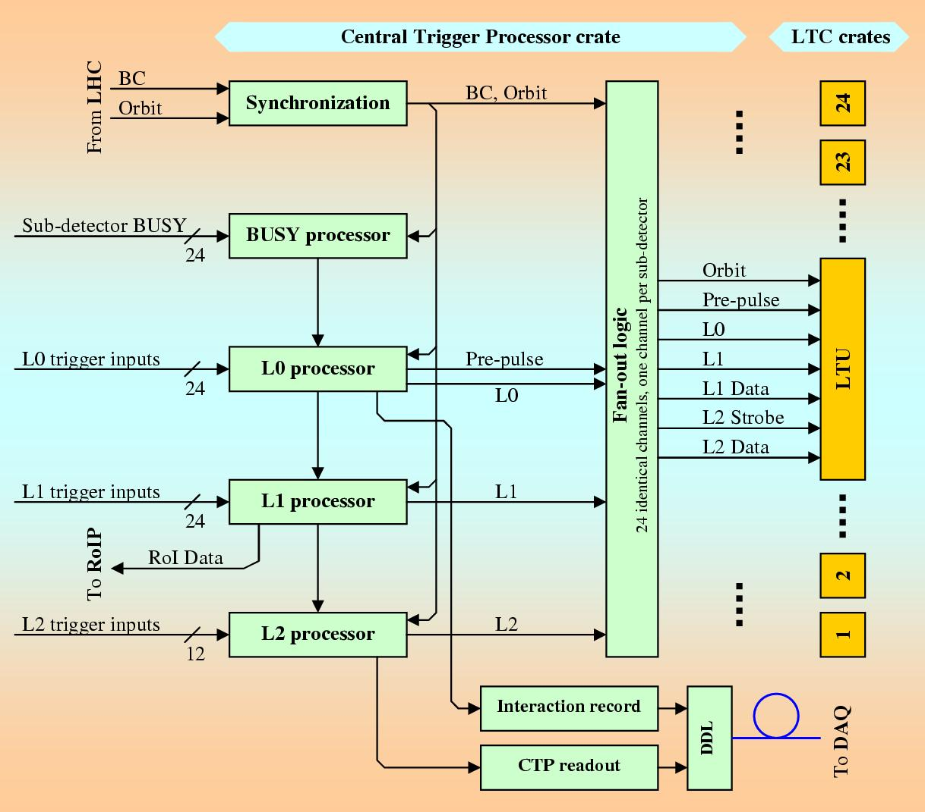
CTP data flow

Slide 6
Requirements for Run 2
New CTP level -> LM (instead of TRD pretrigger)
100 classes (instead 50)
8 physics clusters (instead 6)

Slide 7
LM trigger for TRD

Slide 8
New trigger level -> LM
Currently TRD pre-trigger is generated even if CTP is busy i.e. TRD pre-trigger electronics doesn`t see CTP busy signal
In order to reduce the level of “wasted” pre-triggers currently generated by TRD pre-trigger, the pre-trigger electronics will be replaced by a new level (LM) of trigger logic, run at the CTP, which will be used to generate a wake-up signal to the TRD
    Needs new faster inputs from T0, and VZERO
    Needs relocation of T0 and VZERO electronics closer to CTP -> in progress
    Needs re-cabling of T0, VZERO and TRD trigger cables -> in progress
    Needs new L0 board

Slide 9
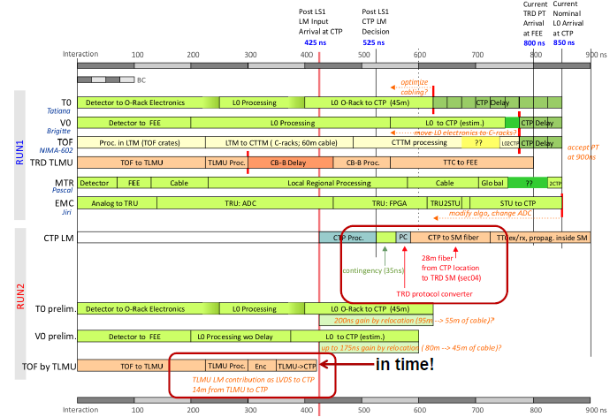
Preliminary timing for TO, V0 and TOF trigger inputs

Slide 10
LM trigger for TRD
Two trigger sequences for TRD
  GTU receives standard TTC sequence ( L0 – L1 – L2 ) from LTU -> TTCex
  FEE receives custom trigger sequence ( LM – L0 – L1 ) from CTP -> Protocol Converter -> TTCex
Global\Standalone mode
  In global mode CTP generates LM trigger which is sent to Protocol Converter (PC) board
  In standalone mode PC board generates LM trigger which is sent to PULSER input on LTU board

Slide 11
LM trigger for TRD
LM
generated
by PrC
(standalone
mode)
TTCex board
L0,L1,L1m,L2m
(optical signal)
New L0 board
LTU board
Protocol Conv. board
GTU
BUSY
BUSY
LM
generated
by CTP
(global mode)
TTCex board
L-1 trigger
Inputs
T0
V0
(LVDS signals)
TTC-A
LM, L0, L1
(optical sig.)
TRD FEE
TTC-B
CTP
TRD

Slide 12
LM trigger for TRD – FPGA logic
Delayed copy of LM trigger input will be provided at L0 time

Slide 13
Extension of Classes

Slide 14
100 classes
Extension of the number of classes, each defined in the same way as at present
    Simple to implement at CTP (just scaling)
    Need to check space on L1, L2, FO boards (their FPGAs)
    Simple to implement in offline
    no restrictions on attributes e.g. bc masks
Consequences:
    Change of L2A message (50 bits longer)
    Change of Common Data Header (CDH)

Slide 15
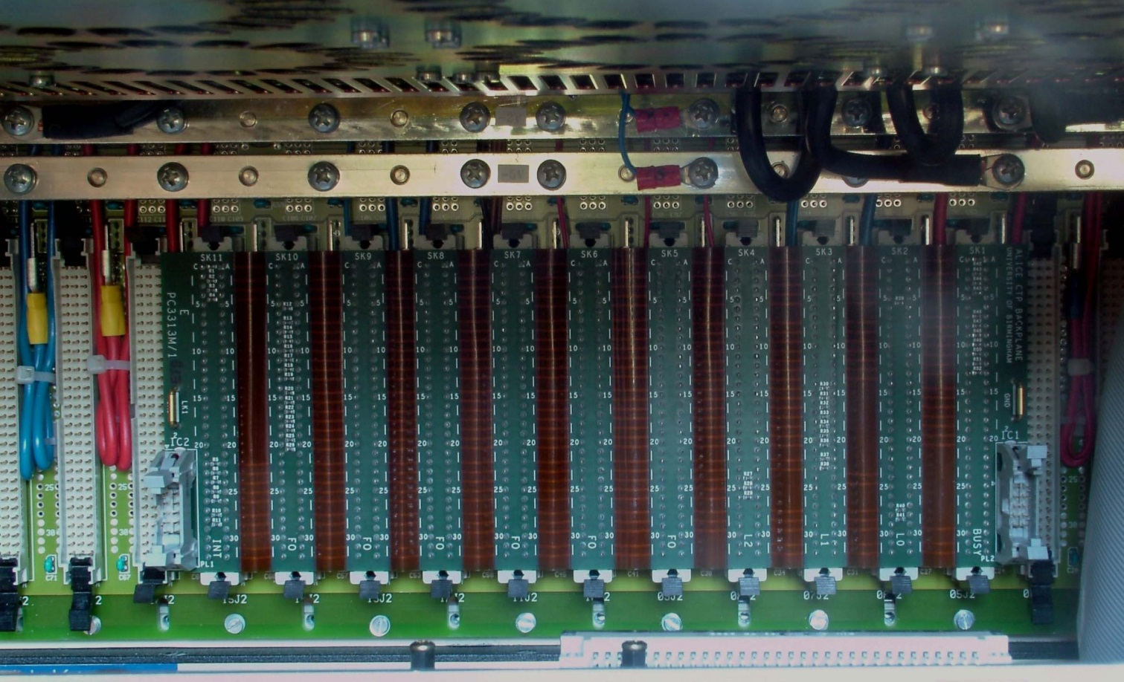
All connections between CTP boards are on CTP backplane
Flex PCB with VME connectors
User Defined (UD) pins on VME are used for connections

Slide 16
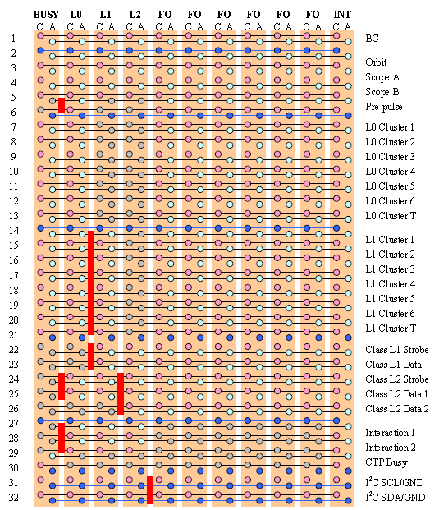
100 classes
2 links:
  L0 Class data
  L0 Class strobe
L0 Class data used on current CTP to transmit 50 class bits
L0 Class strobe used on current CTP to transmit “L0 inputs” (sent from INT board to DAQ after each L2a trigger)
New L0 board => “L0 inputs” sent to DAQ directly (after each L0 trigger)
L0 Class strobe can be used to transmit another 50 class bits

Slide 17
Extension of Clusters

Slide 18
Clusters
6 physics + 1 software cluster available now
Limited by number of links on backplane connections between L0/L1/2 and FO boards
Increasing number of clusters to 8 requires multiplexing on backplane
Consequences:
  Increased latency of CTP for L0 trigger by at least one BC
  Change in L2a trigger message

Slide 19

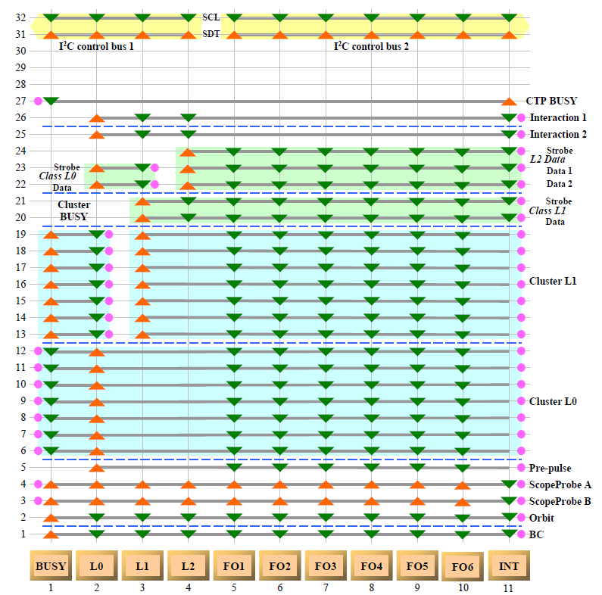
CTP backplane limitations for clusters

Slide 20
Cluster data on CTP backplane
  Cluster strobe can start at even or odd slice of transmission
  2 consecutive BCs x 7 links = 14 bits available
  STROBE + 9 data bits + 4 Hamming bits
  8 clusters + 1 test cluster (sw triggers) + 4 Hamming bits
CLST_1 | CLST_7
CLST_2 | CLST_8
CLST_3 | CLST_9 (T)
CLST_4 | Hamming_1
CLST_5 | Hamming_2
CLST_6 | Hamming_3
STROBE | Hamming_4

Slide 21
Cluster BUSY on CTP backplane
2 consecutive BCs x 7 links = 14 bits available
STROBE + 9 data bits + 4 Hamming bits
Consequences -> 1 BC delay for BUSY
CLST_1_B | CLST_7_B
CLST_2_B | CLST_8_B
CLST_3_B | CLST_9_B (T)
CLST_4_B | Hamming_1
CLST_5_B | Hamming_2
CLST_6_B | Hamming_3
STROBE | Hamming_4

Slide 22
Current solution for Cluster BUSY
  If no cluster BUSY => no cluster BUSY strobe active
  Cluster BUSY strobe can start at even or odd slice of transmission
  Always make OR from 2 consecutive BUSY signals in order not to miss BUSY during transmission (50 ns)
  8 clusters BUSYs + 1 test cluster BUSY (sw triggers) + Hamming bits

Slide 23
New format for L1 and L2 trigger data
L1 Data serial format
Serial bit | Data | Sequence List |  | L1 Message
 |  | Word | Bit | Word | Bit
1 | Spare | 0 | 15 | 1 | 11
2 | ClT | 0 | 14 | 1 | 10
3..6 | RoC[4..1] | 0 | 13..10 | 1 | 9..6
7 | ESR | 0 | 9 | 1 | 5
8 | L1SwC | 0 | 8 | 1 | 4
9..10 | L1Class[50..1] | 0 | 7..6 | 1 | 3..2
11..12 |  | 1 | 15..14 | 1 | 1..0
13..24 |  | 1 | 13..2 | 2 | 11..0
25..26 |  | 1 | 1..0 | 3 | 11..10
27..36 |  | 2 | 15..6 | 3 | 9..0
37..42 |  | 2 | 5..0 | 4 | 11..6
43..48 |  | 3 | 15..10 | 4 | 5..0
49..58 |  | 3 | 9..0 | 5 | 11..2
59..70 | L1Class[100..51] | 8 | 11..0 | 6 | 11..0
71..74 |  | 8 | 15..12 | 7 | 3..0
75..82 |  | 9 | 7..0 | 7 | 11..4
83..90 |  | 9 | 15..8 | 8 | 7..0
91..94 |  | 10 | 3..0 | 8 | 11..8
95..106 |  | 10 | 15..4 | 9 | 11..0
107..108 |  | 11 | 1..0 | 10 | 1.0
 | Spare |  |  | 10 | 11..2

Slide 24
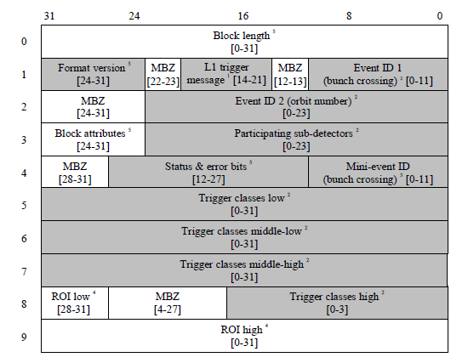
New Common Data Header format
change

Slide 25
Second link to DAQ

Slide 26
Second (new) link to DAQ
  10G Ethernet
  New interaction (INT) record -> send 24 (48) inputs with each BC when interaction occurred instead of many INT definitions
  DAQ pick-up L0 trigger inputs from interaction stream (discussion with Alice DAQ group ongoing)

Slide 27
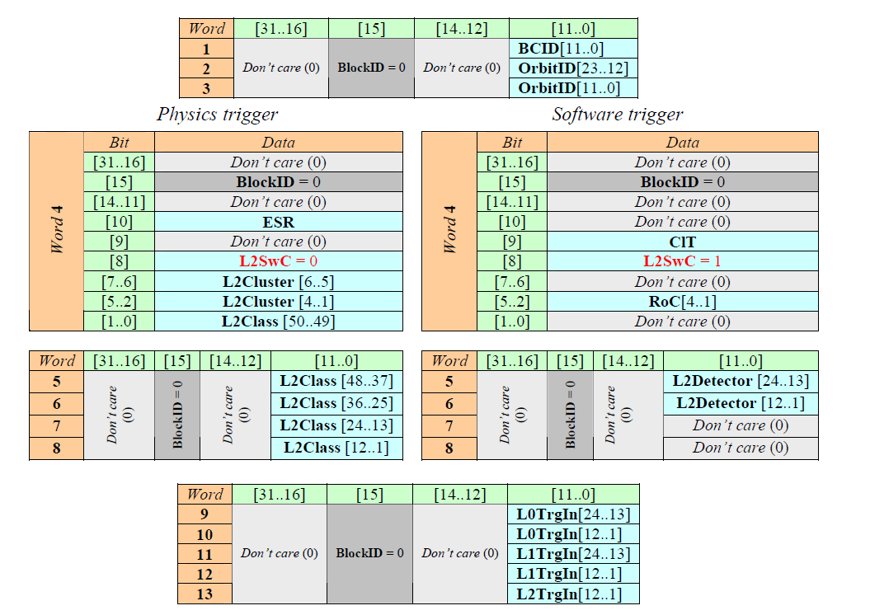
New format of CTP readout
(via first link to DAQ)

Slide 28
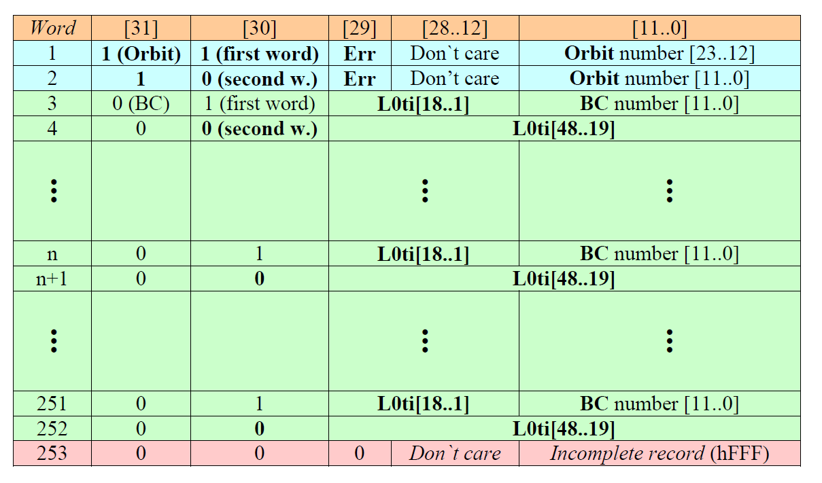
New Interaction record format
(proposal)
  Discussion with Alice DAQ group ongoing

Slide 29
New L0 board

Slide 30
Alice trigger system for Run 2
Faster inputs from T0 and V0
Upgrade of firmware for L1 ,L2 ,FO, BUSY and INT boards
Completely new L0 board
New L0 board

Slide 31
New L0 board
  96 trigger inputs -> new type of connector for front panel (48 inputs for L0 + other possible trigger inputs)
  New FPGA – Xilinx Kintex7
  Bigger memory (DDR3 - 1GB)
  Synchronized downscaling
  CTP switch for L0 trigger inputs (48->24) inside FPGA
  More counters i.e. for classes and clusters
  New 10G link to DAQ from L0 board
  New interaction record -> send 24/48 inputs with each interaction
  Control of L0 board via 10G Ethernet (or other protocol) in future

Slide 32
New L0 board – block diagram
1 GB DDR3 memory
Ethernet IP core
VME logic
DAQ
Control
(DCS)
DMA
L0 logic
LHC clock
Standalone
oscillator
Connections
to other CTP
boards via
User defined
pins on
VME backplane
96 trigger inputs

Slide 33
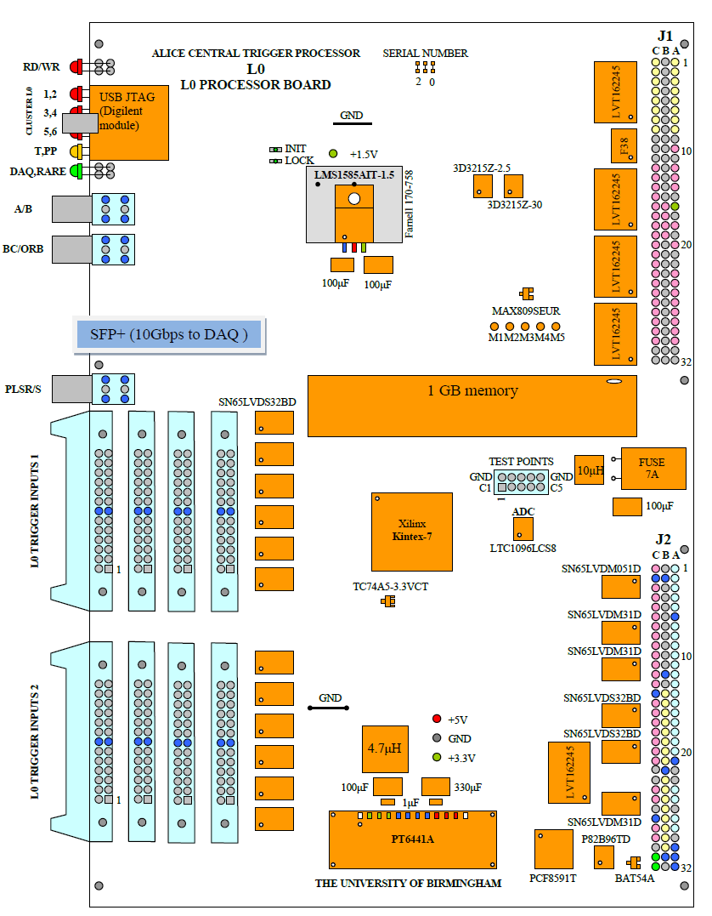
New
L0 board
Very limited space
for 4 flat cables

Slide 34
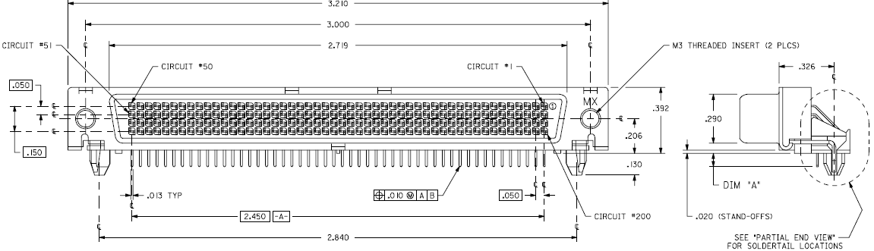
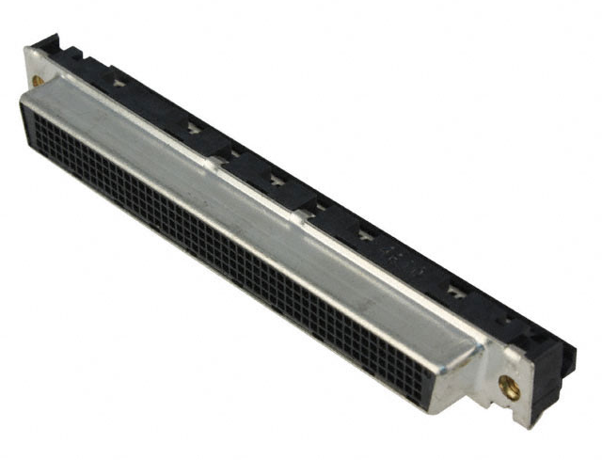
Front panel connector for 96 LVDS trigger inputs (200 pins - 96 diff. pairs + 8 GND pins)
Right angle connector for 6U VME board
(81.534 mm x 9.957 mm)

Slide 35
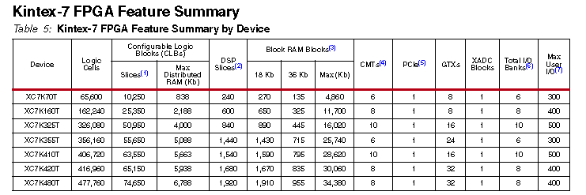
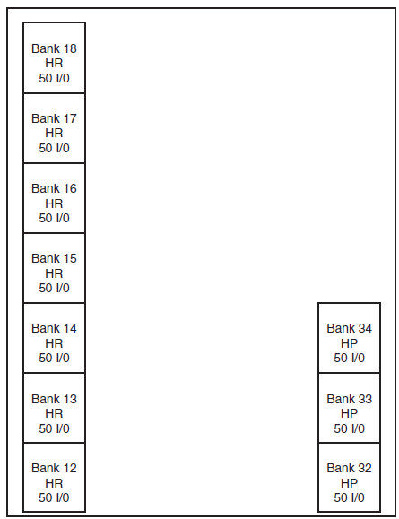
FPGA - Xilinx XC7K325TFFG900
10 usable I/O banks
  7 High Range (HR) banks –> support 1.35 – 3.3V standards
  3 High Performance (HP) banks -> support 1.35 – 1.8 V standards

Slide 36
Configuration of Xilinx XC7K325T FPGA from memory
The Master SPI configuration mode supports reading from an SPI flash using a data bus up to four bits wide
Config. CLK generated by FPGA
Configuration bitstream length -> 91,548,896
MICRON - N25Q128 (128-Mbit 3 V, 4-data pins, serial flash memory with 108 MHz SPI bus interface

Slide 37

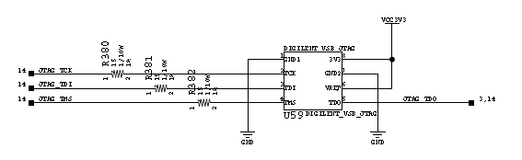
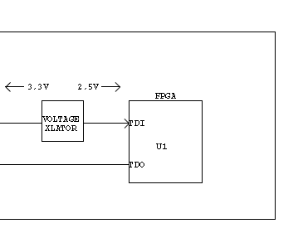
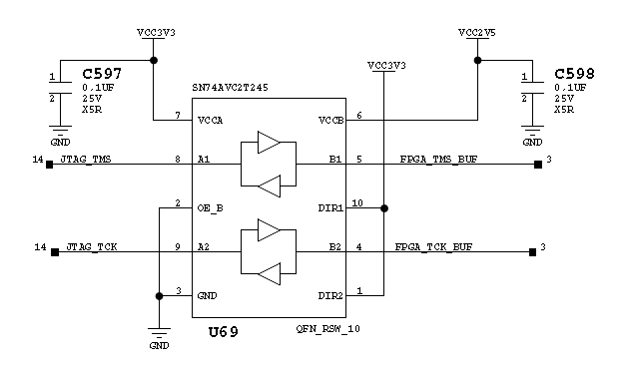
Configuration of FPGA via JTAG serial interface
JTAG interface for prototyping and debugging
On-board JTAG configuration circuitry to enable configuration over USB
USB JTAG module (DIGILENT, price 40 USD)

Slide 38
Remote configuration of FPGA
USB
cable
New L0 board
Raspberry Pi (model B)
USB
cable
Ethernet
USB hub
Broadcom BCM2835 700MHz ARM1176JZFS processor with FPU and Videocore 4 GPU
GPU provides Open GL ES 2.0, hardware-accelerated OpenVG, and 1080p30 H.264 high-profile decode
GPU is capable of 1Gpixel/s, 1.5Gtexel/s or 24GFLOPs with texture filtering and DMA infrastructure
512MB RAM
Boots from SD card, running a version of Linux
2 x USB 2.0 sockets
10/100 BaseT Ethernet socket
Price: £25.92

Slide 39
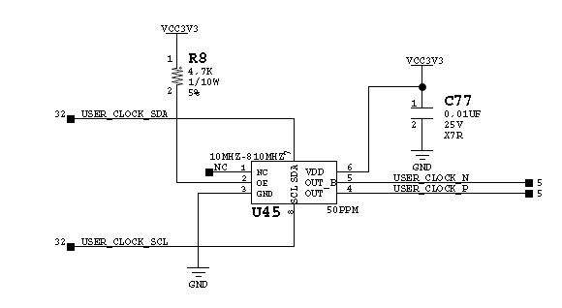
Clock
LHC clock as default
In case LHC clock missing -> “switch over” functionality inside Xilinx Kintex-7 used for on-board oscillator (SILABS 570BAB000544DG)
  Programmable (via I2C) oscillator 10-810 MHz

Slide 40
Ideas for CTP upgrade for Run 3

Slide 41
3 Trigger levels
LM: latency 0.8 µs, contribution from interaction trigger (upgraded V0/T0)
L0: latency 1.2us, possible contribution from EMCAL, PHOS, TOF, ACORDE
L1: latency 1.2-6 µs (fixed latency, but programmable in the given range), possible contribution from ZDC, EMCAL
LM would still just be used as TRD pretrigger and would NOT be distributed to the other detectors.

Slide 42
Continuous and Triggered mode
ITS, TPC and Muon Chambers can work in continuous AND triggered mode
ITS is read out upon L0, all other detectors are read out upon L1
If we do not introduce any selectivity at L1, then L1 can be made equal to L0.

Slide 43
Each detector as separate cluster
The default operation for PbPb, pPb and pp reference running would be a readout of all detectors, that are not busy, upon an Minimum Bias (MB) interaction trigger, with ITS, TPC and MCH in continuous readout mode.

Slide 44
Cluster with more detectors still possible
Operating at rates beyond the EMCAL readout rate it might then happen that there are a fraction of events with EMCAL data only and another fraction with TRD data only, and very few with both of them. Triggering an additional cluster containing EMCAL and TRD and triggering this cluster with a controlled rate will guarantee a given number of events with both detectors.
For calibration purposes one might also want to have a fraction of events with ALL detectors present, so there would be an additional cluster with ALL detectors.

Slide 45
Elimination of CTP dead time
At 100kHz interaction rate the present CTP deadtime of 1.5 µs would lead to 15% inefficiency, which is of course too much.
The deadtime must therefore be reduced below 100ns and additional “input FIFO” can eliminate the CTP deadtime (de-randomizing in addition the CTP must be able to accept more than one L0 before arrival of L1).
In this way the CTP is not responsible for any rejection of data, it will only depend on the detector capabilities what fraction triggers is rejected by their own Busy i.e. by their deadtime and buffering capabilities.

Slide 46
Heartbeat trigger
Specific trigger issued by CTP at appropriate ORBIT/BC
Reduces trigger data bandwidth
Carrying commands and specific synchronization information
Used by detectors – create “heartbeat events” sent via output links
Used by processing nodes – data segmentation, fault finding, recovery procedures, …

Slide 47
Trigger distribution -> GBT/TTC
Proposal is to use GBT
Some detectors will keep TTC
CTP needs to serve both systems

Slide 48
Detector`s behaviour
ITS Cont / L0
TPC Cont / L1
TRD LM/LM+L1
TOF L1
EMC/PHOS L0+L1
HMPID L0+L1
MuID L1
MCH Cont / L1
V0/T0 L1
ZDC L1

Slide 49
Distribution of trigger signals
Custom protocol
Electrical or optical
transmission
Daisy – chain of FI/FO boards in case that
more than one FI/FO board is necessary
LM01 board
Detector 1
FI/FO board 1
FI/FO board 2
FI/FO board n
Detector 2
DAQ
. . . . . . . . . .
Detector 24
96 trigger inputs
GBT
GBT
TTC

Slide 50
Distribution of trigger signals
Custom protocol
Electrical or optical
transmission
Custom protocol
Electrical or optical
transmission
LM01 board
Detector 1
repeater
FI/FO board 1
FI/FO board 2
FI/FO board n
Detector 2
. . .
. . .
DAQ
Detector 24
96 trigger inputs
GBT
GBT
TTC

Slide 51
Summary
Activities for relocation and recabling of T0, V0 and TRD are ongoing.
A new L0 board is in progress, production expected in Autumn 2013
Firmware development and testing in 2014
CTP proposal for run 3 is in preparation
The upgraded CTP for Run 3 will be able to provide enough flexibility for all foreseen running scenario

Slide 52
Back up slides

Slide 53
Summary table (Run 3)
Detector | type | MEB | t_{RO} PbPb | Max. PbPb readout rate | Max. pp and pPb readout rate
ITS | Cont. / L0 | n.a. / ? | n.a. / ? | 100 kHz | 400kHz
TPC | Cont. / L1 | n.a. | n.a. | n.a. | n.a.
TRD | LM/LM+L1 | no | 7-8 µs | 100 kHz | 100kHz
TOF | L1 | yes | 5 µs | 200 kHz | 400kHz
EMC/PHOS | L0+L1 | yes at L1 | 20 µs | 50 kHz | 50kHz
HMPID | L0+L1 | ? | ? | 10 kHz | 10kHz
MuID | L1 | yes | <200 ns | 100 kHz | 400kHz
MCH | Cont. / L1 | n.a. | n.a. | 100 kHz | 400kHz
V0/T0 | L1 | yes | 5us | 200 kHz | 400kHz
ZDC | L1 | yes | 5 µs | 100kHz | 400kHz

Slide 54
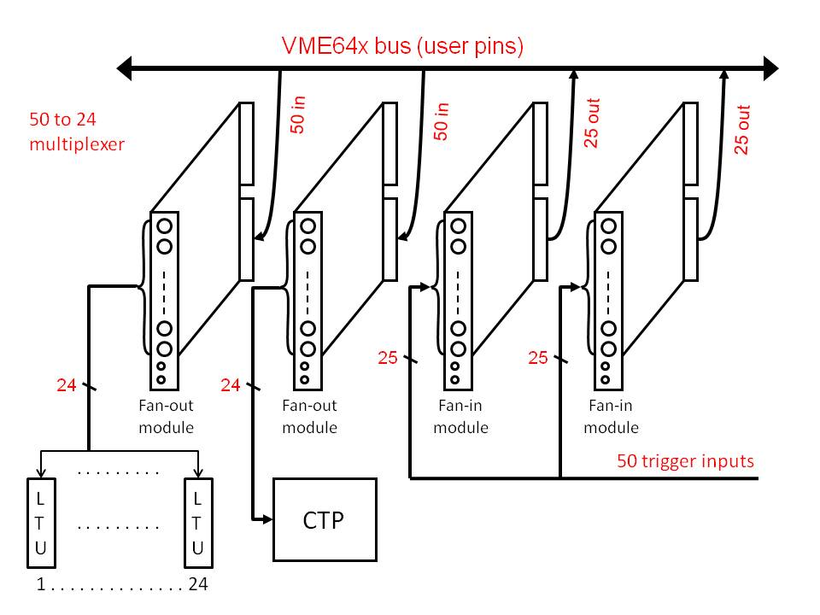
Current L0 trigger input switch
In order to handle more L0 trigger inputs the L0 trigger input multiplexer 50:24 has been made from available Faninout boards

