Slide 1
Digital Archiving & Preservation :
How to compare and contrast
Knowledge is power
Don’t lose it
Jon Tilbury
28-jun-2013

Slide 2
Introduction
Jon Tilbury
Director of Archiving Solutions at Tessella
20 users of our “Safety Deposit Box” Technology
  Archives, Libraries, STFC (Rutherford Appleton)
  Your premises and cloud
  Research led
Also scientific technology support
  Software, consultancy
  Pharmaceuticals, Government Science, Consumer Goods, Energy
33 year heritage

Slide 3

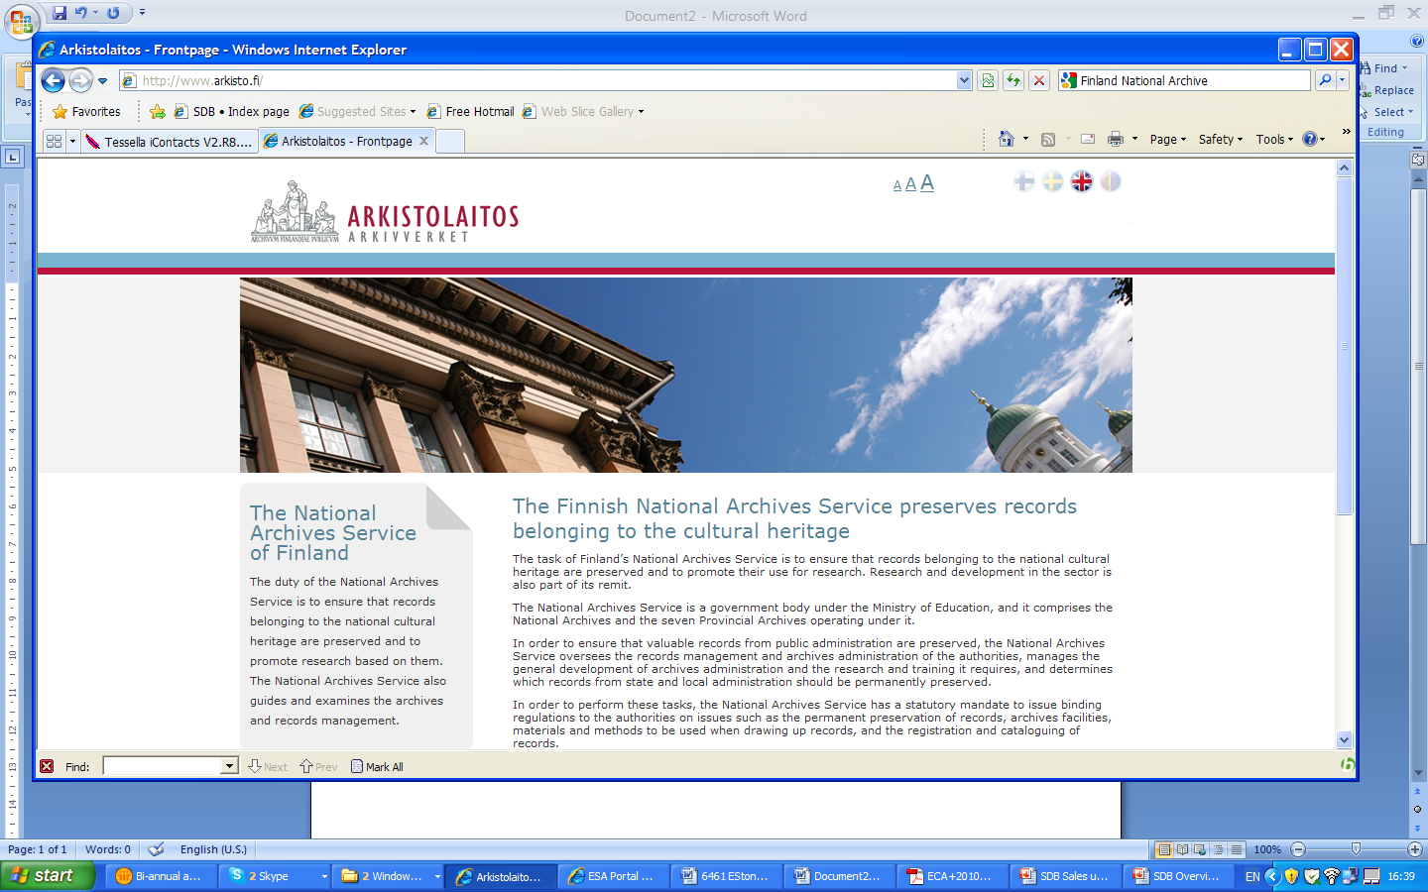




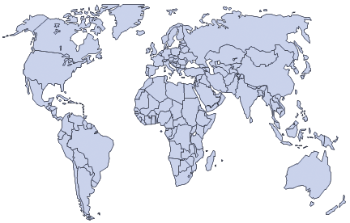





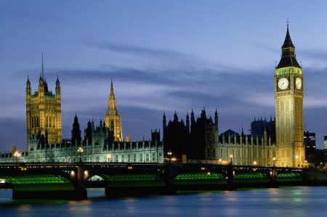




Systems in 11 Countries across 4 Continents
Wellcome Trust
Corporate Archives
Finnish National Archives
Estonian National Archives
Latvian National Archives
UK National Archives
Rotterdam City Archive
National Archives of Hungary
Budapest City Archives
Dutch National Archives
Malaysian Archives
UK Parliament
Swiss Federal Archives
Austrian Archives

Slide 4
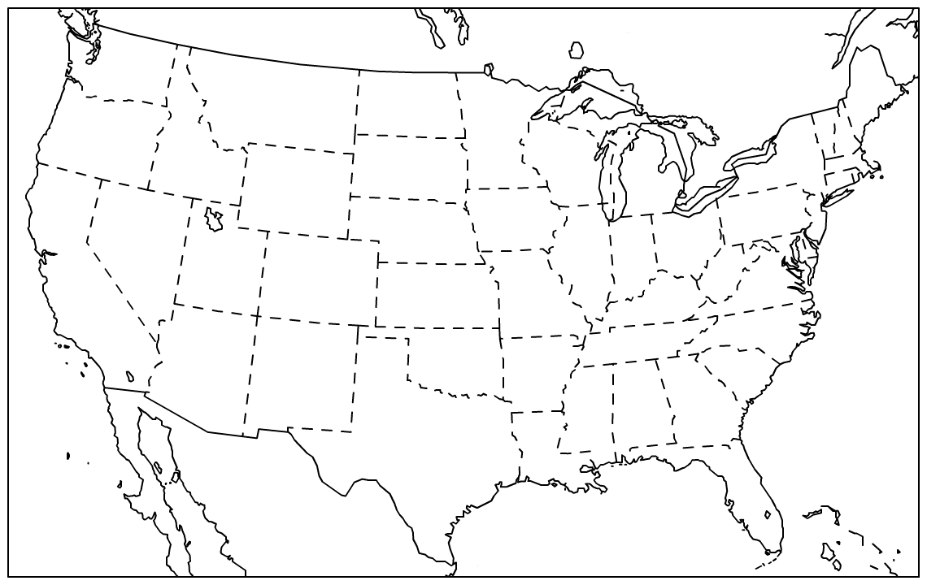




Cloud version launched in the US, soon in EU
Archives of Michigan

Slide 5
Examples
STFC
  Multitenant solution, available for other departments
  Preserving Neutron Scattering data from ISIS
  Ask Jens Jensen / Juan Bicarregui
FamilySearch
  Genealogy Information from around the world
  Digitising microfilm to JPEG2000
  Digitised in Utah, preserved in Maryland
  Initial storage 7Pb
  Ingest rate : 20Tb per day, rising to 50Tb per day
  Standard workflows on medium application servers
  Very fat pipes (especially to work area)
  Multiple parallel tape writers
  Dedicated pipe across US to replace FedEx

Slide 6
How to compare archiving systems
Digital Archiving has many meanings
  Email archiving
  Backup++
  Second line storage
  Bit store
  Etc
How do we compare the approaches and evaluate what we want?

Slide 7
Digital Archiving Maturity Model
File format obsolescence : identify, assess, migrate, validate
Advanced software for high throughput, workflows, APIs, integration
6. Information Preservation
Software to manage hierarchy, security, metadata, search, browse, download
Preservation
Constant checking of fixity, self healing from alternate copy
5: Information Processes
Information preservation
Ingest
Access
Data Man.
Move content to appropriate storage Multiple locations, cost / performance / durability criteria
4: Information Organisation
OAIS
ISO
14721
3: Storage Validation
Reliable storage with high reliability e.g. RAIDx, long life tape, etc
Administration
Storage
2: Storage Management
Bit level preservation
1: Safe Storage

Slide 8










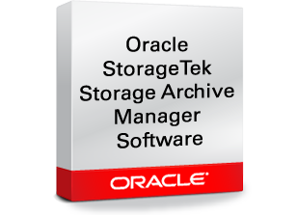
Examples
6. Information Preservation
5: Information Processes
4: Information Organisation
3: Storage Validation
S3 Storage
2: Storage Management
1: Safe Storage

Slide 9


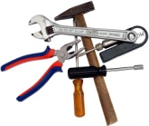
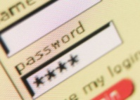

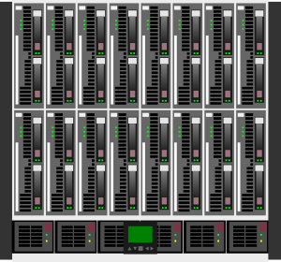
Digital Preservation Implementation
Tenancy
myData = getData()
Workflow
Programmer Interface
Web based GUI
SDB
Preservation
Platform
Preservation Action
Preservation Tools
Preservation
Planning
Ingest
Access
Admin
Data
Management
Archival
Storage
LDAP server
Database
Mass storage

Slide 10
Summary
Use the Maturity Model to understand :
  What you want
  What competing systems do
Implement the system that is right for you
  Don’t start from scratch
  Use available components, commercial if necessary
  Make sure you have the flexibility to grow
  Share knowhow, tools, techniques

