Slide 1
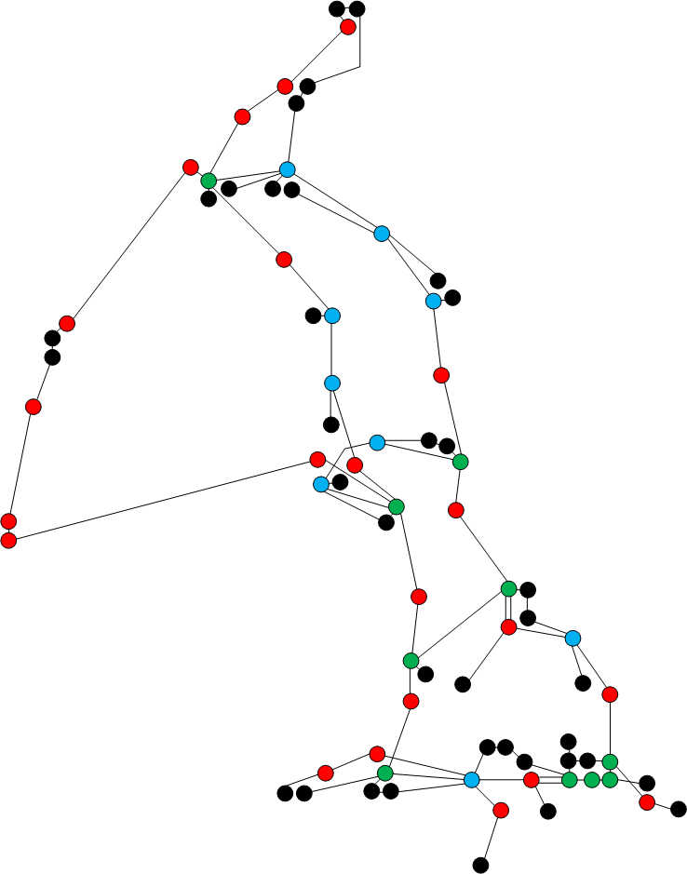
Network Developments
Paul Lewis
Research Support
Big Data Imperial College
28th June 2013

Slide 2
What is Janet?
UK Research and Education Research Network (NREN)
Founded in 1984, covering whole of UK (England, Scotland, Wales and Northern Ireland)
Currently serves Universities, Research Establishments, Higher Education and Local Government.
Approx 18m users & around 700gbit/s peerings to the Internet, private orgs and other research networks

Slide 3
What Services to we offer?
IP provision of high capacity ‘commodity’ connectivity.
Lightpath is a centrally managed Layer 2 service that provides dedicated point-to-point network connections between Janet-connected organisations (and internationally via GN3+).
Specialist network advice to researchers from all disciplines ranging from high energy physics to molecular biology – generally around ‘big data’, data throughput and many other things…

Slide 4
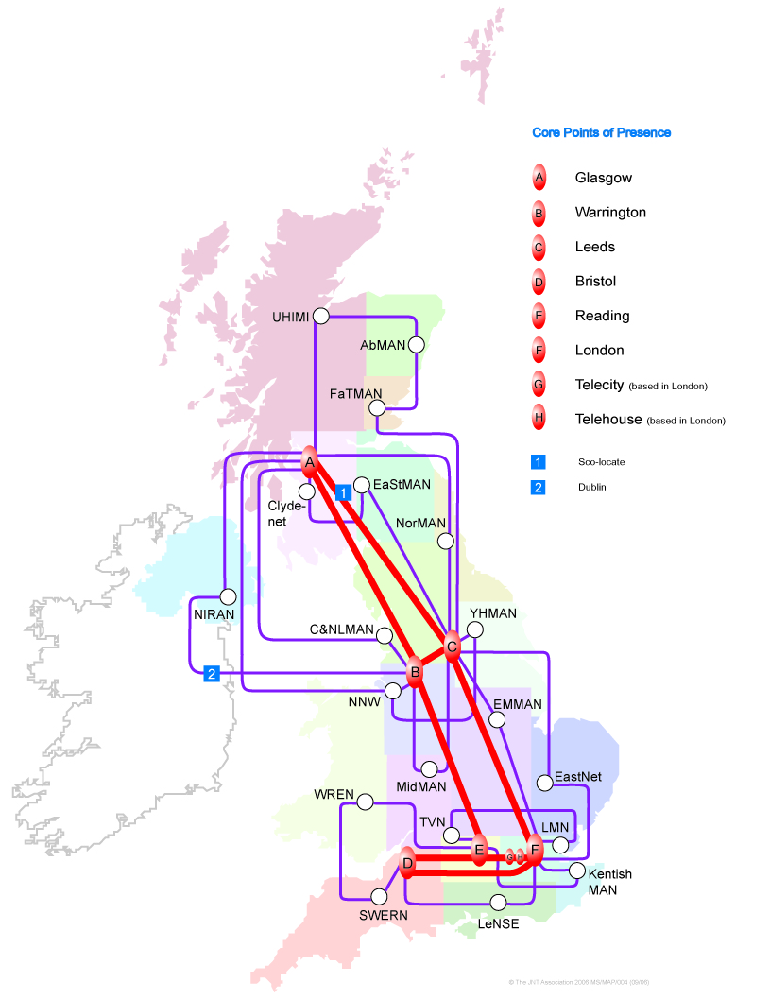

Janet6 Background 6,5,4,3,2,1…
Janet6: Project to replace the UK wide Janet backbone, SuperJanet5 with Dense Wavelength Division Multiplex technology
SuperJanet5: 2006 to 2013
Requirements gathering & analysis | 2010 to 2011
Procurement Fibre infrastructure Optical transmission equipment | Oct 2011 to Sept 2012
Rollout | Sept 2012 to April 2013
Transition SJ5 to J6 | May 2013 to July 2013
SJ5 ‘turned-off’ | Oct 2013

Slide 5
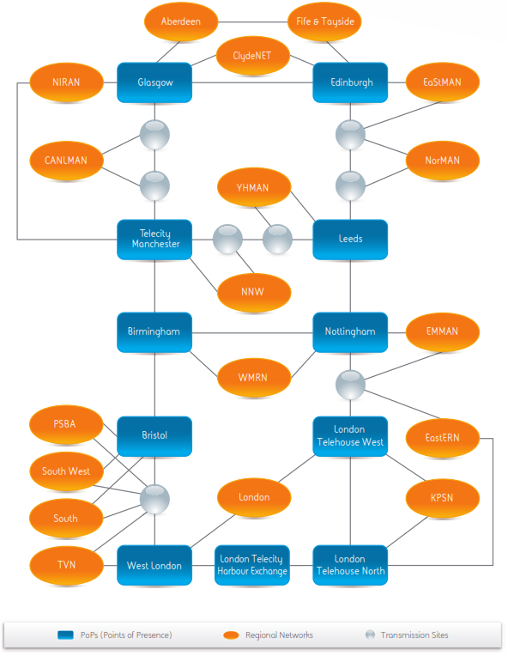
What we’re building
Look familiar?
6,000km (ish) of G.652 fibre
79 Points of Presence
Core capacity n x 100Gbit/s
RNs connect at n x 10G
Most are getting an upgrade
  Range from 10G to 60G

Slide 6
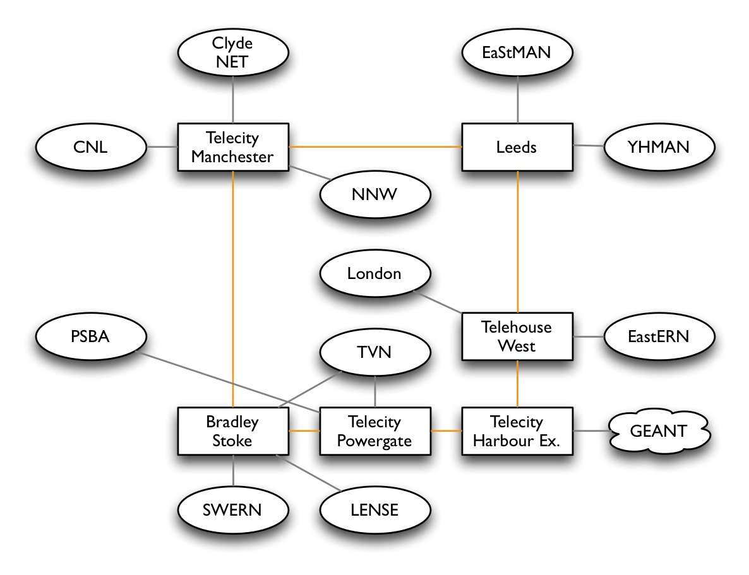
What we’re building – New Lightpath Network
Run in parallel from normal IP provision
Increase bandwidth between backbone nodes to 100GE
Implemented via Multiprotocol Label Switching (MPLS)

Slide 7
Janet6 IP Platform
Original 2006 T-640 chassis still in service
  40Gbit/s per slot, 32 10Gbit/s ports per chassis
Most upgraded to T-1600
  Same chassis, new switching fabric and PSUs
  100Gbit/s per slot
T-4000
  Same chassis, new switching fabric and PSUs
  240Gbit/s per slot, 192 10Gbit/s ports per chassis
  Two power supplied for resilience
    Each one takes 6, 60A, 48VDC feeds – 17kVA!
Migration
  Janet6 will be in new PoPs
  Can’t move all the connections overnight
  New routers and hand back the old

Slide 8
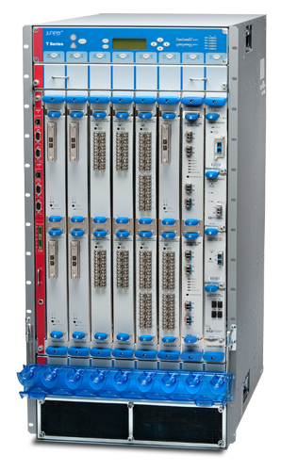
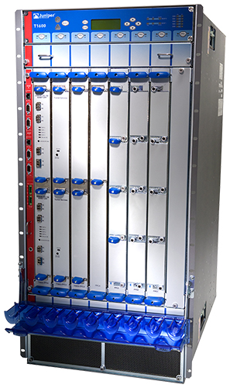
How we’re getting on – IP routing equipment
Upgrade: Juniper T1600 Juniper T4000

Slide 9
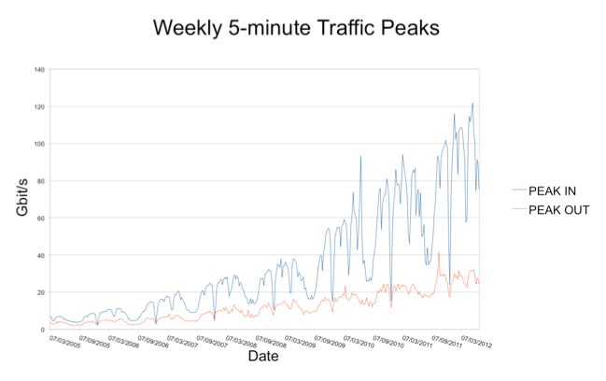
Why? – Growth (2008 -2012)

Slide 10
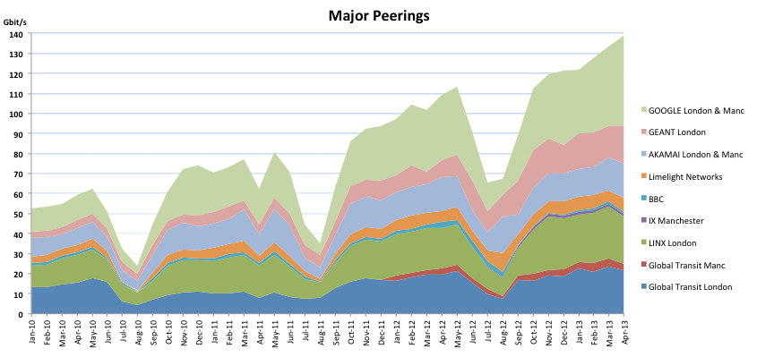
External Peering (Jan 2011 – June 2013)

Slide 11
E-Infrastructure

Slide 12
Janet & E-Infrastructure
Oct 2011 – E-infrastructure announcement - £26M
Phase 1 – Augmentation of Janet6 plans
Phase 2 – Strategic Sites
      Hinxton Genome Campus (Cambridgeshire)
      Norwich Research Park
      Met Office (Exeter)
      Francis Crick Inst (London)
Phase 3 – Industrial connectivity/Services.
      Moonshot
      State Aid
      Test cases
Phase 4 – Further plans for potential connectivity upgrades

Slide 13
High Throughput SIG
Over the past 2-3 years a number of scientific disciplines have instruments that are capable in generating appreciably large datasets or have researchers that have collected big datasets (social networks).
Generation and processing capabilities are generally physically located in different locations around the UK,
Growing requirement from the community to transfer large (>1Tb) files, or multiples thereof, in the shortest possible time frame.
Whilst the Janet network provides significant capability at the wide area network level we need to look at the problem holistically.
http://tinyurl/HTNSIG - 24th July

Slide 14
Finally a Thought Experiment….
Theoretical maximum throughput for network connections:
100 Mbit/s = ~ 41 Gigabytes per hour
1 Gbit/s = ~ 0.41 Terabyte per hour
10 Gbit/s = ~ 4.1 Terabytes per hour
40 Gbit/s = ~ 16 Terabytes per hour
Health warning!
Assumes no contention, simple infrastructure,’ specialist’ transfer applications and protocol 20% overhead.

Slide 15
Thanks!

