Slide 1
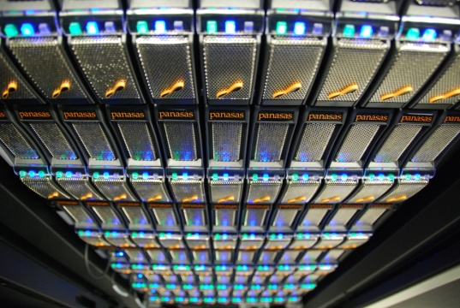
Big Data and the Earth Observation and Climate Modelling Communities:
JASMIN and CEMS
Workshop on the Future of Big Data Management
27-28 June 2013
Philip Kershaw
Centre for Environmental Data Archival
RAL Space, STFC Rutherford Appleton Laboratory

Slide 2
Some Challenges
Velocity – a data deluge
  Earth Observation e.g. new generation of ESA Sentinel satellite missions, S-3 ~1PB/year
Volume
  Climate modelling e.g. the CMIP3 generated 35TB in one central archive, CMIP5 > 2PB in a federated archive.
Variety
  Not a new factor to our community (a topic for another talk)
We run a number of active data archives
  the data lifetime is an important factor, we need to keep the data – in the case of CMIP5 indefinitely
  The availability of the data: we have a responsibility to a much wider and set of communities than merely those who created the data
How do we analyse the data?
  How responsive can we be with the hardware and software we use to address the needs?

Slide 3
Presentation Structure
Introduce CEDA
Tell a story starting with,
What life was like before JASMIN and CEMS
System description
Initial application of the infrastructure for:
  Archive management
  Data handling and analysis for Climate model data
  Earth Observation data reprocessing
How patterns of usage have emerged from these experiences
How these patterns are influencing our future plans

Slide 4
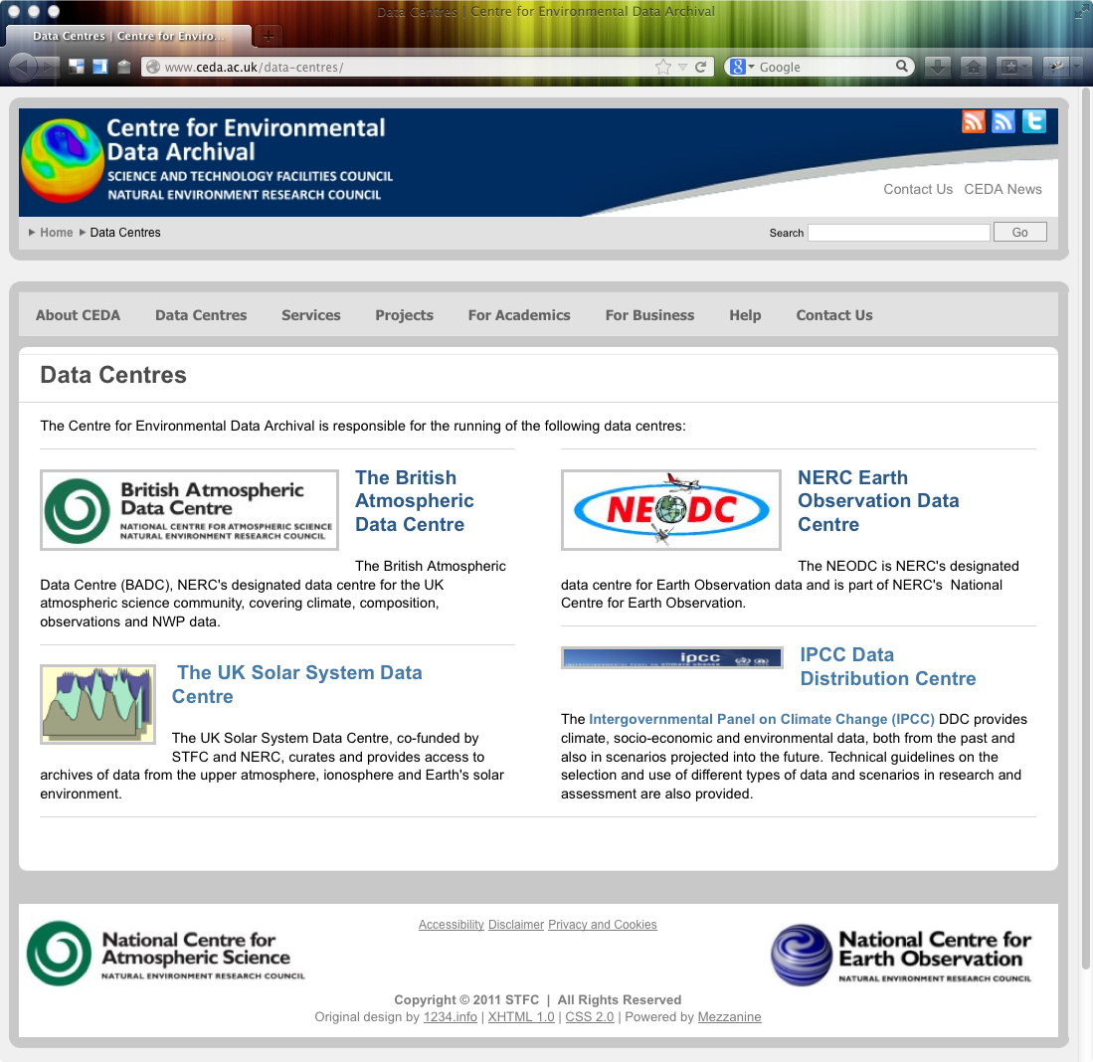
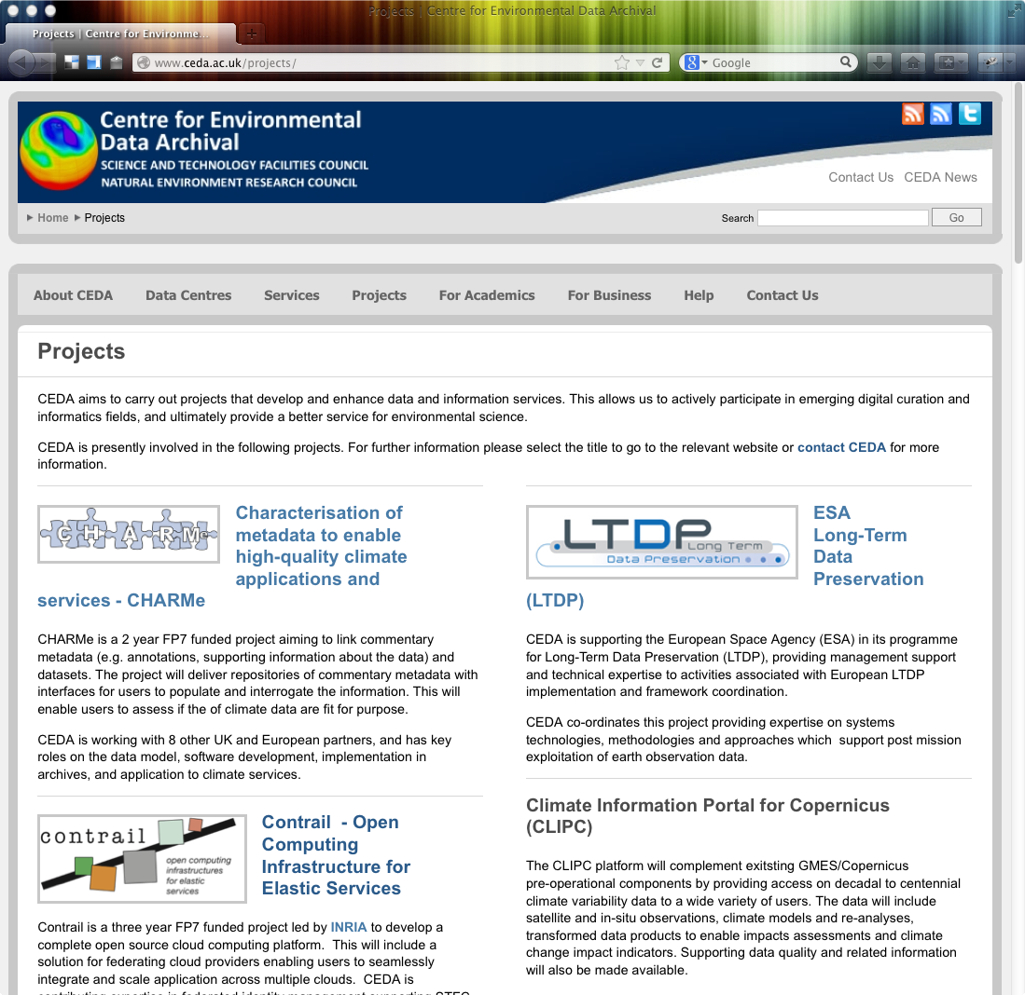
CEDA – The Centre for
Environmental Data Archival
Our mission:
  to curate data and
  facilitate science
We run 3 NERC data centres
20 projects underway currently covering
  Data modelling, preservation, publishing
  Web applications and services
  Cloud computing
http://www.ceda.ac.uk

Slide 5
Life before JASMIN and CEMS
Snapshot at the beginning of 2012, infrastructure hosted within RAL Space:
  200 million files
  ~1.5PB of NAS disk on
  ~150 disk partitions, split into 600 datasets
  ~300 different computers, incl. VMs
  ~30 hypervisors (Xen)
  Lots of tapes in STFC Atlas data store
This was not a designed environment, it was organic, it grew over a decade
CEDA was straining under this legacy:
  inexplicable network problems.
  lots of time spent moving data as machine lifetimes expired
  user services suffered.
It has taken us a year to migrate our data to JASMIN, it'll probably take nearly as long to retire all the services on legacy hardware

Slide 6
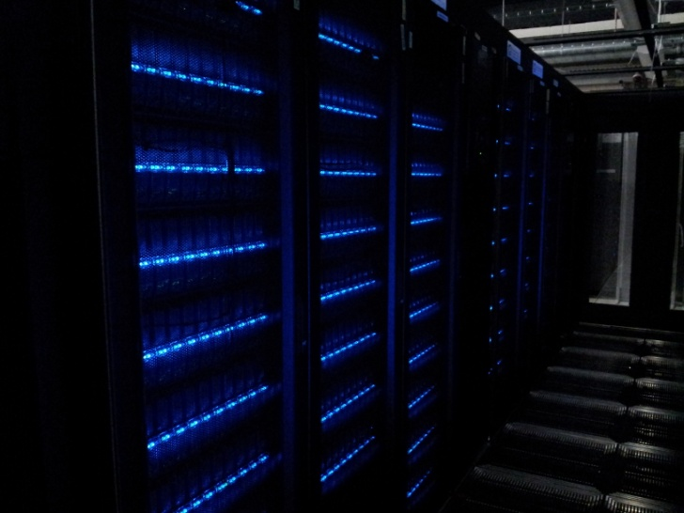
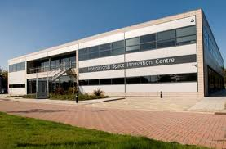
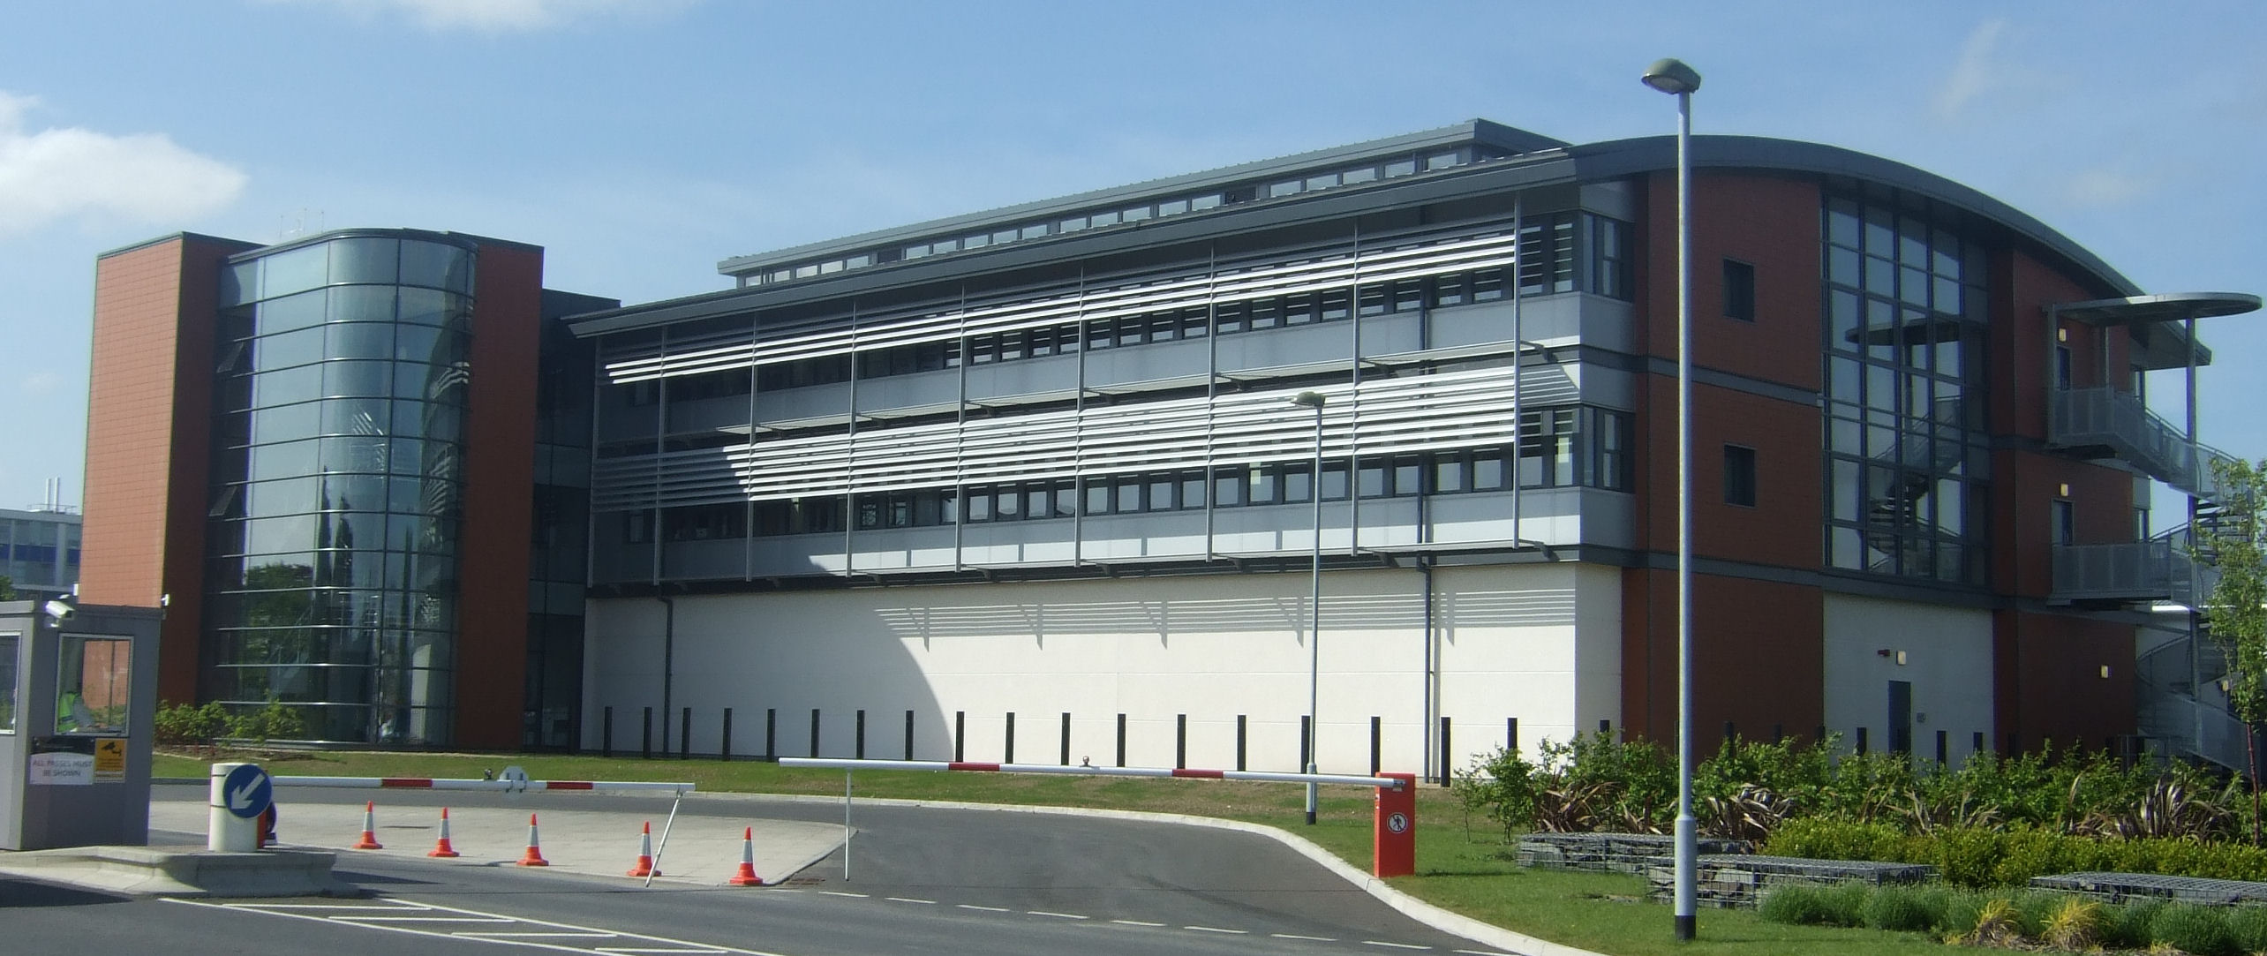
Introducing JASMIN and CEMS
Panasas storage in RAL R89 server room
Petascale fast disk via low latency networks
Supports batch processing, hosting environments and Cloud
Supports two communities atmospheric science and earth observation (CEMS)
Initially funded through e-Infrastructure capital investment in 2011 through BIS
CEMS – the facility for Climate and Environmental Monitoring from Space
CEMS consists of two components:
  the academic CEMS infrastructure, running on JASMIN
  commercial CEMS infrastructure part of the new UK Satellite Applications Catapult centre
JASMIN and CEMS
Electron Building, Catapult
R89 Building, RAL STFC
CEMS Commercial
CEMS Academic
JASMIN
Physical network link, Sharing of expertise, collaboration
Shared infrastructure and overlapping research domains

Slide 7
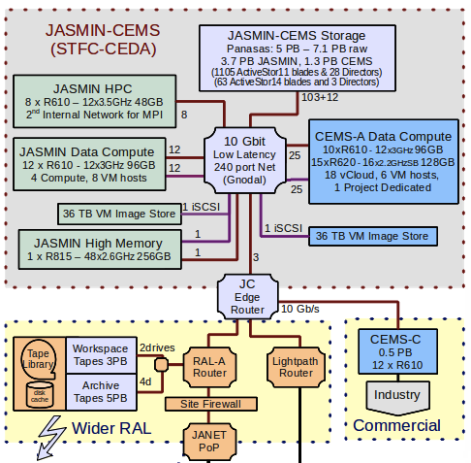
JASMIN-CEMS topology
6 major components to the system:
  The low latency core network (based on Gnodal switches);
  The Panasas parallel storage
  The batch compute system (Lotus);
  bare metal compute and hypervisors for virtual machines (VMs);
  A High Memory System and
  Two image stores to support the private disks of VMs.

Slide 8
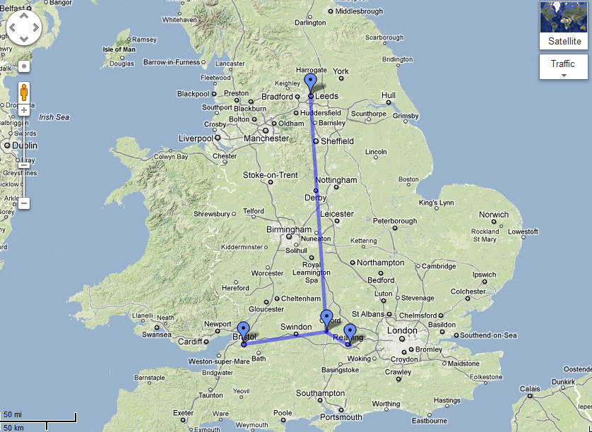
Distributed JASMIN Infrastructure
JASMIN-North
University of Leeds
150 TB
JASMIN-Core
STFC RAL
3.5 PB + compute
JASMIN-West
University of Bristol
150 TB
JASMIN-South
University of Reading
500 TB + compute
Notes:
A central node of geographically spread e-infrastructure

Slide 9
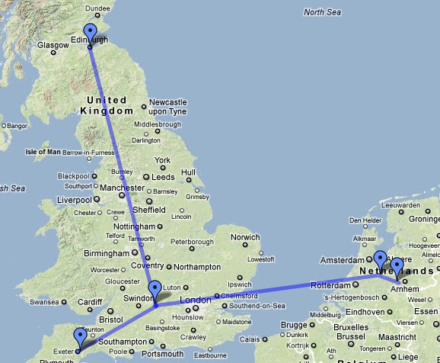





Links to HPC Facilities
HECToR Cray XE6, 90k cores (to be replaced with ARCHER)
For the modelling community - provide dedicated links to HPC facilities
JASMIN – provide one place to analyse outputs
But also combine outputs from multiple sources
MONSooN 5000 core IBM P7

Slide 10


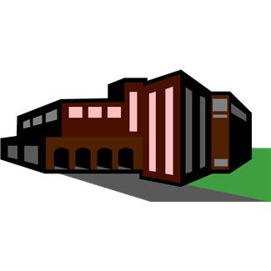
Virtualisation and Cloud
VMware and vCloud chosen
Why not Open Source?
  Capital expenditure project + short time scales
  Assessment of maturity of Open Source solutions at the time
Organised into two vSphere pools
JASMIN using virtualisation only
CEMS full vCloud
  RHEL, CentOS, Fedora14 vApps
  6 Virtual Data Centres (vDC)
  Web interface available to Plymouth Marine Laboratory
Interest in larger VMs with batch queues
vCloud REST API very promising but still to be fully exploited
Issues:
  Remote root console access
  Panasas file system integration
from libcloud.compute.types import Provider
from libcloud.compute.providers import get_driver
vcloud_driver = get_driver(Provider.VCLOUD)
self.conn = vcloud_driver(‘pjkershaw’, passwd,
host=“cemscloud.jc.rl.ac.uk”,
api_version='1.5’)
# Query VM images available
images = self.conn.list_images()
log.info('Creating vApp ...')
node = self.conn.create_node(name='Phil-Test-Node01’,
image=images[0])

Slide 11
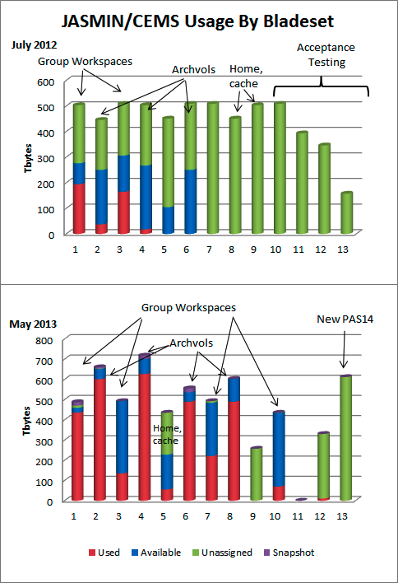
Disk usage
  4.6PB deployed in 6 Hours!
Migrating the archive from the legacy NAS storage was a whole project in itself – 6 months
Reaching capacity in under a year!
Filling both the archive volumes and Group workspaces (user caches)
$ df –h
Filesystem Size Used Avail Use% Mounted on
nfs01.jc.rl.ac.uk:/ 4.9P 3.0P 2.0P 61% /mnt/nfs01

Slide 12
Data Archive: CMIP5
CMIP5 (5th Coupled Model Intercomparison Project) has so far produced over 2 PB of requested data from over
  100 different numerical experiments run by 29 different modelling centres
  using 61 different climate models.
Stored in a globally distributed archive currently using 23 geographically distinct data nodes (the Earth System Grid Federation)
Three centres have agreed to manage replicates of as much of the requested data as possible including
  British Atmospheric Data Centre (a core component of CEDA).

Slide 13
Climate Modelling: UPSCALE
A high resolution climate modelling experiment, run under the UK Joint Weather and Climate Research Programme (JWCRP, joint between NERC and the UK Met Office)
144 million core hours on the German supercomputer HERMIT, producing 330TB.
The data retrieved to JASMIN over GridFTP at 1-10 TB/day.
At JASMIN, a second copy was kept until the data had also been copied to the Met Office tape
At its peak, the UPSCALE archive online at JASMIN approached 600TB - and it is now around 380TB (including post-processed products).
These data are expected to provide a hugely valuable resource for the study of current and future climate, => feed into ESGF and the CEDA archive.
Benefit of single analysis environment:
  post-processing involves comparisons with CMIP5 and earth observation data held within JASMIN.

Slide 14
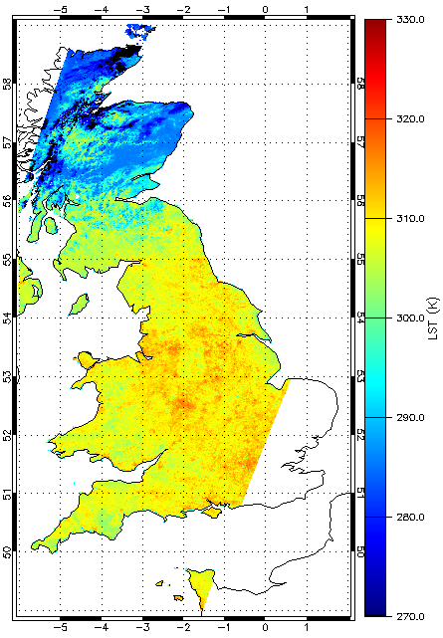
Earth Observation: ATSR Processing
Examples (re)processing for whole satellite missions, a job that hitherto was done rarely.
A number of different groups generated products from (the Along Track Scanning Radiometer) using brightness temperature data held in the CEDA archive:
  Cloud detection and sea surface temperature
  Land surface temperature
  Cloud ECV (Essential Climate Variable)
Trivial to parallelise
They had prior evidence of being i/o bound on previous hosting environments
LST plot for the UK [John Remedios and Darren Ghent, University of Leicester].
Notes:
Level 1b geolocated calibrated instrumental radiances from the archive are processed firstly into swaths of product data (level 2), and then into more conventionally gridded data products (level 3).

Slide 15
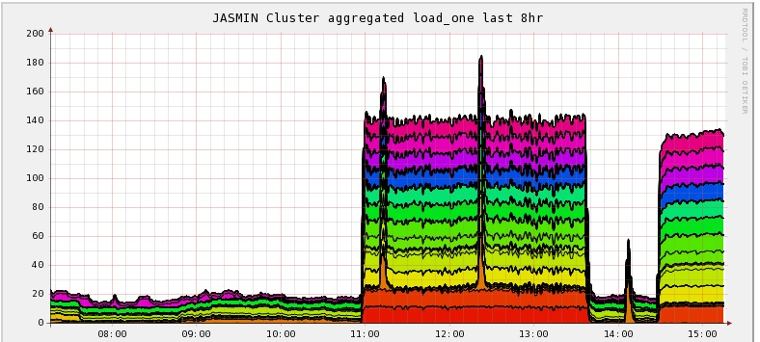
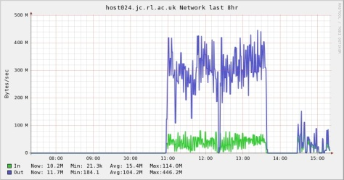
ATSR1 and 2 Reprocessing Project
140-185 jobs in parallel with no IO issues.
Virtualised environment for initial trials:
  cores/VM, memory, operating system
This showed that standard CEMS Redhat distro was fine => suitable for bursting to JASMIN’s Lotus compute cluster
One month’s L1B data processing in 12 minutes where on previous system it took 3 days
  Impact of parallisation and fast i/o
LSF was used for job scheduler so that adding Lotus to the processing was simple.
A hybrid approach: compute cluster + VMs
Importance of documentation and direct support to orient users and enable them to avoid pitfalls
Each colour represents a node, 12 cores / node
3.0GB/s x 8 = 24Gb/s (would swamp a NAS/NFS server)

Slide 16


Future Plans
JASMIN / CEMS Academic [R89 Building STFC Rutherford Appleton Laboratory]
Provided a range of service models
Direct access to the data archive and compute
  Performance
  Great level of trust with user
  Set-up time and training
Virtualisation
  Flexibility for management of system
  Greater autonomy for user
  Performance overhead (and expense VMware)
Private Cloud
  hosted on an independent internal network for greater security but also autonomy
  Less privileged access to the archive
Possibility of moving storage and compute between environments dynamically
  Nodes can be run as hypervisors or bare metal compute
Data Archive and compute
Protected area
Bare Metal Compute
Panasas Storage
Virtualisation
Cloud burst as demand requires
Internal Private Cloud
External Cloud Providers
Cloud Federation API
Direct access to the data archive - Hosted processing and analysis environments

Slide 17
Conclusions
The role of a dedicated data analysis environment integral to our support for Big Data for EO and atmospheric science for the forseeable future
The first projects have show the impact such an infrastructure can make on the science
Data curation – we could not have gone as we had before
A lot to handle in a very short space of time
  Scratching surface about data analysis issues
Looking to the future, use a flexible combination of processing clusters, virtualisation and public and private Cloud to best support the usage patterns

Slide 19

<= Increased level of trust in user
Lower level of trust in user =>
Users and usage
Great security risk usage patterns
Increased set-up time, but longer usage
More dynamic and autonomous usage patterns
Service Offered
Hosted Processing
Hosted Infrastructure
Application Hosting
PaaS – Hosted Analysis Environments
Shared Scientific Analysis hosts
SOA
High performance file system
Virtual Infrastructures for other organisations
Cloud Federation / Brokering
Virtual Storage
Bare metal
Increasing virtualisation =>
Virtualisation and networking
Direct Access to the File System
Cloud platform
Isolated network
Sandboxed environments

