Slide 1
Hadoop: Beyond MapReduce
Steve Loughran, Hortonworks
stevel@hortonworks.com
@steveloughran
Big Data workshop, June 2013

Slide 2
Hadoop MapReduce
  Map: events ➔ <k,v>* pairs
  Reduce: <k,[v₁, v₂,.. v_{n}]> ➔ <k,v'>
Map trivially parallelisable on blocks in a file
Reduce parallelise on keys
MapReduce engine can execute Map and Reduce sequences against data
HDFS provides data location for work placement

Slide 3
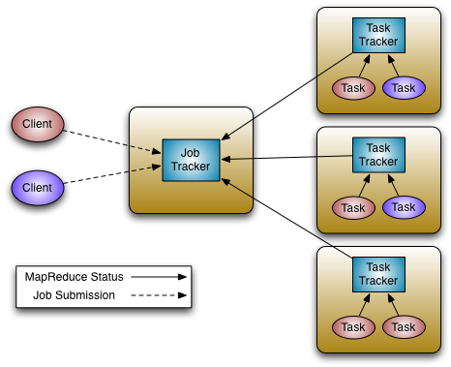
MapReduce democratised big data
Conceptual model easy to grasp
Can write and test locally,
superlinear scaleup
Tools and stack
You don't need to understand parallel coding to run apps
across 1000 machines

Slide 4











The stack is key to use
Kafka

Slide 5
Example: Pig
generated = LOAD '$src/$srcfile'
USING PigStorage(',' , '-noschema')
AS (line: int, gaussian: double, b: boolean, c:chararray );
sorted = ORDER generated BY c ASC;
result = FILTER sorted BY gaussian >= 0;

Slide 6
Example: Apache Giraph
Graph nodes in RAM
exchange data with peers at barriers
use cases: PageRank, Friend-of-Friend
But also: modelling cells in a heart
Bulk-Synchronous-Parallel -read Pregel paper

Slide 7
But there is a lot more we can do

Slide 8
New Algorithms and runtimes
Giraph for graph work
Stream processing: Storm
Iterative and chained processing: Dryad-style
Long-lived processes

Slide 9
Production-side issues
Scale to 10K nodes
Eliminate SPOFs & Bottlenecks
Improve versioning by moving MR engine user-side
Avoid having dedicated servers for other roles

Slide 10
YARN: Yet Another Resource Negotiator
App Master manages the app
AM can request containers and run code in them

Slide 11
YARN vs Other Resource Negotiators
MapReduce #1 initial use case
Failures:
AM handles worker failures, YARN handles AM failures
Scheduling Locality: sources of data, destinations. AM gets provides location requests along with (CPU, RAM

Slide 12
Pig/Hive-MR versus Pig/Hive-Tez
SELECT a.state, COUNT(*)
FROM a JOIN b ON (a.id = b.id)
GROUP BY a.state
I/O Synchronization
Barrier
I/O Pipelining
Pig/Hive - Tez
Pig/Hive - Tez

Slide 13
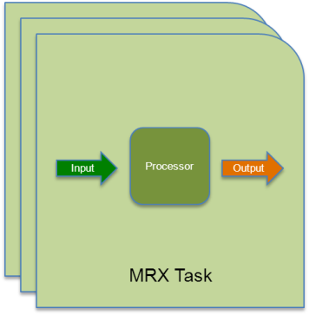







FastQuery: Beyond Batch with YARN
Tez Generalizes Map-Reduce
Simplified execution plans process
data more efficiently
Always-On Tez Service
Low latency processing for
all Hadoop data processing

Slide 14
You too can write a distributed execution framework -if you need to

Slide 15
Start the work in progress
Hamster: MPI
Storm-YARN from Yahoo!
Hoya: HBase on YARN ⬅ me
And start with other people's code
Continuuity Weave -looks best place to start

Slide 16
What are the services and algorithms we are going to need?

Slide 17

P.S: we are hiring
http://hortonworks.com/careers/

