Slide 1
Federated Data Stores
Volume, Velocity & Variety
Future of Big Data Management Workshop
Imperial College London
June 27-28, 2013
Andrew Hanushevsky, SLAC
http://xrootd.org

Slide 2
Big Data Access & The 3 V’s
Volume
  Increasing amount of data
    No single site can host all of the data
Velocity
  Increasing number of analysis jobs
    No single site can host all of the jobs
Variety
  Increasing number of sites
    Introduces many different storage systems

Slide 3
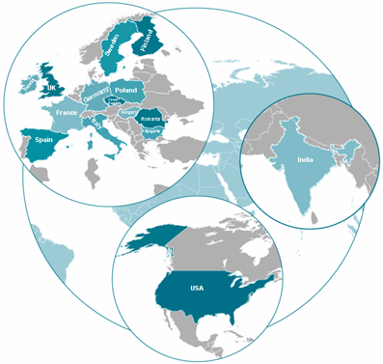
Data & Access & The World
Data
Many places
Complete subsets
Sometimes not
Compute
Many places
Data co-located
Sometimes not
Data is distribute and many times replicated largely driven by computational needs

Slide 4
Multiple Sites – Unified View
Reality check…
  Multiple sites
  Different administrative domains
How to logically combine all the storage?
  Provide storage access across multiple sites
  Requires a minimal set of rules
    Intersecting security model
    Promise of minimal service

Slide 5
Data Storage Federations
“A collection of disparate space resources managed by co-operating but independent administrative domains transparently accessible via a common name space.”
Unifies storage access
  Independent of data and compute location

Slide 6

A Solution Using XRootD
A system for scalable cluster data access
Not a file system
Not just for file systems
  To handle variety
Used in HEP and Astrophysics
xrootd
cmsd

Slide 7
XRootD Synergistic Approach
Minimize latency
Velocity
Minimize hardware requirements
Minimize human cost
Maximize scaling
Volume
Maximize utility
Variety

Slide 8
Variety Via Plug-In Architecture
Protocol Driver
Any n protocols
Authentication
krb5 sss x.509 …
Protocol
cms http xroot …
Authorization
Entity Names
Logical File System
dpm sfs sql …
Storage System
HDFS gpfs Lustre UFS, …
Clustering
(cmsd)
8

Slide 9
Volume Via B⁶⁴ Scaling
xrootd
cmsd
xrootd
xrootd
cmsd
xrootd
cmsd
Manager
(Root Node)
cmsd
SLAC
xrootd
64¹ = 64
xrootd
cmsd
cmsd
64² = 4096
xrootd
xrootd
xrootd
xrootd
Supervisors
(Interior Nodes)
cmsd
cmsd
cmsd
cmsd
xrootd
xrootd
64³ = 262144
xrootd
xrootd
cmsd
cmsd
cmsd
cmsd
64⁴ = 16777216
Data Server
(Leaf Nodes)
xrootd
xrootd
xrootd
xrootd
cmsd
cmsd
cmsd
cmsd
GCE Ephemeral Storage
Private Cluster

Slide 10
WYSIWYG Scalable Access
xrootd
cmsd
open()
redirect
Client
open()
redirect
open()
xrootd
cmsd
xrootd
64¹ = 64
xrootd
cmsd
cmsd
64² = 4096
xrootd
xrootd
xrootd
xrootd
cmsd
cmsd
cmsd
cmsd
Request routing is very different from traditional data management models

Slide 11
Real World Example (HEP)
Federated ATLAS XRootD (FAX)
Independent sites federated by region
global
regional1
endpoint1
endpoint2
regional2
endpoint3
c
a
b
c=max(a,b)
Graphic courtesy of Rob Gardner)

Slide 12
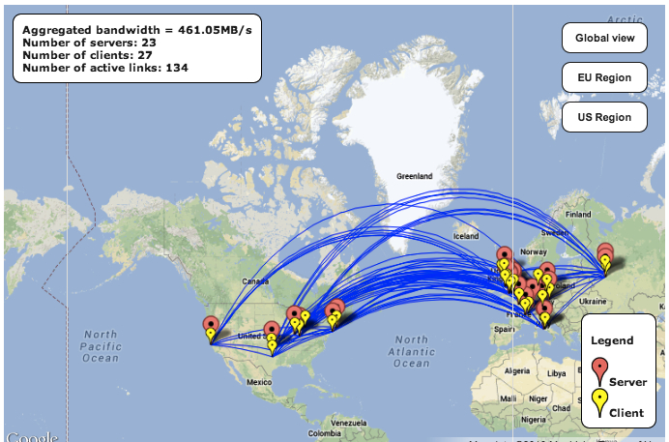
ATLAS FAX Infrastructure (From Rob Gardner)
Provides a global namespace
Unifies dCache, DPM, Lustre/GPFS, Xrootd storage backends
Xrootd an efficient protocol for WAN access
Main Fall-back use case in production at many sites
Regional redirection network provides lookup scalability
A powerful capability which must be introduced to production carefully

Slide 13
HEP Deployment
LHC ALICE
  Data catalog driven federation
LHC ATLAS
  Regional topology
LHC CMS
  Uniform topology
LSST (Large Synoptic Sky Telescope)
  Clusters mySQL servers for parallel queries

Slide 14
Conclusion
Federated storage is key for big data
  Distributed management + uniform access
    Preserves administrative autonomy
    Inherently scalable
      The whole is greater than the sum of its parts
XRootD provides flexible federation
  Addresses volume, velocity, and variety
    Three main big data challenges

Slide 15
Acknowledgements
Current Software Contributors
  ATLAS: Doug Benjamin, Patrick McGuigan,
  CERN: Lukasz Janyst, Andreas Peters, Justin Salmon
  Fermi: Tony Johnson
  JINR: Danila Oleynik, Artem Petrosyan
  Root: Gerri Ganis, Bertrand Bellenet, Fons Rademakers
  SLAC: Andrew Hanushevsky, Wilko Kroeger, Daniel Wang, Wei Yang
  UCSD: Matevz Tadel
  UNL: Brian Bockelman
  WLCG: Fabrizio Furano, David Smith
US Department of Energy
  Contract DE-AC02-76SF00515 with Stanford University

