Slide 1
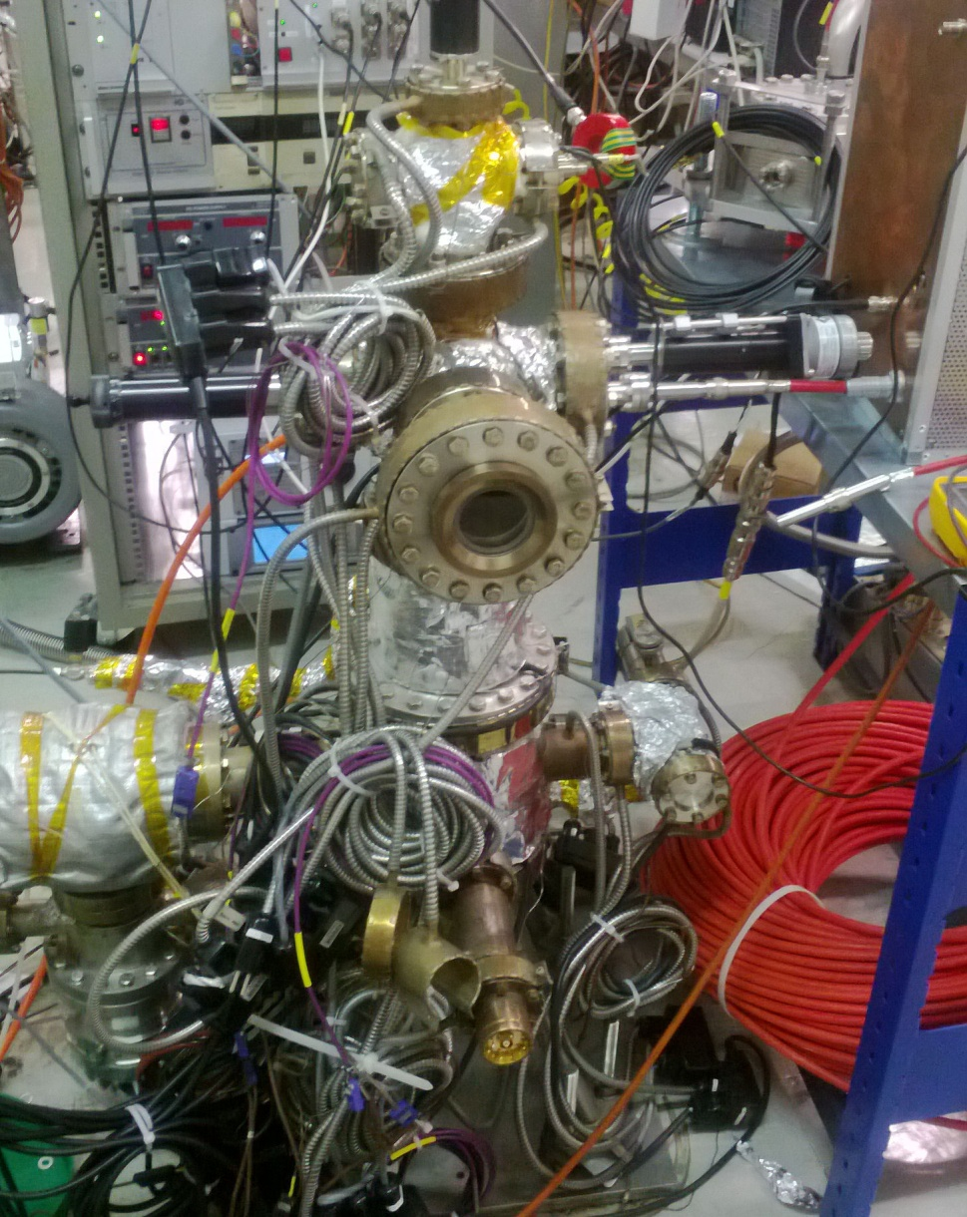
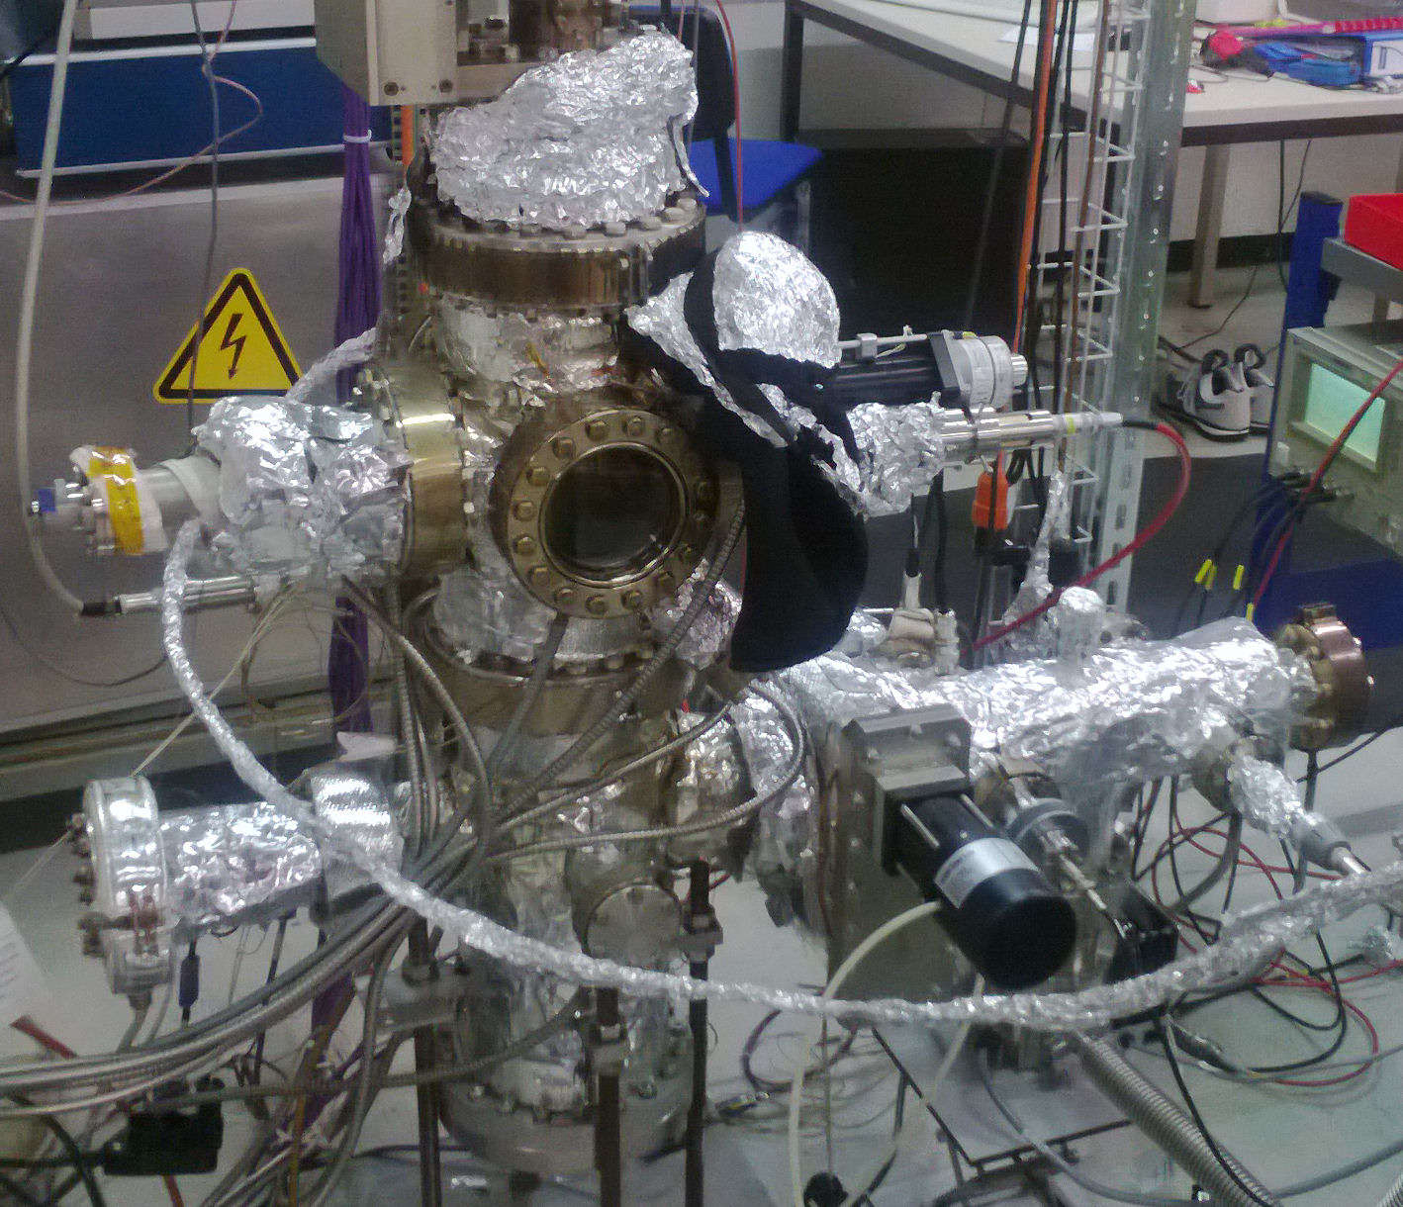
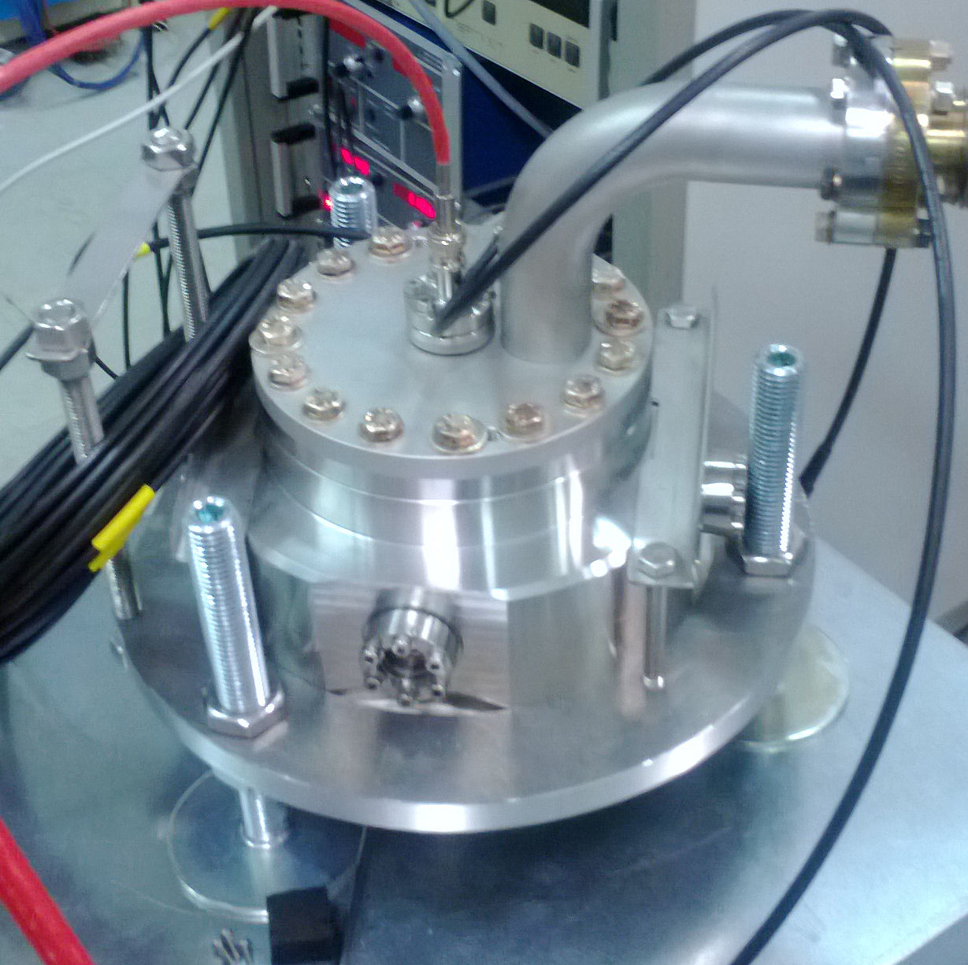
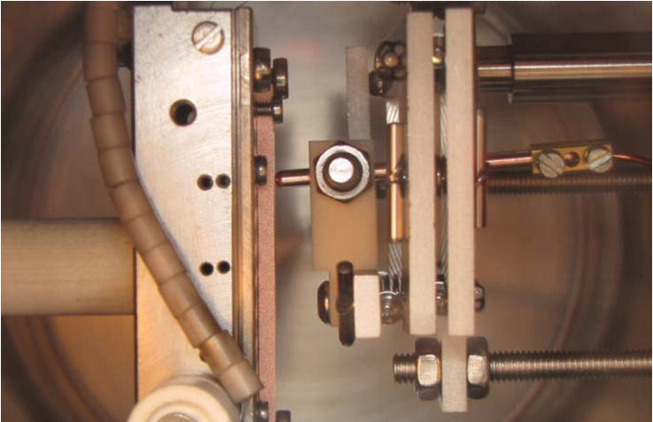
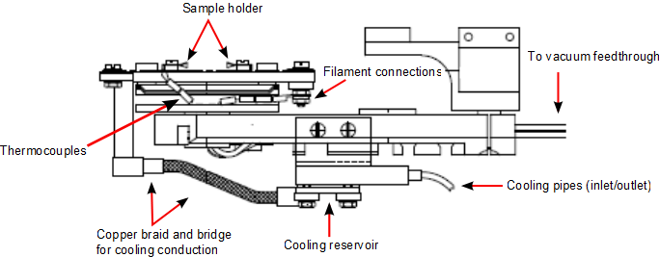
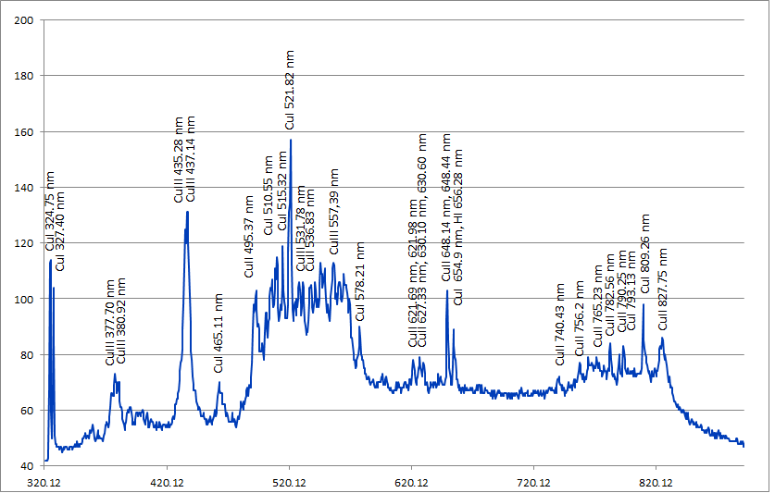
Instrumentation developments in the DC spark systems at CERN
Anders Korsbäck, Nicholas Shipman, Tomoko Muranaka, Iaroslava Profatilova
CERN, Geneva, Switzerland
Susceptibility to electrical breakdown is currently the main limitation on achievable acceleration gradients in accelerating structures. Hence, finding ways of decreasing breakdown susceptibility is of paramount importance for the economics of linear accelerator construction. The Compact Linear Collider (CLIC) has a design goal of 100 MV/m acceleration and a breakdown rate (BDR) of < 3x10⁻⁸ per RF pulse and metre of accelerating structure, a goal current prototype structures are unable to achieve. Three DC spark systems exist at CERN for the study of the effect of different conditions and electrode materials on breakdown. A pin-shaped anode and a cathode plate form a spark gap, and by using kV voltages and µm gap sizes, electric fields of comparable magnitude to those used in accelerating structures are achieved. A presentation of recent instrumentation development follows.
Overview
Spark System I is optimized for achieving a high repetition rate, achieved through HV transistor switching. This allows for BDR statistics to be collected in experiments where the gap is exposed to short voltage pulses mimicking those an accelerating structure is subjected to.
Spark System II allows for the measurement of field emission current at the breakdown site, allowing for the field enhancement factor β and the local enhanced field strength to be measured.
The Fixed Gap System has a fixed gap between two large surface electrodes, reducing error from uncertainty in gap size and providing a large surface for BD to happen over. It is compact to allow it to be mounted inside an electromagnet to study BD under external magnetic fields.
Non-contact gap control
As electric field strength is inversely proportional to gap size, a relative uncertainty in the gap size directly causes an equal relative uncertainty in field strength, making precise setting and maintenance of gap size important. Previously, the gap was set using a manually operated linear screw, going into contact and withdrawing the required amount. This method lacks the ability to monitor the gap after having set it, making the setting susceptible to inaccuracy from mechanical backlash and leaving gap size susceptible to drift over the course of measurements, particularly due to thermal expansion when temperature control is used. Also, going into contact might damage the cathode at the point of contact and affect subsequent breakdown measurements.
For these reasons we have implemented capacitive gap measurement and control into System II. We use an LCR bridge meter to measure the capacitance between the electrodes, which is of pF order and negatively, monotonically dependent on gap size. We perform a calibration measurement by going into contact and measuring capacitance along the way, and then performing the actual breakdown measurements over a new, untouched spot. With repeat calibration measurements we can bring the uncertainty in gap size down to 1.20 um, and reset the gap regularly over the course of a measurement series.
Temperature control
Theoretical work (Nordlund & Djurabekova, Univ. of Helsinki) indicates an exponential dependency between temperature and breakdown rate. To study this dependency empirically, a temperature control system was implemented for System II, using electron bombardment for heating and a circuit of liquid nitrogen for cooling of the cathode. We have a verified ability to achieve cathode temperatures ranging from 143 K to 1147 K.
Electrodes inside System II, with a 20 µm gap set. The cathode is fixed in position while the anode is moved by a linear actuator pushing the anode via a gearing system allowing it to be moved in sub-µm steps.
Illustrative diagram of the temperature controller of System II
Optical spectroscopy of plasma
System II has been upgraded by adding an optical spectrometer. This allows for characterization of the breakdown plasma and for the extraction of information such as the relative prevalence of different ions and their respective time-evolutions. Such information is valuable to provide input for and validation of breakdown plasma simulations.
Example of optical spectrum of breakdown plasma, with spectral lines corresponding to known transitions marked
Example of calibration curve of gap capacitance as a function of gap size
Charging pulse gap measurement
System I has previously lacked any method of measuring gap size. The voltage pulse used to cause breakdown can be used to determine the capacitance of the gap by integrating the current resulting from the charging of the gap capacitance. Gap size is determined from capacitance as for System II. This method adds an additional uncertainty of up to 2 µm but requires no switching between gap measurement breakdown measurement.
Contact: anders.korsback@helsinki.fi

