Slide 1
HL LHC LAYOUT FROM Interaction POINT TO SEPARATION DIPOLE
Napa Valley, 8th April 2013
LARP – Hilumi collaboration meeting
E. Todesco
CERN, Geneva Switzerland
Acknowledgements: B. Dalena, M. Giovannozzi, R. De Maria, S. Fartoukh, B. Holzer, P. Fessia, M. Karppinen, A. Ballarino, J. P. Burnet, R. Ostojic, H. Prin, F. Toral, D. Ramos
Revised version 12 April 2013

Slide 2
WHERE ARE WE
January 2012
  Preliminary exploration of 4 layouts (120/140 mm, Nb-Ti and Nb₃Sn), both triplet and separation dipole
July 2012
  Aperture and technology selection, 150 mm Nb₃Sn
Summer 2012
  Estimates of heat load, shielding and cooling
  Target of 40 MGy, 5 mW/cm³ possibly reduced to 20 Mgy
    So same levels as in LHC – please remember
Fall 2012
  Conceptual design correctors
Winter 2012-2013:
  Powering, interconnections, layout from IP to D1

Slide 3
Layouts
LHC
Phase-I
Layout of Phase I and LHC [R. Ostojic, S. Fartoukh, Chamonix 2010]

Slide 4
layouts
LHC
Thick boxes are magnetic lengths
Thin boxes are cryostats
Phase I
HL LHC

Slide 5
QUADRUPOLES
150 mm aperture, 140 T/m, Q1 and Q3 split in two
  0.5 m between split cold masses (Q1 and Q3)
  0.5 m between end of magnetic length and end of the cryostat
  Substantial design work ongoing to [P. Ferracin, G. Ambrosio, H. Felice, F. Borgnolutti, S. Izquierdo, M. Juchno, H. Prin …]
Cryostat choices:
  We keep symmetry and modularity (two types only)
  Alternative: reducing number of cryostats from 4 to 3

Slide 6
ORBIT CORRECTORS
Requirement is to have 2.5 T m around Q2, and 4.5 T m between Q3 and D1
  Nested option to save space (4 m)
  2.1 T given by 50% margin with Mikko 4.6 mm
  width cable, one layer
    So 1.2 m and 2.2 m respectively allocated
Proposal for nested MCBX (M. Karppinen)

Slide 7

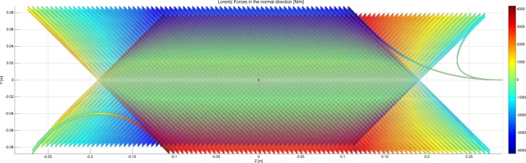
ORBIT CORRECTORS
Alternative options
  I would exclude design with two layers, 4 T, saving 2 m but having 4 times torque
  Canted dipole ? – Some preliminary work being done
Proposal for canted dipole [J. V. Nutgeren, S. Caspi]

Slide 8
NON LINEAR CORRECTORS
Superferric option, no nested, max saturation of 20% TF
  We satisfy the ABP requirements including a safety factor 2 for order 2,3,4 and a factor 1.5 for 5 and 6 corrector strength [F. Toral]
  Typical length of 100 mm – short coil ends
  Longer: skew quadrupole (730 mm) and b₆ ( 350 mm)
  a₂, b₃, a₃, b₄, a₄, b₅, a₅, b₆, a₆: nine objects
  Assume 100 mm distance coil to coil (80 mm magnet to magnet) – Total length is 2.5 m

Slide 9
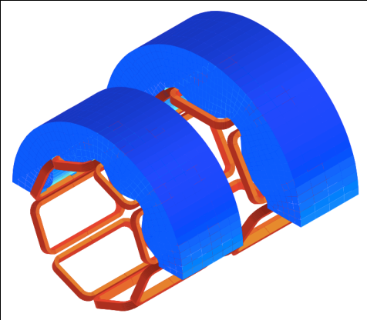
NONLINEAR CORRECTORS
Requirements based on tracking studies [M. Giovannozzi et al]
Problem of longitudinal
cross-talk being studied
[F. Toral, B. Auchmann]

Slide 10
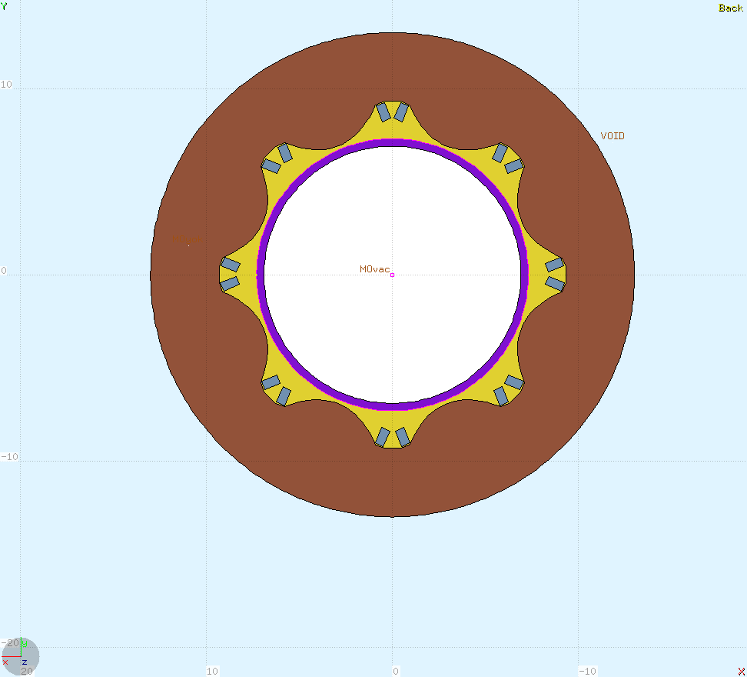
NON LINEAR CORRECTORS
Advantages
  Not nested – easier operation
  Very short heads (20 mm)
  Very robust to radiation
Alternative options
  LHC design – larger field so shorter magnet
  But longer heads

Slide 11
SEPARATION DIPOLE D1
35 T m required
  Assuming one layer of MB dipole cable, 5.2 T at 70% on the loadline – less than 6.7 m long [Q. Xu, T. Nakamoto]
  One layer reduces fringe field
  Alternative options: two layers, or reduce margin (in both cases we gain 1-2 m)
    I would wait to know heat load – first results coming in the next weeks

Slide 12
BPM position
Grey lines: position to avoid for BPM
  Multiple of 3.74 m [J. P. Koutchouk, R. Jones, and S. Fartoukh]
    Allowable band width ~1.5 m around optimal position – to be assessed
  So they are all ok except the last one between CP and D1

Slide 13
CURRENTS AND POWERING
Currents
  Quadrupoles: 17 kA (four circuits or one plus two trims)
  Corrector dipole: 2.4 kA (two times three circuits)
  Nonlinear correctors: 100 A (nine cicuits)
  Separation dipole: 11 kA (outer dipole cable)
Cooling [R. Van Weelderen]
  Triplet and orbit correctors: two HX, 80 mm, at 45 degrees
  Best option: a separate HX for D1 and corrector package

Slide 14
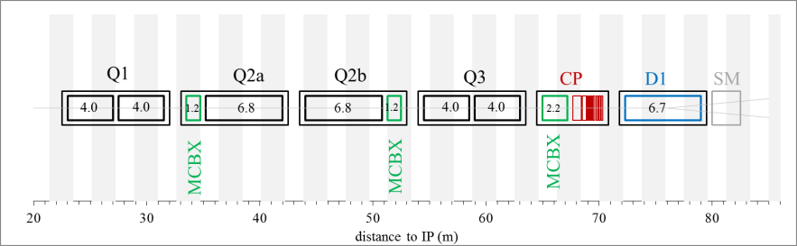
CURRENTS AND POWERING
Favourite option
actively cooled
actively cooled
Phase-separator &
Piping entries/exits
Phase-separator &
Piping entries/exits
Possible QRL-jumper
SM &
QRL-jumper
Phase-separator
Piping entries/exits
Q1,Q2a,Q2b,Q3: actively cooled for about 41 m, double-HXs needed
CP,D1 : actively cooled for about 16 m, double-HXs needed

Slide 15
CURRENTS AND POWERING
Currents
  Quadrupoles: 17 kA (four circuits or one plus two trims)
  Corrector dipole: 2.4 kA (two times three circuits)
  Nonlinear correctors: 100 A (nine cicuits)
  Separation dipole: 11 kA (outer dipole cable)
Cooling [R. Van Weelderen]
  Triplet and orbit correctors: two HX, 80 mm, at 45 degrees
  Best option: a separate HX for D1 and corrector package

Slide 16
CURRENTS AND POWERING
Currents
  Quadrupoles: 17 kA (four circuits or one plus two trims)
  Corrector dipole: 2.4 kA (two times three circuits)
  Nonlinear correctors: 100 A (nine cicuits)
  Separation dipole: 11 kA (outer dipole cable)
Cooling [R. Van Weelderen]
  Triplet and orbit correctors: two HX, 80 mm, at 45 degrees
  Best option: a separate HX for D1 and corrector package

Slide 17
CURRENTS AND POWERING
Three possibilities for the triplet
  One power converter, four magnet in series plus trims
    Discarded because of complexity
  Four power converter, one per magnet
    Discarded because too many kA to bring around
  This leaves one option …

Slide 18
CURRENTS AND POWERING
Powering layout 2 –proposed baseline [A. Ballarino, J. P. Burnet]
D1 Q3 Q2b Q2a Q1
SC Link
Quads
Q1
and Q3
Quads
Q2a
and Q2b
Dipole
Trim
Q3
Trim
Q2b
Leads
11 kA
17.3 kA
2 kA
0.2 kA
17.3 kA
+
-
+
-
-
+
-
+

Slide 19
WHO DOES WHAT (TENTATIVE)

Slide 20
RISKS
We have chosen the layout that maximizes performance
  This (obviously) does not minimize risk
Main concerns
  Large fraction of coils rejected – not suitable for production
    Producing and testing coils reduces the risk
  The choice of a cored cable has never been validated
    HQ02 will have it, we should have also HQ03
  If all resources switched on QXF we stay two years without data
  HQ started in 2009, in 5 years two magnet tested – too slow for QXF
    Acceleration on HQ needed – its results relevant for QXF design
How to minimize risks
  Profit of synergies with 11 T
  HQ03 should be planned and done asap
  Manufacturing and test of long coils should be pursed (LHQ)

Slide 21
CONCLUSION
We have a baseline from IP up to D1
This is needed to estimate the heat load on correctors and D1 [June 2013]
  So dimensioning cryogenics, iron holes, and possibly feeding back on aperture
    Do we really need 160 mm D1 aperture ?
    Do we need larger aperture for correctors ?
We will review the layout at the end of the year
  Feeding back more information on the heads and interconnections
Layout up to Q4 needed by June
  Work on D2 started [P. Wanderer, R. Gupta]
  Work on Q4 ongoing – final choice coming soon [M. Segreti, J. M. Rifflet]

