Slide 1

SPEAR3 Accelerator Physics
James Safranek for the SPEAR3 core team
  Lower Emittance
  Beam-based optimization algorithms
    MOGA coupling correction, (K. Tian et al.)
    RCDS online optimizer (X. Huang et al.)

Slide 2
Emittance Reduction (4.380 M$, FY13-15)
 | Achromat | Low emittance | “Lower” emittance | Superconducting damping wiggler
 | 2004-2007 | 2007-now | 20% injection | future
ε_{x0} (nm) | 18.0 | 11.2 | 6.8 | ~5.3
ε_{x}, IDs (nm) | 14.6 | 9.6 | 6.1 | 4.9
ε_{x,eff} (nm) | 14.6 | 10.1 | 6.7 | 5.65
η, ID (m) | 0 | 0.1 | 0.12 | 0.1
σ_{E} (permil) | 0.96 | 0.98 | 0.97 | 1.26
ν_{x} | 14.13 | 14.13 | 15.32 | 15.32
Cost (k$) 4380 ?
x’
x
  Effective emittance, ε_{x,eff} includes η_{x}:
Notes:
Note: can make vertical emittance as small as 5 pm, beyond beamline optics resolution.

Slide 3
Brightness (500 mA)
Brightness improvement: (x3, ε_{x})(x5, current)(top-off) = x20 total
Notes:
Will result in over a factor of 3 in brightness from emittance reduction since SPEAR3 started.
Add a factor of 5 for current + an additional factor from top-off - ~*20 increase in brightness from start of SPEAR3.

Slide 4
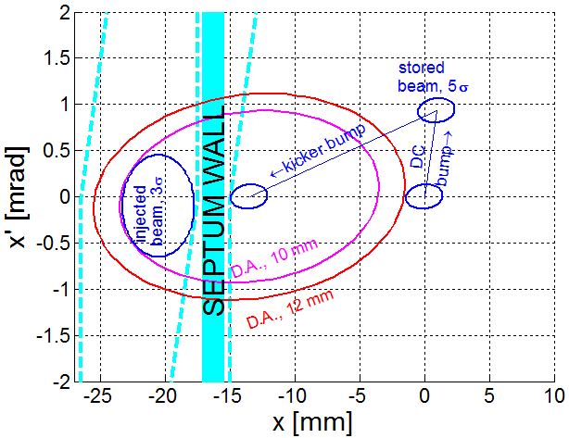
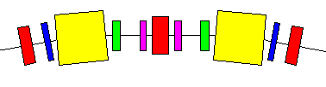
Injection optimization for lower ε_{x}
Reduce septum wall width
6.3 mm to 2.5 mm
Upgrade K2 injection kicker pulser
Improve dynamic aperture
  Increase number of sextupole power supplies from 4 to 10
  Individual supplies too costly
  MOGA optimization
Improve control of injected beam
(Reduce injected beam emittance)
Arc cell:
QF
QD
QFC
QD
QF
BEND
BEND
SD
SF
SF
SD
Notes:
Mention that 72 PSs gives negligible improvement.

Slide 5
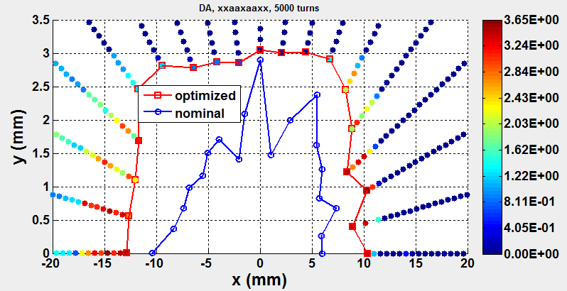
Benefit of additional sextupole power supplies
log10(turns)
Dynamic aperture improved
Sextupole strength distribution

Slide 6
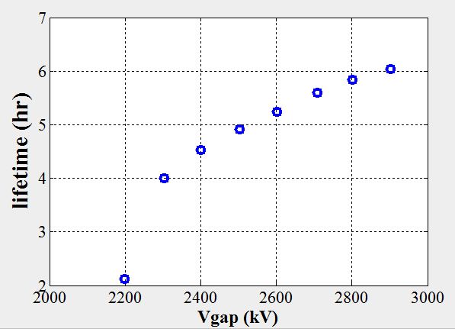
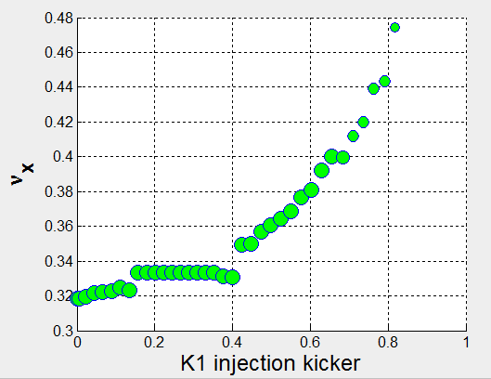


Experiments with lower ε_{x} lattice
20% injection efficiency
Corrected linear optics (LOCO), ε_{y} = 4 pm
Measurement of chromaticity (w/ high order)
Energy acceptance
3ν_{x} resonance characterization
Injection rate vs. tune scan
Measurement of detuning coefficients
6 hour lifetime
ε_{y} = 8 pm
500 mA

Slide 7
Automated beam-based optimization
Motivation
  USR designs fine-tuned with detailed analytical and computational optimization
  As built machines are never exactly as designed
  Need to develop detailed beam-based optimization
Techniques
  K. Tian et al. (to be published)
    Genetic optimization
    Minimize ε_{y}
    Maximize measured beam loss as function of 13 skew quadrupoles
  X. Huang et al. (NIMA 726, 2013)
    New optimization algorithm, RCDS (robust conjugate direction search)
    Tested in simulation and online
    Optimization of injection efficiency, coupling, kicker bump matching

Slide 8
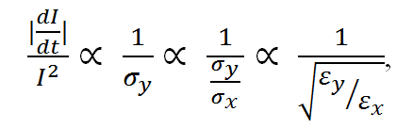
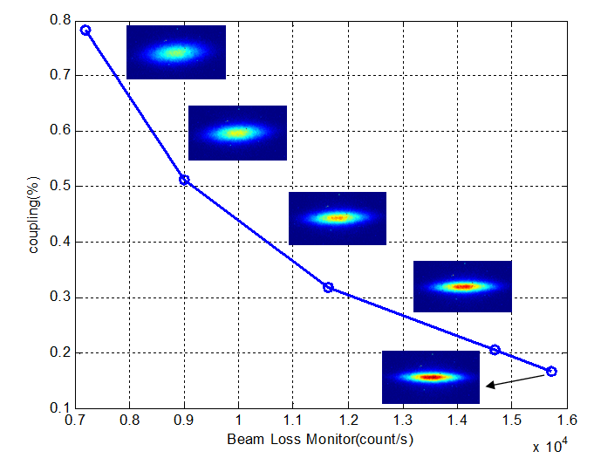
Beam Loss Rates and Coupling
K. Tian et al.
By inserting the horizontal scraper, we collect most of the touschek beam loss at one location. A simple scaling for beam loss rates, beam size, and the linear coupling is (assuming ε_{x} and σ_{x} are constant):
Experimental Verification:
1/σ_{y} (1/μm)
coupling (%)
DCCT loss rate (A.U.)
loss monitor (counts/s)
loss monitor (counts/s)
Minimize Coupling
Maximize Loss Rates

Slide 9
Machine Based GA for Maximizing Beam Loss Rate
K. Tian et al.
Decision Variables: 13 skew quads
Objective Functions: Measured Beam Loss Rates
Population size: 120
Genetic Operators: real-coded Simulated Binary Crossover (SBX) and polynomial mutation
normalized beam loss
(cnts/mA²)
current (A)
220 generations for over 9 hours
time (s)
skew quadrupole
Comparison of linear coupling and beam loss:
 | LOCO | GA
Linear Coupling | 0.0605% | 0.0461%
Normalized Beam Loss rate | 2.07 | 2.44

Slide 10
Robust Conjugate Direction Search, RCDS
X. Huang et al.
Fast, minimize objective evaluations
Robust – surviving noise, outliers and machine failures
Algorithms considered:
  Gradient based method are not considered because of noise.
  Iterative 1D scan (that automates manual tuning procedure)
  Nelder-Mead (downhill) simplex method
  MOGA (Not efficient).
  Powell’s conjugate direction method
  Robust conjugate direction method (RCDS) – A combination of Powell’s method and a new noise resistant line optimizer.

Slide 11
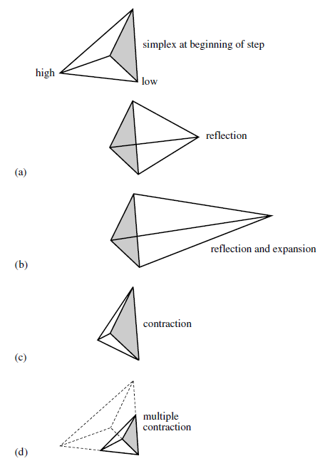
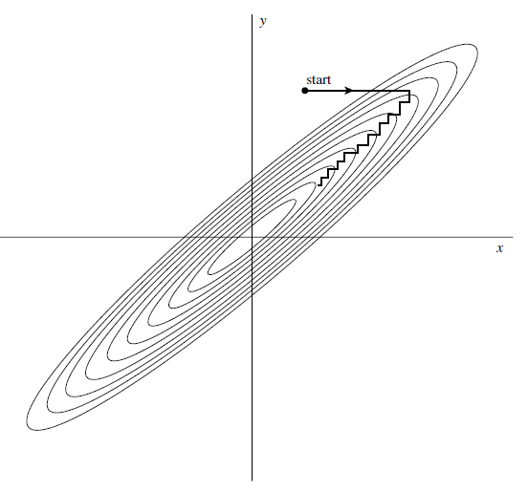
Parameter scan and simplex methods
Iterative parameter scan may be inefficient. In a common situation depicted above, each x- or y-scan makes a tiny step downward*.
Simplex method may fail to reach the optimum when noise starts to change results of vertex comparison.
*W.H. Press, at al, Numerical Recipes

Slide 12
The robust line optimizer
objective
Initial solution
conjugate variable
Step 1: bracketing the minimum with noise considered; scan until Obj-Obj_{min} > 3σ
Step 2: Fill in empty space in the bracket with solutions and perform quadratic fitting. Remove any outlier and fit again. Find the minimum from the fitted curve.
Global sampling within the bracket helps reducing the noise effect.
RCDS is Powell’s conjugate method* + the new robust line optimizer.
*however, since the online run time is usually short, it is important to provide a good initial conjugate direction set which may be calculated with a model.

Slide 13
RCDS tests – simulation and experiments
Simulation
  SPEAR3 coupling
  Transport line optics
Experiments
  SPEAR3 coupling
  Kicker bump match
  Injected beam steering
  Transport line optics
coupling ratio
RCDS fast & effective
#objective evaluations
β-oscillation (μm)
-DCCT loss rate (mA/min)
#objective evaluations
#objective evaluations

Slide 14
The Matlab RCDS package
The RCDS algorithm is implemented in Matlab.
Features
  Each parameter has a specified range, i.e., the parameter space is bounded. This is important for online application.
  The parameter space is normalized to a hyper unit cube (each parameter normalized to [0, 1]).
  Optimization algorithm is decoupled from the specific application. Application to a new problem is done by defining the objective function. Users need not to look into the algorithm.
  Data are saved in Matlab global variable space and won’t get lost (unless Matlab crashes).
This package is available.

Slide 15
Summary
Plans to reduce SPEAR3 emittance to 6 nm
  10²⁰ brightness
  Probably close to limit for SPEAR3 geometry
  5 nm with S.C. damping wigglers
  Ideas?
Beam-based optimization algorithm development
  MOGA coupling correction, (K. Tian et al.)
    Publication soon
  RCDS online optimizer (X. Huang et al.)
    NIMA 726, 2013
    Code available (ask Xiaobiao)

Slide 16
Extra slides beyond this point

Slide 17
Comparison of performance (best of 6-s cases)
The IMAT method uses the same RCDS line optimizer, but keep the direction set of unit vectors (not conjugate).
Clearly,
the line optimizer is robust against noise.
Searching with a conjugate direction set is much more efficient.
Note that the direction set has been updated only about 8 times after 500 evaluations (out of 13 directions). So the high efficiency of RCDS is mostly from the original direction set.

Slide 18
Transport line optics
BTS transport line optics matching
  Varying 6 quads in BTS for optics matching between transport line and storage ring.
  Noise is generated from the finiteness of the number of particles. With 1000 particles in a distribution, the noise sigma of injection efficiency is 1.6%.
  Initial conjugate direction set is from SVD of beam moments (elements of the σ-matrix) w.r.t. quads.
  Dynamic aperture of the ring is intentionally shrunk to 12.5 mm in the simulation.

Slide 19
Coupling correction with loss rate
Beam loss rate is measured by monitoring the beam current change on 6-second interval (no fitting). Noise sigma 0.04 mA/min.
Data were taken at 500 mA with 5-min top-off.
Initially setting all 13 skew quads off. Loss rate at about 0.4 mA/min.
Final loss rate at about 1.75 mA/min.
At 500 mA, the best solution had a lifetime of 4.6 hrs. This was better than the LOCO correction (5.2 hrs)
On a later shift (5/6/2013), with 6-s DCCT data fit for loss rate, loss rate reached >2.0 mA/min at 500 mA and lifetime was 4.2 hrs.

Slide 20
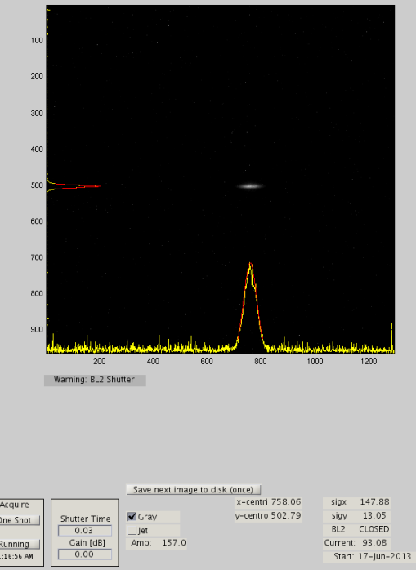
Coupling correction with pinhole camera
Sigmay noise level at 0.3 micron.
All 13 skew quads were off initially.
Experiments were done with septum off (while beam loss-based experiments were with septum on).
The operation lattice (with lifetime 8.4 hrs at 500 mA) has a vertical beam size of sigmay = 20 um.
The best solution from this run had sigmay = 13 um.

Slide 21
Kicker bump matching
Parameters: Adjusting pulse amplitude, pulse width and timing delay of K1 and K3 (with K2 fixed) and two skew quads for vertical plane (This is the setup by James for kicker bump matching), 8 parameters total.
Objective: sum of rms(x) and rms(y) of turn-by-turn orbit (for 30~300 turns).
First time of getting kicker bump for low alpha lattice matched.
The LA20 lattice matching was further improved on a second shift.

Slide 22
Injected beam steering for SPEAR3
Use four end steering magnets in the BTS transport line to steer the injected beam.
The objective function is injection efficiency.
Low betay lattice
Injection efficiency noise level: sigma=1%.
Low betay lattice

Slide 23
BTS optics
For injection optics matching, ideally we need to decouple the steering effect of quadrupole changes (when beam trajectory is off-center). But we haven’t done that yet.
To test the algorithm, we changed the 9 BTS quads setpoints randomly to mess up injection and use the code to bring injection back.
Knobs: 9 BTS quads.
Objective: injection efficiency.

