Slide 1




Charging pulse gap measurement
Nick Shipman 16.04.2013

Slide 2
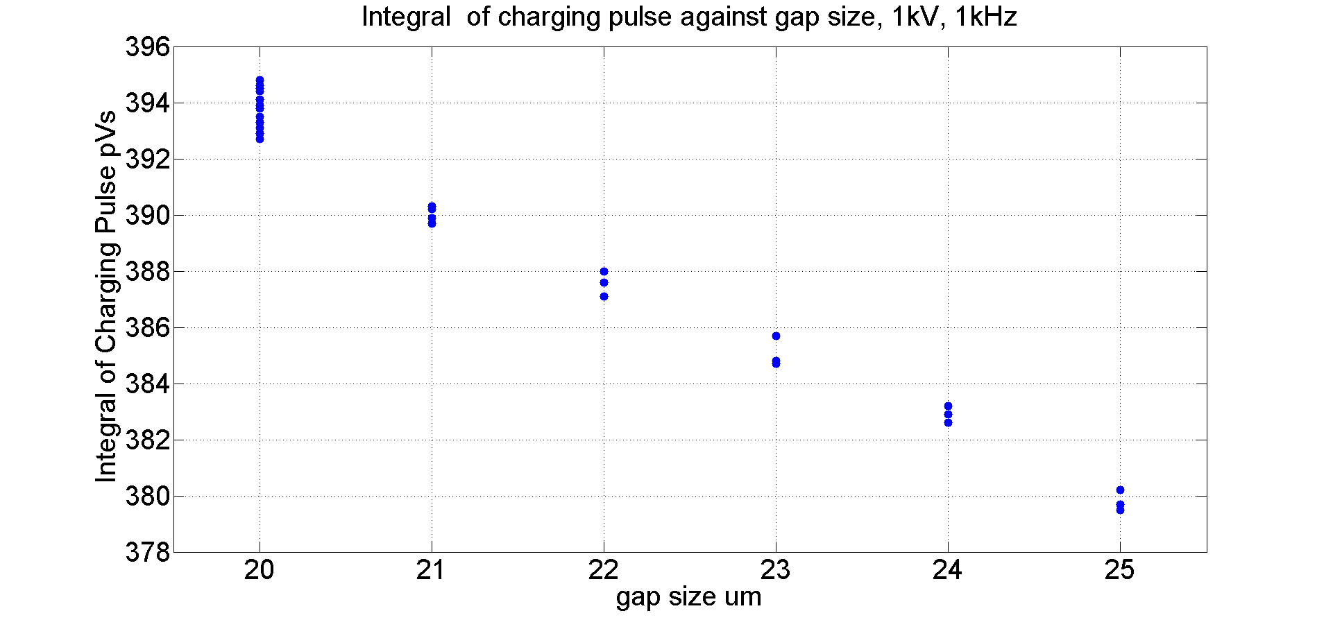
Results so far!

Slide 3
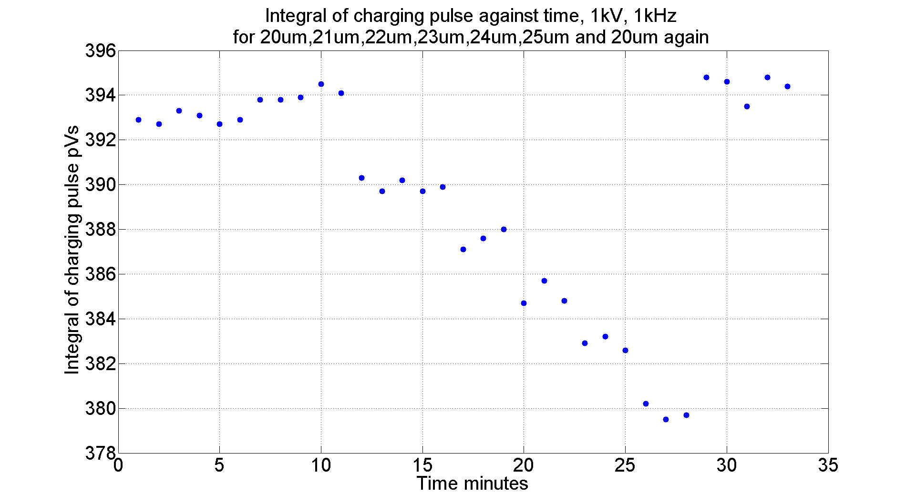
Results so far!

Slide 4
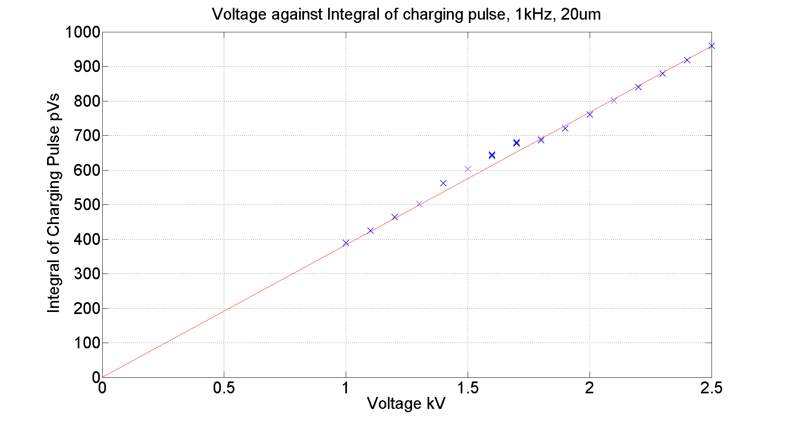
Results so far!

