Slide 1



Production of radioactive molecular beams
Christoph Seiffert
CERN-ISOLDE \TU Darmstadt
Supported by the Wolfgang Gentner programme

Slide 2
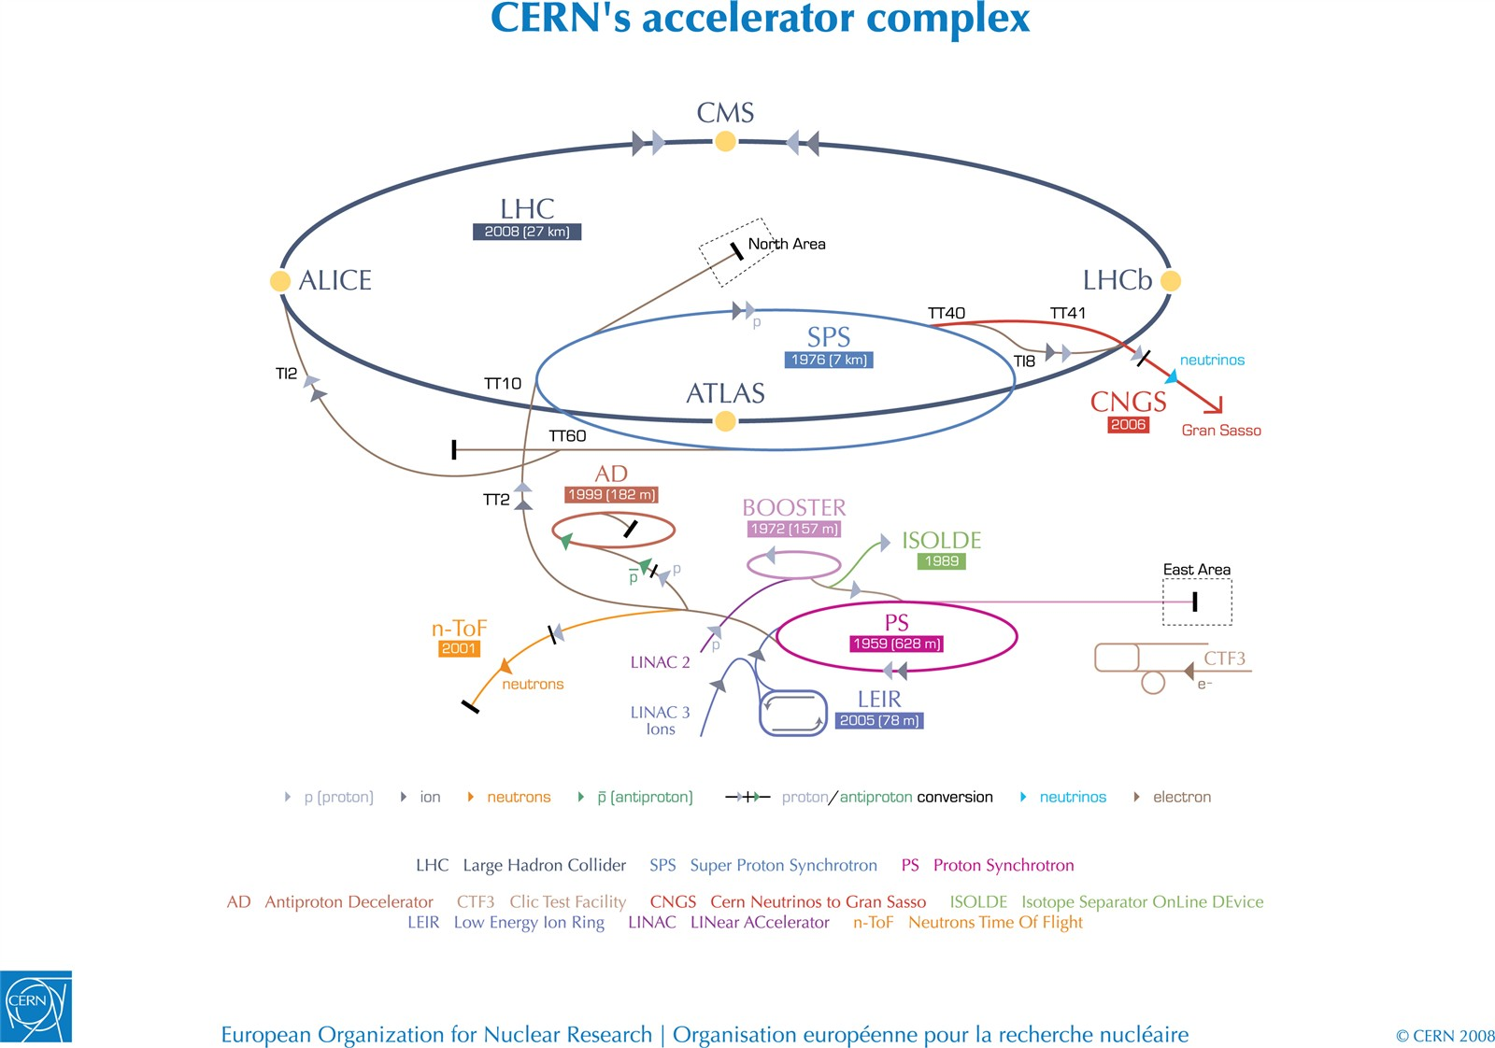
CERN/ISOLDE
https://mediastream.cern.ch/MediaArchive/Photo/Public/2008/0812015/0812015/0812015-A4-at-144-dpi.jpg

Slide 3
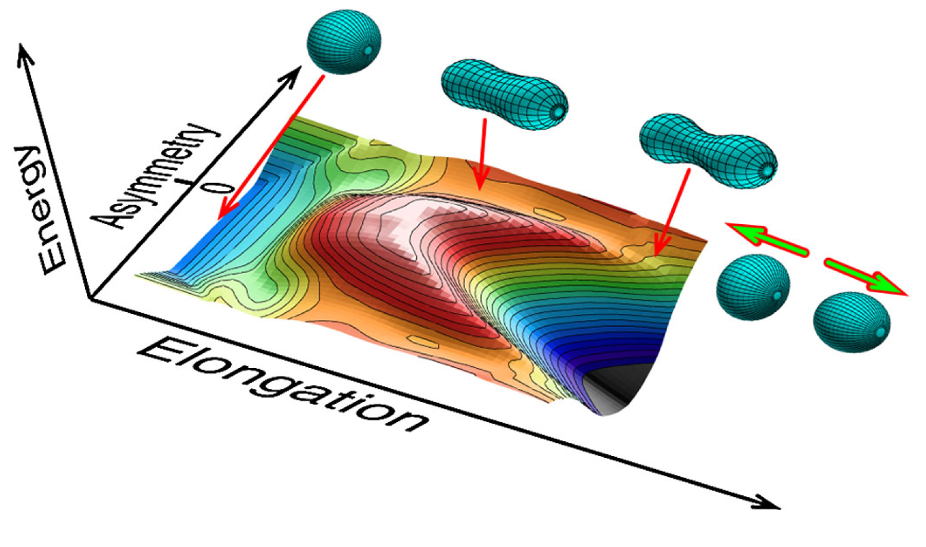
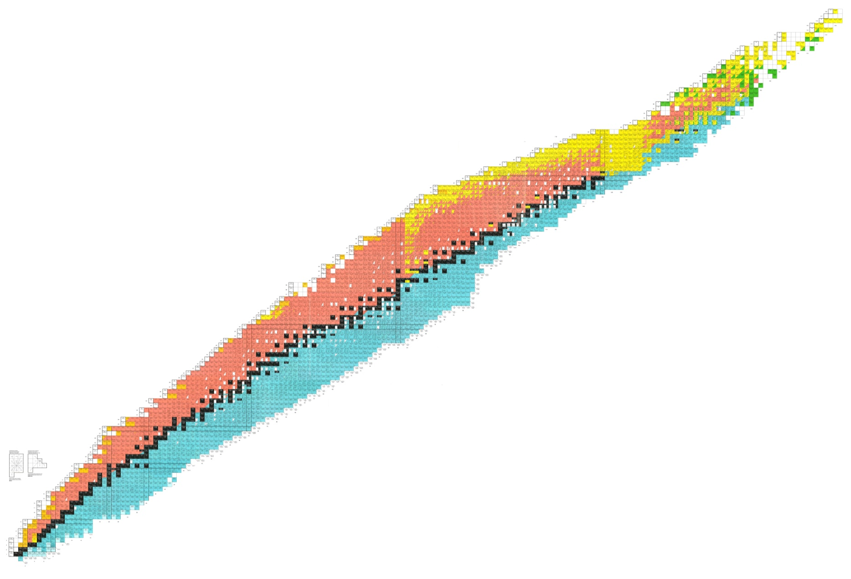
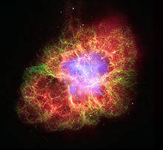
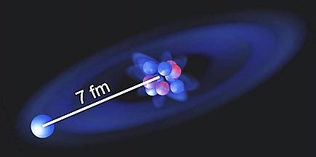
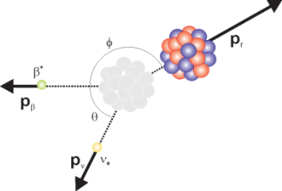
The Nuclear Chart
Isoltrap: ²³³Fr, ²²⁹Rn - new isotopes (K. Blaum et al.)
Windmill: Asymmetric β-delayed fission of ¹⁸⁰Tl
(A. N. Andreyev et al.)
Collaps: Size and Shape of Exotic Nuclei
Precision measurement of ⁸²Zn mass
(S. Kreim et al.)
Halo nucleus ¹¹Be
W. Nörtershäuser et al.
Witch: Fundamental Symmetries
P
β-decay of ³⁵Ar
(M. Breitenfeld et al.)
Biophysics
First β-NMR experiment on soft matter
(M. Stachura et al.)
N

Slide 4

The Nuclear Chart
Strong physics interest
  8-Boron:
    Neutrino source, β-beams
    Halo nuclei
    Boron as semi conductor dopant
  9-Carbon:
    Investigations on 10-N
    Decay structure
P
N

Slide 5
The Nuclear Chart
Short lived isotopes of some light nuclei not available
Reasons:
  High boiling points
  High adsorption enthalpy
  Chemical reactivity
9-C seen once for 24h. Why?
Isotope | Half life | Boiling point [C]
8-B | 770ms | 3927
9-C, 17-C | 123ms/175ms | 3642
P
N

Slide 6
The Nuclear Chart
Short lived isotopes of some light nuclei not available
Reasons:
  High boiling points
  High adsorption enthalpy
  Chemical reactivity
Isotope | Half life | Boiling point [C]
8-B | 770ms | 3927
9-C, 17-C | 123ms/175ms | 3642
P
Extract isotopes as molecular ions: CO+, BF2+
N

Slide 7
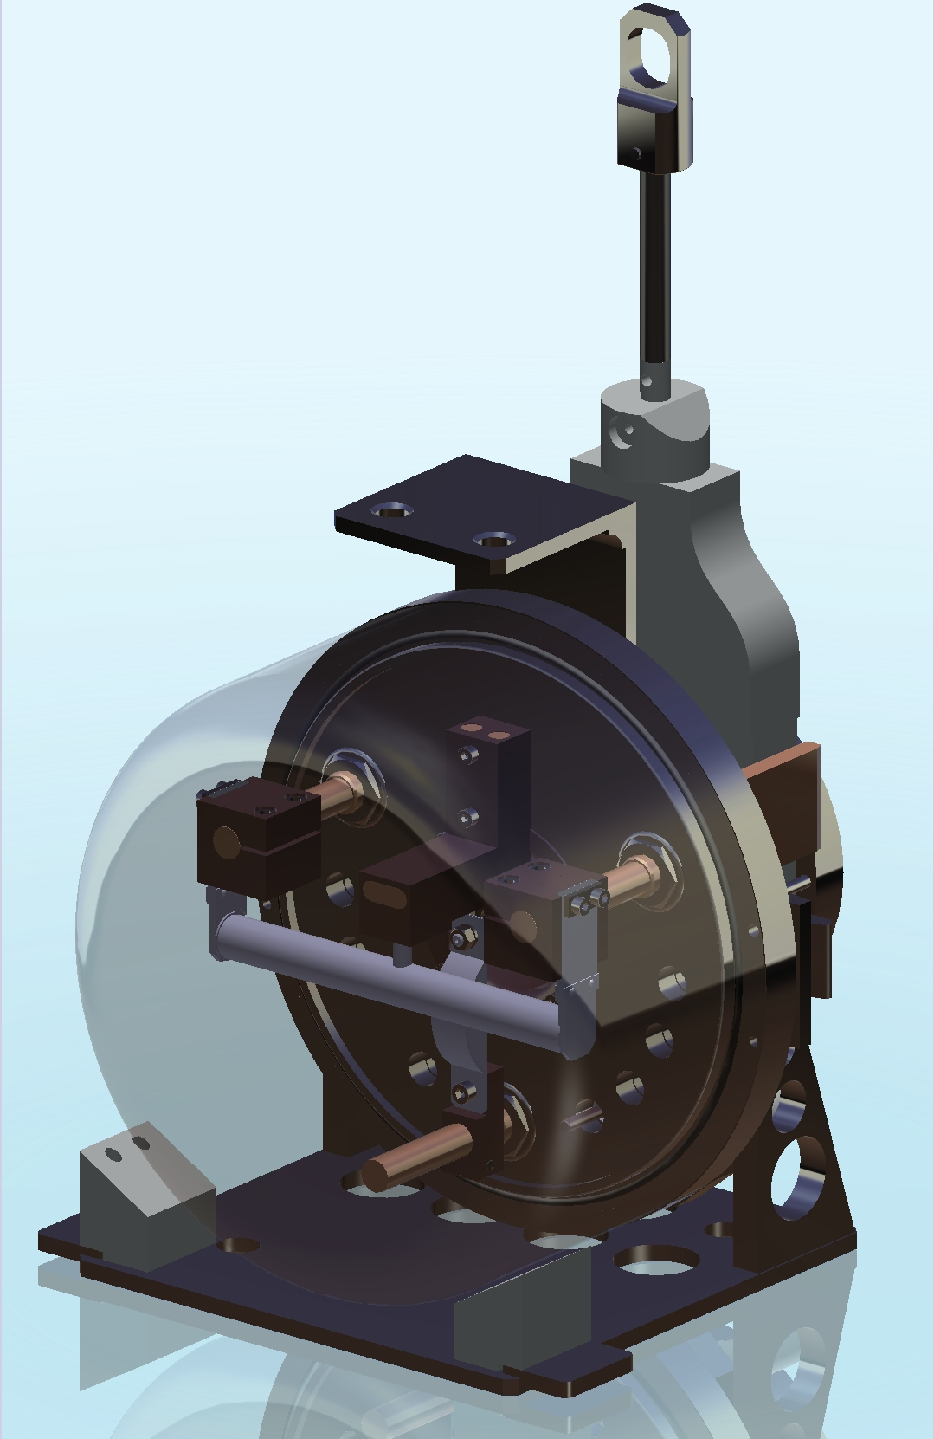
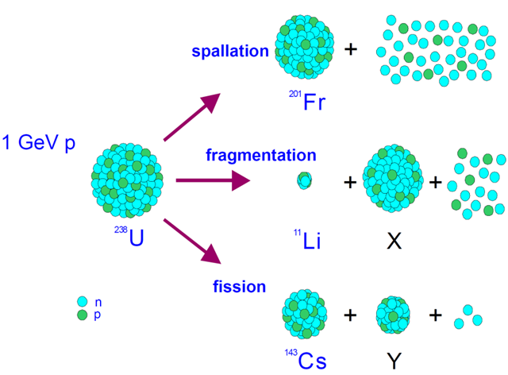
Production of Radioisotopes
spallation
²⁰¹Fr
1.4 GeV
proton
fragmentation
²³⁸U
¹¹Li
X
fission
¹⁴²Cs
Y

Slide 8
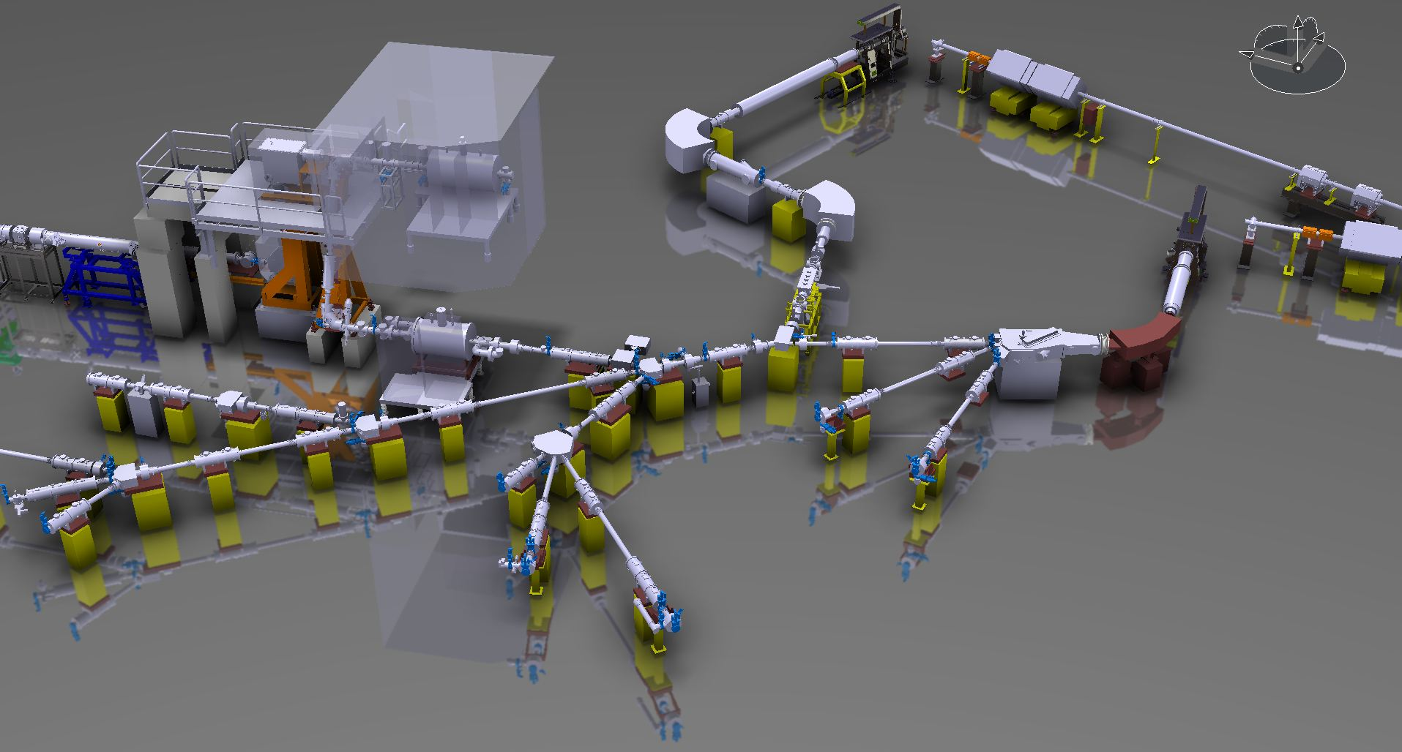
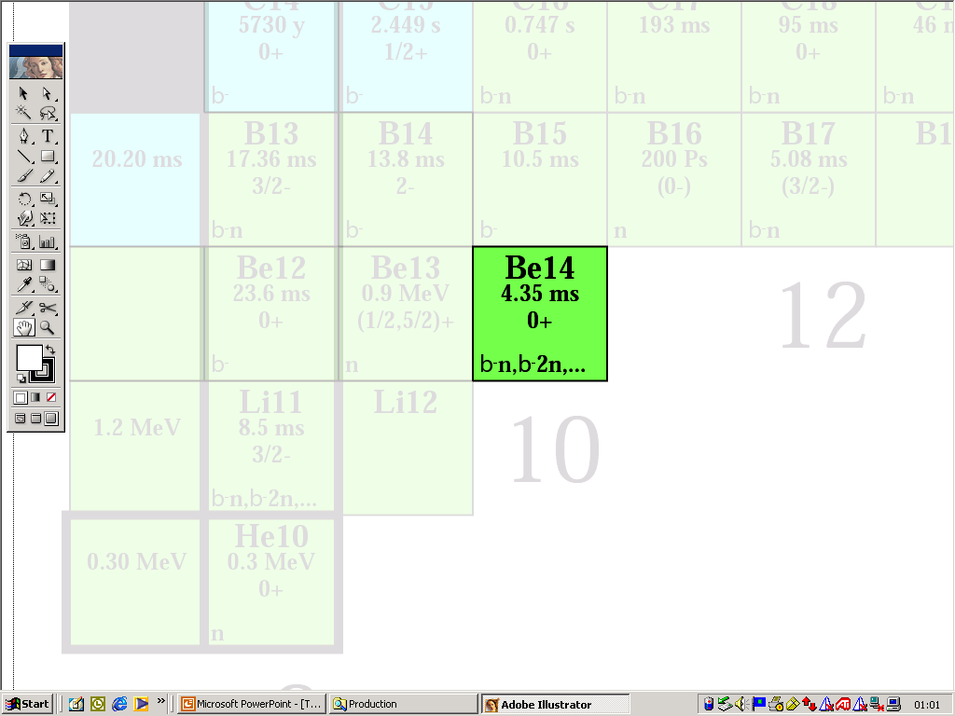
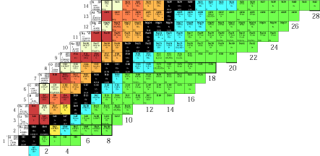
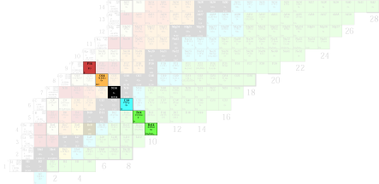
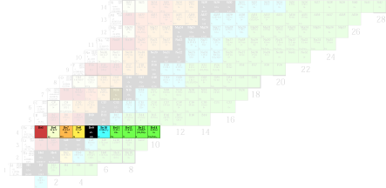

Selection Process
HRS
FE 6
FE 7
GPS
beam lines

Slide 9
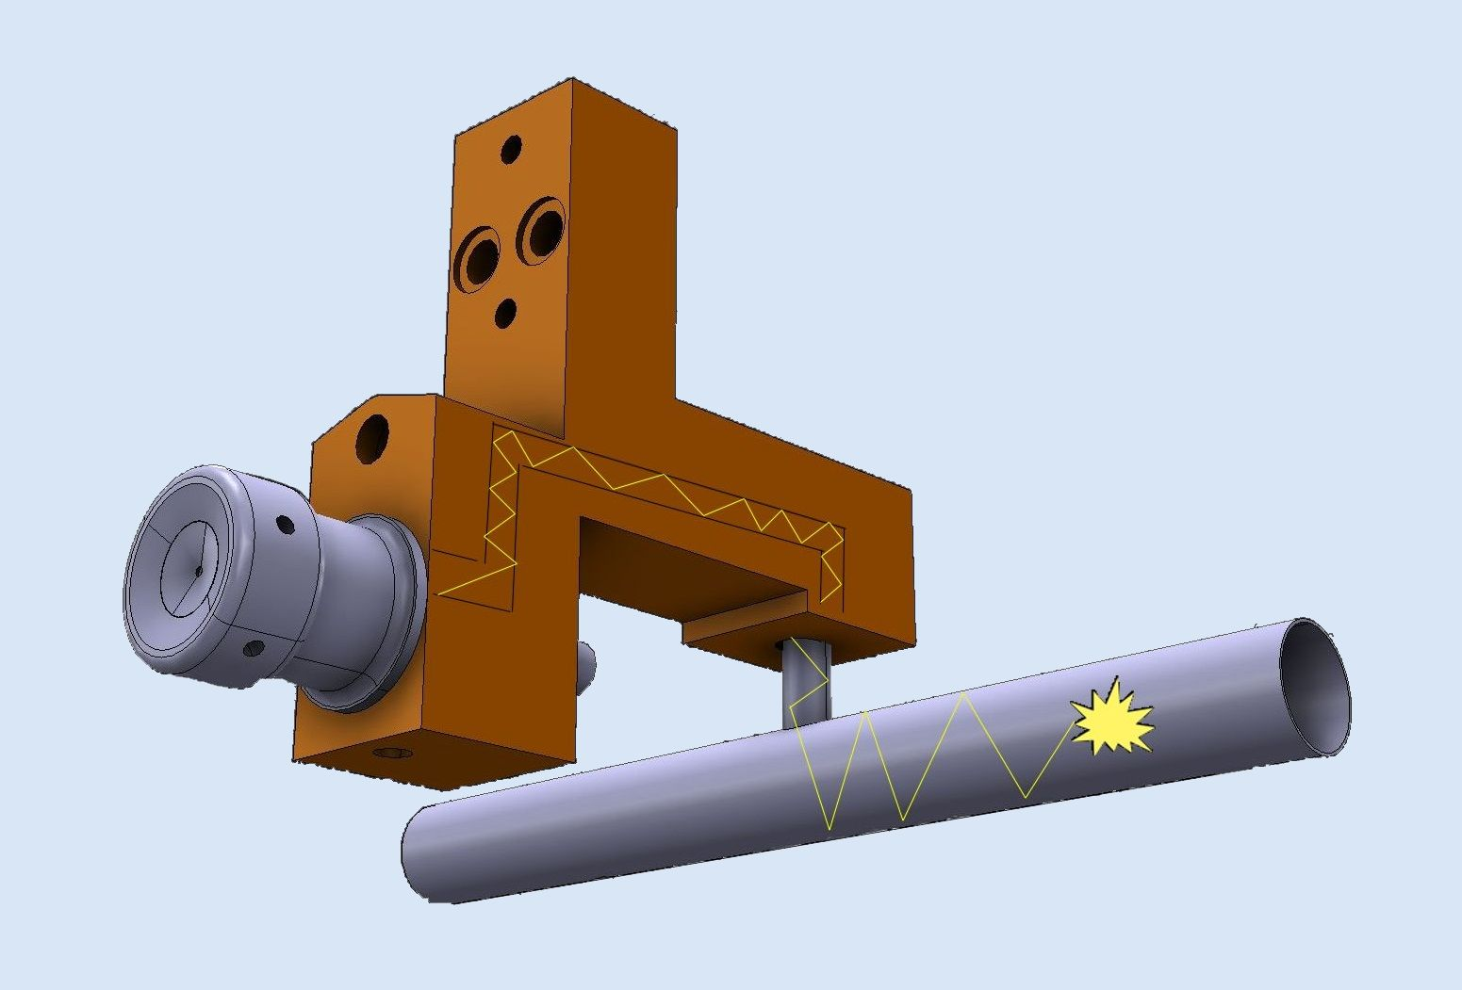
Steps In Isotope Extraction
Effusion: interaction with target and line
Isotope production
Ionization
Diffusion
Molecule formation
I=I₀ *exp(-λ*(t_{diff}+t_{eff}))*ε_{(ion source)} *ε_{(formation)}* ε_{(chemical loss)}

Slide 10

Isotope Production
Effusion: interaction with target and line
Isotope production
Protons
Ionization
Diffusion
Molecule formation
1.4 GeV proton beam from Booster
Depending on target material isotope production with cross section σ

Slide 11
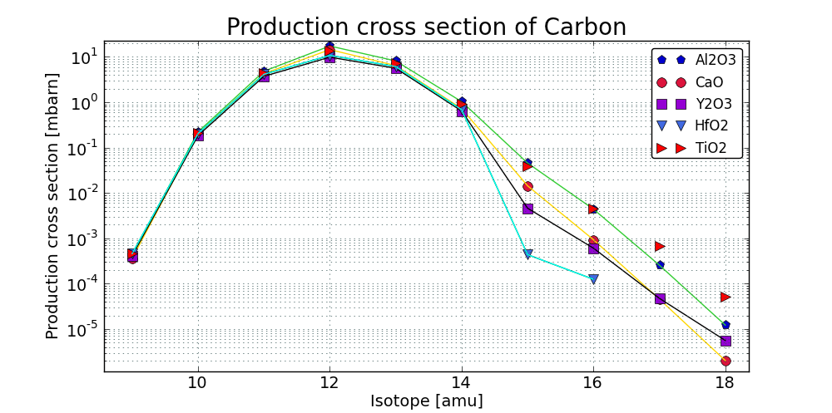
Isotope Production
I=I₀ *exp(-λ*(t_{diff}+t_{eff}))*ε_{(ion source)} *ε_{(formation)}* ε_{(chemical loss)}
I₀=n_{p}*σ*δ_{A}
Computed with ABRABLA

Slide 12
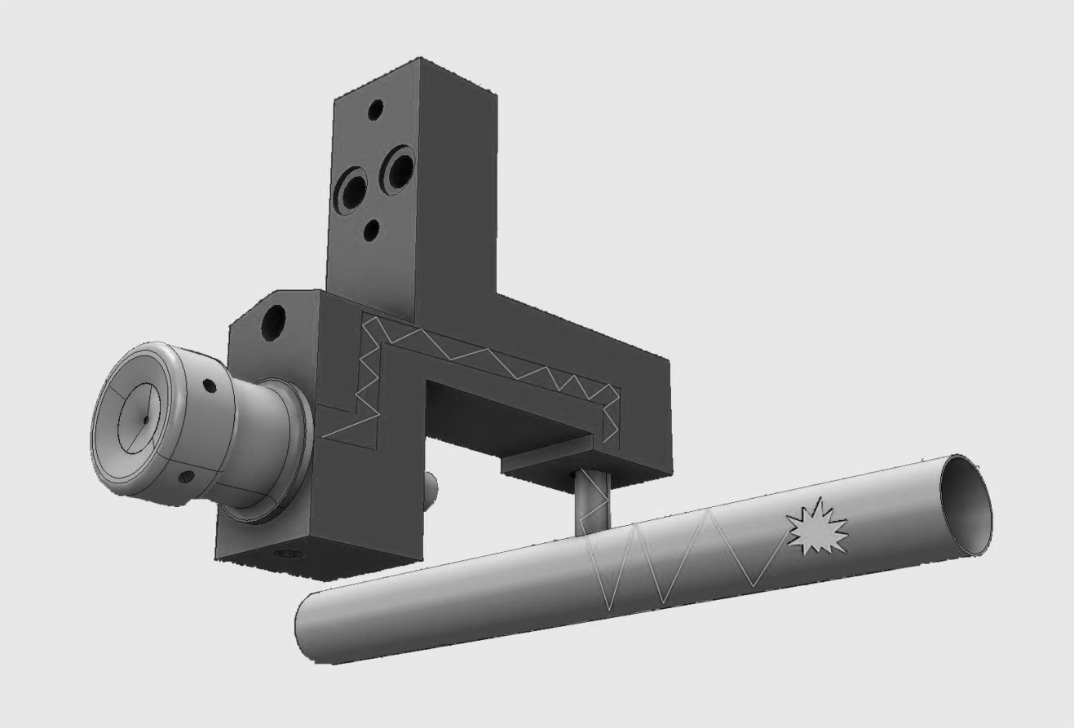
Steps In Isotope Extraction
Effusion: interaction with target and line
Isotope production
Ionization
Diffusion
Molecule formation
I=I₀ *exp(-λ*(t_{diff}+t_{eff}))*ε_{(ion source)} *ε_{(formation)}* ε_{(chemical loss)}

Slide 13
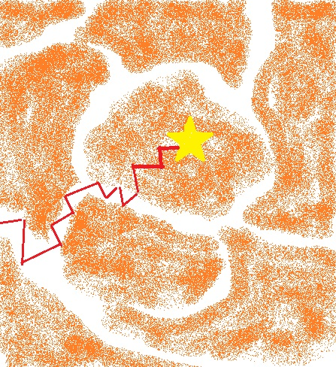

Diffusion
Arrhenius equation
  $D\left(T\right)=D0∗exp⁡(−\frac{Ea}{R∗T})$ D0: maximum diffusion coefficient [cm2/s]
        Ea: activation energy
I=I₀ *exp(-λ*(t_{diff}+t_{eff}))*ε_{(ion source)} *ε_{(formation)}* ε_{(chemical loss)}

Slide 14
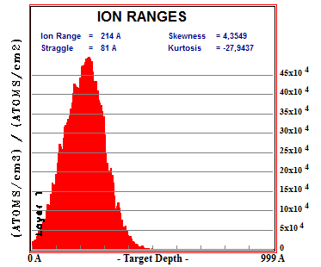
Studies on Boron
Diffusion studies with boron neutron depth profiling method (bndp) [10-B(n,α)7-Li ]
  Step 1: Implantation of 10-B as 10-BF2 into target materials
12.5 keV 10-B in Carbon
+
B
+
F
F
B
F
F

Slide 15
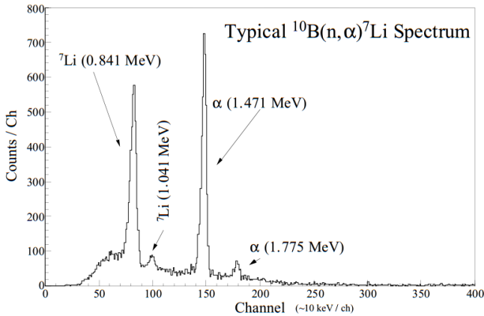
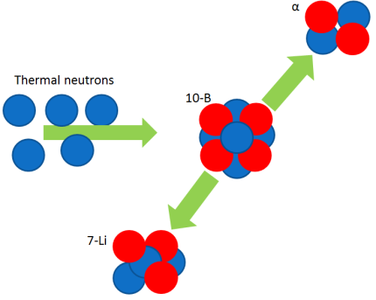
Studies on Boron
Diffusion studies with boron neutron depth profiling method (bndp) [10-B(n,α)7-Li ]
  Step 1: Implantation of 10-B as 10-BF2 into target materials
  Step 2: Measurement of (initial) distribution
    σ_{[10-B(n,α)7-Li ]}=3840 barn
    Pu-Be source: 1.1*10^8 neutrons/second @4Pi
    Same effect used in cancer therapy
α detector

Slide 16
Studies on Boron
Diffusion studies with boron neutron depth profiling method (bndp) [10-B(n,α)7-Li ]
  Step 1: Implantation of 10-B as 10-BF2 into target materials
  Step 2: Measurement of (initial) distribution
    σ_{[10-B(n,α)7-Li ]}=3840 barn
    Pu-Be source: 1.1*10^8 neutrons/second @4Pi
  Step3: Heating of Sample

Slide 17
Studies on Boron
Diffusion studies with boron neutron depth profiling method (bndp) [10-B(n,α)7-Li ]
  Step 1: Implantation of 10-B as 10-BF2 into target materials
  Step 2: Measurement of (initial) distribution
    σ_{[10-B(n,α)7-Li ]}=3840 barn
    Pu-Be source: 1.1*10^8 neutrons/second @4Pi
  Step3: Heating of Sample
  Step4: Repeat step 2 and step 3

Slide 18
Studies on Boron
Study on chemical behaviour and diffusion properties
Boron can be extracted as a fluoride
Diffusion studies with boron neutron depth profiling method (bndp) [10-B(n,α)7-Li ]
  Step 1: Implantation of 10-B as 10-BF2 into target materials
  Step 2: Measurement of (initial) distribution
    σ_{[10-B(n,α)7-Li ]}=3840 barn
    Pu-Be source: 1.1*10^8 neutrons/second @4Pi
  Step3: Heating of Sample
  Step4: Repeat step 2 and step 3
Goal: Choice of target material which allows fast diffusion and therefore efficient extraction

Slide 19
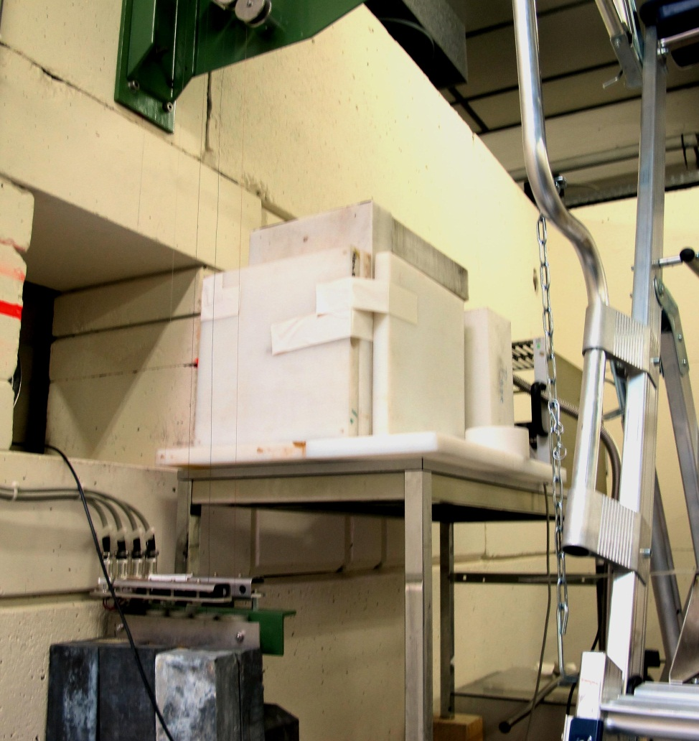

Studies on Boron
Overnight measurement (Oct-2013)
α (1.418MeV)

Slide 20

Chemical Interactions
Effusion: interaction with target and line
Isotope production
Ionization
Diffusion
Molecule formation

Slide 21
Chemical interactions
Materials found in an ISOLDE target:
Molybdenum
Copper
Rhenium
Tantalum
I=I₀ *exp(-λ*(t_{diff}+t_{eff})) *ε_{(chemical loss)}*ε_{(ion source)} *ε_{(formation)}

Slide 22
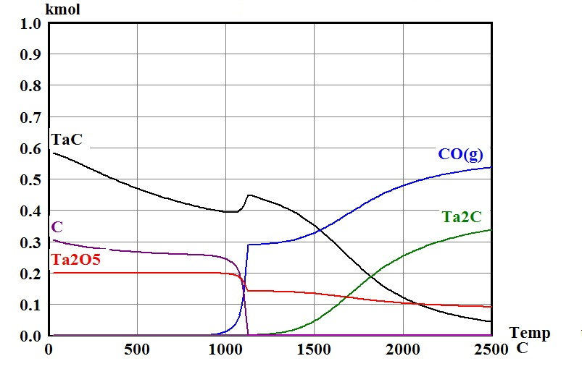
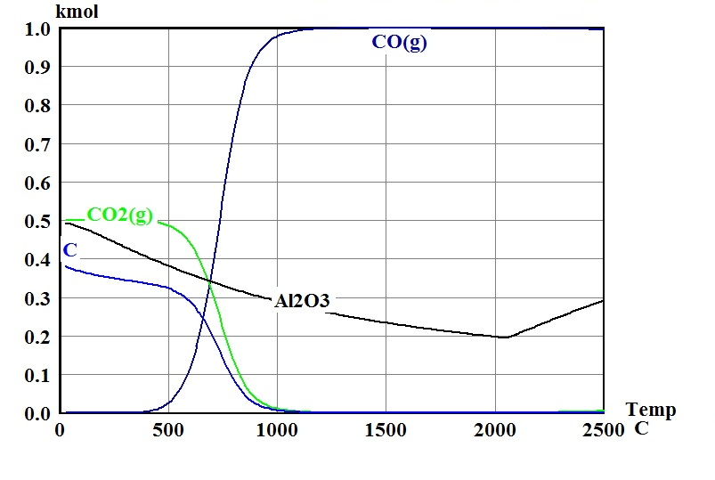
Chemical interactions
Chemical equilibrium of Ta and CO
Chemical equilibrium of Al2O3 and CO
I=I₀ *exp(-λ*(t_{diff}+t_{eff}))*ε_{(ion source)} *ε_{(formation)}* ε_{(chemical loss)}

Slide 23
Chemical interactions
Chemical equilibrium of Ta and CO
Chemical equilibrium of Al2O3 and CO
Substitute materials which react with Carbon and Boron
I=I₀ *exp(-λ*(t_{diff}+t_{eff}))*ε_{(ion source)} *ε_{(formation)}* ε_{(chemical loss)}

Slide 24
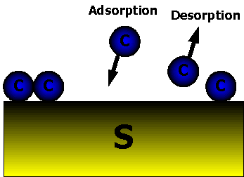
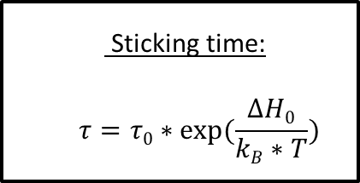
Adsorption on surfaces
I=I₀ *exp(-λ*(t_{diff}+t_{eff}))*ε_{(ion source)} *ε_{(formation)}* ε_{(chemical loss)}
  Sticking time:
  $$τ=τ0∗exp⁡(\frac{∆H0}{kB∗T})$$
http://www.buetzer.info/fileadmin/pb/HTML-Files/WebHelp/Die_Adsorption_von_Gasen_und_gel_sten_Stoffen.htm

Slide 25
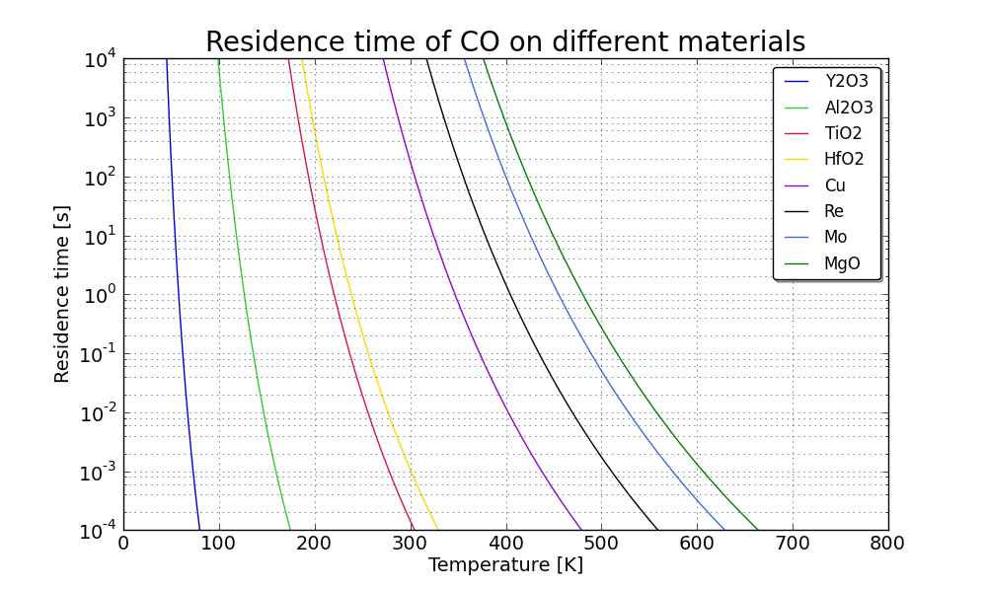
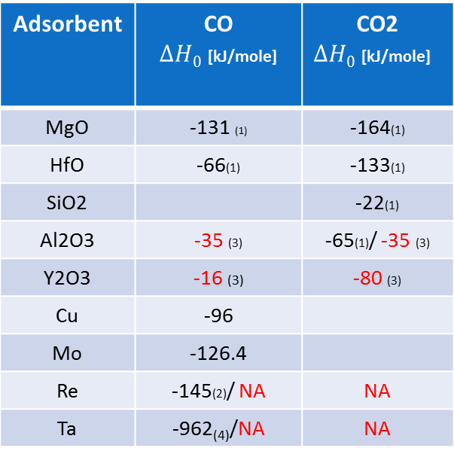
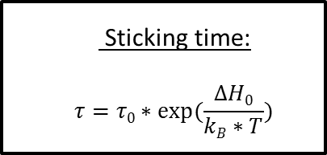
Effusion
Adsorption enthalpies for CO and CO2:
Adsorbent | CO $∆H0$ [kJ/mole] | CO2 $∆H0$ [kJ/mole]
MgO | -131 (1) | -164(1)
HfO | -66(1) | -133(1)
SiO2 |  | -22(1)
Al2O3 | -35 (3) | -65(1)/ -35 (3)
Y2O3 | -16 (3) | -80 (3)
Cu | -96
Mo | -126.4
Re | -145(2)/ NA | NA
Ta | -962₍₄₎/NA | NA
  Sticking time:
  $$τ=τ0∗exp⁡(\frac{∆H0}{kB∗T})$$
For $∆H0$ > - 40 kJ/mole Chemisorption: strong interaction, irreversible, monolayer
For $∆H0$ < - 40kJ/mole Physisorption : weak interaction (VDW Force), reversible, multilayer
(1)Production of exotic, short lived carbon isotopes in ISOL-type facilities, Hana Franberg, Uni Bern 2008
(2)Chemisorption on Rhenium: N 2 and CO JOHN T. YATES, JR., AND THEODORE E. MADEY National Bureau oj Standards, Washington, D. C. 20234
(3)TPD measurements, Roman Bulanek, University of Pardubice, CZ
(4) (Im)possible Isol beams, U.Koester et al, Eur.Phys.J.Special Topics 150, 285-291 (2007)

Slide 26
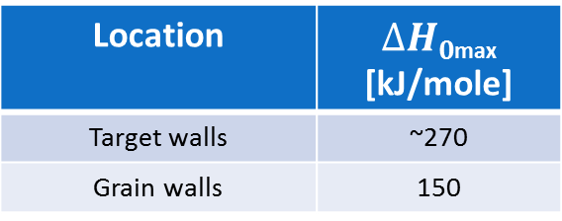
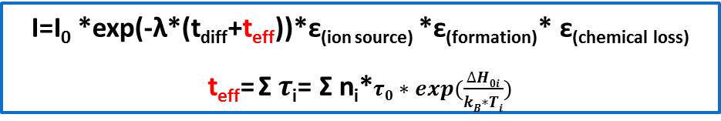
Chemical interactions
I=I₀ *exp(-λ*(t_{diff}+t_{eff}))*ε_{(ion source)} *ε_{(formation)}* ε_{(chemical loss)}
  t_{eff}= Σ $τ$_{i}= Σ n_{i}*$τ0∗exp⁡(\frac{∆H0i}{kB∗Ti})$
Location | n_{i}
Target walls | ~10^2
Grain walls | >10^6
⁹C
Location | $∆H0$_{max} [kJ/mole]
Target walls | ~270
Grain walls | 150
t_{max}=t_{1/2} =123ms

Slide 27
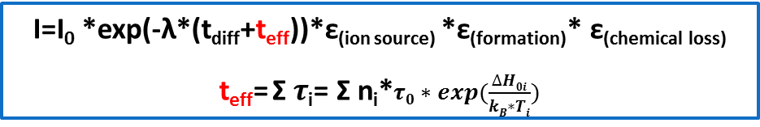
Chemical interactions
I=I₀ *exp(-λ*(t_{diff}+t_{eff}))*ε_{(ion source)} *ε_{(formation)}* ε_{(chemical loss)}
  t_{eff}= Σ $τ$_{i}= Σ n_{i}*$τ0∗exp⁡(\frac{∆H0i}{kB∗Ti})$
Location | n_{i}
Target walls | ~10^2
Grain walls | >10^6
⁹C
Location | $∆H0$_{max} [kJ/mole]
Target walls | ~270
Grain walls | 150
t_{max}=t_{1/2} =123ms
Structural material | Target material
Tantalum | Al2O3
Molybdenum | HfO2
Rhenium | Y2O3
Copper | MgO
SiO2 | CaO
http://www.buetzer.info/fileadmin/pb/HTML-Files/WebHelp/Die_Adsorption_von_Gasen_und_gel_sten_Stoffen.htm

Slide 28
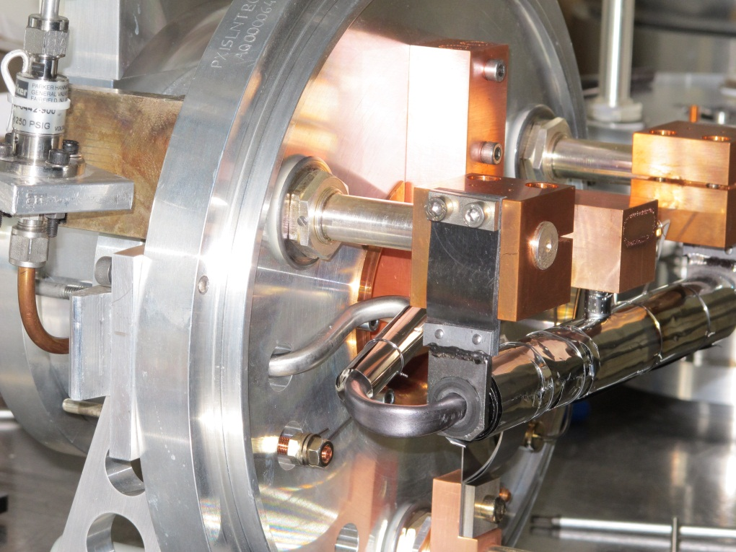
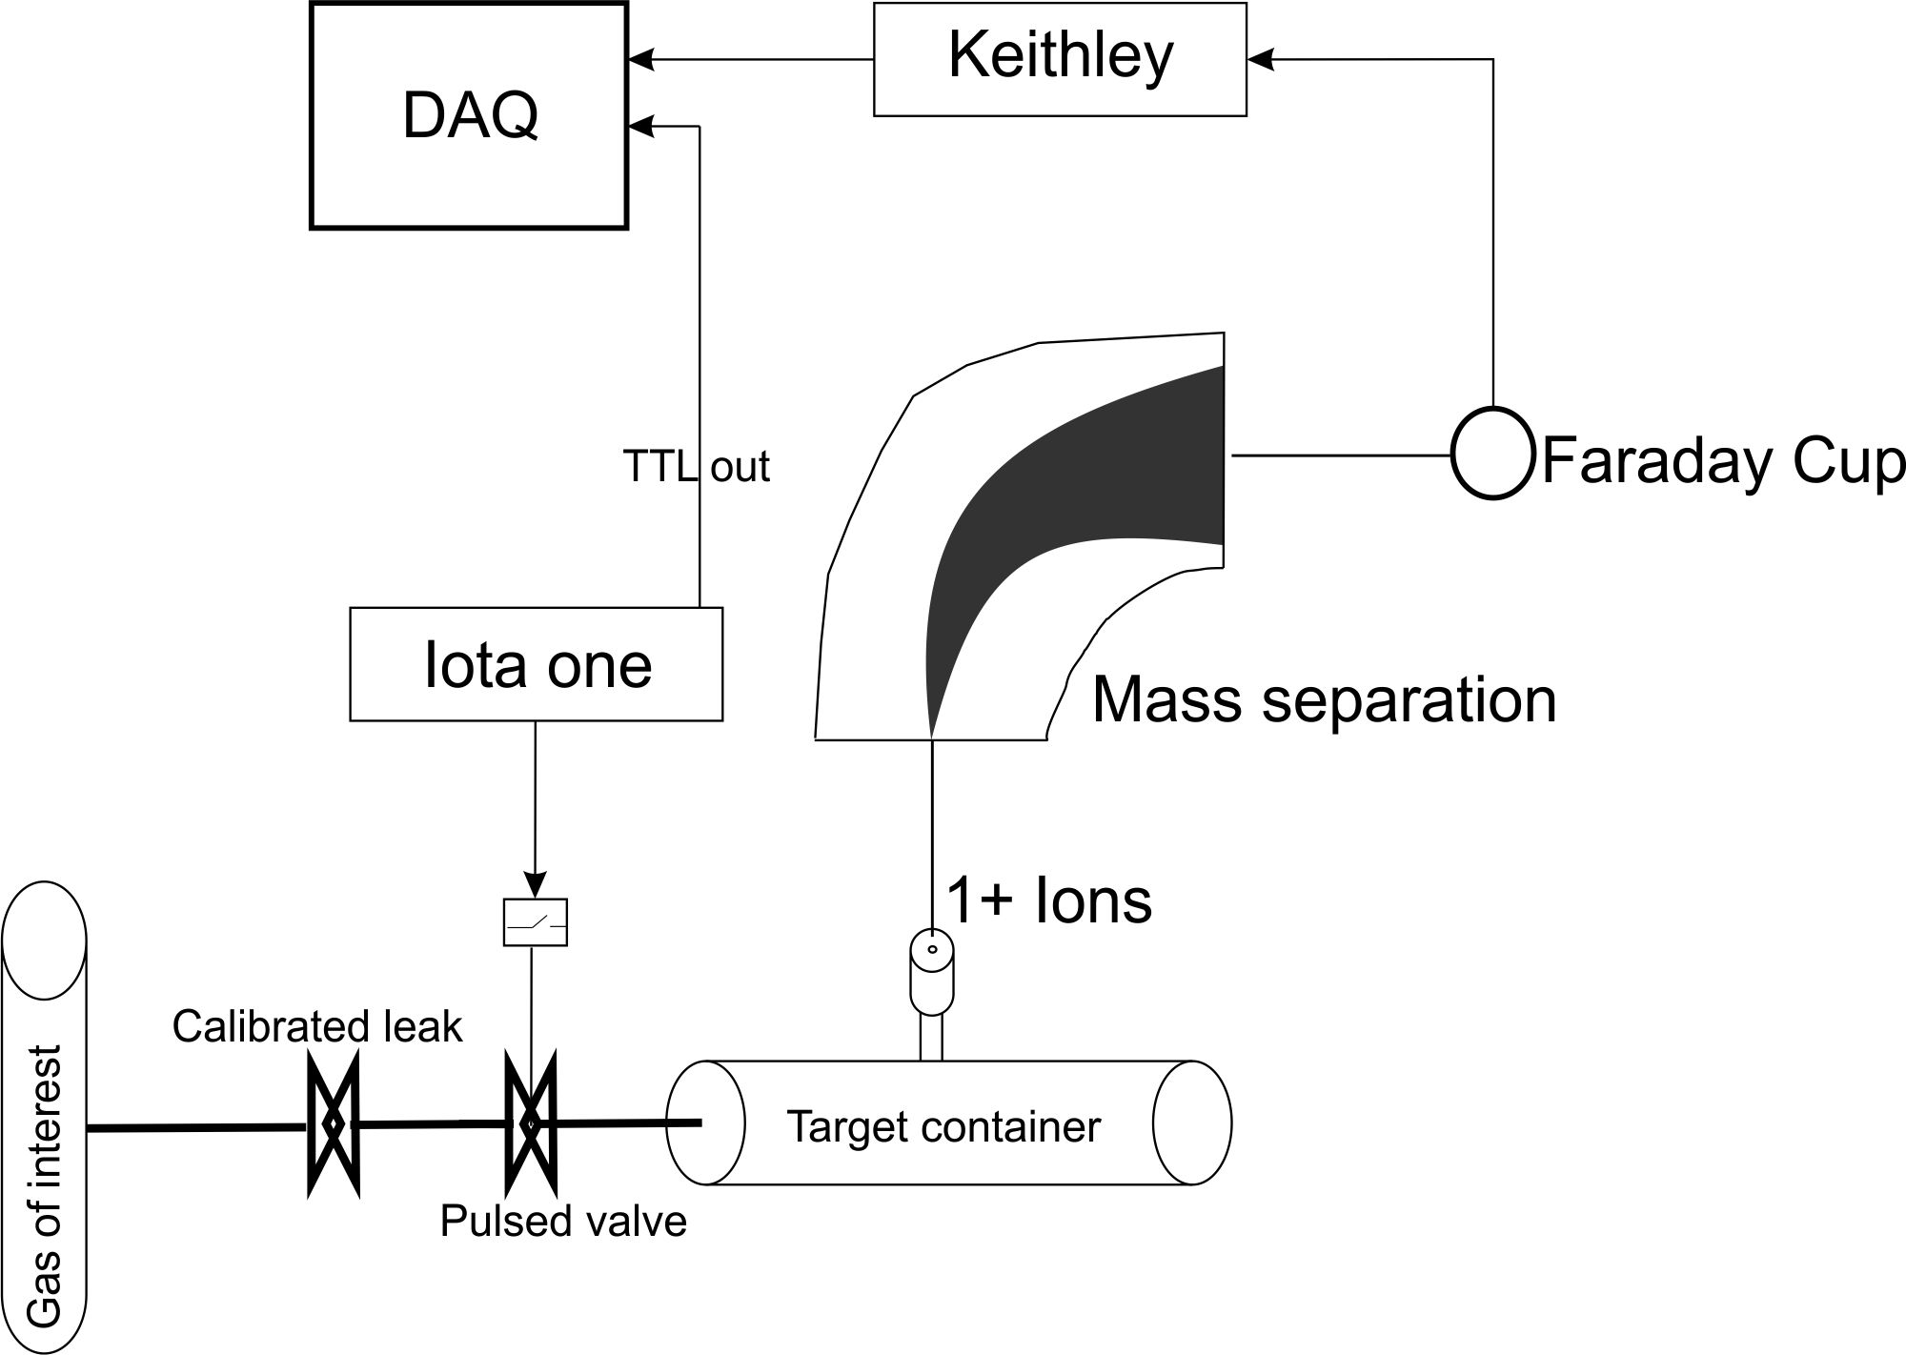
Release Studies on CO+
Release studies at Off-line mass separator
  Injection of bursts of gas of interest (13-CO2, 13-CO, noble gases)
  Release gives information about release efficiency and time structure
  Investigation of different ion sources and materials

Slide 29
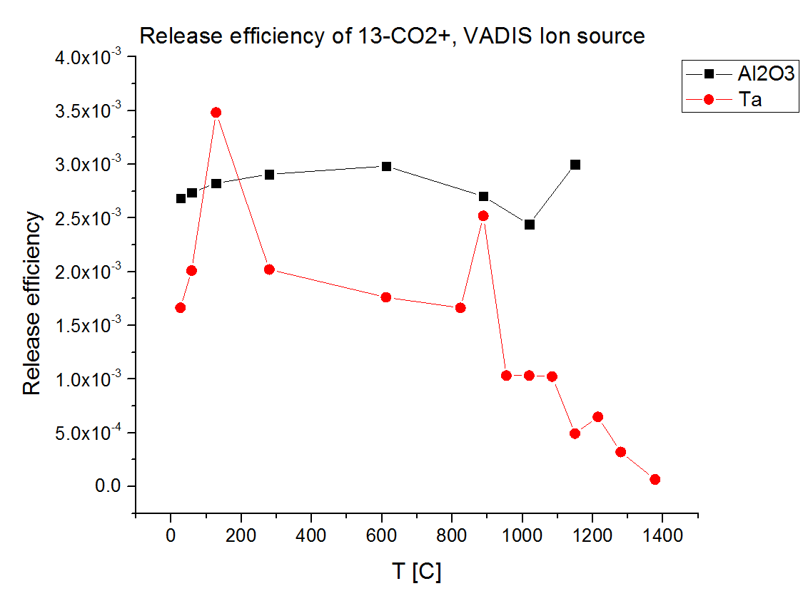
Release Studies on CO+
Release studies at Off-line mass separator
  Injection of bursts of gas of interest (13-CO2, 13-CO, noble gases)
  Release gives information about release efficiency and time structure
  Investigation of different ion sources and materials

Slide 30
Steps In Beam Production
Effusion: interaction with target and line
Isotope production
Ionization
Diffusion
Molecule formation
I=I₀ *exp(-λ*(t_{diff}+t_{eff}))*ε_{(ion source)} *ε_{(formation)}* ε_{(chemical loss)}

Slide 31
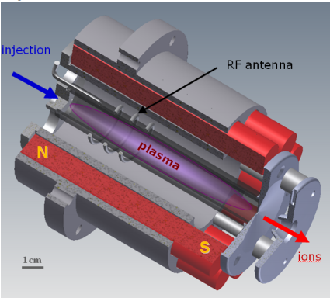
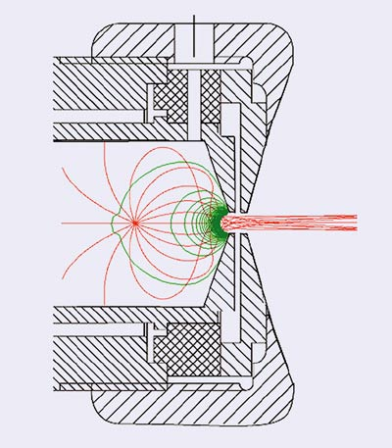
HELICON Ion Source
Ionization efficiencies
An ion source for molecular beams
  No hot tantalum surface
  Helicon developed by Pekka Suominen & Matthias Kronberger
Gas | HELICON | VADIS
CO | 2.5 % | -
CO2 | 0.3% | 0.3%
HELICON ion source
VADIS ion source
I=I₀ *exp(-λ*(t_{diff}+t_{eff}))*ε_{(ion source)} *ε_{(formation)}* ε_{(chemical loss)}
[1]Production of molecular sideband radioisotope beams at CERN-ISOLDE using a Helicon-type plasma ion source , M.Kronberger et al, NIM B

Slide 32
Thank you!
Work supported by the Wolfgang-Gentner-Programme of the Bundesministerium für Bildung und Forschung (BMBF)

