Slide 1
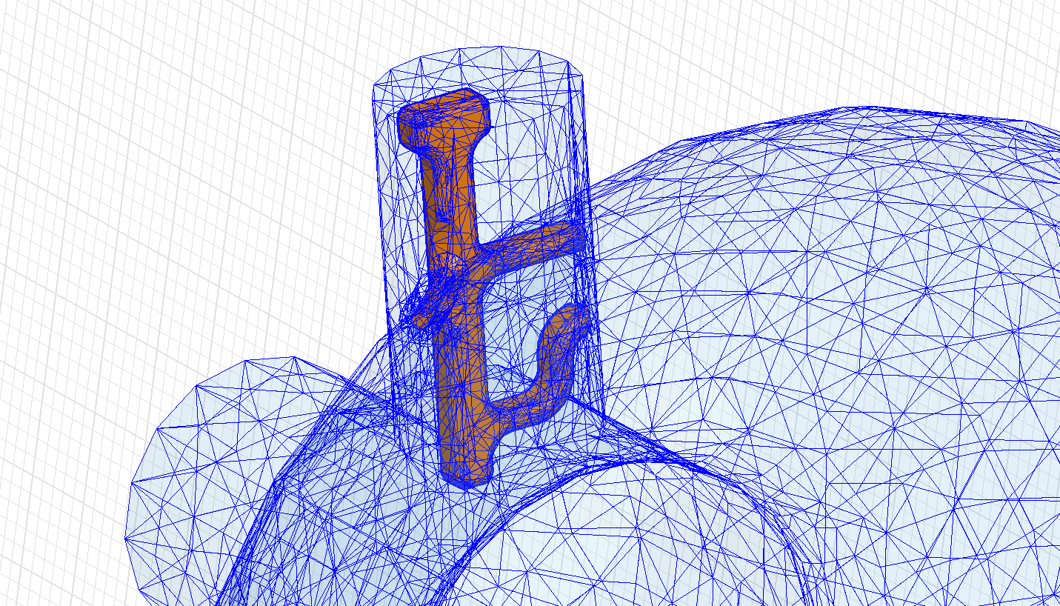
HOM Couplers for CERN SPL Cavities
Comparison of different design approaches
K. Papke, F. Gerigk, U. van Rienen
Work supported by the Wolfgang-Gentner-Programme of the Bundesministerium für Bildung und Forschung (BMBF)

Slide 2
Outline
Overview
RF Characteristics
Mechanical Issues
Heat Loss Investigation
Summary
Outlook

Slide 3
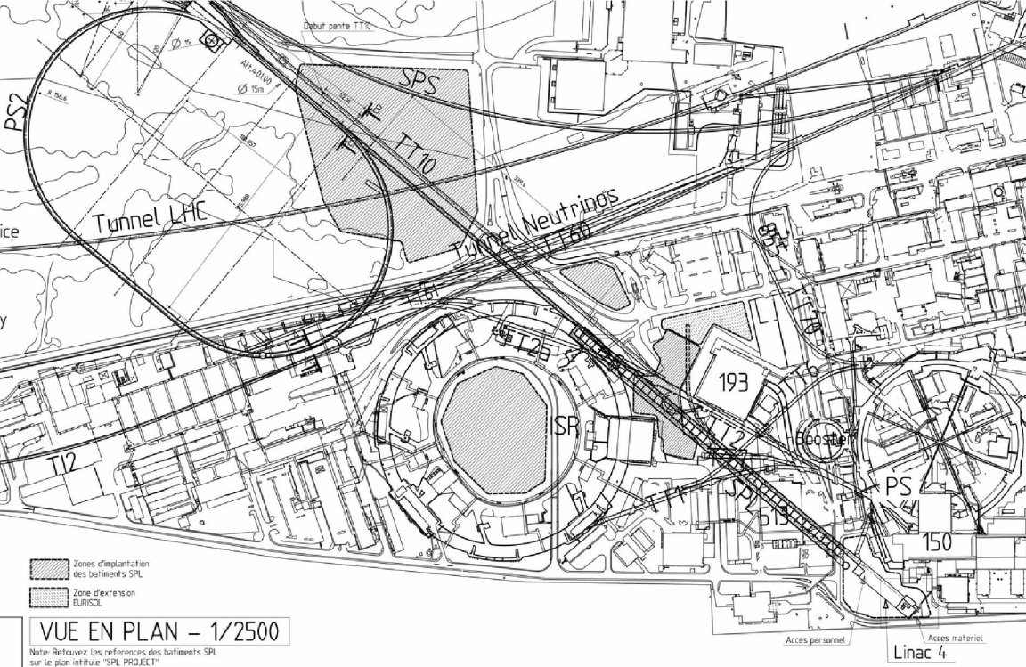
Overview
Present
Optional Future
LP-SPL: Low Power-Superconducting Proton Linac
PS2: High Energy PS (~ 5 to 50 GeV – 0.3 Hz)
HE-LHC: “High Energy” LHC (≥ 14 TeV/ring)
1978
Proton flux / Beam power
50 MeV
Linac2
Linac4
SPS
160 MeV
1975
PS2
1.4 GeV
PSB
LP-SPL
4 GeV
1959
26 GeV
PS
PS2
PS
50 GeV
SPL
450 GeV
SPS
2008
LHC /
HE-LHC
7 TeV
LINAC4
R. Garoby, SPL Seminar 2012

Slide 4
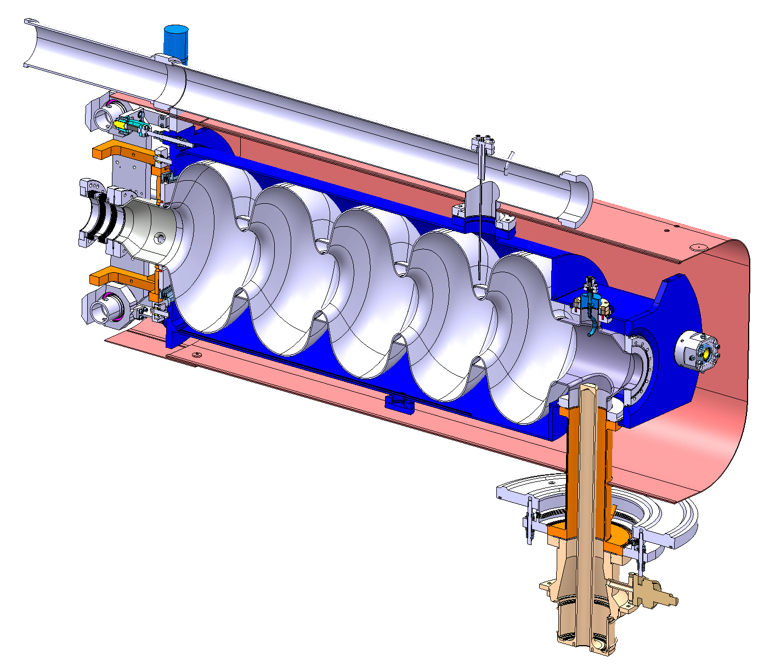
Overview
Bi-phase helium tube
Helium Tank
Bellows
CEA’s tuner
Bulk Niobium 5 Cells cavity
Magnetic shielding
HOM Coupler
Inter-cavity support
Double walled tube
RF Power Coupler
O. Capatina, SPL Seminar 2012

Slide 5
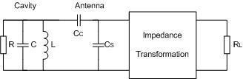
Overview
HOM-Coupler used to extract or dissipate unwanted, higher order modes in the cavity induced by the beam
Resonant circuit
Antenna
Extracted power
Cavity
HOM-Coupler
Very high impedance for the notch frequency (704.4MHz)
Low impedance for “all” other modes

Slide 6

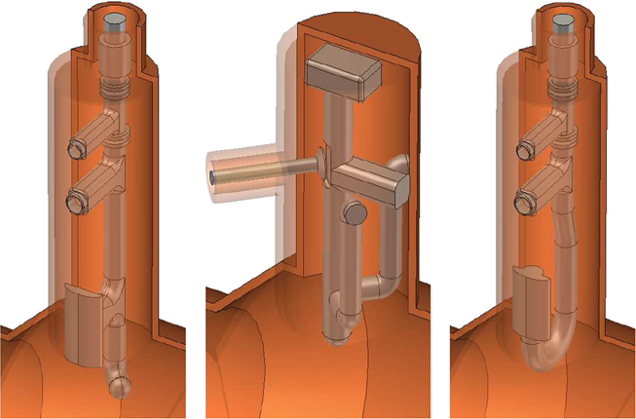
Overview
Design goal of HOM filter: block the transmission of the accelerating mode, while transmitting HOMs, which have significant (R/Q) values
Bulk Niobium 5 Cells SPL cavity
Approaches for HOM coupler
probe
coupler
modified TESLA
design
hook
coupler
O. Capatina, SPL Seminar 2012

Slide 7
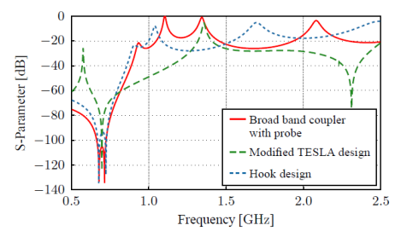
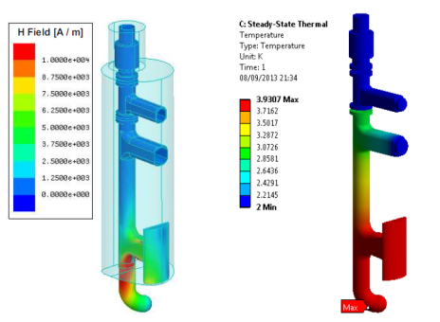
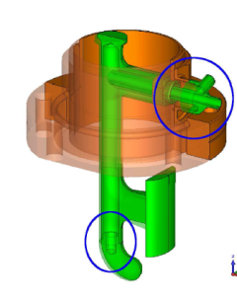

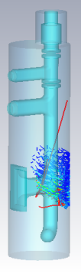
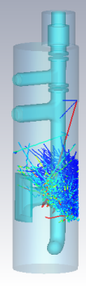
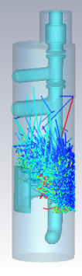
Overview
Number of factors such as RF transmission behaviour, power dissipation, multipacting sensitivity, field emission, heat loss, mechanical restrictions
RF characteristics
Heat loss
Design approaches for HOM coupler
Mechanical issues
Multipacting
Probe
coupler
modified TESLA
design
Hook
coupler

Slide 8
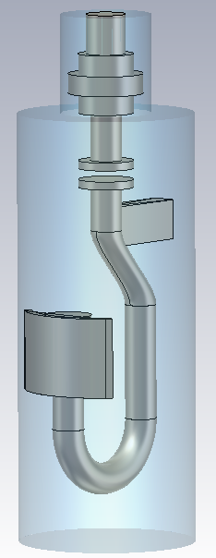
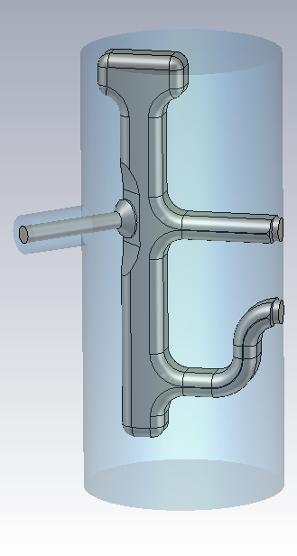
RF Characteristics
Coaxial port (50 Ohm)
Capacitive coupling for impedance matching
Mutual inductance of the resonant circuits
fixing of the whole inner conductor
may support liquid helium for cooling
Notch capacitor couples to the outer conductor
Notch inductance which together with the red labeled capacitance creates the notch filter
E- and H-field coupling
Every part of the coupler (also the non labeled) affects more or less its frequency dependent impedance characteristic
8

Slide 9
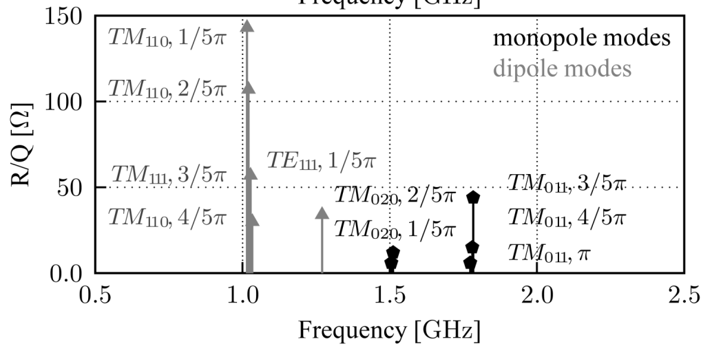

RF Characteristics - Requirements
3 MeV
50 MeV
102 MeV
160 MeV
750 MeV
4/5 GeV
H⁻ source
RFQ
chopper
DTL
CCDTL
PIMS
β=0.65
β=1.0
Schematic layout of the linac
(Conceptual design of the SPL II)
352.2 MHz
704.4 MHz
For SPL dipole HOMs are considered less problematic
In case of recirculators or synchrotrons dipole HOMs should be also considered
HOM spectra for the medium and high beta Cavities:
Medium beta cavity (beta = 0.65)
High beta cavity (beta = 1)
M.Schuh, F. Gerigk. “Influence of higher order modes on the beam stability in the high power superconducting proton linac“, Phys. Rev. ST Accel. Beams, 2011

Slide 10
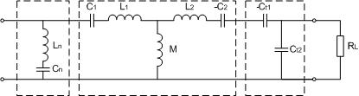
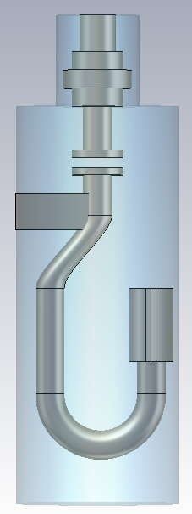
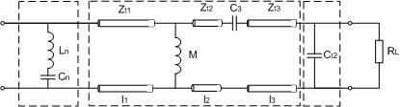
RF Characteristics - Design Process
Initial estimation for design by transmission line models
Approximation
by lumped circuit model
Calculation of the lumped circuit elements for a desired frequency spectrum
Initial
design
Transformation in Transmission Lines gives the lengths of the coupler parts
10

Slide 11
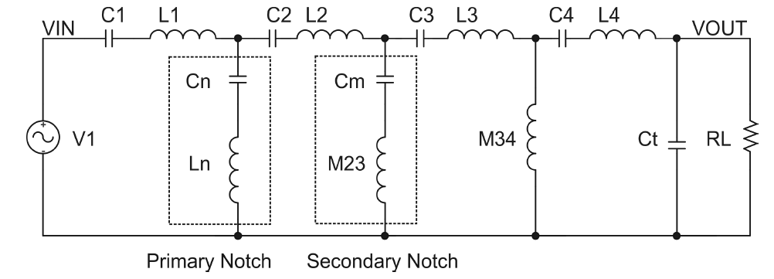
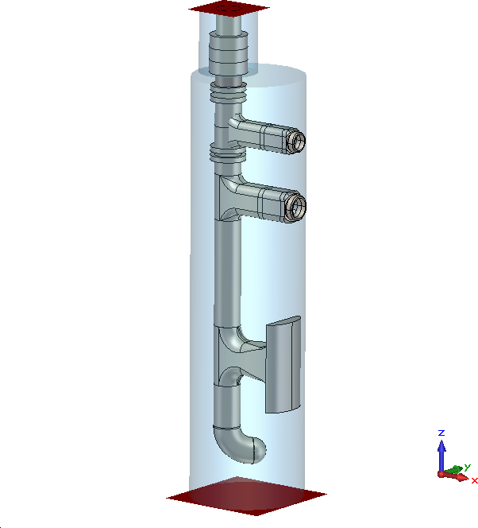
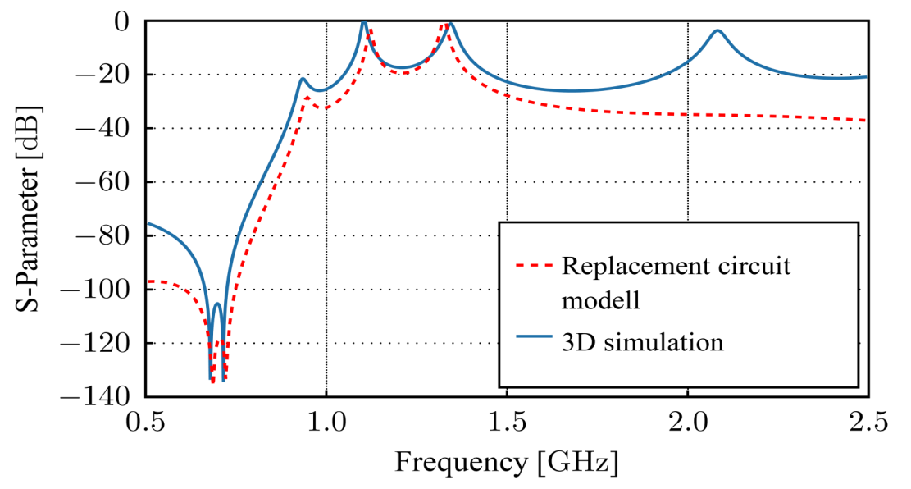
RF Characteristics - Design Process
For analysing and optimizing, simplified replacement circuit models were used and synthetized to a coupler model using transmission line theory (TML)
TEM
TML
Initial design
TM₀₁ – TEM – Transmission
3D Simulation to optimize design
Notch filter
TM₀₁, TE₁₁
11

Slide 12
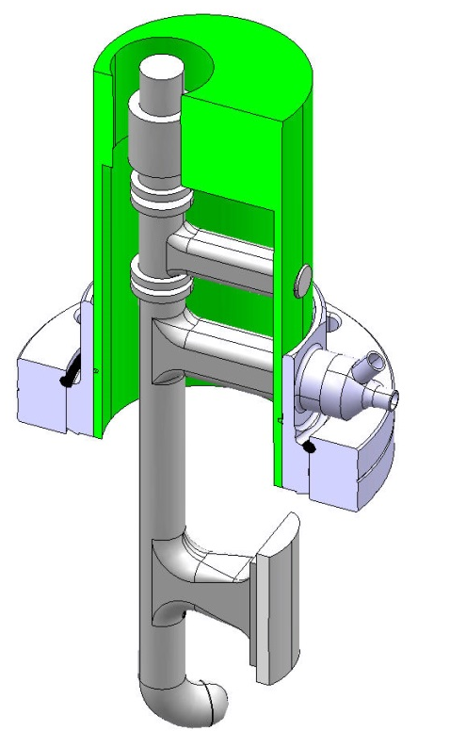
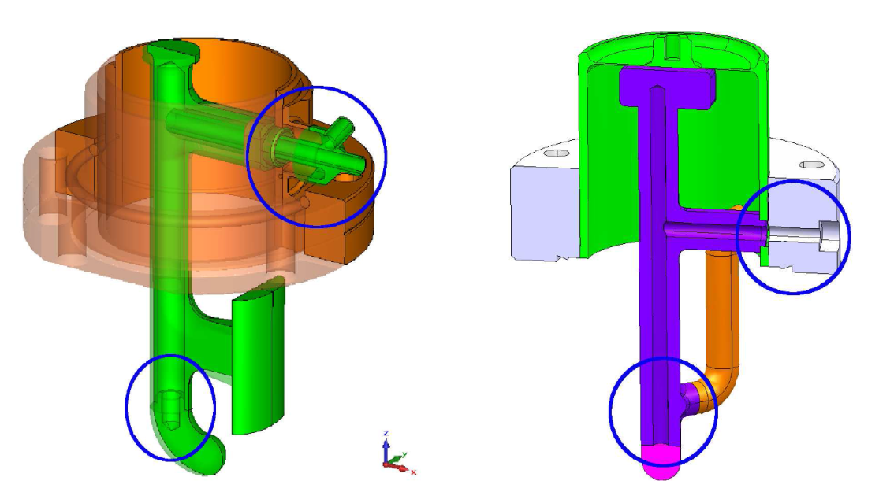
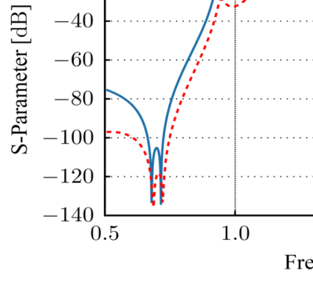
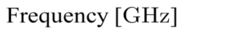
Mechanical Issues
Reasonable tolerance for mechanical design: ± 0.2 mm
Notch filter for TESLA design easy to tune to ± 0.02 mm
Higher notch filter band width for Probe and Hook design to bypass the notch tuning
Cooling circuits at first foreseen (maybe not necessary)
Probe coupler (sub part)
modified TESLA design
Probe coupler
Notch capacitance
(± 0.02 mm tol.)
Frequency tuning of the notch filter
Additional inductive post increases band width of Notch filter
40 MHz band width
(± 0.2 mm tol.)
Cooling circuits

Slide 13
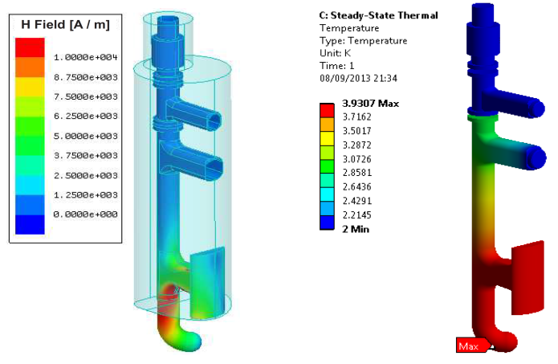
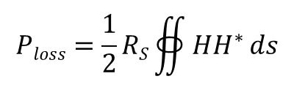
Heat Loss Investigation
Coupled Simulation performed by HFSS (EM Field calculation) and ANSYS (steady state thermal analysis)
H-Field of fundamental Surface loss density derived from the H field of the accelerating mode (mode with the highest energy)
Surface loss density
Design | P_{loss} [mW] | T_{max} [K]
Probe | 10.1 | 3.93
TESLA | 12.8 | 2.84
Hook | 10.0 | 4.08
Flange | < 0.1 | 2.01
Tube | 11.5 | 2.08
Cavity cell | 101.5·10³ | 2.89
$$Ploss=\frac{1}{2}RS∯{HH^{∗}}ds$$
Surface resistant increases exponential with temperature (tolerance of +/-100%) ^{1,2}
Thermal conductivity dependent on the material purity (RRR)
worst case study/ Iterative scheme
Here: Rs = 200 nΩ is assumed (worst case)
¹ G. Ciovati, et al., “Residual Resistance Data From Cavity Production Projects at Jefferson Lab“, IEEE TRANSACTIONS ON APPLIED SUPERCONDUCTIVITY, 2011
² T. Junginger, et al., “RF and Surface Properties of Superconducting Samples“, CERN-ATS-2011-037, 2011

Slide 14

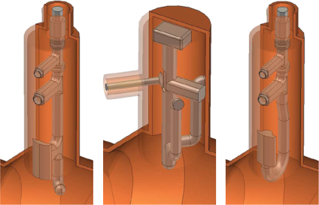
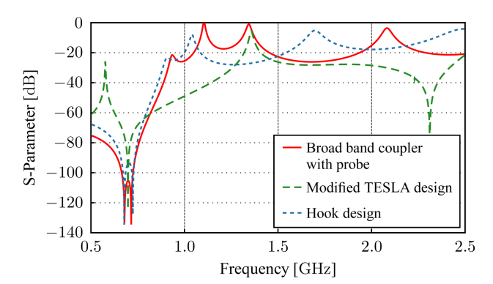

Summary
Different designs of HOM coupler have been optimized for the requirements of the SPL cavities regarding RF behavior, mechanical issues and thermal losses
Qualitative results for the designs:
High beta cavity (beta = 1)
Low
HOM Bandwidth
High
TESLA
Hook
Probe
TM₀₁ – TEM (monopole coupling)
Low
Notch Bandwidth
High
TESLA
Hook, Probe
Easy
Tuning
Difficult
Probe
TESLA
Hook
TESLA
Hook, Probe
Low
Thermal & mechanical robustness
High
TE₁₁ – TEM (dipole coupling)
Hook, Probe
TESLA
Medium beta
Cavity preferences
High beta
Hook
TESLA, Probe
14

Slide 15

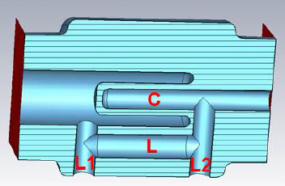
Outlook
Fabrication of 2 prototypes (Probe, mod. TESLA)
Further filter designs under consideration
Heat loss investigation for pure copper models → much cheaper, maybe sufficient
Improvements of RF behavior for bulk coupler (if active cooling isn’t necessary)
Investigation of Multipacting barriers
Project extension onto LHC crab cavities
Probe
TESLA
Thank you for your attention
B.P. Xiao: Proposal of filter design for LHC crab cavities

