Slide 1
The Future of ATLAS Track Reconstruction
Robert Langenberg (TU München, CERN)
Robert Langenberg – Gentner Day 2013
Notes:
Preparing the Track Reconstruction in ATLAS for a high multiplicity future

Slide 2
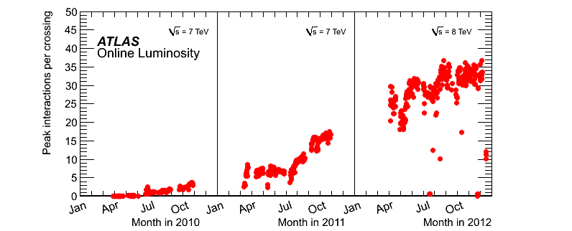
Outstanding LHC performance in run 1
exceeded design specifications for pile-up
put huge pressure and CPU & disk resources
LHC design
specification
Robert Langenberg – Gentner Day 2013

Slide 3
ID track reconstruction is main consumer
Takes about 50 % of total time
~88 Mio channels in the Inner Detector only
Pattern recognition is a combinatorial problem
Reconstruction workload close to 100% of capacity
  Memory usage is close to 4GB
  Current production software doesn’t allow parallel processing of events per program instance
  Parallel CPU capabilities not exploited
Robert Langenberg – Gentner Day 2013

Slide 4
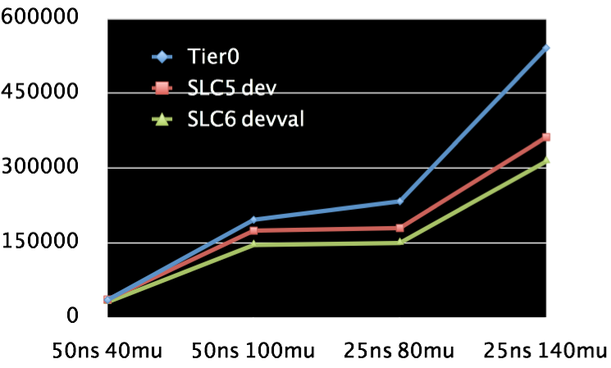
Challenges for Run 2
Pile-up will increase
  depends on 25/50 ns
  up to factor of 2.5
Computing budget for Run 2 is constant
  Electricity cost substantial factor
  More machines or longer runtimes not affordable
  Memory limited to below 3GB per core
  New machines don’t run faster nowadays but have more cores
Robert Langenberg – Gentner Day 2013

Slide 5
Goals
Increase computational throughput at least two-fold without decreasing physics performance
Increase maintainability of code
Show correctness of physics results of changed code
Get it done before the end of LS1
Robert Langenberg – Gentner Day 2013

Slide 6
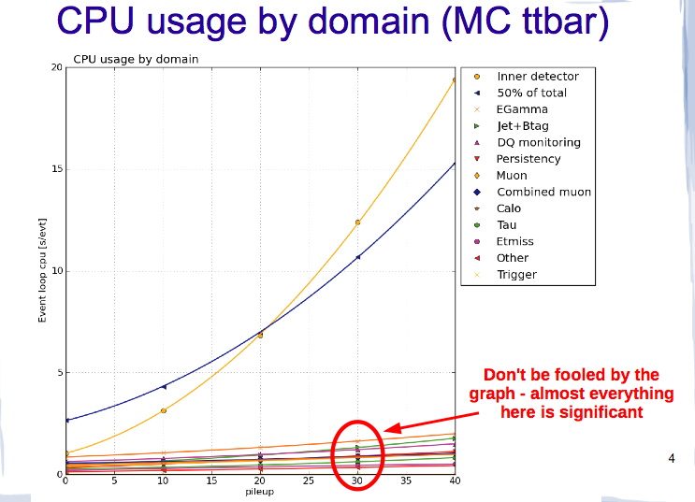
Analysis Means
Hotspot analysis
  Wall time
    I/O analysis
    CPU utilization
  Memory usage
    Memory churn analysis
    Heap/Stack analysis
Robert Langenberg – Gentner Day 2013
Notes:
PMB grafik?

Slide 7
Optimization Means
Replacing algorithms
Optimizing algorithms
  High level (improving the algorithm, e.g. caching results)
  Low level (tailoring the algorithm to suit hardware architecture)
Change algorithms to run in parallel
  By vectorizing
  By multithreading
Robert Langenberg – Gentner Day 2013

Slide 8
Applied Optimizations
Replacing libraries
Optimize memory usage
Manually vectorizing algorithms
Restructuring event data model (EDM)
Robert Langenberg – Gentner Day 2013

Slide 9
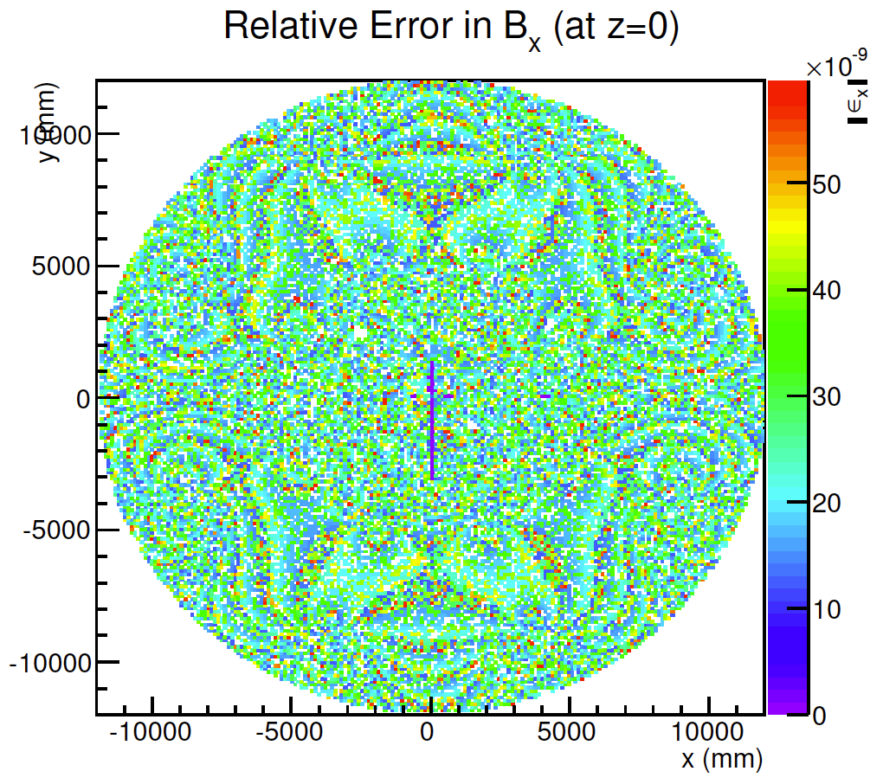
Efforts: Magnetic Field
Change from Fortran77 to C++
  Code a lot more readable now
  Reduced function call depth
Adding field value cache
  Greatly affects performance
  as particles are traced along
  their trajectory
Unit Conversion Minimization
  Affects accuracy and performance
Make code autovectorizable and applying intrinsics
Speed-up of 20% (reco) up to 60 % (single particle simulation)
Robert Langenberg – Gentner Day 2013

Slide 10
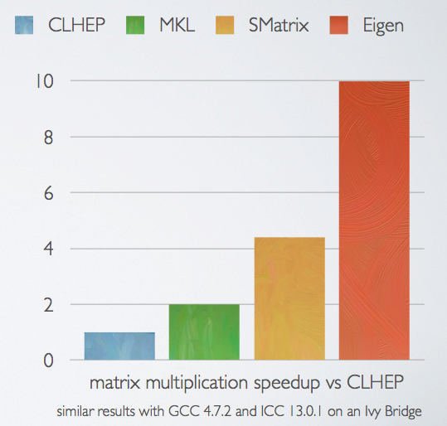
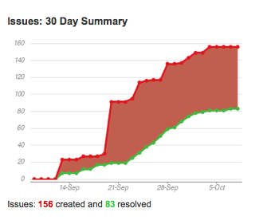
Efforts: Library Change
Change from CLHEP to Eigen
  Huge software migration
    O(1000) packages affected
  Eigen library functions
  can vectorize if compiled
  accordingly
Exchanging the allocator
Exchanging GNU libm
  Under investigation: VDT, libimf
Robert Langenberg – Gentner Day 2013

Slide 11
Eigen library extensions
  Extending Eigen by inline functions for a more CLHEP like API facilitating migration
    Macro allows Eigen extension without inheritance
Adding optimized functions for symmetric matrices
  Eigen doesn’t have symmetric matrices or optimized operations
  Overhead free matrix data access as double*
  E.g. Gauss-Jordan inversion implemented
Robert Langenberg – Gentner Day 2013

Slide 12
Eigen library integration
Creation of Amg:: namespace for Eigen
Access unification to all Eigen types
  Facilitates future changes
  Simplifies access (before there were 3 different wrappers for e.g. CLHEP::Vector3D)
  Direct access to Eigen discouraged
All but equal interface allows the same tests running on both Amg and CLHEP
  Any other library, e.g. Root’s Smatrix can be wrapped in the same way to allow easy comparison
Robert Langenberg – Gentner Day 2013

Slide 13
Eigen library findings
Performance findings very promising:
  Conversion of global to local coordinates 3x faster with Eigen
Numerical differences to CLHEP
  Comparison of conversion local -> global -> local shows Eigen to be closer to the original value than CLHEP
Inlining greatly affects speed
  Deactivating inlining for Eigen diminishes performance advantages
Unified access through single interface improves readability and maintainability
Robert Langenberg – Gentner Day 2013

Slide 14
Efforts: Tcmalloc and libm
Tcmalloc version in use is outdated
  Uses less memory than all newer mallocs but provides unaligned memory
    Cannot vectorize
Many newer allocators faster
  Facebook’s jemalloc up to 10% faster
GNU libm slow compared to other libs
  Intel’s Libimf and CMS’ VDT provide up to 10x faster trigonometric functions
Both libraries can be replaced with minimum effort using LD_PRELOAD
Robert Langenberg – Gentner Day 2013

Slide 15
Tcmalloc and libm
Tcmalloc and libm are both responsible for about 5% of total reconstruction time
Number of mallocs will decrease after Eigen migration
  Eigen uses less temporaries than CLHEP which now makes up more than 10% of all mallocs
Increased speedup expected for vdt when migrating and therefore allowing inlining
Final decision outstanding, short term measure: LD_PRELOAD for libimf
Robert Langenberg – Gentner Day 2013

Slide 16
Efforts: Event Data Model (EDM)
Initial Tracking EDM was highly polymorph
  Design before data taking was focused on
  flexibility rather than CPU performance
  Experiences of Run 1 now integrated, EDM reworked:
    Flatter EDM structure
    Avoidance of dynamic casts
    Persistency considerations
    enter transient EDM
Example:
  New templated track parameterisation,
  removed 98 % of C++ code lines
Robert Langenberg – Gentner Day 2013

Slide 17
 | stage | migration status | ID CPU time | comments
 | space point formation | done | -1% | fully validated
 | space point seeded track finding | done | -20% | slightly increased track finding efficiency
 | ambiguity solving & track fitting | done | - ? % | biggest relative CPU saving potential, currently crashing
 | vertex reconstruction | ongoing | - ? % | Depends on ongoing changes
 | particle creation | ongoing | - ? % | in analysis EDM
Robert Langenberg – Gentner Day 2013

Slide 18
Future Efforts Necessary
Goals require further action
  Current projects expected to yield at least 20% reconstruction performance improvement
Other options include
  Preparing code for autovectorization
  Manual vectorization of hot-spots w. intrinsics
  Creating data pools to avoid frequent malloc/free calls
  Parallelizing algorithms to run on multiple cores
Robert Langenberg – Gentner Day 2013

Slide 19
Summary
At least two fold performance improve required
Optimization projects ongoing
  Replacing various libraries (requiring different effort)
  Optimizing algorithms
  Optimizing memory
Further efforts required to achieve goals
Many other optimizations possible
  E.g. parallelization, vectorization, data pools
Cost-benefit analysis for future projects ongoing
Robert Langenberg – Gentner Day 2013

