Slide 1

Beam Simulation at COMPASS
Karl A. Bicker
Gentner Day 2013
2013-10-30

Slide 2
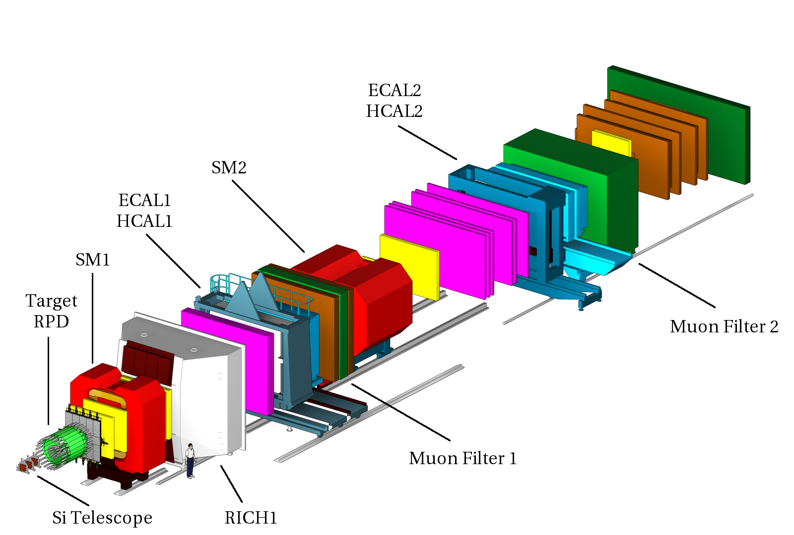
The COMPASS Spectrometer
Fixed target
Two-stage spectrometer
160/190 GeV muon/hadron beams

Slide 3
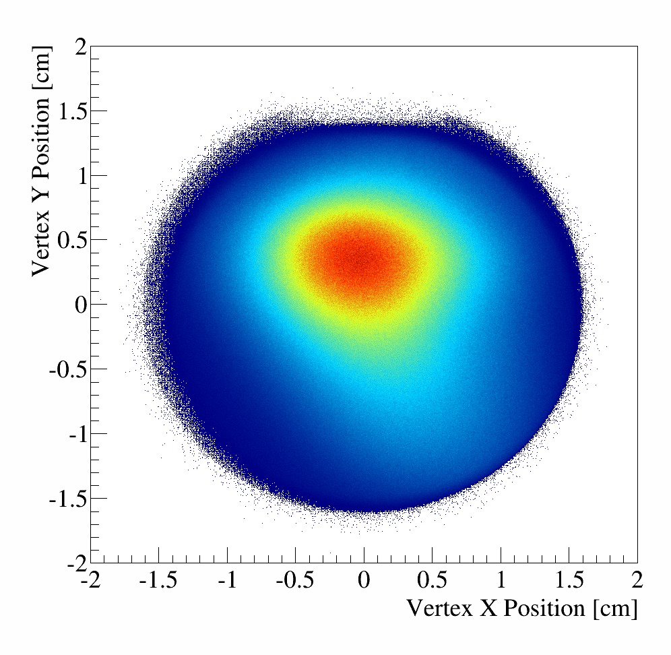
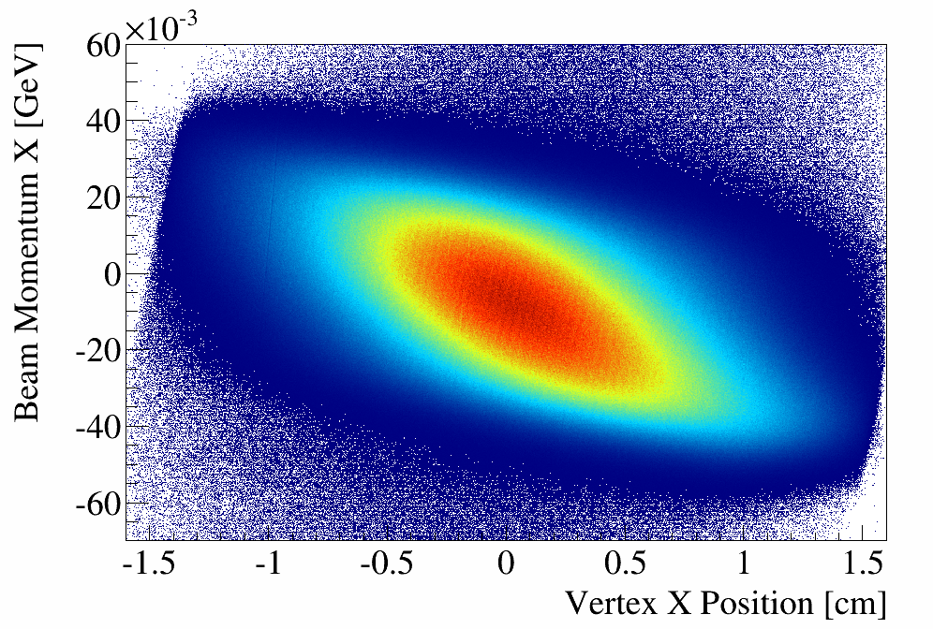
Beam Simulation at COMPASS
Beam Simulation package should generate vertices and beam vector
5-dimensional distribution in [ v_{x}, v_{y}, b_{x}, b_{y}, b_{z} ]
(z: beam direction, y: up)
Complex correlations between all 5 variables
→ Impossible to do analytically

Slide 4
Idea
Use real events for beam simulation
→ [x, y, p_{x}, p_{y}, p_{z}] from every event
→ Beamfile
Problem
Need more Monte Carlo than real data events
→ The same vertex/beam is used several times
Proposal
Smear events
Use mean distance between two events as sigma for the smearing (different for every event!)

Slide 5
Defining the Mean Distance
Basic idea:
  Divide the 5d distribution into bins of equal content
  For every bin, calculate the mean volume per event
  The 5 mean distances will be the edge lengths of the hypercuboid with the same edge ratios as the bin itself, and a volume that is equal to the mean volume per event
mean distance ≙ “sigma”

Slide 6
Binning

Slide 7
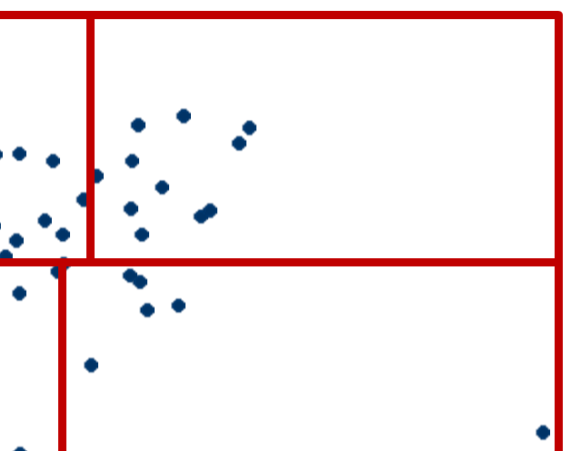
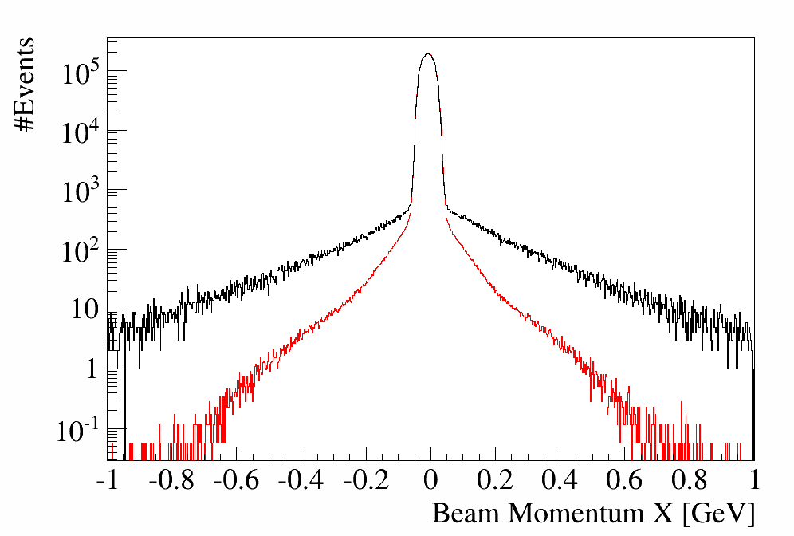
Edge Bins are a Problem
Single event can artificially enlarge bin
Solution: use sigmas from neighboring bins
Average over all neighboring bins which are not on the edge
But: in 5d, most bins are on the edge
Even worse: most of them have only neighbors which are also on the edge

Slide 8
What if there are only edge bins?
For every event…
Find a hypersphere containing 15 events around it
Calculate the CoG and find a new sphere containing all events
Use the volume of the sphere to calculate the mean volume per event

Slide 9
Post Processing
Sphere-procedure still produces big sigmas, cap them by hand
Binning introduces artifacts: The bin boundary of the first division goes through the whole volume
Solution:
Produce 5 beamfiles, starting binning with a different coordinate each time
For every coordinate, take the sigmas from the beamfile where the coordinate was divided last and merge them to form one beamfile

Slide 10
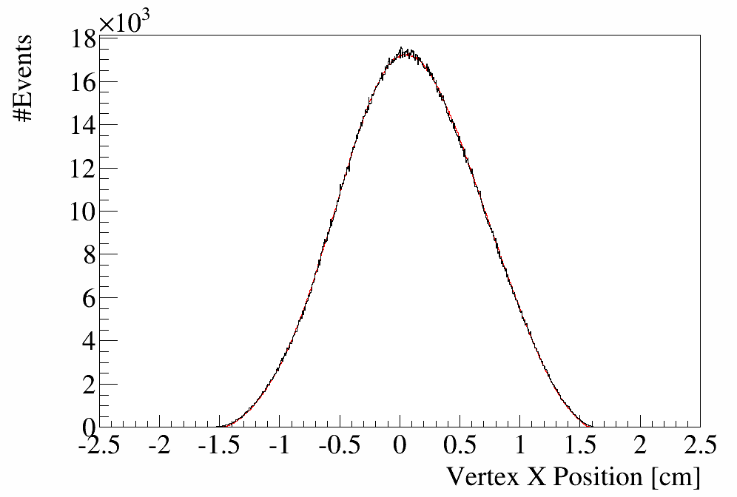
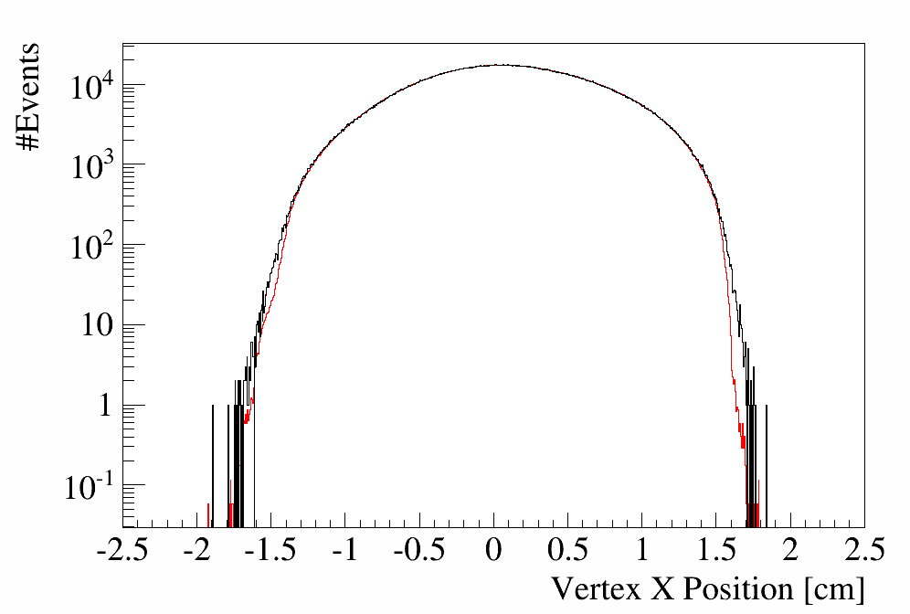
Results: Vertex X Position

Slide 11
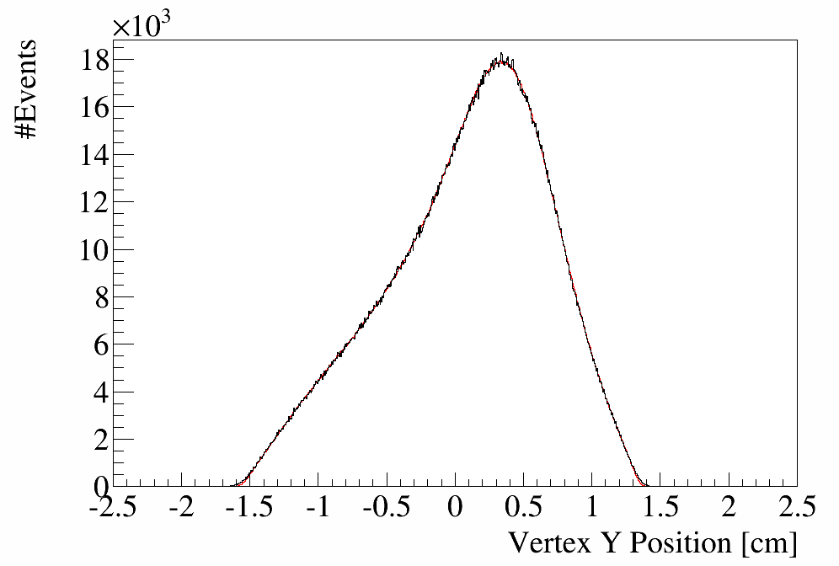
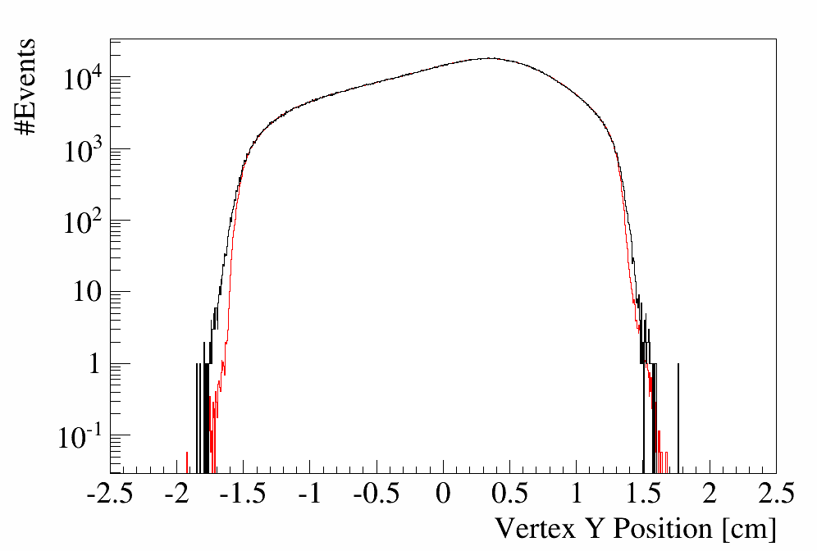
Results: Vertex Y Position

Slide 12
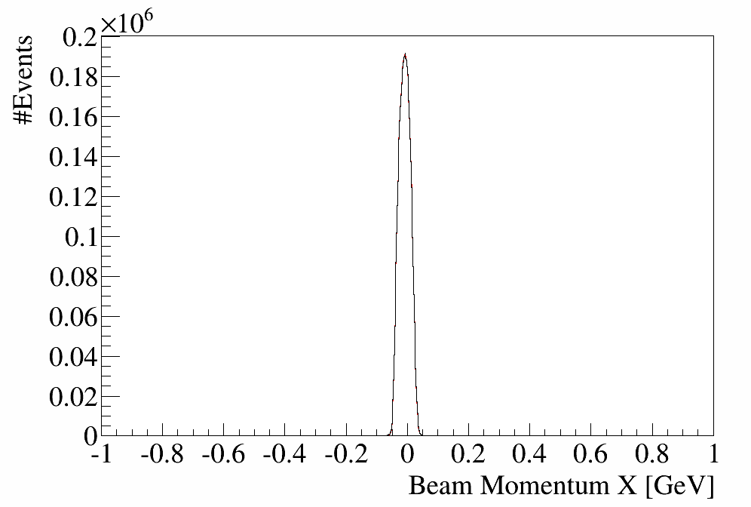
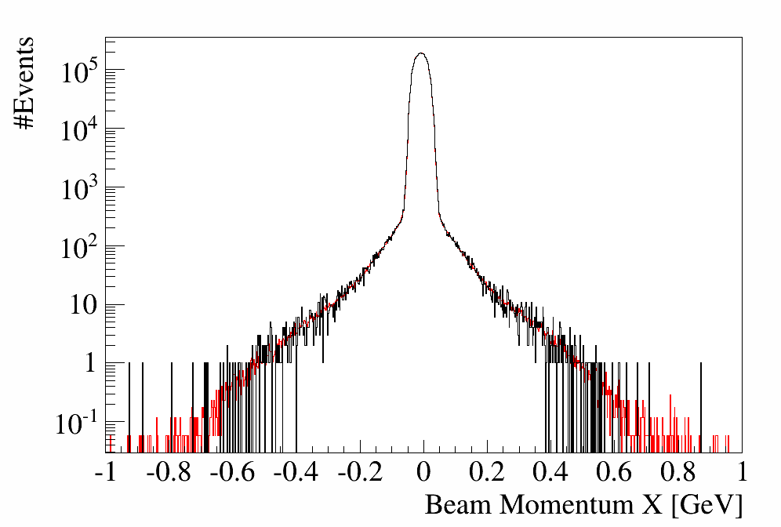
Results: Beam Momentum X

Slide 13
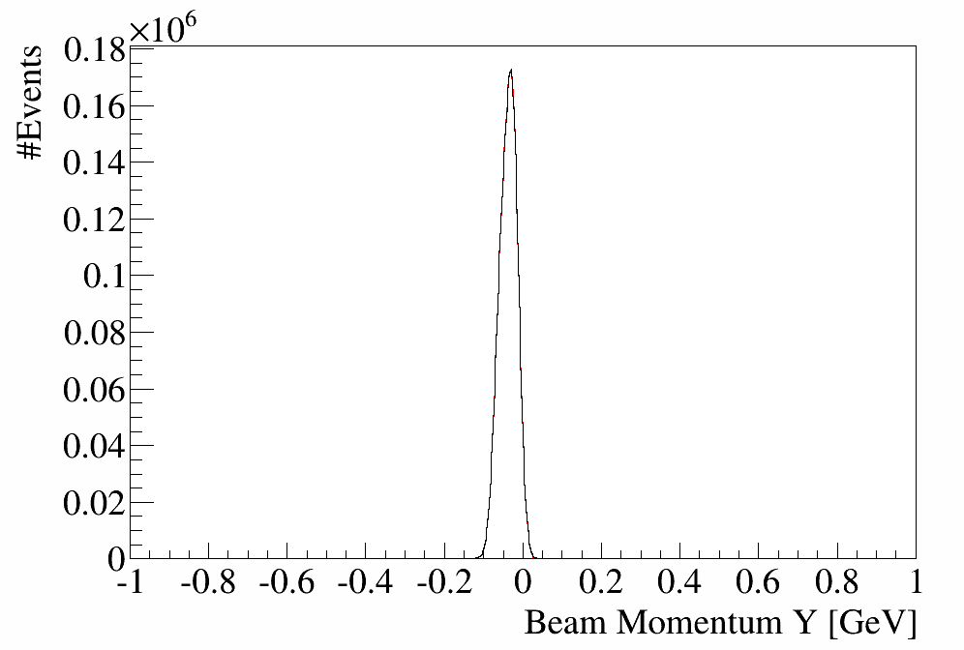
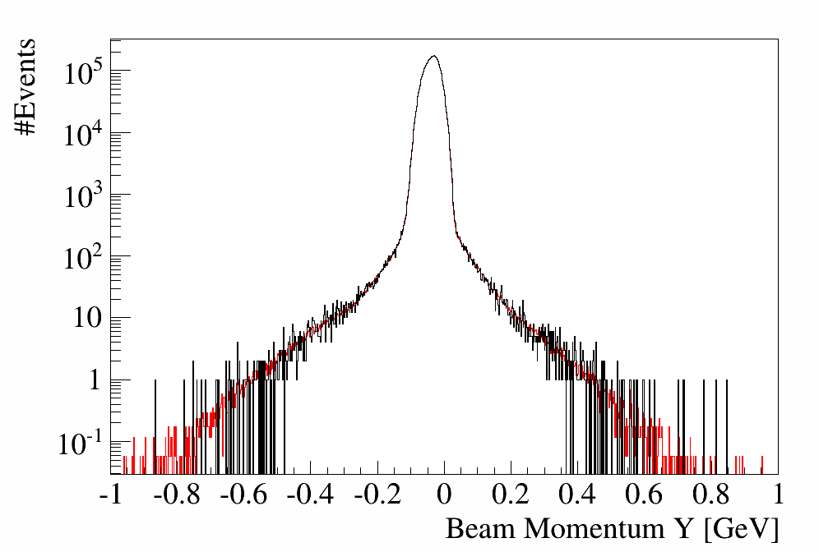
Results: Beam Momentum Y

Slide 14
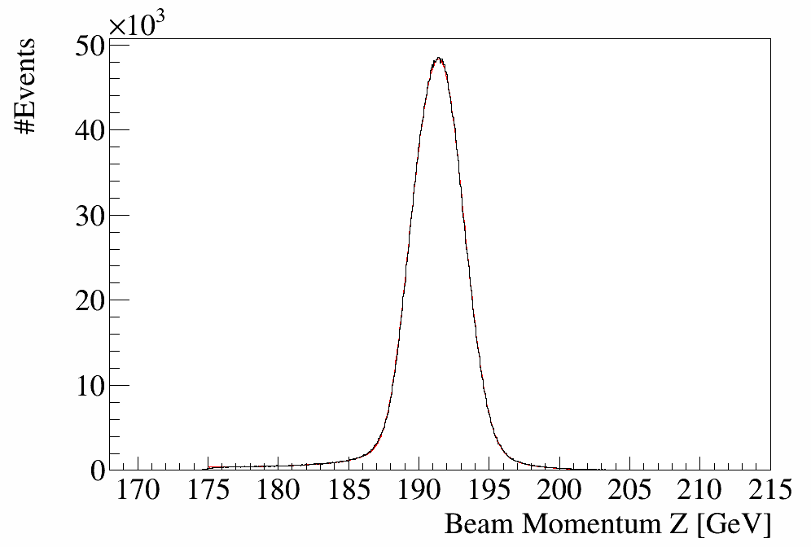
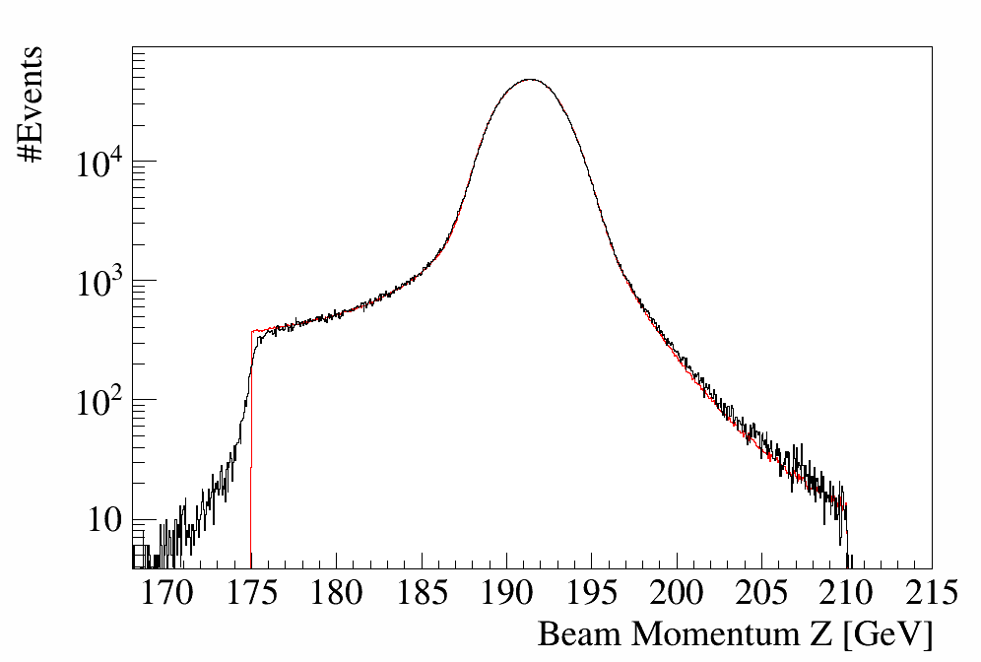
Results: Beam Momentum Z

Slide 15
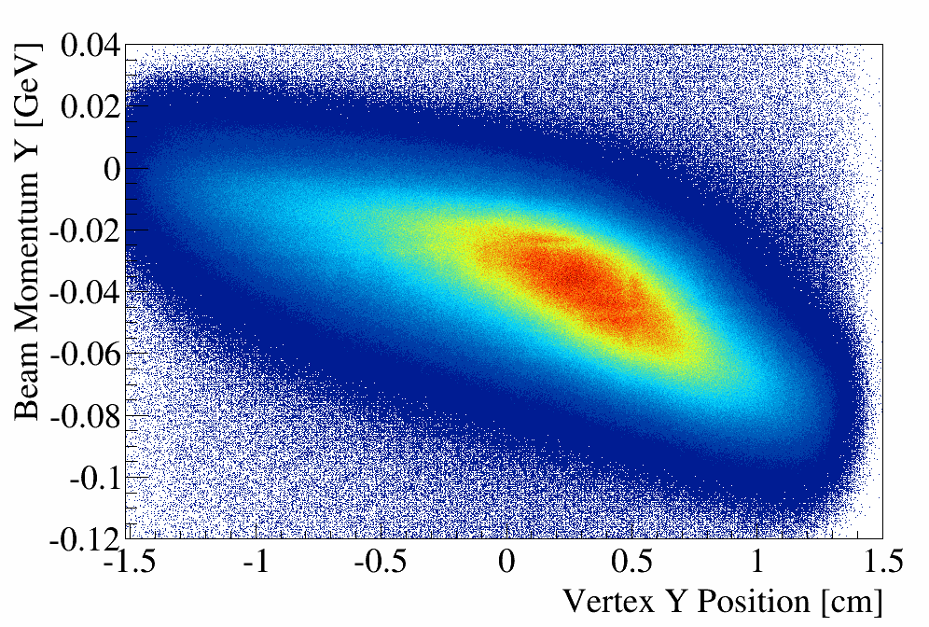
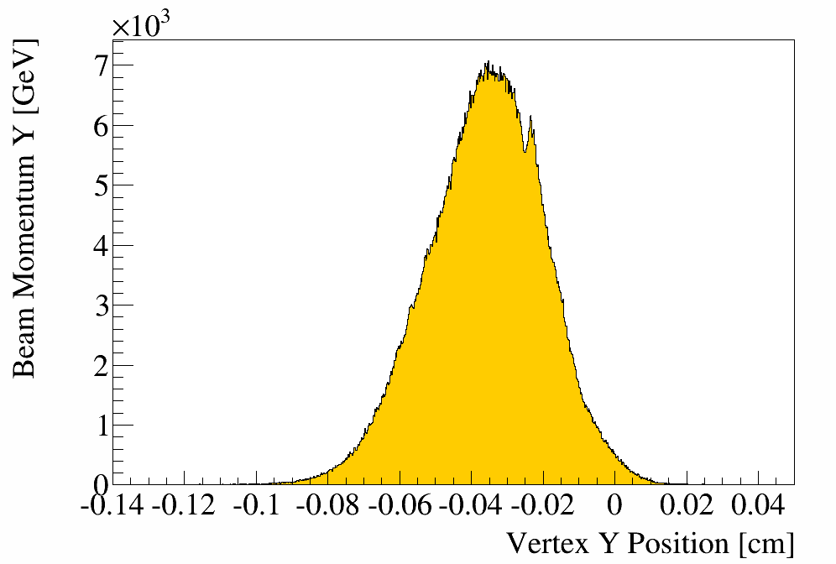
Small Binning Artifacts Remain

Slide 16
Conclusion
A new beam simulation package was developed and tested
The vertex and beam distributions of generated events reproduce the data reasonably well
First test with physics analyses have been started

