Slide 1
Investigation of Tuning Schemes of High-Q Ferrite-Loaded Cavities
Johannes Eberhardt
CERN, Beams Department / TU Darmstadt, TEMF Institute
Presentation of PhD Project
01.03.2013 – 29.02.2016
CERN Supervisor: Dr.-Ing. Christine Völlinger
TEMF Supervisor: Prof. Dr.-Ing. Harald Klingbeil

Slide 2
Tuning Schemes of Ferrite Cavities
Motivation
State of the art
Scope of the work
First results for G-510 material characteristics
Next steps and challenges

Slide 3
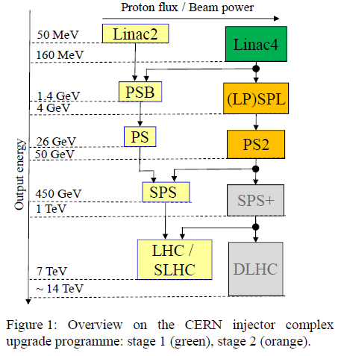
Motivation – Which Application?
CERN injector complex update programme
PS2: novel accelerating cavity with 18 – 40 MHz tuning range required

Slide 4
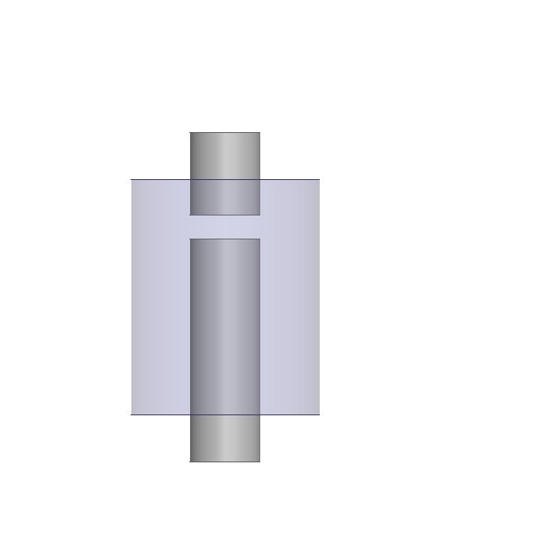
Motivation – How does an Accelerating Cavity work?
cylindrical structure
accelerating gap
beam pipe
H_{RF}
E_{RF}
λ/4

Slide 5
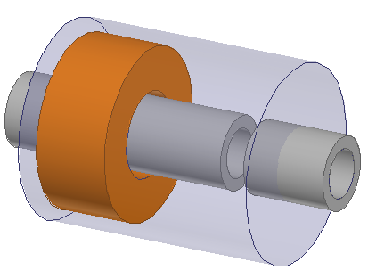



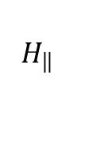


Motivation – Why Ferrite Loaded?
$$H_{RF}$$
$$f_{res}\text{\sim }\frac{1}{\sqrt{μ_{r}}}$$
Tuning 18 – 40 MHz →$r_{μ}=\frac{μ_{r}(18 MHz)}{μ_{r}(40 MHz)}\text{ ≈ }\text{5}$
$$H_{\left\| \right.}$$
ferrite ring
$$I_{bias}$$
$$H_{┴}$$
$$I_{bias}$$

Slide 6
State of the Art – Examples
Name | Tuning Range | Biasing Method | Type of ferrite
CERN PS | 2.8 – 9.6 MHz | Parallel | Ni-Zn
TRIUMF Booster | 46 - 62 MHz | Perpendicular | Yttrium Garnet
New PS Update Cavity | 18 – 40 MHz | Parallel, Perpendicular or both? | Yttrium Garnet

Slide 7
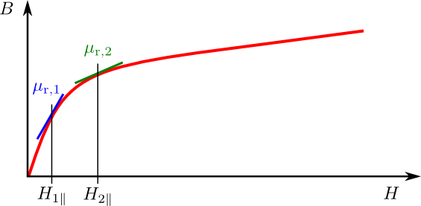


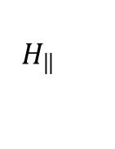
State of the Art – Parallel Biasing
$$H_{\left\| \right.}$$
μ_{r} ~ slope of tangent line
increasing H_{1ll} to H_{2ll} $→$ shifts μ_{r,1} to μ_{r,2}
$$H_{RF}$$

Slide 8
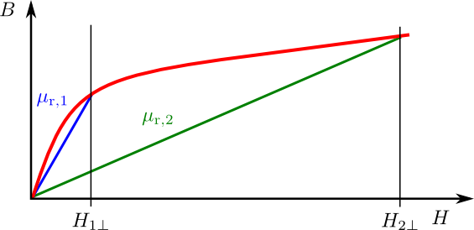


State of the Art – Perpendicular Biasing
μ_{r} ~ slope of secant from origin to B-H curve.
Higher Magnetic Field strength needed
Operating point is closer to saturating magnetization 4πM_{s} $→$ reduced RF losses and higher Q values.
$$H_{┴}$$
$$H_{RF}$$

Slide 9
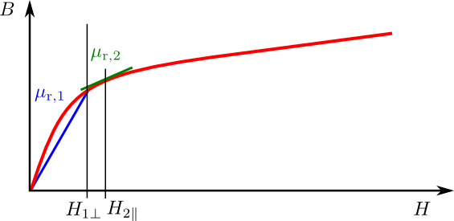
State of the Art – 2 Directional Biasing
$$H_{\left\| \right.}$$
First applying H_{1⊥}→ operating point close to saturating magnetization
Rotating direction to H_{2ll} → modest increase in bias field
$$H_{┴}$$
$$H_{RF}$$

Slide 10
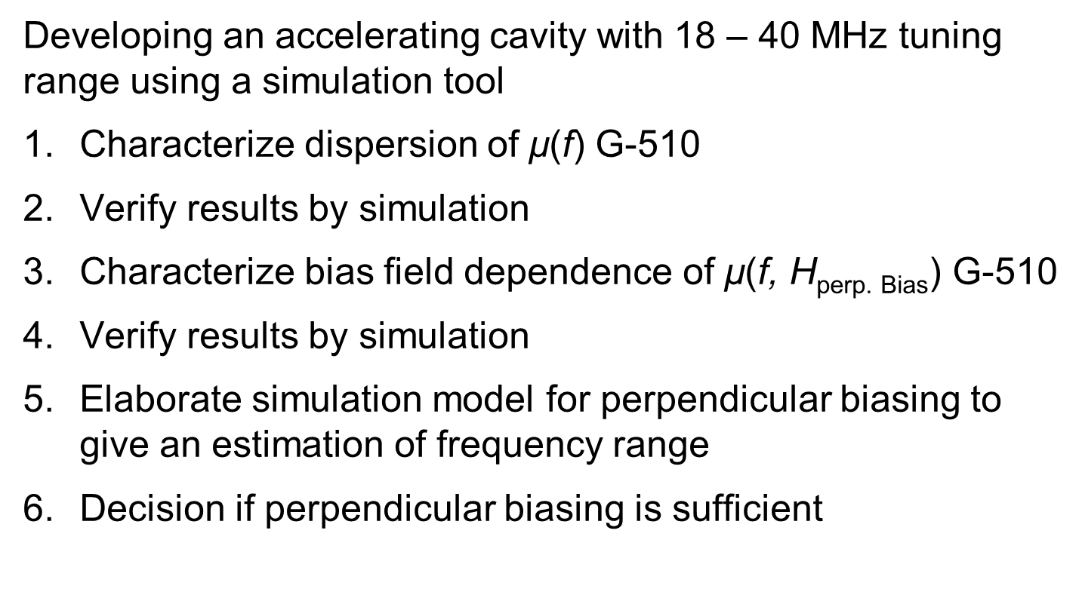
Scope of the Work – Overview
Developing an accelerating cavity with 18 – 40 MHz tuning range using a simulation tool
Characterize dispersion of $\text{μ}\text{(}\text{f}\text{)}$ G-510
Verify results by simulation
Characterize bias field dependence of $\text{μ}\text{(}\text{f}\text{, }\text{H}\text{perp}\text{. }\text{Bias}\text{)}$ G-510
Verify results by simulation
Elaborate simulation model for perpendicular biasing to give an estimation of frequency range
Decision if perpendicular biasing is sufficient

Slide 11
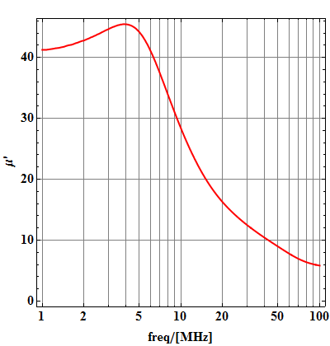
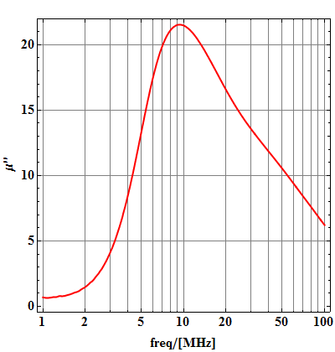


First Results – G-510 $\text{μ}\text{(}\text{f}\text{)}$
Coaxial short-circuit technique to determine $\text{μ}\text{r}\text{ = }\text{μ}\text{′}\text{ − }\text{j}\text{μ}\text{′′}$
Measuring S₁₁ for empty and filled sample holder
Analytical calculation of $\text{μ}\text{r}$(S₁₁) for sample holder

Slide 12
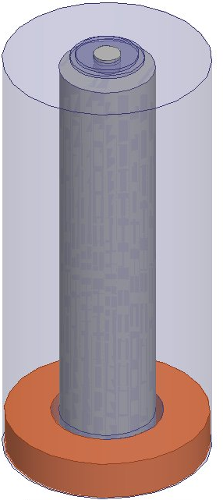
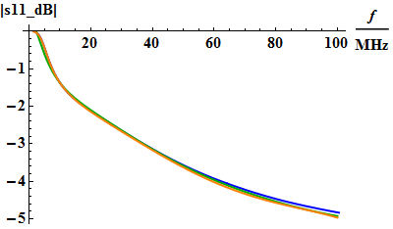
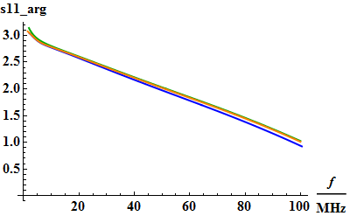

First Results – Verification by Simulation
Simulation of sample holder with $\text{μ}\text{′}$(f) and $\text{μ}\text{′}\text{′}$(f) as input

Slide 13
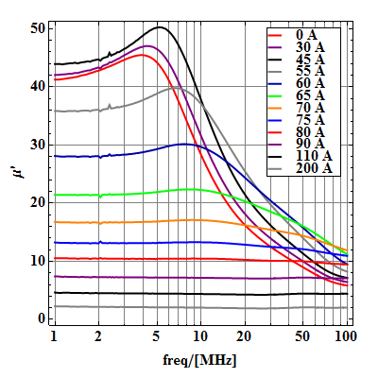
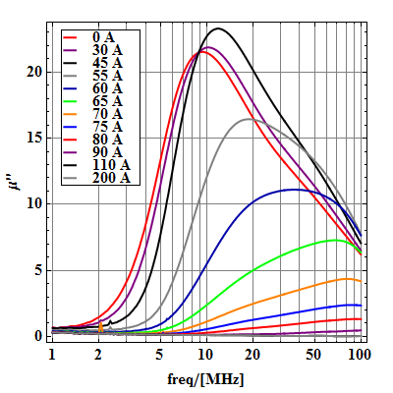

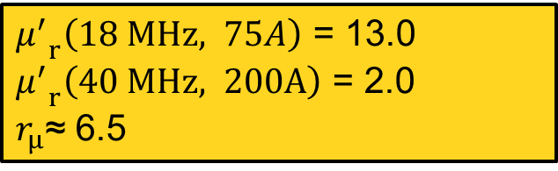
First Results – G-510 $\text{μ}\text{(}\text{f}\text{, }\text{H}\text{perp}\text{. }\text{Bias}\text{)}$
Same method but for different bias field
${μ^{′}}_{r}\left(18 MHz, 75A\right)$ = 13.0
${μ^{′}}_{r}\left(40 MHz, 200A\right)$ = 2.0
$r_{μ}$≈ 6.5

Slide 14
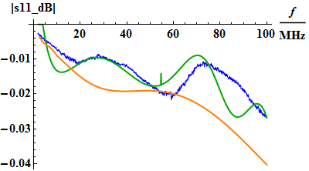
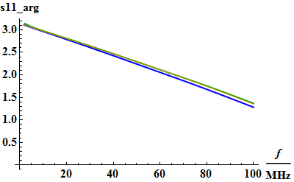

First Results – Verification by Simulation
Simulation of sample holder with $\text{μ}\text{′}$(f) and $\text{μ}\text{′}\text{′}$(f) for $\text{H}\text{perp}\text{. }\text{Bias}$ = 200A

Slide 15
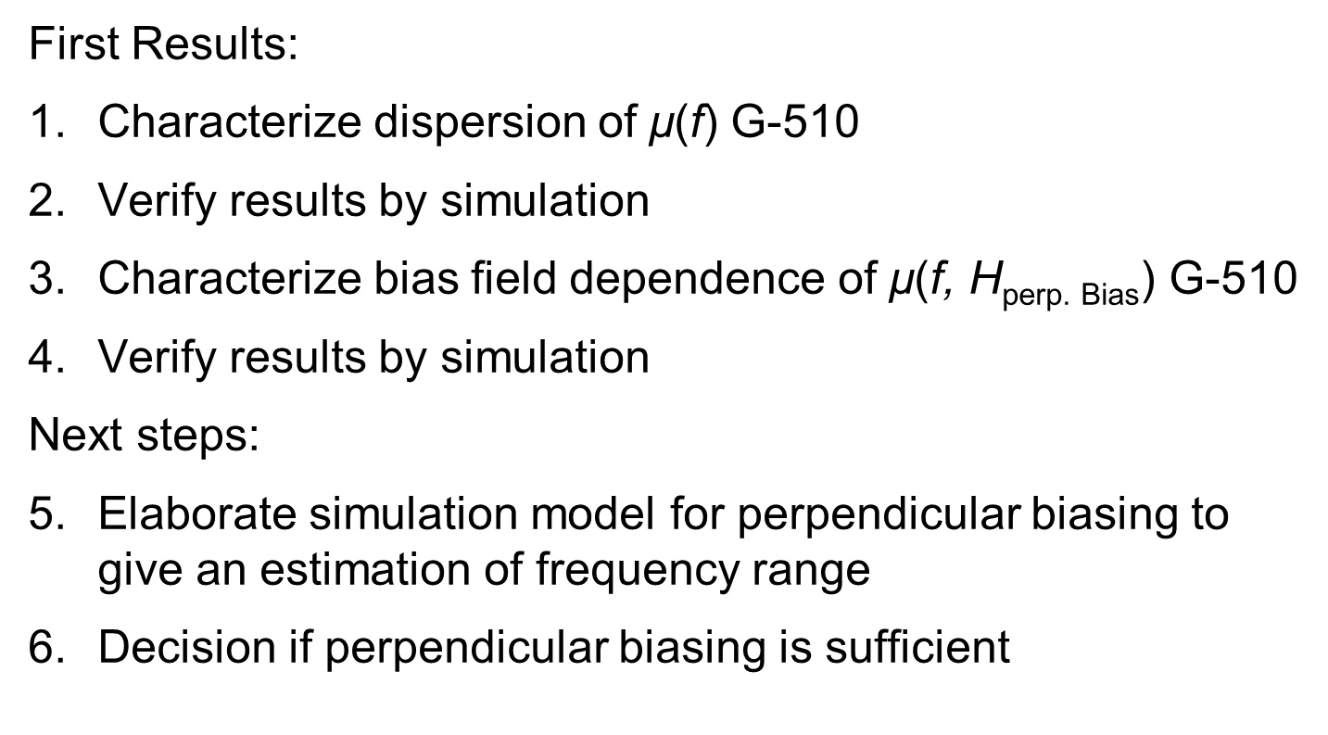
Scope of the Work – Overview
First Results:
Characterize dispersion of $\text{μ}\text{(}\text{f}\text{)}$ G-510
Verify results by simulation
Characterize bias field dependence of $\text{μ}\text{(}\text{f}\text{, }\text{H}\text{perp}\text{. }\text{Bias}\text{)}$ G-510
Verify results by simulation
Next steps:
Elaborate simulation model for perpendicular biasing to give an estimation of frequency range
Decision if perpendicular biasing is sufficient

Slide 16
Thank you for your attention!

