Slide 1

SPSC109 summary for IEFC – Part II
Lau Gatignon / EN, S.Maury / BE
Open Session: DIRAC, CLOUD, DREAM/RD52, NA62, AWAKE
Closed Session: ν FUTURE, ν-STORM, AD EXPERIMENTS, BASE, NA61,
COMPASS, OPERA, ICARUS, CAST, OSQAR, UA9

Slide 2
COMPASS
COMPASS is preparing for the Drell-Yan run in 2014, in particular preparing the new target area
inside the EHN2 hall. The super-conducting magnet of the polarized target has been repaired.
Overall the preparations of the Drell-Yan run are on track.
They published one paper (gluon polarization from open charm) and submitted another.
OPERA
OPERA has submitted a sterile neutrino paper and observed a third ν_{τ} candidate, recently presented in a LNGS seminar. An extensive report will be prepared for the June SPSC meeting.
The brick analysis and scanning is progressing well with record performance.
Six publications are in preparation.

Slide 3
CAST
Preparing for new data-taking starting in the fall of this year
A new MoU must be signed in June.
OSQAR
OSQAR has now two Argon lasers available: one 25 W from Cerla at Lille and a 7-9 W laser from Rouen, both on loan. Transport of the 25 W laser to CERN is foreseen for May/June.
They plan a series of measurements from July till September 2013.
The SPSC notes with pleasure the successful procurement of an adequate laser to perform the axion search programme.
The SPSC recommends data taking in 2013.
NA61
NA61 has successfully completed the energy scan with Beryllium with 3 M events per point.
They are studying some major hardware upgrades: a readout upgrade, the construction of forward tracking detectors, the vertex detector
There are ongoing tests and discussions with the CERN cryogenics group to determine necessary upgrades and maintenance of the VTX-1 and VTX-2 vertex magnets.

Slide 4
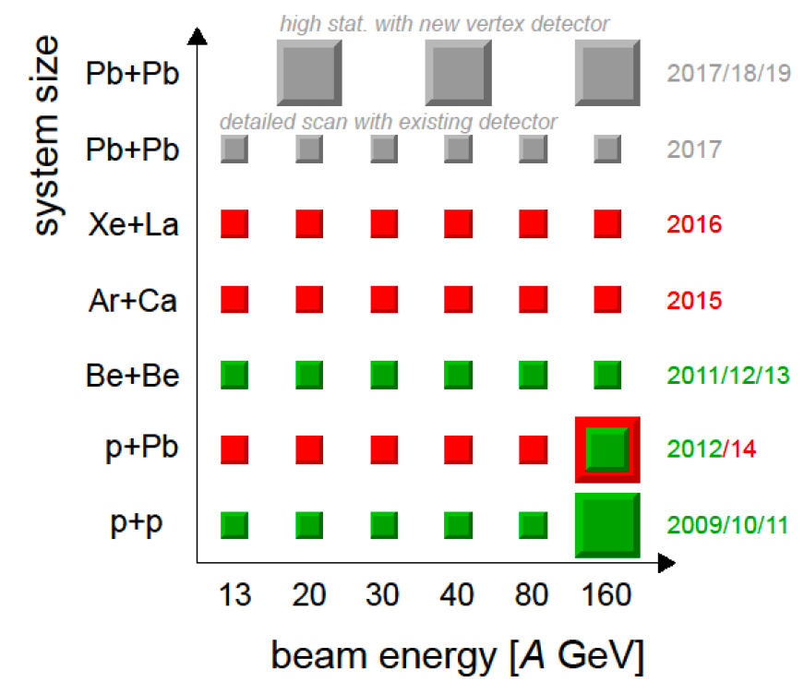
NA61:

Slide 5
UA9/CRYSTAL
UA9 is now installing “LHC-grade” goniometers in the SPS and they also have the possibility of
piezo goniometers which are more precise, shorter (lower impedance) and cheaper.
They are testing short crystals at Frascati for later installation at the SPS.
On the detector front they will drop the MediPix and go for micro-strips and a Cerenkov detector.
The LAL group (6-8 persons) has joined the collaboration.

Slide 6
AD EXPERIMENTS
ATRAP reported a factor 680 improvement in the precision of the anti-proton magnetic moment.
They are now continuing this work with protons, where some collaboration members published
the observation of spin flips of a single proton. They are preparing a new vacuum enclosure
for the Ioffe trap. They are disappointed by the non-availability of demineralized water
but working on solutions.
ASACUSA is further optimizing its CUSP trap and collaborating with the ELENA team on the
electrostatic beam line. A new target and laser system for the pbar-He program are in preparation.
ALPHA has repaired the leak in its cooling system. A safety issue was observed with the HTSC leads
and is now being worked on with the CERN safety experts. The non-availability of demineralized
water is a problem for them, where they are looking for solutions.
AeGIS is working on technical installations and solving some technical problems. The work on
different detectors is continuing and they are analyzing the data from the 2012 run.
GBAR reported that the slow e⁺ beam line at Saclay is now equipped with detectors and will
concentrate on positron accumulation in their Penning trap. In parallel they continue to work
on the layout of the experiment together with the ELENA team.

Slide 7
BASE TDR
The BASE TDR was discussed at the January meeting and a list of 5 questions was sent to them.
Very satisfactory answers were given to all of them, including a detailed installation and
CERN resource planning. They also provided a detailed comparison with ATRAP, pointing out the
differences and similarities, showing the excellence of their set-up (faster cooling, better S/N,
unique single particle detectors, four-trap concept allowing to run through a shutdown).
BASE formulated a clear strategy for reaching their goal of 10⁻⁹ precision, including possible
longer term improvements to reach even higher precision. They have already observed single
proton spin-flips and have developed a more precise technique with a double Penning trap.
If BASE can be made operational by the end of LS1, 10⁻⁹ precision may be reached
in the 2014/2015 shutdown already.
The funding structure of both the CERN based and Mainz based parts of the experiment was
clearly explained, showing that the CERN part is fully funded for the coming 5 years by BASE.
A location has been found in place of the ATRAP cleaning room. The transfer line has been optimized and shortened to provide more space for the experiment.
The SPSC notes that all remaining issues have been satisfactorily addressed and recommends the BASE proposal for approval as an AD-experiment. The Committee also recommends installation of the experiment during the shutdown of the injector accelerators with the goal to allow the BASE collaboration to start data taking in 2014.

Slide 8
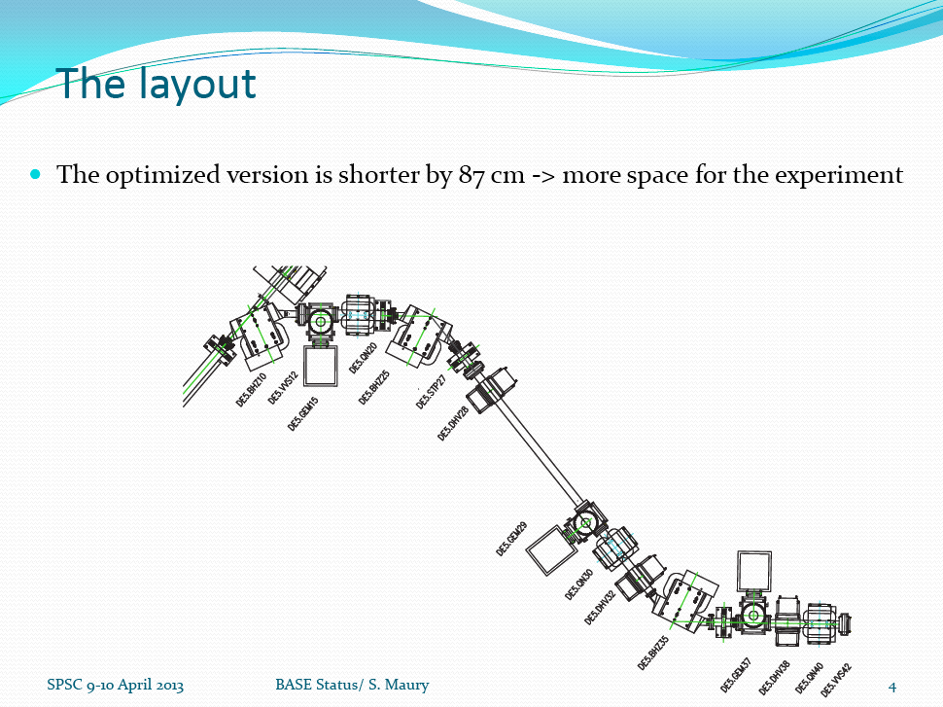

Slide 9
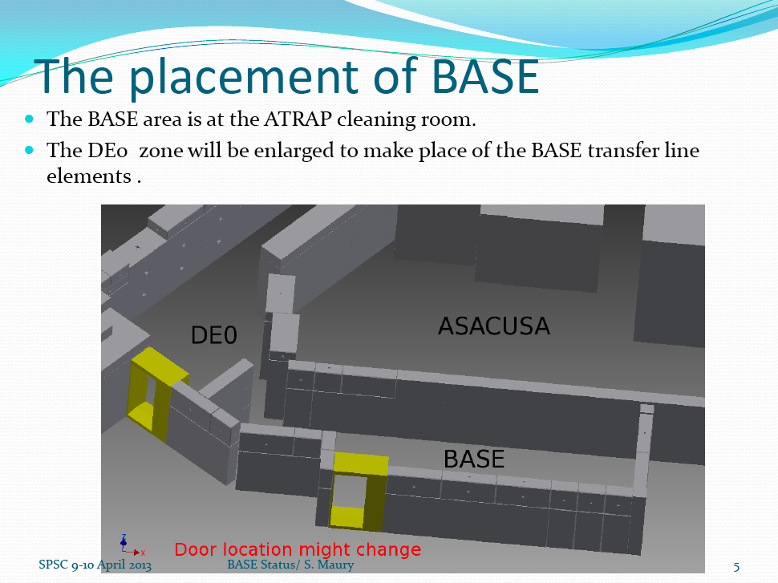

Slide 10
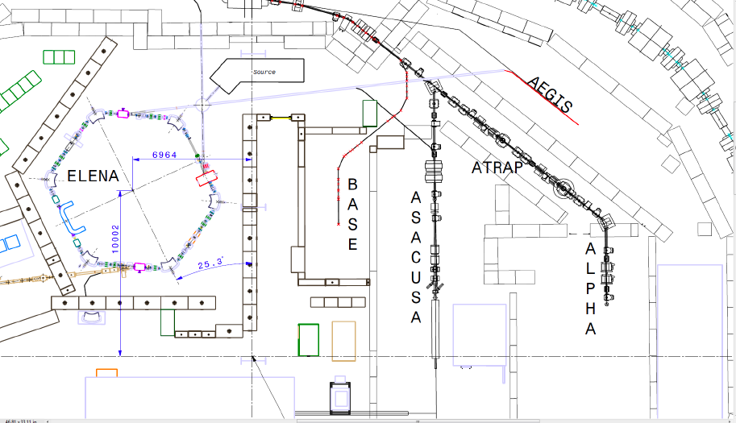

Slide 11
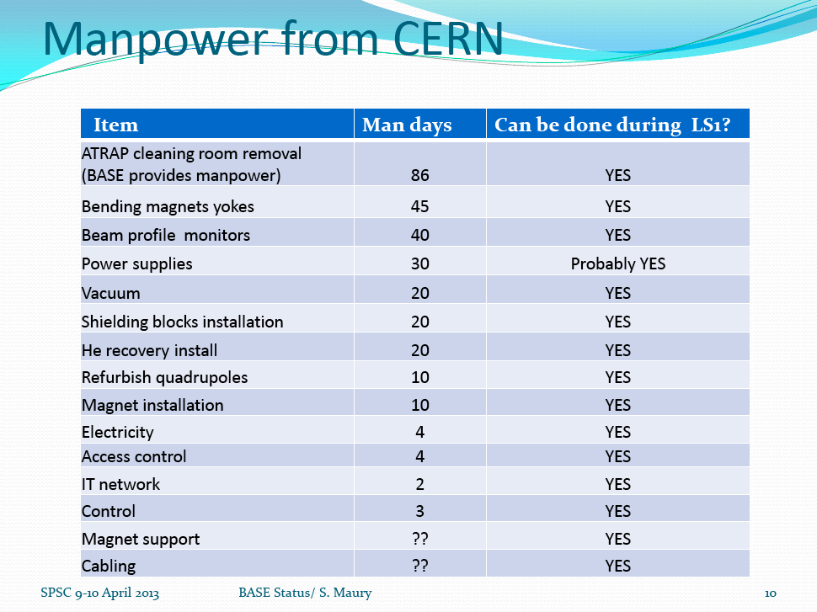

Slide 12
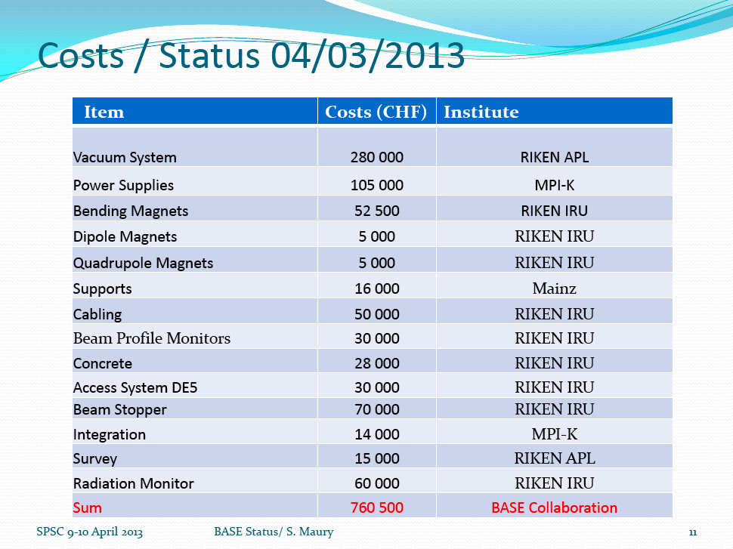

Slide 13
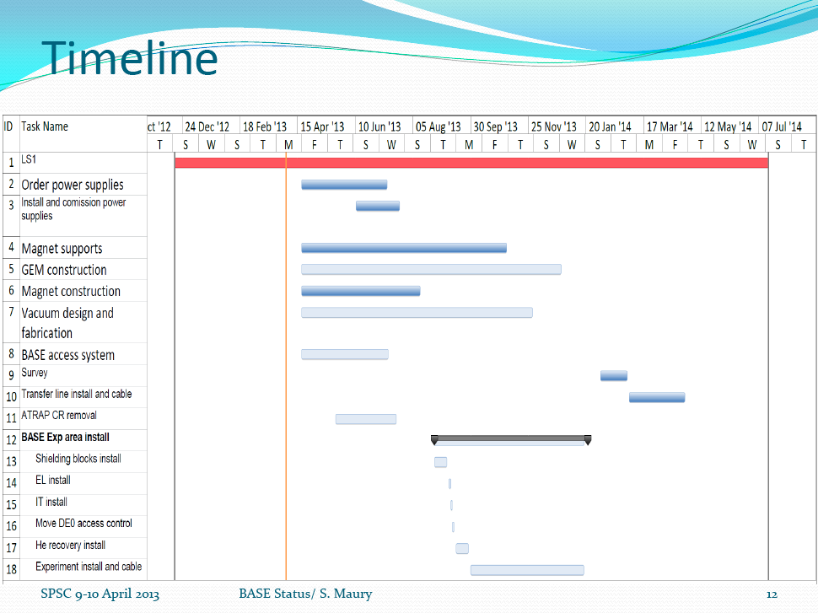

Slide 14
NEW ACTION ITEMS
Meeting | Experiment | Action item | Comments
SPSC109 | AWAKE | Validate resource estimates | Staging impact on resources?
SPSC109 | CLOUD | Can the control room and experimental area be made larger?
SPSC109 | CLOUD | See what can reasonably be done for CLOUD run in 2013 | Find out needs, tap water, space, etc?

Slide 15
STILL OPEN ITEMS
Meeting | Experiment | Action item | Comments
SPSC108 | BASE | Evaluate CERN manpower
SPSC108 | All AD | Cooling water availability through LS1
SPSC107 | NA61 | Investigate consolidation needs | e.g. VTX magnets
SPSC107 | NA61 | Finalize planning for Argon run in 2015
SPSC107 | NA63 | Is the Pb beam sufficiently de-bunched?
SPSC105 | P347/SBL | Find storage location for T600 | In 2013

