Slide 1
SPS Magnet Test Campaign and Consequences for LS1
J. Bauche*, P. Catherine, K. Cunnington, M. Dumas

Slide 2
Outline
MNC maintenance program
Inspections, tests and outcome
Magnet activities during LS1
Summary and acknowledgments

Slide 3
MNC maintenance program
MNC magnet maintenance program in IEF
  Beam operation: intervention 24h/24 (piquet + experts)
  Short technical stops: systematic visual inspections; corrective maintenance
  Short shutdowns: previous + audio-visual inspection in pulsed mode; electrical tests; preventive maintenance; small consolidations
  Long shutdowns: previous + thermal inspections; large consolidations; major activities in highly radioactive areas
Associated with suitable spare policy
  Continuous refurbishment of large magnet families with few spares
  Certification program to prepare spares “ready to install” for all magnet types with (in progress, prioritized with magnet risk score for beam operation)
➔ Ultimate goal: mitigate MTTR and MTBF
  Nota: Operation mode with ~monthly TS, yearly SD and ~ 5-yearly LS convenient to magnet maintenance rhythm !

Slide 4
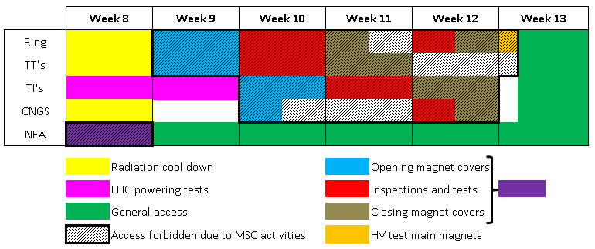
Inspections and Tests Campaign
Conditions required:
  All technical services, infrastructure, power converters available
  Support from BE/OP and other equipment groups
  Safety: access restricted to magnet experts; consignations; EIS out of chains
Planning
  Coordination of several non-MNC activities during inspection campaign: lift maintenance, TT10 geodesic survey, IT works in BA’s, VIC’s

Slide 5
Inspections, Tests and Outcome
Audio-visual inspection in pulsed mode
To detect coil movements or mechanical degradation
Magnets concerned
  Main dipoles and quadrupoles (960)
  Transfer line quadrupoles type QTL/QNL/QWL (~200)
Test process
  Removal of magnet covers
  Audio-visual inspection in pulsed mode
Cure actions
  Typically, replacements of most critical elements (early detection!)
  Shimming in situ often possible for transfer line quadrupoles
Occurrences in LS1 inspections
  In average with previous years
  8 main dipoles, 5 main quadrupoles and 1 transfer line quadrupole will be exchanged in 2013 ➔ already started, should be completed in June

Slide 6
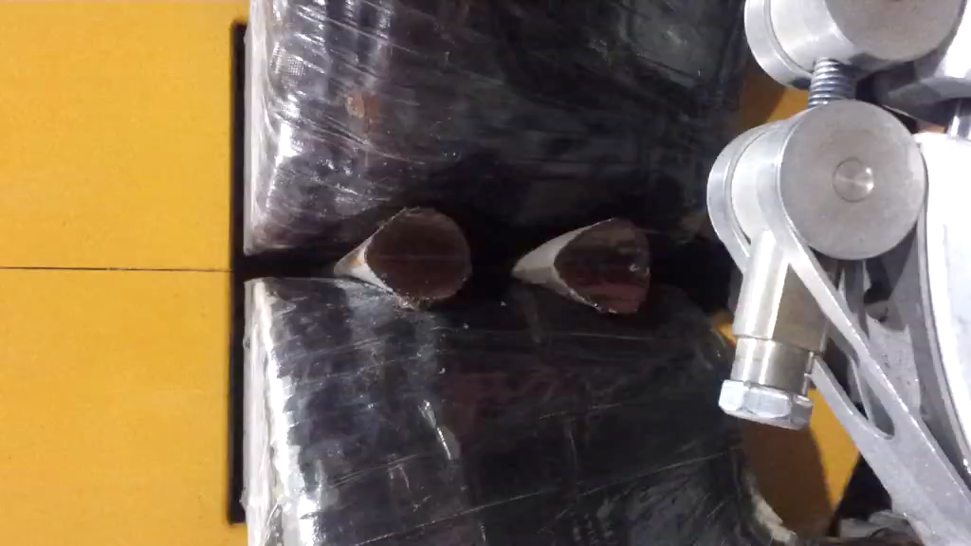
Inspections, Tests and Outcome
Example of coil movement on QNL magnet

Slide 7
Inspections, Tests and Outcome
High voltage tests
To detect weaknesses in coil ground insulation
Magnets concerned
  Main dipoles and quadrupoles (960)
  (Other magnets in case of failure in operation)
Test process
  Machine closed, in dedicated configuration (CIS system of EPC)
  Separation of power converters from load
  Test +/- 6kV on dipole and +/- 4 kV on quadrupole circuits
To be noted
  Busbars and water cooled cables are tested together with magnets!
Outcome of LS1 test
  No failure

Slide 8
Inspections, Tests and Outcome
Capacitive discharge tests
To detect weaknesses in coil inter-turn insulation
Magnets concerned
  Main dipoles (3 x 248)
  (Other magnets in case of failure in operation)
Test process
  Physical fencing and marking of sector (or machine closed)
  Separation of load from power converters
  1.5 kV discharge on individual magnets (no busbar disconnection)
Campaign organization
  Started in SD 2010/2011
  2 sectors/year, first round finished this year
Occurrence in LS1 inspections
  1 MBB in position 32550 ➔ beam orbit perturbations detected in last months of 2012 operation!

Slide 9
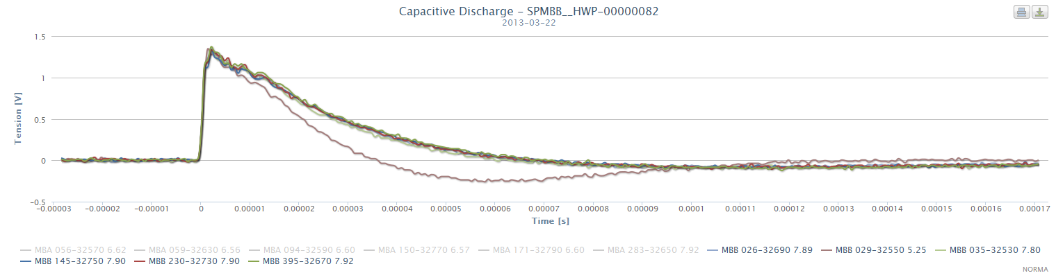
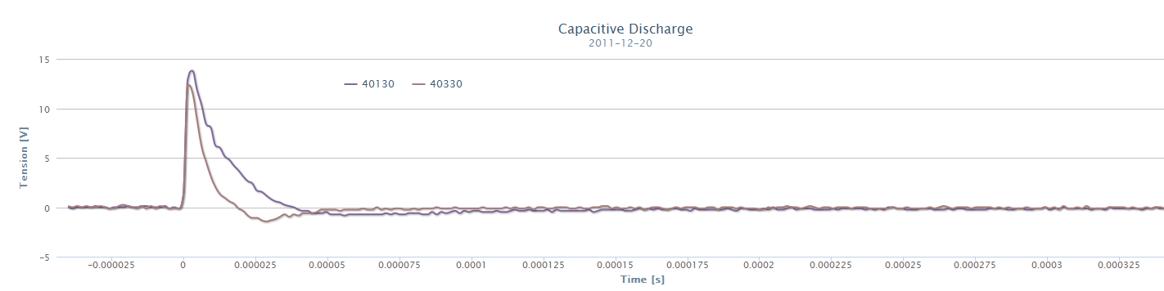
Inspections, Tests and Outcome
Inter-turn short circuit response to capacitive discharge
MBB 32550
LS1
MBB 40130
SD 2011/2012

Slide 10
Inspections, Tests and Outcome
Thermal inspections
To detect clogged cooling circuits in coils and loose electrical connections
Magnets concerned
  All magnets (~3000!)
Test process
  Removal of all magnet covers
  Machine closed, magnets pulsing with maximum RMS
  Inspection of coil surfaces and electrical terminals with thermal camera
Campaign organization
  ~2 weeks needed to remove / reinstall all magnet covers! → only during LS
Findings in LS1 campaign
  Cooling circuit restriction on MBB 50690 → magnet has already been removed for manifold inspection in workshop
  Several minor problems of loose connections, but one major…

Slide 11
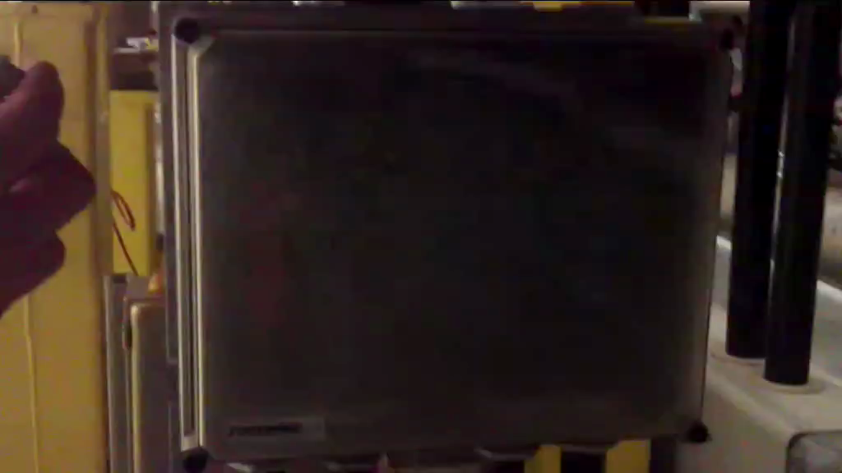
Inspections, Tests and Outcome
Smoldering connection on LSF.42405 interconnection box

Slide 12
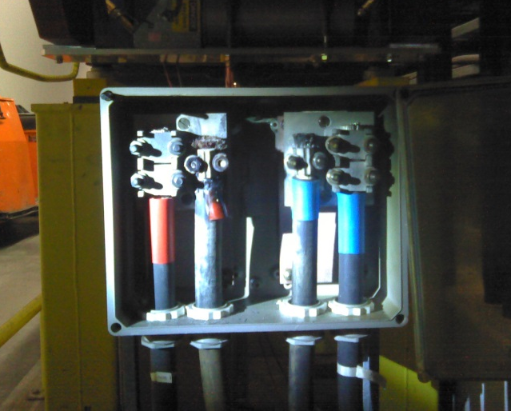
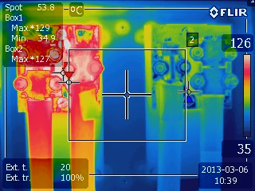
Inspections, Tests and Outcome
Smoldering connection on LSF.42405 interconnection box

Slide 13
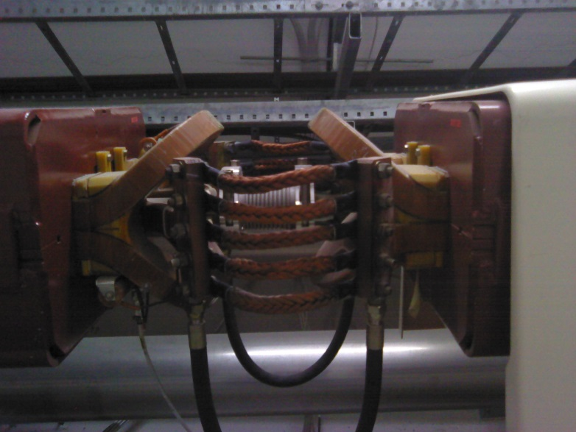
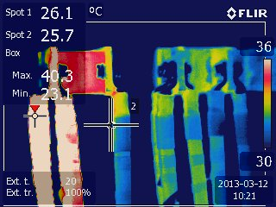
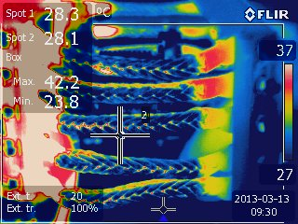
Inspections, Tests and Outcome
Examples of other minor issues of loose connections
Untightened power cabling connection to MBBT magnet in TT20
MBI interconnection copper strands in TI8

Slide 14
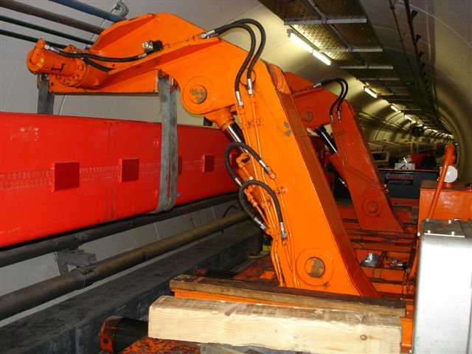
Magnet activities during LS1
Corrective / preventive maintenance
  Replacement of 20 magnets
  8 main dipoles, 5 main quadrupoles and 1 TL quadrupoles for coil movements
  1 main dipole with flow restriction on cooling circuit
  1 main dipoles with inter-turn short circuit
  4 main dipoles with loose pole shim temporarily repairs during the last 3 years
Organization
  2 main dipoles and 2 main quadrupoles already exchanged this month
  16 remaining will be exchanged in June, in between the cabling replacement campaigns
Main dipole exchange in the SPS

Slide 15
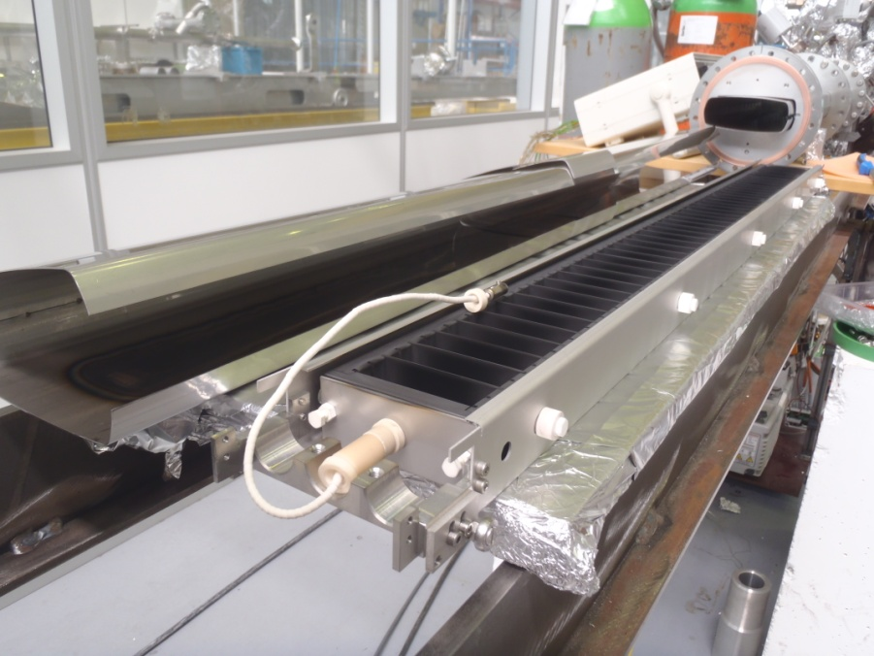
Magnet activities during LS1
LIU-SPS
  Coating of 16 dipoles and 4 quadrupoles from QF 51010 to QD 51310
  Required for further studies of electron cloud mitigation with aC coating during next beam run
Organization
  All magnets have already been removed in one go from machine last week
  Refurbishment and certification of magnets before coating in situ
  Reinstallation of all magnets in one go at the end of LS1 to avoid multiple venting of vacuum sector
Hollow cathode coating equipment for SPS main dipoles
(courtesy of P.Costa Pinto – TE/VSC)

Slide 16
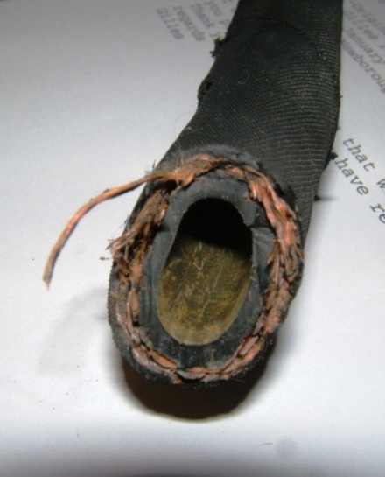
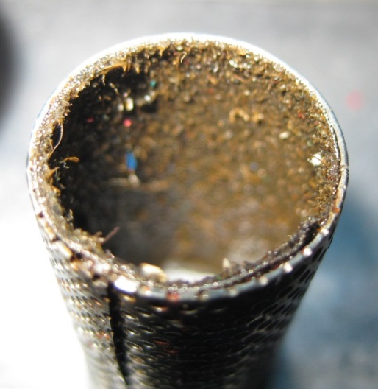
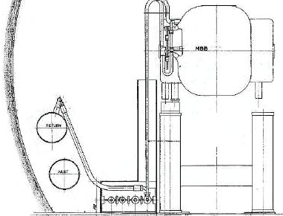
Magnet activities during LS1
Consolidation of magnet cooling supply
  Replacement of all EPDM-Kevlar hoses in SPS complex
  2000 hoses procured since 2010, were waiting for appropriate time slot
  Cleaning of all filters and inspection of busbars to take place in parallel
Organization
  Collaboration with NCBJ Institute (Poland) for additional manpower from September to December 2013 (to be approved)
  Transparent for other SPS activities (in the shadow of EN/CV works)
Delaminated cooling hose
Cleaning of cooling water filters

Slide 17
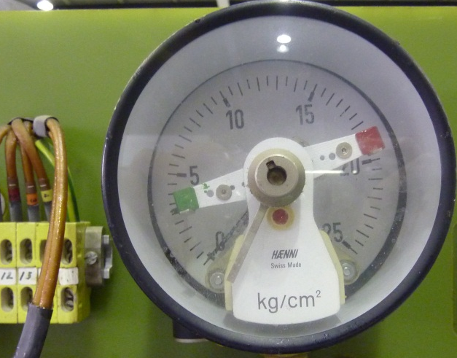


Magnet activities during LS1
North Experimental Area
  Suppression of weak electrical contacts of water pressure and water temperature interlocks
  False triggering of interlock system → important part of piquet interventions
  Shunt of redundant security signals with versatile solution
On all magnets in the NEA
Transparent for other NEA activities
Manometer with gold tip contacts corroding due to water pressure oscillations
Interlock
circuit
kg/cm²

Slide 18

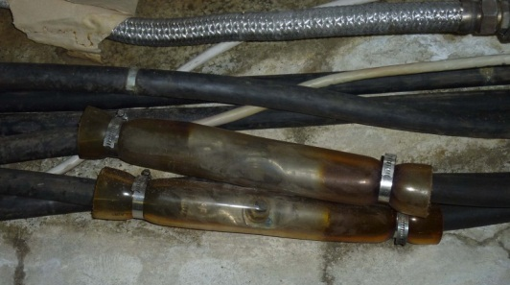
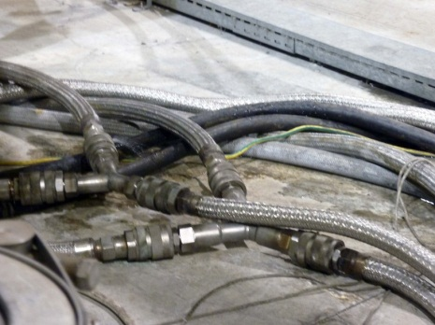
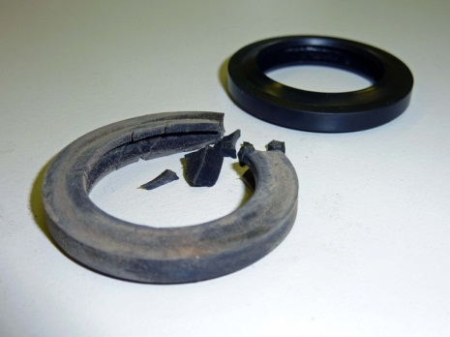
Magnet activities during LS1
North Experimental Area – TCC2
  Improvements to magnet supply circuits
  Upgrade of hoses interconnections with full metallic sealing
  Replacement of obsolete electro-valves and check valves by manual valves
  Proper sleeving of power cable interconnections
In the frame of the TDC2 / TCC2 consolidation project
Quick connector gaskets degraded by irradiation
Improper electrical connections to be sealed with appropriate sleeves

Slide 19
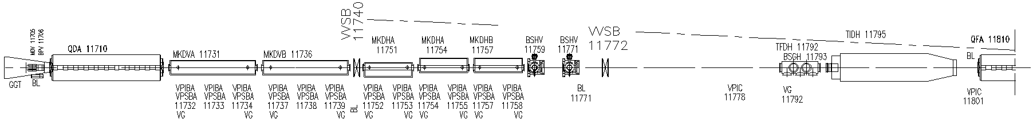
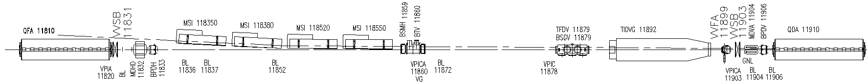
Magnet activities during LS1
Requests from other groups
  EN/EL – Irradiated cable replacement campaign in SPS LSS1+
  Requires removal / reinstallation of some 20 magnets
Magnet work package in preparation for ALARA committee
Layout of LSS1 dumping region
  GS/SE – Civil engineering works in TT10 and TDC2 tunnels
  Requires removal / reinstallation of ~8 quads in TT10 and 3 splitters in TDC2
In the frame of the TDC2 / TCC2 consolidation project

Slide 20
Summary and Acknowledgements
  New operation mode of accelerators with ~monthly TS, yearly SD and ~ 5-yearly LS convenient to magnet maintenance rhythm
Inspections and tests campaign
  Stable situation of known issues, but ambitious magnet replacement program
  Inspections in highly radioactive areas to be performed later in LS1
  Regular electrical connection tightening campaign should be restarted
SPS magnet activities during LS1
  Major activities: TDC2-TCC2 and LSS1, magnet replacements for maintenance and LIU e-cloud, cooling hoses consolidation
  Magnet activities generating co-activity interferences already mostly planned
We acknowledge our colleagues for:
  Their support to our activity… and their understanding!
  Having ensured the availability of all systems during our inspections

