Slide 1
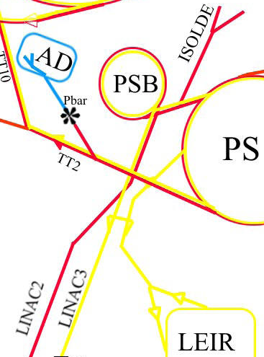
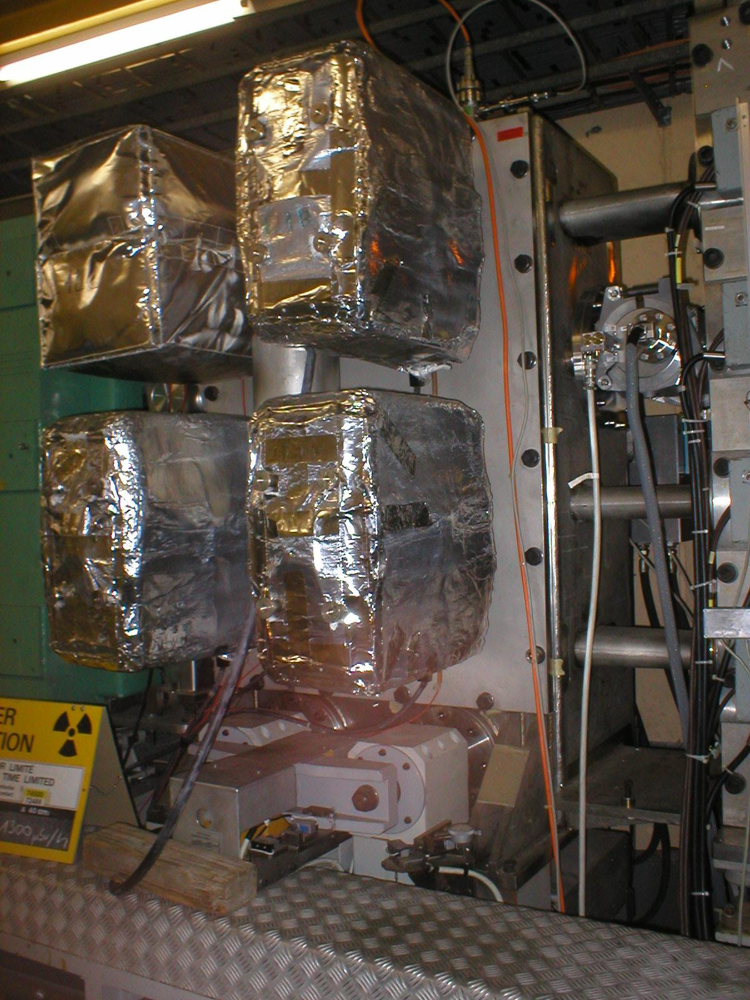
BI.SMH repair
J. Borburgh, T. Masson, A. Prost

Slide 2
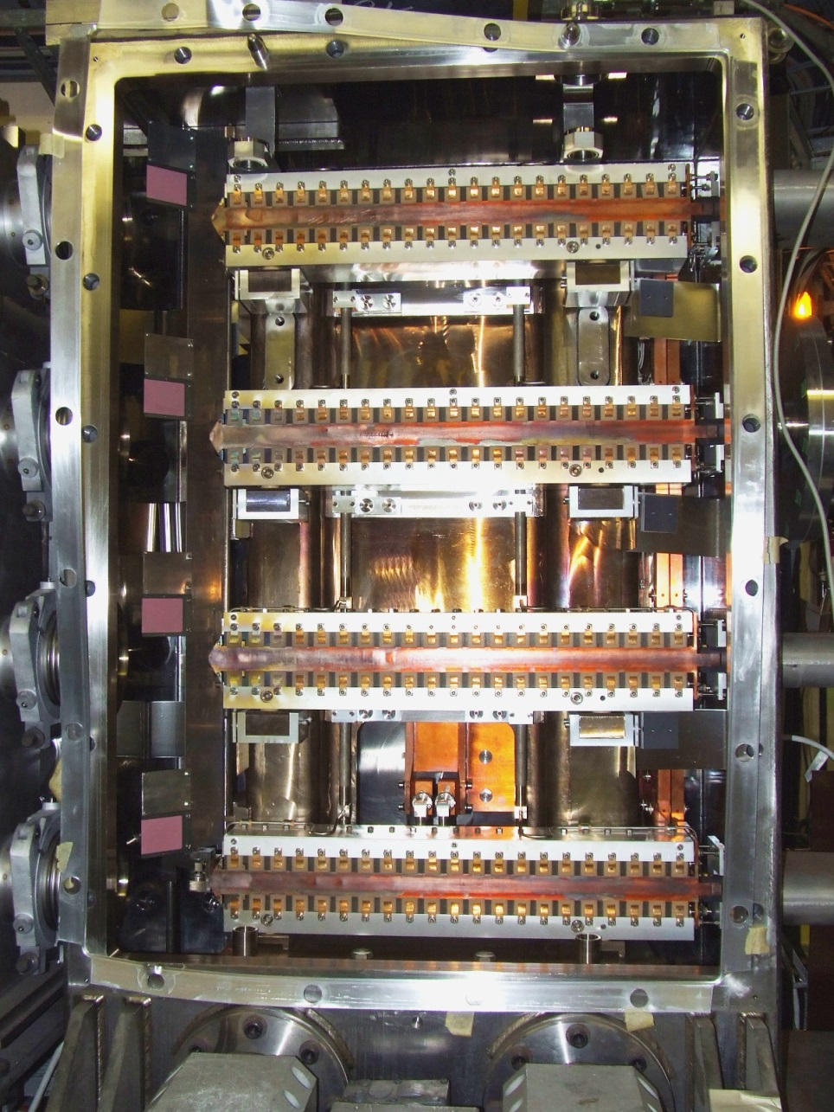
Booster injection septa BI.SMH
Stack of 4 magnets, with injection dumps (winglets)
Powered electrically in series
Cooling circuits are in //
Vacuum tank includes BI equipment
Magnet specs:
I 3.18 kA pulsed
Gap height 40 mm
L_{magnetic} 730 mm
∫B.dl 72 mT.m
Beam observation equipment, stack and winglets inside vacuum vessel

Slide 3
Failure description
TE-VSC detected and re-confirmed leak from magnet cooling circuit to machine vacuum.
Maximum He signal found was 2×10⁻⁶ mbar.l/s @ 8 bars
IEFC (17/4/2013) endorses replacement of magnet stack or feedthrough (as needed) in LS1.

Slide 4
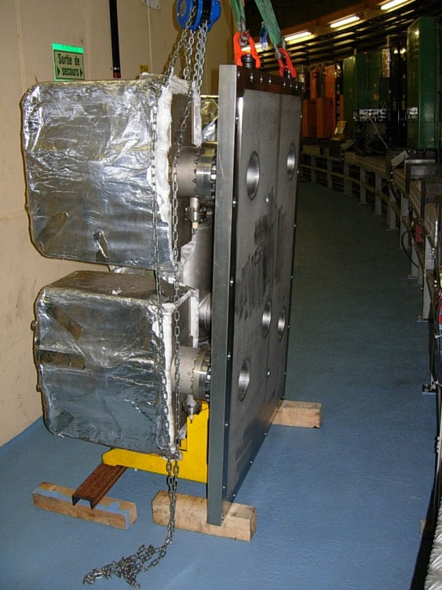
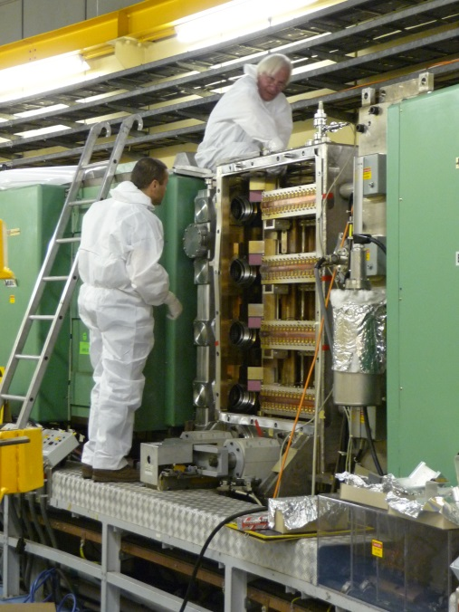
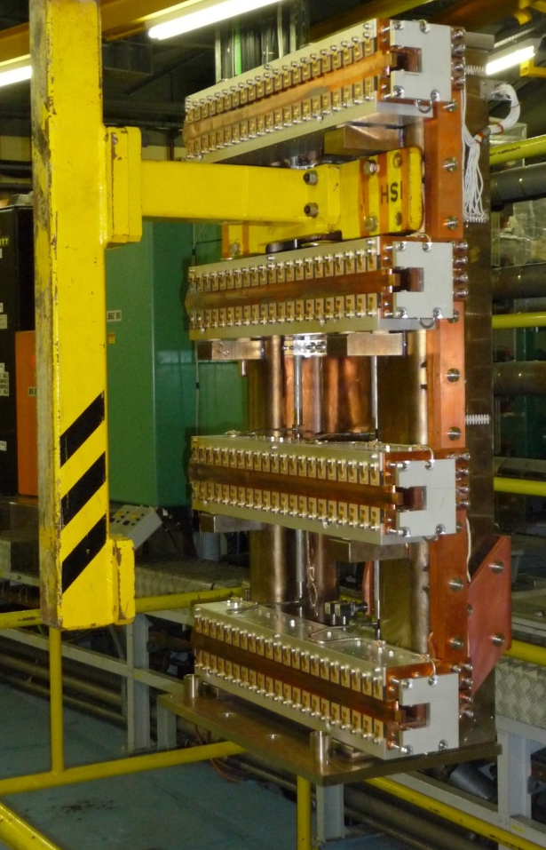
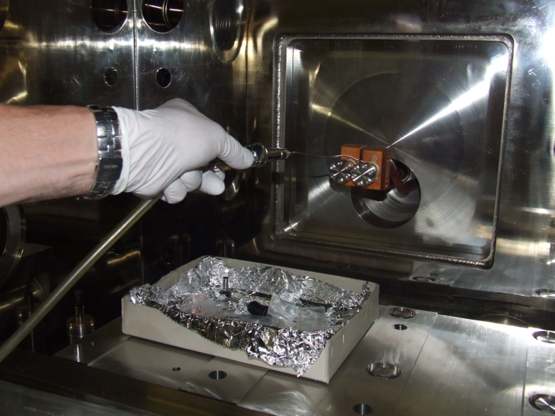
Planned procedure I
Removal of vacuum vessel door
Removal of injection dump winglets
Removal of BI equipment
Removal of magnet stack
Leak test of feedthrough
Door removed
BI equipment experts
Stack being hoisted out
Feedthrough leak test

Slide 5
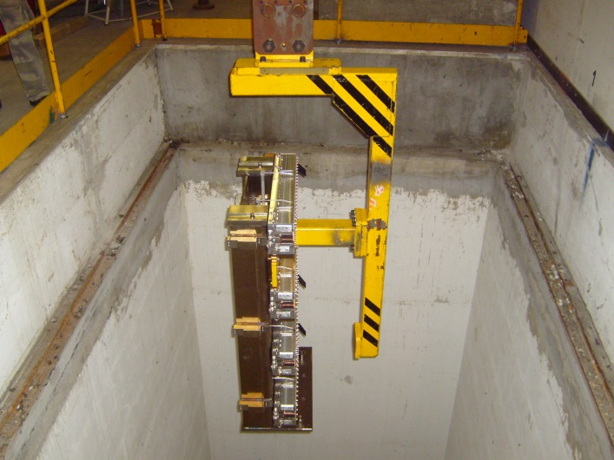
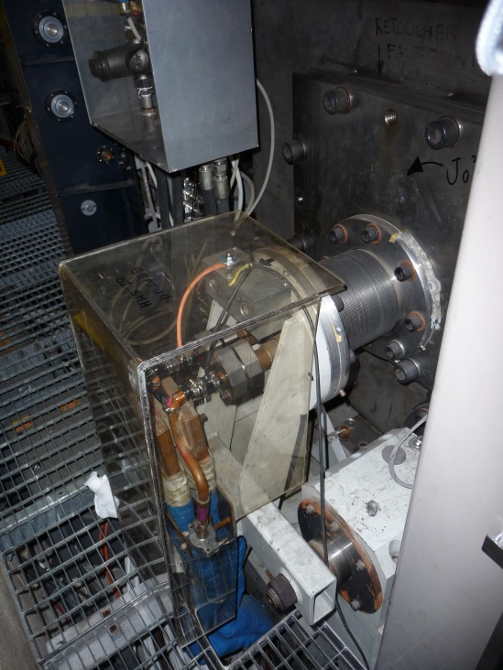
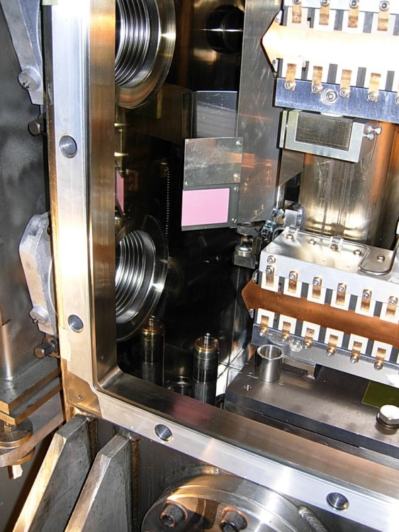
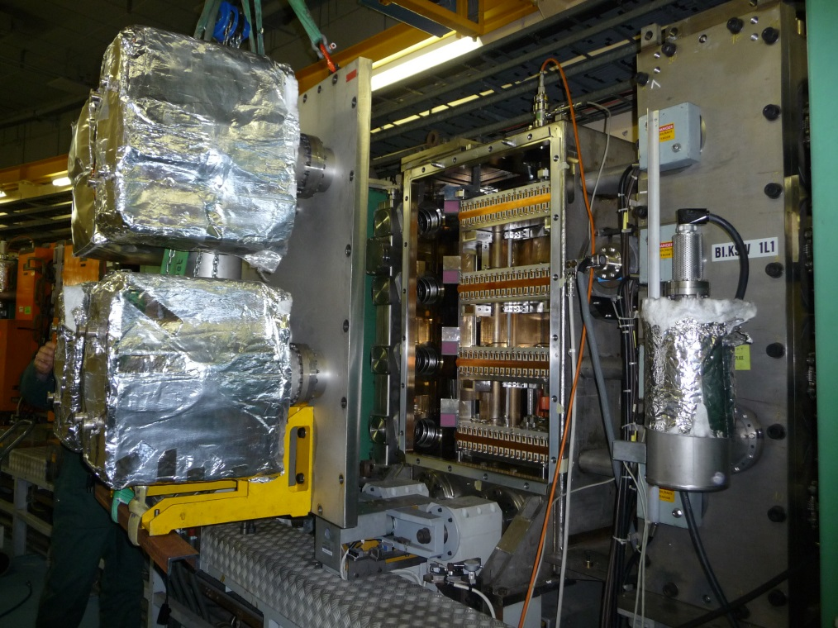
Planned procedure II
Replace feedthrough
and re-install stack
Replace stack by spare
Reinstall BI equipment
Re-install injection dump wings
Close tank door
Pump down in 1st leak test
Spare stack
being lowered into PSB
Feedthrough
BI screen installed
Tank door being closed

Slide 6
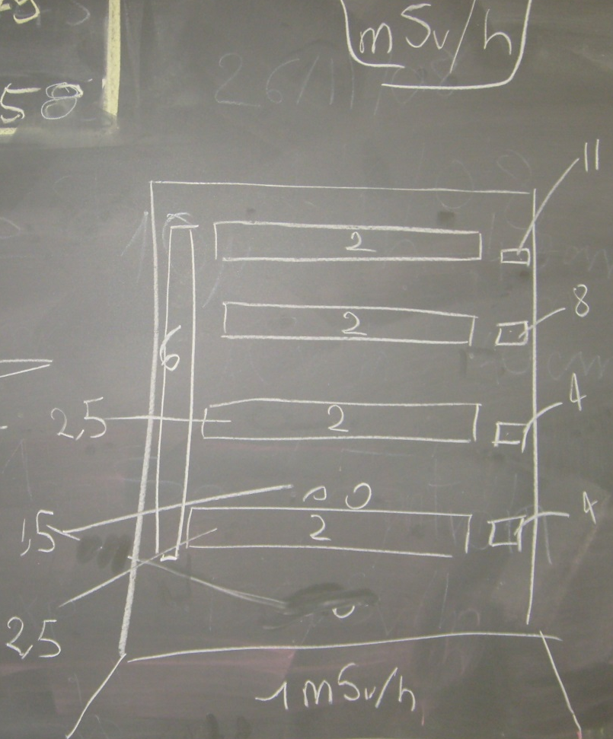
Experience from leak in May 2009 (see IEFC #6)
dose rates
at May 2009
intervention
Lifting jig was certified temporarily; formal certification almost completed.
Work dose planning completed (2009 !), good template;
Collective dose for exchange: 4.8 mSv
We will have to draw upon support from many groups
(TE-VSC, BE-BI, EN-HE, DGS-RP, …)

Slide 7
Tentative schedule
Spare parts validation: end-May
DIMR/Work dose planning approval: mid-June
Intervention in PSB: end-June
Vacuum leak tests feasible immediately after intervention
Re-build spares: Jan - May 2014

Slide 8
Post intervention
Either
(depending on leak position and thus repair action)
Build new spare feedthrough
Re-build new spare stack
Refurbishment of a spare in bldg 867 (essentially during first half of 2014, for spare to be operational once PSB starts up)

Slide 9
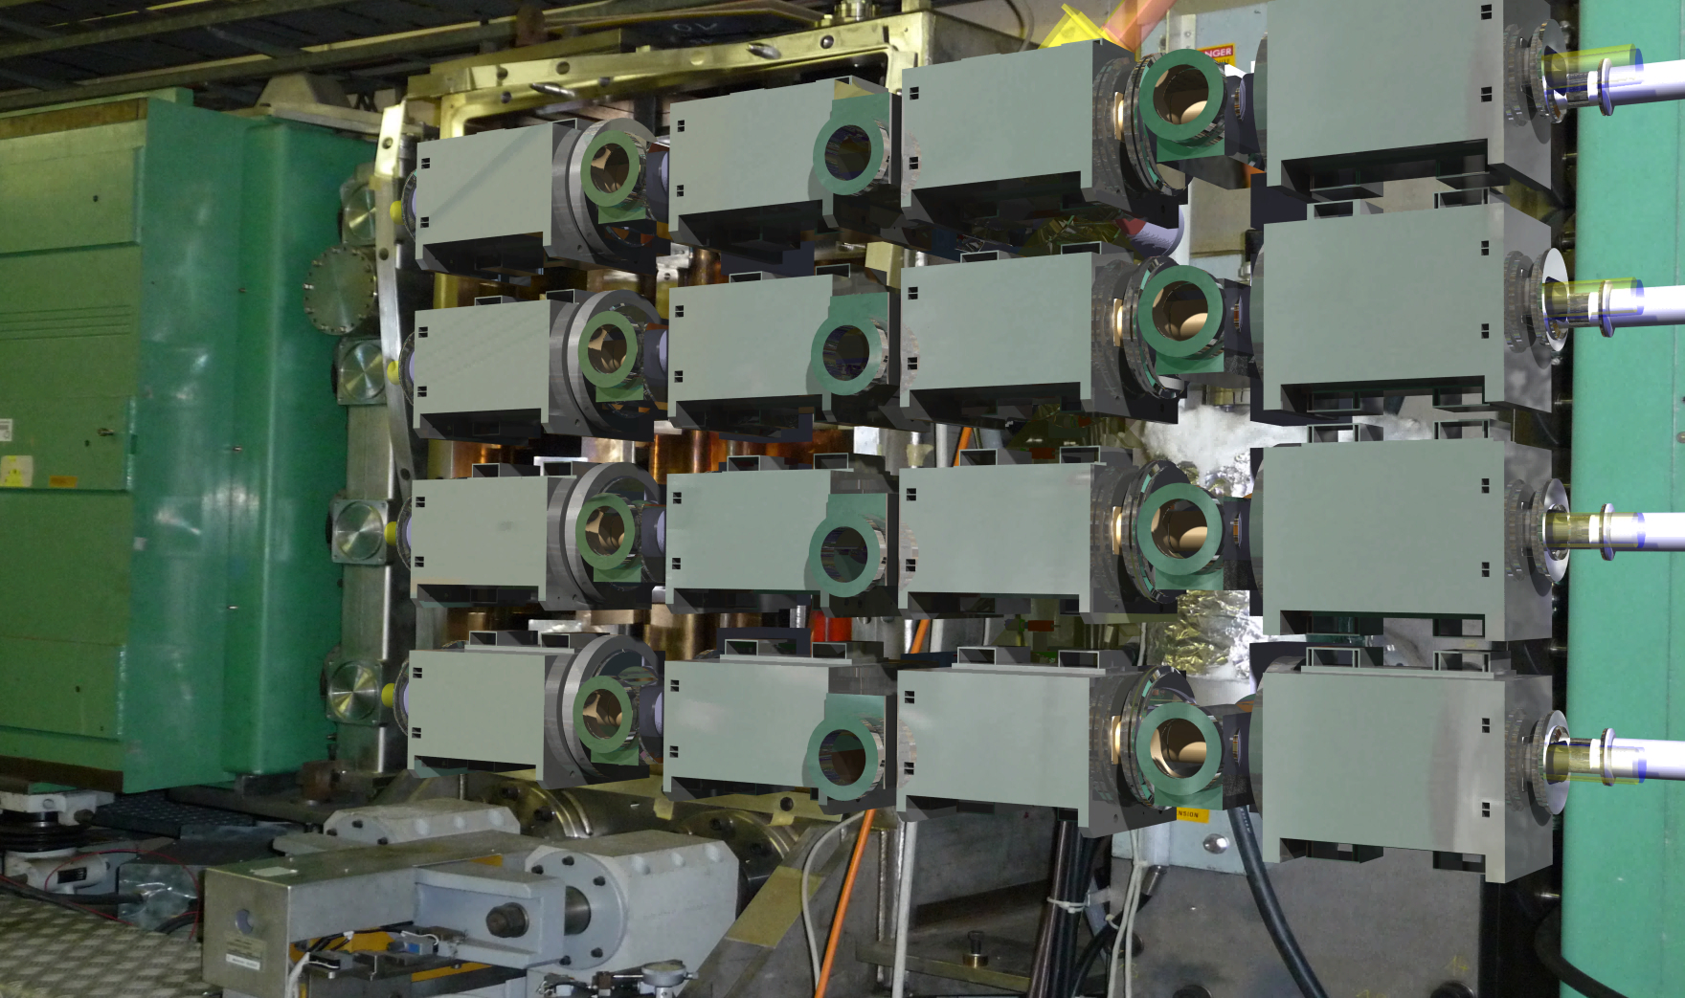
The future (post-LS2):
H⁻ injection from LINAC4

