Slide 1

Discovering Walking Technicolor at LHC and on the Lattice
Koichi Yamawaki
KMI, Nagoya University
@Higgs and Beyond
June 7, 2013 Tohoku

Slide 2
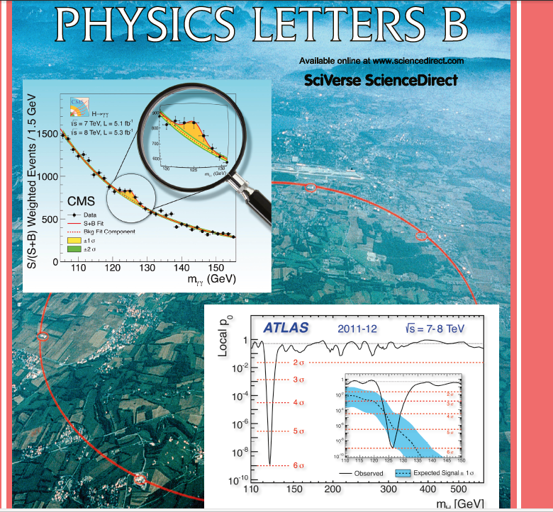
Discovery of
125 GeV Higgs

Slide 3
Standard Model is incomplete
No Dark matter candidates
Baryogenesis: KM CP violation not enough,
No 1st order phase transition
Strong CP Problem: neutron EDM
…
Naturalness Problem BSM on TeV
hierarchy & tachyon :

Slide 4
TC was killed 3 times
FCNC
S,T,U parameters
125 GeV Higgs
Walking TC
(Holographic)
Walking TC
[or ETC effects]
Walking TC
scale inv.

Slide 5
Technicolor = Higgsless Model
S. Weinberg (1976)
L. Susskind (1979)
(No light scalar)
Walking Technicolor KY-Bando-Matumoto (1986)
= Composite Higgs Model
Approx. Scale Symmetry
Techni-dilaton
125 GeV Composite Higgs

Slide 6
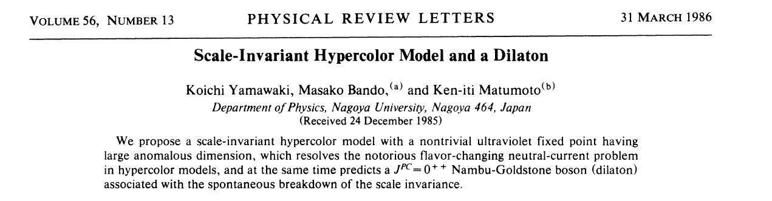
INSPIRE
%\cite{Yamawaki:1985zg}
\bibitem{Yamawaki:1985zg}
K.~Yamawaki, M.~Bando and K.~-i.~Matumoto,
%``Scale Invariant Technicolor Model and a Technidilaton,''
Phys.\ Rev.\ Lett.\ {\bf 56}, 1335 (1986).
%%CITATION = PRLTA,56,1335;%%

Slide 7
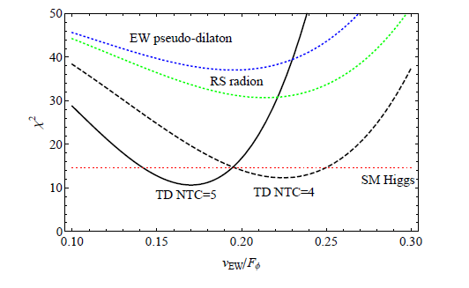

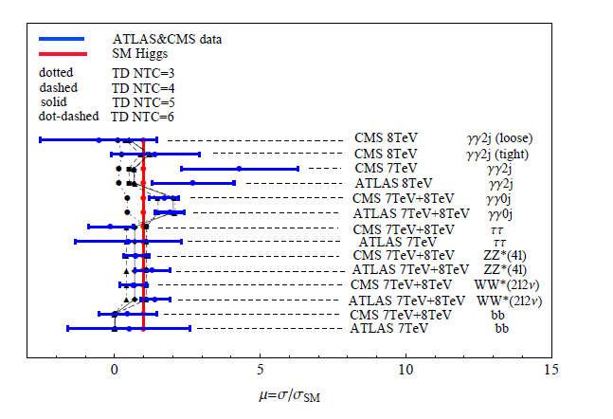
125 GeV Techni-dilaton(TD) at LHC
S.Matsuzaki and K. Y. ,
PLB719 (2013) 378
PRD86 (2012) 115004
TD (in 1FM) is favored by
the current data !!
* diphoton rate
enhaced by techni-fermions
(> W loop contribution)
* goodness-of-fit performed
for each search category
As of July 2012
Consistent with the updated after Moriond/Aspen in March 2013

Slide 8
CONTENTS
Technicolor: QCD-Scale-up (3 times R.I.P.)
Walking Technicolor and Techni-dilaton
Discovering Walking Technicolor at LHC
Techni-dilaton at 125 GeV
Discovering Walking Technicolor on the Lattice
KMI Lattice Project

Slide 9
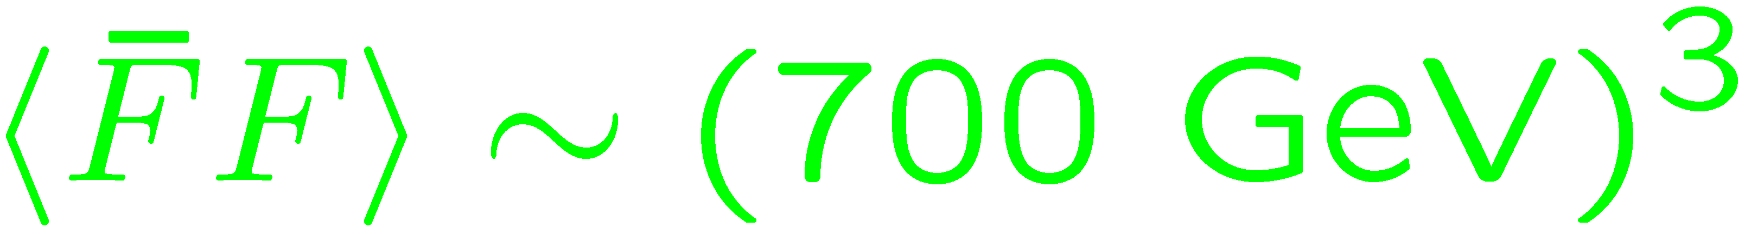

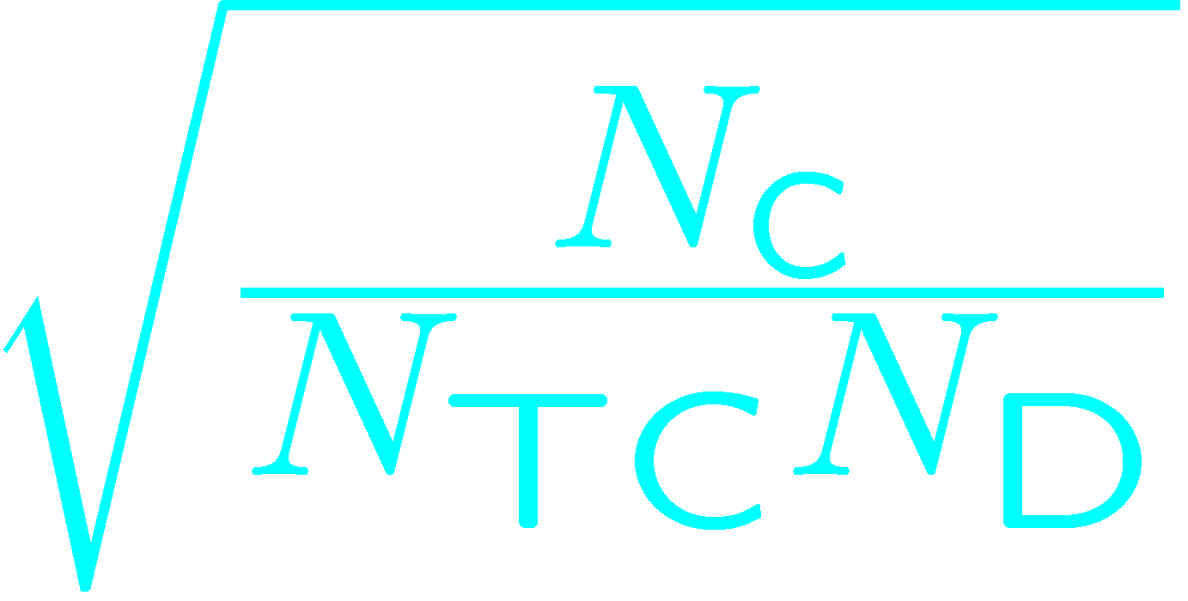
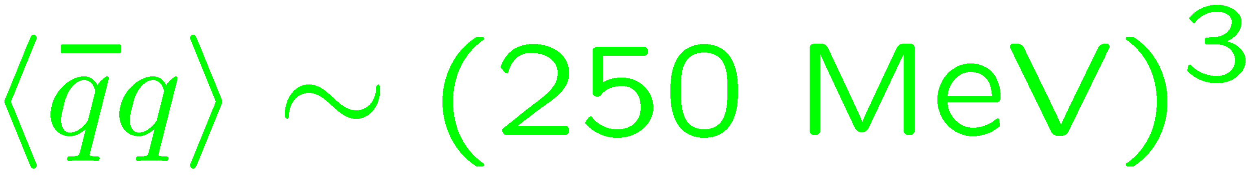
Technicolor: a Scale-Up of QCD
S. Weinberg (1976)
L. Susskind (1979)
X 2600

Slide 10

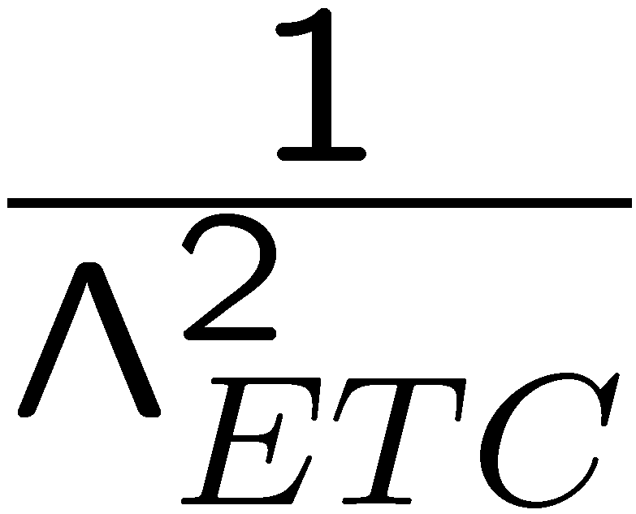
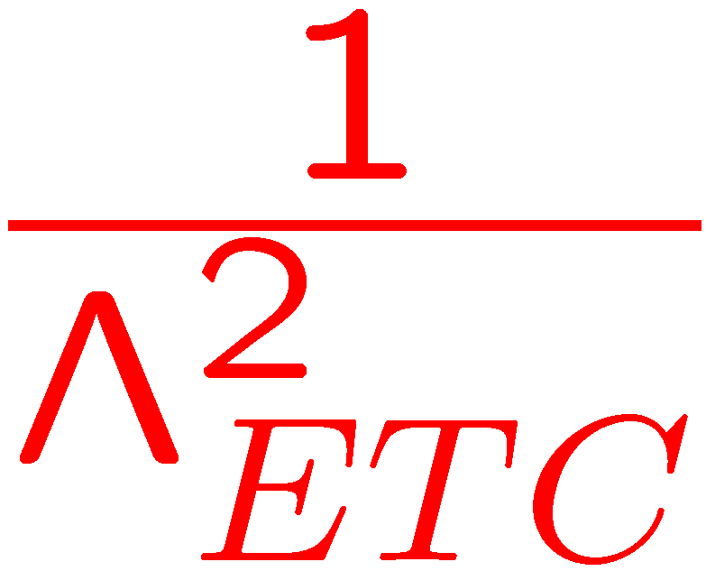
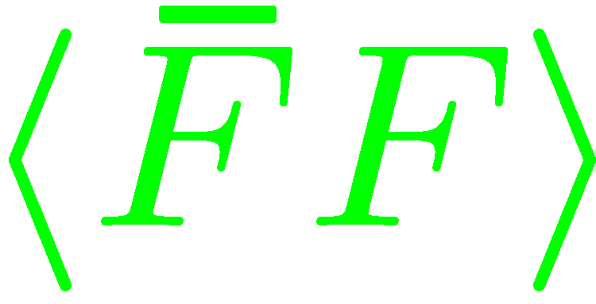

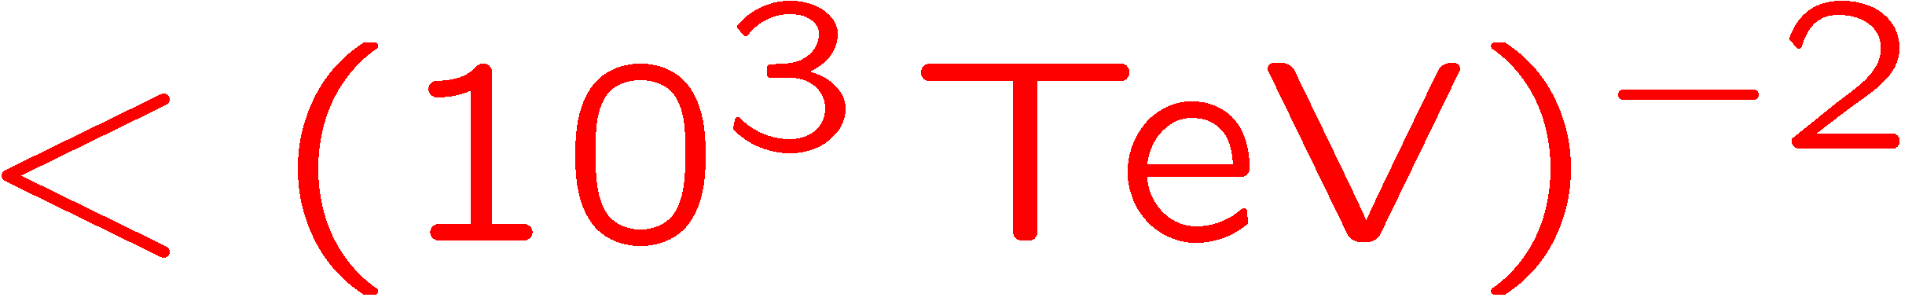
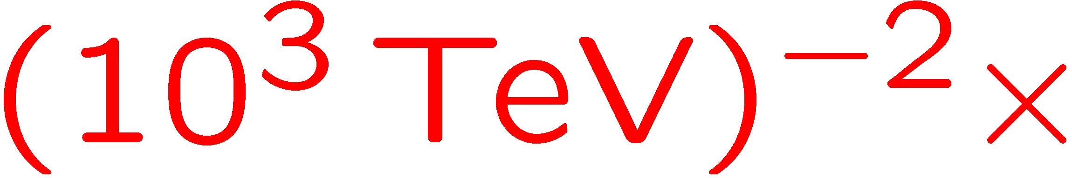
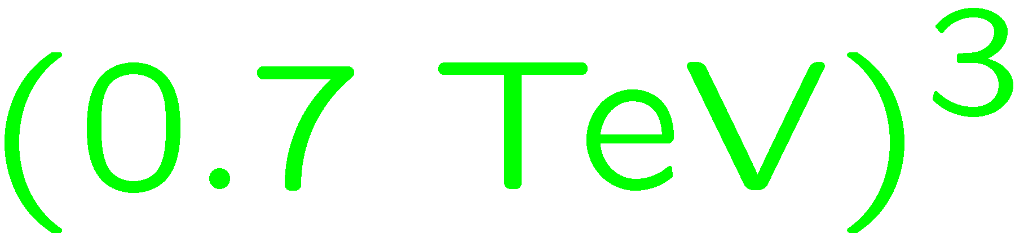
FCNC
FCNC Problems:
F_{L}
q_{R},l_{R}
ETC
q_{L},l_{L}
F_{R}
Mass of Quarks/Leptons
q_{R},l_{R}
F_{L}
X
q_{L},l_{L}
F_{R}
Needs 10³ enhancement

Slide 11
By Large Anomalous Dimension
Holdom (1981)
Pure Assumption of
Existence of Large
No Concrete Dynamics
No Concrete Value

Slide 12
Walking Technicolor
K.Y., Bando, Matumoto (Dec. 24, 1985)
Ladder Schwinger-Dyson Equation
Scale Invariance
FCNC Sol.
Techni-dilaton
Similar FCNC Sol. without notion of ,
Scale Invariance, Techni-dilaton :
Akiba, Yanagida (Jan. 3, 1986)
Appelquist, Karabali, Wijewardhana (June 2, 1986)
( Holdom (Oct. 12, 1984), pure numerical )

Slide 13
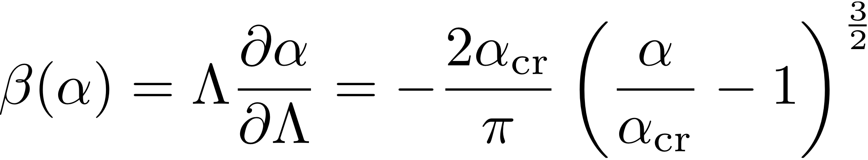
Ladder SD
Miransky Scaling
Essential singularity
UVFP: not a linear zero
=IRFP
Non-perturbative running (“Walking”)
------------
KY-Bando-Matumoto (1986)
----------------------------------

Slide 14
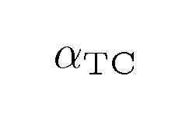
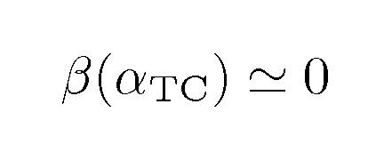

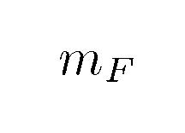
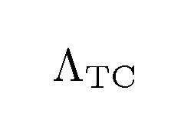
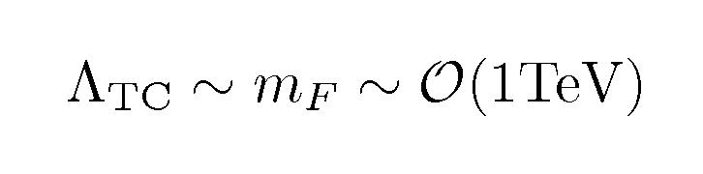
A schematic view of Walking TC
QCD-like
“walking”
QCD-like
QCD-like
(~1TeV)
(ETC~10^3TeV)
nonperturbative
scale anomaly
due to
Pseudo NG Boson: Techni-dilaton
Composite Higgs from technifermions having EW charges

Slide 15
Weakly Coupled Light Scalar Composite
from
Strongly Coupled Dynamics?
Cf: N. Seiberg, Aspen 2013

Slide 16
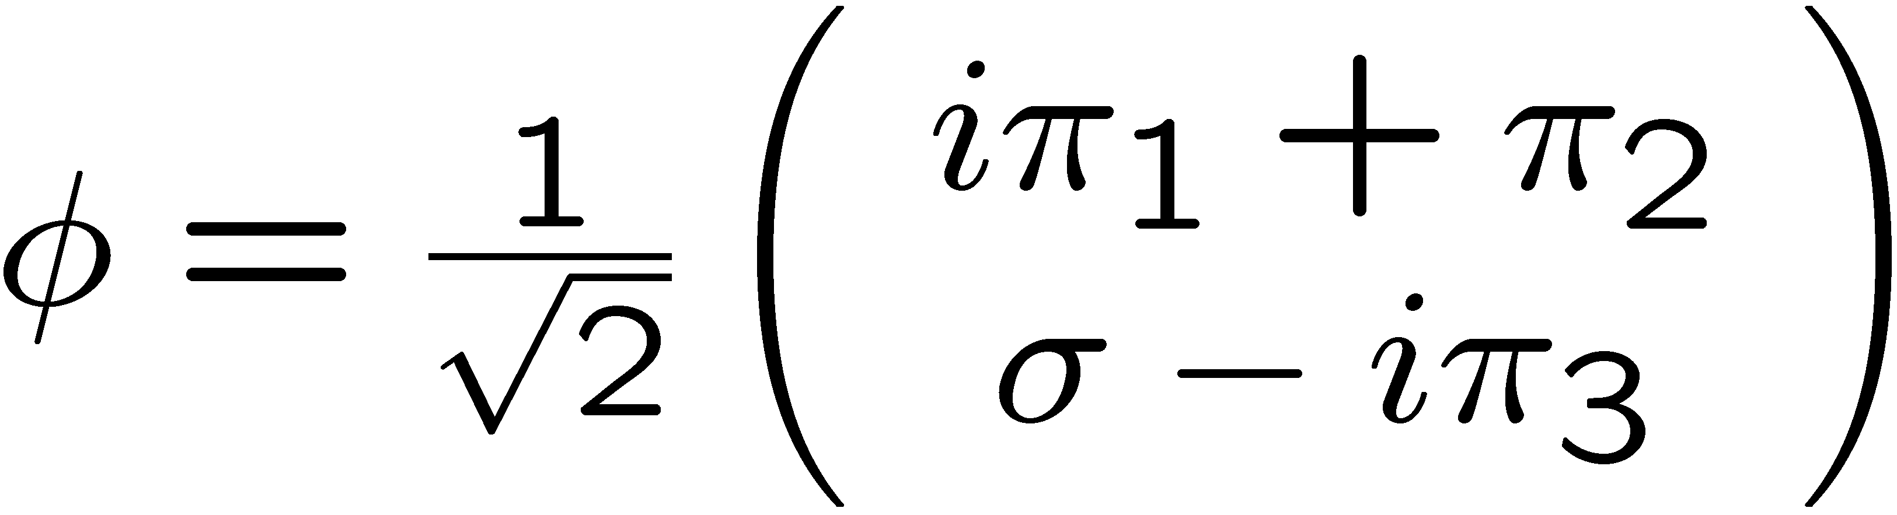
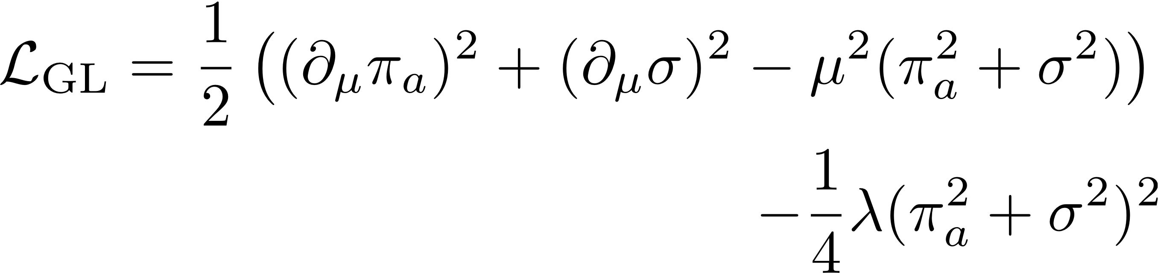
Naïve Arguments (base on LINEAR sigma model)

Slide 17
WTC: Scale-Inv.

Slide 18
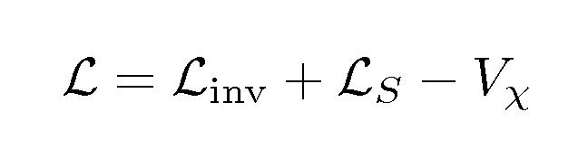

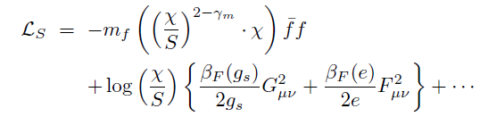


eff. TD Lagrangian
i) The scale anomaly-free part:
ii) The expl. br. due to SM (invariant by including spurion field “S”):
reflecting ETC-induced
TF 4-fermi w/ (3-γm)
iii) The WTC scale anomaly part:
βF: TF-loop contribution
to SM beta function
which correctly reproduces the PCDC relation:

Slide 19
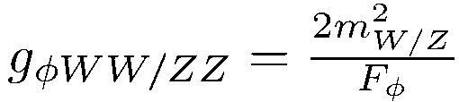
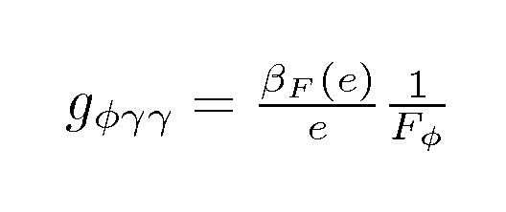
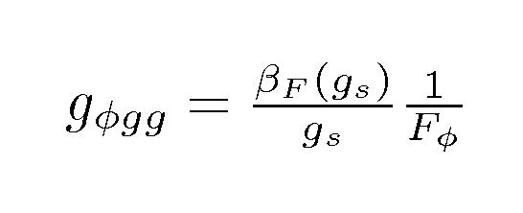
TD couplings to the SM particles
* TD couplings to W/Z boson (from L_inv)
The same form as
SM Higgs couplings
except FΦ and betas
* TD couplings to γγ and gg (from L_S)
βF: TF-loop contribution
t0 beta function

Slide 20
Weakly Coupled Light Scalar Composite
from
Strongly Coupled Dynamics?
Cf: N. Seiberg, Aspen 2013
Lightness
Yes !
Scale inv.
LHC confirmed
Weakness
Coupling to SM sector

Slide 21
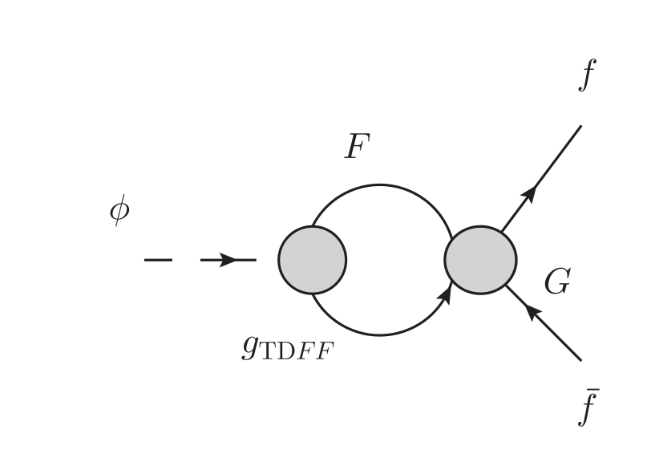
Not a linear sigma model !
TC sector
(Strongly coupled)
SM sector
Weak !
-----------
Even needs enhancement !

Slide 22

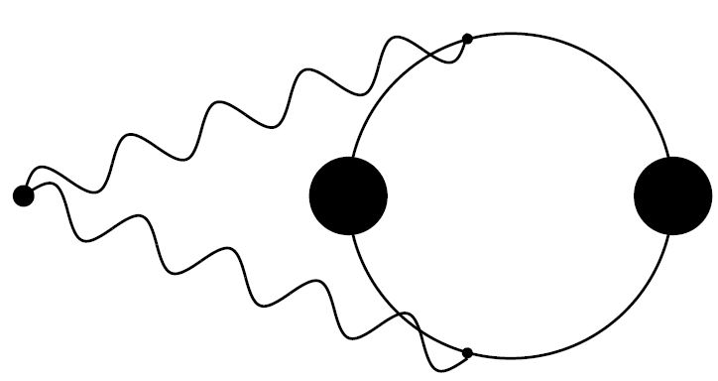


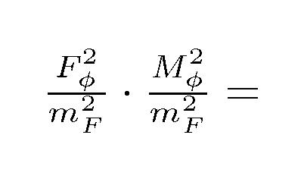
Ladder estimate of TD mass
* LSD + BS in large Nf QCD
A composite Higgs mass
Harada-Kurachi-K.Y. (1989)
～500 GeV
for one-family model (1FM)
still larger than ~ 125 GeV
* LSD via gauged NJL
Shuto-Tanabashi-K.Y. (1990);
Carena-Wagner (1992) ; Hashimoto (1998)
* Using only PCDC still accommodates 125 GeV
Lightness=Weak Coupling
Miransky-Gusynin (1989):
Hashimoto-K.Y. (2011):
where
No exactly massless NGB limit:
finite
only

Slide 23





* Theoretical uncertainties
Ladder Estimate of
Ladder approximation is subject to about 30% uncertainty
for estimate of critical coupling and QCD hadron spectrum
critical coupling : T. Appelquist et al (1988);
Hadron spectrum : K. -I. Aoki et al (1991); M. Harada et al (2004).
±0.3
30%
Estimate
w/ uncertainty included
30%
Weaker than SMH

Slide 24
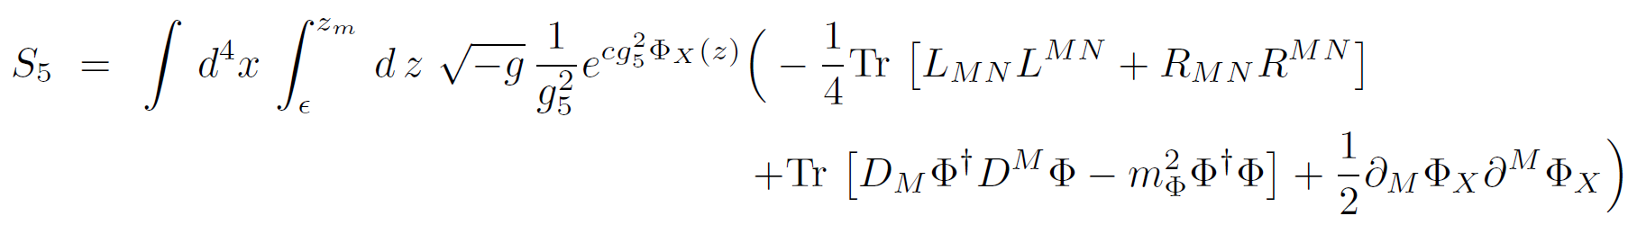
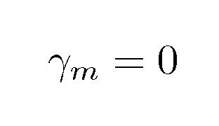
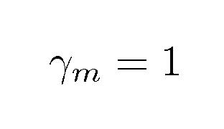
Holographic estimate w/ techni-gluonic effects
Haba-Matsuzaki-KY, PRD82 (2010) 055007
Matsuzaki- K.Y., PRD86 (2012) 115004 PPLB719 (2013) 115004
* Ladder approximation : gluonic dynamics is neglected
* Deformation of successful AdS/QCD model (Bottom-up approach)
Da Rold and Pomarol (2005); Erlich, Katz, Son and Stephanov (2005)
incorporates nonperturbative gluonic effects
0
5d SU(NTF)L x SU(NTF)R
z
UV
IR
QCD
WTC

Slide 25
* QCD-fit w/
input
model parameters
fπ = 92.4 MeV
Mρ = 775 MeV
<αGμυ^2>/π = 0.012 GeV^4
fix
ξ = 3.1
G = 0.25
zm^-1 = 347 MeV
Model predictions
measured
Ma1 [a1 meson] : 1.3 GeV
Mf0(1370) [qqbar bound state] : 1.2 GeV
MG [glueball ] : 1.3 GeV
S = - 16 π L10 [S parameter] : 0.31
[- <qbar q>]^(1/3) [chiral condensate] : 277 MeV
1.2 --- 1.3 GeV
1.1 --- 1.2 GeV
1.4 --- 1.7 GeV (lat.)
0.29 --- 0.37
200 --- 250 MeV
Monitoring QCD works well!

Slide 26
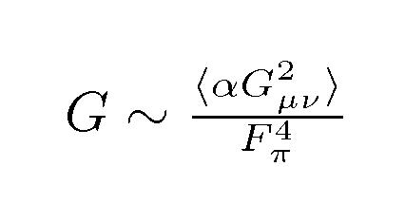

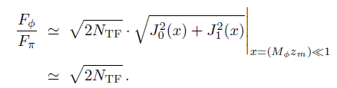

*WTC-case with
--- TD mass (lowest pole of dilatation current correlator)
125 GeV TD is realized by a large gluonic effect : G 〜 10
for one-family model w/ Fπ = 123 GeV (c.f. QCD case, G ~ 0.25 )
--- TD decay constant (pole residue)
free from holographic-parameters !!
Massless NGB limit (“conformal limit”) is realized:
in contrast to ladder approximation

Slide 27

Estimate of -- Holographic approach
Matsuzak- K.Y., PRD86 (2012) 115004
* TD decay constant for the light TD case w/ G ~ 10:
Indep. of S
(S<0.1 tunable)
holographic-parameter free !!
Theoretical Uncertainties: 1/N_{TC} corr. (20% ~ 30% )
Weaker than SMH
This is consistent with ladder estimate:
LHC best fit (before Moriond ’13)
ladder

Slide 28
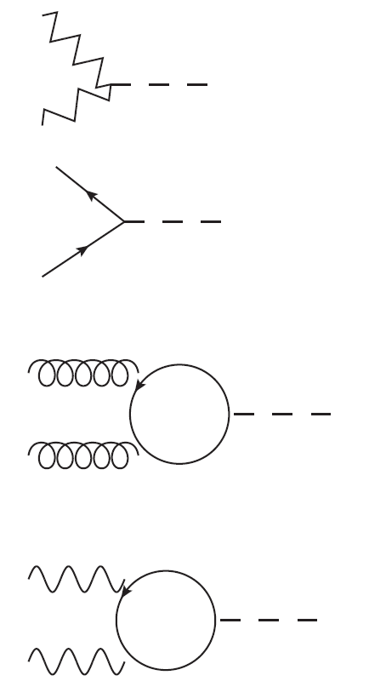


Characteristic features of
125 GeV TD in 1FM (w/ NTC=4,5) at LHC
W,Z
v.s. SM Higgs
gφ= (vEW/FΦ) gH=(0.1--0.3) gH
di-weak bosons
φ
suppressed
W*,Z*
b,τ
gφ
quark, lepton pairs
φ
suppressed
b,τ
F, t
g
gφ
φ
enhanced
digluon
g
QCD-colored TF contributions
F, t
γ
gφ
diphoton
φ
>> W -loops
enhanced
γ
EM-charged TF contributions

Slide 29
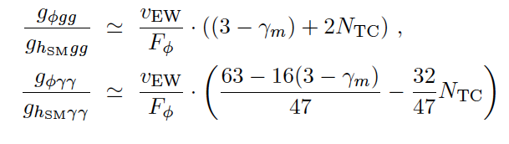
Technifermion loop contributions to
N_{TC}=4
1/3
10
3
<1
1

Slide 30
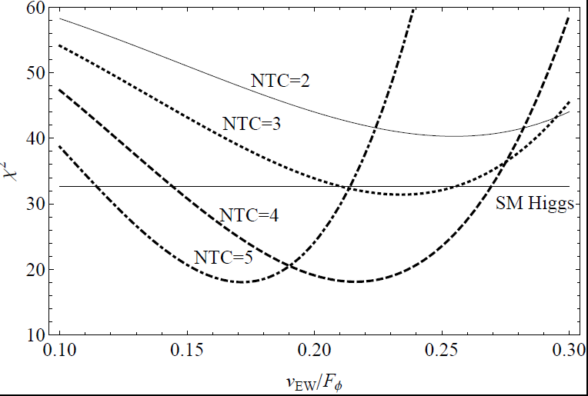
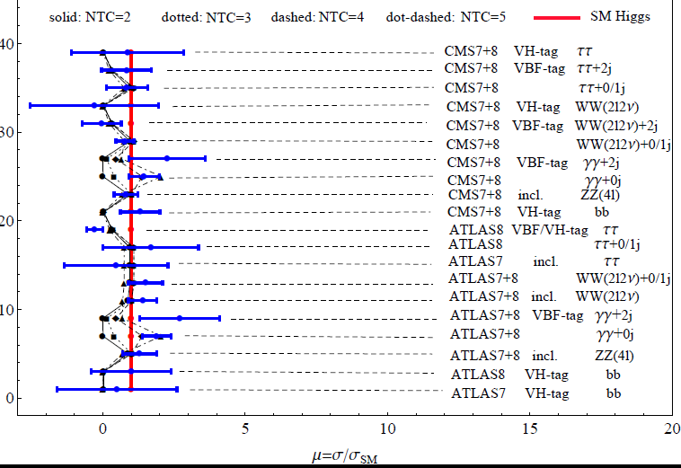
The 125 GeV TD signal fitting
to the current Higgs search data
*updated after HCP2012
S. Matsuzaki, 1304.4882
----------------------------------------------------------------
NTC [vEW/FΦ ]best χ^2 min /d.o.f.
----------------------------------------------------------------
4 0.22 18/19 = 0.95
----------------------------------------------------------------
5 0.17 18/19 = 0.95
----------------------------------------------------------------
* TD can be better than the SM Scalar(chi^2/d.o.f= 33/20=1.6),
due to the enhanced diphoton rate,
by extra BSM (TF) contributions!

Slide 31
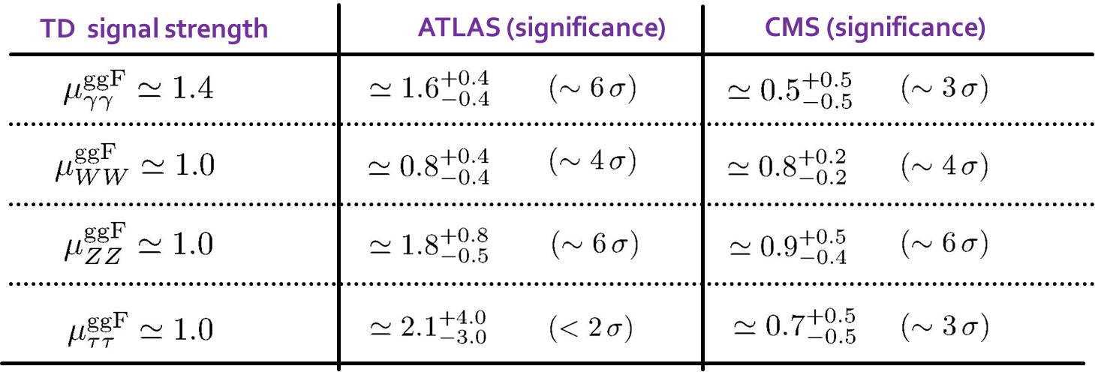
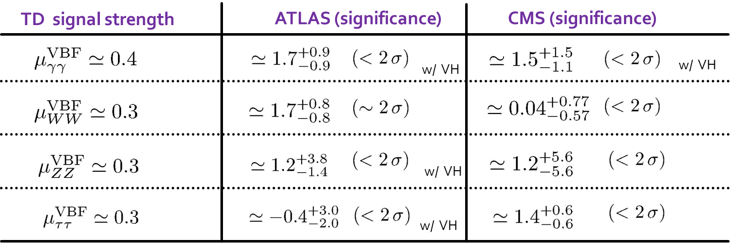
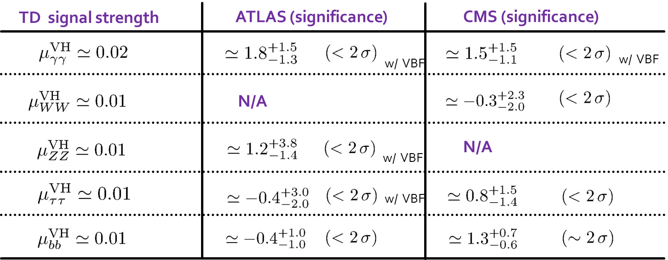
TD signal strengths (μ = σ x BR/SM Higgs)
vs the data Moriond EW&QCD (ASPEN) March, 2013
w/ NTC=4, vEW/Fφ = 0.2
(i) ggF–tag
Distinguished from SM Higgs
(ii) VBF –tag
VH –tag

Slide 32
Theoretical Issues
Walking Dynamics beyond Ladder/Holography ?
More Precise Quantitative Predictions?
Lattice !

Slide 33
Discovering Walking Technicolor on the Lattice
KMI Lattice Project
(LatKMI Collaboration)
Finding a candidate for WTC on the Lattice
Finding a light scalar composite on the Lattice
Calculating the composite spectra on the Lattice

Slide 34
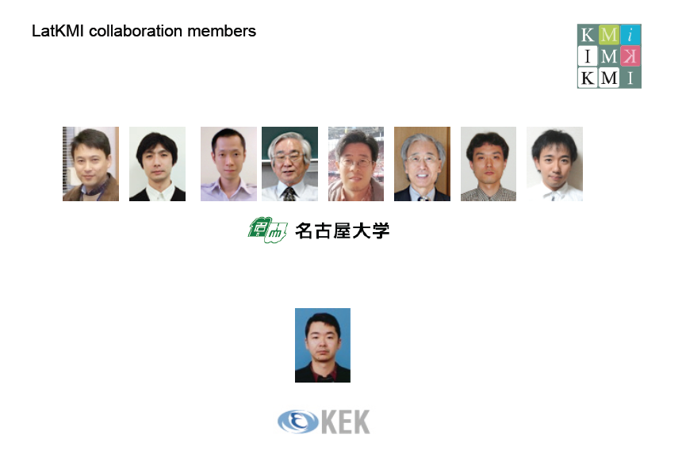


M. Kurachi
T. Maskawa
K. Nagai
K. Yamawaki
Y. Aoki
T. Aoyama
T. Yamazaki
H. Ohki
A. Shibata
E. Rinaldi

Slide 35
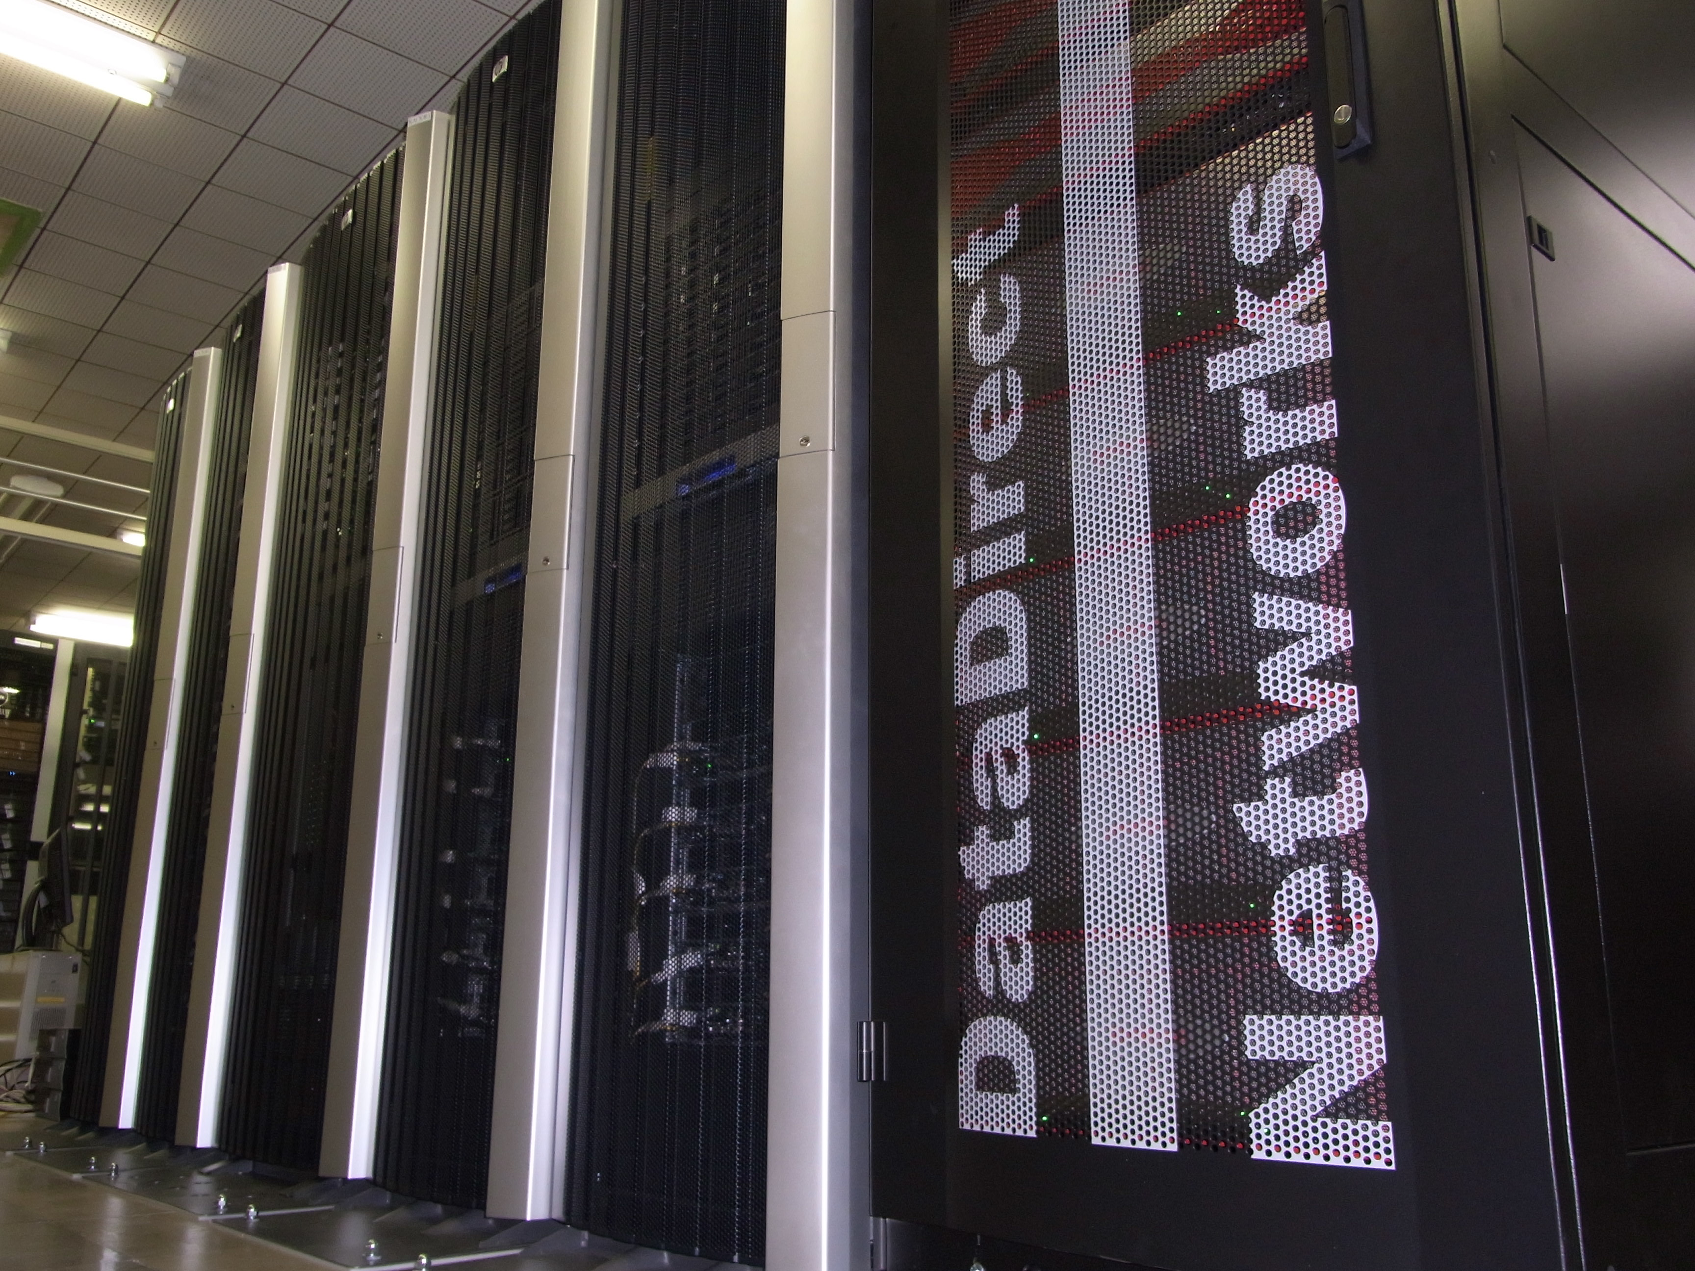
KMI Computer
(March 02, 2011~)
Only for Beyond SM Physics
62.41 TFLOPS
26.88 TFLOPS (128 nodes)
35.53 TFLOPS (23 nodes /w GPGPU)

Slide 36
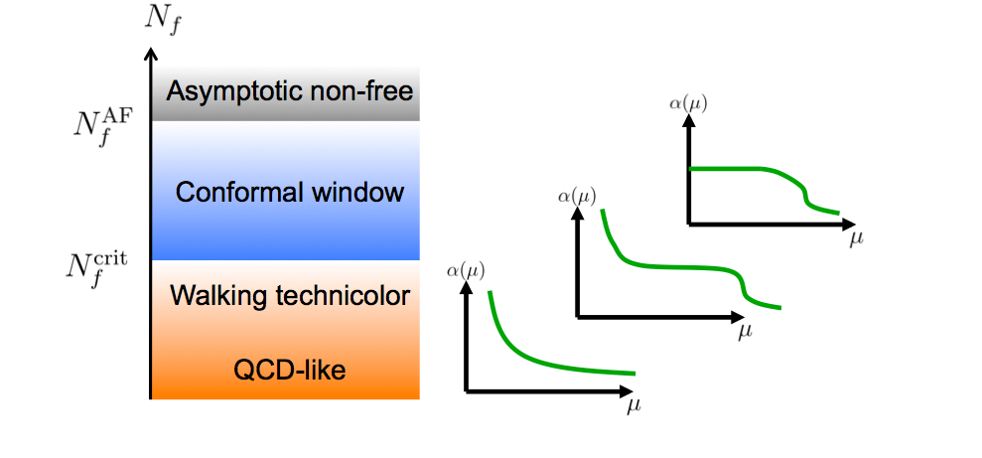

Slide 37
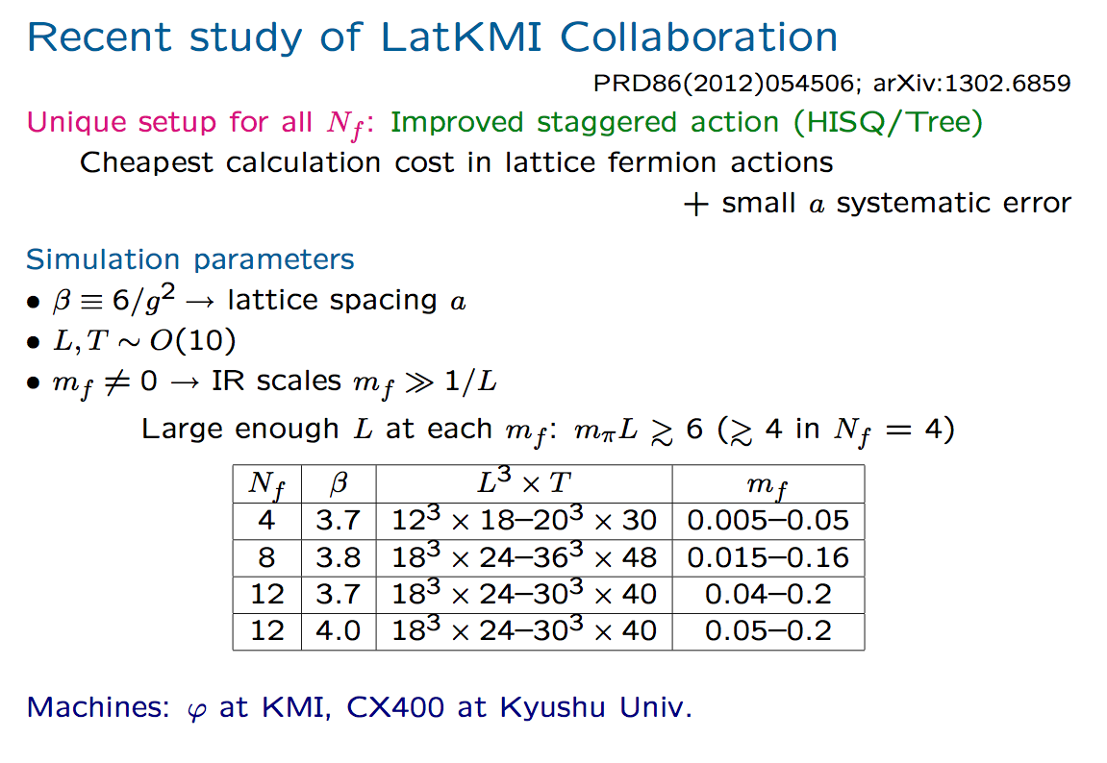
LatKMI Collaboration, PRD86, 054506 (2012);
D87, 094511 (2013);
arXiv:1305.6006

Slide 38
Walking candidate & Scalar
Nf=8 : Walking,
Nf=12: Conformal
Light flavor-singlet scalar (& scalar glueball)
in Nf=12
Light flavor-singlet scalar (& scalar glueball)
in Nf=8 (Very Preliminary)
LatKMI Collaboration,
Phys. Rev. D 87, 094511 (2013).
LatKMI Collaboration, Phys. Rev. D86, 054506 (2012)
LatKMI Collaboration, (arXIv: 1302.4577), arXiv:1305.6006

Slide 39
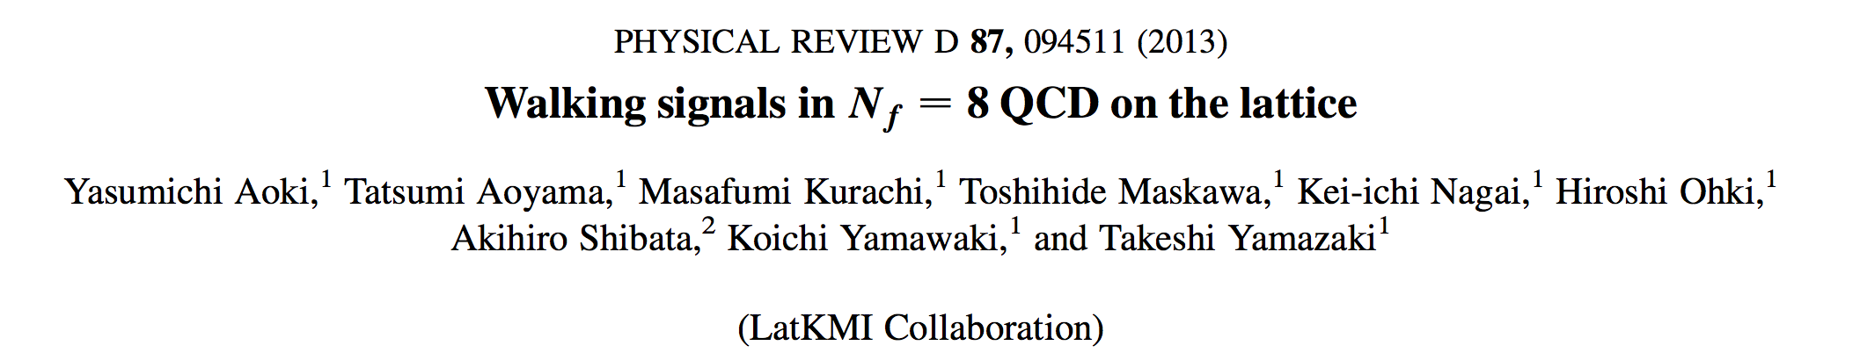
Up to lattice IR, UV scales:

Slide 40
LatKMI Coll, PRD 87, 094511 (2013)
LatKMI Coll, PRD86 (2012)054506
LatKMI Coll, PRD 87, 094511 (2013)

Slide 41
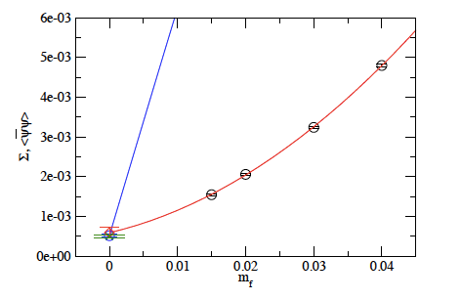
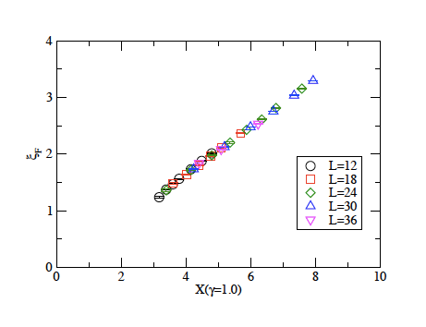
HISQ
SχSB
``Conformal’’

Slide 42
Chiral broken
Conformal

Slide 43
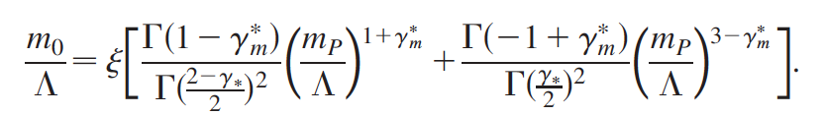
Nf=8 data
Hyperscaling relation is not for a universal
After corrections
Universal value (up to correction ansatz)
For large
Corrections such as higher power of
Cf: SD equation in the conformal phase
LatKMI Collaboration, Phys. Rev. D85, 074502 (2012)

Slide 44
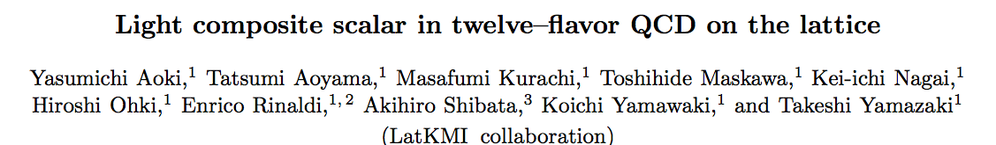

(arXIv: 1302.4577), arXiv:1305.6006
Nf=12,
β＝４．０
Noise reduction method
with Nr=64

Slide 45

LatKMI Collaboration, arXiv:1305.6006

Slide 46
LatKMI Collaboration, arXiv:1305.6006

Slide 47





Slide 48


Slide 49


Very Preliminary
Nf=8
Noise reduction
with Nr=64
β＝３．８

Slide 50
Expected Picture
Chiral broken
Conformal

Slide 51
Conclusion
A light composite Higgs can be generated in the Walking Technicolor (Strongly coupled theory) as a Pseudo-NG boson of Scale Symmetry (Techni-dilaton), which is Weakly coupled to the SM particles.
Techni-dilaton is consistently identified with the 125 GeV Higgs
Lattice results of LatKMI Collaboration are consistent with
Nf=12 QCD: conformal behavior
Nf=8 QCD : walking behavior; chiral broken (mf=0.015-0.04),
(approx.) conformal (mf =0.05-0.16)
Lattice results of LatKMI Collaboration observed
Nf=12: clean signal of a scalar lighter than pion
Nf=8: indication of a scalar slightly lighter than pion (just for one
parameter mf=0.06) (Very preliminary)
Both reflecting (near) conformality for a wide IR region below the
asymptotically free UV region
Hope to give the lattice answer to the theoretical issues
before 13/14 TeV LHC

Slide 52
Backup Slides

Slide 53






Other characteristic spectrum in one-family WTC
Chiral symmetry breaking: SU(8)L x SU(8)R → SU(8)V
3 “would-be” NGBs: eaten by W, Z
60 (pseudo) NGB = techni-pions (TPs)
: color-octet scalars (# 32)
: color-triplet scalars (“leptoquark”) (#24)
Expected masses :
300 ～ 500 GeV
: color-singlet scalars (# 4)
J.Junji, S.Matsuzaki, K.Y.,
PRD87.016006. (2012)

Slide 54










Techni-pions: couplings to WW and ZZ highly suppressed (NO NGB-NBG-NGB vertex)
→ narrow resonances (tot.width ~ 5--10GeV)
J.Junji, S.Matsuzaki, K.Y., PRD87.016006. (2012)
Discovering isospin singlet TPs: and
* produced ONLY from ggF :
VBF, VH,
* Predominantly decaying to SM fermions
@ ~ 300GeV
@ ~ 400GeV
@ ~ 500GeV
* decays to glue-gamma/Z
@ ~ 500GeV

Slide 55




* One-family walking techni-rho mesons (#63)
Expected masses :
1 ～ 4 TeV
consistent w/
EW precision tests
: color-octet vectors (# 32)
: color-triplet vectors (# 24)
: color-singlet vectors (# 4)
S.Matsuzaki and K.Y.,
PRD86.115004. (2012)
: color-singlet vectors (# 3)
[corresponding to vector states
for eaten NGBs]
Typical discovery channels: decays to WLWL (ZLZL)or TP and WL
q
W,Z,γ
ρ
WL, ZL
W,Z,γ
ρ
TP
q
WL,
ZL
WL, ZL
Novel discovery channel: decays to W(Z,γ) and TD!
q
W,Z,γ
ρ
φ (TD)
S.Matsuzaki and K.Y., in progress
q
W,Z,γ

Slide 56














* AdS/CFT recipe:
generating functional
classical solutions
sources = UV boundary values
for bulk scalar, vector, axial-vector fields
Current collerators
are calculated as a function of three IR –boundary values and :
dual
: IR value of bulk scalar
: IR value of bulk scalar
: IR-brane position

Slide 57







AdS/CFT dictionary:
* UV boundary values = sources
* IR boundary values:
chiral condensate
gluon condensate

Slide 58




The model parameters:
Φ IR
value
Φx IR
value
IR brane
position
5d
coupling
Φ UV
value
Φx UV
value
coeff.
of M
coeff.
of Φx
set explicit breaking
sources = 0
matching to current correlators
ΠV
G^2 term
ΠS
Leading log term
ΠV
Leading log term
3 phenomenological input values
Fix
Fπ = 246 GeV/√ND = 123 GeV (1FM)
MΦ = 125 GeV
S = 0.1

Slide 59
S.Matsuzaki and K.Y., 1209.2017
Other holographic predictions (1FM w/ S=0.1)
NTC = 3
Techni-ρ , a1 masses : Mρ = Ma1 = 3.5 TeV
Techni-glueball (TG) mass : MG = 19 TeV
TG decay constant : FG = 135 TeV
dynamical TF mass mF : mF = 1.0 TeV
NTC = 4
Techni-ρ , a1 masses : Mρ = Ma1 = 3.6 TeV
Techni-glueball (TG) mass : MG = 18 TeV
TG decay constant : FG = 156 TeV
dynamical TF mass mF : mF = 0.95 TeV
NTC = 5
Techni-ρ , a1 masses : Mρ = Ma1 = 3.9 TeV
Techni-glueball (TG) mass : MG = 18 TeV
TG decay constant : FG = 174 TeV
dynamical TF mass mF : mF = 0.85 TeV

Slide 60












Other pheno. issues in TC scenarios
S parameter
: # EW doublets
too large!
Cf: S(exp) < 0.1 around T =0
One resolution: ETC-induced “delocalization” operator
vector channel
Chivukula-Simmons-He-Kurachi-
Tanabashi (2005)
ETC
in low-energy
w/
modifies SM f-couplings to W, Z
contributes to S “negatively”

Slide 61






Top quark mass generation
ETC
ETC scale associated w/ top mass
too small!
One resolution: Strong ETC
Miransky-K.Y. (1989), Matumoto(1989), Appelquist-Einhorn-Takeuchi-Wijewardhana (1989)
--- makes induced 4-fermi (tt UU) coupling large
enough to trigger chiral symm. breaking (almost by NJL dynamics)
boost-up
T parameter
(Strong) ETC generates large isospin breaking
→ highly model-dependent issue

Slide 62

Nf=12 Taste Symmetry （HISQ）
LatKMI Collaboration, PRD86 (2012)054506

Slide 63



Slide 64


Slide 65

Scalar Glueball vs Flavor-singlet Scalar

Slide 66


