Slide 1

Information
Akimasa Ishikawa
for the organizing committee

Slide 2
Bathroom
The bathroom in this floor is small.
You can go to the larger bathroom in the ground floor.

Slide 3
Banquet
We will have a banquet at Shozankan this evening.
The bus goes to Shozankan from the Hagi Hall on 18:50.
The bus goes back from Shozankan and drop you off
  (1) near Sendai Station
  (2) at Ark Hotel
  (3) at Hagi Hall

Slide 4
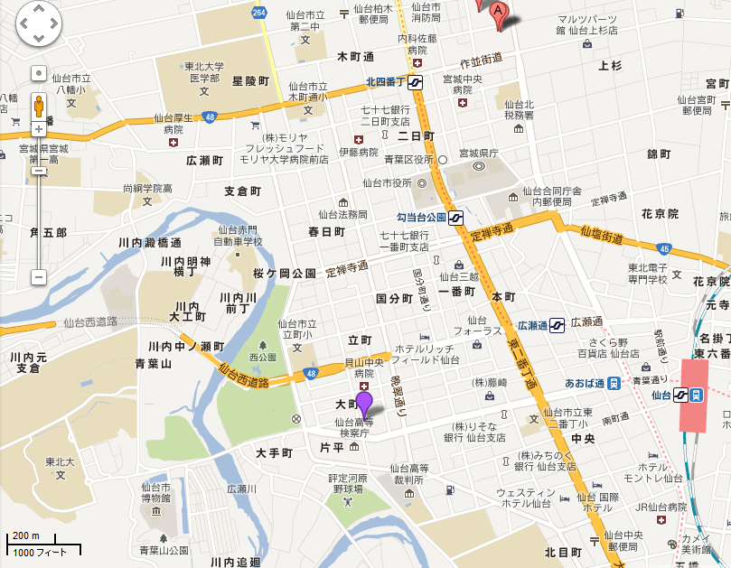
Banquet : Bus
The bus goes to Shozankan from the Hagi Hall on ~19:00.
  Please take your belongings and name tag so that we can ID who is who
  No smoking please at Shozankan
The bus goes back from Shozankan and drop you off
  (1) near Sendai Station
  (2) near Ark-Hotel
  (3) at Hagi Hall
Shozankan
(2)
(1)
(3)

Slide 5
Group Photo
To be taken in front of Hagi Hall on 7th Friday before lunch (12:40).
If it rains, we will take a photo on 7th Friday but also do on 8th Saturday.

Slide 6
Kitakami ILC Candidate Site Tour
On 9th Sunday, we will have Kitakami ILC candidate site tour.
We will meet at Sendai Station on 8:30 to get on the Shinkansen leaving from Sendai on 8:58.
Get off at Ichinoseki on 9:31 and change to a tour bus.
We will go to
  Kitakami ILC candidate site
  Geibikei. River Cruising
  World Heritage Hiraizumi. Chusonji Temple and Motsuji Temple.
Go back to Sendai by the tour bus and drop you off
  (1) near Sendai Station
  (2) at Hagi Hall
  (3) at a few hotels based on your hotel information give at registration
Additional information to be given on Saturday.

Slide 7

Finally
We have discovered
Dark Matter.
It’s flavored.
two flavors Fruit Punch and Grape, the third one Raspberry is missing.
You can find the Dark Matter at coffee desk.
Please enjoy the workshop and tastes of the Dark Matter.

