Slide 1


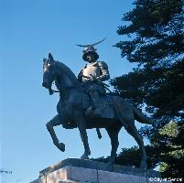

125 GeV Higgs at the LHC: h→ZZ, WW
Susumu Oda (Kyushu University)
On behalf of the ATLAS and CMS Collaborations
Higgs and Beyond 2013
Tohoku University, 2013-06-05

Slide 2
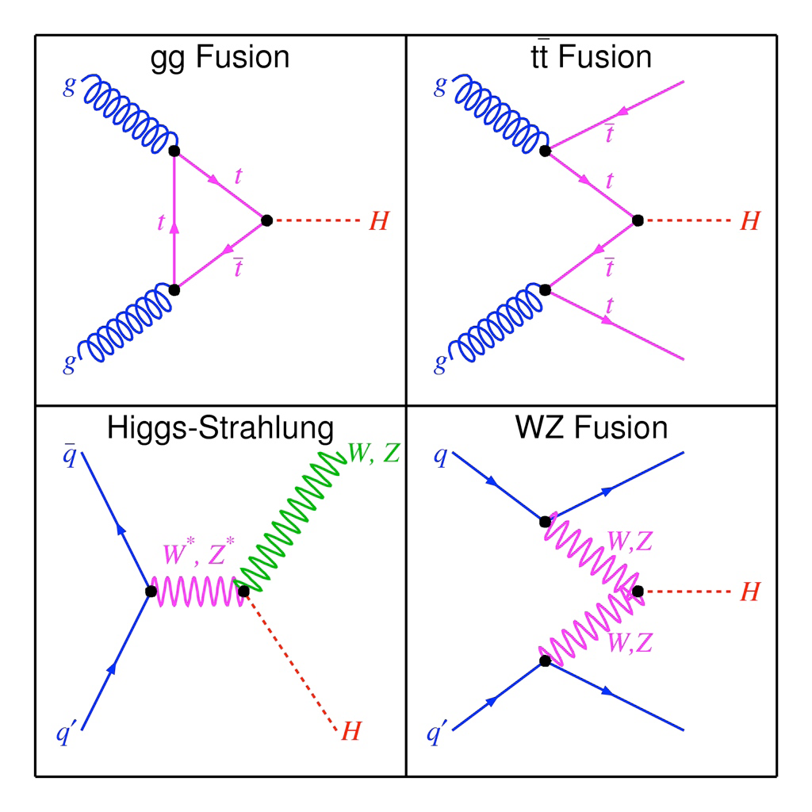
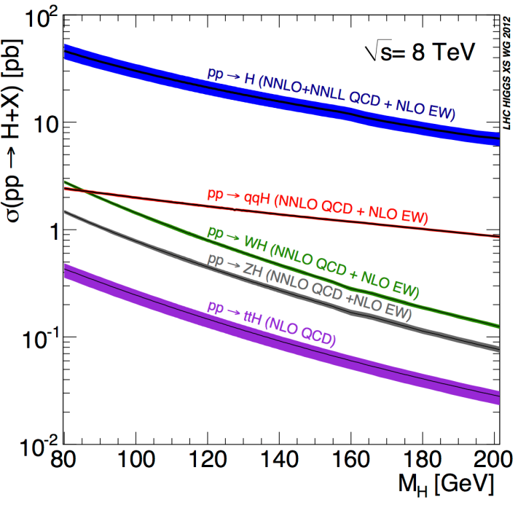
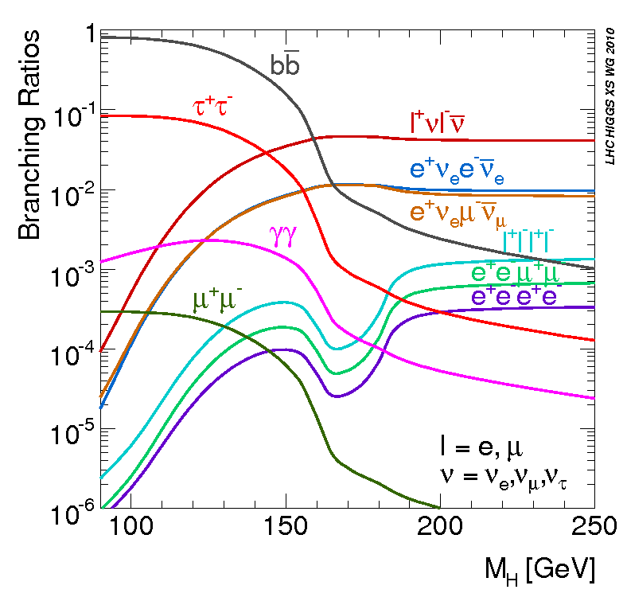
Production and decay of the SM Higgs boson
A new boson with a mass of about 125 GeV was observed in the Standard Model Higgs boson searches by ATLAS and CMS in 2012.
Gluon-gluon fusion process is the dominant production mode.
I will focus on the two decay modes with the highest sensitivities.
ZZ^{(*)}→4l decay mode provides the cleanest final state with the full reconstruction of the mass of the new boson.
  The statistics are limited.
WW^{(*)}→lνlν decay mode provides a large branching ratio and a relatively clean final state.
  Limited mass resolution due to missing E_{T} by undetected neutrinos
(ggF)
(ttH)
Fermionic
(VH)
(VBF)
Bosonic

Slide 3
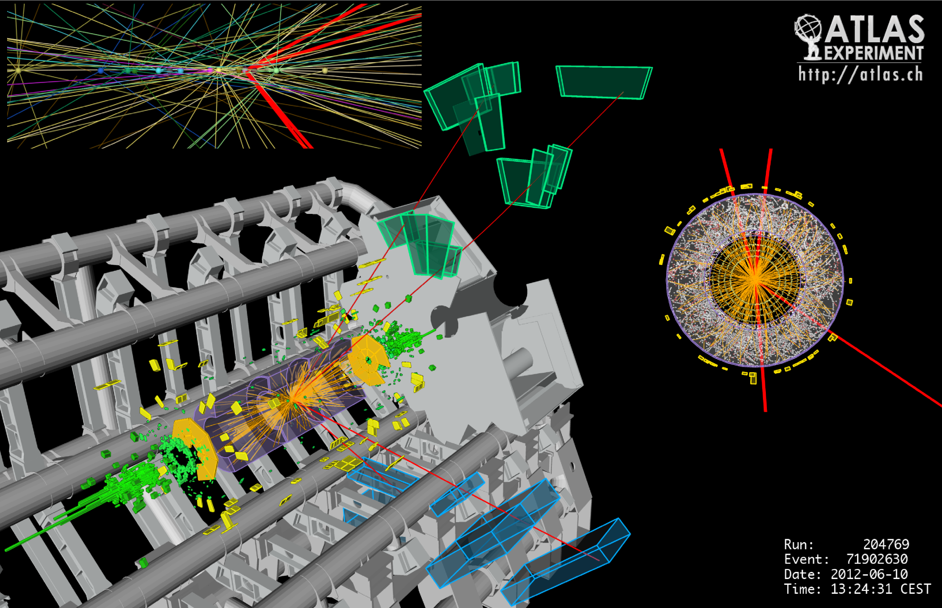
h→ZZ^{(*)}→4l: event display
m_{4l}=127.4 GeV
Four isolated high-p_{T} leptons (two same-flavor opposite-sign lepton pairs)
Invariant mass of the 4-lepton system, m_{4l}, is the final discriminating variables.

Slide 4
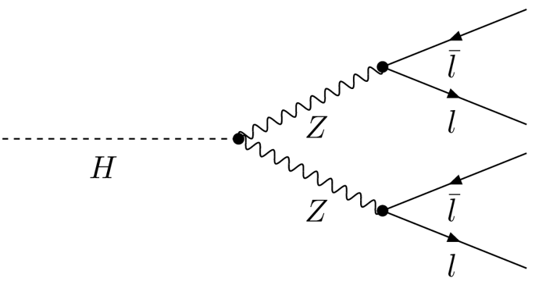
h→ZZ^{(*)}→4l: selections (1/3)
High mass Z
Z₁, m₁₂=m_{Z1}
4 final states at low mass Higgs search: 4e, 2e2μ, 2μ2e, 4μ
In the 2e2μ/2μ2e case, pairs ordered respect to mass.
Low mass Z^{(*)}
Z₂, m₃₄=m_{Z2}
^{(*)}
ATLAS
Electrons
  p_{T}>7 GeV
  |η|<2.47
  Cut based identification
Muons
  p_{T}>6 GeV
  |η|<2.7
Taus
  Not used
CMS
Electrons
  p_{T}>7 GeV
  |η|<2.5
  Multivariate based identification
Muons
  p_{T}>5 GeV
  |η|<2.5
Taus
  Used for high mass Higgs search

Slide 5
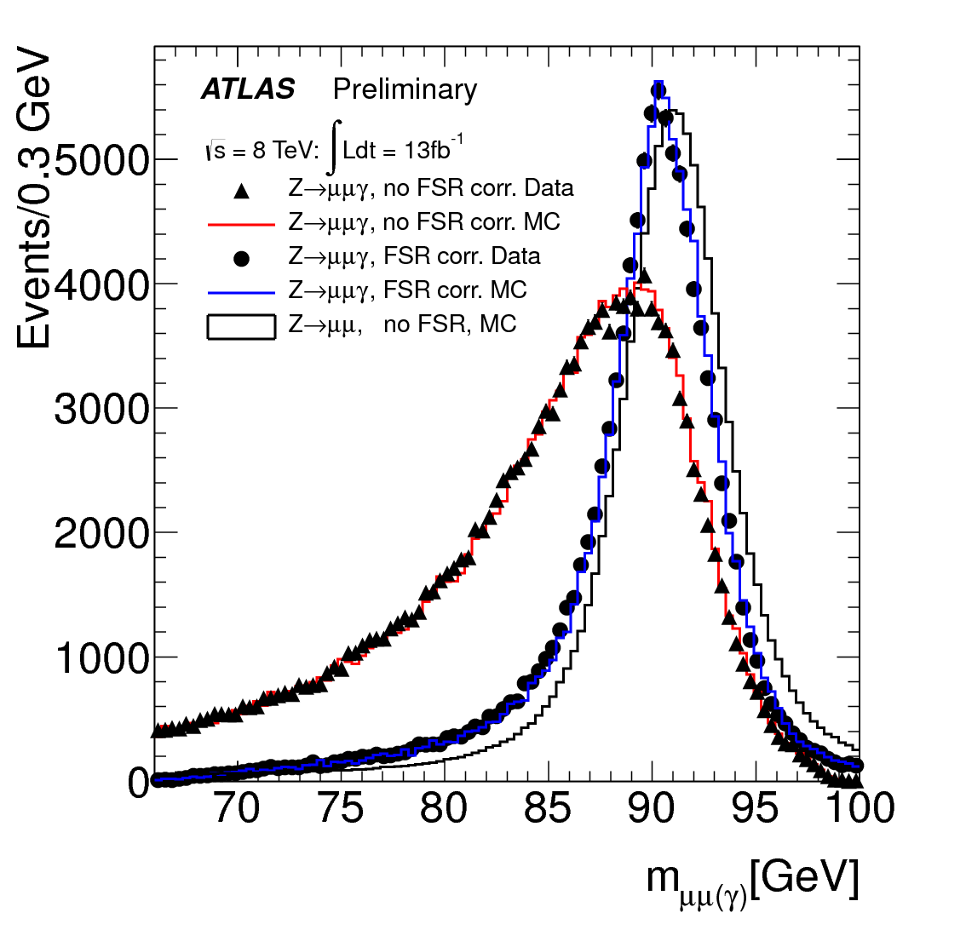
h→ZZ^{(*)}→4l: selections (2/3)
ATLAS
Isolation cuts
  Normalized by the lepton p_{T}
  Track isolation (ΔR=0.2)<0.15
  Calorimeter isolation (ΔR=0.2)<0.2 (0.3) for electrons (muons)
Impact parameter cut
  IP significance (2D) <6.5σ (3.5σ) for electrons (muons)
Final State Radiation correction
  Only for Z₁→μμ,
    66<m₁₂<89 GeV and m_{μμγ}<100 GeV
  Photons
    E_{T}<3.5 GeV, ΔR<0.08
    E_{T}>3.5 GeV, ΔR<0.15
  Efficiency: 70%
  Purity: 85%
CMS
Isolation cut
  Normalized by the lepton p_{T}
  Sum of p_{T} of charged tracks and neutral particles in ΔR=0.4
  Selection cut is <0.4
Impact parameter cut
  IP significance (3D) <4σ
Final State Radiation correction
  All leptons
  Photons
    2<E_{T}<4 GeV, ΔR<0.07
    E_{T}>4 GeV, 0.07<ΔR<0.5
    Normalized isolation<0.1
  Efficiency: 50%
  Purity: 80%

Slide 6
h→ZZ^{(*)}→4l: selections (3/3)
ATLAS
Quadruplet
  p_{T}>20, 15, 10, 7 GeV
    >6 GeV if the 4th lepton is a muon
  m₁₂=[50, 106] GeV
  m₃₄=[12*, 115] GeV
    *Lower cut increases for m_{4l}>140 GeV
Jets
  Anti-k_{T} ΔR=0.4
  p_{T}>25 (30) GeV for |η|<2.5 (2.5<|η|<4.5)
Integrated luminosity
  4.6 fb⁻¹ at √s=7 TeV
  20.7 fb⁻¹ at √s=8 TeV
CMS
Quadruplet
  p_{T}>20, 10, 7, 7 GeV
    >5 GeV if the 3rd or 4th lepton is a muon
  m₁₂=[40, 120] GeV
  m₃₄=[12, 120] GeV
Jets
  Anti-k_{T} ΔR=0.5
  p_{T}>30 GeV, |η|<4.7
Integrated luminosity
  5.1 fb⁻¹ at √s=7 TeV
  19.6 fb⁻¹ at √s=8 TeV
ATLAS and CMS use similar selections and amount of data .
Notes:
CMS PAS HIG-13-003
Page 3
A combinatorial background arises from
low-pT jets from pile-up interactions which get clustered into high-pT jets. In the 2012 data the
number of pile-up events is larger and a multivariate selection is applied to separate jets from
the primary interaction from those reconstructed due to energy deposits associated with pileup.
The discrimination is based on the differences in the jet shapes, in the relative multiplicity of
charged and neutral components and in the different fraction of transverse momentum which
is carried by the hardest components.

Slide 7
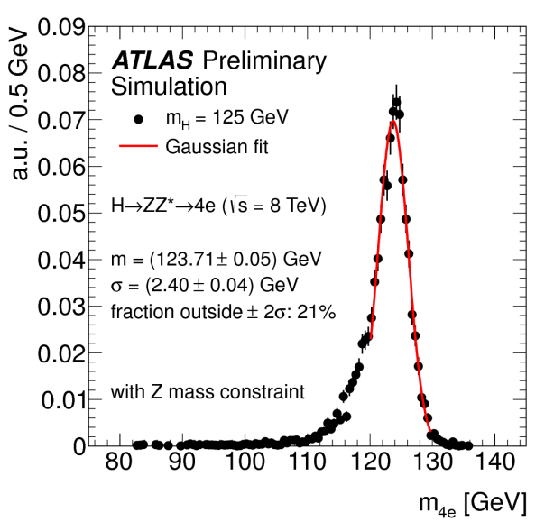
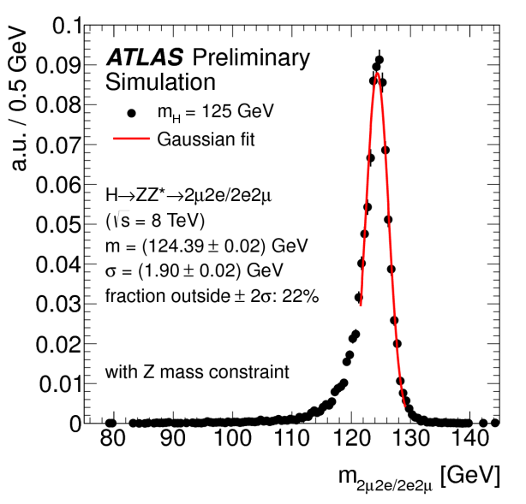
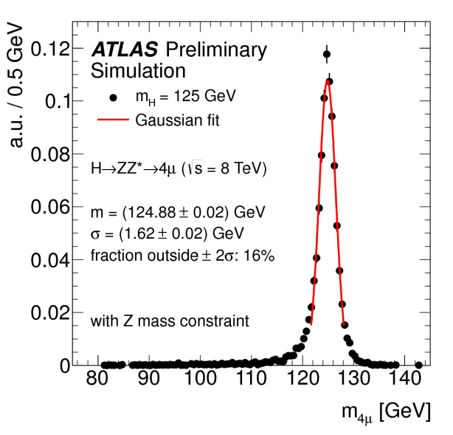
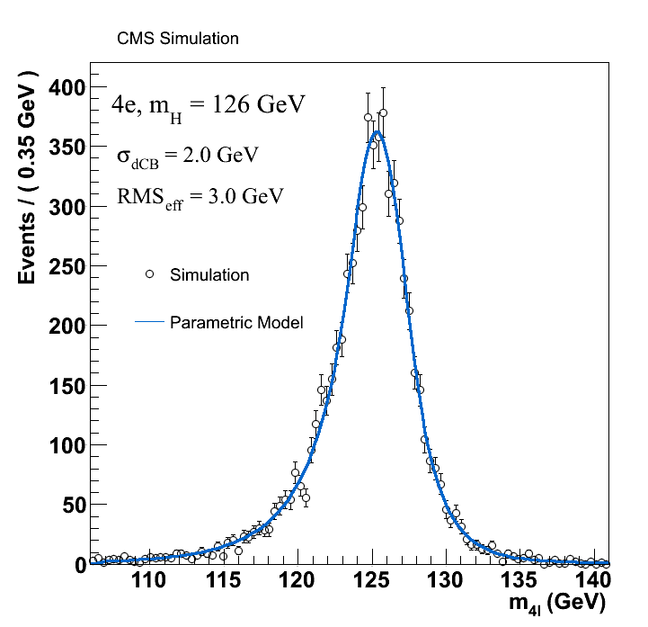
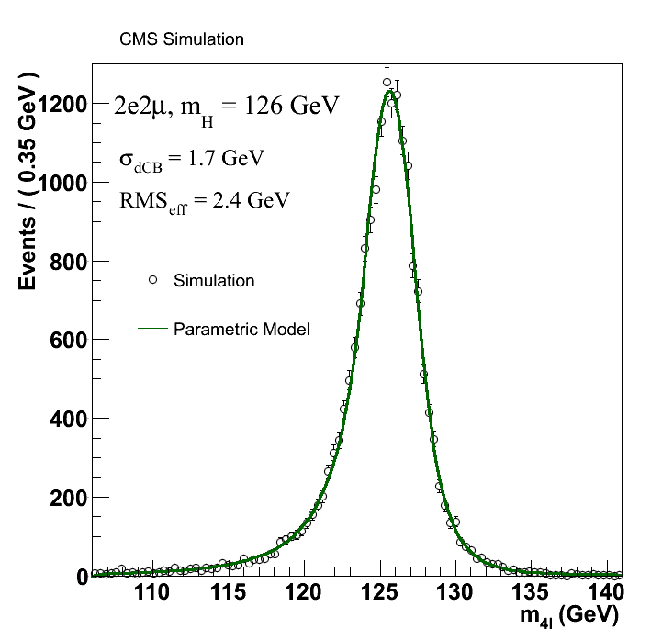
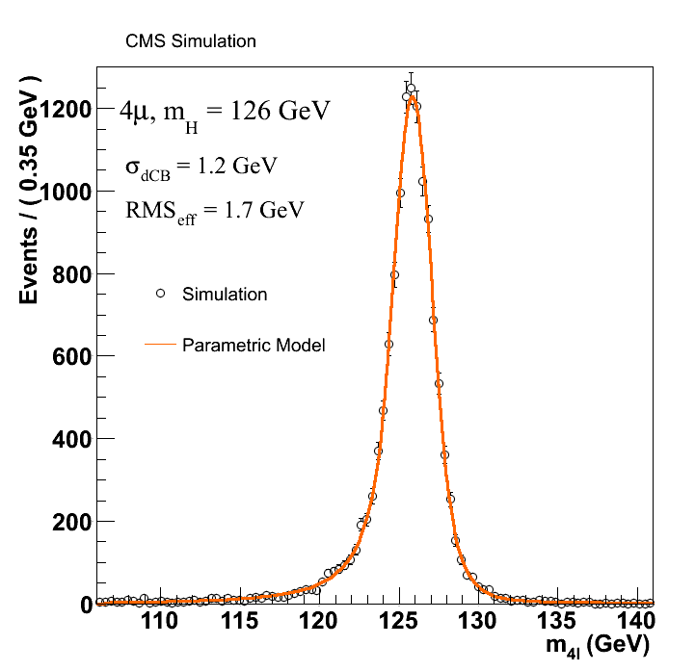
h→ZZ^{(*)}→4l: signal mass resolution
4e
2e2μ/2μ2e
4μ
ATLAS
σ=2.4 GeV
σ=1.9 GeV
σ=1.6 GeV
Single Gaussian
function
with the
Z mass constraint on Z₁
σ=2.0 GeV
σ=1.7 GeV
σ=1.2 GeV
CMS
Double-sided Crystal-Ball function
CMS has slightly better resolution than ATLAS mainly due to better
calorimeter energy resolution and stronger solenoid B-field (3.8 T vs 2.0 T).

Slide 8
h→ZZ^{(*)}→4l: event categorization
ATLAS
There are at least two jets.
The 1st and 2nd highest p_{T} jets are separated by >3 in η and have the invariant mass of >350 GeV.
yes
VBF-like category
There are jets in the forward and backward regions.
no
There is at least one lepton with p_{T}>8 GeV.
yes
VH-like category
no
There is at least one lepton from a W or Z boson
ggF-like category
Others
CMS
yes
There are at least two jets.
Category II
no
About 20% signal from VBF
Category I
About 5% signal from VBF
In Category I, p_{T}/m_{4l} is used to discriminate VBF and VH from ggF.
In Category II, a linear discriminant (V_{D}) is formed by combining two VBF sensitive variables, the difference in η (Δη_{jj}) and the invariant mass of the two leading jets (m_{jj}).

Slide 9
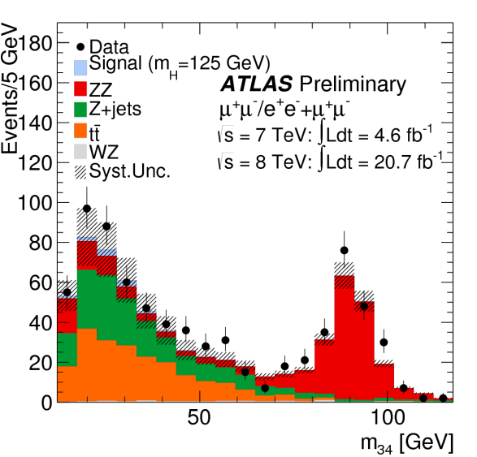
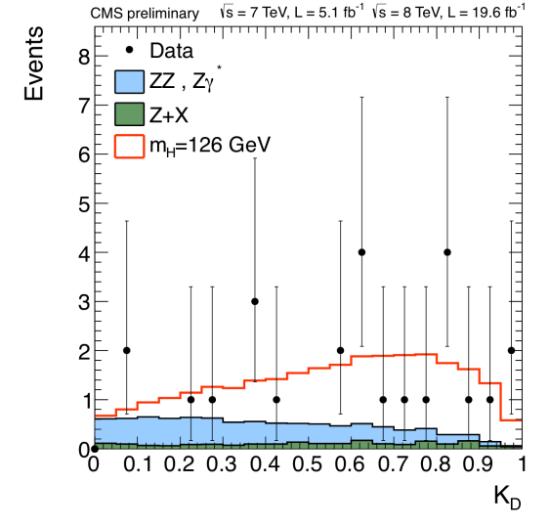
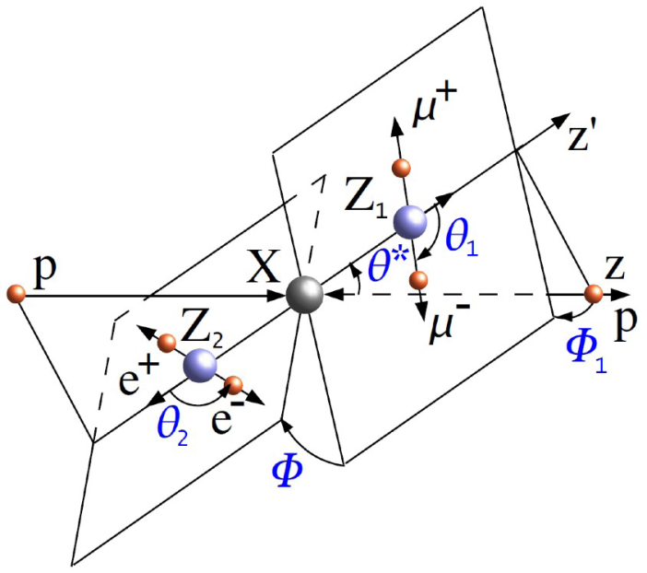
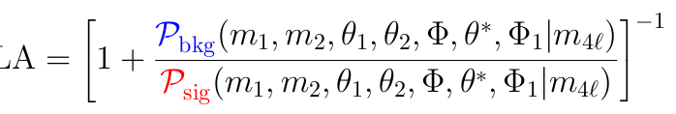
h→ZZ^{(*)}→4l: backgrounds
ZZ^{(*)} di-boson production: irreducible background
  Estimated using MC simulation normalized to the theoretical cross section.
Z+jets, ttbar: reducible background
  Estimated with data-driven methods with Z+ll and Z+l control regions
    Increase the statistics by loosening or inverting the selections of additional lepton(s)
    Estimate background composition
    Extrapolate the background composition to the signal region based on simulation
CMS uses a kinematic discriminant (K_{D}) to reject the irreducible ZZ^{(*)} background.
  K_{D} is based on the probability ratio of the signal and background hypotheses.
  Leading-order matrix elements define the probabilities.
K_{D}

Slide 10
h→ZZ^{(*)}→4l: expected and observed events
ATLAS (100-160 GeV) at 8 TeV | 4e | 2e2μ/2μ2e | 4μ
ZZ^{(*)} | 5.4 +/- 0.5 | 14.7 +/- 0.9 | 12.4 +/- 0.6
Z, Zbbbar, ttbar | 2.5 +/- 0.6 | 6.1 +/- 1.5 | 1.9 +/- 0.6
Total background | 8.0 +/- 0.8 | 20.8 +/- 1.8 | 14.3 +/- 0.8
Signal m_{H}=125 GeV | 2.9 +/- 0.4 | 7.0 +/- 0.9 | 5.8 +/- 0.7
Data | 13 | 28 | 27
CMS (110-160 GeV) at 7 TeV and 8 TeV | 4e | 2e2μ/2μ2e | 4μ
ZZ^{(*)} | 6.6 +/- 0.8 | 18.1 +/- 1.3 | 13.8 +/- 1.0
Z+X | 2.5 +/- 1.0 | 4.0 +/- 1.6 | 1.6 +/- 0.6
Total background | 9.1 +/- 1.3 | 22.0 +/- 2.0 | 15.4 +/- 1.2
Signal m_{H}=125 GeV | 3.5 +/- 0.5 | 8.9 +/- 1.0 | 6.8 +/- 0.8
Data | 16 | 32 | 23
Although this is not direct comparison,
ATLAS and CMS seem to have similar signal acceptance and S/N ratio.

Slide 11
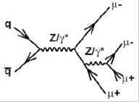
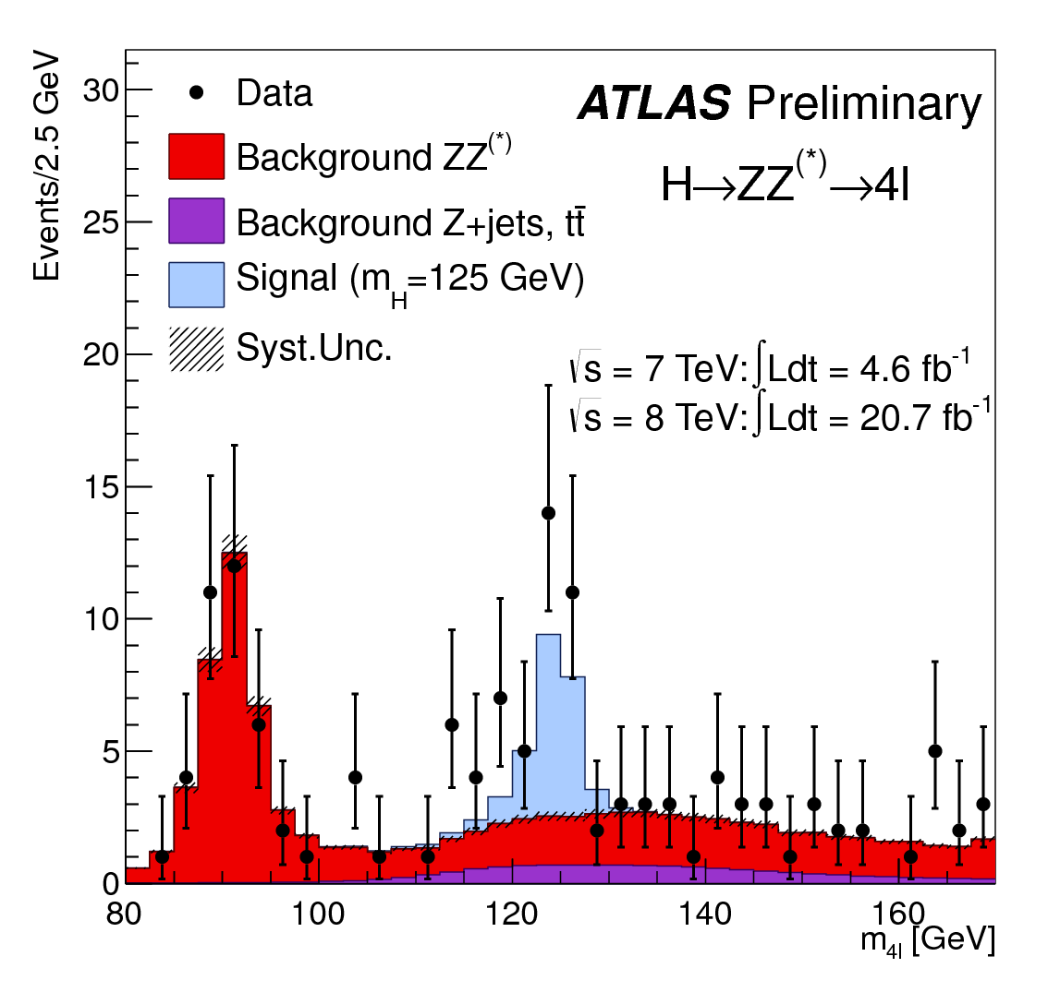
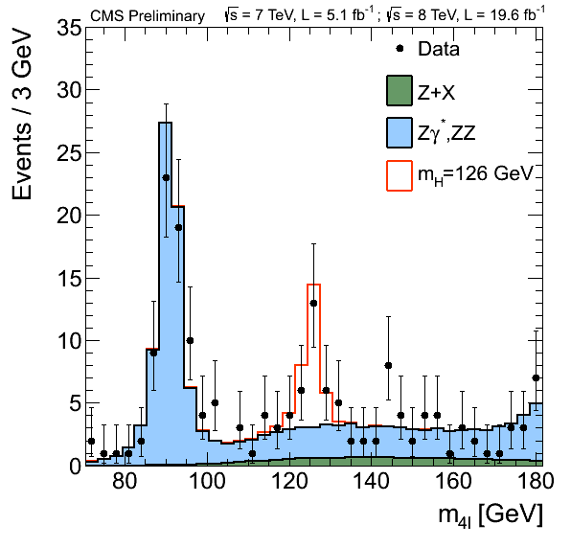
h→ZZ^{(*)}→4l: m_{4l} distributions
A clear peak exceeding expected backgrounds is seen around m_{4l}=125 GeV by both ATLAS and CMS.
Single resonant Z→4l peak is seen at right position and height.
ATLAS
CMS

Slide 12
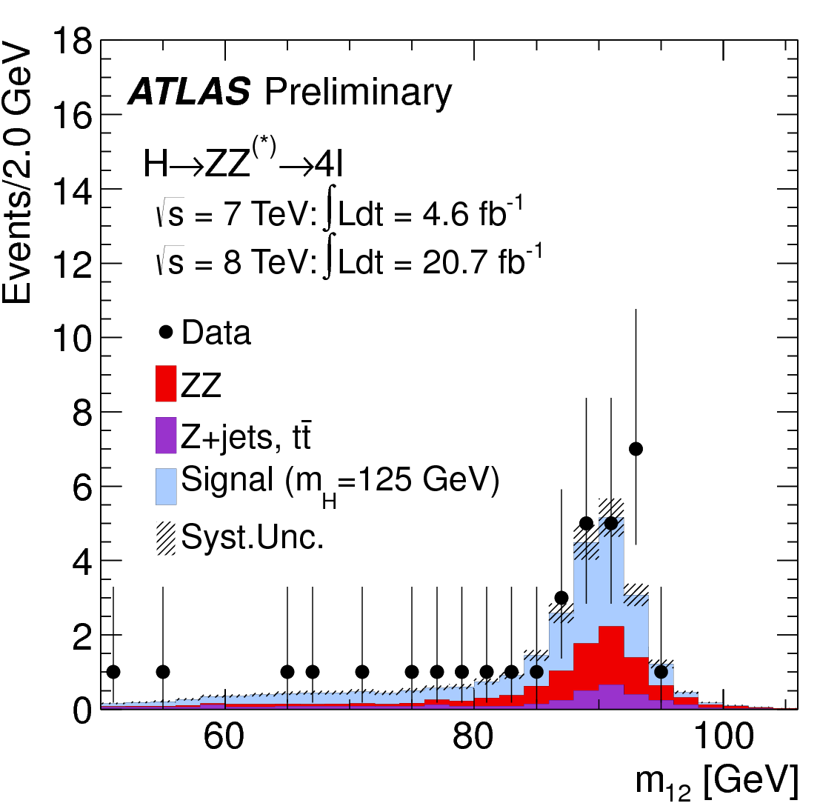
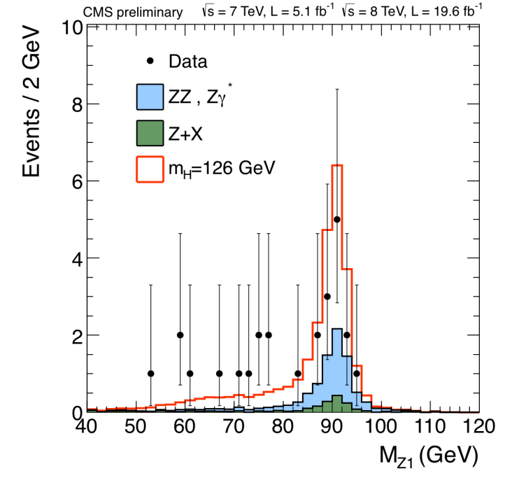
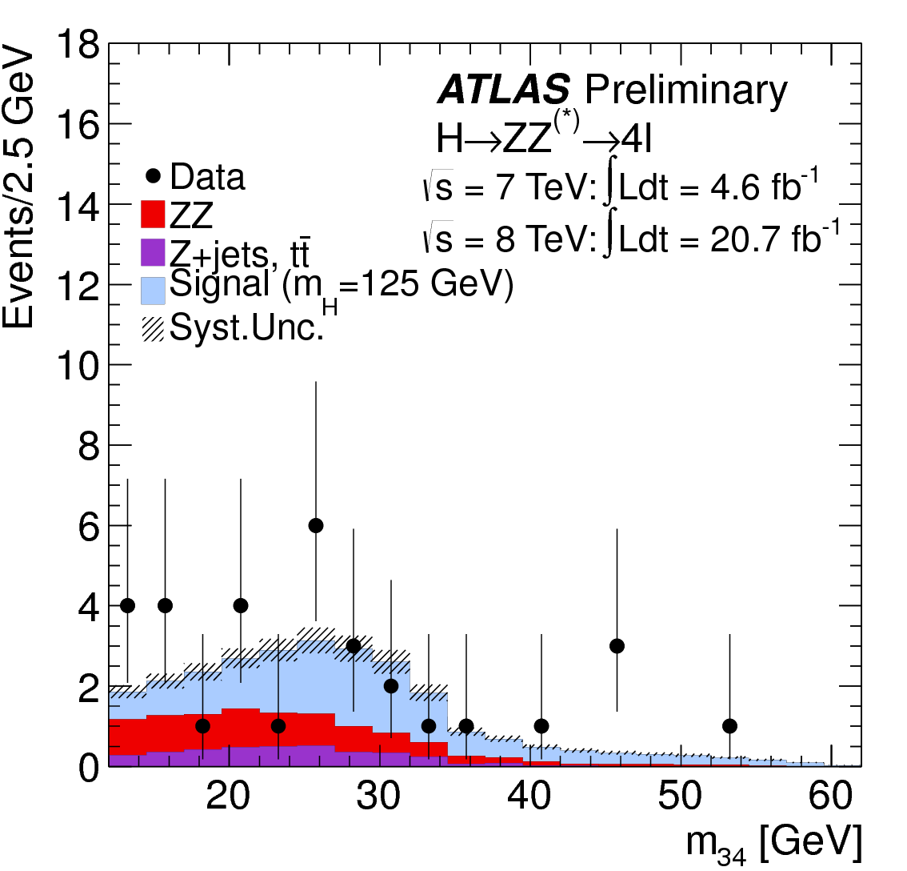
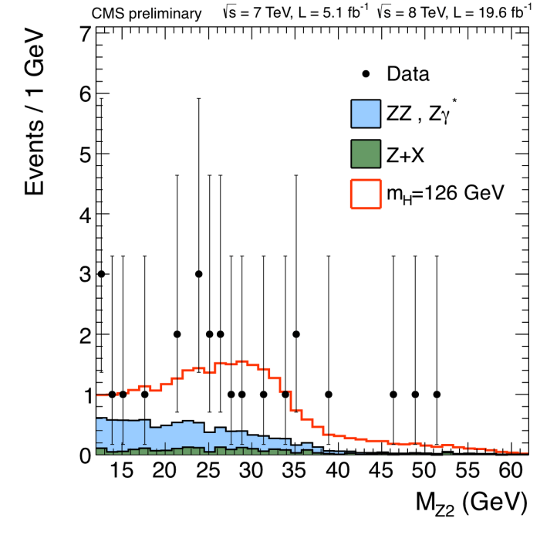
h→ZZ^{(*)}→4l: m₁₂ and m₃₄ distributions
ATLAS (120<m_{4l}<130 GeV)
CMS (121.5<m_{4l}<130.5 GeV)
m₁₂=M_{Z1}
Data agree with the expected distributions.
m₃₄=M_{Z2}

Slide 13
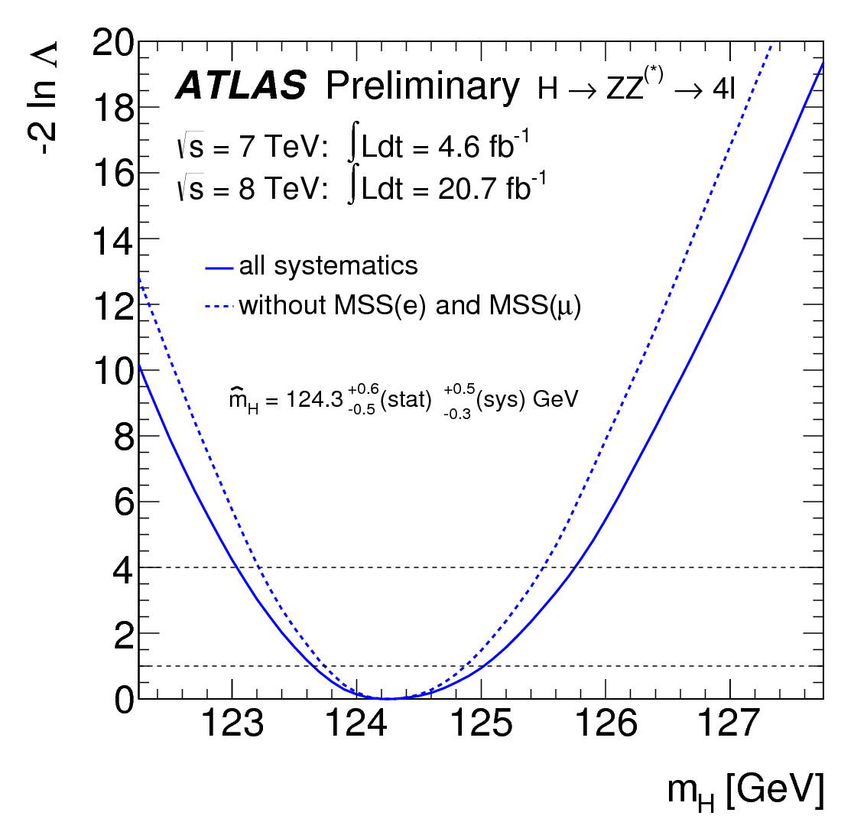
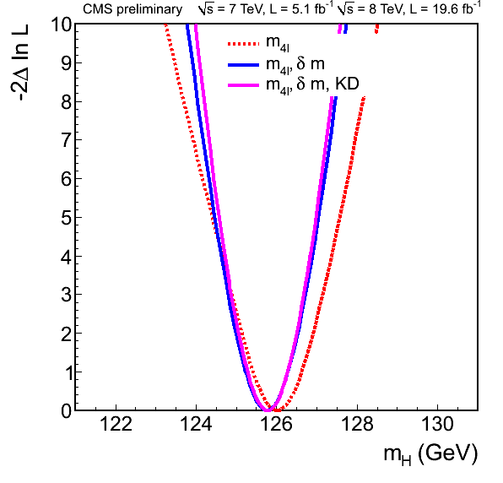
h→ZZ^{(*)}→4l: mass of the Higgs-like boson, m_{H}
ATLAS: 1D fit to m_{4l}
CMS: 3D fit to m_{4l}, event-by-event uncertainty (δm), K_{D}
The systematic uncertainty is dominated by electron energy and muon momentum scale systematic uncertainties.
ATLAS
CMS

Slide 14
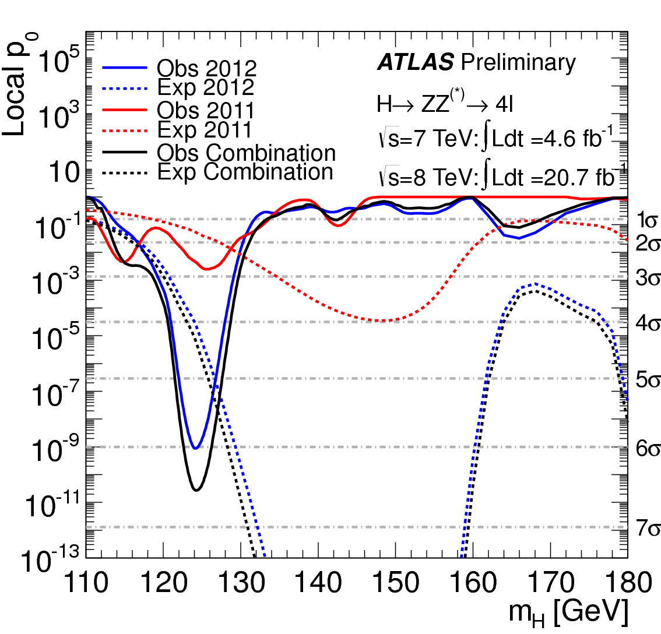
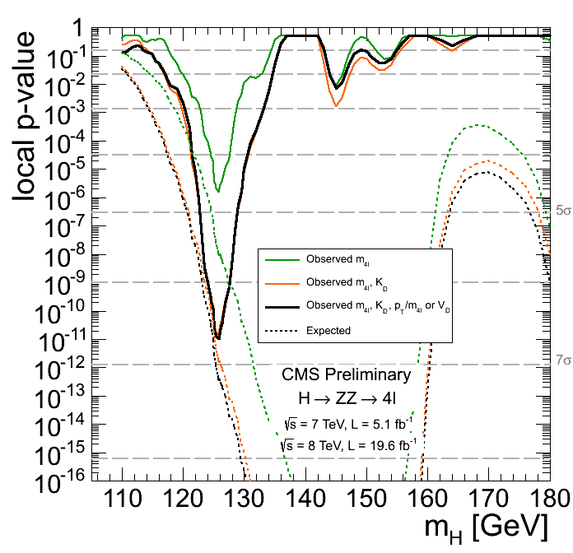
h→ZZ^{(*)}→4l: significance
ATLAS: 1D fit to m_{4l}
  6.6σ observed (4.4σ expected) at m_{H}=124.3 GeV
CMS: 3D fit to m_{4l}, K_{D}, p_{T}/m_{4l} or V_{D}
  6.7σ observed (7.2σ expected) at m_{H}=125.8 GeV
    1D (m_{4l}) fit gives 4.7σ observed (5.6σ expected) at m_{H}=125.8 GeV
  3D fit of CMS largely improves statistical significance.
ATLAS
CMS

Slide 15
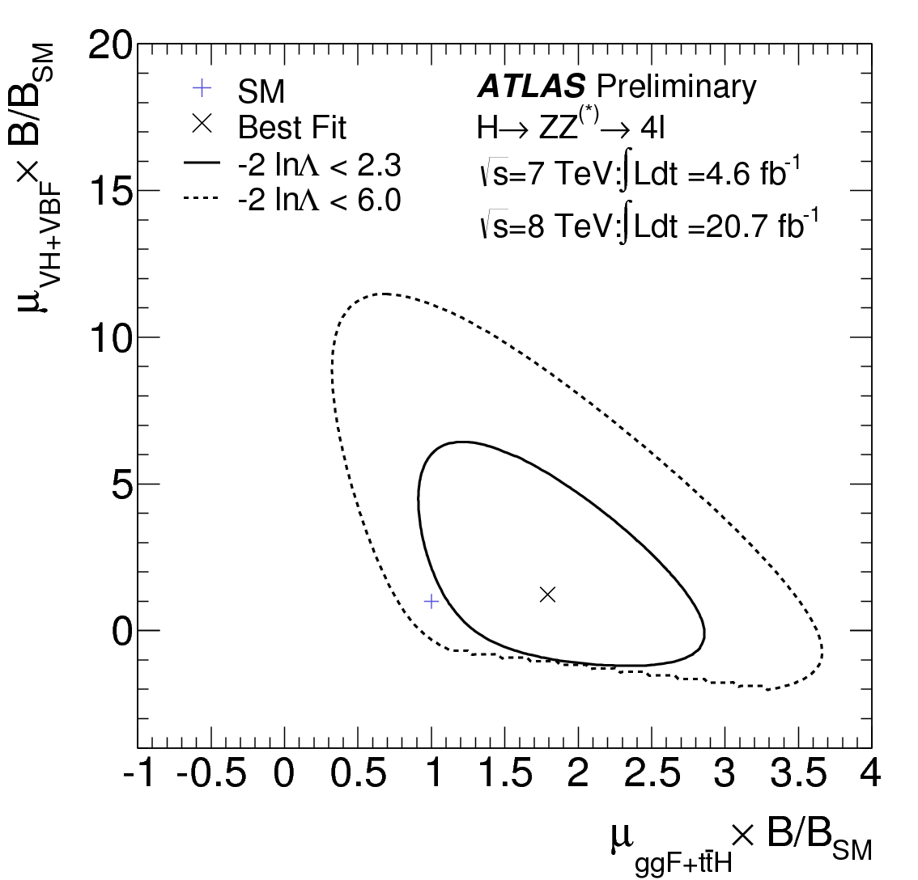
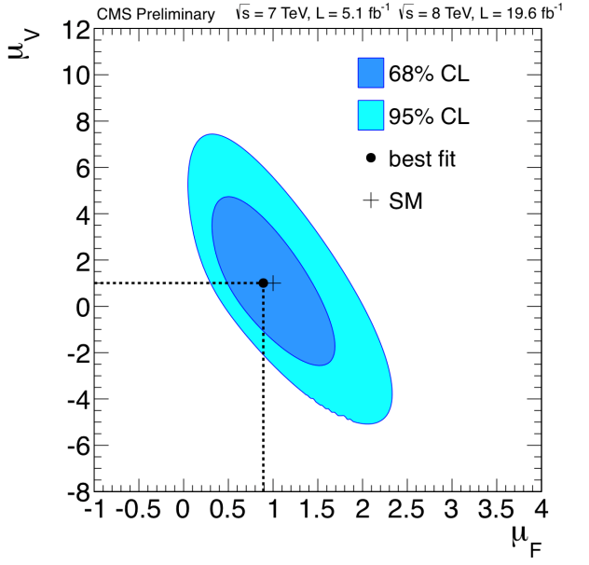
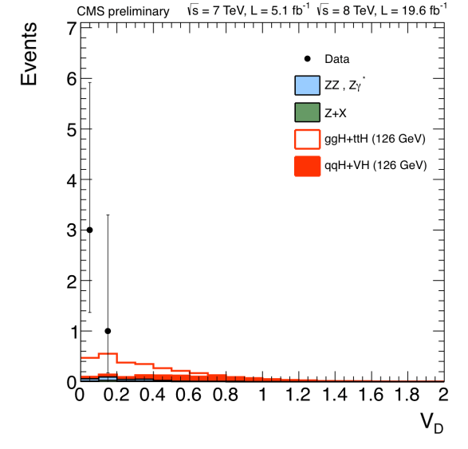
h→ZZ^{(*)}→4l: signal strength (=σ_{obs}/σ_{SM})
ATLAS
CMS
One VBF-like event at 123.5 GeV observed
0.71 +/- 0.10 event expected (~0.4 event from VBF)
No VBF-like (V_{D}>0.5) events observed in Category II
 | Inclusive μ | Fermionic μ_{F} | Bosonic μ_{V} | Ratio μ_{V}/μ_{F}
ATLAS at m_{H}=124.3 GeV | 1.7^{+0.5}_{-0.4} | 1.8^{+0.8}_{-0.5} | 1.2^{+3.8}_{-1.4} | 0.7^{+2.4}_{-0.3}
CMS at m_{H}=125.8 GeV | 0.91^{+0.30}_{-0.24} | 0.9^{+0.5}_{-0.4} | 1.0^{+2.4}_{-2.3} | -
All signal strengths are consistent with 1 (=the SM expectation) within 2σ uncertainties.
Used masses are different and results cannot be directly compared.
Notes:
ATLAS-CONF-2013-034
The factors mu_i are not constrained to be positive in order to account for a deficit of events from the corresponding production process.
As described in Ref. [12], while the signal strengths may be negative, the total probability density function must remain positive everywhere, and hence the total number of expected signal+background events has to be positive everywhere.
This restriction is responsible for the sharp cutoff in the H->ZZ(*)->4l contour.
[12] ATLAS Collaboration, Phys. Rev. D86 (2012) 032003, arXiv:1207.0319 [hep-ex]

Slide 16
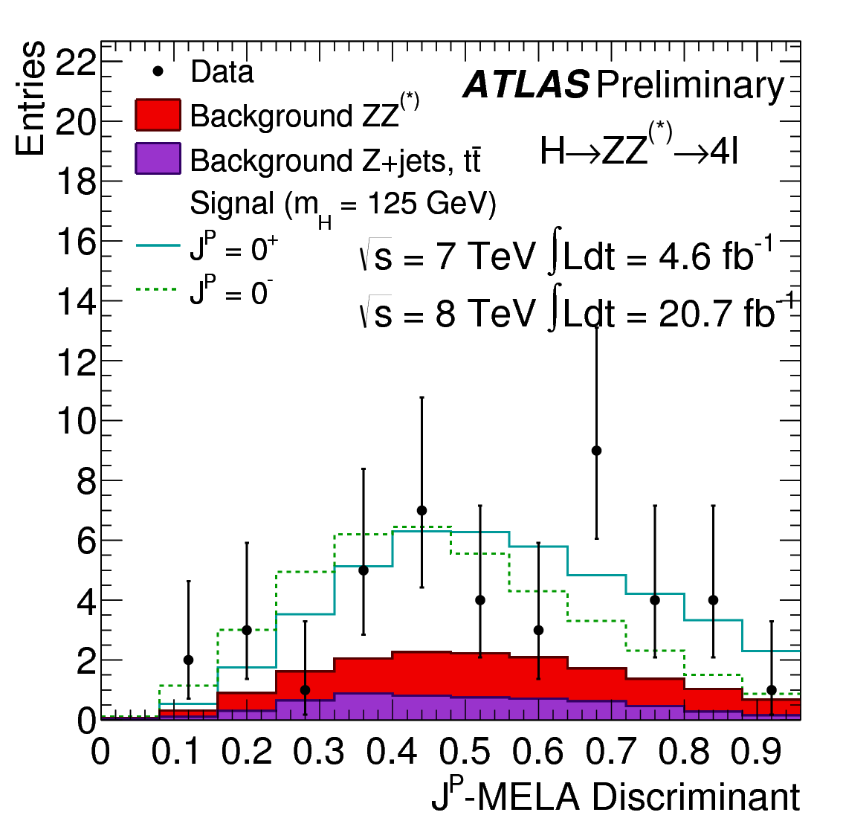
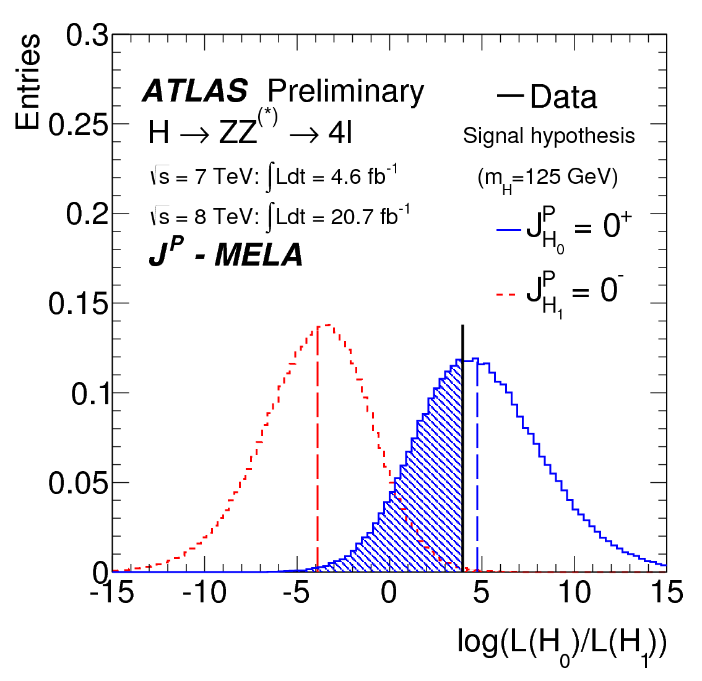
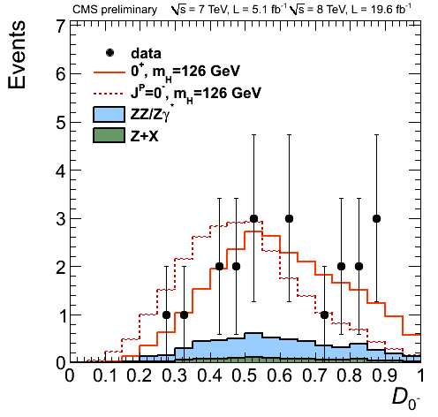
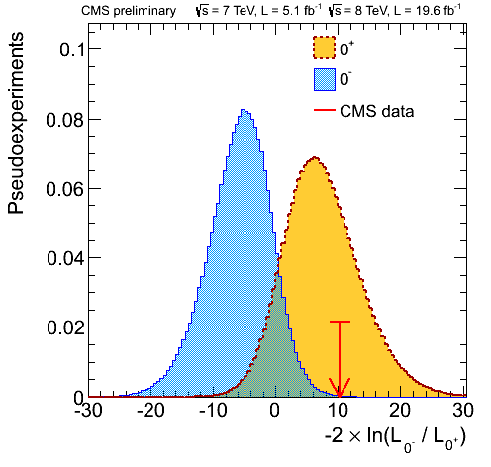
h→ZZ^{(*)}→4l: spin and parity
Several J^{P} hypotheses are tested against the J^{P}=0⁺ hypothesis (=Standard Model Higgs) with Matrix Element Likelihood Approach and Boosted Decision Tree.
Data strongly favor J^{P}=0⁺.
J^{P} | BDT CL_{s} | J^{P}-MELA CL_{s}
0⁻ | 2.2% | 0.4%
1⁺ | 0.2% | 0.6%
1⁻ | 6.0% | 3.1%
2⁺_{m} | 16.8% | 18.2%
2⁻ | 25.8% | 11.6%
ATLAS
J^{P} | J^{P}-MELA CL_{s}
0⁻ | 0.16%
0⁺_{h} | 8.1%
1⁺ | <0.1%
1⁻ | <0.1%
2⁺_{mgg} | 1.5%
2⁺_{mqq} | <0.1%
CMS

Slide 17
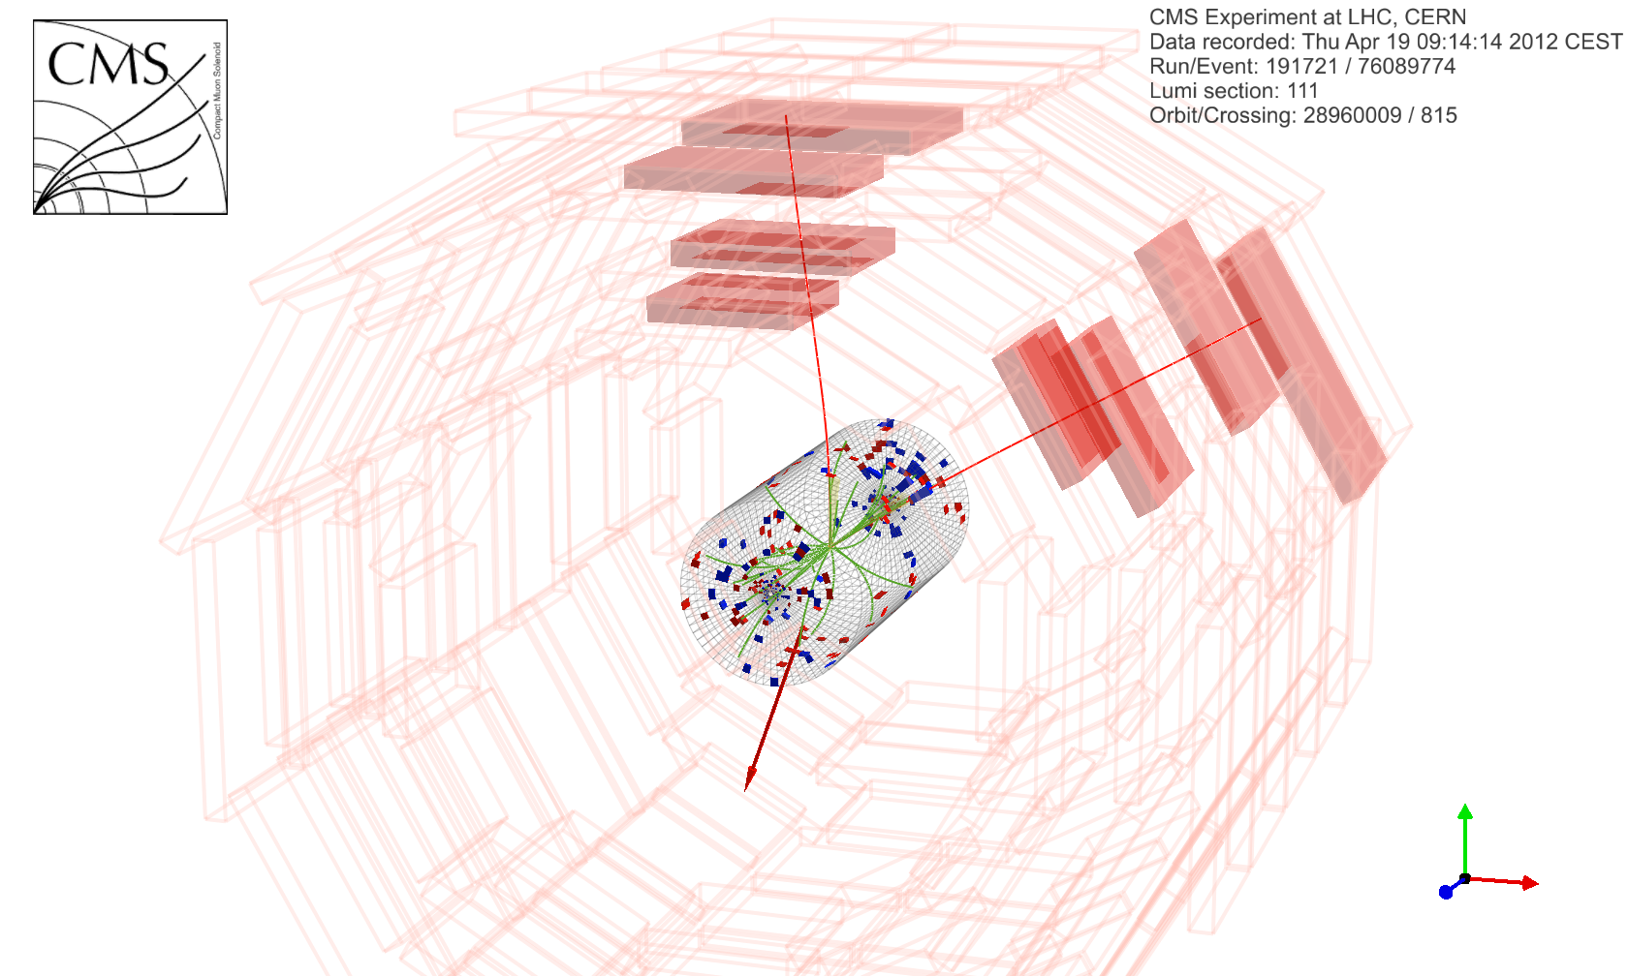
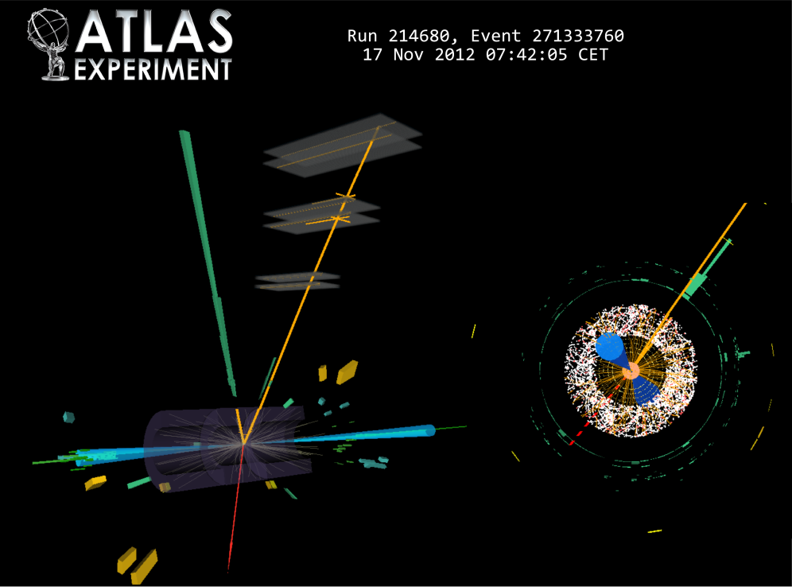
h→WW^{(*)}→lνlν: event displays
Two isolated high-p_{T} leptons with opposite charges with small opening angle
and large missing transverse energy (+ two forward jets in VBF production)

Slide 18
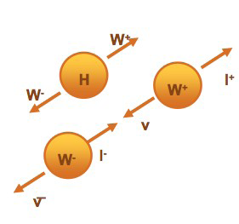
h→WW^{(*)}→lνlν: selections (1/2)
Vectors from the decay of a scalar particle and the V-A structure of the W boson decay lead to a small opening angle.
Different flavor (DF: eμ, μe) and same flavor (SF: ee, μμ)
Discriminating variables: p_{Tll}, m_{ll}, Δφ_{ll}, m_{T}
ATLAS
Events with >=2 jets are considered for the VBF analysis.
Lepton p_{T} thresholds
  25, 15 GeV
m_{ll} cuts
  m_{ll}>10 GeV (DF), >12 GeV (SF)
  m_{ll}<50 GeV (N_{jet}=0, 1), <60 GeV (N_{jet}>=2)
  Δφ_{ll}<1.8 radian cut
  p_{Tll}>30 GeV only for N_{jet}=0
CMS
Events with >=2 jets are not considered.
Lepton p_{T} thresholds
  23, 10 GeV
m_{ll} cuts
  m_{ll}>12 GeV
  m_{ll}<43 GeV
Δφ_{ll}<1.75 radian (=100 degrees) cut
p_{Tll}>30 GeV

Slide 19
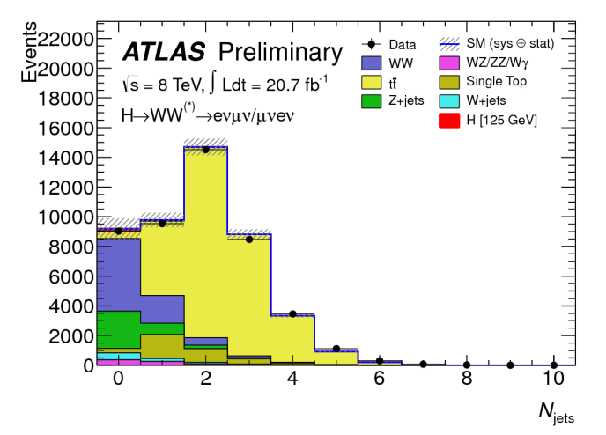
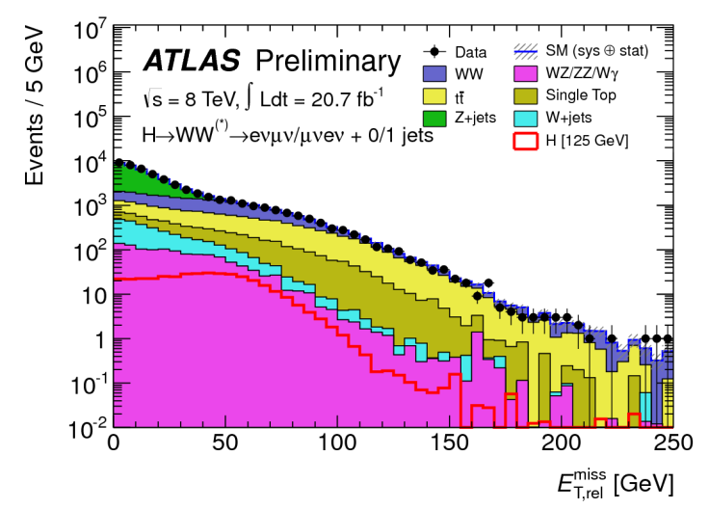
h→WW^{(*)}→lνlν: selections (2/2)
ATLAS
Z→ττ veto for N_{jet}=1, >=2
Missing E_{T}, charged track MET (=MpT)
  Relative to leptons and jets
  Track MET only in same flavor channels
  MET rel>25 GeV (different flavor), >45 GeV (same flavor)
  MpT rel>45 GeV (same flavor)
m_{T} cuts
  93.75 < m_{T} < 125 GeV for N_{jet}=<1
  m_{T}<150 GeV for N_{jet}>=2
CMS
Z→ττ veto is not used.
Missing E_{T,} charged track MET (=MpT)
  Relative to leptons
  Track MET in all channels
  MET rel>20 GeV
  MpT rel>20 GeV
m_{T} cuts
  80 < m_{T} < 123 GeV

Slide 20
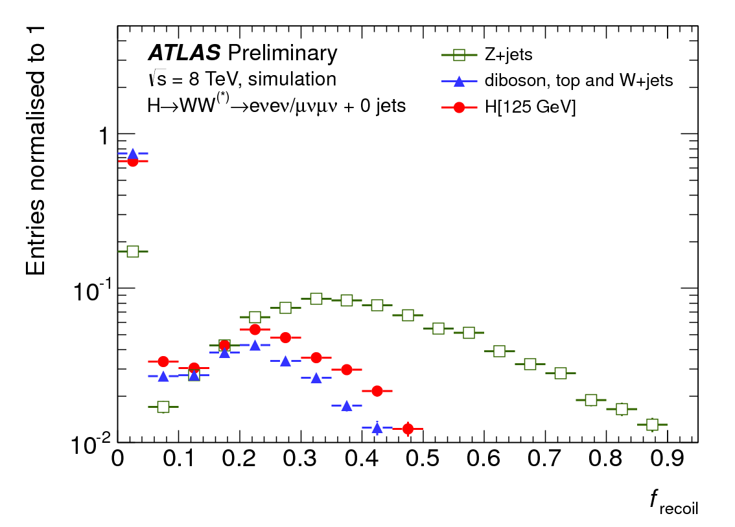
h→WW^{(*)}→lνlν: backgrounds
Where feasible, background contributions are estimated directly from data or normalized to the observed rate in a data control region.
Non-resonant WW^{(*)} di-boson production
  More uniform opening angle (small opening angle by H→WW^{(*)}→lνlν)
  ATLAS: estimated with control region is 50<m_{ll}<100 GeV (N_{jet}=0), m_{ll}>80 GeV (N_{jet}=1)
  CMS: estimated with control region is m_{ll}>100 GeV
Top quark production
  ATLAS: suppressed by b-jet veto with nominal threshold (E_{T}>25 GeV)
  CMS: suppressed by b-jet veto with sub-threshold (E_{T}>15 GeV), soft muon veto
Drell-Yan process (Z/γ*) in same flavor
  ATLAS: Tight MET/MpT, f_{recoil} (a measurement
  of soft hadronic recoil opposite to dilepton
  (dilepton+jet) system in N_{jet}=0 (N_{jet}=1))
    Rejection ~2-4 with efficiency ~70%
  CMS: A dedicated multivariate selection with
  MET, kinematic and topological variables.
    Rejection ~1000 with efficiency >50%

Slide 21
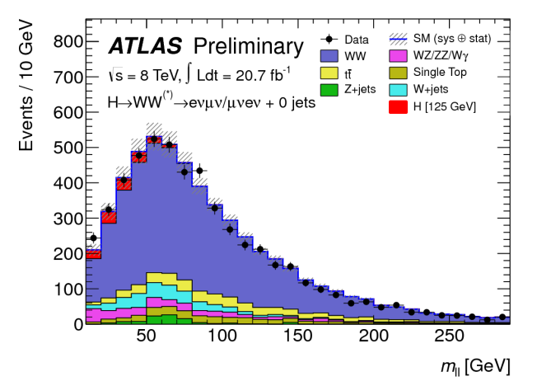
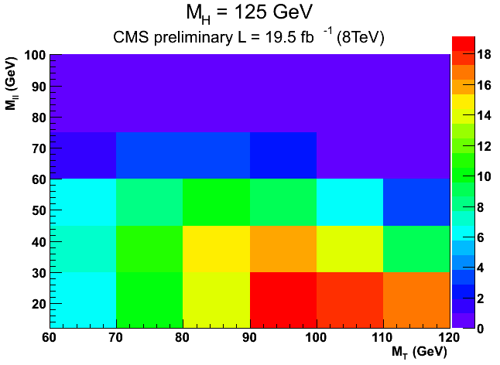
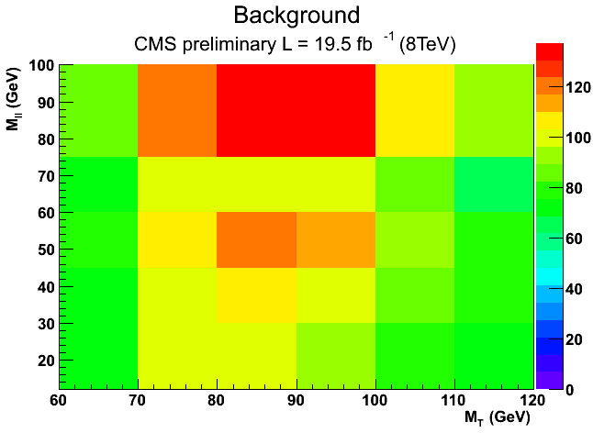
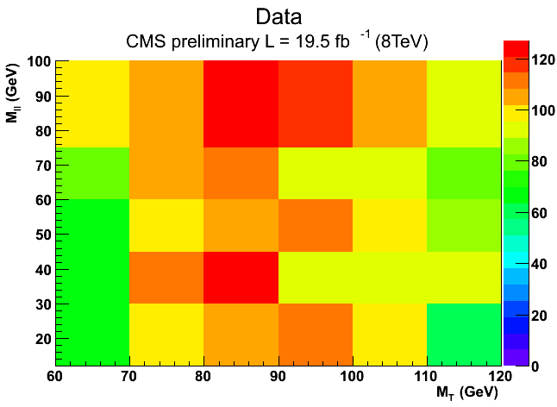
h→WW^{(*)}→lνlν: signal extraction
ATLAS
  Split eμ+μe at m_{ll}=30 GeV for N_{jet}=0 and 1
  The full m_{T} distribution is divided into 5, 3 and 4 bins for N_{jet}=0, 1 and >=2, respectively.
  Fit m_{T} distribution to extract signal strength, μ.
CMS
  Cut-based analysis
  2D shape-based analysis with m_{T} and m_{ll} is used for different flavor.
SR1: 10<m_{ll}<30 GeV
SR2: 30<m_{ll}<50 GeV
WW CR: 50<m_{ll}<100 GeV

Slide 22
h→WW^{(*)}→lνlν: expected and observed events
ATLAS (8TeV) | N_{obs} | N_{sig} | N_{bkg} | N_{WW} | N_{ttbar} | N_{Z/γ*}
N_{jet}=0 | 831 | 97 +/- 20 | 739 +/- 39 | 551 +/- 41 | 23 +/- 3 | 30 +/- 10
N_{jet}=1 | 309 | 40 +/- 13 | 261 +/- 28 | 108 +/- 40 | 68 +/- 18 | 12 +/- 6
N_{jet}>=2 | 55 | 10.6 +/- 1.4 | 36 +/- 4 | 4.1 +/- 1.5 | 4.6 +/- 1.7 | 22 +/- 3
CMS (8TeV) | N_{obs} | N_{sig} | N_{bkg} | N_{WW} | N_{top} | N_{WZ,ZZ,Z/γ*}
N_{jet}=0 eμ+μe | 505 | 90 +/- 19 | 429 +/- 34 | 310 +/- 29 | 20.0 +/- 4.3 | 11.4 +/- 1.1
N_{jet}=0 ee+μμ | 421 | 56 +/- 12 | 360 +/- 38 | 207 +/- 19 | 9.3 +/- 2.2 | 106 +/- 31
N_{jet}=1 eμ+μe | 228 | 42 +/- 12 | 209 +/- 14 | 80 +/- 11 | 78.9 +/- 4.5 | 12.9 +/- 1.2
N_{jet}=1 ee+μμ | 140 | 18.0 +/- 5.2 | 111.3 +/- 8.6 | 39.8 +/- 5.4 | 40.4 +/- 3.1 | 21.2 +/- 5.4
ATLAS has less signals and less backgrounds than CMS.
  N_{jet}=0: signal (97 vs 146), backgrounds (739 vs 789)
  N_{jet}=1: signal (40 vs 60), backgrounds (261 vs 320)
Notes:
The ATLAS numbers are taken from Table 11 of ATLAS-CONF-2013-030.
The CMS numbers are taken from Table 4 of CMS-PAS-HIG-13-003.

Slide 23
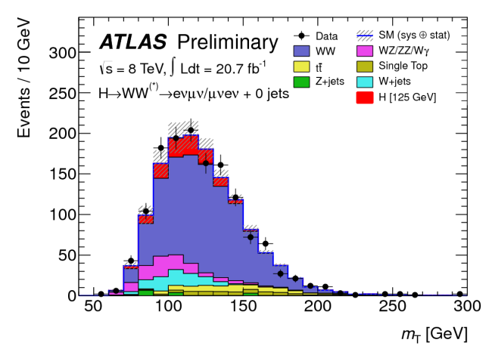
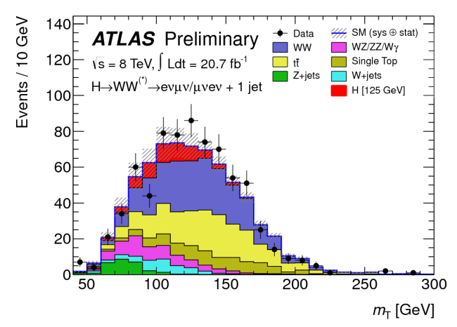
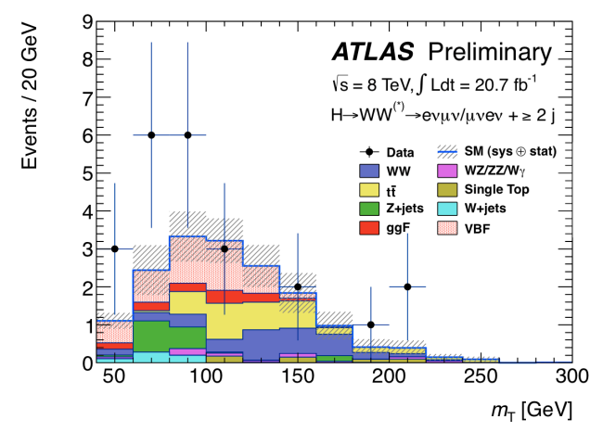
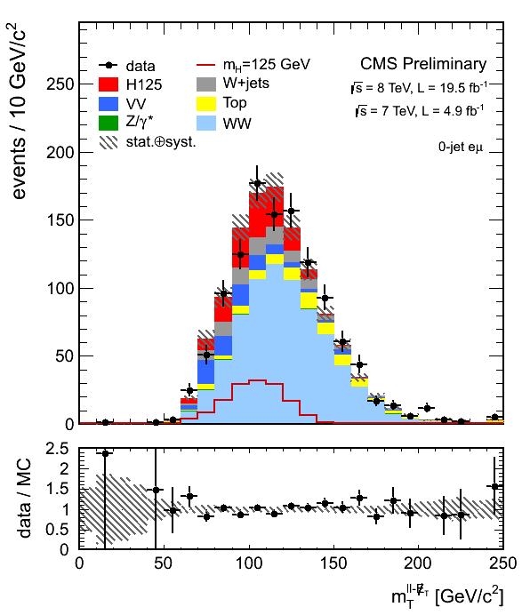
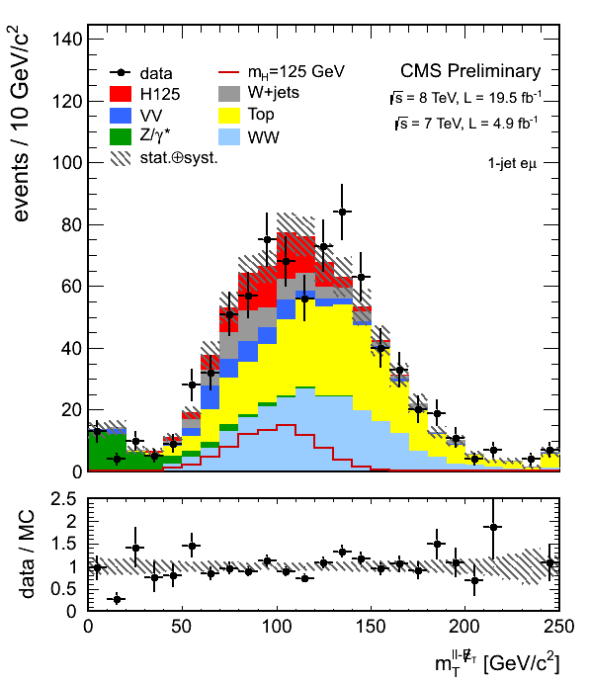
h→WW^{(*)}→lνlν: m_{T} distributions
Different flavor results are shown.
Data well agree with the expectation including 125 GeV Higgs signals.
N_{jet}=0
N_{jet}=1
N_{jet}>=2
ATLAS
For the VBF analysis
m_{jj}>500 GeV
|Δy_{jj}|>2.8
No jets (p_{T}>20 GeV)
in rapidity gap
Require both lepton
in rapidity gap
CMS

Slide 24



h→WW^{(*)}→lνlν: significance
ATLAS
  Combined: 3.8σ observed (3.7σ expected) at m_{H}=125 GeV
  VBF: 2.5σ observed (1.6σ expected) at m_{H}=125 GeV
CMS
  Shape-based: 4.0σ observed (5.1σ expected) at m_{H}=125 GeV
  Cut-based: 2.0σ observed (2.7σ expected) at m_{H}=125 GeV
    Shape-based analysis largely improves sensitivity.
CMS
ATLAS

Slide 25



h→WW^{(*)}→lνlν: signal strength (=σ_{obs}/σ_{SM})
ATLAS
CMS
ATLAS (for m_{H}=125 GeV)
CMS (for m_{H}=125 GeV)
All values are consistent with 1 (=the SM expectation).
When μ_{F} (μ_{V}) is evaluated, μ_{V} (μ_{F}) is profiled and constrained mainly by N_{jet}<=1 (N_{jet}>=2) signal region.

Slide 26


h→WW^{(*)}→lνlν: spin
Minimal graviton-like spin-2 model (2⁺_{m}) hypothesis is tested against the SM (0⁺) hypothesis.
2⁺_{m} hypothesis is disfavored at CL_{S}=1% to 14% by ATLAS and CMS.
f_{qqbar} | CL_{s}
0% | 5%
25% | 3%
50% | 2%
75% | 1%
100% | 1%
ATLAS
Varied qqbar→X and gg→X fractions.
Boosted Decision Trees with m_{ll}, p_{Tll}, Δφ_{ll} and m_{T}.
CMS
Consider gg→X process only.
Maximum likelihood fit using 2D (m_{T}-m_{ll}) templates
f_{qqbar} | CL_{s}
0% | 14%

Slide 27
Conclusions
ZZ^{(*)} and WW^{(*)} final states are excellent tools for Higgs Physics at the LHC.
Statistical significance of the new boson around 125 GeV gets higher.
  ZZ^{(*)}: 6.6σ (ATLAS 124.3 GeV), 6.7σ (CMS 125.8 GeV)
  WW^{(*)}: 3.8σ (ATLAS 125 GeV), 4.0σ (CMS 125 GeV)
Its mass is determined with <1 GeV uncertainty by each experiment.
Its signal strengths, spin and parity are almost consistent with those of Standard Model Higgs boson.

Slide 28
References
h→ZZ^{(*)} decay mode
  h→ZZ^{(*)}→4l
    ATLAS-CONF-2013-013, CMS-PAS-HIG-13-002
  h→ZZ→llνν
    ATLAS arXiv:1205.6744, CMS-PAS-HIG-13-014
  h→ZZ^{(*)}→llqq
    ATLAS arXiv:1206.2443, ATLAS-CONF-2012-163
h→WW^{(*)} decay mode
  h→WW^{(*)}→lνlν
    ATLAS-CONF-2013-030, ATLAS-CONF-2013-031, CMS-PAS-HIG-13-003
  h→WW→lνqq
    ATLAS arXiv:1206.6074, CMS-PAS-HIG-13-008
  Wh→WWW^{(*)}→lνlνlν
    ATLAS-CONF-2012-078, CMS-PAS-HIG-13-009
  2HDM H→WW^{(*)}→eνμν
    ATLAS-CONF-2013-027
https://twiki.cern.ch/twiki/bin/view/AtlasPublic/HiggsPublicResults
https://twiki.cern.ch/twiki/bin/view/CMSPublic/PhysicsResultsHIG

Slide 29
Backup slides
Backup

Slide 30
Program
http://www.ilc.tohoku.ac.jp/higgsandbeyond2013/?page_id=10
== 5th June ==
2. Overview
– Theoretical Introduction – Michael Dine (University of California, Santa Cruz)
– Higgs physics Theoretical Overview – tbc
– LHC accelerator status and plan before HL-LHC – Frank Zimmermann (CERN)
– Summary of Higgs and BSM physics at ATLAS – Francesco Conventi (University of Napoli)
– Summary of Higgs and BSM physics at CMS - Serguei Ganjour (DSM/DAPNIA, CEA/Saclay)
3. Higgs at the LHC
– h –> ZZ, WW – Susumu Oda (Kyushu University)
– h –> gamma gamma Matteo Sani (University of California, San Diego)
– h –> tautau, mumu – Harald Fox (Lancaster University)
– h –> bb – Tristan Arnoldus Du Pree (University Catholique de Louvain)
[Banquet]
== 6th June ==
3. Higgs at the LHC
– tth – Michele Pinamonti (INFN Udine and SISSA Trieste)
– Combined analysis : mass, width, J^PC, coupling – Alessio Bonato (CERN)

Slide 31
Trigger E_{T}/p_{T} thresholds in 2012
 | ZZ* |  |  | WW*
 | single | double | triple | single | double
ATLAS | 25 (e) 24 (μ) | 12/12 (e) 12 (e)/ 8 (μ) 24 (e)/ 8 (μ) 13/13 (μ) 18/8 (μ) |  | 24 (e and μ)
CMS |  | 17/8 (e and μ) | 15/8/5 (e) | ? (e and μ) | ? (e and μ)
ATLAS (ZZ*)
4e: ε~100%
4μ: ε>97%
ATLAS (WW*)
single-e: ε~90%,
single-μ (|η|<1.05): ε~70%
single-μ (1.05<|η|<2.4): ε~90%
CMS (ZZ*): ε>98%
CMS (WW*)
ee: ε~98%,
μμ: ε~97%
eμ: ε~96%
ATLAS-CONF-2013-013, page 4
ATLAS-CONF-2013-030, page 1
CMS-PAS-HIG-13-002, page 4
CMS-PAS-HIG-13-003, page 2

Slide 32







ATLAS resonance plots

Slide 33






CMS resonance plots

Slide 34





h→ZZ^{(*)}→4l: CMS discriminant variables

Slide 35


h→ZZ^{(*)}→4l: signal strength and mass
ATLAS
CMS

Slide 36



h→ZZ^{(*)}→4l: mass
ATLAS
CMS

Slide 37




Phys. Rev. D 81, 075022 (2010)

Slide 38



h→ZZ^{(*)}→4l: spin and parity
ATLAS
0⁺ vs 2⁺_{m}
CMS

Slide 39
MC simulation (ATLAS)
Process | MC generator
ggF | POWHEG+PYTHIA8
VBF | POWHEG+PYTHIA8
VH, ttH | PYTHIA8
gg, qq→H(alternative J^{P}) | JHU+PYTHIA8
qq, gq→WW | POWHEG+PYTHIA6
qq, gq→WW+2j | Sherpa with no O(α_{s}) terms
ZZ(*)qq | Sherpa
gg→WW | GG2WW+HERWIG
gg→ZZ | gg2ZZ
tt | MC@NLO+HERWIG
Single top: tW, tb | MC@NLO+HERWIG
Single top: tqb | Acer MC+PYTHIA6
Drell-Yan Z/γ*, inclusive | ALPGEN+HERWIG
Z(*)→ll+2j | Sherpa process up O(α_{s})
Z(*)Z(*)→4l | POWHEG+PYTHIA8
WZ/Wγ*, m_{Z/γ*}>7 GeV | POWHEG+PYTHIA8 (WW), PYTHIA (ZZ)
Wγ*, m_{γ*}<7 GeV | MadGraph+PYTHIA6
Wγ | ALPGEN+HERWIG
Parton showering (PYTHIA8), hadronization(PYTHIA8), underlying event (PYTHIA8) or
Parton showering (HERWIG), hadronization(HERWIG), underlying event (JIMMY)
CT10 PDF for POWHEG, MC@NLO
CTEQ6L1 PDF for ALPGEN, MadGraph, PYTHIA6, PYTHIA8, JHU

Slide 40
MC simulation (CMS)
Process | MC generator
ggF | POWHEG+PYTHIA6
VBF | POWHEG+PYTHIA6
VH, ttH | PYTHIA6
gg, qq→H(alternative J^{P}) | JHU+PYTHIA6
qq→WW | MadGraph+PYTHIA6
gg→WW | GG2WW+PYTHIA6
gg→ZZ | gg2ZZ+PYTHIA6
tt | POWHEG+PYTHIA6
Single top: tW | POWHEG+PYTHIA6
Drell-Yan Z/γ*, inclusive | MadGraph+PYTHIA6
W+jets | MadGraph+PYTHIA6
Z(*)Z(*)→4l | POWHEG+PYTHIA6
WZ | MadGraph+PYTHIA6
CT10 PDF for POWHEG
CTEQ6L PDF for MadGraph, PYTHIA6, JHU

