Slide 1

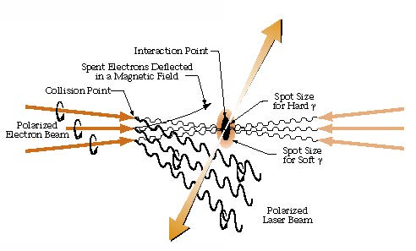
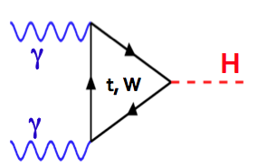


Photon-Photon Colliders (γγC)
Mayda M. Velasco
Northwestern University
Higgs and Beyond -- June 5-9, 2013 -- Japan

Slide 2
Full understanding of the Higgs boson and EWSM
Will benefit not only the
  LHC
  e⁺e⁻ colliders with M_{Z} ≤ E_{cm} ≤ top-pair threshold
But also a γγC Higgs factory
  Γ_{γγ} to 2% (Model independent)
    Results in a 13% on Γ_{Total}
    Results in a Y_{tt} of 4%
  Measure CP mixing to better than 1%
  At higher energies: λ_{hhh} to a few %
Γ_{γγ} proportional to
Γ_{Fermions}- Γ_{Vectors} - Γ_{Scalars}
in the loop

Slide 3
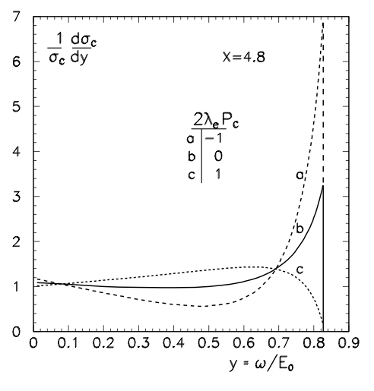
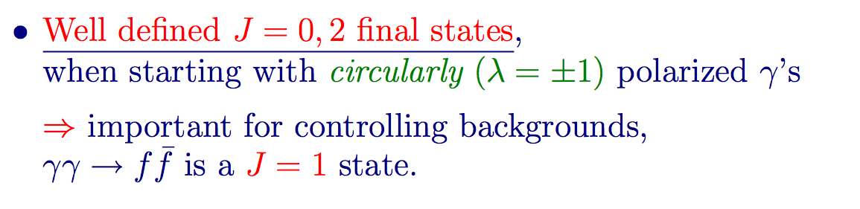
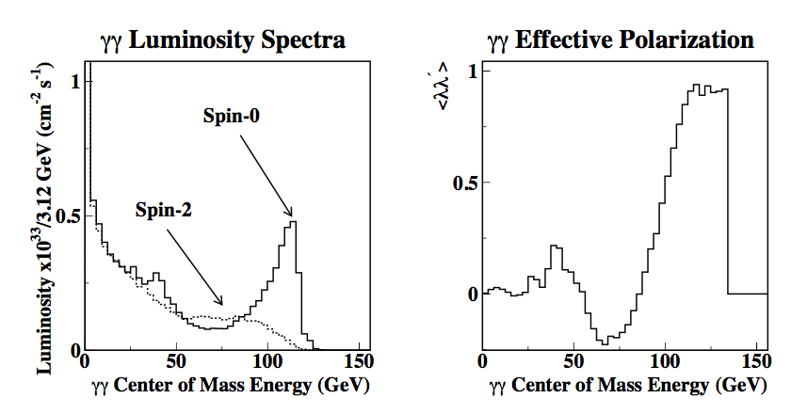
Idea of γγC Based on Compton Backscattering NOT New
σ( γγ → H ) >200 fb
e⁻ γ_{laser} → e⁻ γ
With circularly polarized γ_{laser} (P_{C}= ±1) & polarized e- (λ_{e} = 1)
±
Example:
Optimized
as a Higgs
Factory

Slide 4


What is “New” ? (I)
Higgs Discovery in
July 2012
Higgs relatively light
M_{H}~125 GeV
E_{ee}~160 GeV enough to
produce γγ→H

Slide 5
What is “New” ? (II)
Development of compact γγC starting from e⁻e⁻ :
  Based on already existing accelerator technology
  Polarized and low energy e⁻ beam: E_{e} = 80 GeV and λ_{e}= 80%
  Independent of e⁺e⁻ program
  “Low” cost
Required laser technology is becoming available and affordable. Two options:
  Fiber based laser (ICAN)
  High power laser developed for fusion program (LLNL)

Slide 6
3 New Designs that will Produce 10K Higgs/year
HFiTT: Higgs Factory in Tevatron Tunnel
  Fermilab specific
SILC: SLC-ILC-Style γγ Higgs Factory
  SLAC specific
SAPPHiRE: Small Accelerator for Photon-Photon Higgs production using Recirculating Electrons
  Developed at CERN, but can be built elsewhere
Detector and beam environment not more difficult than what we are experiencing at the LHC
➔ 3 machines in 1: e⁻e⁻ , e⁻ γ, γ γ

Slide 7
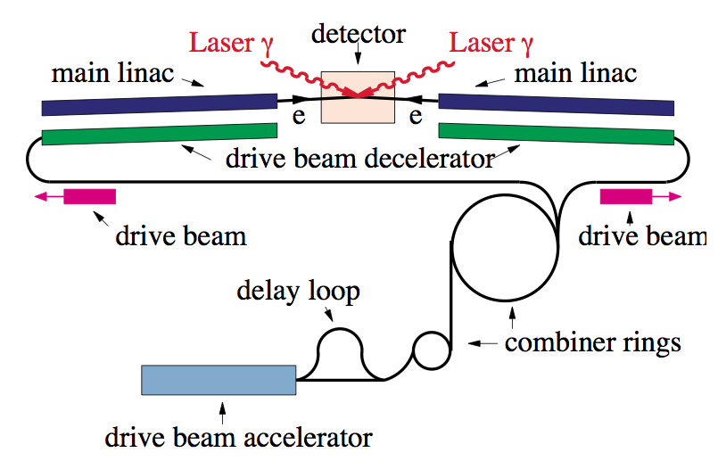
Earlier e-e- based γγC design
CLICHÉ : CLIC Higgs Experiment
From SNOWMASS 2001 – hep-ex/0110056
Aggressive design with > 20k Higgs / year
Design to be revised to take into account latest knowledge of the CLIC team

Slide 8
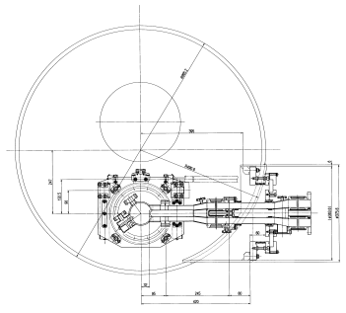
ASTA =
Advanced
Superconducting
Test
Accelerator
HFiTT – Latest Design
RF (1.3 GHz, 8 sets, 5 cryomodules 1.25 GV /set)
RF
RF
e⁻ (80 GeV)
2000 m
Fiber Laser
(0.351 μm, 5 J, 47.7 kHz)
γγ collision
(125 GeV)
2.438 m
(8 ft)
e⁻ (80 GeV)
RF
RF
e⁻ (0.75-8 GeV)
Project X or ASTA
e⁻ (0.75-8 GeV)
E = 80 GeV
= 800 m
U = 4.53 GeV/turn
I = 0.15 mA x 2
P(rf) = 27 MW
Tunnel Cross Section
(16 permanent magnet beam lines,
B = 0.05 – 3.3 kG)
RF
RF
3.048 m (10 ft)
arXiv:1305.5202
RF

Slide 9
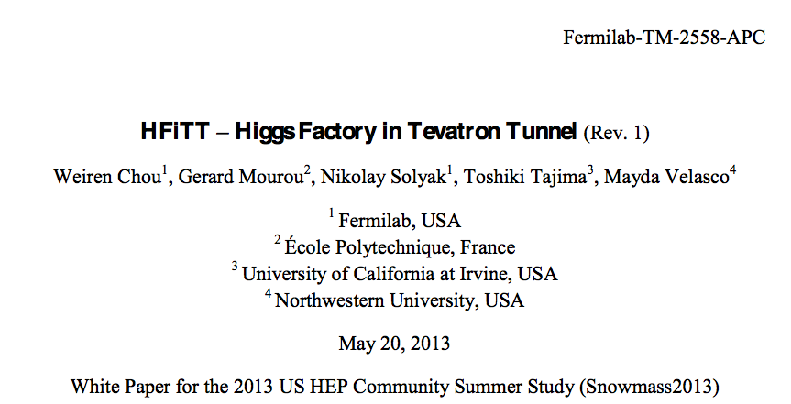
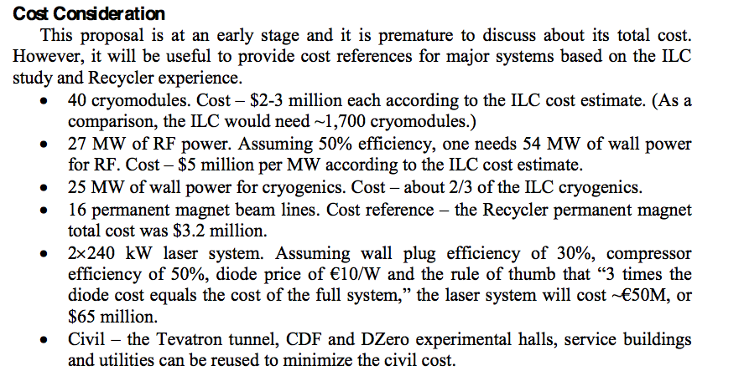
Cost estimate for HFiTT
< 1Billion
USD
With Laser
design by ICAN
collaborators
and based on
Fiber laser

Slide 10
SILC – Presented by Tor Raubenheimer
ICFA Higgs Factory Workshop November 14th, 2012
2-pass design
1.6 Billion without Laser
45 GeV, 1.5 km
or 85 GeV, 3 km
250 m
1 km radius

Slide 11
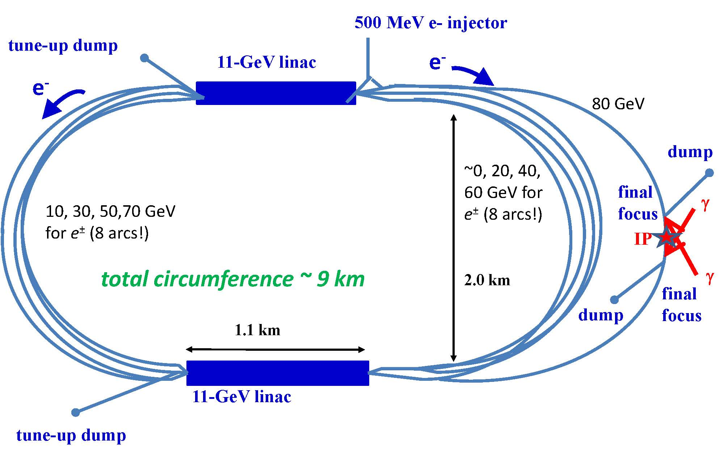
SAPPHiRE – Presented in 2012 at European Strategy Meeting arXiv:1208.2827
Reconfiguring LHeC → SAPPHiRE
Scale ~ European XFEL
~ 1 Billion
Energy lost | 3.89 GeV

Slide 12
Primary Parameters
Parameter | HFiTT | Sapphire | SILC
cms e-e- Energy | 160 GeV | 160 GeV | 160 GeV
Peak γγ Energy | 126 GeV | 128 GeV | 130 GeV
Bunch charge | 2e10 | 1e10 | 5e10
Bunches/train | 1 | 1 | 1000
Rep. rate | 47.7 kHz | 200 kHz | 10 Hz
Power per beam | 12.2 MW | 25 MW | 7 MW
L_ee | 3.2e34 | 2e34 | 1e34
L_gg (Eγγ > 0.6 Ecms) | 5e33* | 3.5e33 | 2e33
CP from IP | 1.2 mm | 1 mm | 4 mm
Laser pulse energy | 5 J | 4 J | 1.2 J
Total electric power |  | < = 100 MW
γ_{laser}: In all designs a laser pulses
of a several Joules with a λ~350nm (3.53 eV) for E_{e-} ~ 80 GeV

Slide 13
These γγC designs need Flat Polarized e- bunches with low emittance
Flat beams
Design parameters are within the present state of the art (e.g. the LCLS photo-injector routinely achieves 1.2 μm emittance at 1 nC charge)
Required R&D for 1nC polarized e- bunches with 1 μm emittance already in progress:
Low-emittance DC guns @
  MIT-Bates, Cornell, SACLA,JAEA,KEK, etc
Polarized SRF guns @
  FZD, BNL, etc
➔ For more details see Frank Zimmermann:
HF2012 – FNAL (16 Nov 2012)

Slide 14
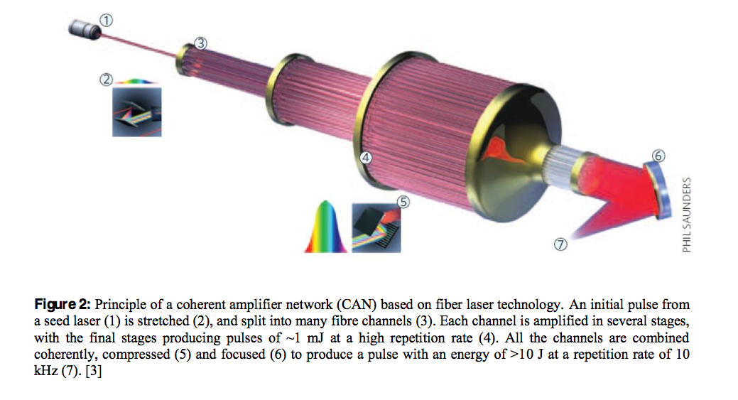
Option #1:
Fiber Lasers -- Significant breakthrough
Gerard Mourou et al., “The future is fiber accelerators,” Nature Photonics, vol 7, p.258 (April 2013).
ICAN – International Coherent
Amplification Network – will finish
design a single-stage laser system
by July. Aiming at >10 J per pulse and >10 kHz with 100-200 fs pulses.
Example: HFiTT needs 5 J at ~40kHz!

Slide 15
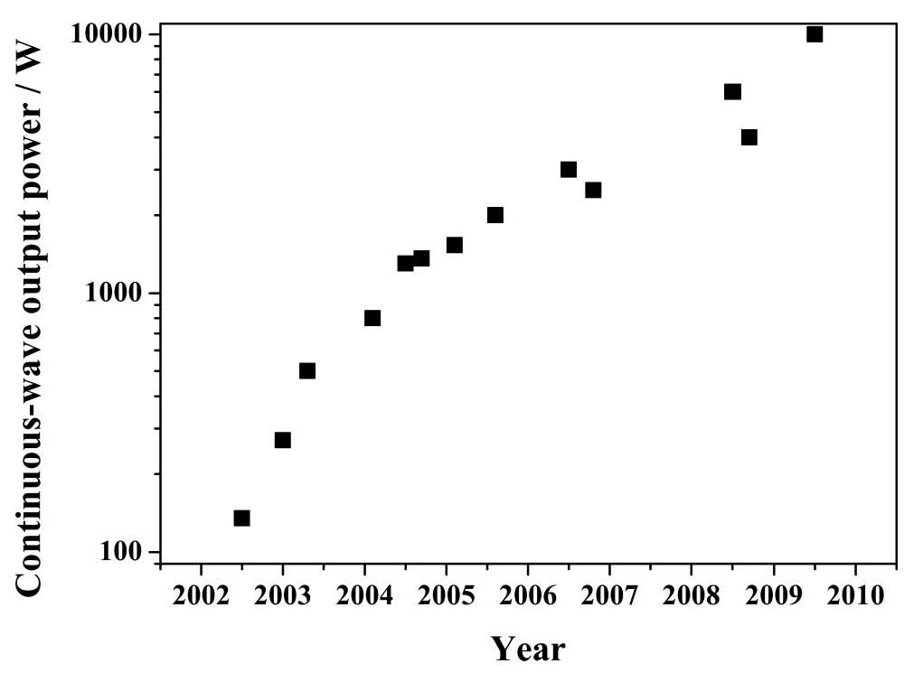
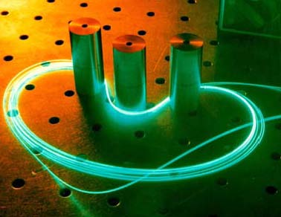
Side comment: Fiber lasers should continue to get better ☺
Power evolution of cw double-clad fiber lasers

Slide 16
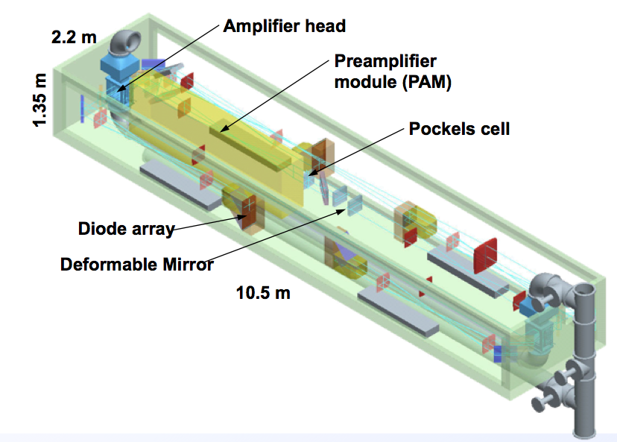
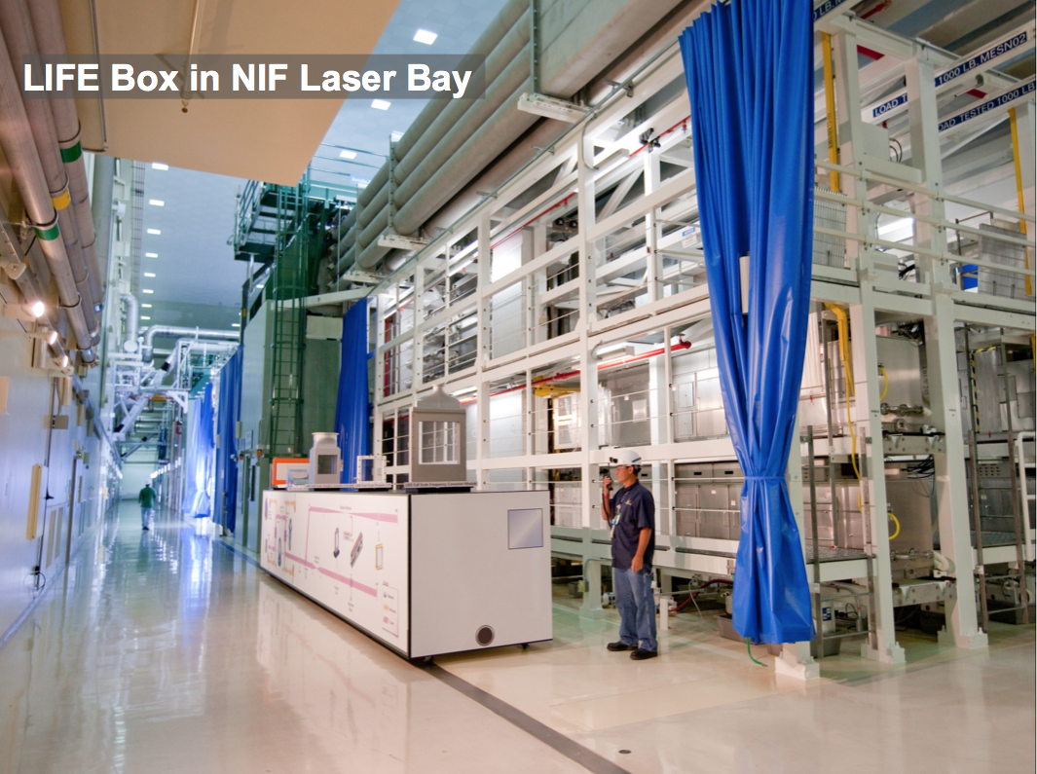
Option #2: The high peak & high average power lasers needed are also available from
➔ LIFE: Laser Initiated Fusion Energy
LIFE beam line :
- Pulses at 16 Hz
- 8.125 kJ / pulse
- 130 kW average power
- ns pulse width
LLBL

Slide 17
LIFE based options for SAPPHIRE-like γγC
J. Gronberg (LLNL)
Single pass system would have MW average power
Recirculating cavity would have 10kW average power
➔ 10 LIFE beam lines running at 20kHz, each with 100kW average power and interleave pulses to create 200kHz
Advantages:
  Easier control of photon beam polarization
  Eliminate issues with recirculating cavities
Disadvantages:
  Higher capital cost and energy requirements
➔ 1 LIFE beam line at 200kHz, 0.05J/pulse & 10 kW average power
Advantages:
  Minimized capital cost and small power requirement
Disadvantages:
  Phase matching required
  Cavity capital cost and operation
  Reduced polarization control

Slide 18
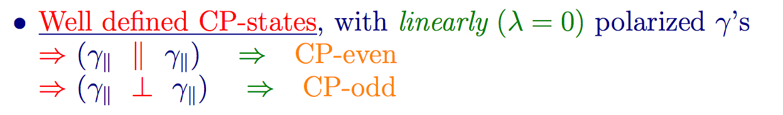
Motivation for γγC as Higgs Factory and Associated e⁻e⁻C and e⁻γC
e⁻e⁻C
Running of sin²θ_{W}
    e⁻e⁻ → e⁻e⁻
γγC
Higgs CP Mixing
and Violations
e⁻γC
- Structure
and M_{W}
e⁻ γ → Wν

Slide 19
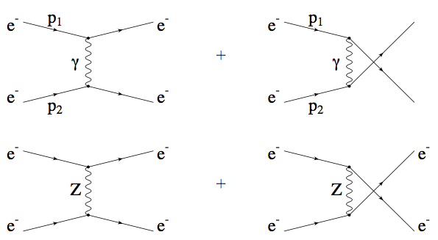
1st “run”: e⁻e⁻ mode
Commission e-e- and understand e- beam polarization
L_{ee} = 2 x 10³⁴ cm⁻²s⁻¹ ➔ 10⁷sec per year: 200,000 pb⁻¹
➔ Moller scattering e- e- → e- e-
  E_{cm} = 160 GeV ; Scatt. angle > 5° ; P_{T} > 10 GeV for outgoing e-
P_{1e} × P_{2e}= 0 → σ = 2981 pb
P_{1e} × P_{2e}=-1 → σ = 3237 pb
P_{1e} × P_{2e}=+1 → σ = 2728 pb
➔ N_{ev} ~ 6 × 10⁸ / year

Slide 20
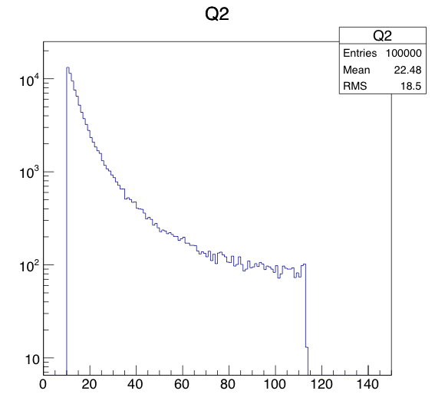
Precision on sin² θ_{W} at SAPPHIRE
μ = E_{cm} sqrt{ ½ (1-cos θ)}
= scattering angle
→ Maximum μ~113 GeV
Like SLAC-SLC (& LEP) at M_{Z}
  A_{LR} based on 150K event
  δA_{LR} ~ 0.003
  δsin² θ_{W} ~ 0.0003
SAPPHiRE at highest μ
  A_{LR} based on 10⁶ event
  δA_{LR} ~ 0.001
  δsin² θ_{W} ~ 0.0004
In addition to precise measurement of running down to 10 GeV
LR Asymmetry
@ the Z-pole
μ(GeV)

Slide 21
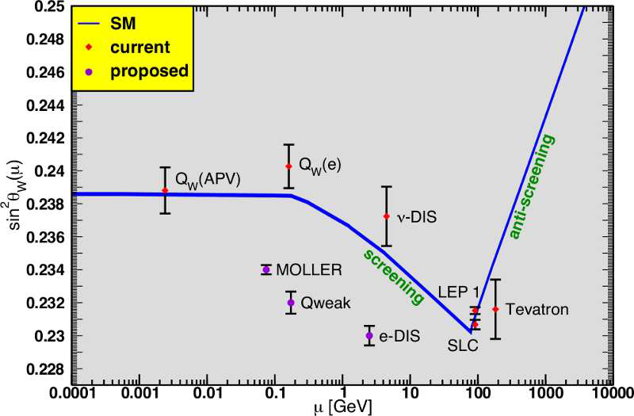
e⁻e⁻: Moller Scattering to measure running of sin² θ_{W}
SAPPHIRE
➔ Complements future lower energy programs

Slide 22

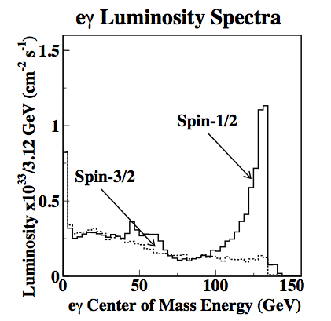
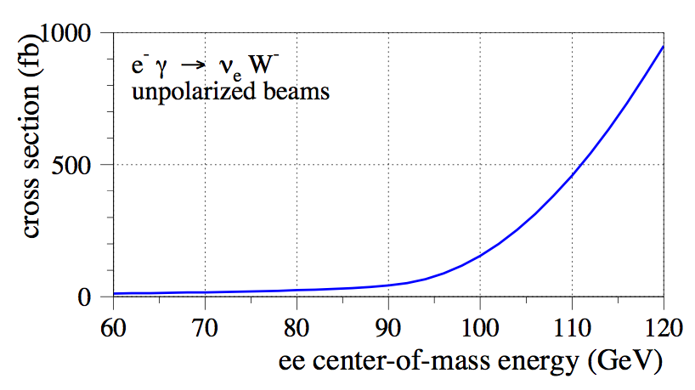
2nd “run”: e⁻ γ M_{W} from e⁻γ → W⁻ν and photon structure
Commission e-γ collisions
Understand γ beam spectrum & polarization
Or from
energy scan
M_{W} measurement from W → hadron events

Slide 23
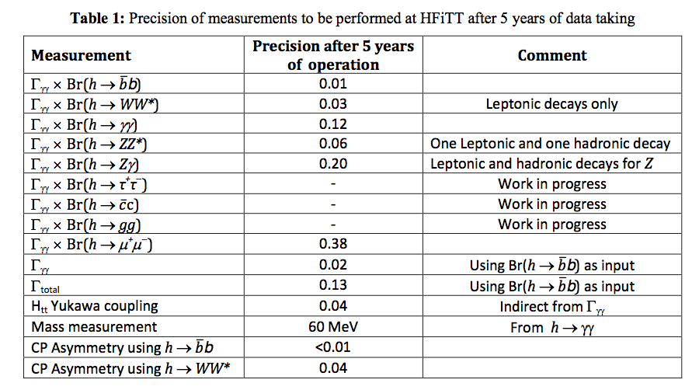
3rd “run” : γγC Higgs-factory
*
*
*
**

Slide 24
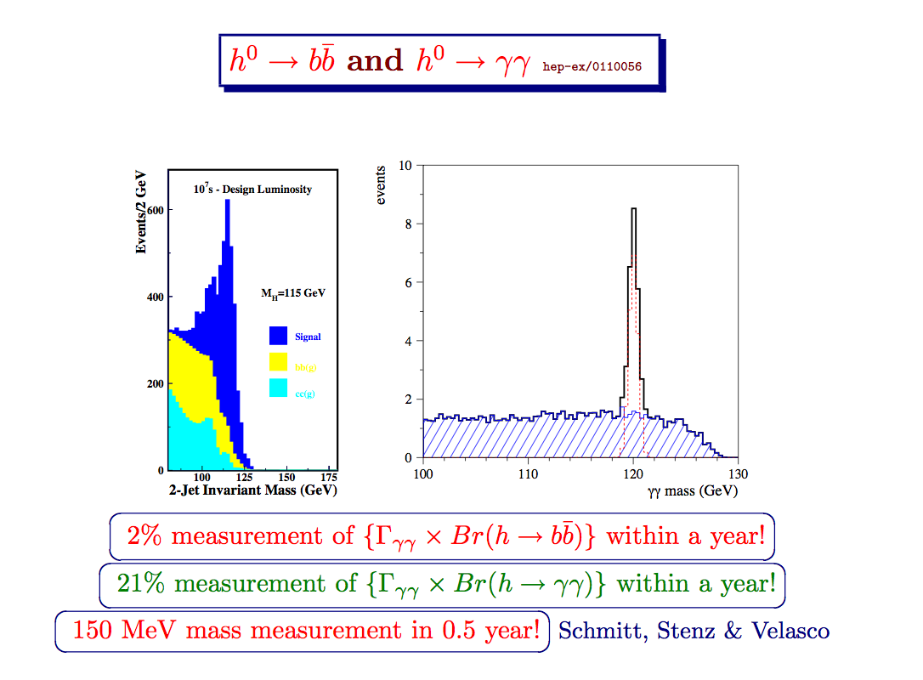
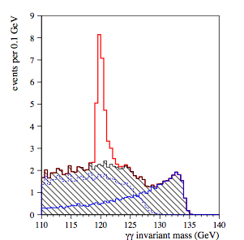

γγC a good option for the USA
Physics capabilities complementary to those of the LHC and future e+e- collider
hep-ex/0110056
H to bb
H to γγ
Similar performance for H to bb predicted by other studies:
S.Soldner-Rembold, P.Niezurawski, Rosca, etc…

Slide 25
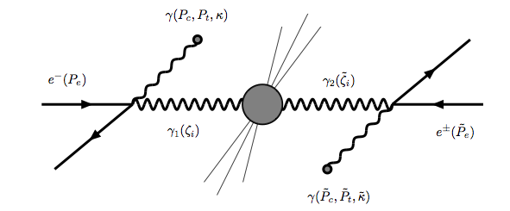

γγC Higgs-factory to Study CP Violation in Detail
Linearly polarized laser
Circularly polarized laser

Slide 26

Only with γγC
In s-channel production of Higgs:
== 0 if CP is conserved
== +1 (-1) for CP is conserved for
A CP-Even (CP-Odd) Higgs
If A₁≠0, A₂≠0 and/or |A₃| < 1, the Higgs
is a mixture of CP-Even and CP-Odd states
Possible to search for CP violation in
γγ→ H → fermions without having to measure their polarization
In bb, a ≤1% asymmetry can be measure with 100 fb⁻¹
that is, in 1/2 years
JS Lee arXiv:0705.1089v2

Slide 27
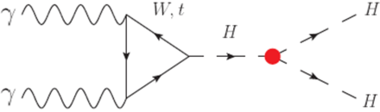
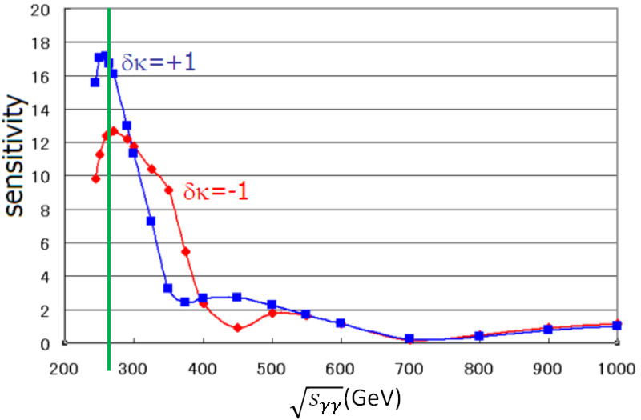
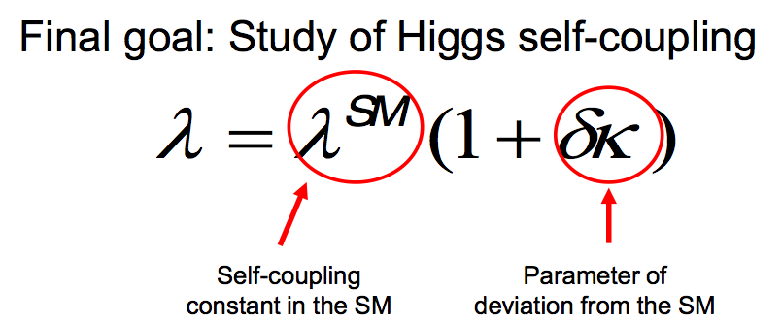
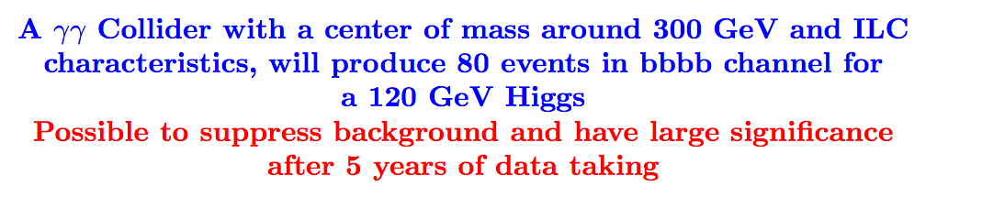
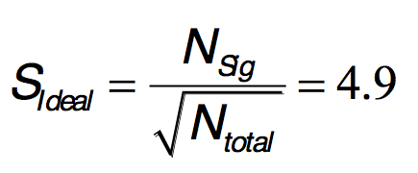
Higgs Self-Coupling

Slide 28
γγC Summary (I)
The Higgs factory γγC Physics program is
  Complementary to other programs (LHC & e-e-)
    Γ_{γγ} to 2% (Model independent)
      Results in a 13% on Γ_{Total}
      Results in a Y_{tt} of 4%
  AND nevertheless unique:
    Precise measurements of CP-admixture < 1% in Higgs
More physics topics that go well beyond Higgs
  Already mention: Running of sin² θ_{W} in e⁻e⁻ → e⁻e⁻
  Other examples:
    τ factories: including g-2
      e⁻e⁻→e⁻ e⁻ τ⁺ τ⁻, eγ → Wν → τ ν ν, γγ → τ τ γ [σ(γ γ → τ τ γ) > 100 pb]
    Exotic: e-e- → W⁻W⁻ to search for Majorana neutrino

Slide 29
γγC Summary (II)
γγC is an interesting option that is starting to look more realistic:
  Laser technology needed to generate γ – beam becoming a reality
    Notice that this involves a new scientific community that would like to be an active collaborator, like the ICAN laser group. That will increase the technology transfer capability of this machine.
  Various designs available that are:
    Cost effective (<1 Billion)
    Take advantage of exciting technology and infrastructure
Therefore, we might be able to build and operate SAPPHIRE and HFiTT like machines in parallel to the more ambitious e+e- program. Increasing the possibility of answering some our questions within our lifetime ☺

