Slide 1


CIRCULAR HIGGS FACTORIES
Alain Blondel Higgs and Beyond, Sendai June 2013

Slide 2
Why a Higgs factory?
Question 1: is the H(126) The Higgs boson
-- do we know well enough from LHC?
-- how precisely do we need to know before we are convinced?
Question 2: is there something else in sight?
-- known unknown facts need answer
neutrino masses, (Dirac, and/or Majorana, sterile and right handed, CPV, MH..)
non baryonic dark matter,
Accelerated expansion of the Universe
Matter-antimatter Asymmetry
-- can the Higgs be used as search tool for new physics that answer these questions?
-- precision measurements sensitive to the existence of new particles through loops
-- how precisely do we need to know before we are convinced?
Question 3: which Higgs factories ?
-- HL-LHC
-- (V)HE-LHC
-- mu+mu-
-- gamma-gamma
-- e+e- : linear and circular

Slide 3
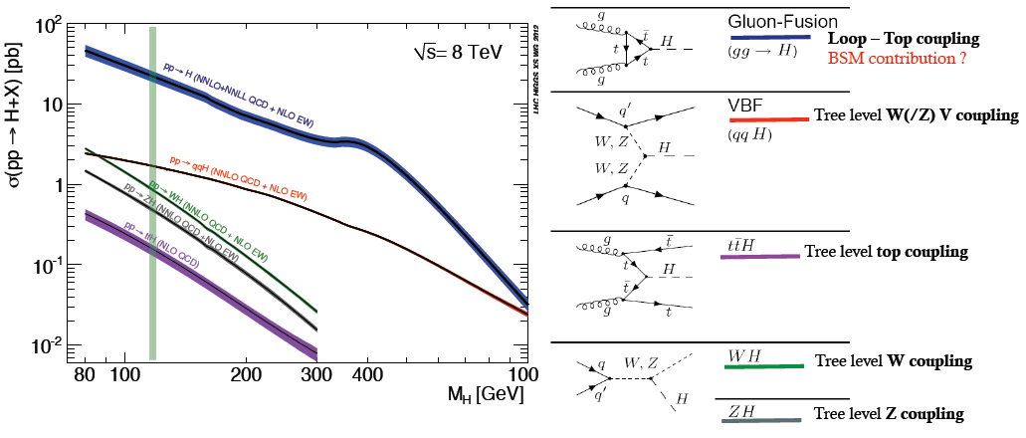
The LHC is a Higgs Factory !
1M Higgs already produced – more than most other Higgs factory projects.
15 Higgs bosons / minute – and more to come (gain factor 3 going to 13 TeV)
Difficulties: several production mechanisms to disentangle and
significant systematics in the production cross-sections σ_{prod} .
Challenge will be to reduce systematics by measuring related processes.
σ_{i→f} ^{observed} ∝ σ_{prod} (g_{Hi} )²(g_{Hf})² extract couplings to anything you can see or produce from
Γ_{H} if i=f as in WZ with H→ ZZ → absolute normalization

Slide 4
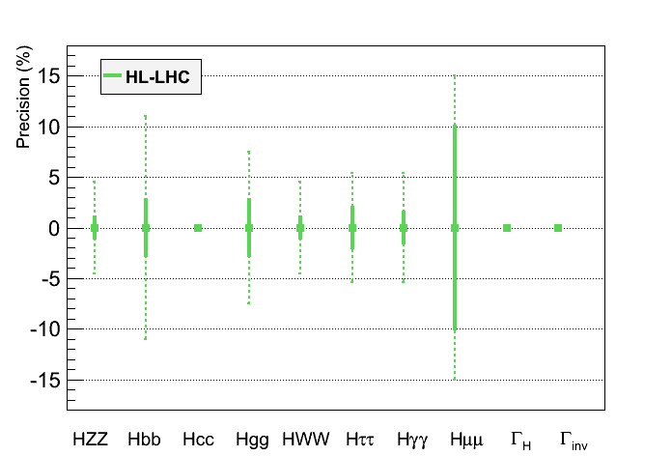
HL-LHC (≡3 ab⁻¹ at 14 TeV):
Highest-priority recommendation from European Strategy
c) The discovery of the Higgs boson is the start of a major programme of work to measure this particle’s properties with the highest possible precision for testing the validity of the Standard Model and to search for further new physics at the energy frontier.
The LHC is in a unique position to pursue this programme.
 | LHC | HL-LHC
End date | 2021 | 2030-35?
N_{H} | 1.7 x 10⁷ | 1.7 x 10⁸
Δm_{H} (MeV) | 100 | 50
Δg_{Hγγ}/g_{Hγγ} | 6.5 – 5.1% | 5.4 – 1.5%
Δg_{Hgg}/g_{Hgg} | 11 – 5.7% | 7.5 – 2.7%
Δg_{Hww}/g_{Hww} | 5.7 – 2.7% | 4.5 – 1.0%
Δg_{HZZ}/g_{HZZ} | 5.7 – 2.7% | 4.5 – 1.0%
Δg_{HHH}/g_{HHH} | -- | < 30%
Δg_{Hμμ}/g_{Hμμ} | <30% | <10%
Δg_{Hττ}/g_{Hττ} | 8.5 – 5.1% | 5.4 – 2.0%
Δg_{Hcc}/g_{Hcc} | -- | --
Δg_{Hbb}/g_{Hbb} | 15 – 6.9% | 11 – 2.7%
Δg_{Htt}/g_{Htt} | 14 – 8.7% | 8.0 – 3.9%
No measurement g_{Hcc} and Γ_{H}
Assume no exotic Scalar decays
?
?
?
In bold, theory uncertainty are assumed to be divided by a factor 2,
experimental uncertainties are assumed to scale with 1/√L,
and analysis performance are assumed to be identical as today
Coupling measurements with precision :
in the range 6-15% with LHC - 300 fb⁻¹
in the range 1-4% with HL-LHC - 3000 fb⁻¹
NB: at LEP theory errors
improved by factor 10 or more….
B. Mele

Slide 5
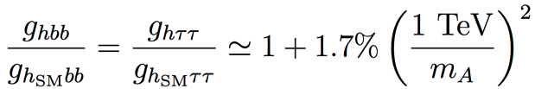
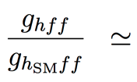
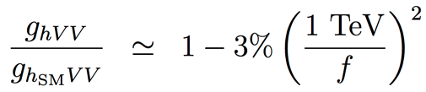
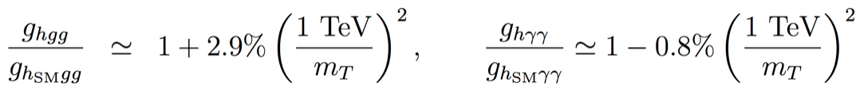
Some guidance from theorists:
New physics affects the Higgs couplings
  SUSY , for tanβ = 5
  Composite Higgs
  Top partners
  Other models may give up to 5% deviations with respect to the Standard Model
  Sensitivity to “TeV” new physics needs per-cent to sub-per-cent accuracy on couplings for 5 sigma discovery.
  LHC discovery/(or not) at 13 TeV will be crucial to understand the strategy for future collider projects
R.S. Gupta, H. Rzehak, J.D. Wells, “How well do we need to measure Higgs boson couplings?”, arXiv:1206.3560 (2012)
H. Baer et al., “Physics at the International Linear Collider”, in preparation, http://lcsim.org/papers/DBDPhysics.pdf

Slide 6
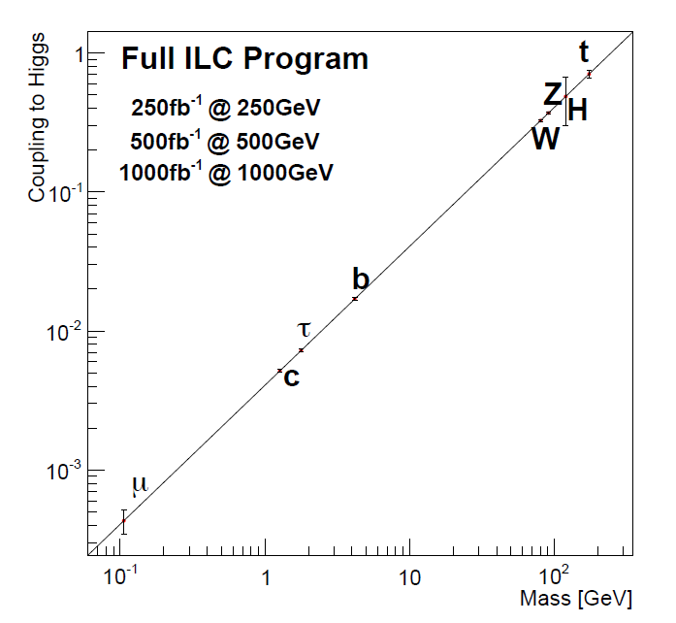
t
Full HL-LHC
H
Z
W
b
τ
μ

Slide 7
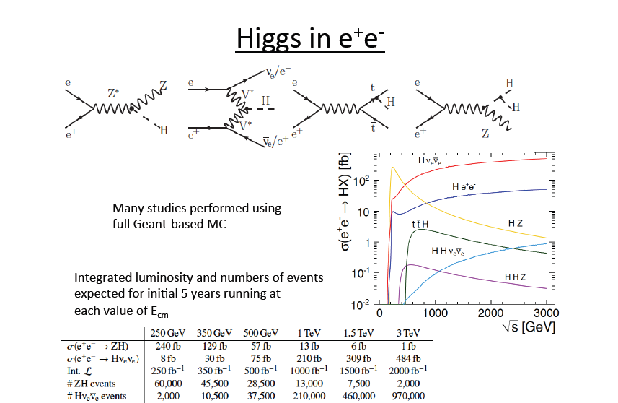
Wyatt, Cracow
ILC:

Slide 8
Circular e+e- colliders to study THE BOSON X(126)
a relatively young concept
(although there were many predecessors)

Slide 9
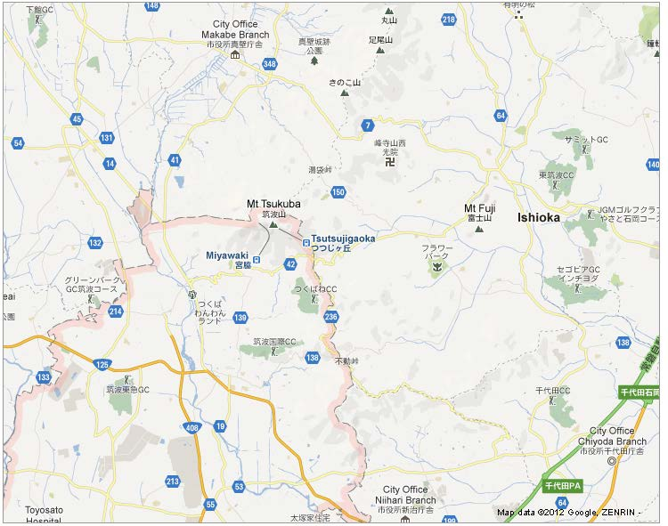
80 km ring in KEK area
12.7 km
KEK

Slide 10
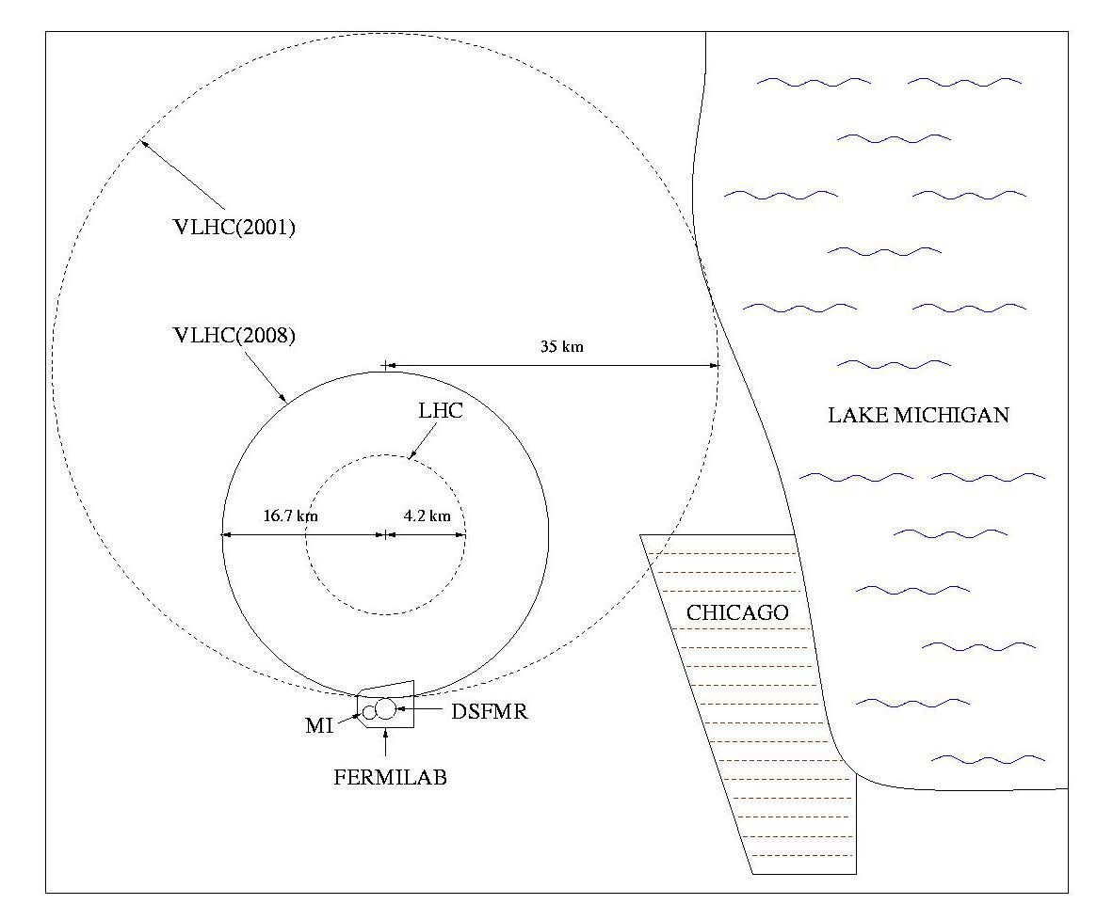
105 km tunnel near FNAL
(+ FNAL plan B
from
R. Talman)
H. Piekarz, “… and … path to the future of high energy particle physics,” JINST 4, P08007 (2009)

Slide 11
What is a (CHF + SppC)
China Higgs Factory (CHF)
Circular Higgs factory (phase I) + super pp collider (phase II) in the same tunnel
pp collider
e⁻e⁺ Higgs Factory

Slide 12
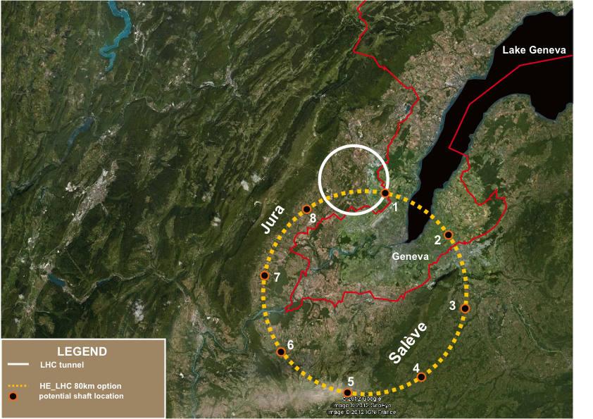
prefeasibility assessment for an 80km project at CERN
John Osborne and Caroline Waiijer ESPP contr. 165

Slide 13
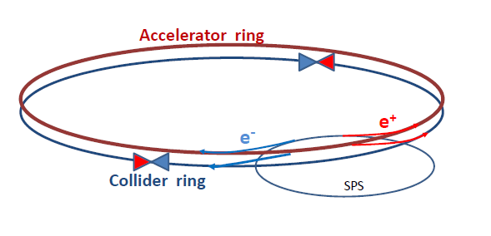
How can one increase over LEP 2 (average) luminosity by a factor 500
without exploding the power bill?
Answer is in the B-factory design: a very low vertical emittance ring with
higher intrinsic luminosity and a small value of β_{y}*
electrons and positrons have a much higher chance of interacting
➔ much shorter lifetime (few minutes)
➔ feed beam continuously with a ancillary accelerator
Storage ring has separate beam pipes for e+ and e- for multibunch operation

Slide 14
circular e⁺e⁻ Higgs factories LEP3 & TLEP
option 1: installation in the LHC tunnel “LEP3”
  + inexpensive (only pay for new accelerator -- <~2B CHF)
  + tunnel exists
  + reusing ATLAS and CMS detectors
  + reusing LHC cryoplants
  - interference with LHC and HL-LHC
option 2: in new 80-km tunnel “TLEP”
  + higher energy reach, 5-10x higher luminosity
  + decoupled from LHC/HL-LHC operation & construction
  + tunnel can later serve for VHE-LHC 100 TeV machine long term vision
  - more expensive because of tunnel

Slide 15
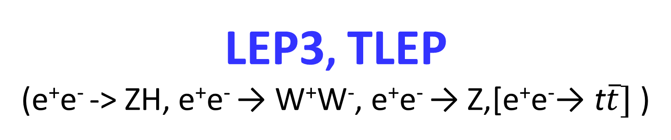
LEP3, TLEP
(e⁺e⁻ -> ZH, e⁺e⁻ → W⁺W⁻, e⁺e⁻ → Z,[e⁺e⁻→ t$\overline{t}]$ )
key parameters
 | LEP3 | TLEP
circumference | 26.7 km | 80 km
max beam energy | 120 GeV | 175 GeV
max no. of IPs | 4 | 4
Luminosity/IP at 350 GeV c.m. | - | 1.3x10³⁴ cm⁻²s⁻¹
Luminosity/IP at 240 GeV c.m. | 10³⁴ cm⁻²s⁻¹ | 4.8x10³⁴ cm⁻²s⁻¹
Luminosity/IP at 160 GeV c.m. | 5x10³⁴ cm⁻²s⁻¹ | 1.6x10³⁵ cm⁻²s⁻¹
Luminosity/IP at 90 GeV c.m. | 2x10³⁵ cm⁻²s⁻¹ | 5.6 10³⁵ cm⁻²s⁻¹
2-8 times
ILC lumi
at ZH thresh.
10-40 times
ILC lumi
at ZH thresh.
at the Z pole repeat the LEP physics programme in a few minutes…

Slide 16
Luminosity estimates, limitations … and solutions
Going to higher intensities and small bunch length leads to higher beamstrahlung
(beam particles radiate energy in the EM field of the colliding bunch)
This is well known for linear colliders where it limits the resolution and precision in center-of mass energy
Here it causes loss of beam particles which lose more than a certain momentum
acceptance and reduces the beam lifetime. (Telnov)
To keep the beams colliding 12000 times per second (in TLEP with 4 IP) for 100 seconds one needs to lose less than 10⁻⁶ particle per collision.
In a circular machine, the energy spread is increased by ~30% of a few permil and the central energy is essentially unchanged.
e⁻
e⁻
γ

Slide 17
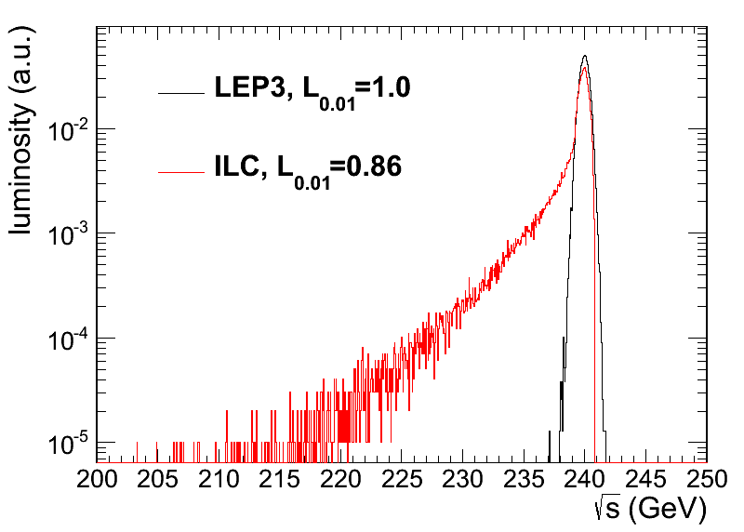
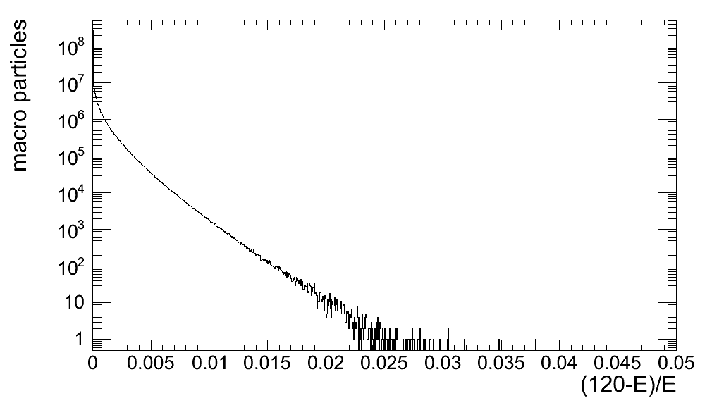
Ring HFs – beamstrahlung
simulation w 360M macroparticles (guinea-pig)
τ varies exponentially with momentum acceptance η
TLEP at 240 GeV post-collision
E tail → lifetime τ
luminosity E spectrum
τ>20 s at η=1.0%
τ>3 min at η=1.5%
τ>20 min at η=2.0%
τ>4h at η=3%
R-HF beamstrahlung more benign than for linear collider
M. Zanetti (MIT)

Slide 18
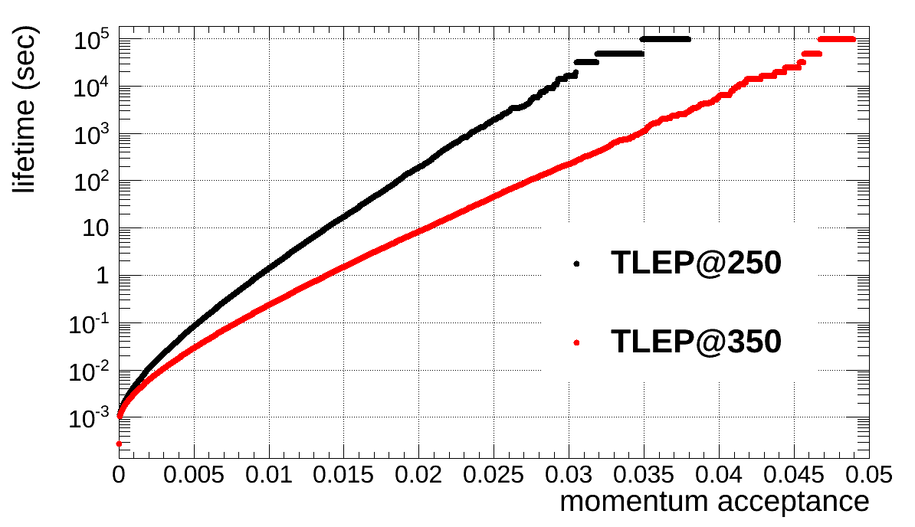
beamstrahlung lifetime
simulation w 360M macroparticles
τ varies exponentially w energy acceptance η
post-collision E tail → lifetime τ
beam lifetime versus acceptance δ_{max} for 4 IPs:
ε_{y}/ε_{x} =0.1%
ε_{y}/ε_{x} =0.4%
SuperKEKB: ε_{y}/ε_{x} <0.25%!
M. Zanetti

Slide 19
Luminosity estimates, limitations … and solutions
Just like in the LC the mitigation of beamstrahling is
to increase the horizontal beam size while keeping a constant beam area
➔ increase ratio of emittances ε_{x} / ε_{y} ➔flat beams!
parameter | LEP2 | Ring Higgs Factory @240 GeV
β_{y}* | 5cm | 1mm
RF frequency | 352MHz | ~700 MHz
Energy loss per turn | 3 GeV | 2 (TLEP) -7 (LEP3) GeV
Beam lifetime from Bhabha scattering | 6hrs | 16 min
Emittance ratio ε_{x} / ε_{y} | 200 | 200 | 400 | 800
Beamstrahlung life time | Very long | 100s | 100s | 100s
Required Momentum Acceptance | uncritical | 4% difficult | 2.7% ~OK | 1.9% good☺
← Fix this
For good performance

Slide 20
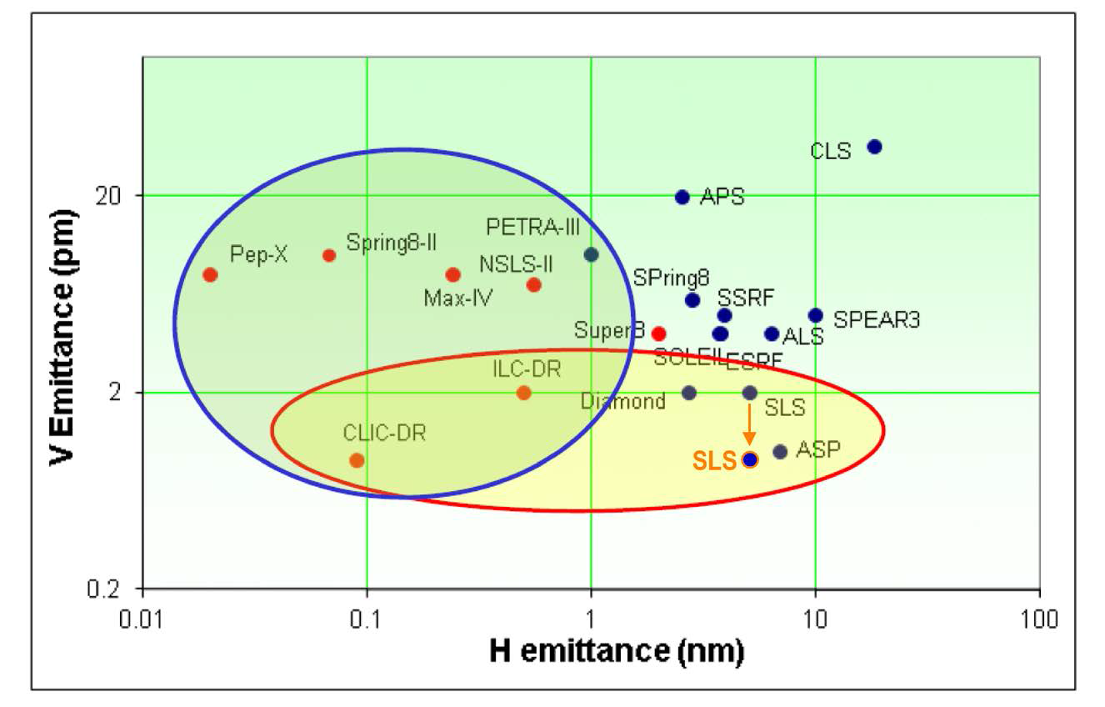
Existing (blue) and future (red) storage rings
Κ_{ε}=500
Κ_{ε}=1000
Κ_{ε}=2000
Plot from L. Rivkin, 2nd TLEP3 day

Slide 21
Conclusions on beamstrahlung and luminosity
The effect must be understood by analytical calculations (Telnov)
as well as simulations (Zanetti).
We have now a consistent set of parameters achieving 2 10³⁵/cm²/s @240 GeV
Improvement in the emittance ratio w.r.t. LEP2 desirable from about 250 up to >500 .. Set aim at 1000.
Synchrotron light sources (Diamond, SLS) routinely achieve ratio better than 1000
Topping up is key to success:
at LEP optics corrections had to be repeated at each fill.
➔ Smart orbit corrections (y and D_{y} corrections, coupling etc..) have to be included at design level
NB: Chinese colleagues are working on designing optics with larger mom. acceptance. (Wang et al., IPAC’13)

Slide 22
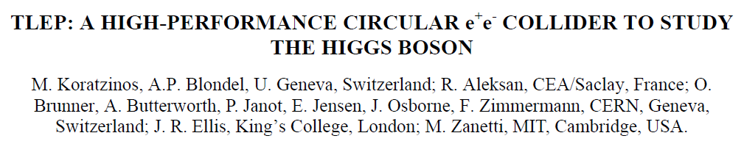
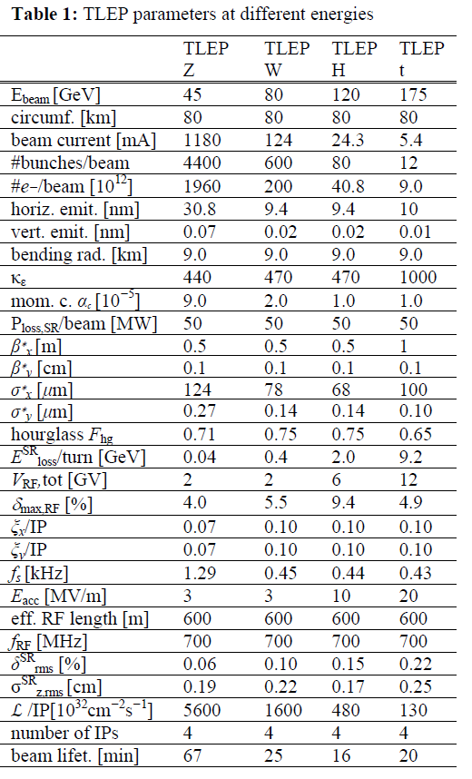
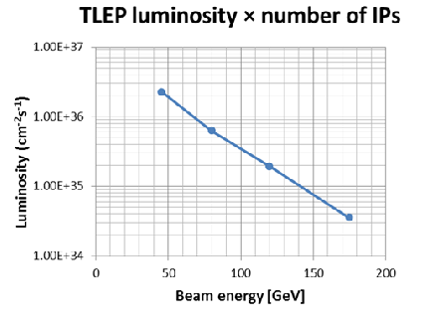
http://arxiv.org/abs/1305.6498.
Note: we consistently use 4 IPs as this is the least extrap from LEP2
It is expected that luminosity grows like sqrt(N_{IP})
So total luminosity for a machine with 2 IP should be
L (2.IP) = L (4.IP)/sqrt(2)
This will need to be verified by proper simulation.

Slide 23
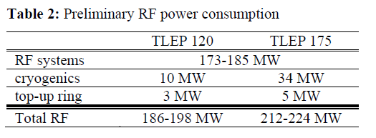
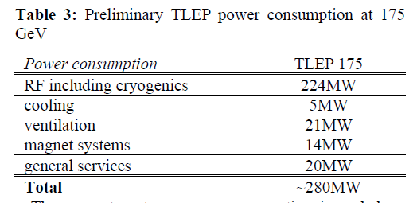
Full facility power consumption (except detectors)
Notes: 1. In a circular machine the RF is operated in standing wave (CW)
this is more efficient (55-60%) than pulsed mode
2. The RF power system is the main cost
this is independent on the size of the ring
➔ Except for the tunnel, all ring machines have similar costs!
3. total power consemption <300 MW (or other value)
is design parameter

Slide 24
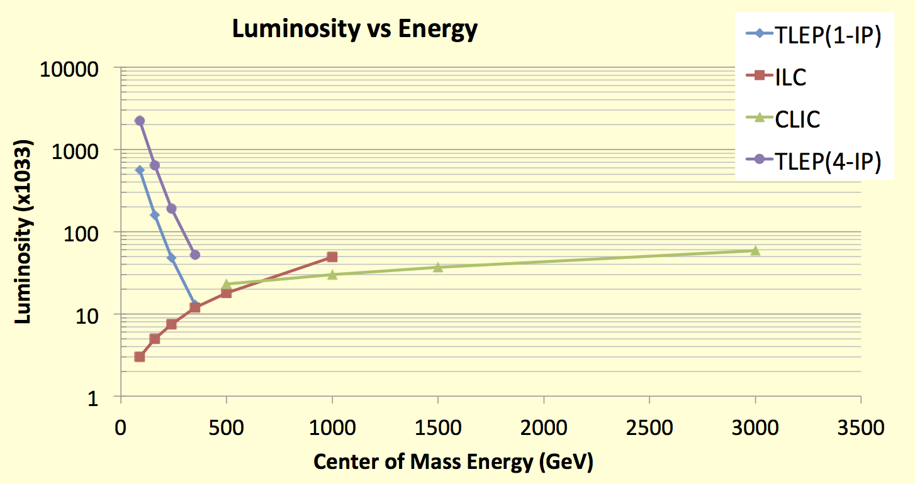
Performance of e+ e- colliders
Luminosity : Circular colliders can have several IP’s
    Lumi upgrade (×3) now envisioned at ILC : luminosity is the key at low energy!
    Crossing point between circular and linear colliders ~ 400 GeV
    With fewer IP’s expect luminosity of facility to scale approx as (N_{IP})^{0.5 – 1}
TLEP : Instantaneous lumi at each IP (for 4 IP’s)
Instantaneous lumi summed over 4 IP’s
Z, 2.10³⁶
WW, 6.10³⁵
HZ, 2.10³⁵
tt , 5.10³⁴
R. Aleksan

Slide 25
Higgs Production Mechanism in e+ e- collisions
For a light Higgs it is produced by the “higgstrahlung” process close to threshold
Production xsection has a maximum at near threshold ~200 fb
10³⁴/cm²/s ➔ 20’000 HZ events per year.
e⁻
H
Z – tagging
by missing mass
Z*
e⁺
Z
For a Higgs of 125GeV, a centre of mass energy of 240GeV is sufficient
➔ kinematical constraint near threshold for high precision in mass, width, selection purity

Slide 26
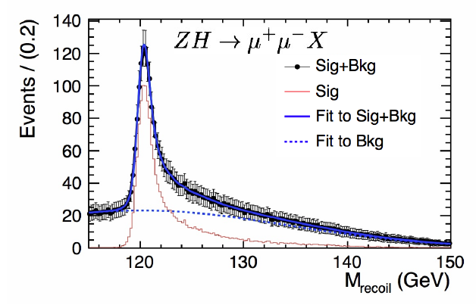
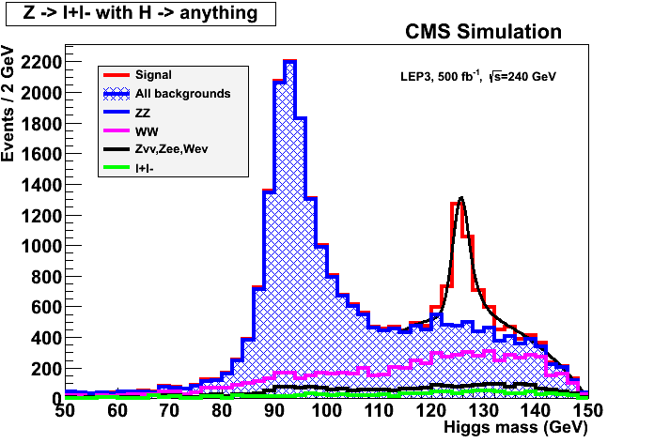
ILC
Z – tagging
by missing mass
total rate ∝ g_{HZZ}²
ZZZ final state ∝ g_{HZZ}⁴/ Γ_{H}
➔ measure total width Γ_{H}
empty recoil = invisible width
‘funny recoil’ = exotic Higgs decay
easy control below theshold
e⁻
H
Z*
e⁺
Z

Slide 27
Higgs Physics with e⁺e⁻ colliders above 350 GeV
  1. Similar precisions to the 250/350 GeV Higgs factory for W,Z,b,g,tau,charm, gamma and total width. Invisible width best done at 240-250.
  2. ttH coupling possible with similar precision as HL-LHC (4%)
  3. Higgs self coupling also very difficult… precision
  30% at 1 TeV similar to HL-LHC prelim. estimates
  10-20% at 3 TeV (CLIC)
  ➔ percent-level precision might need to wait for a 100 TeV machine
  ➔ For the study of H(126) alone, and given the existence of HL-LHC, an e+e- collider with energy above 350 GeV is not compelling w.r.t. one working in the 240 GeV – 350 geV energy range.
  ➔ The stronger motivation for a high energy e+e- collider will exist if new particle found (or inferrred) at LHC, for which e+e- collisions would bring substantial new information

Slide 28
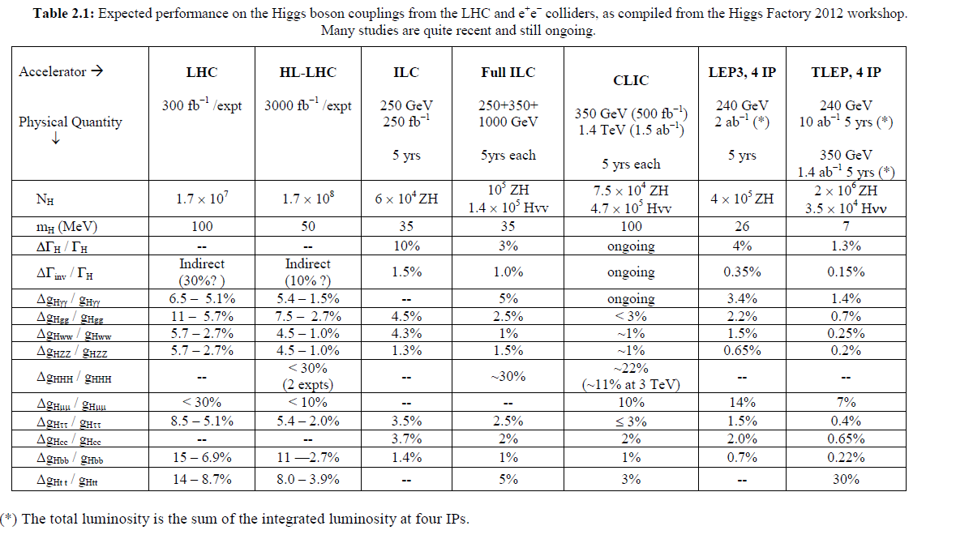
Higgs factory performances
Precision on couplings, cross sections, mass, width, Summary of the ICFA HF2012 workshop (FNAL, Nov. 2012) arxiv1302:3318
Circular Higgs Factory really goes to
precision at few permil level.

Slide 29
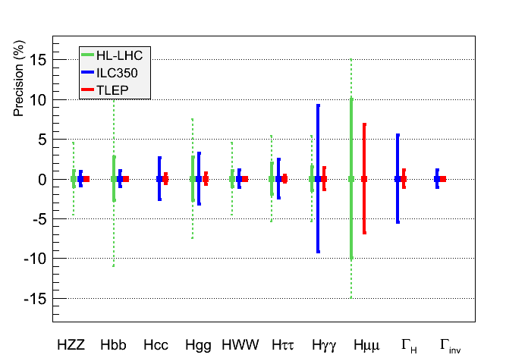
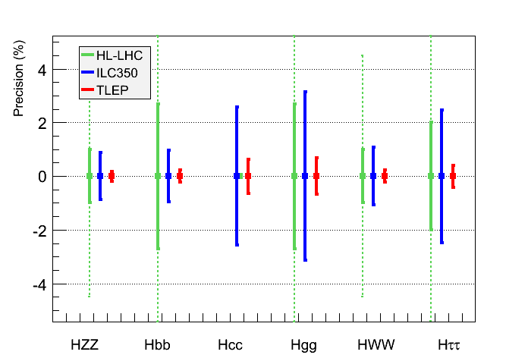
Same assumptions as for HL-LHC for a sound comparison
  Assume no exotic decay for the SM scalar
    ILC complements HL-LHC for (g_{Hcc}, Γ_{H} , Γ_{inv})
    TLEP reaches the sub-per-cent precision (>1 TeV BSM Physics)
      Progress on the theoretical side also needed
J. Ellis et al.

Slide 30
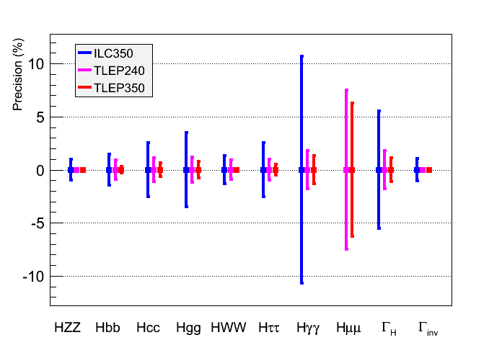
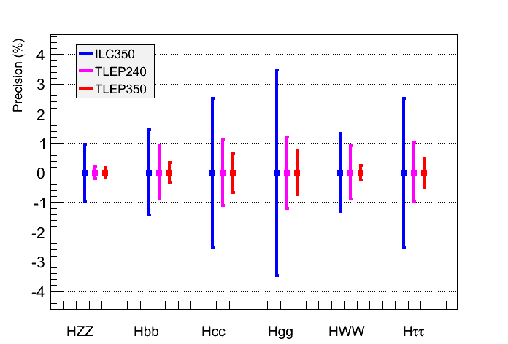
Performance Comparison
Same conclusion when Γ_{H} is a free parameter in the fit
    TLEP : sub-percent precision, adequate for BSM Physics sensitivity beyond 1 TeV
  Expected precision on the total width
μ⁺μ⁻ | ILC350 | ILC1000 | TLEP240 | TLEP350
5% | 5% | 3% | 2% | 1%

Slide 31
TERA-Z and Oku-W
Precision tests of the
closure of the Standard Model

Slide 32
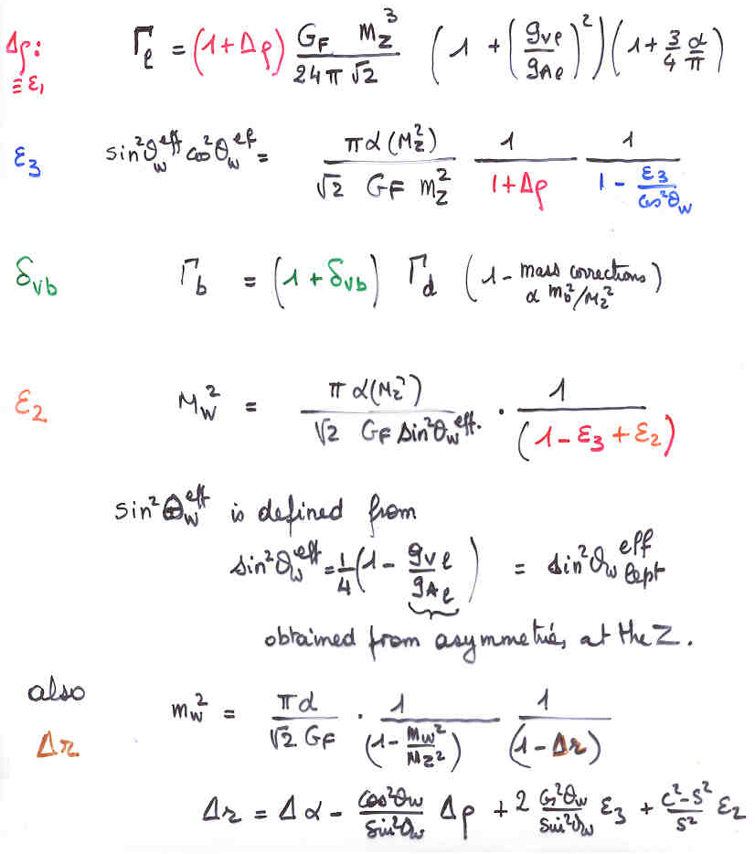
EWRCs
relations to the well measured
G_{F} m_{Z} α_{QED}
at first order:
Δρ = α /π (m_{top}/m_{Z})²
- α /4π log (m_{h}/m_{Z})²
ε₃ = cos²θ_{w} α /9π log (m_{h}/m_{Z})²
δ_{νb} =20/13 α /π (m_{top}/m_{Z})²
complete formulae at 2d order
including strong corrections
are available in fitting codes
e.g. ZFITTER , GFITTER

Slide 33
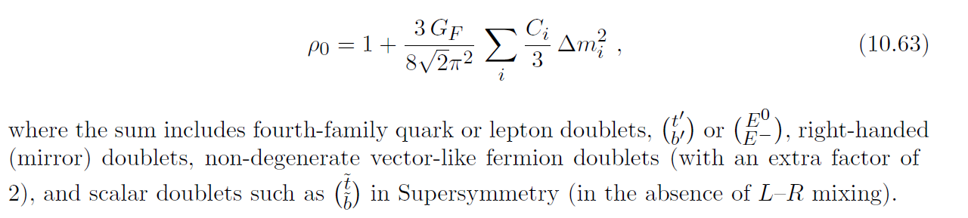
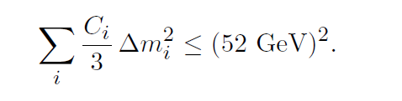
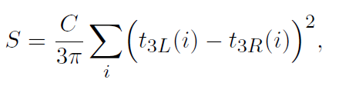
Example (from Langacker& Erler PDG 2011)
Δρ =ε₁=α(M_{Z}) . T
ε₃=4 sin²θ_{W} α(M_{Z}) . S
From the EW fit
Δρ = 0. 0004+0.0003−0.0004
-- is consistent with 0 at 1σ
-- is sensitive to non-conventional Higgs bosons (e.g. in SU(2) triplet with ‘funny v.e.v.s)
-- is sensitive to Isospin violation such as m_{t} ≠ m_{b}
Present measurement implies
Similarly:

Slide 34
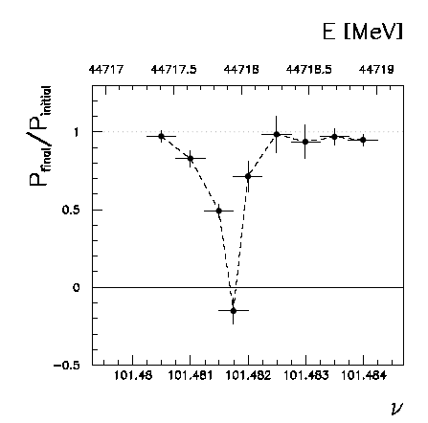
Beam polarization in Ring HF
Beam polarization is a crucial tool for precise measurement
of the beam energy by resonant depolarization (~100 keV)
At LEP transverse polarization was achieved routinely at the Z peak and was
intrumental in the 10⁻³ measurement of the Z width which led to the prediction
of the top quark mass (179+- 20 GeV) for winter conf. 1994.
Polarization in beam collisions was observed only once (40% at BBTS = 0.04)
At high energy it was destroyed by the beam energy spread above 60 GeV
At TLEP (because radius is larger) this corresponcds to availability of transverse
polarization for 80 GeV beams
We plan to use ‘single’ bunches (non-interacting) to measure the beam energy
continuously and eliminate interpolation between measurements
➔ 100 keV beam energy calibration around Z peak and W pair threshold.
Δm_{Z} ~0.1 MeV, ΔΓ_{Z} ~0.1 MeV, Δm_{W} ~ 0.5 MeV

Slide 35
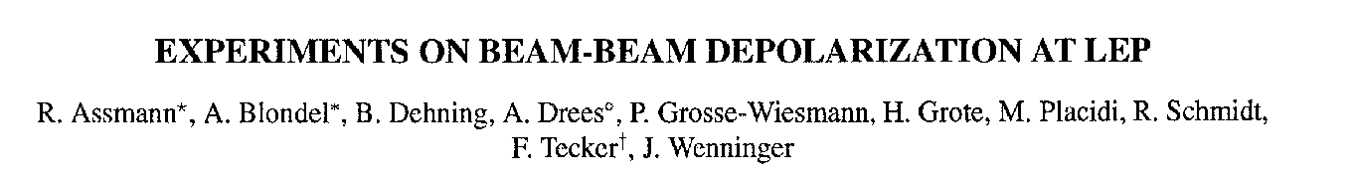
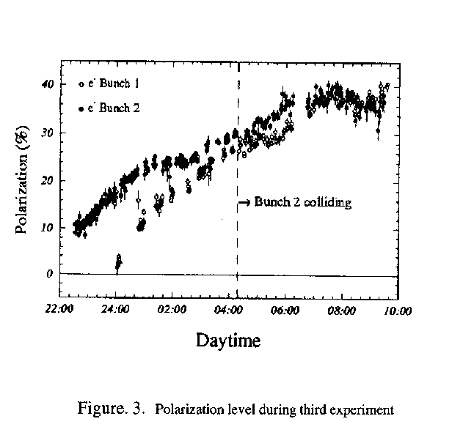
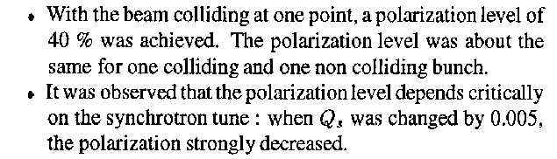
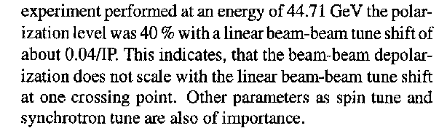
PAC 1995
This was only ever tried 3 times!
Best result: P = 40% , ξ*_{y}= 0.04 , one IP
Assuming 4 IP and ξ*_{y}= 0.01 ➔
reduce luminositiy x 10 still, 10¹¹ Z @ P=40%

Slide 36
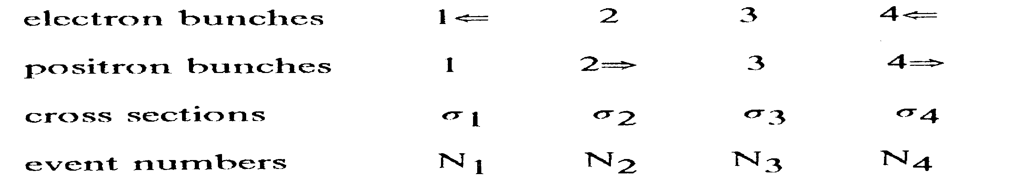
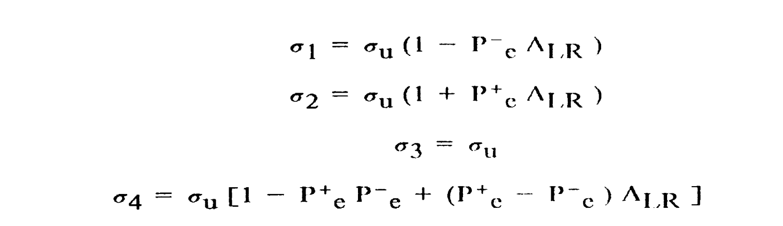
Measurement of A_{LR}
Verifies polarimeter with experimentally measured cross-section ratios
ΔA_{LR} =
statistics
ΔA_{LR} = 0.000015 with 10¹¹ Z and 40% polarization in collisions.
Δsin²θ_{W}^{eff} (stat) = O(2.10⁻⁶)

Slide 37
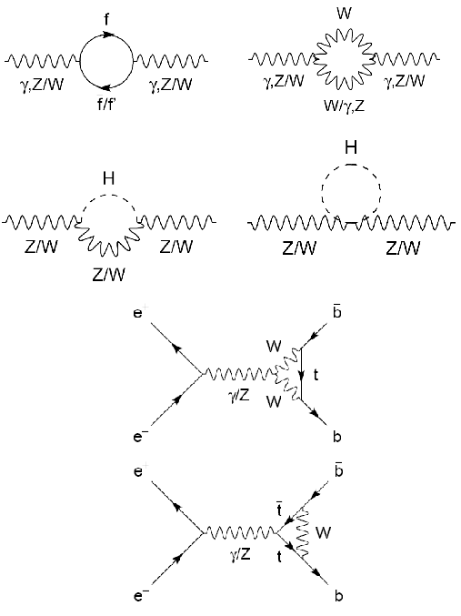
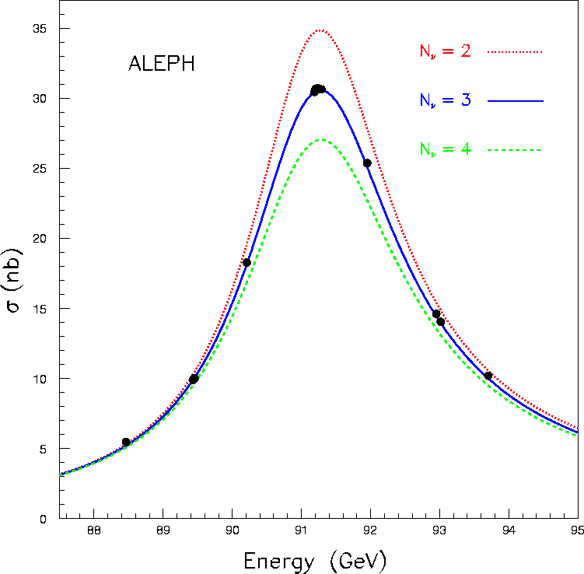
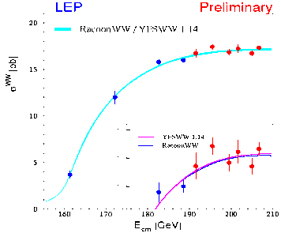
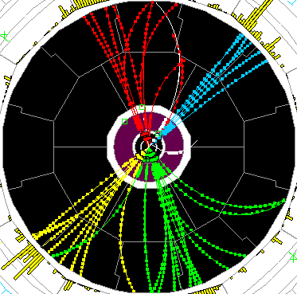
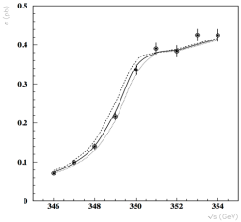
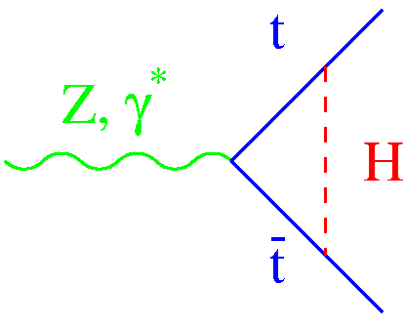
Precision tests of EWSB
 | LEP | ILC | TLEP
√s ~ m_{Z} | Mega-Z | Giga-Z | Tera-Z
#Z / year Polarization Precision vs LEP1/SLD Error on m_{Z}, Γ_{Ζ} | 2×10⁷ Yes (T) 1 2 MeV | Few 10⁹ Easy 1/5 to 1/10 – | 10¹² (>10¹¹ b,c,τ) Yes (T,L) ~1/100 < 0.1 MeV
√s ~ 2m_{W}
#W pairs / year Polarization Error on m_{W} | Few dozens No 220 MeV | 2×10⁵ Easy 7 MeV | 2.5×10⁷ Yes (T) 0.5 MeV
√s = 240 GeV |  |  | Oku-W
# W pairs / 5 years Error on m_{W} | 4×10⁴ 33 MeV | 4×10⁶ 3 MeV | 2×10⁸ 0.5 MeV
√s ~ 350 GeV |  |  | Mega-Top
# top pairs / 5 years Error on m_{top} Error on λ_{t} | – – – | 100,000 30 MeV 40% | 500,000 13 MeV 15%
Asymmetries, Lineshape
WW threshold scan
WW production
-
tt threshold scan
TLEP : Repeat the LEP1 physics programme every 15 mn
Transverse polarization up to the WW threshold
  Exquisite beam energy determination (10 keV)
Longitudinal polarization at the Z pole
        Measure sin²θ_{W} to 2.10⁻⁶ from A_{LR}
        Statistics, statistics …

Slide 38
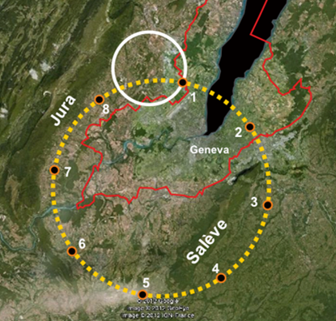
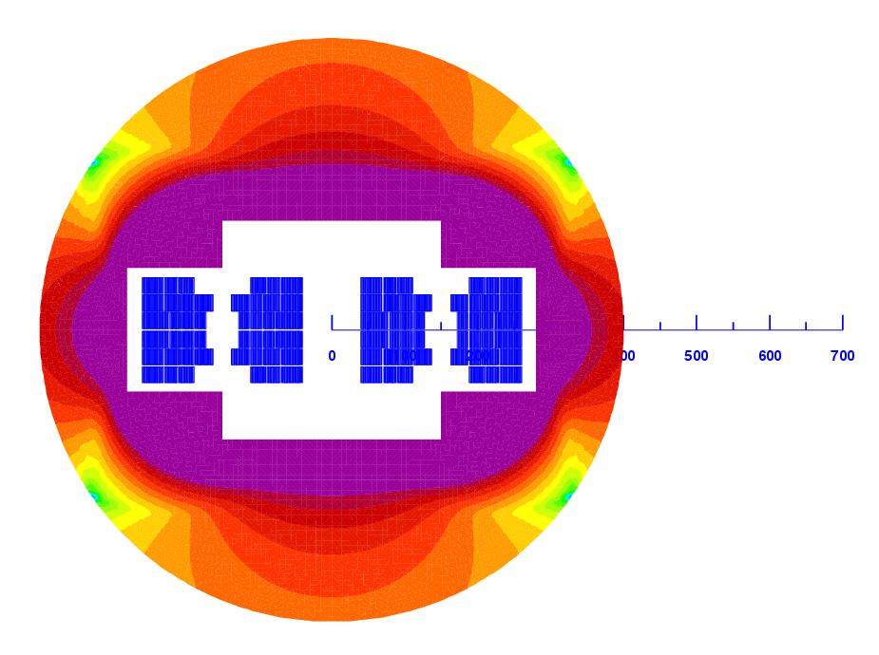
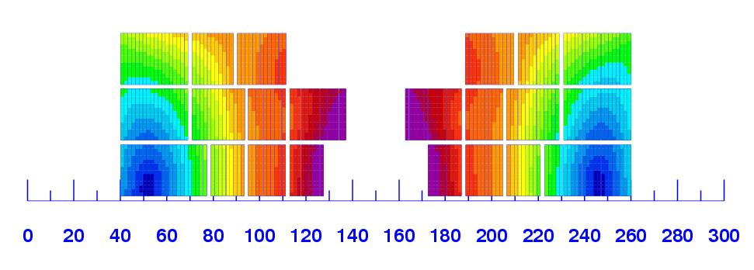
The Next-to-Next Facility
TLEP can be upgraded to VHE-LHC
  Re-use the 80 km tunnel to reach 80-100 TeV pp collisions
  Need to develop 16-20 T SC magnets
    Needs R&D and time (TLEP won’t delay VHE-LHC)
  Early conceptual design
    Using multiple SC materials
L. Rossi
20 T field!

Slide 39






The Next-to-Next Facility
Performance comparison for the SM scalar
  Measurement of the more difficult couplings : g_{Htt} (Yukawa) and g_{HHH} (self)
    In e⁺e⁻ collisions
    In pp collisions
H
H
M. Mangano
HE-LHC
VHE-LHC
H
H
H

Slide 40

The Next-to-Next Facility
Performance comparison for the SM scalar (cont’d)
  Only ttH and HHH couplings
    Other couplings benefit only marginally from high √s
    VHE-LHC : Largest New Physics reach and best potential for g_{Htt} and g_{HHH}
(NP=New Physics reach)
√s, NP
J. Wells et al.
arXiV:1305.6397
TLEP
√s, NP
HF2012
ILC500, HL-LHC ILC1TeV, HE-LHC CLIC3TeV, VHE-LHC

Slide 41
At the moment we do not know for sure what is the most sensible scenario
LHC offered 3 possible scenarios: (could not lose)
Discover that there is nothing in this energy range.
➔ This would have been a great surprise and a
great discovery!
Discover SM Higgs Boson
and that nothing else
is within reach
Most Standard scenario
great discovery!
Discover many new effects or particles
great discovery!
NO
So far we are here
But….
Keep looking
in 13/14 TeV data!
Also: understand scaling
of LHC errors with luminosity
Answer in 2018
High precision
High energy
BE PREPARED!

Slide 42
Recommendation from European Strategy (2)
High-priority large-scale scientific activities
  Second-highest priority, recommendation #2
    Excerpt from the CERN Council deliberation document (22-Mar-2013)
d) To stay at the forefront of particle physics, Europe needs to be in a position to propose an ambitious post-LHC accelerator project at CERN by the time of the next Strategy update, when physics results from the LHC running at 14 TeV will be available.
CERN should undertake design studies for accelerator projects in a global context, with emphasis on proton-proton and electron-positron high-energy frontier machines. These design studies should be coupled to a vigorous accelerator R&D programme, including high-field magnets and high-gradient accelerating structures, in collaboration with national institutes, laboratories and universities worldwide.
The two most promising lines of development towards the new high energy frontier after the LHC are proton-proton and electron-positron colliders. Focused design studies are required in both fields, together with vigorous accelerator R&D supported by adequate resources and driven by collaborations involving CERN and national institutes, universities and laboratories worldwide. The Compact Linear Collider (CLIC) is an electron-positron
machine based on a novel two-beam acceleration technique, which could, in stages, reach a centre-of-mass energy up to 3 TeV. A Conceptual Design Report for CLIC has already been prepared. Possible proton-proton machines of higher energy than the LHC include HE-LHC, roughly doubling the centre-of-mass energy in the present tunnel, and VHE-LHC, aimed at reaching up to 100 TeV in a new circular 80km tunnel. A large tunnel such as this could also host a circular e⁺e⁻ machine (TLEP) reaching energies up to 350 GeV with high luminosity.

Slide 43

Design Study is now starting !
Visit http://tlep.web.cern.ch
and suscribe for work, informations, newsletter
Global collaboration: collaborators from Europe, US, Japan, China ➔
Next events: TLEP workshops 25-26 July 2013, Fermilab
16-18 October, CERN
Joint VHE-LHC+ TLEP kick-off meeting in February 2014

Slide 44

The first 200 subscribers:
Janot
The distribution of the country of origin reflects the youth of the TLEP project and the very different levels of awareness in the different countries.
The audience is remarkably well balanced between Accelerator, Experiment, and Phenomenology -- the agreement with the three colour model is too good to be a statistical fluctuation!

Slide 45

Conveners at interim.
Zimmermann
Janot
Janot

Slide 46


tentative time line
1980
1990
2000
2010
2020
2030
2040
LHC
Design,
R&D
Proto.
Constr.
Physics
HL-LHC
Design,
R&D
Constr.
Physics
TLEP
Design,
R&D
Constr.
Physics
VHE-LHC
Design,
R&D
Constr.
Physics

Slide 47
Conclusions
Discovery of H(126) focuses studies of the next machine
  News ideas emerging for Higgs factories and beyond
    Prospects for the future look very promising
    The HL-LHC is already an impressive Higgs Factory
It is important to choose the right machine for the future
  Cannot afford to be wrong for 10 billion CHF !
  -- Must bring order of magnitude improvement wrt LHC
A large e+e- storage ring collider seems the best complement to the LHC
  Permil precision on Higgs Couplings
  Unbeatable precision on EW quantities (m_{Z} , Γ_{Z}, m_{W} , A_{LR} , R_{b} etc, etc…..)
  Most mature technology
  A first step towards a 100 TeV proton proton collider and a long term vision.
Results of the LHC run at 14 TeV will be a necessary and precious input
  Towards an ambitious medium and long term vision
  In Europe: Decision to be taken by 2018
  -- Design study recommended and being organized
  -- A circular H.F. in Japan would benefit from the great experience of KEK B factory!
The numbers speak for themselves!

Slide 48
LEP3/TLEP parameters -1
soon at SuperKEKB:
β_{x}*=0.03 m, β_{Y}*=0.03 cm
 | LEP2 | LHeC | LEP3 | TLEP-Z | TLEP-H | TLEP-t
beam energy Eb [GeV] circumference [km] beam current [mA] #bunches/beam #e−/beam [10¹²] horizontal emittance [nm] vertical emittance [nm] bending radius [km] partition number J_{ε} momentum comp. α_{c} [10⁻⁵] SR power/beam [MW] β∗_{x} [m] β∗_{y} [cm] σ∗_{x} [μm] σ∗_{y} [μm] hourglass F_{hg} ΔE^{SR}_{loss}/turn [GeV] | 104.5 26.7 4 4 2.3 48 0.25 3.1 1.1 18.5 11 1.5 5 270 3.5 0.98 3.41 | 60 26.7 100 2808 56 5 2.5 2.6 1.5 8.1 44 0.18 10 30 16 0.99 0.44 | 120 26.7 7.2 4 4.0 25 0.10 2.6 1.5 8.1 50 0.2 0.1 71 0.32 0.59 6.99 | 45.5 80 1180 2625 2000 30.8 0.15 9.0 1.0 9.0 50 0.2 0.1 78 0.39 0.71 0.04 | 120 80 24.3 80 40.5 9.4 0.05 9.0 1.0 1.0 50 0.2 0.1 43 0.22 0.75 2.1 | 175 80 5.4 12 9.0 20 0.1 9.0 1.0 1.0 50 0.2 0.1 63 0.32 0.65 9.3
SuperKEKB:ε_{y}/ε_{x}=0.25%
even with 1/5 SR power (10 MW) still > L_{ILC}!

Slide 49
LEP3/TLEP parameters -2
LEP2 was not beam-beam limited
 | LEP2 | LHeC | LEP3 | TLEP-Z | TLEP-H | TLEP-t
V_{RF,tot} [GV] δ_{max,RF} [%] ξ_{x}/IP ξ_{y}/IP f_{s} [kHz] E_{acc} [MV/m] eff. RF length [m] f_{RF} [MHz] δ^{SR}_{rms} [%] σ^{SR}_{z,rms} [cm] L/IP[10³²cm⁻²s⁻¹] number of IPs Rad.Bhabha b.lifetime [min] ϒ_{BS} [10⁻⁴] n_{γ}/collision Δδ^{BS}/collision [MeV] Δδ^{BS}_{rms}/collision [MeV] | 3.64 0.77 0.025 0.065 1.6 7.5 485 352 0.22 1.61 1.25 4 360 0.2 0.08 0.1 0.3 | 0.5 0.66 N/A N/A 0.65 11.9 42 721 0.12 0.69 N/A 1 N/A 0.05 0.16 0.02 0.07 | 12.0 5.7 0.09 0.08 2.19 20 600 700 0.23 0.31 94 2 18 9 0.60 31 44 | 2.0 4.0 0.12 0.12 1.29 20 100 700 0.06 0.19 10335 2 37 4 0.41 3.6 6.2 | 6.0 9.4 0.10 0.10 0.44 20 300 700 0.15 0.17 490 2 16 15 0.50 42 65 | 12.0 4.9 0.05 0.05 0.43 20 600 700 0.22 0.25 65 2 27 15 0.51 61 95
LEP data for 94.5 - 101 GeV consistently suggest a beam-beam limit of ~0.115 (R.Assmann, K. C.)

Slide 50
beam-beam effect (single collision)
 | TLEP-H | TLEP-t | ILC (250) | ILC (350)
beam energy [GeV] | 120 | 175 | 125 | 175
disruption D_{y} | 2.2 | 1.5 | 23.4 | 84.5
ϒ_{BS} [10⁻⁴] | 15 | 15 | 207 | 310
n_{γ}/collision | 0.50 | 0.51 | 1.17 | 1.24
Δδ^{BS}/collision [MeV] | 42 | 61 | 1265 | 2670
Δδ^{BS}_{rms}/collision [MeV] | 65 | 95 | 1338 | 2760
TLEP: negligible beamstrahlung apart for effect on beam lifetime

Slide 51

LEP = 16 Million hadronic Z decays, 1.7 Million leptonic decays,
10³¹ /cm²/s → 0.3 Z events per second + 4 times that rate in Bhabhas = 1.5 events per second.
10³⁶ /cm²/s → 30’000 events per second 30KHz …. 120 KHz with the Bhabhas 10⁷ seconds → 3 10¹¹ Z decays. TeraZ
CHALLENGE I design of detector and DAQ system to keep high
precision in cross-section measurement
Small angle e+e- is necessary for luminosity determination as large angle e+e- is dominated by
Z decays themselves

Slide 52


