Slide 1
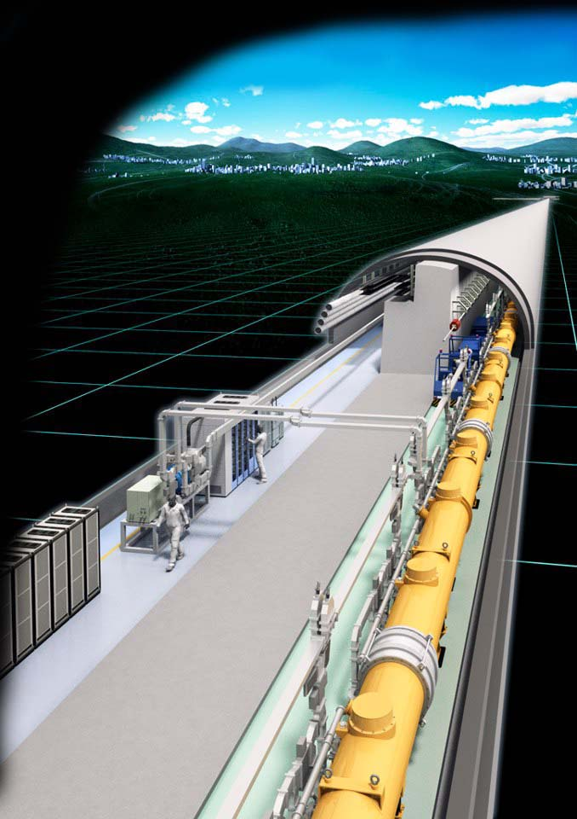
The ILC Project
Hitoshi Yamamoto
Tohoku University
Higgs and Beyond
June 8, 2013, Tohoku University

Slide 2
Four reasons for the recent progress of the ILC situation：
The discovery of the Higgs-like particle
Completion of the ILC TDR
Expressions of international supports
Announcement of the Japanese government that it will call for negotiations with other countries

Slide 3
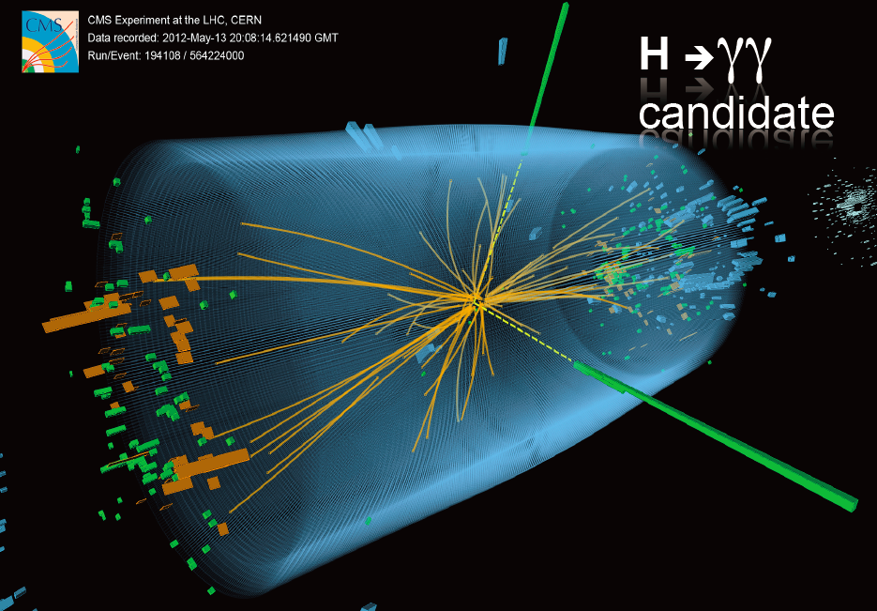
Discovery of Higgs-like particle
▸ The fine-tuning problem of the SM became real. (unless ‘multiverse’)
▸ The problem of missing dark matter in the SM became accute
▸ : Compelling reasons for the next step.
A new era of particle physics has begun!
The ILC is designed to lead the new era.

Slide 4
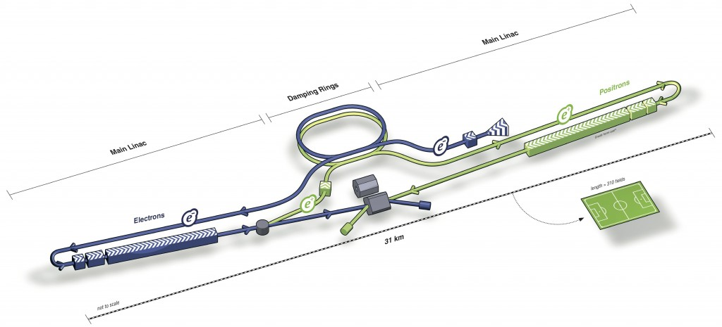
ILC (International Linear Collider)
Main linac
Damping ring
Positron beam
Main linac
31 km
electron
500 GeV CM with 31 km → upgrade later to ~ 1TeV CM with 50 km
Beam size at IP : 6 nm x 500 nm x 300 μm
Luminosity ~ 2 x 10³⁴ /cm²s

Slide 5
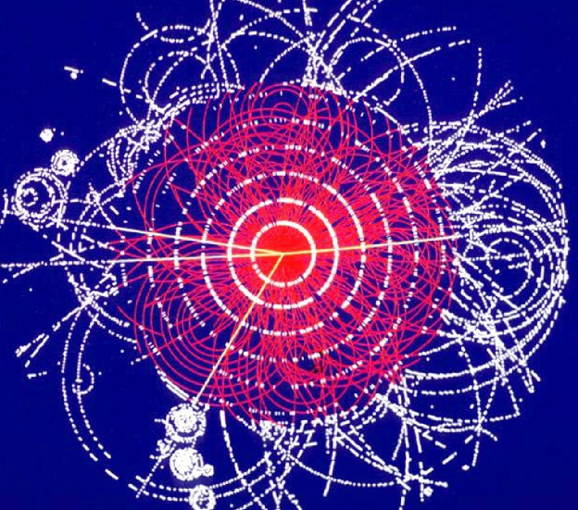
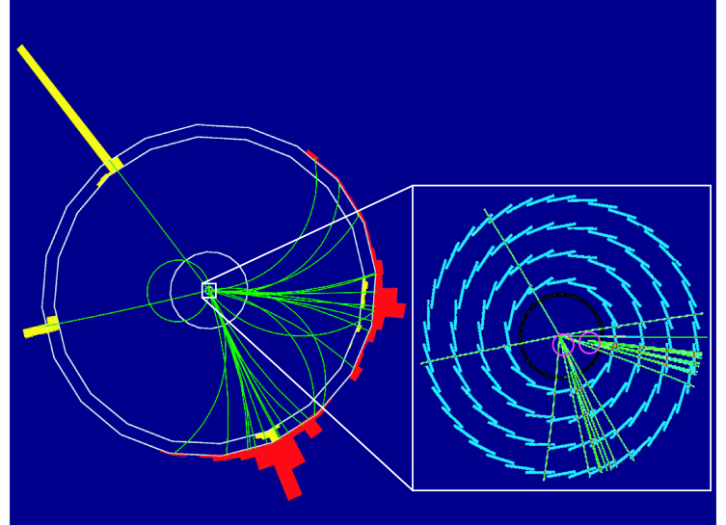
ILC features : cleanliness
Collision of two elementary particles
  proton + proton at LHC
    Proton = 3 quarks + gluons
  electron + positron at ILC
  → Signal is clearly seen without much noises
quark
LHC
gluon
proton
proton
  → Trigger-less data taking
ILC
  → Theoretically clean
  (less theoretical uncertainties)
electron
positron
LHC
LC
All from Higgs

Slide 6
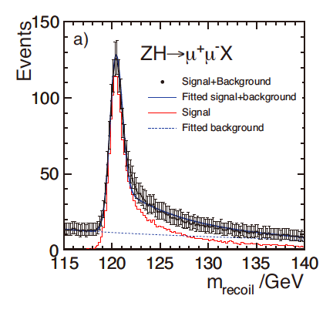
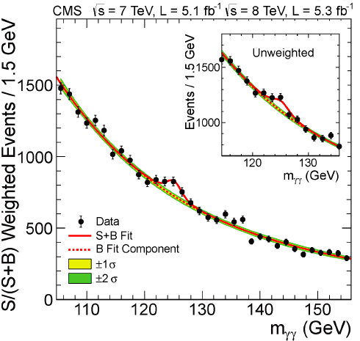
ILC features : control
Initial state of electron-positron interaction :
  Energy-momentum 4-vector is specified
  Electron polarization (90%) is specified
    Positron polarization (60%) is optional (30% comes for free)
Energy-momentum 4-vector
→ e.g. recoil mass analysis
Higgs to ALL (including invisible final state) is seen
ILC
LHC

Slide 7
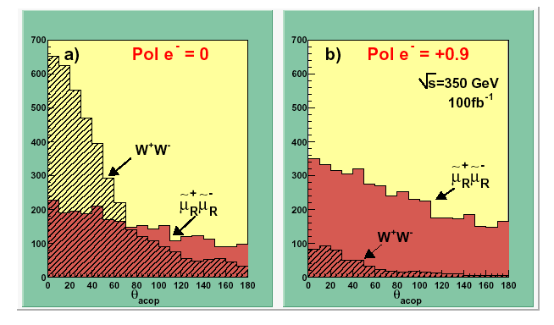
Electron polarization
Specify the intermediate state
  Right-handed e- turns off A⁰
    Information on the character of the final state
Right-handed e- turns off W
    Background rejection
e⁺
γ,Z
(B,A⁰)
e⁻
e⁺
W⁺
e⁻
W⁻
e.g. acoplanar muon pair produciton
such as smuon pair production

Slide 8
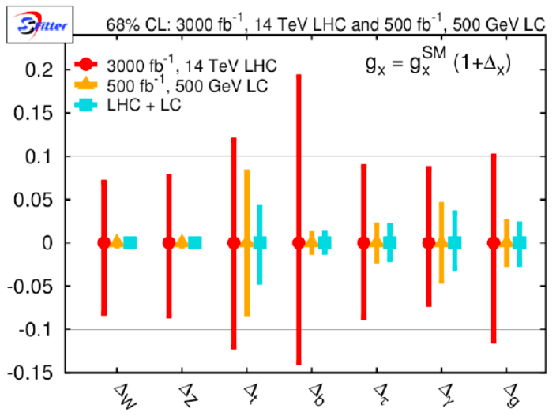
Measurement errors of Higgs couplings
LHC 14 TeV 3000 fb-1 and LC 500 GeV 500 fb-1
D. Zerwas
Apart from top and γ, ILC errors are 1/4~1/10 of LHC
(statistical equivalent: 1~2 orders of magnitude more- at about the same cost )
• LHC may improve systematics
• ILC may improve analysis methods
Great prospect for HEP : ILC and LHC running in parallel!

Slide 9
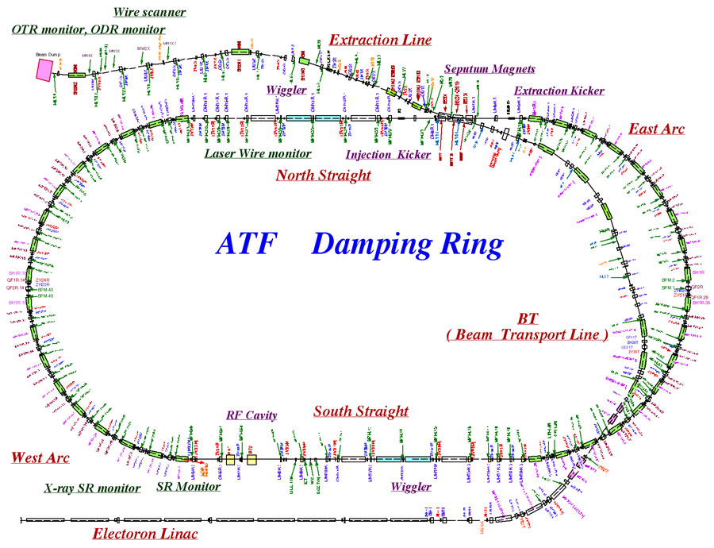
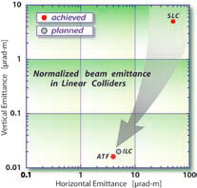
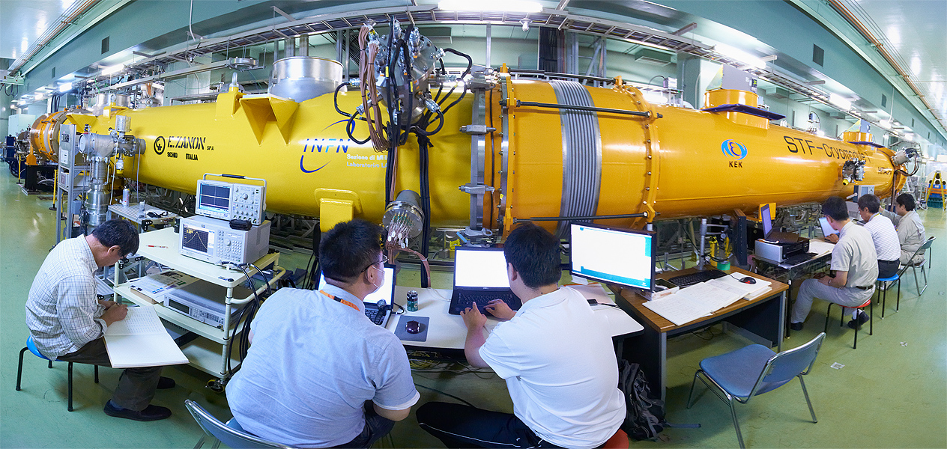
ILC Accelerator
Ultra-small beam
  Low emittance : KEK ATF (Accelerator Test Facility)
    Achieved the ILC goal.
  Small vertical beam size : KEK ATF2
    Goal = 37 nm, 70 nm achieved
      Limit is in measurement. No basic problem seen.
  Stabilize the beam at nm scale: KEK ATF2
    Feedback system successful (FONT)
Main acceleration
  Accelerating cavity
    Spec: 31.5 MV/m ±(<20%)
    >80% yield achieved (90% goal)
  Cryomodule assembly
    Combine cavities from all over the world
      KEK S1-global successful
ILC technology is now ready

Slide 10
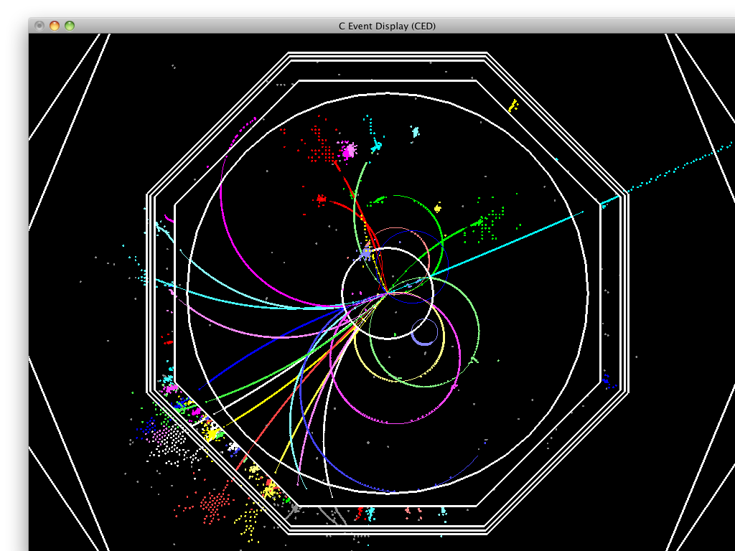
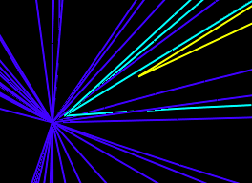
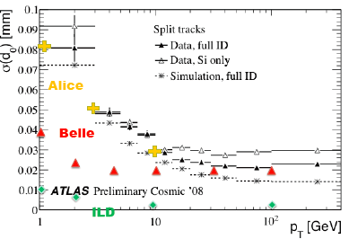
ILC Detector
Concept of SiD, ILD : Particle Flow (PFA)
  × 2 better jet energy resolution than LHC
  Quark (b/c) flavor identification by vertexing
→ Requires high granularity (wrt LHC)
ILC：detect track
of each particle
Vertexing (e.g. fine-pixel CCD)
  Pixel area 1/1000
  Material 1/30
  Vertex resolution 1/20
Main tracker (e.g. TPC)
  Material 1/6
  Momentum resolution 1/10
Calorimeter (Si-W and Schint+MPPC-W/Fe)
  Cell area 1/200
Vertexes
Vertex resolution
1 mm
Detector elements R&Ds:
Principles proven
Now R&D is in systematization

Slide 11
ILC Organization (old)
Until June 2013
ILCSC
Chair: Jonathan Bagger
GDE
Director: Barry Barish
RD
Director: Sakue Yamada
Accelerator
Physics/Detector
GDE : Global Design Effort
RD : Research Directorate
Mandate : TDR (Technical Design Report)
(DBD for the detectors)

Slide 12
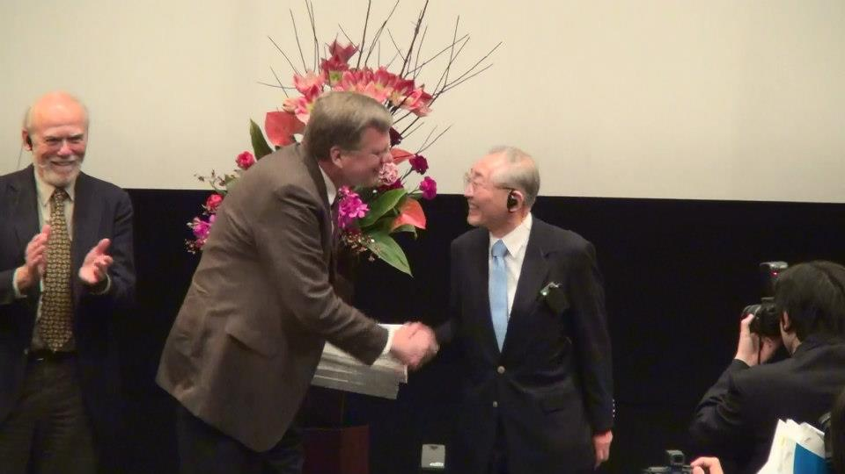
ILC TDR Draft Completion Ceremony
Dec. 15, 2012
Tokyo
The TDR draft was handed from Barry Barish (GDE)
and Sakue Yamada (RD) to Jonathan Bagger (ILCSC).
ILC is now technically ready.

Slide 13
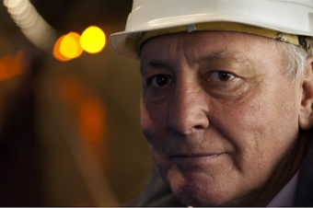
New International Organization (ILC+CLIC)
LC Board
Chair : Sachio Komamiya
LCC (LC Collaboration)
Deputy Director
Hitoshi Murayama
LC Collaboration Director
Lyn Evans
Lyn Evans
ILC accelerator
Mike Harrison
CLIC accelerator
Steinar Stapnes
ILC/CLIC Phys./Det.
Hitoshi Yamamoto
To be officially started on Feb. 21, 2013 in Vancouver.
Primary Goal: ‘Realize the ILC’- Lyn Evans
2013 Feb~Jun : transition period

Slide 14
TDR/DBD
TDR
Now ‘really’ complete.
  Vol1 Executive Summary
  Vol2 Physics
  Vol3 Accelerator Part 1 & 2
  Vol4 Detectors (DBD)
  Outreach document
Sent to the printer
Not ready for E-distribution yet
  Ready soon!
Official devut
  June 12 ‘ILC a worldwide event – from design to reality’
  The Asian part : at Tokyo U.
outreach

Slide 15

‘ILC TDR June Event’
On June 12, 2013, Ceremony is
relayed from Asia to Europe to
Americas.
Asia: Tokyo University
Europe: CERN
Americas: Fermilab
The event will mark
Completion of the ILC TDR
Full start of the management
by the LCC
http://www.linearcollider.org/events/2013/
ilc-tdr-world-wide-event

Slide 16
Times line
(The possible best scenario)
End 2013
  Japanese government announces its intention to host the ILC. It will start negotiation with other government.
2013-2015
  Negotiations among governments
  Finish R&Ds. Prepare for the international lab.
2015-2016
  BIdding for construction, start construction
2026-2027
  Start operation

Slide 17
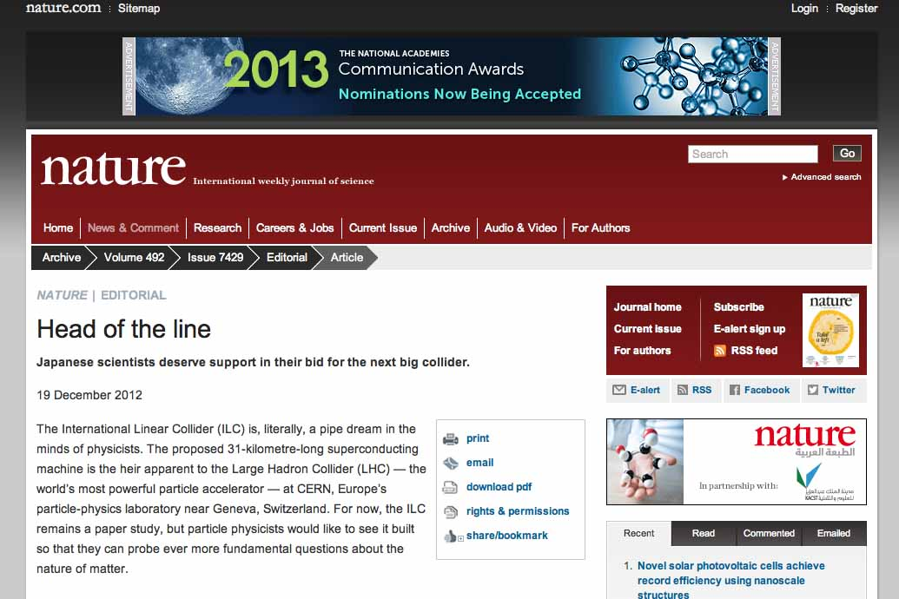
Nature Editorial
2012 Dec. 19

Slide 18
NATURE Editorial (Dec 20, 2012)
http://www.nature.com/news/head-of-the-line-1.12064
Statements of support from overseas will not guarantee that the ILC will go ahead. Japan’s opaque government will still have to debate the programme’s merits internally and come up with a process for committing to its construction. But an early show of support could give the collider the push it needs to get under way. That would be a great victory for Japan, and the world.

Slide 19
European Strategy
- March 22, 2013 -
There is a strong scientific case for an electron-positron collider, complementary to the LHC, that can study the properties of the Higgs boson and other particles with unprecedented precision and whose energy can be upgraded. The Technical Design Report of the International Linear Collider(ILC) has been completed, with large European participation. The initiative from the Japanese particle physics community to host the ILC in Japan is most welcome, and European groups are eager to participate. Europe looks forward to a proposal from Japan to discuss a possible participation.

Slide 20
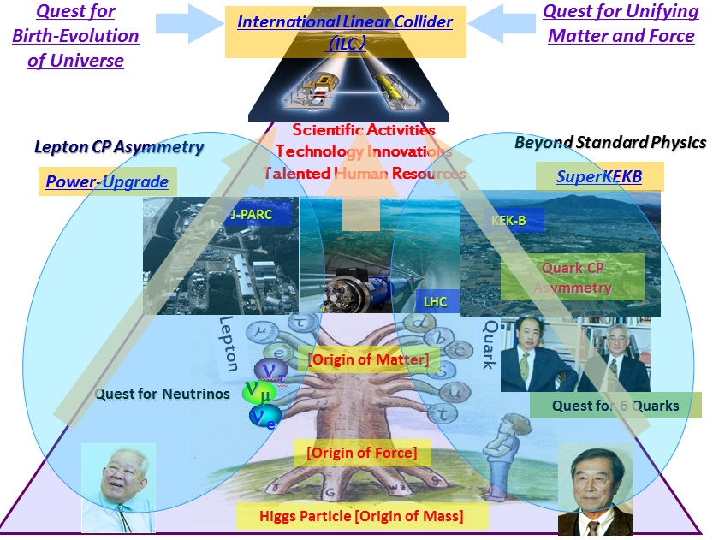
KEK Roadmap 2007
2007
A 5-year plan formed through town hall meetings in 2007
  ILC at the top of the pyramid
Recently went through an update
  just released

Slide 21
KEK roadmap 2013
On the ILC
KEK will play a central role in creating an international preparatory group and will lead the effort on advanced R&D, the engineering design of the apparatus and facility, and the organizational design toward groundbreaking for the linear collider project to be hosted in Japan, within the framework of a global collaboration.

Slide 22
JAHEP (Japan Association of High Energy Physicists)
A report on large projects (March 2012)
  After 2 years of intensive meetings listening to a large amount of talks and opinions
  ILC and neutrino experiment at highest priority.
  On ILC:
  Should a new particle such as a Higgs boson with a mass below approximately 1~TeV be confirmed at LHC, Japan should take the leadership role in an early realization of an e+e- linear collider. In particular, if the particle is light, experiments at low collision energy should be started at the earliest possible time.
  (Now, Higgs particle has been found and it is ‘light’)

Slide 23
JAHEP
A proposal for staging of ILC (October 2012)
  Staging
    A Higgs factory with a CM energy of ~250 GeV to start
    Upgraded in stages to ~500 GeV (RDR baseline)
    Technical expandability to ~1 TeV to be secured
  Guideline for cost sharing
    The host country to cover 50% of the expenses (construction) of the overall project of the 500 GeV machine.
    The actual contribution, however, should be left to negotiations among the governments.
This is now an official proposal of the Japanese HEP community.

Slide 24

LDP (Liberal Democratic Party) Victory
in the lower-house election in Oct, 2012
Our new prime minister
Shinzo Abe
The ILC appears twice explicitly in the policy document:
  Science and technology policies
  Creation of top-class research centers
LDP policy document
for the election

Slide 25
LDP (Liberal Democratic Party) : New Ruling Party
Election ‘promises’
32 Rebuilding true command tower functions that strongly advance science and technology policies
  …We will actively promote the critical fields of energy creation, energy conservation, energy storage, etc. as knowledge-concentrated national strategies - for example, our country should be able to play a leading role in creation of international centers for scientific innovations such as the ILC (the international linear collider) project which is a grand project in the field of particle physics.
92 Creation of globally top-class centers for research and development
  …We will significantly strengthen supports for universities and public research facilities that perform studies at levels above the intentional standards, such as significant expansion of WPIs and playing a leading role in creation of international centers for scientific innovations such as the ILC (the international linear collider construction) project which is a grand project in the field of particle physics.

Slide 26
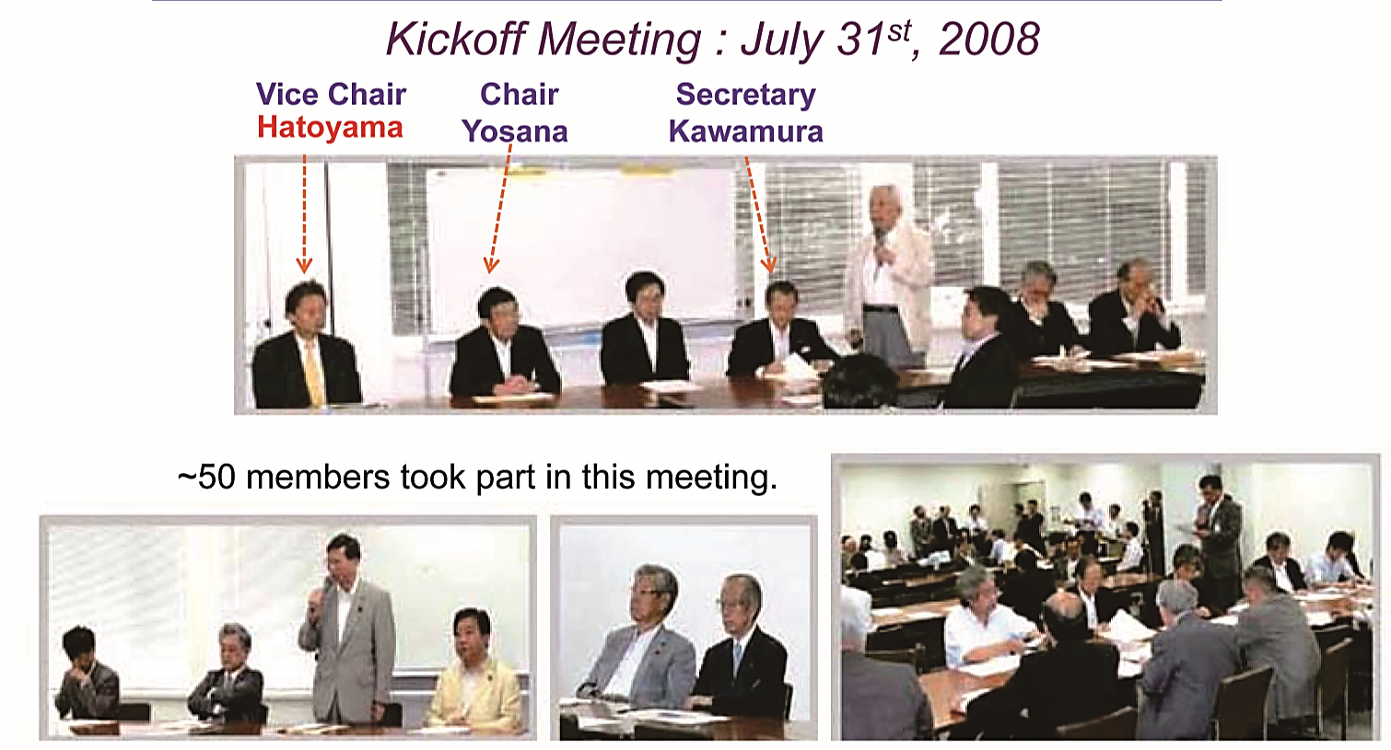
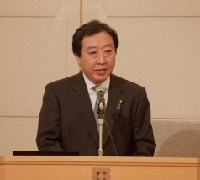
Political Parties
‘Federation of diet members for promotion of the ILC’
  Established in 2008
  Expanded to a multi-partizan group
  Previous PM Noda made a positive remark on ILC in one of the symposiums co-hosted by the federation.
  Re-invigorated after the Higgs discovery: now ~150 members!
  New chair: Mr. Kawamura (former MEXT minister)

Slide 27
Report by the Association of Corporate Executives (経済同友会）
‘… The Japanese government should announce the intention
to site the ILC in Japan, and propose to related countries to begin
discussions toward its realization. ‘
‘… On down-selecting the Japanese candidate sites to one, it is
important to proceed with a fair selection process in order to build
an All-Japan framework. The selection process should be based on
the results of the geological and technical studies being conducted by
experts, and should be decided fairly.’

Slide 28
Activities of the new Federation (Diet)
General meetings
  Feb 1. 2013 : re-establishing the federation
    Huge attendance:
    45 diet members and 25 proxies + researchers/companies
  Feb 26, 2013 : re-organization
  March 25, 2013 : invite Lyn Evans (LC collaboration director).
  Apr : two general meetings held
Mini-lecture series
    eg: March 13, by Sakue Yamada etc.
Visit Washington DC
  Co-host US-Japan symposium, Apr 30-May 1, 2013
  goal : enlarge US-Japan collaboration on the ILC

Slide 29
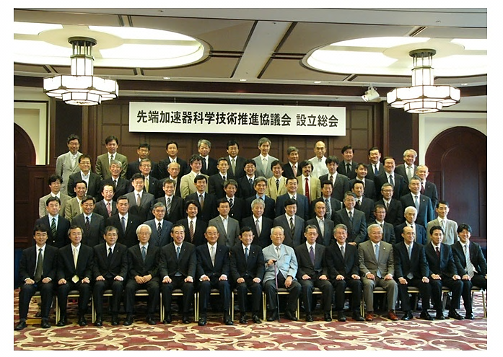
Science-Industry Alliance
‘Advanced Accelerator Association for promoting science and technology (AAA)’
  Established in 2008
  Headed by a former CEO of Mitsubishi Heavy Industries: Mr. Nishioka
  Hitachi, Toshiba, Mitsubishi, etc.
  ~90 industries + ~30 universities
Intensive activities:
Lecture series, symposiums
Civil engineering study
Studies on large projects
Science-industry cooperation
…

Slide 30
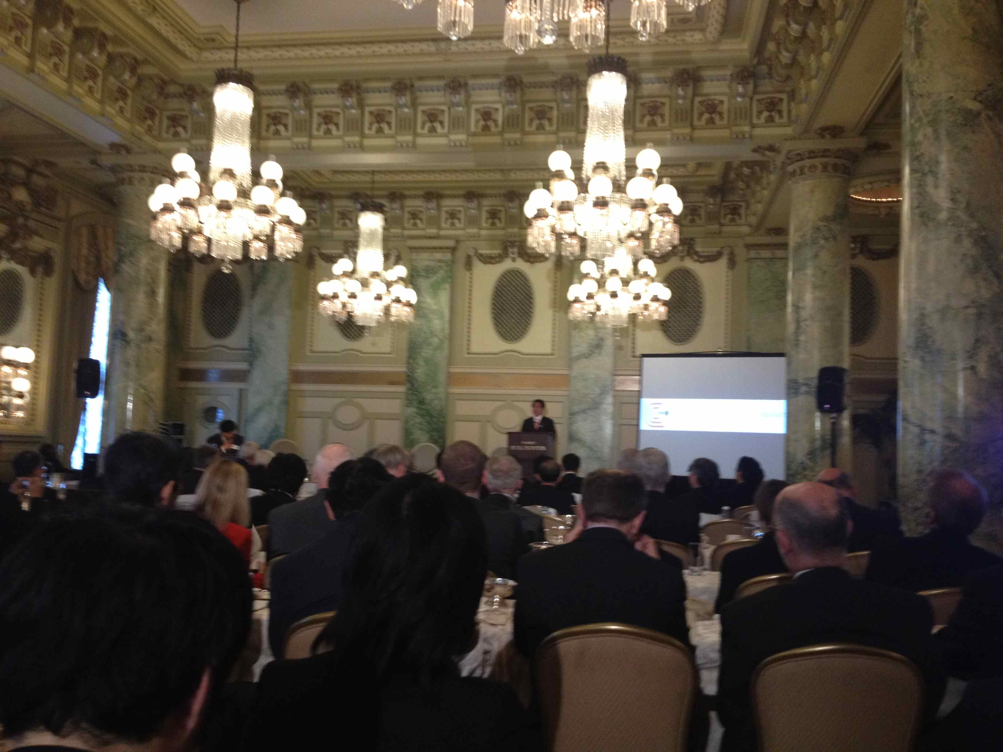
US-Japan Symposium on Advanced Science and Technology
Apr 30, 2013, Washington DC
Speakers from Japan
  Shimomura: MEXT mininster
  Kawamura: chair of the federation of diet members for ILC, former MEXT minister
  Masuda: former minister of interior
  etc.
Speakers from the US
  Daniel B. Poneman: deputy secretary of energy
  L.K. Len: OHEP DOE
  Tony Favale: president, AES
  etc.
In the morning, an agreement was signed between US and Japan on coorperation in science and technology
  A HEP annex is being written

Slide 31
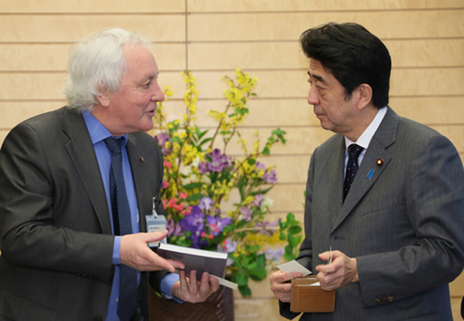
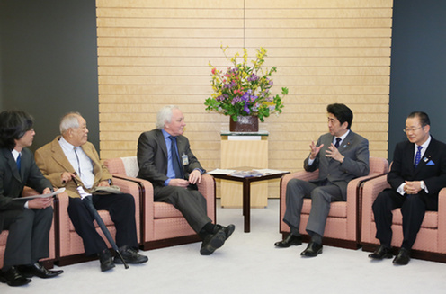
Lyn Evans visits PM Abe et al.
Apr 25-27, 2013, Tokyo
PM Abe
Visited
  Prime Minister Shinzo Abe
  Miinitster of sicence and technology, Ichita yamamoto:
  Takeo Kawamura: chair of the federation of diet members for ILC, former MEXT minister
    With Koshiba, Murayama, Yamashita
  Hakubun Shimomura: MEXT minister
  HIroya Masuda: former minister of interior
  Kiyohiko Ito: managing director JACE
  etc. etc.

Slide 32
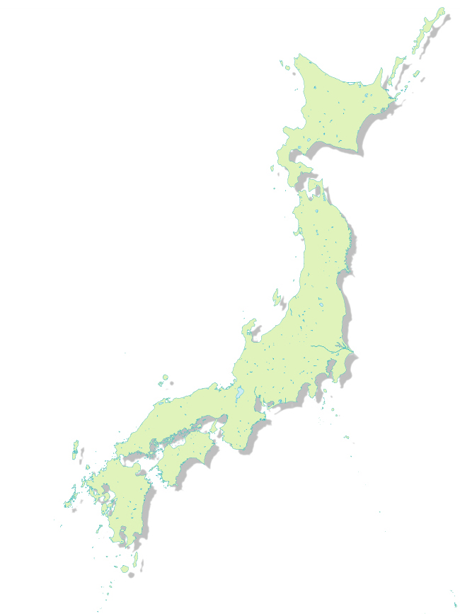
Two Candidate Sites
Kitakami
Kyushu
  Sefuri mountains
Tohoku
  Kitakami mountains
  Strong and stable granite bedrocks
One of them will be chosen by end of July 2013 based on:
  Geology and technical aspects
  Infrastructure and economic ripple effects
Sefuri
Notes:
Minimum design - common fund, site dependent - host

Slide 33
Regional Organizations : Kyushu
Kyushu
  ‘Association of Advanced Fundamental Science and Future Accelerators’
    Established in 2007
    Local governments, companies and universities
  ‘Kyushu and Saga Universities Promoting ILC’
    Established in 2007
  ‘ILC-Asia-Kyushu Conference Promoting ILC’
    Established in 2013 Feb 14
  ‘City of Karatsu Conference Promoting ILC’
    Established in 2013 Feb 19
  ‘City of Saga Conference Promoting ILC’
    Established in 2013 Feb 26
City of Karatsu
City of Saga

Slide 34
Regional Organizations : Tohoku
  ‘Tohoku Conference for the Promotion of the ILC’
    Local governments, companies and universities
    Cities of Oshu, Ichinoseki, Kesennuma joined the Tohoku Conference for the Promotion of the ILC
      2013 Mar 6
    New members joining rapidly now!
  ‘Tohoku University Council for the Promotion of the ILC’
    Established in 2012
  ‘Federation of Assembly Members Promoting the ILC’
    Iwate Prefecture : established 2013 Mar 13
    Miyagi Prefecture : to be established at next assembly
~300 newspaper articles on ILC this year
by major journals in Iwate and Miyagi
Iwate Assembly Members
visiting KEK

Slide 35
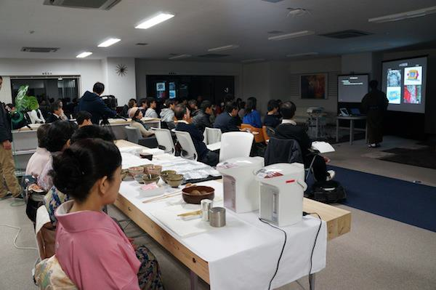
Regional Activities (both regions)
Geological survey
  Borings, seismic surveys, electrical surveys, etc.
  Field studies (reconnaissance)
Study on international academic city
and economic ripple effects
  Residences, medical, educations, etc.
  Official reports produced
Outreaching to local public
  Lectures, symposiums, science cafes etc.
    high school lectures (>10k students) and
    >50 public lectures, etc. after 2010.
  Meetings to explain site studies
  Production of PR DVDs
Science Cafe
Symposium

Slide 36
National Coverage of the ILC
Many TV and newspaper coverages
  ‘Close-up Today’ (クロースアップ現代）Feb 2013
    NHK’s flag-ship news program (30 min)
    ‘Go beyond Higgs – Japan’s Large Accelerator Project’
Anchor: Hiroko Kuniya

Slide 37
Summary
The ILC is technically ready.
There are strong supports from the international scientific community. (will they translate to commitments?)
Japanese government is now willing to negotiate with other governments toward siting the ILC in Japan.
If the negotiation fails, there will be no ILC in Japan (and probably anywhere).
In order for the governments of Americas and Europe to commit substantial resources to the ILC, your support is essential.

