Slide 1
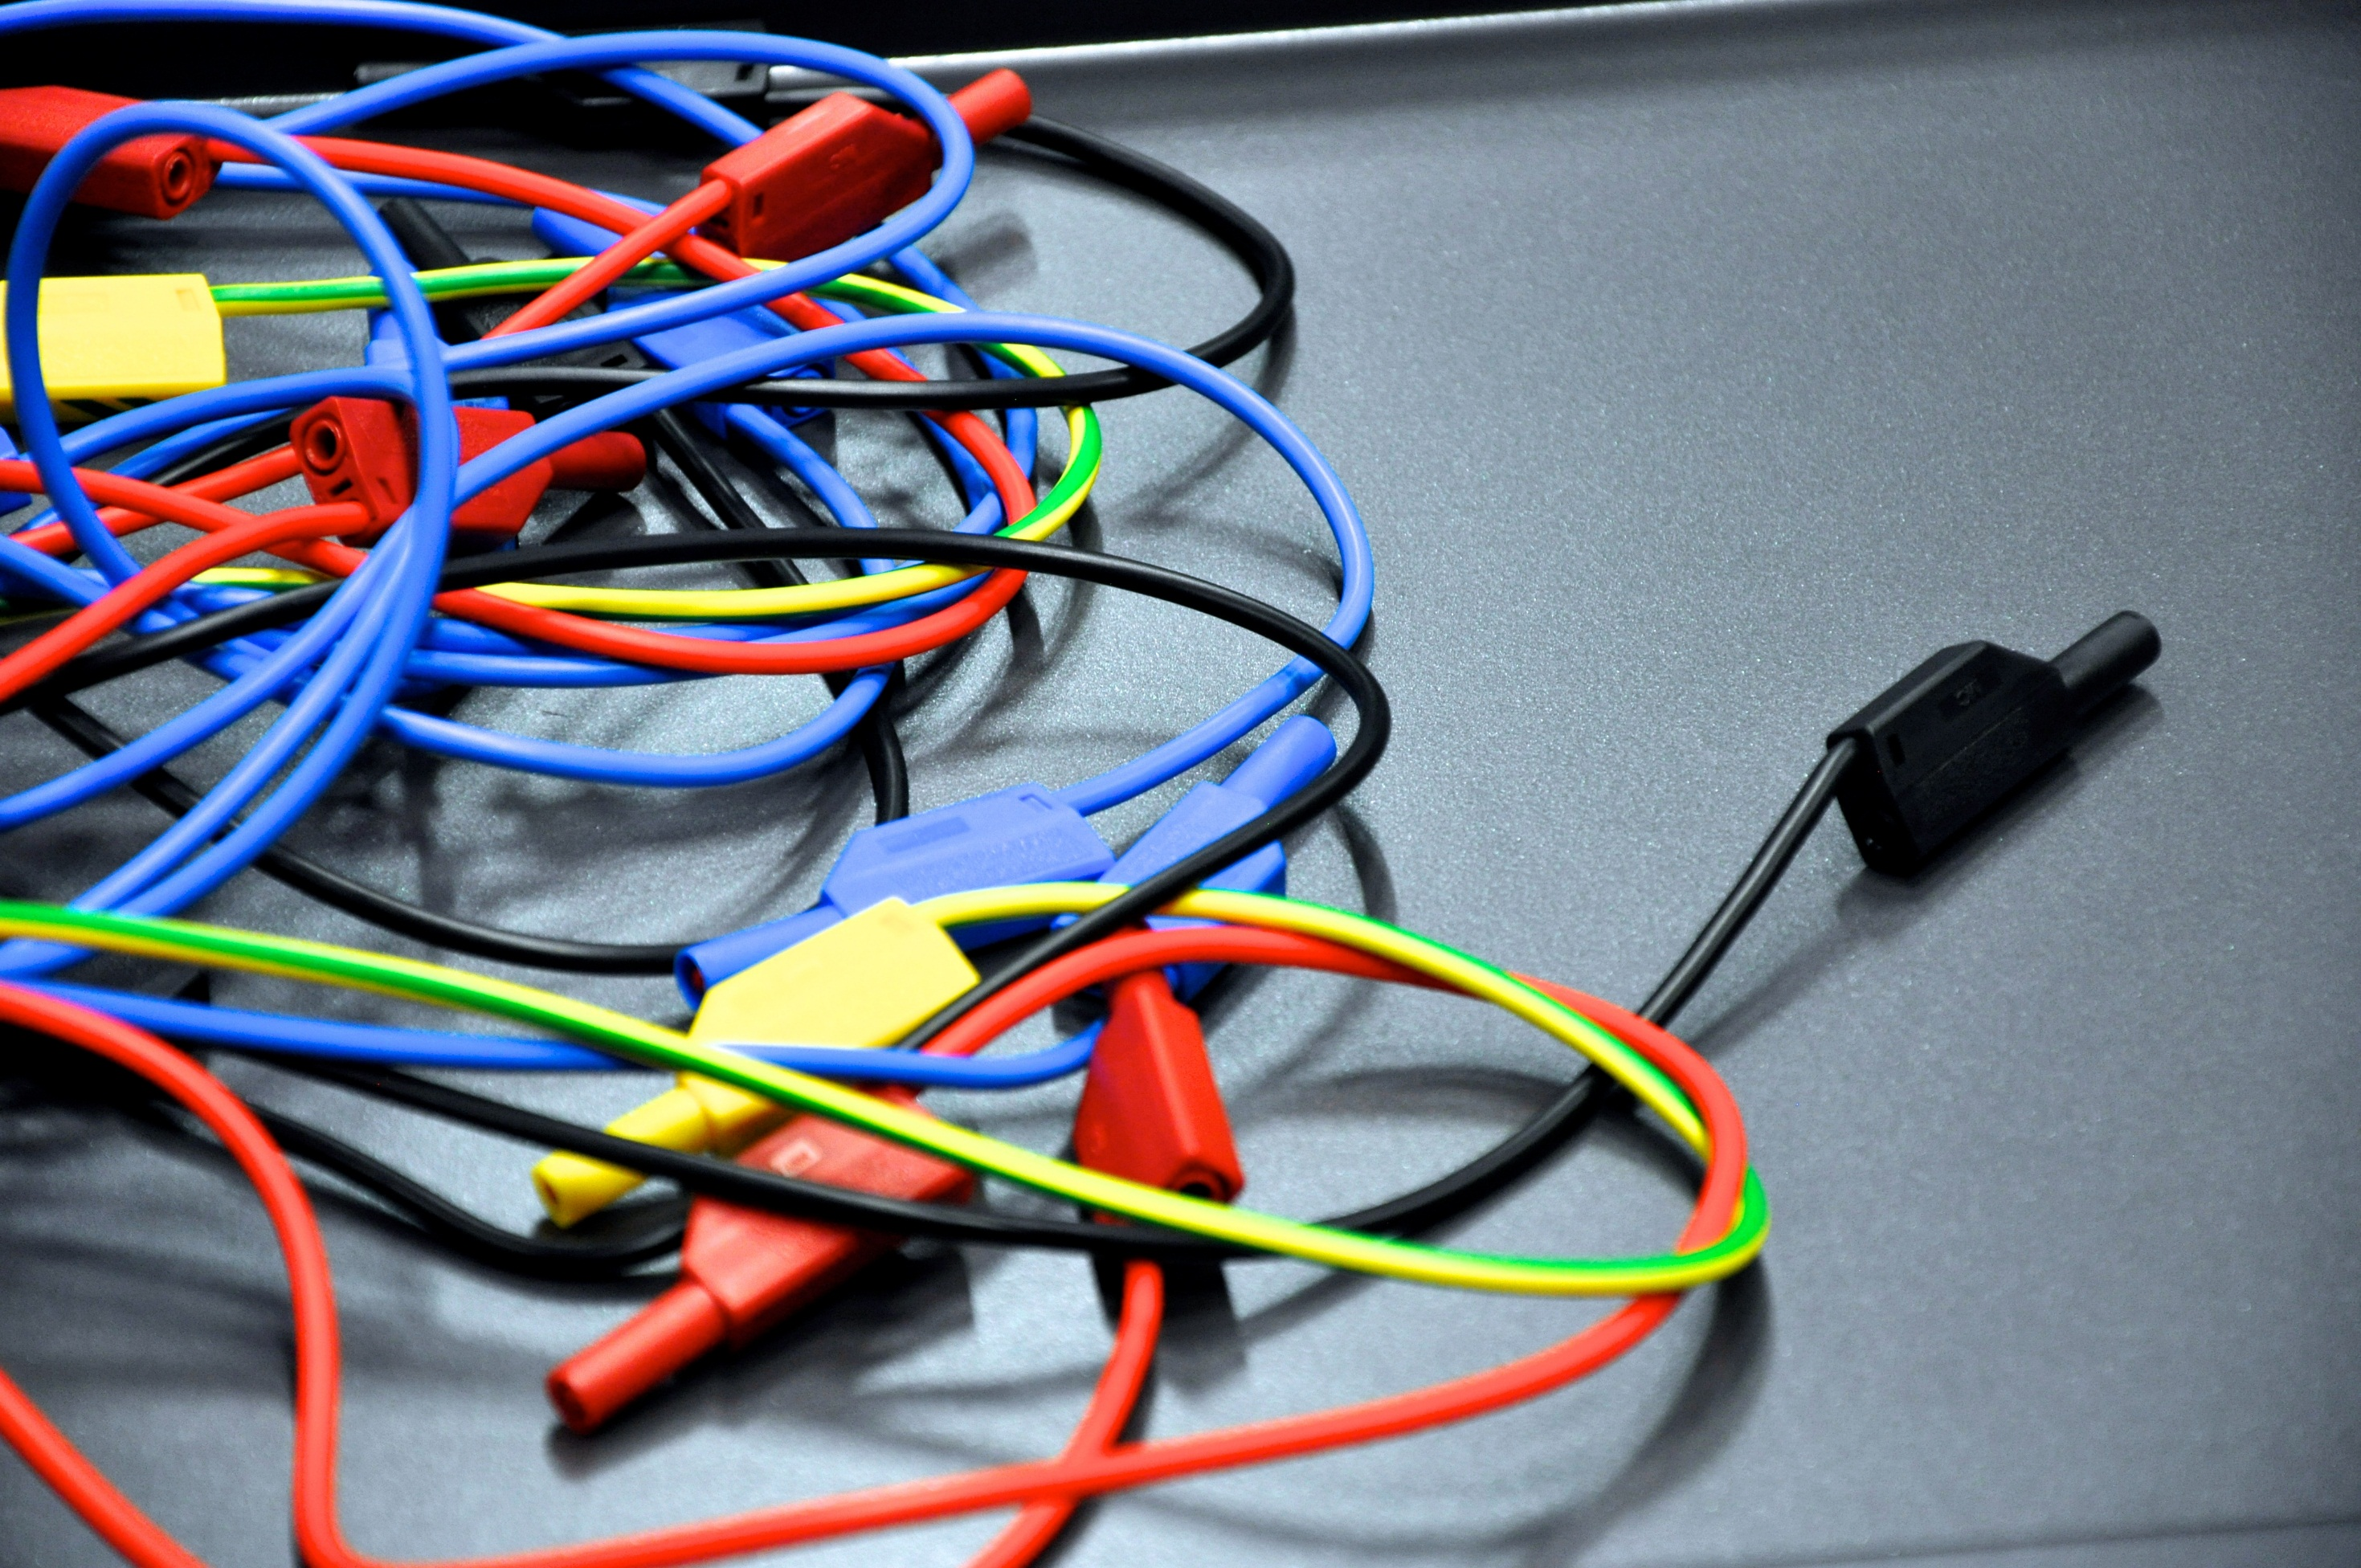

Nebelkammer Workshop Julia.Woithe@cern.ch

Slide 3
Outline
Geschichte
Anleitung und Sicherheit
Selbstbau einer Nebelkammer
Abbau
Diskussion der Beobachtungen

Slide 4
Geschichte

Slide 5
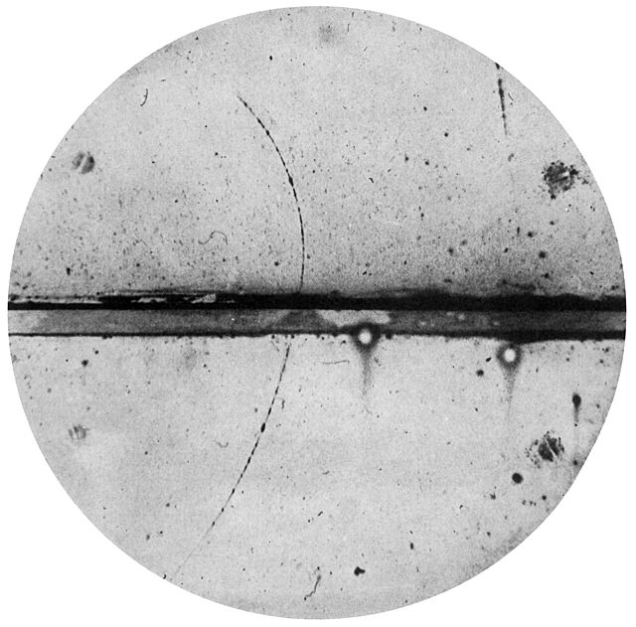
History
Charles T. R. Wilson (1869 - 1959)
Carl Anderson (1905 - 1991)
This Scottish physicist perfected the first (expansion) cloud chamber in 1911 and received the Nobel Prize in 1927.
This physicist discovered the positron in 1932 and the muon in 1936 using a cloud chamber. He received the Nobel Prize in 1936.
C. T. R. WILSON: On an Expansion Apparatus for Making Visible the Tracks of Ionising Particles in Gases and Some Results Obtained by Its Use. Proc. R. Soc. Lond. A. 1912 87 277-292 DOI:10.1098/rspa.1912.0081
Carl D. Anderson (1905–1991) - Anderson, Carl D. (1933). "The Positive Electron". Physical Review 43 (6): 491–494. DOI:10.1103/PhysRev.43.491.

Slide 6
Anleitung und Sicherheit

Slide 7
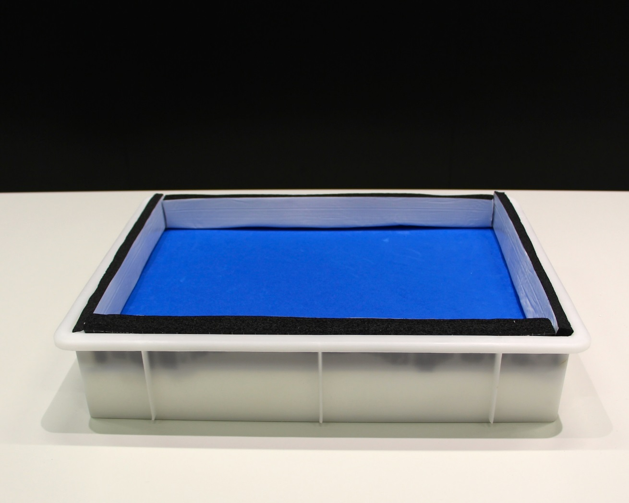
Build your cloud chamber - step by step

Slide 8
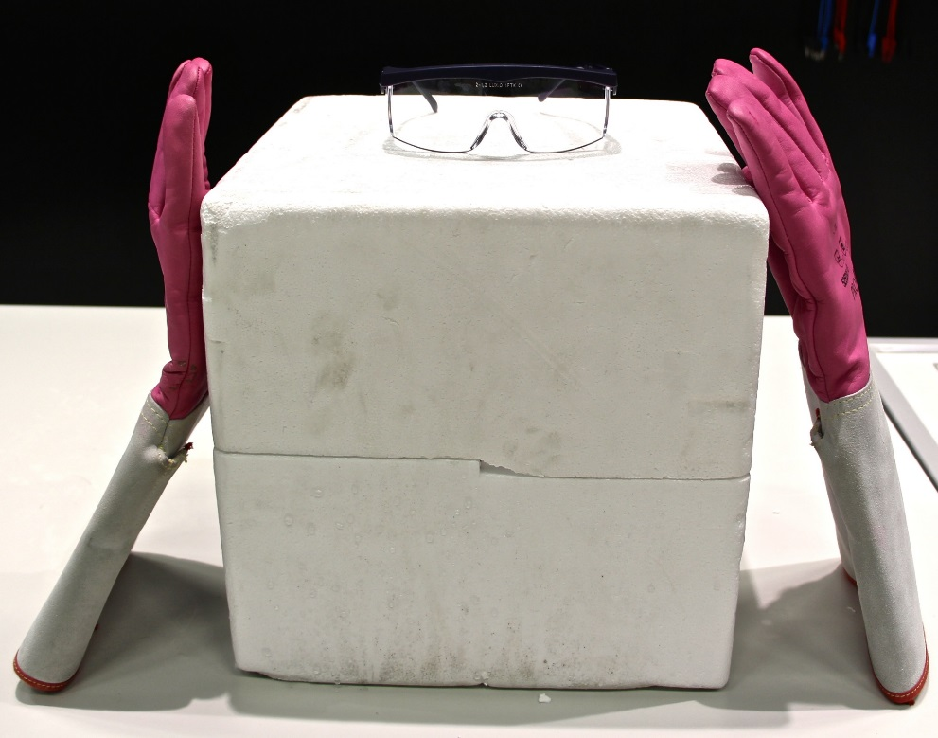
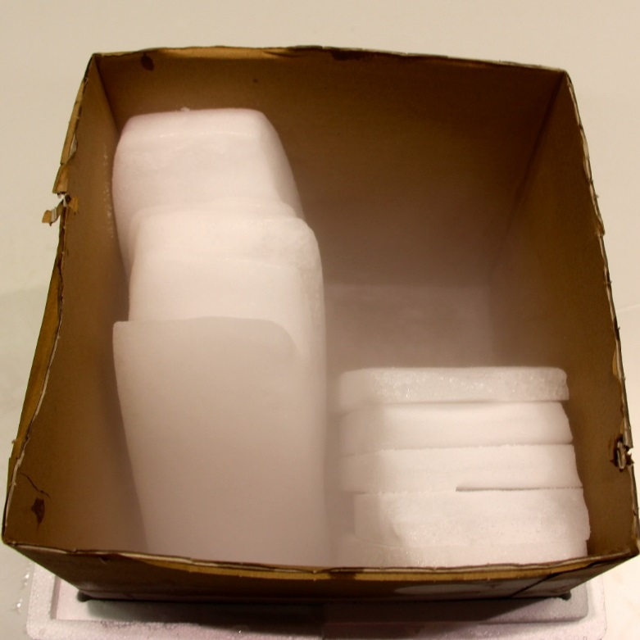
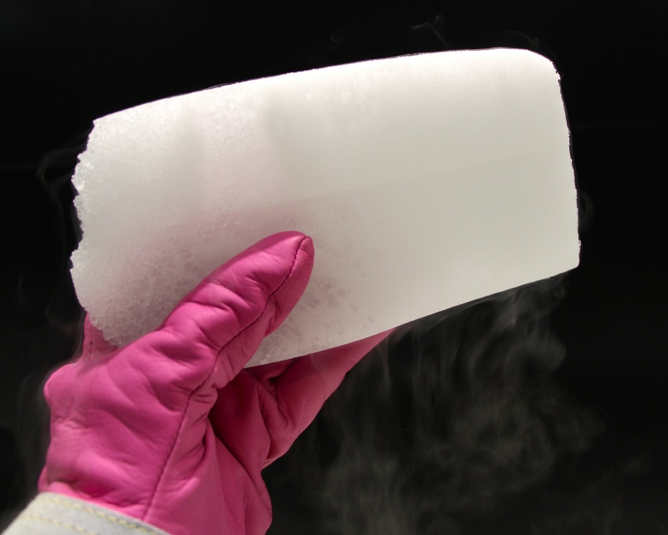
Build your cloud chamber - step by step

Slide 9
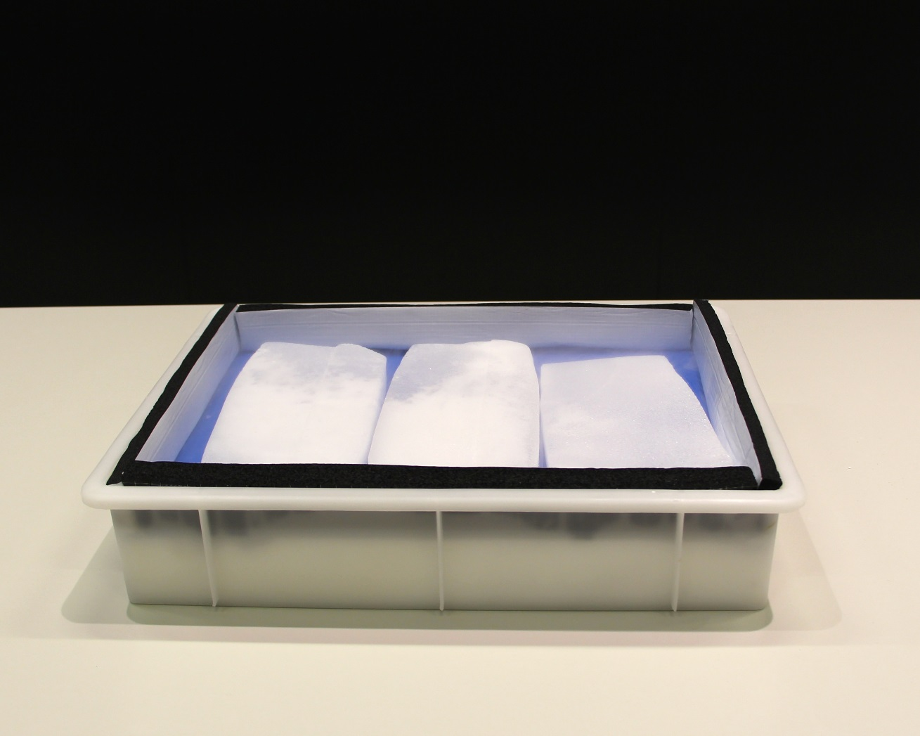
Build your cloud chamber - step by step

Slide 10
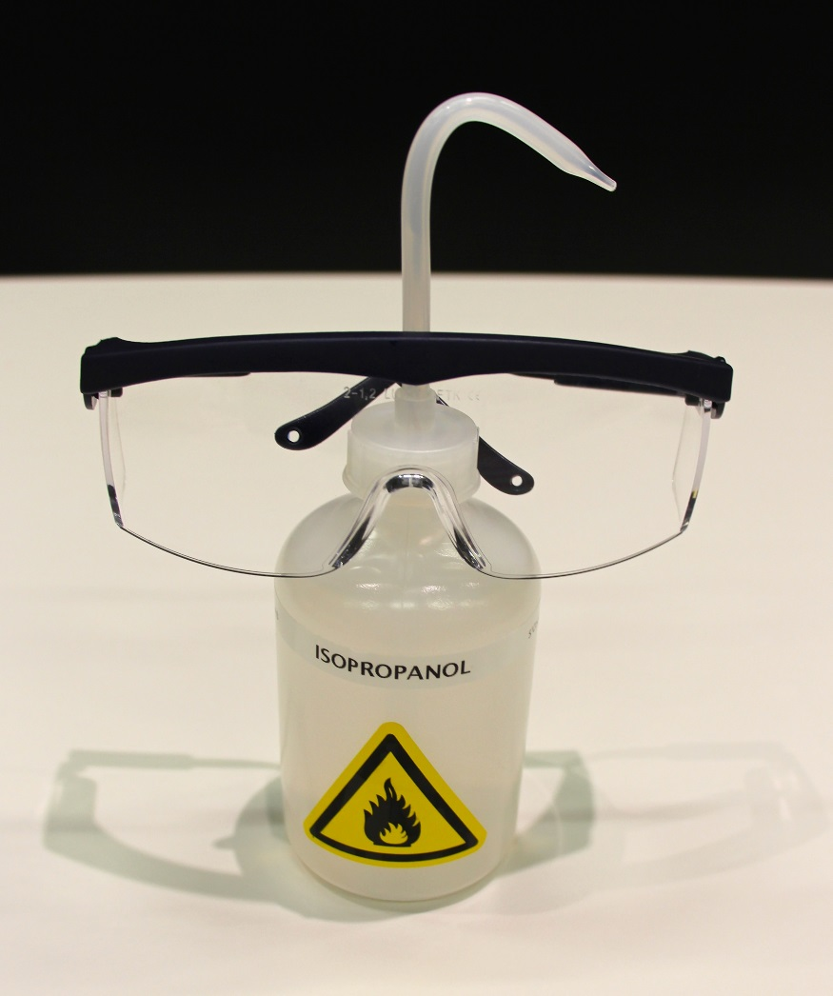
Build your cloud chamber - step by step

Slide 11
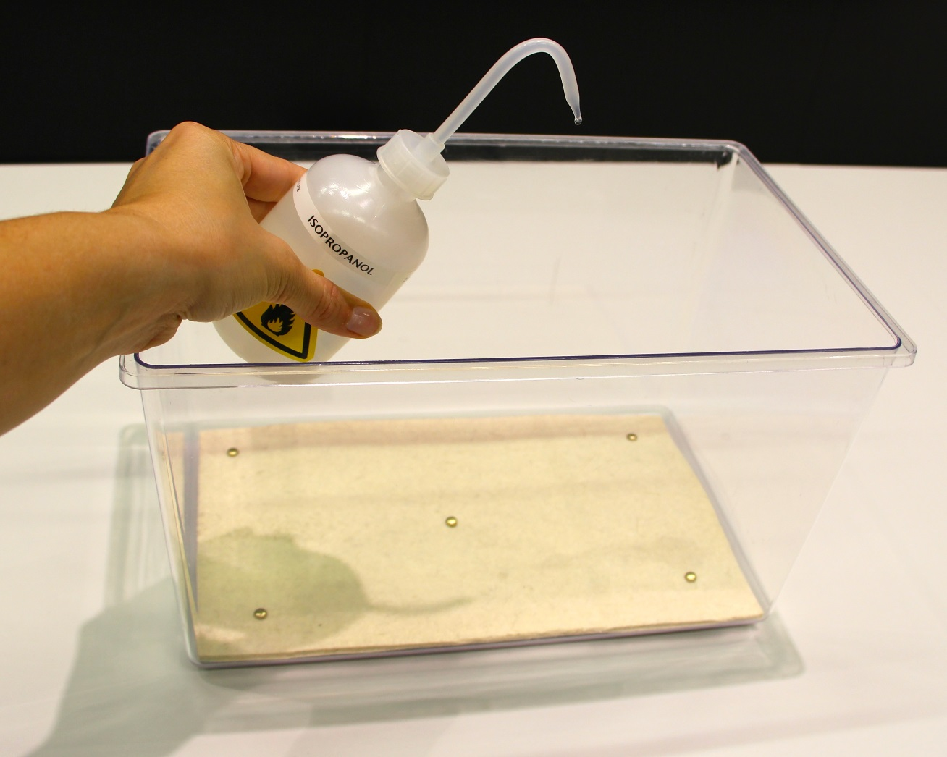
Build your cloud chamber - step by step

Slide 12
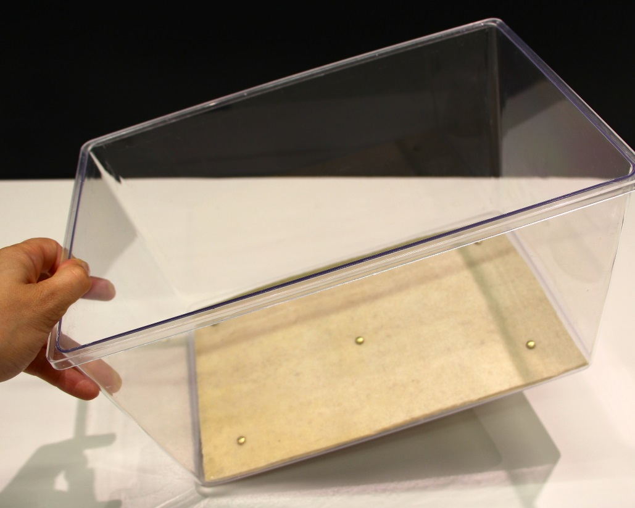
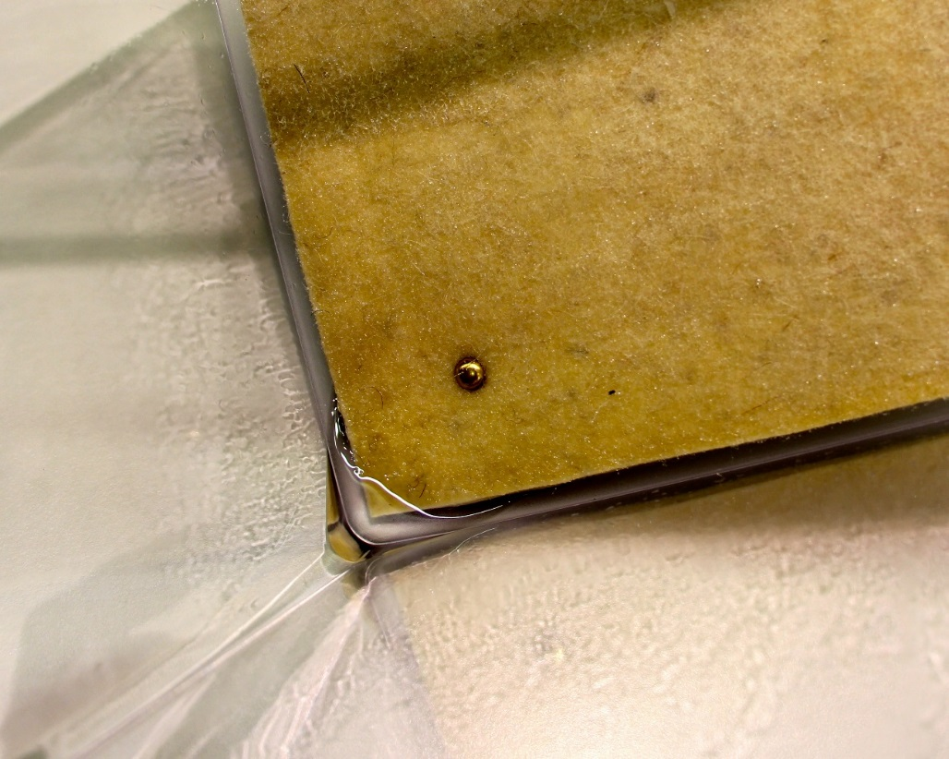
Build your cloud chamber - step by step

Slide 13
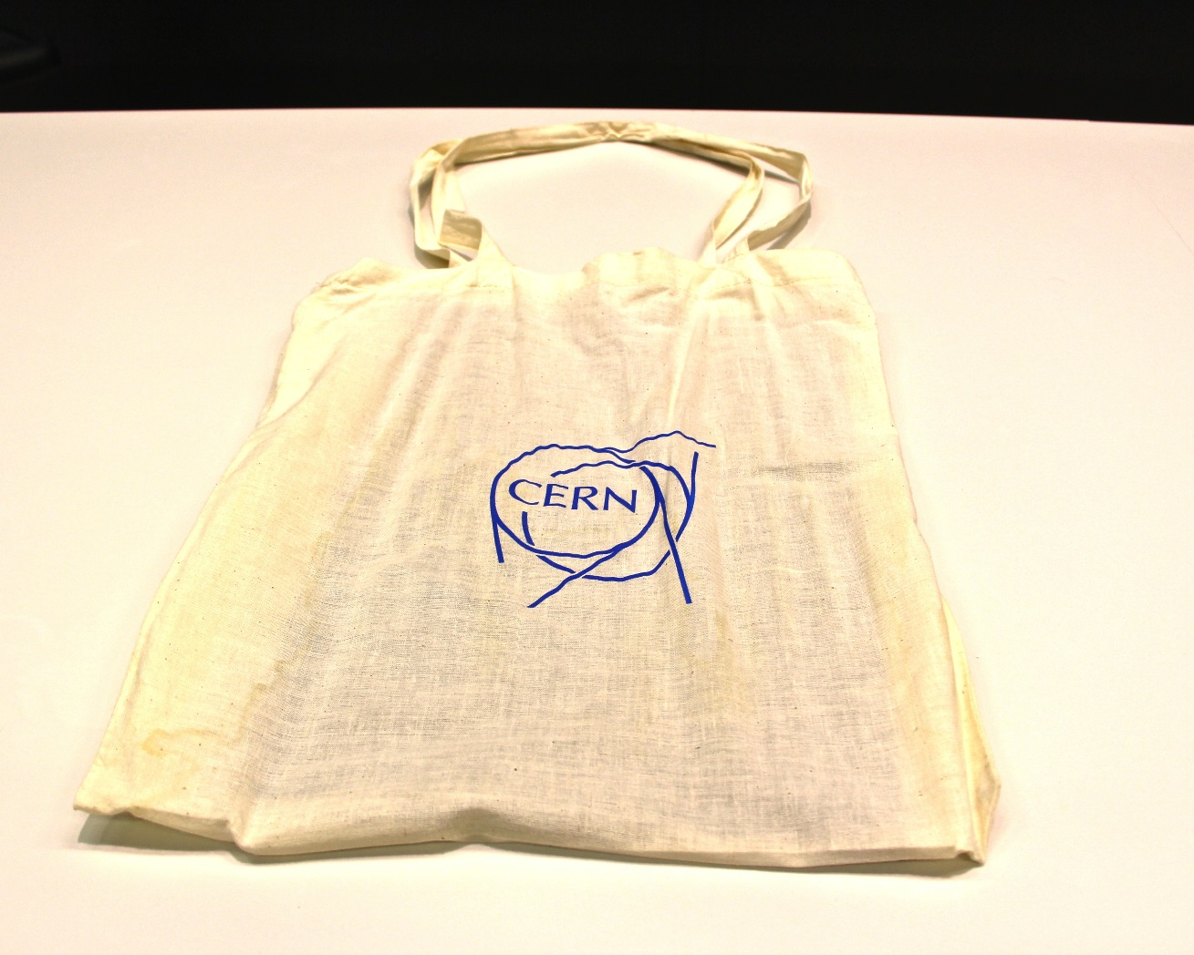
Build your cloud chamber - step by step

Slide 14
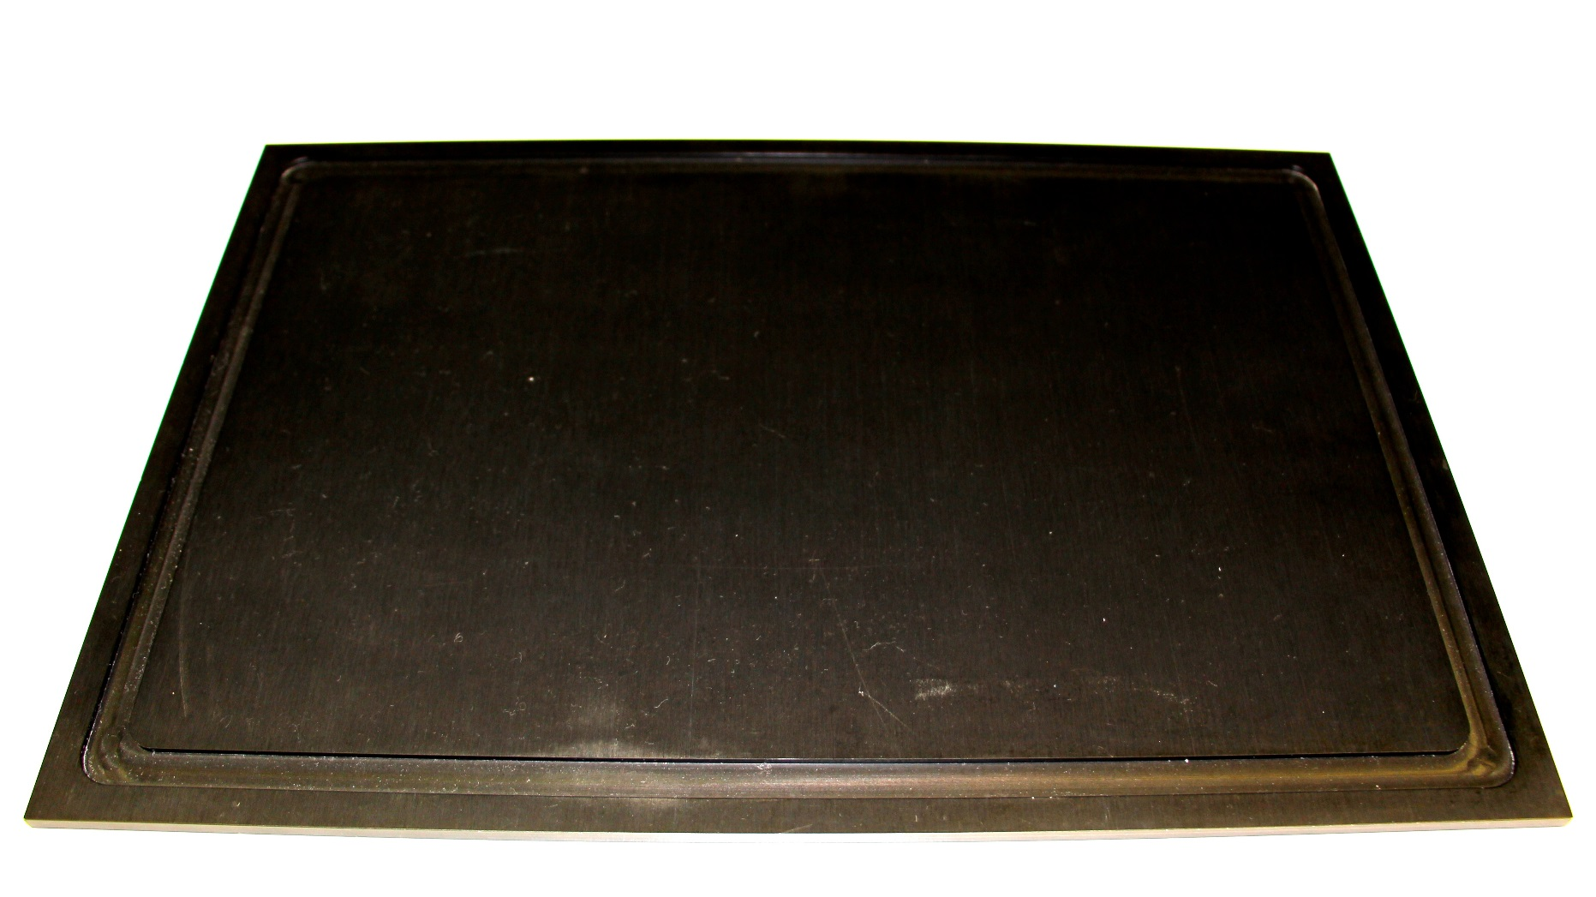
Build your cloud chamber - step by step

Slide 15
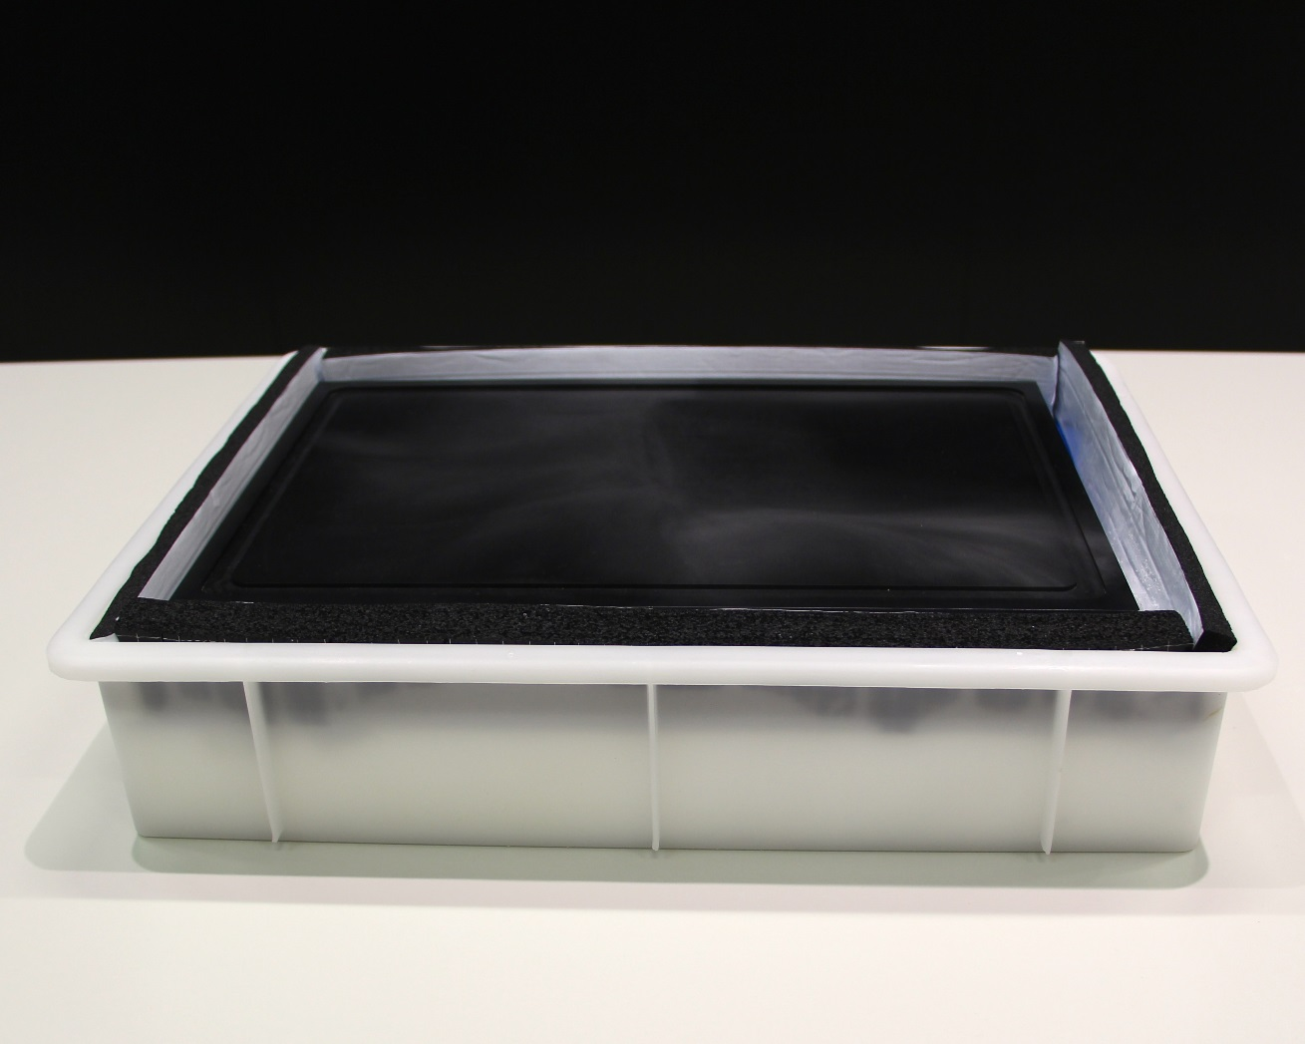
Build your cloud chamber - step by step

Slide 16
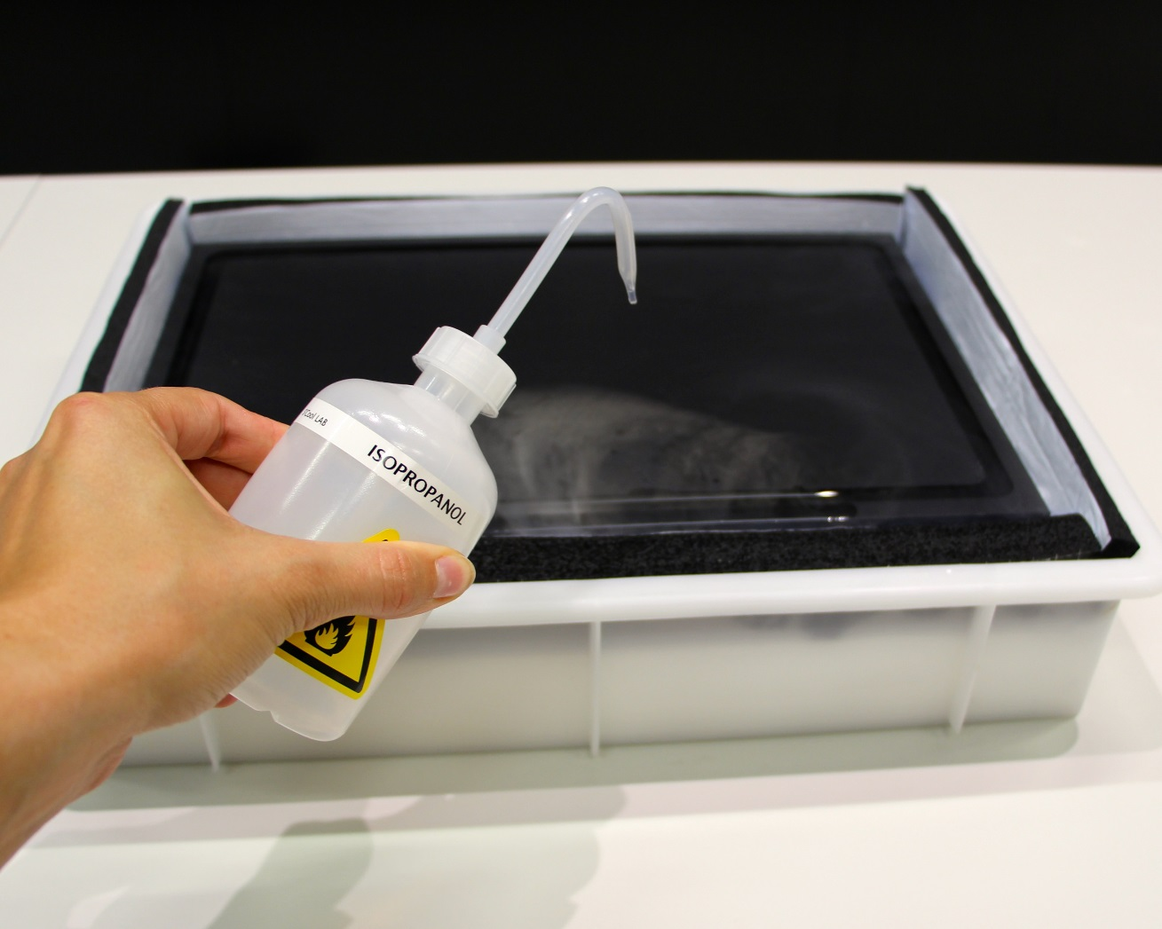
Build your cloud chamber - step by step

Slide 17
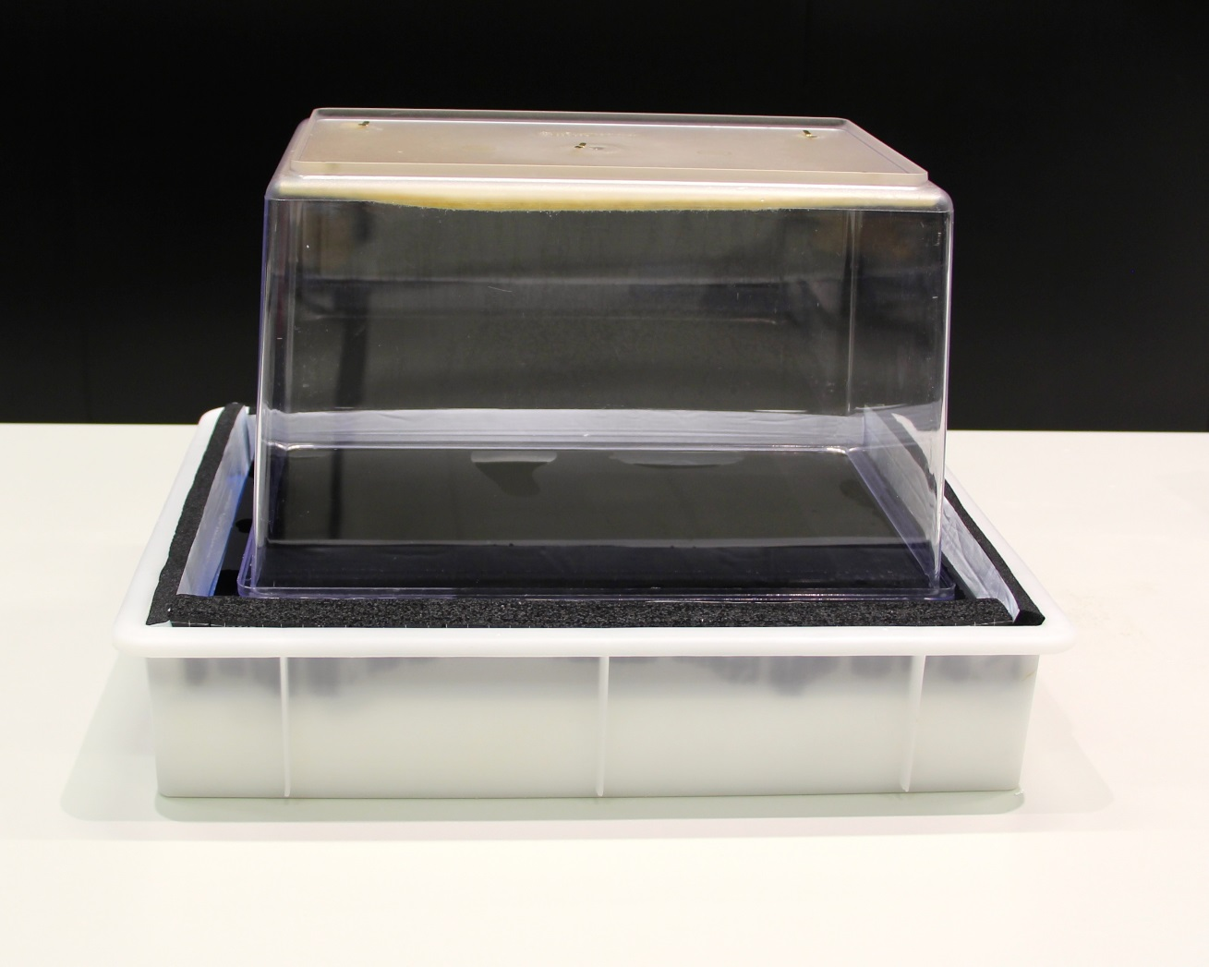
Build your cloud chamber - step by step

Slide 18
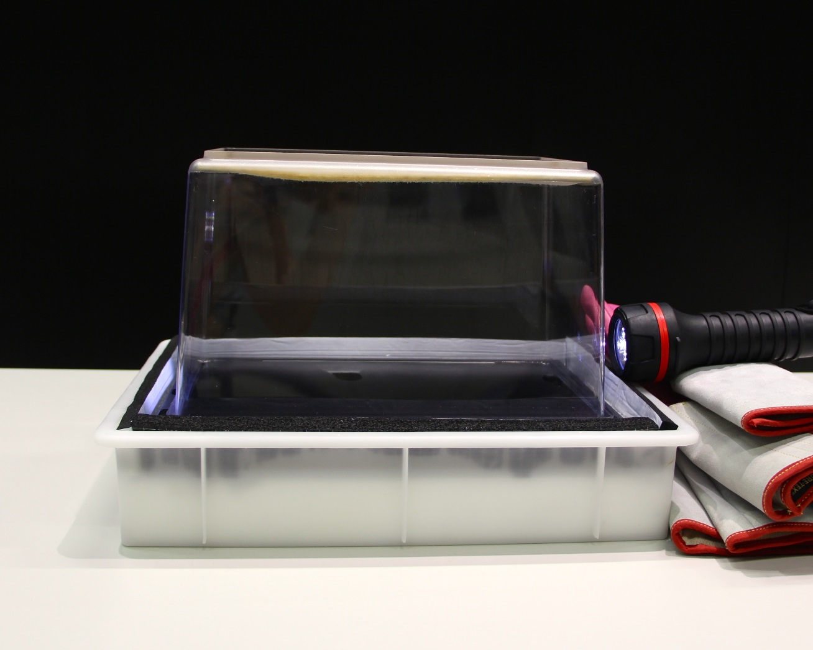
Build your cloud chamber - step by step

Slide 19
Selbstbau einer Nebelkammer

Slide 20
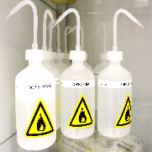
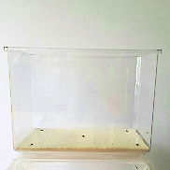
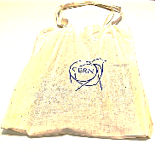

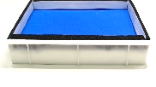
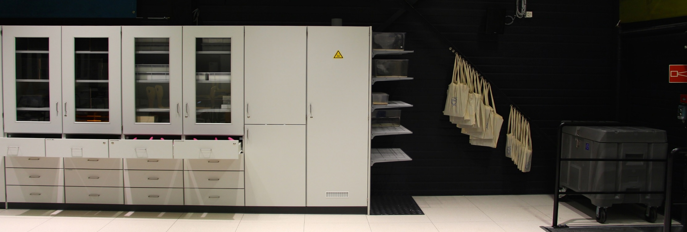
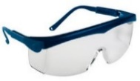
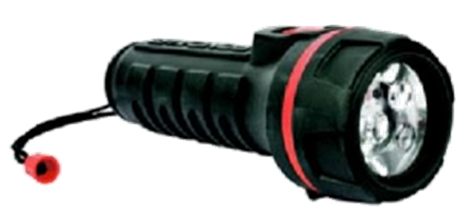
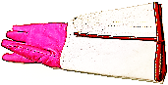
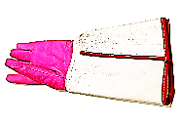
Shopping List
Aufgabe: Beobachten Sie Ihre Nebelkammer. Beschreiben Sie sichtbare Spuren (Form, Länge, Breite, …). Diskutieren Sie in der Kleingruppe, durch welche Teilchen diese Spuren hervorgerufen werden.

Slide 21
Abbau

Slide 22
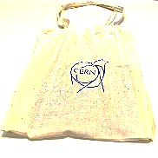
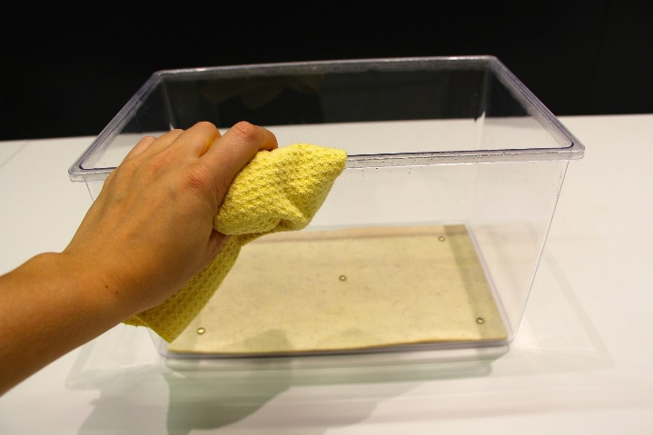
Inverse Shopping List

Slide 23
Diskussion der Beobachtungen
… am Whiteboard

Slide 24
Zusatzmaterial

Slide 25
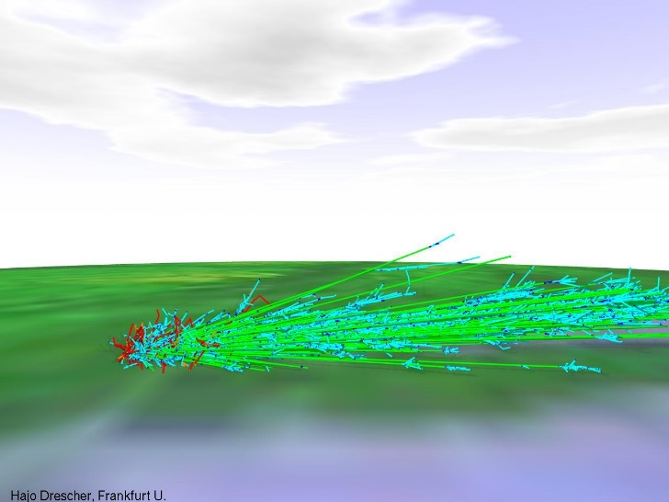
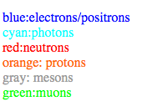
Air Shower Simulation
Cosmic Ray Air Shower Pictures
by H.-J. Drescher drescher@th.physik.uni-frankfurt.de.
Air showers are cascades of secondary particles induced in the atmosphere by high energy cosmic rays. What you see here is a visualisation of realistic simulations of these showers. Of course, not all of the particles in a shower are displayed, there are far too many! The fraction displayed here is about 1e-6, sampled with a thinning algorithm.
http://th.physik.uni-frankfurt.de/~drescher/CASSIM/

Slide 26
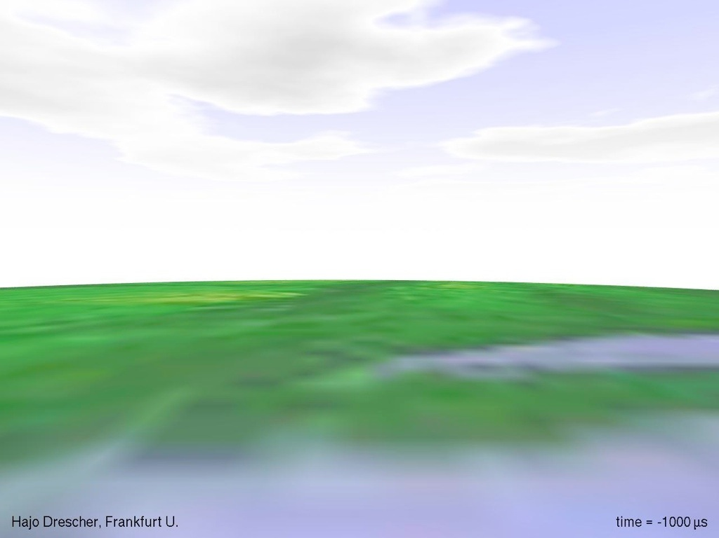

Slide 27


Slide 28


Slide 29


Slide 30


Slide 31


Slide 32
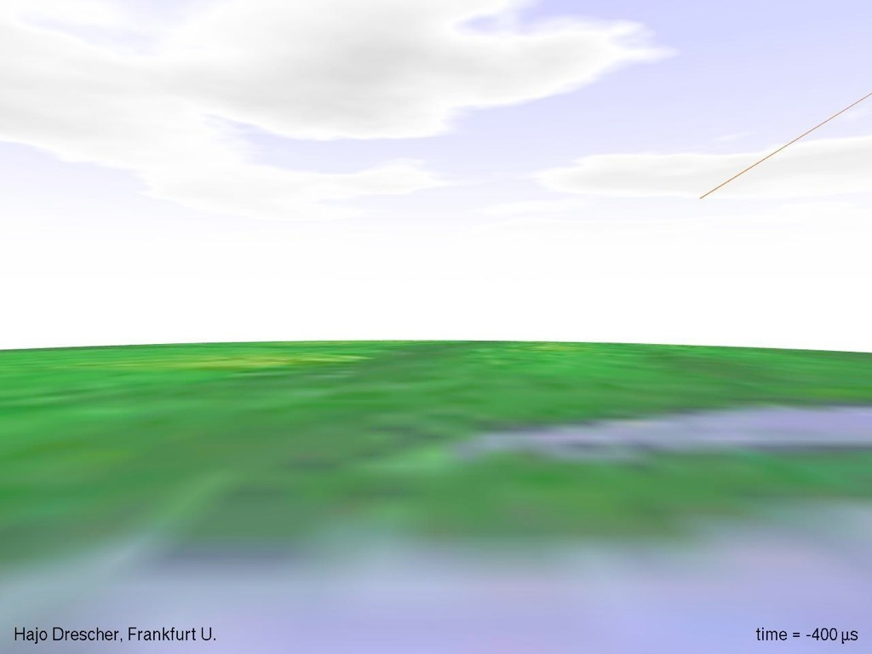

Slide 33
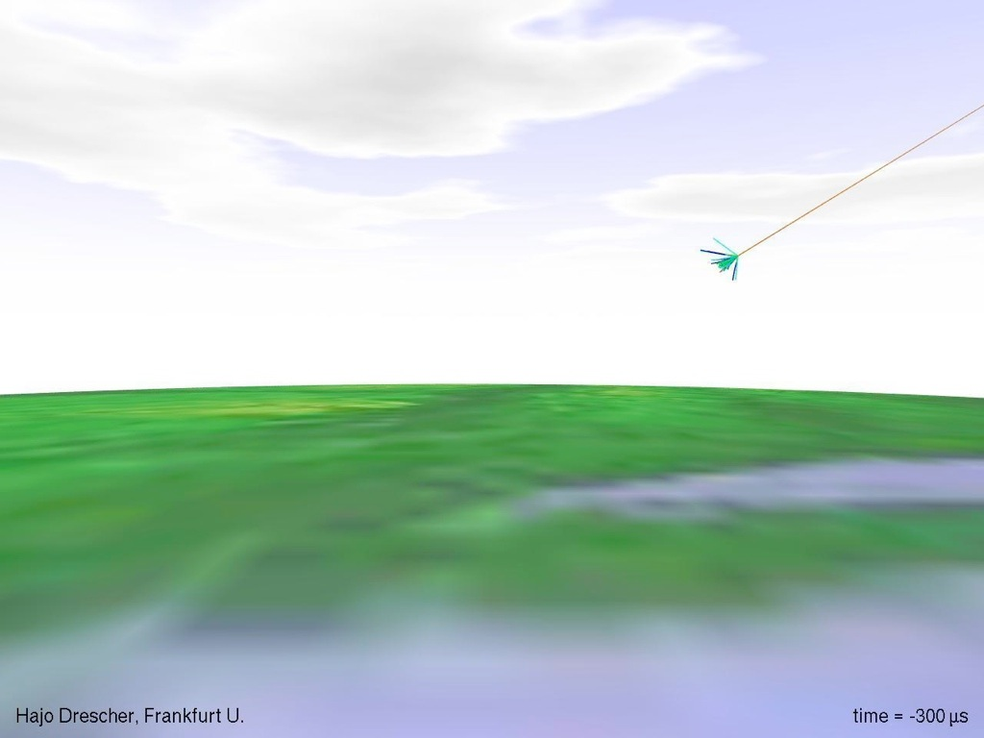

Slide 34
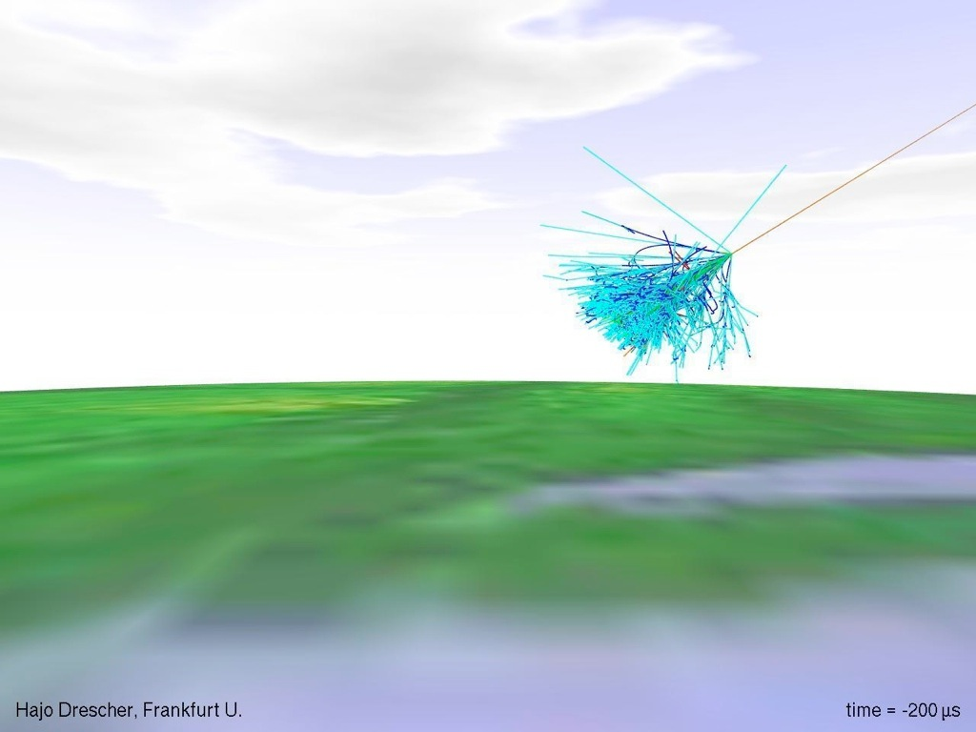

Slide 35
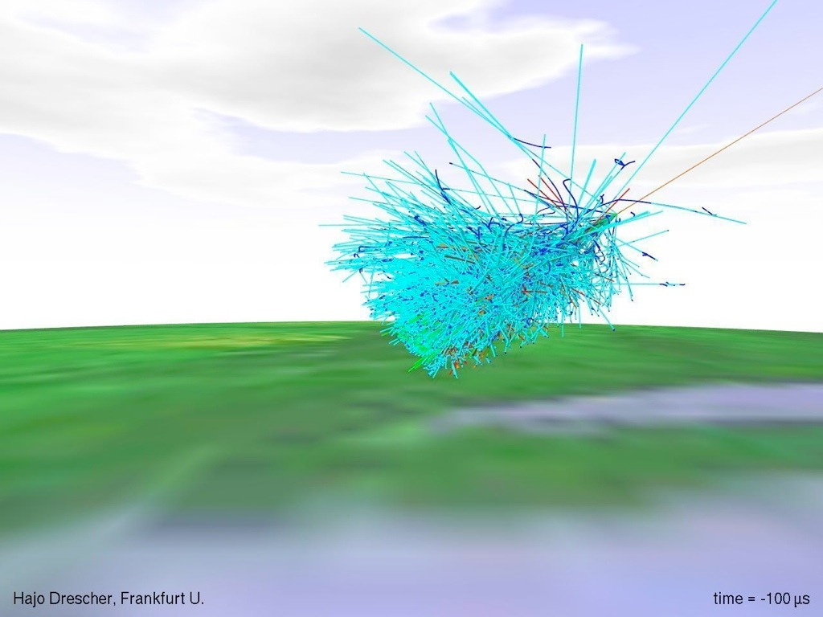

Slide 36
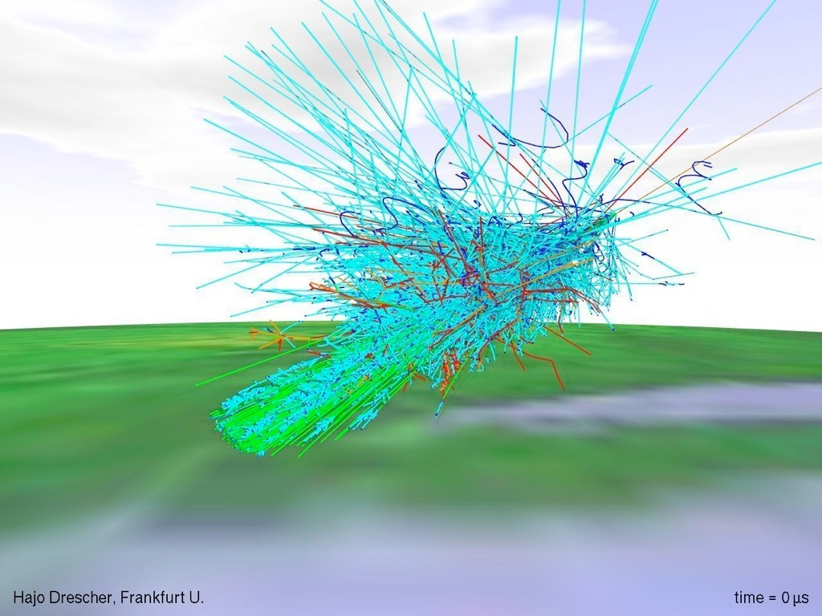

Slide 37
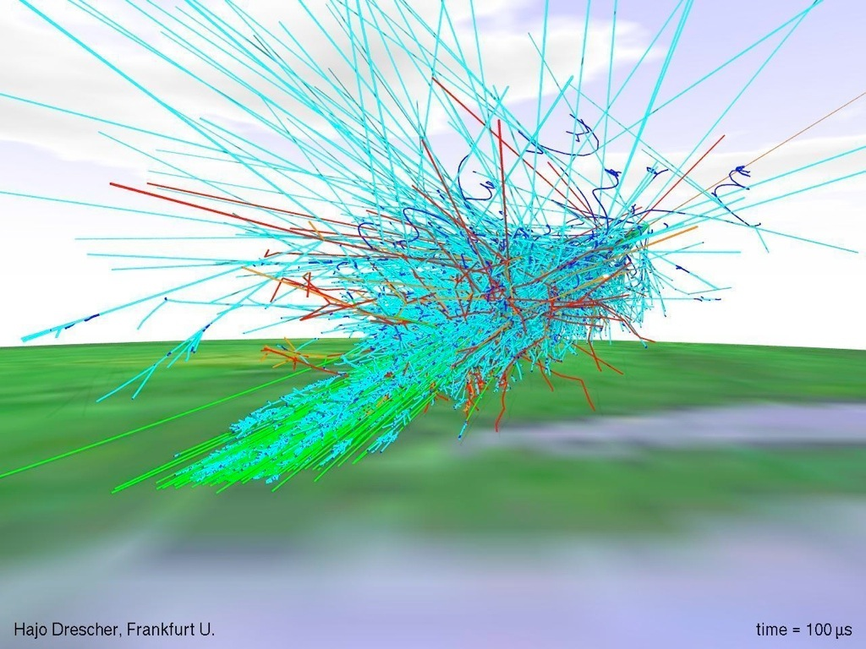

Slide 38


Slide 39
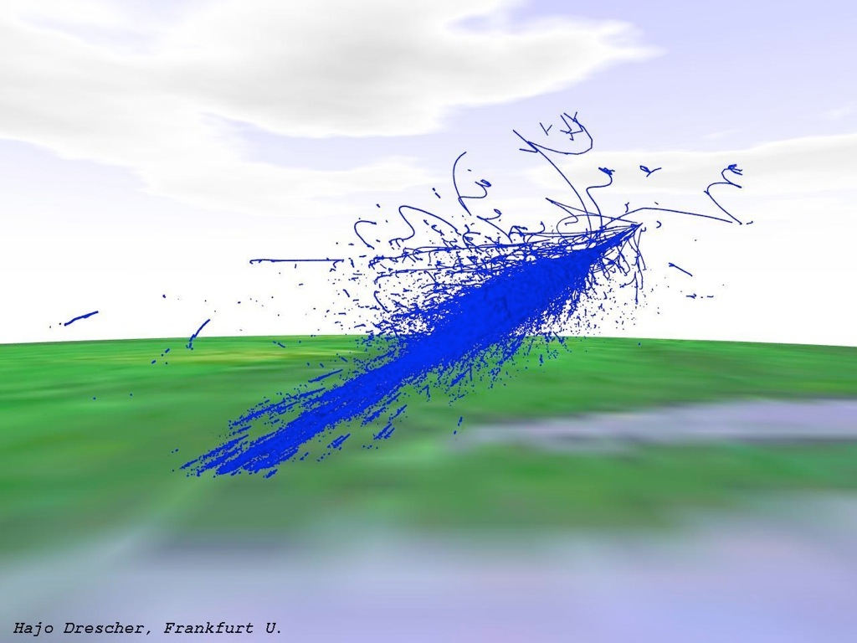

Slide 40
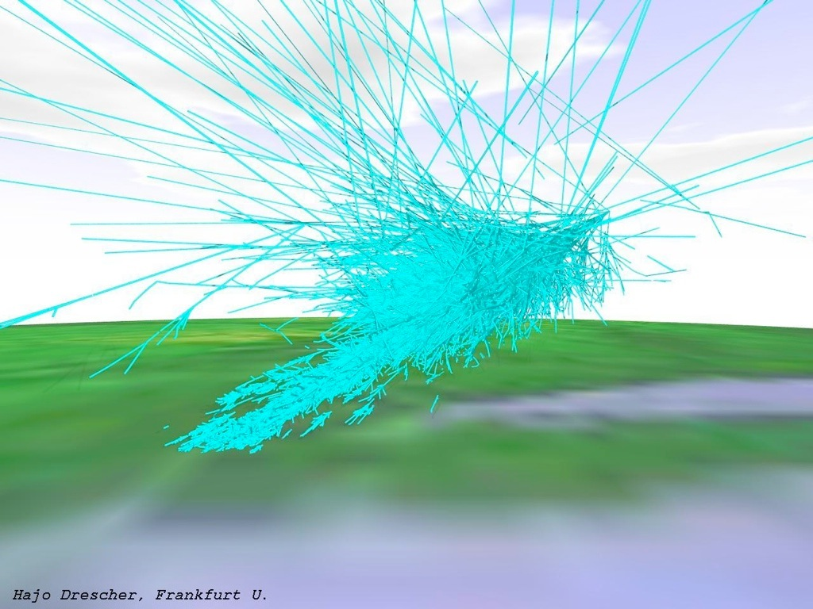

Slide 41
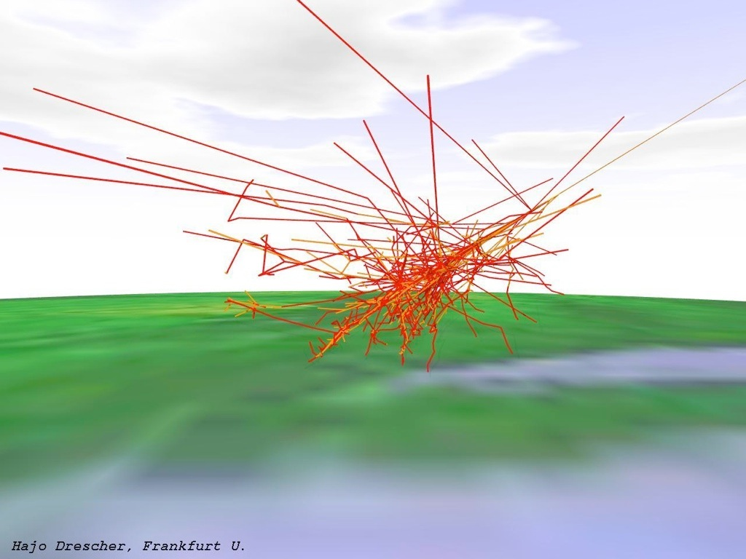

Slide 42
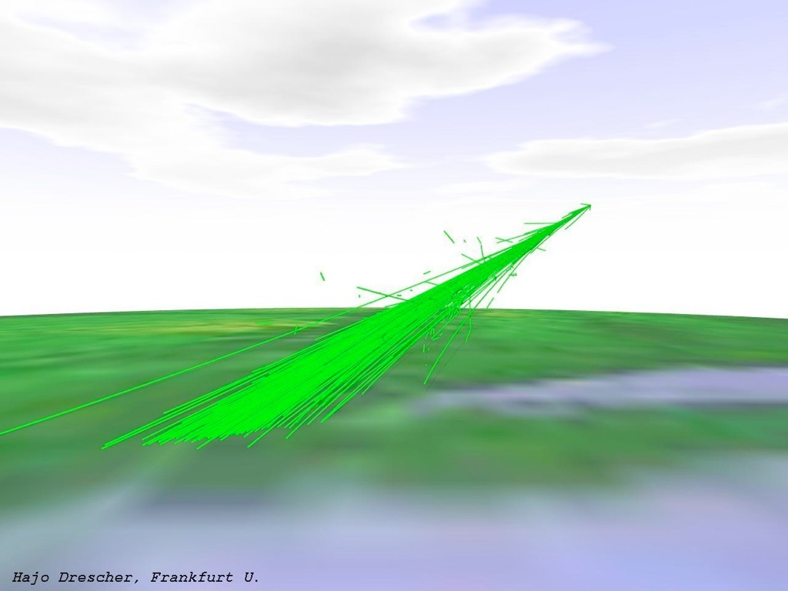

Slide 43
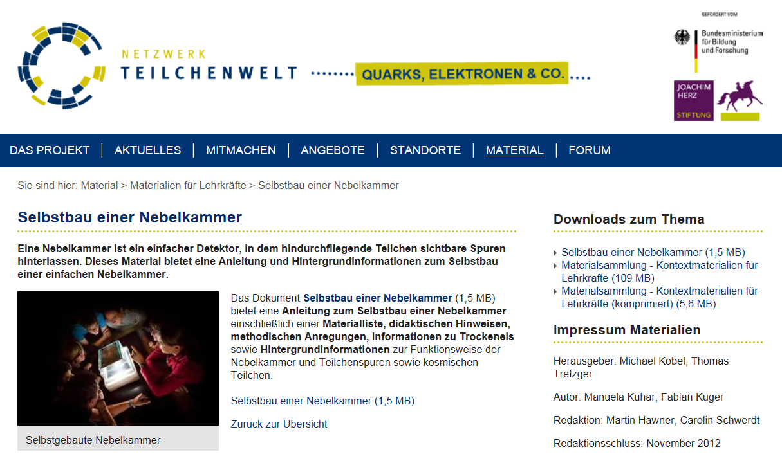
http://www.teilchenwelt.de/material/materialien-fuer-lehrkraefte/selbstbau-einer-nebelkammer/de

