Slide 1
Deploying perfSONAR-PS for
WLCG: An Overview
Shawn McKee/University of Michigan
WLCG PS Deployment TF Co-chair
Fall 2013 HEPiX
Ann Arbor, Michigan
October 29th, 2013

Slide 2
Science Motivations for perfSONAR-PS
WLCG (World-wide LHC Computing Grid) encompasses the 4 main LHC experiments: ATLAS, CMS, ALICE and LHCb. We all have heard of the Higgs and the science at the LHC…it is the leading edge instrument for both high-energy and nuclear physics research. Our global grid infrastructure was even noted as critical to the Higgs discovery
WLCG has a critical reliance upon ubiquitous, high-performance networks to tie together data, applications, computing and storage to enable and expedite scientific discovery.

Slide 3
Introductory Considerations
All distributed, data-intensive projects critically depend upon the network.
  Network problems can be hard to diagnose and slow to fix
  Network problems are multi-domain, complicating the process
  Standardizing on specific tools and methods allows groups to focus resources more effectively and better self-support (as well as benefiting from others work)
  Performance issues involving the network are complicated by the number of components involved end-to-end. We need the ability to better isolate performance bottlenecks
WLCG wants to make sure their(our) scientists are able to effectively use the network and quickly resolve network issues when and where they occur

Slide 4
Vision for perfSONAR-PS in WLCG
Goals:
  Find and isolate “network” problems; alerting in a timely way
  Characterize network use (base-lining)
  Provide a source of network metrics for higher level services
First step: get monitoring in place to create a baseline of the current situation between sites (see details later)
Next: continuing measurements to track the network, alerting on problems as they develop
Choice of a standard “tool/framework”: perfSONAR
  We wanted to benefit from the R&E community consensus
perfSONAR’s purpose is to aid in network diagnosis by allowing users to characterize and isolate problems. It provides measurements of network performance metrics over time as well as “on-demand” tests.

Slide 5
Initial perfSONAR-PS Issues
perfSONAR-PS was designed to be standalone and federated. Nice for standalone end-users/sites; bad for VOs who want to understand what their ensemble of sites and networks are doing
  USATLAS identified that having dashboard to gather, grade, store and display network test metrics is REQUIRED for effective use.
  Managing a set of sites for USATLAS or LHCOPN or ‘x’ showed another shortcoming: changes to the set of sites required ALL sites to update their configurations. Not scalable!
Reliability and resiliency are critical. The feasibility of getting all relevant sites to deploy perfSONAR-PS depends upon it being easy to install, and (most importantly) robust in its operation.
  Sites don’t have manpower or expertise to baby-sit/diagnose PS issues

Slide 6
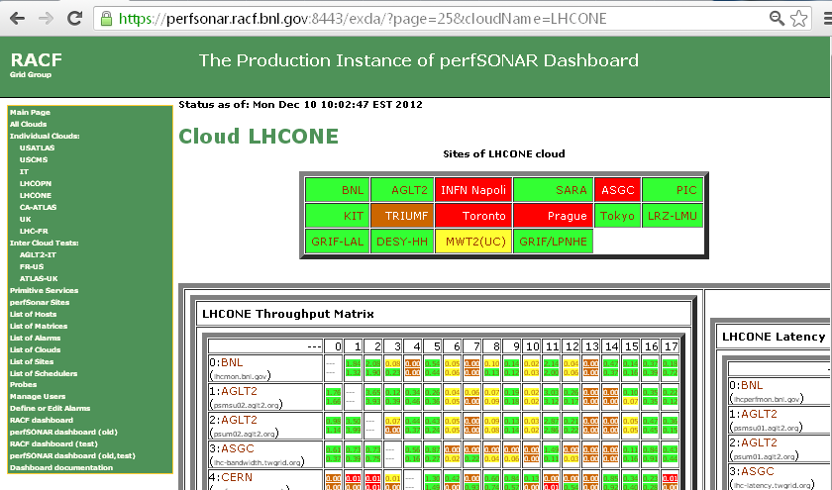
Example of Dashboard showing LHCONE
See https://perfsonar.racf.bnl.gov:8443/exda/?page=25&cloudName=LHCONE

Slide 7
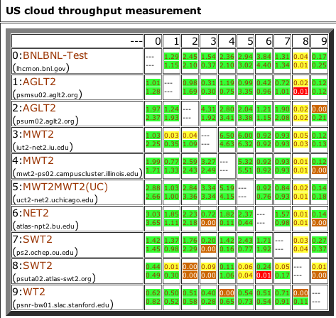
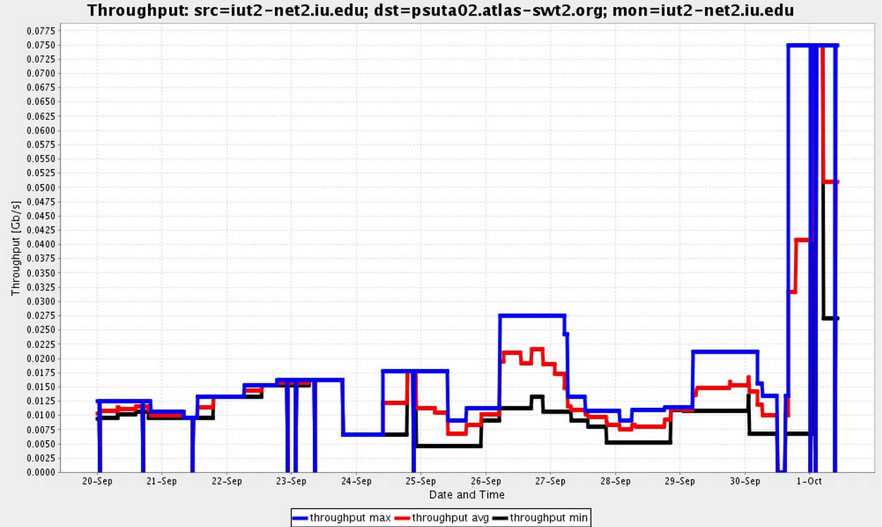
The perfSONAR Modular Dashboard
Centrally aggregates measurements from all PS hosts
  Provides a web UI and REST interface
  http://perfsonar.racf.bnl.gov:8080/exda/
A new implementation maturing production quality
  Addressing scalability issues for large meshes
  Providing a more extensive REST API
  Self-configuring from mesh definitions
  Fancier …
  http://perfsonar.racf.bnl.gov:8080/PsDisplay-1.0-SNAPSHOT/matrices.jsp?id=62
Discussions with OSG about hosting the Modular Dashboard service and automating mesh-config creation
bwctl last 30 days
50Mb/s
10Mb/s

Slide 8
Configuration of Network Testing
One of the lessons learned from LHC use of perfSONAR-PS was that setting up and maintaining scheduled tests for the perfSONAR-PS toolkit instances was a challenge.
As sites changed, joined or left, every other site needed to update their configuration to change, add or remove tests.
  Labor intensive, slow to get all updates in place and gets worse as we increase the size of the deployments!
Aaron Brown/Internet2 provided a solution: the “mesh” configuration which allows sites to track a central configuration and update themselves when it changes.
http://www.usatlas.bnl.gov/twiki/bin/view/Projects/PerfSONAR_PS_Mesh
For current perfSONAR-PS deployments a set of patches and new RPMS needs to be installed to enable the mesh-config
V3.3.1 has all functionality for the mesh built-in
SUCCESS!

Slide 9
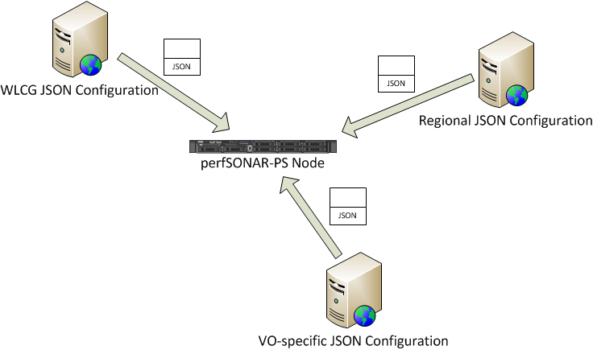
perfSONAR-PS Mesh Example
perfSONAR-PS toolkit instances can get their configuration information from a URL hosting an suitable JSON file
An agent_configuration file on the PS node defines one or more URLs
The perfSONAR-PS instances can participate in more than one configuration (WLCG, Tier-1 cloud, VO-based, etc.)
The WLCG mesh configurations are centrally hosted at CERN and exposed through HTTP
https://grid-deployment.web.cern.ch/grid-deployment/wlcg-ops/perfsonar/conf/

Slide 10
Plans for WLCG Operations
Simone Campana and I are leading a WLCG (Worldwide LHC Computing Grid) operations task-force for perfSONAR:
  Encouraging all sites to deploy and register two instances
  All sites to use the “mesh” configuration
  One set of test parameters to be used everywhere
  Detailed instructions at https://twiki.cern.ch/twiki/bin/view/LCG/PerfsonarDeployment
Simone presented at CHEP 2013 bringing perfSONAR-PS to an international audience
The current dashboard is a central source for network information. We also need to make sure we are gathering the right metrics and making them easily accessible
  We need to encourage discussion about the types of metrics our frameworks and applications would like concerning the network

Slide 11
WLCG deployment plan
WLCG choose to deploy perfSONAR-PS at all sites worldwide
  A dedicated WLCG Operations Task-Force was started in Fall 2012
Sites are organized in regions
  Based on geographical locations and experiments computing models
  All sites are expected to deploy a bandwidth host and a latency host
Regular testing is setup using a centralized (“mesh”) configuration
  Bandwidth tests: 30 seconds tests
    every 6 hours intra-region, 12 hours for T2-T1 inter-region, 1 week elsewhere
  Latency tests; 10 Hz of packets to each WLCG site
  Traceroute tests between all WLCG sites each hour
  Ping(ER) tests between all site every 20 minutes

Slide 12
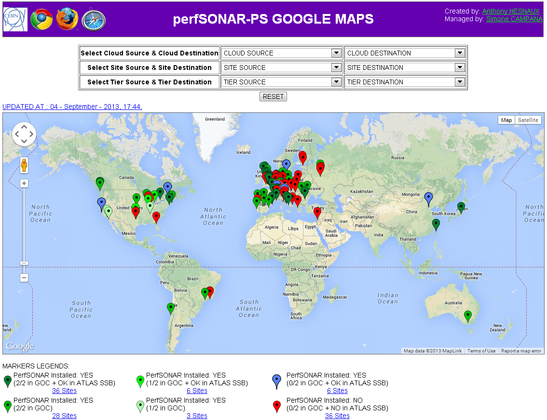
Current WLCG Deployment
115 sites shown, estimated ~150 sites eventually

Slide 13
Use of perfSONAR-PS Metrics
Throughput: Notice problems and debug network, also help differentiate server problems from path problems
Latency: Notice route changes, asymmetric routes
  Watch for excessive Packet Loss
On-demand tests and NPAD/NDT diagnostics via web
Optionally: Install additional perfSONAR nodes inside local network, and/or at periphery
  Characterize local performance and internal packet loss
  Separate WAN performance from internal performance
Daily Dashboard check of own site, and peers

Slide 14
Debugging Network Problems
Using perfSONAR-PS we (the VOs) identify network problems by observing degradation in regular metrics for a particular “path”
  Packet-loss appearance in Latency tests
  Significant and persistent decrease in bandwidth
  Currently requires a “human” to trigger.
Next check for correlation with other metric changes between sites at either end and other sites (is the problem likely at one of the ends or in the middle?)
Correlate with paths and traceroute information. Something changed in the routing? Known issue in the path?
In general NOT as easy to do all this as we would like with the current perfSONAR-PS toolkit

Slide 15
Success Stories
The deployment of perfSONAR-PS toolkit instances has found numerous network issues
  In USATLAS the first time sites deployed PS, we found numerous network issues (dirty fibers, misconfigurations) as soon as we started regular testing
  Once the scheduled tests were in place we found problems as network configurations were changed. Some recent examples:
    OU routing changed from NLR to Internet2 and we almost immediately identified a path problem.
    AGLT2 suddenly saw significant transfer slowdowns but just to some Tier-2s. Used PS measurements to identify a dirty jumper in Chicago after a networking change.
    Transitions to using LHCONE were tracked with PS tests. Nebraska and OU both saw problems in one direction identified by PS tests
    Similar experiences in Europe and Asia as PS testing was deployed
In general, subtle problems abound and it requires standard measurements to identify them and isolate them.

Slide 16
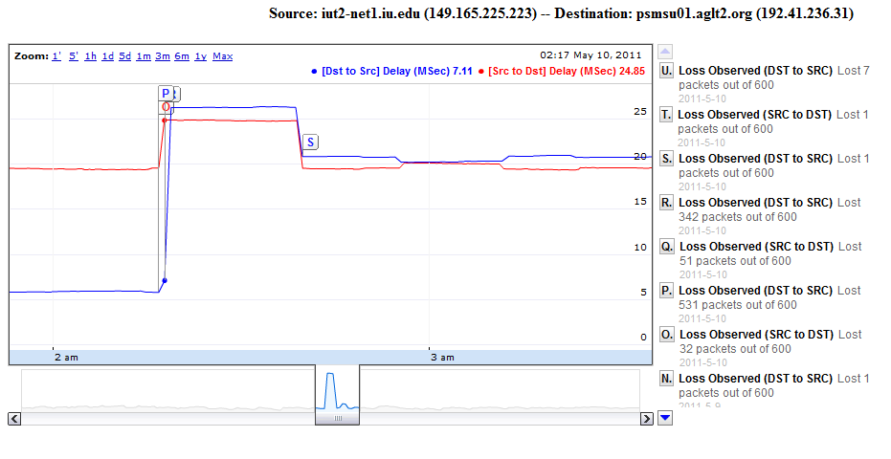
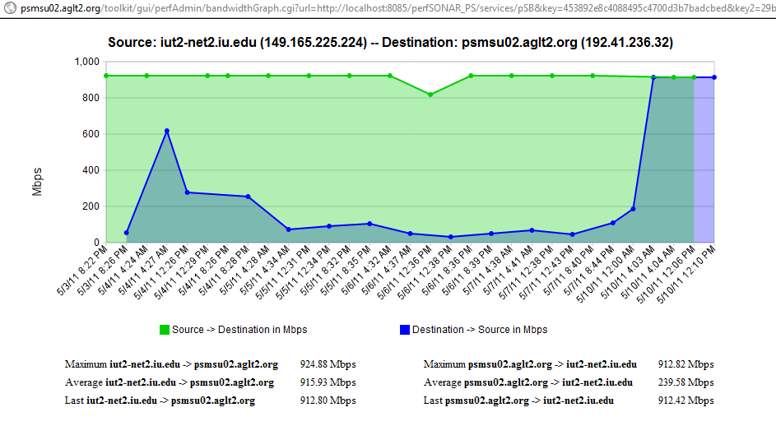
Example: Fix Assymetric Throughput
Asymmetric throughput between peer sites IU and AGLT2 resolved

Slide 17
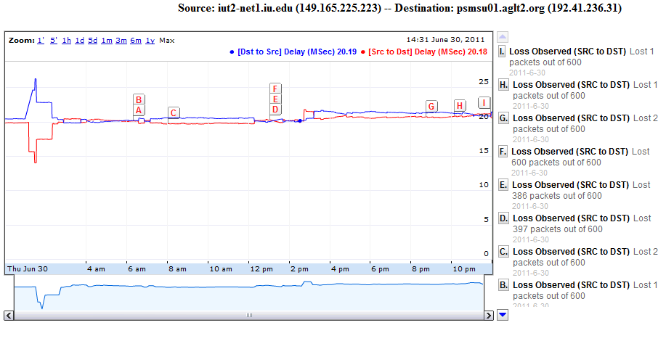
Example of Problem Solving
Problem at MSU after routing upgrade work, noticed small 0.7ms latency increase
Traceroute found an unintended route change (packets destined to MSU were going through UM) → routing prefs quickly fixed

Slide 18
High Level perfSONAR-PS Issues
If we want to rely upon network metrics we need to be sure we understand what we are collecting and how we are collecting it.
  All sites should co-locate perfSONAR-PS instances with their storage resources (same subnet and switches)
  If some sites are not doing this we need to flag them appropriately
The complete set of metrics: latency/packet-loss, bandwidth and traceroute need to be collected on “important” paths
  Some test-sets (meshes) may end up with subsets depending upon impact
We know there are potential anomalous readings when testing between 10g and 1g instances. Need to flag those.
  perfSONAR-PS developers are aware of this issue but there is not yet a solution provided within the toolkit

Slide 19
Network Monitoring Challenges
Getting hardware/software platform installed at all sites
Dashboard development: Need additional effort to produce something suitable quickly and ensure it meets our needs…
Managing site and test configurations
  Testing and improving “centralized” (VO-based?) configurations
  Determining the right level of scheduled tests for a site, e.g., Tier-2s test to other same-cloud Tier-2s (and Tier-1)?
  Address 10G vs 1G tests that give misleading results
Improve path monitoring (traceroute) access within the tool
Alerting: A high-priority need but complicated:
  Alert who? Network issues could arise in any part of end-to-end path
  Alert when? Defining criteria for alert threshold. Primitive services are easier. Network test results more complicated to decide
Integration with VO infrastructures and applications

Slide 20
Improving perfSONAR-PS Deployments
Based upon the issues we have encountered we setup a Wiki to gather best practices and solutions to issues we have identified: http://www.usatlas.bnl.gov/twiki/bin/view/Projects/LHCperfSONAR
This page is shared with the perfSONAR-PS developers and we expect many of the “fixes” will be incorporated into future releases (most are in v3.3.1 already)
Improving resiliency (set-it-and-forget-it) a high priority. Instances should self-maintain and the infrastructure should be able to alert when services fail (OIM/GOCDB tests)
Disentangling problems with the measurement infrastructure versus problems with the measurements…

Slide 21
perfSONAR-PS Wishlist
Continued reliability/resiliency improvements
  Must be “set-it-and-forget-it” to meet the needs of the bulk of our users
Topology/path diagnosis support
  Traceroute sensitive to ECMP (“Paris” traceroute)
  Tools/gui to:
    visualize route
    show router port usage
    show drops/errors
    Identify perfSONAR-PS instances on the path
  Path comparison/correlation tools using metrics coupled + traceroutes (identify “bad” paths via multiple measurements)
Alerting and alarming
  Support for configuring notification to alert users to network problems
    NAGIOS support exists but not well matched to multidomain issues
  Alarms targeted at most likely problem domain
Handle jumbo frames and NIC speed mismatches
  10GE testing to 1GE “overruns” and provides misleading information
Support for additional tests (Iperf variants, new tools, etc)

Slide 22
Future Use of Network Metrics
Once we have a source of network metrics being acquired we need to understand how best to incorporate those metrics into our facility operations.
Some possibilities:
  Characterizing paths with “costs” to better optimize decisions in workflow and data management (underway in ANSE)
  Noting when paths change and providing appropriate notification
  Optimizing data-access or data-distribution based upon a better understanding of the network between sites
  Identifying structural bottlenecks in need of remediation
  Aiding network problem diagnosis and speeding repairs
  In general, incorporating knowledge of the network into our processes
We will require testing and iteration to better understand when and where the network metrics are useful.

Slide 23
Closing Remarks
Over the last few years WLCG sites have converged on perfSONAR-PS as their way to measure and monitor their networks for data-intensive science.
  Not easy to get global consensus but we have it now after pushing since 2008
The assumption is that perfSONAR (and the perfSONAR-PS toolkit) is the de-facto standard way to do this and will be supported long-term
  Especially critical that R&E networks agree on its use and continue to improve and develop the reference implementation
Modular dashboard critical for “visibility” into networks. We can’t manage/fix/respond-to problems if we can’t “see” them.
Having perfSONAR-PS fully deployed should give us some interesting options for better management and use of our networks

Slide 24
Discussion/Questions
Questions or Comments?

Slide 25
Relevant URLs
perfSONAR-PS site http://psps.perfsonar.net/
Install/configuration guide: http://code.google.com/p/perfsonar-ps/wiki/pSPerformanceToolkit33
Modular Dashboard: https://perfsonar.racf.bnl.gov:8443/exda/ or http://perfsonar.racf.bnl.gov:8080/exda/
Tools, tips and maintenance: http://www.usatlas.bnl.gov/twiki/bin/view/Projects/LHCperfSONAR
OSG networking pages https://www.opensciencegrid.org/bin/view/Documentation/NetworkingInOSG
GitHub perfSONAR Modular Dashboard: https://github.com/PerfModDash/PerfModDash
http://perfsonar.racf.bnl.gov:8080/PsDisplay-1.0-SNAPSHOT/matrices.jsp?id=1
WLCG Installs http://twiki.cern.ch/twiki/bin/view/LCG/PerfsonarDeployment

