Slide 1
HEPiX bit-preservation WG
Dmitry Ozerov/DESY
Germán Cancio/CERN
HEPiX Fall 2013, Ann Arbor

Slide 2
Agenda
Bit-preservation WG: background, mandate
Large archive sites survey
  main findings
Conclusions & next steps

Slide 3

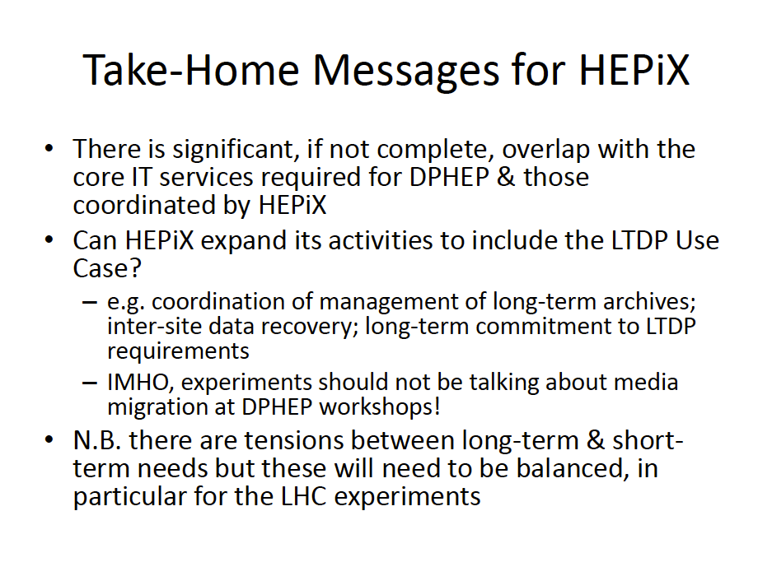
Bit-preservation WG: Background
Request from DPHEP @ HEPiX spring 2013:

Slide 4
Bit-preservation WG: Mandate
The goal of the HEPiX Bit Preservation Working Group is to share ideas, practices and experience on bit stream preservation activities across sites providing long-term and large-scale archive services. Different aspects should be covered like: technology used for long-term archiving, definition of reliability, mitigation of data loss risks, monitoring/verification of the archive contents, procedures for recovering unavailable and/or lost data, procedures for archive migration to new-generation technology.
The Working Group responds to a request by the DPHEP collaboration for advice on technical matters of bit preservation.
The Working Group will produce a survey on existing practices across HEPiX and WLCG sites responsible for large-scale long-term archiving. The collaboration should ideally be extended to other large-scale archive sites from other research fields outside HEP.
Based on best practices and development in storage preservation activities, the Working Group will provide recommendations for sustainable archival storage of HEP data across multiple sites and different technologies.

Slide 5
Bit-preservation WG: Mandate
Collecting and sharing knowledge on bit preservation across HEP (and beyond)
Provide technical advise to
Recommendations for sustainable (distributed) archival storage in HEP
w3.hepix.org/bit-preservation

Slide 6
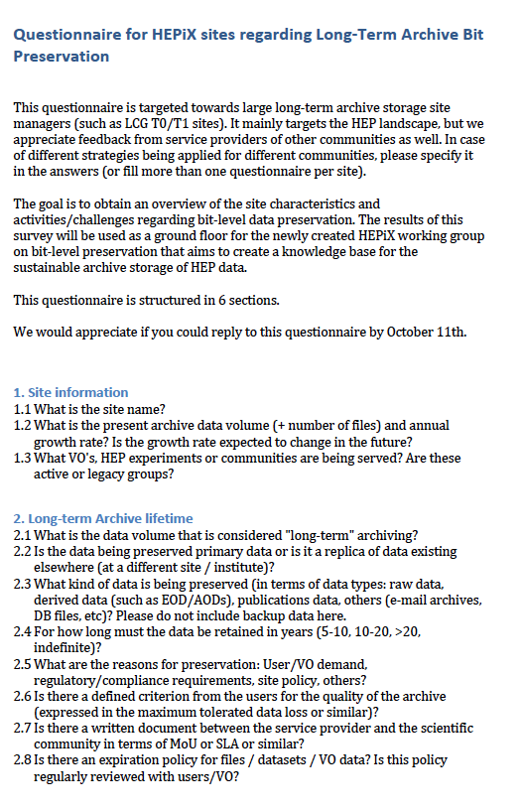
















Large archive sites survey
Targeted towards large long-term sites (such as LCG T0/T1 sites)
Goal is to obtain an overview of the site characteristics and activities/challenges regarding bit-level data preservation.
40 questions structured in 6 sections
Survey sent to 21 sites, received 18 answers: THANKS
  2 sites had no input to provide (“young” sites, no archiving experience)
  All “large” HEPiX/WLCG Tier-1 sites provided input

Slide 7
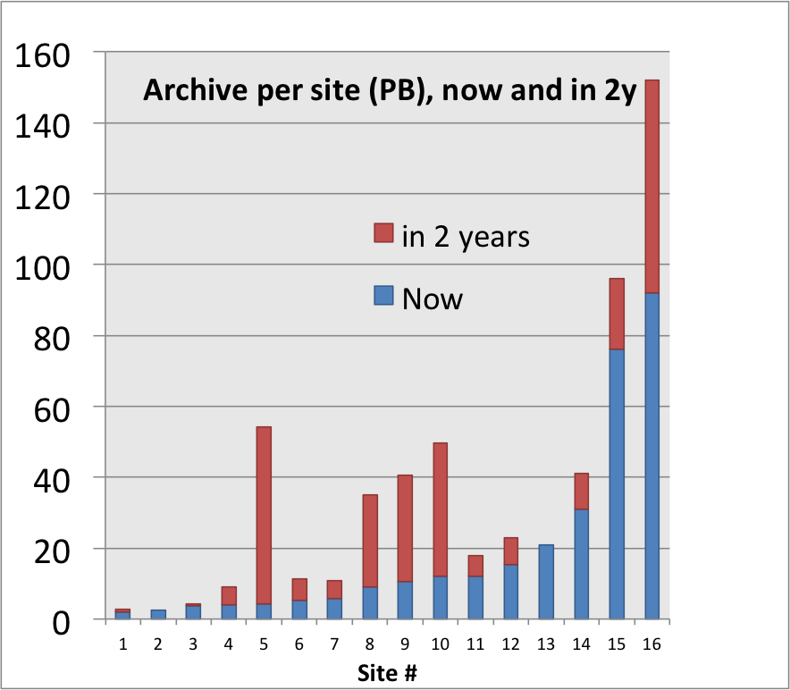
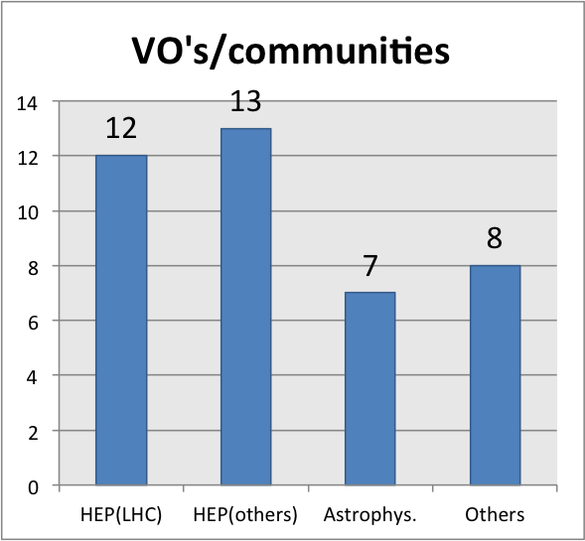
Survey: Site information
Per-site archive volume: 2-92PB
  Total archive space = 306 PB
  Future yearly growth 0% - 10x
  > 0.57 EB (+86%) expected end 2015!
Served VO’s/communities:
  2 sites serving only LHC
  One site serving a single community
  8 sites serving non-running HEP experiments

Slide 8
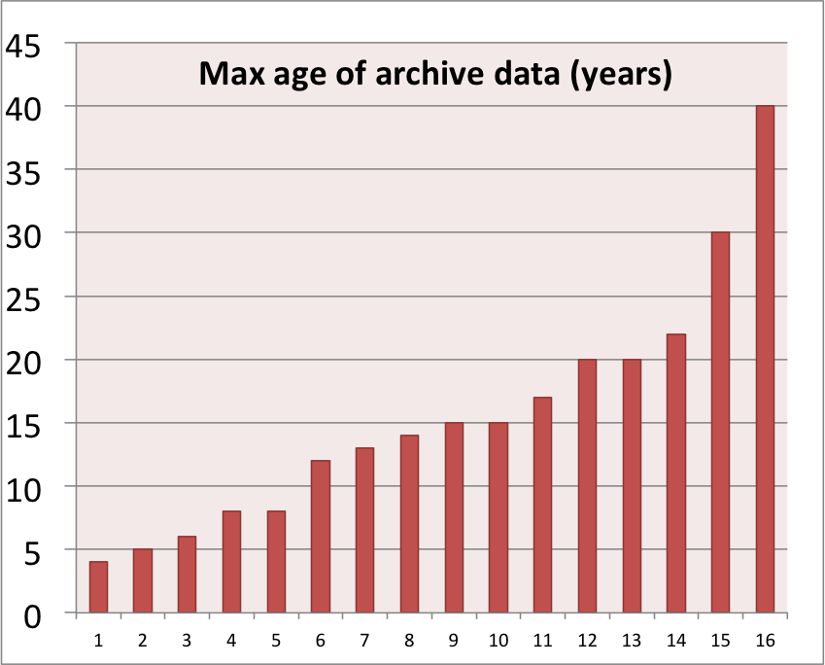
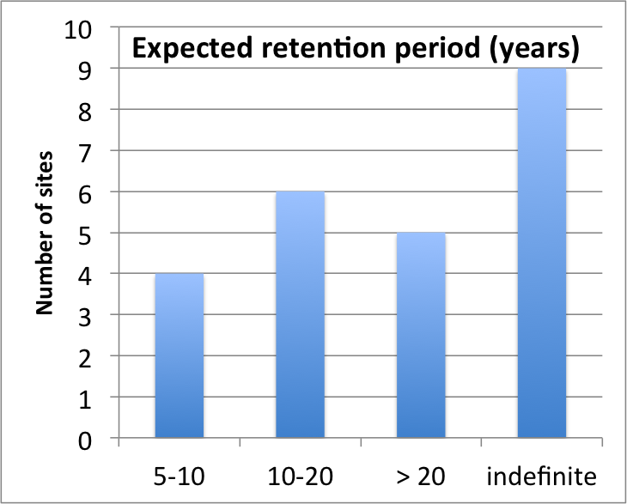
Survey: Archive lifetime(1)
Vast majority of sites see all archived data as “long-term” (297PB out of 306PB)
ALL sites store custodial data (no replica elsewhere). LHC data – mostly replicated; non-LHC: mostly not!
Current archived data dating back 4..40 years
Expected retention period: 5y.. indefinite (≠ infinite!)
Only 2 sites have a data expiration policy
  4 sites admit preserving data “for no good reason” (unclear utility / ownership)
Only 4 sites confirm that budget is secured
for the complete preservation lifetime!

Slide 9
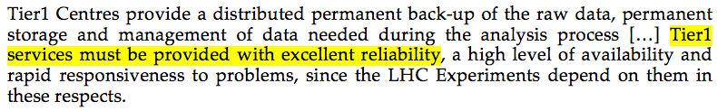
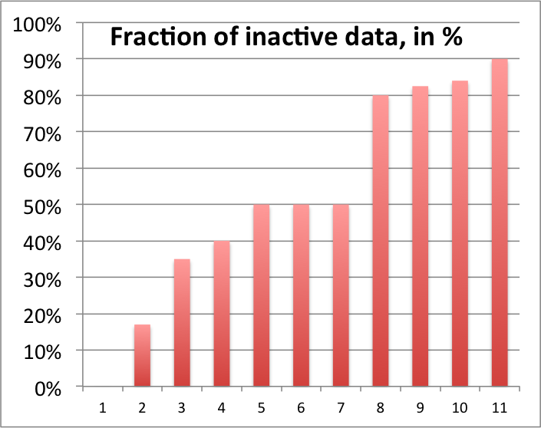
Survey: Archive lifetime(2)
Only 4 sites have an SLA or QoS user agreement wrt data loss. 8 have signed the WLCG MoU…
Most sites quoting “no data loss” as user expectancy(!)
Large fractions of “cold” data (average: 53%)
  “cold” == not accessed > 12 months

Slide 10
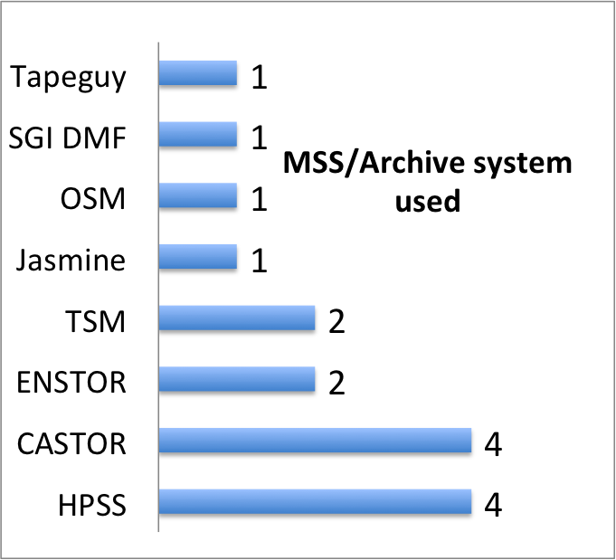
Survey: Archive Storage / Access
All but one sites: No dedicated archiving solution, main MSS == main archive
  Not an intentional choice, but became so de-facto
8 different systems (commercial/OSS)
  3 single-instance tools
  Staffing ~ >=1 FTE (more for larger sites)
On all sites data is available online or “nearline” (robotic libraries)
Data is accessible directly to the users via standard POSIX-like and/or HEP protocols (ie SRM/GridFTP/xroot).
  Except one site where data is “packaged” and needs user transformation

Slide 11
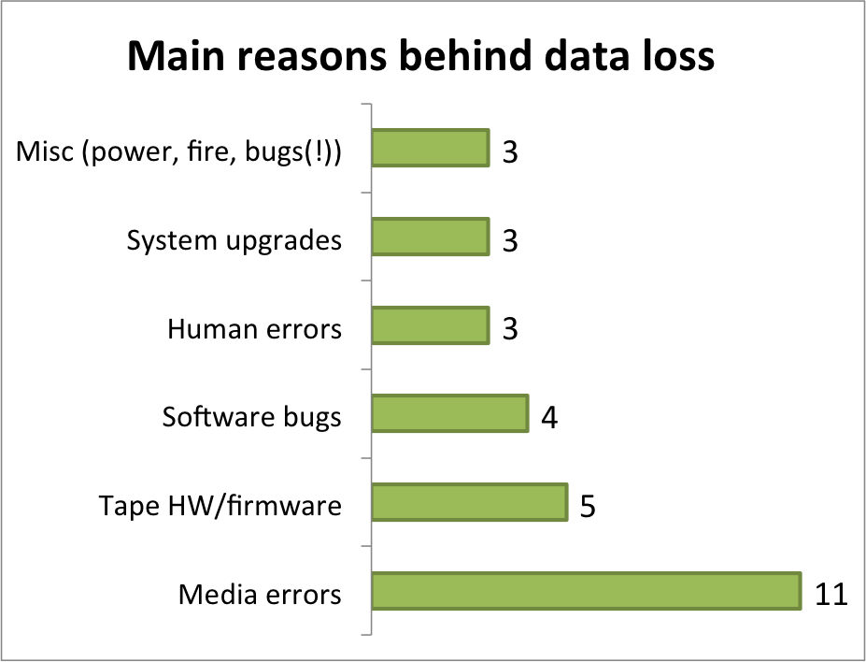

Survey: Archive reliability
Observed data losses ranging from O(10⁻⁸) to O(10⁻⁴) bytes lost / bytes written / year.
  (or… from 10MB up to 100GB lost/PB/year !!)
  Big sites: O(10⁻⁸) to O(10⁻⁷)
  1 site: 0% loss (redundant
  data)
  1 site: 12% (human error
  during migration)
Bit Rot

Slide 12

Survey: Archive protection / audit
Most sites (11) use checksums (adler32, md5)
Most sites (10) use file-level replication for “important” data. No RAIT used
One (large) site flips the R/O tab once tapes get filled
(Background) media scans done by half of the sites.
  All tape contents scanned (2 sites)
  partial scans (begin/end/random samples) (5 sites)
Survey shows correlation between higher data loss and no media scanning!
Data loss notification is manual in all cases
  Sites contact the owner or the VO/community … via e-mail or issuing a ticket (WLCG)
Recovery after data loss is always left to the affected user/community
  No site-to-site recovery procedure even if replicas exist elsewhere.

Slide 13
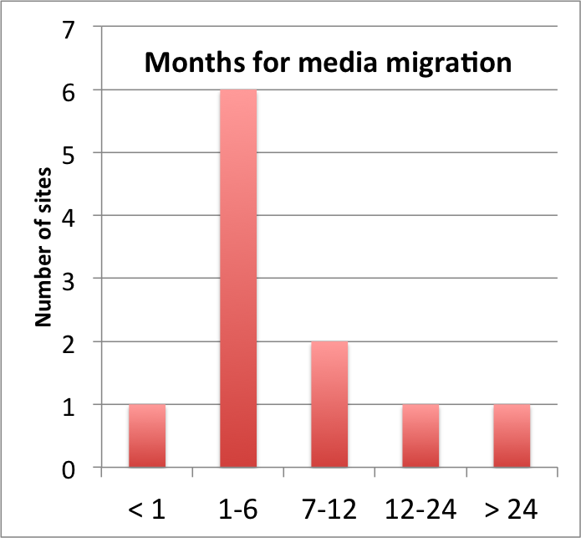
Survey: Archive migration
Most sites (13) have media migration experience.
Migration interval in line with tape hardware cycles: 3-5 years, duration in function of archive size
Manpower involved for most of sites <1FTE (except larger sites)
Two sites require users to select what needs to be migrated -> all others: everything!
50 % of the sites report integrity problems -> data loss detected during migration.
2 sites report that they won’t be able to bring forward their complete archive to newer storage generations (lack of funding/resources)

Slide 14
Survey: Summary
Archiving has become a reality by fact rather than by design (MSS==archiving system)
Often no clear understanding, SLA or agreement of how long archived data should live.
  Often no funding commitment across complete preservation period.
  Data owners are currently active experiments, many about to terminate, who takes over?
Bit rot implying data loss is a reality. Missing QoS or detailed SLA’s defining acceptable data loss rates. Users seem to expect “no data loss”
Redundancy of data is a way for reducing data loss
  Intra-site for small / legacy experiments with small footprint
  Inter-site for larger ones (LHC et al)
Regular archive audits help improving reliability & reducing migration troubles
  “Cold” data growing and can’t be left alone
No inter-site replica recovery; sites rely on users/VO’s for this.
  Is this optimal?
  Complexity is high: ~ to (# VO’s) x (Storage systems) x (Sites).

Slide 15
Conclusions and next steps
Survey gives good overview of HEP bit-level archiving
  Mostly encouraging results with room for improvement
  Redo survey outside HEP (large scientific communities) and compare results?
Collect, document and share best practices at forthcoming HEPiX meetings
  Archive protection and audit
Tackle automation of data recovery for distributed archives
Contributors welcome
  w3.hepix.org/bit-preservation
  bit-preservation@hepix.org

Slide 16
Reserve slides

Slide 17
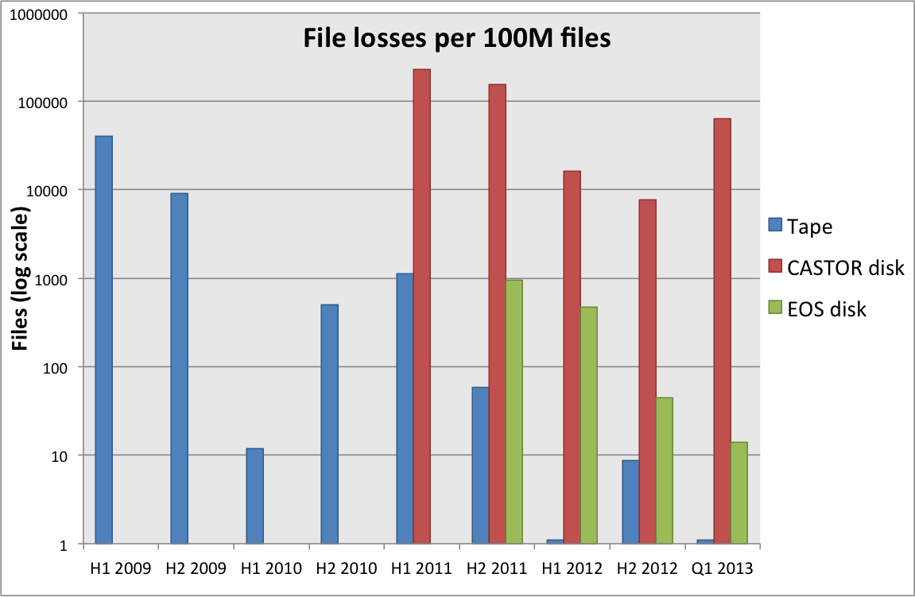
Reliability
File loss is unavoidable and needs to be factored in at all stages
Good news: it has been getting better for both disk and tape
Disk storage reliability greatly increased by EOS over CASTOR disk
  RAID-1 does not protect against controller or machine problems, file system corruptions and finger trouble
Tape reliability still ~O(1) higher than EOS disk
  Note: single tape copy vs. 2 copies on disk

