Slide 1
RAL Site Report
HEPiX Fall 2013, Ann Arbor, MI
28 Oct – 1 Nov
Martin Bly, STFC-RAL

Slide 2
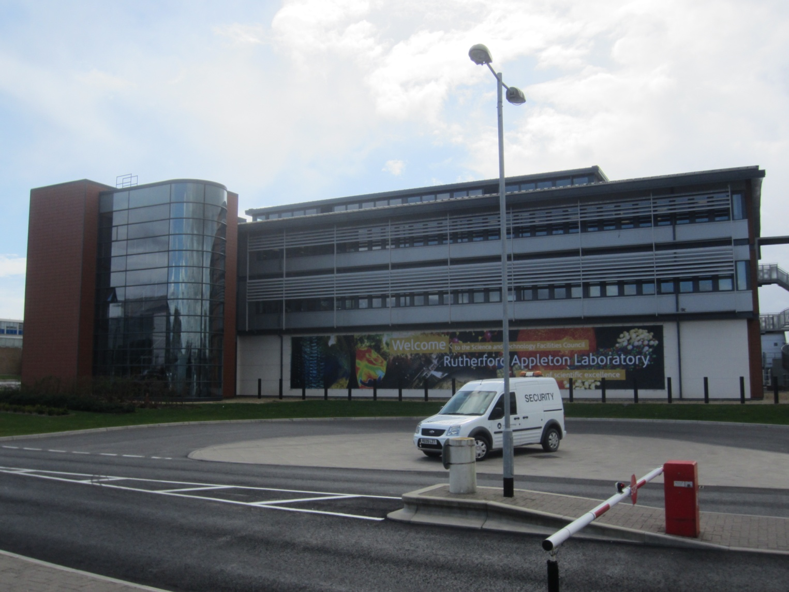

Slide 3
Tier1 Hardware
CPU: ~97k HS06 (~10k cores)
Storage: ~8PB disk
Tape: 10k slot SL8500
FY13/14 procurement
  ~7.0PB useable capacity disk storage
  ~46k HS06 CPU
  Tenders evaluated, in EU standstill period
  Much better benchmarking by vendors this time!
  Same as the FY12/13 model with bigger drives or faster CPUs
2007 kit mostly decommissioned
2008 generation being phased out
Notes:
Usual litany of hardware updates.

Slide 4
Networking
WAN
  RAL site has migrated to new Janet6 (aka SuperJanet 6) backbone
  Dual 30Gb/s active/passive failover link
  Two routes on to site
Tier1 link to boundary now re-established at 20Gb/s
  10Gb/s to CERN, 10Gb/s to Janet6
LAN
  Mix of Dell/Force10 S4810p & 60, Arista 7124, Nortel/Avaya 55xx & 5
  6xx series. Mesh and routing with z9000 and Extreme x670
  Tier1 migration to Mesh network
    Testing internally complete, testing routing connections

Slide 5
Batch system
HTCondor selected as replacement for Torque/Maui
  Rollout in progress
Migrating from CREAM to ARC CEs
  SL6
Current status
  All batch resources on SL6
  50% CPU resources moved to HTCondor
  Migration will be completed in early November
Testing opportunistic use of resources from private cloud in the batch system
See talk by Andrew Lahiff

Slide 6
Grid Services
SL6 migration mostly done
New FTS3 system
  MySQL backend database, VMs
  Advanced testing
  Production transfers with Atlas
Quattor/Aquilon
  200 systems now managed with Aquilon
  Research Infrastructure Group experimenting with it
Most services on VMs
  Have or had issues with ganglia, BDIIs
CVMFS service working well
  Talk on Stratum-0 by Ian Collier

Slide 7
CASTOR / Storage
Stats as of October 2013:
  64m files
  Stored data capacities:14PB on tape and 8PB on disk
Recent news:
  Preparing for T10KD tape media for production next year
  Developed a new WebDAV front end
    Not fully production ready yet.
Next generation (disk) storage project continues
  Challenge: Try to find something simple and easy to run in conjunction with CASTOR for tape access
  Review of options in May concluded that there was no compelling reason to move from CASTOR at this time
  Testing of CEPH continues as option for storage in Cloud infrastructure
AFS: Terminating RAL cell on November 5th

Slide 8
UPS circuit uprating / testing
Uprating of ‘Essential Power Board capacity
  400A to 630A
  Requires complete isolation from supply and UPS
  No UPS supply to protect HA services etc
    Tier1, HPC and Corporate systems
  Plan to have minimum service running
    Migrate various essential Corporate services up to Daresbury Lab
    Migrate Tier1 VMs to Hypervisor cluster in old computer centre
  Shutdown Castor, batch, all non-essential services
Mandatory testing requirement – regulatory requirement
  Taking opportunity to test all UPS circuits from source
Half-day for Essential Board, Castor fast-restart thereafter
Batch resumes when all other services are back and stable

Slide 9
Other stuff
‘Facilities’ are using Castor, StorageD services
  Run by SCD
  Dedicated Castor instance with a set of associated services
  Separate Nagios instance
    using "Icinga" rather than "Nagios”
Various UPS generator ‘failures’
  Failed starts, failure to assume load etc
  Due to latent faults and poor initial installation
  More rigorous testing regime
    Full load tests conducted more often

Slide 10
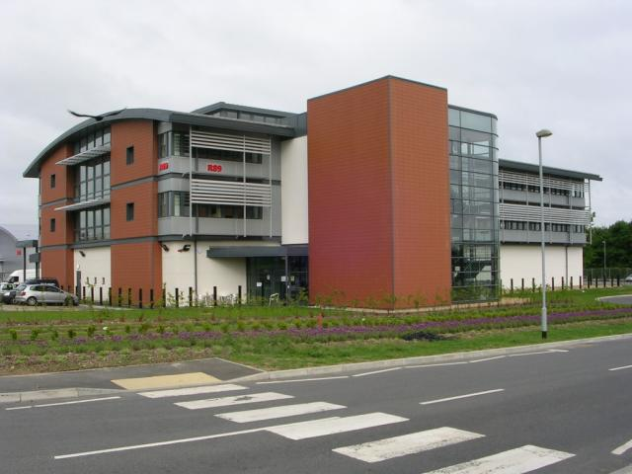
Questions?

