Slide 1

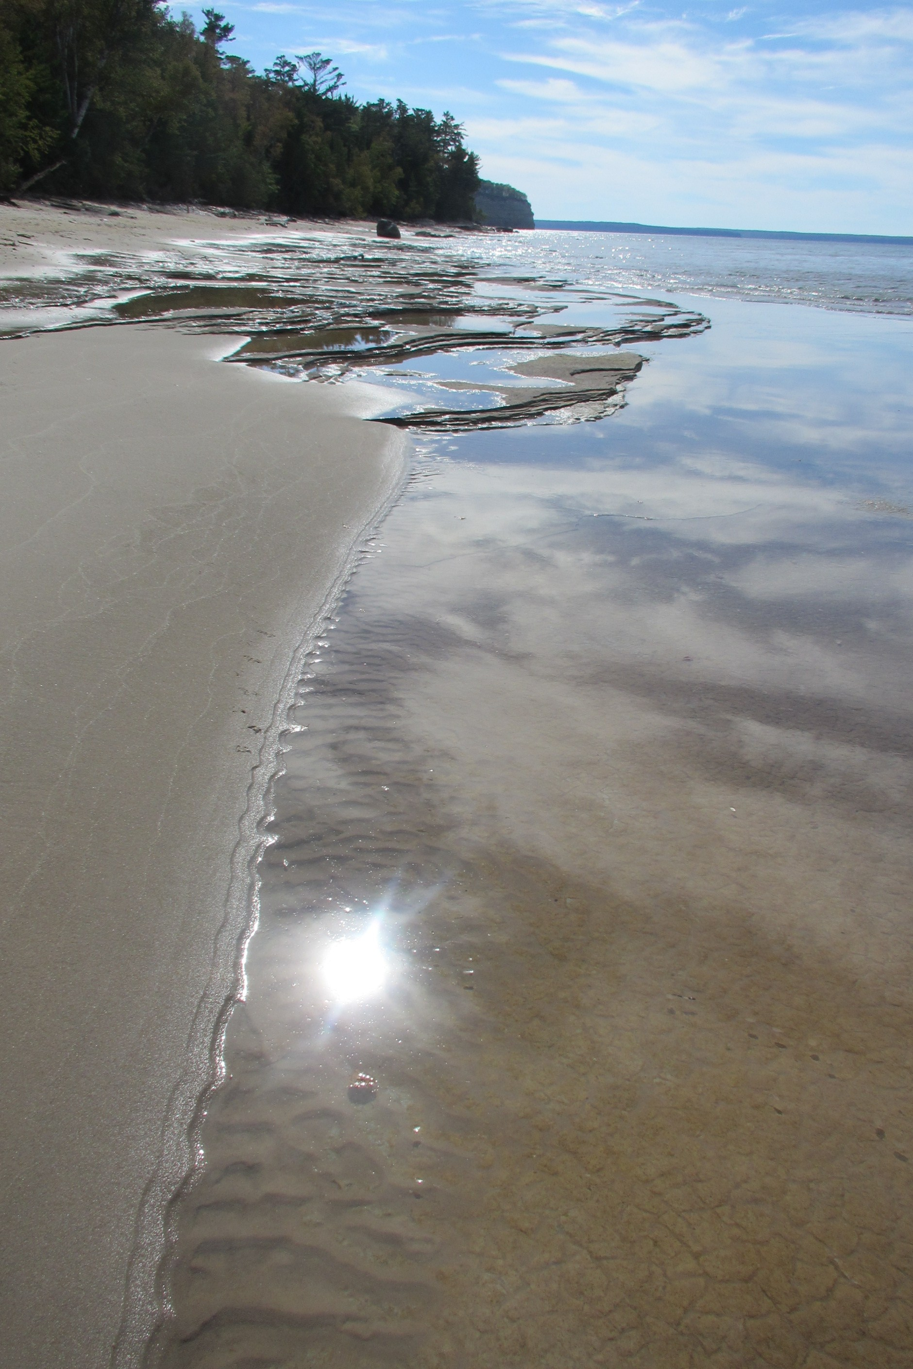

AGLT2 Site Report
Benjeman Meekhof
University of Michigan
HEPiX Fall 2013

Slide 2
Outline
Site Summary and Status
Transition to SL6 and Rocks 6
Provisioning with Cobbler
Complete transition to CFEngine 3
AFS on Linux ZFS
dCache Status
Virtualization Status
Networking Upgrade
Conclusion
Benjeman Meekhof
University of Michigan

Slide 3
Site Summary
The ATLAS Great Lake Tier-2 (AGLT2) is a distributed LHC Tier-2 for ATLAS spanning between UM/Ann Arbor and MSU/East Lansing. Roughly 50% of storage and compute at each site
  4616 single core job slots
  10 eight-core (multi-core) job slots
  350 Tier-3 job slots usable by Tier-2
  Average 9.03 HS06/slot
  3.5 Petabytes of storage
Most Tier-2 services virtualized in VMware
10Gb redundant ring for inter-site connectivity, lots of 10Gb internal ports and 12 x 40Gb ports
High capacity storage systems have 2 x 10Gb bonded links
40Gb link between Tier-2 and Tier-3 physical locations
Benjeman Meekhof
University of Michigan

Slide 4
Rocks 6 and SL6
Installed using Rocks 6.1 jumbo roll
Uses SL6.4 as OS roll
  Created from SL6 rpm repo using "rocks create mirror“
DB of appliances, WN, etc created using ASCII command dumps from previous Rocks5 headnode
  Utilized various "rocks dump" and "rocks list" commands
  Separate head nodes for WN at MSU and UM sites
Initial rollout to a subset of WN, fed by an SL5 gatekeeper
  Re-tested with SL6 gatekeeper
Full rollout in May, 2013
Benjeman Meekhof
University of Michigan

Slide 5
Rocks 6 and SL6
Rocks software distribution via rolls (T. Rockwell original development)
  Eg, agl-osg3, agl-condor, agl-cvmfs....
  Keeps various functionality logically separated
  Understanding of rpm significance is greatly simplified
Rolls updated to SL6, built, and distribution tested
  Based upon existing SL5 xml maintained in AGLT2 svn repository
  SL5 functionality maintained with additional SL6 requirements
Additional post-build configuration applied via CFEngine 3
Benjeman Meekhof
University of Michigan

Slide 6
Provisioning with Cobbler
Before Cobbler: simple PHP script to generate kickstart files using information inserted into Rocks database (for lack of better place)
Now we have Cobbler server configuration managed by CFEngine and duplicated at both sites for building service nodes (excepting site-specific network/host info)
  Created flexible default kickstart template with Cobbler’s template language (Cheetah) to install a variety of “profiles” as selected when adding system to Cobbler (server, cluster-compute, desktop, etc).
  Simple PXE based installation from network
  Cobbler handles (with included post-install scripts) creating bonded NIC configurations – used to deal with those manually
  Cobbler manages mirroring of OS and extra repositories
Kickstart setup is kept minimal and most configuration done by CFEngine on first boot
Dell machines get BIOS and Firmware updates in post-install using utils/packages from Dell yum repositories
Long term we plan to replace Rocks with Cobbler for compute nodes
Benjeman Meekhof
University of Michigan

Slide 7
Complete transition to CFEngine 3
Our first configuration management system was CFEngine 2
  Implemented at UM, not MSU
  Not used in compute cluster, only service nodes
About 1+ years ago introduced CFEngine 3 for basic management of compute cluster – other systems still version 2.
Finally this year we’ve migrated all necessary CFEngine 2 logic to version 3
  UM and MSU sites use identical policy code for compute and service nodes
  Policy changes versioned in SVN
Developed workflow which easily allows any person to work on their own SVN branch and export it for testing from policy server
Performed extensive evaluation of Puppet/Foreman
  Combination of Foreman/Puppet/Hiera/PuppetDB has interesting features
  We have already extensive CFEngine expertise and working policy
  Prefer the simplicity and flexibility of CFEngine
  Cobbler isn’t as pretty as Foreman but good CLI, ISO export, simpler setup.
Benjeman Meekhof
University of Michigan

Slide 8
AFS on Linux ZFS
At AGLT2 we run our own AFS cell atlas.umich.edu
Originally this was run on dedicated hardware nodes and had 3 DB servers and 3 file servers (1TB /vicepX partitions)
We added an additional two file servers at CERN in 2008 to provide specific storage for ATLAS muon chamber data
Once we invested in VMware we migrated our AFS services there
  All three DB servers were virtualized
  The three file servers at UM were virtualized and the /vicepX partitions were moved on iSCSI locations (still using ext3)
As ZFS on Linux was available we migrated to it for our AFS /vicepX storage: compression, snapshots and data integrity were primary motivations
  Compression providing factor of 1.26-1.6 increase in space depending on partition
  ‘zfs get “all” zfs/vicepg | grep compressratio’
One issue: snapshots “steal” filesystem space! Have had “full” partitions a few times requiring us to manually fix. Just need to tune snapshots and balance space
  Check space used via ‘zfs list –t snapshot’
Has worked well for us over the last few months.
Benjeman Meekhof
University of Michigan

Slide 9
dCache Status
AGLT2 running dCache 2.2.17 now
We hit unusual problem with billing DB related to rate
  Seems billing was unable to keep up with load
  Cause out-of-memory in other cells as backlog piled up.
  Lots of support emails and debugging resulted in a revised/tuned set of postgresql triggers. Problem solved!
Problem: FAX xrootd backport doesn’t work
  Can use 2.2.15 for xrootd backport but no SHA-2
  Temp-fix: run 2.2.15 on xrootd door node only
dCache 2.6.x supports BOTH xrootd backport and SHA-2 BUT requires gPlazma2 only…no gPlazma1 support
  AGLT2 had some issues converting their gPlazma1 config into gPlazma2.
  Tigran helped get the conversion working…now ready! Plan to upgrade soon
Benjeman Meekhof
University of Michigan

Slide 10
Virtualization Status
Most Tier-2 services on VMware (vSphere 5.1)
UM uses iSCSI storage backends
  Dell MD3600i, MD3000i and SUN NAS 7410
  vSphere manages virtual disk allocation between units and RAID volumes based on various volume performance capabilities and VM demand
MSU runs on DAS – Dell MD3200
Working on site resiliency details
  vSphere and storage operational at MSU
  SSO operational between sites
  Still exploring vSphere Replication and other capabilities
  Need to determine details of overall site resilient configuration, how to move services and inform upstream (or do transparently)
Goal is to have MSU capable of bringing up Tier-2 service VMs within 1 day of loss of UM site
  MSU is already operating many site-specific Tier-2 VMs (dcache doors, xrootd, cobbler) on vSphere
  Need to finish testing and specifics of disaster recovery for UM Tier-2 services
Benjeman Meekhof
University of Michigan

Slide 11
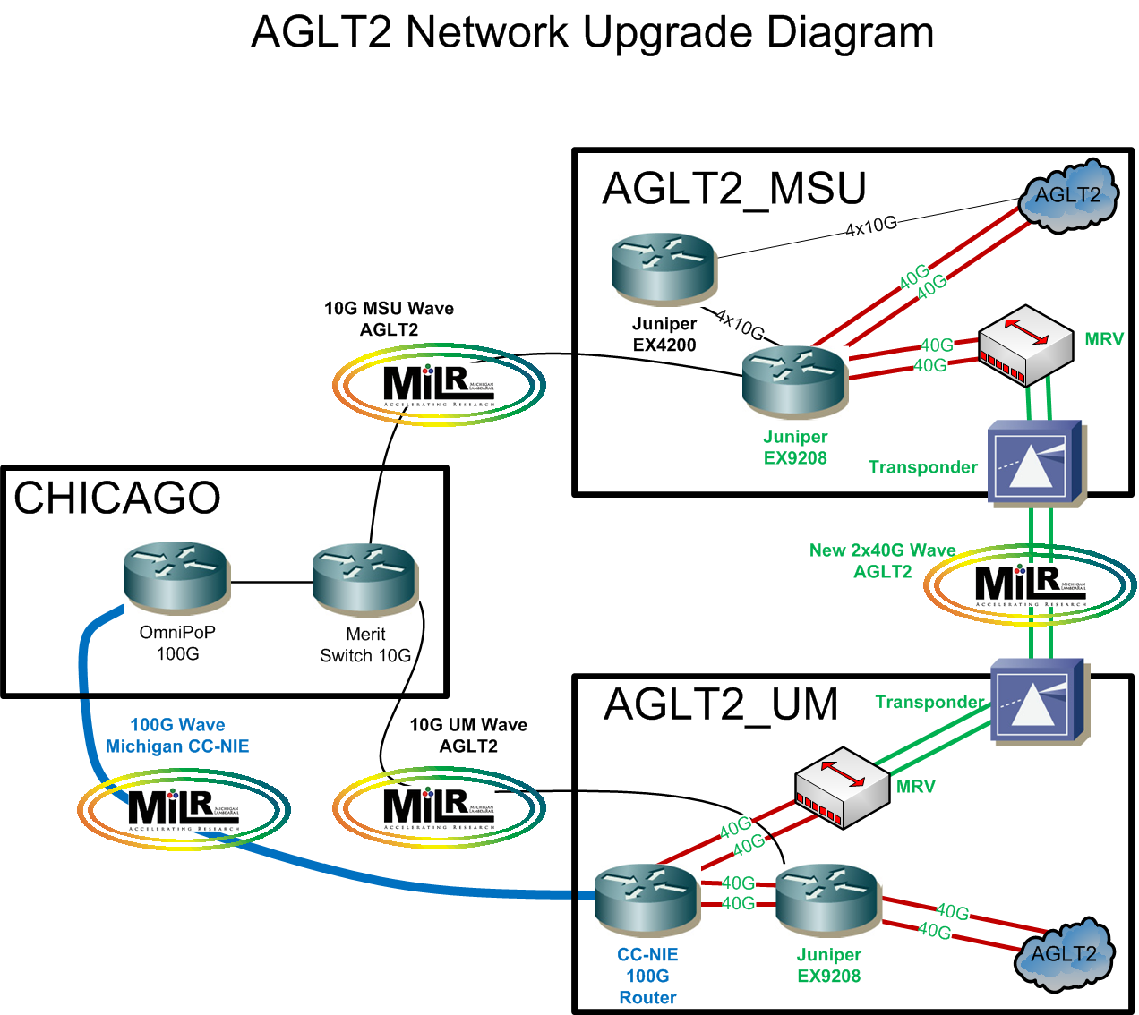
Networking Upgrade
AGLT2 is in the process of upgrading our LAN/WAN
U Michigan has a new 100G connection to Chicago (funded by NSF CC-NIE)
Tier-2 used
project funds to
purchase Juniper
EX9208 routers at
UM/MSU
Deploying 2x40G
over the next month or
two. Will have 2x40G + 2x10G
to the WAN once complete
Benjeman Meekhof
University of Michigan

Slide 12
perfSONAR-PS at AGLT2
Shawn will report tomorrow on WLCG and perfSONAR-PS but I wanted to update you on how we use perfSONAR-PS at AGLT2 in this site report
The UM site has 3 sets of instances on physical machines
  Original KOI boxes (5 years old) are now in Tier-3 area
  Test-instance Dell R410 using KVM to provide bandwidth/latency
  New Dell R310/R610 “production” versions at Tier-2
In addition UM has a virtualized latency instances “pinned” to each VMWare host system to verify vSwitch connectivity
MSU also has 3 sets of instances within their Tier-2
  Original KOI boxes at the network distribution layer
  Production instances (Dell R310s) at access layer (near storage)
  Additional two boxes at the AGLT2 network border
This config allows debugging of our LAN as well as WAN
Benjeman Meekhof
University of Michigan

Slide 13
Conclusion
The Tier-2 is running well, site resiliency work is nearing a “final” solution, and Scientific Linux 5 is close to being no more than a memory
  Some minor service nodes remain SL5 (webservers, svn server, some others)
The move to Scientific Linux 6 was a major transition but it pushed us to move more quickly on transitions to new provisioning system and CFEngine 3. Our site is more manageable and organized today than ever before
  Cobbler is working out well, should be able to phase out Rocks for compute cluster
  Still see occasional SL6 issues not specific to our site
Our new Juniper switch is installed and will become the “core” switch very soon
Plans to upgrade to 40G network are underway
Despite the problems a couple months ago, dCache is running stably for us now
Benjeman Meekhof
University of Michigan

