Slide 1
Hard Disk Drive - Reliability Overview
Dr. Amit Chattopadhyay
Sr. Engineering Manager, Recording Sub-Systems
Advanced Reliability Engineering
Western Digital, San Jose

Slide 2
Outline
1
State of affairs in HDD Field Reliability
a
HDD complexity leads to a myriad of possible failure modes
b
Macroscopic objects at molecular dimensions: Head-disk Interface
c
Critical Parameters: Clearance and Workload
2
HDD reliability modeling
a
Historical model: derivation and limitations
b
Importance of workload and temperature
c
Drive parametric measurements: Virtual Failures
3
Data Center Fleet Management: In-field Health Monitor

Slide 3
Core problem in HDD reliability
Try to avoid something analogous to a ‘BP’ moment (Deepwater Horizon oil spill of 2010) - Avoid an un-manageable catastrophe midway (or beyond) through a product’s warranty life
  Referred to as ‘wear-out’ mode in reliability → unbounded Failure Rate at large times
For the drives out in the field, develop a predictive analysis for failures
QUESTIONS
How do we define a product’s “lifetime”?
How do we get visibility into what happens during this lifetime?
Can we help our customers perform effective Fleet Management in real time?

Slide 4
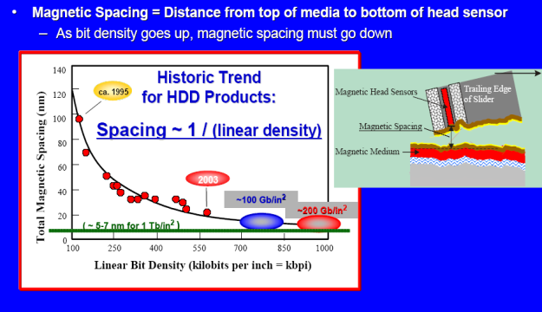
Current HDD Reliability Landscape
Increases in areal density have largely come by decreasing the head-disk spacing
  The Magnetics vs Tribology dilemma
Current head-media spacings are at molecular dimensions: 1 – 2nm
  Operating at these clearances can impact the HDD failure rates, and the failure pareto
  As much as 70% of the failure pareto is attributable to low-clearance operation
Operation at ever-decreasing spacings requires special attention be paid to:
  Anamolous physical phenomenon in ultrathin films
  Non-linear response functions, e.g. Adhesive and frictional forces
  Mechanical tolerances
  etc
Clearance trend in recent WD products
Tribology problems explode

Slide 5
Head-Media Interface Failures: A Conceptual Model
The clearance between slider and disk is a dominant factor dictating HDI reliability (∼ 70% of all failures).
Insufficient clearance results in an increased probability of head-disk interaction and eventual failure due to HFW, modulation, or head degradation
1 – 2 nm
Model
Clearance Distribution
2.5nm
2.5nm
Increased failure probability
2.0nm
μ = 2.1nm
Reduce mean
clearance
2.0nm
σ
1.5nm
1.5nm
1.6nm
1.0nm
1.0nm
0.5nm
Head-disk Interaction
0.5nm
Head-disk Interaction
DISK
DISK
In order to ensure acceptable reliability in this spacing regime, one must minimize the probability of contact……
Notes:
5

Slide 6
Influence of Clearance Mean / Sigma
HDDs require control of macro-scale mechanics to atomic dimensions!
Toy model: Failure rates as a function of both the mean clearance and the required standard deviation in clearance are shown below
Design Criteria
σ = 0.7nm
σ = 0.5nm
σ = 0.35nm

Slide 7
Influence of Clearance Mean / Sigma
HDDs require control of macro-scale mechanics to atomic dimensions!
Toy model: Failure rates as a function of both the mean clearance and the required standard deviation in clearance are shown below
Design Criteria
σ = 0.7nm
σ = 0.5nm
σ = 0.35nm
WD produces 200 million drives per year, with each having multiple heads…….. …..something on the order of 1 billion head-disk interfaces / year
The Std dev in clearance for these interfaces must all be held to within the Van der Waals diameter of a single carbon atom = 0.34nm

Slide 8
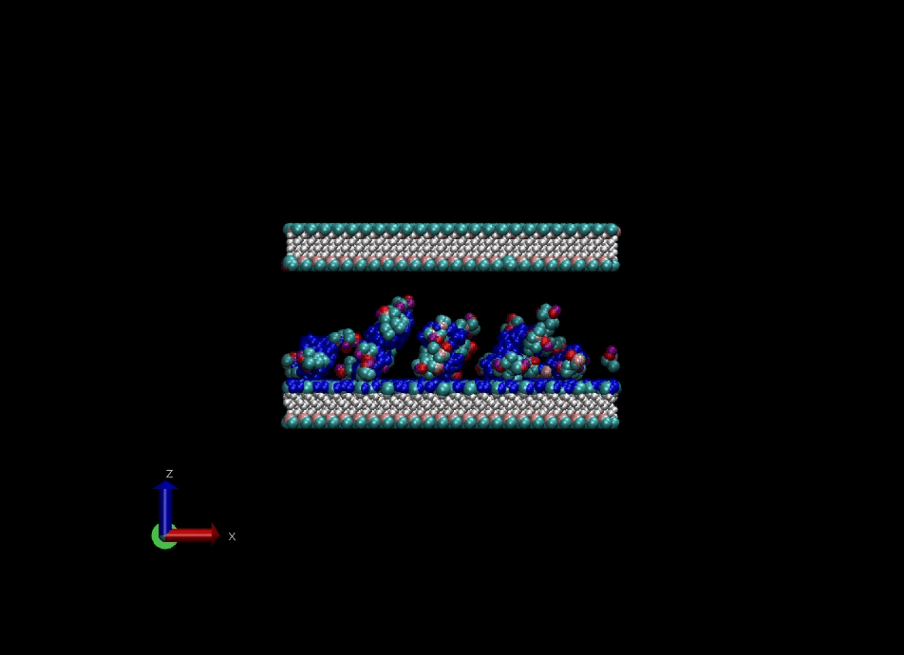
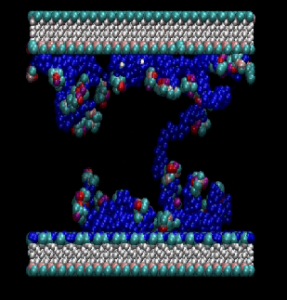
HDI: Head-Disk Interface a major challenge area
HDD are complex devices that push the envelope of our physics understanding in a number of areas
A monolayer of lubricant is used on disk surface to reduce adhesion / friction between slider and disk
Lubricant pick-up by the slider is normal
Pole Tip
Slider
“end-groups”
Lube chains
(0.8nm x 80nm)
Disk

Slide 9
Head-Disk Interface:
HDD are complex devices that push the envelope of our physics understanding in a number of areas
A monolayer of lubricant is used on disk surface to reduce adhesion / friction between slider and disk
Lubricant pick-up by the slider is normal, but lubricant pick-up in excess of one layer can pose a serious reliability risk
  HFW, OTW, modulation, and head degradation
Optical image
Chemical image
Slider
Red = excess lube

Slide 10
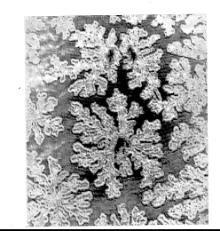
Interface: at the edge of classical thermodynamics
HDD are complex devices that push the envelope of our physics understanding in a number of areas
A monolayer of lubricant is used on disk surface to reduce adhesion / friction between slider and disk
Lubricant pick-up by the slider is normal, but lubricant pick-up in excess of one layer can pose a serious reliability risk
  HFW, OTW, modulation, and head degradation
Monomolecular films can show anamolous behavior
Optical image
Chemical image
Slider
Red = excess lube
  Non-classical thermodynamics: physical properties are dependent on the amount of material present
Terraced Spreading
Lube Fractals
Terraced Spreading
5th monolayer
3rd monolayer
Fractal Formation
Stable bilayer
3 monolayers
Film Thickness (A)
∼4nm height
Stable bilayer
1st Stable monolayer
1 monolayer

Slide 11
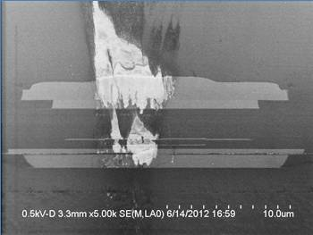
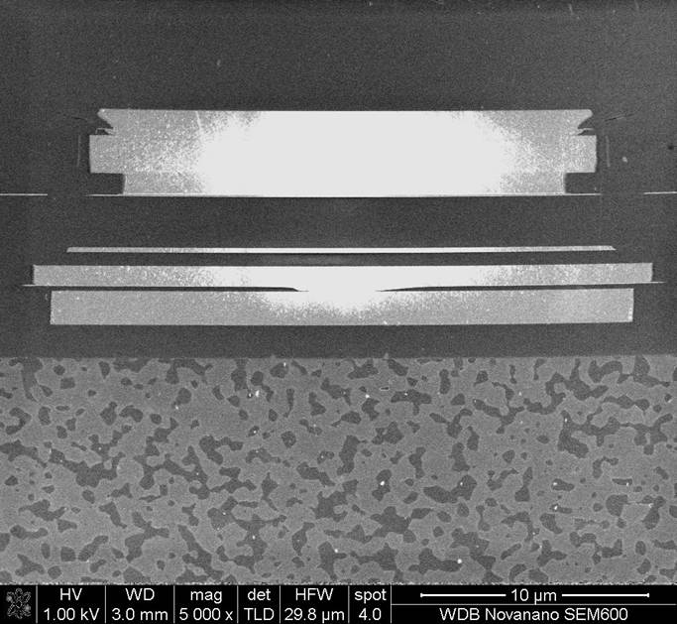
…..with some Chemistry and Materials Science
Protective diamond-like carbon (DLC) overcoats are used on both the head and disk surfaces
  Constant pressure to thin these overcoats for the purpose of decreasing the magnetic separation distance …..and thereby improving magnetic signal / areal density
  Current DLC thicknesses on the order of 2nm
  As these thicknesses are reduced, various reliability risks can arise
Disk example: migration of magnetic material to head-disk interface
  Corrective action required modification to carbon deposition energetics / process
Head example: contact stress can result in wear of the pole tip
  Corrective action required stricter process control measures
  Process optimization of sp³ / sp²
O
O
H
Co
Co⁺²
Co
O
H
Carbon
Co⁺²
N⁺
N⁺
N⁺
Co⁺²
N⁺
Co⁺²
Co⁺²
Co⁺²
2nm
Co⁺²
Co⁺²
Co⁺²
Co⁺²
Co⁺²
Co⁺²
Co⁺²
Magnetics
Co smear
Carbon wear

Slide 12
HDI failure rates: critical component attributes
Maintaining sufficient clearance, and hence ensuring interface reliability is a multi-dimensional problem.
HDD reliability is certainly not boring
  New issues seem to accompany development of each new product generation
  Since HDD complexity complicates reliability modeling, must focus on most likely failure modes
Any simple reliability model is bound to have some weaknesses given this complexity
D:G Ratio
hardness
Media
Lubricant
Bonding kinetics
Polarity
Overcoat Material
End Group Structure
Film Thickness
Bonding Ratio
Humidity sensitivity
Density
Deposition
technique
Thickness
Disjoining Pressure
Roughness
Surface Energy
PFPE Backbone
Polarity
Microwaviness
C1/C2/C3
Polydispersity
Surface
Additives
Molecular Weight
composition
γ
Active sites
type
Concentration
Surface mobility
HDI Failure Rate
Min.FH
Roll
Pitch
Pole tip
protrusion
Fly Height
Profile
Defect Mapping
Humidity
Temperature
Overcoat
composition
stiffness
Positive
Pressure
Channel
Operating
Environment
Seek Profile
ABS
Rotational Velocity
Filter type / location
Contaminants
DFH Bulge
Size / Roughness
Pad Size
Overcoat Thickness
Particulate loading
Pressure/
altitude
Drive Parameters
Head Design

Slide 13
Time to Failure: The “Bathtub” Reliability Model
Classical Reliability Model
“The Bathtub Curve"
Steady State region
  After the weak drives are removed from the population, the failure rate reaches a fixed value for the service life of the drive
Failure Probability
Wear-out Region
  At long times, one enters the wear-out region where normal wear and tear of the system components results in an increasing failure rate with time
Time
Infant mortality region
  Failure rate decreases with increasing time
  Result of defects etiher designed into, or inadvertently built into a product
    Indicative of quality “escapes”
    Marginal materials
    Drives with the least margin for some critical design tolerance.
    Manufacturing anomaly

Slide 14
Time to Failure: The “Bathtub” Reliability Model
Classical Reliability Model
“The Bathtub Curve"
Steady State region
  After the weak drives are removed from the population, the failure rate reaches a fixed value for the service life of the drive
Failure Probability
Wear-out Region
  At long times, one enters the wear-out region where normal wear and tear of the system components results in an increasing failure rate with time
Time
Infant mortality region
  Failure rate decreases with increasing time
  Result of defects etiher designed into, or inadvertently built into a product
    Indicative of quality “escapes”
    Marginal materials
    Drives with the least margin for some critical design tolerance.
    Manufacturing anomaly

Slide 15
Time to Failure: The “Bathtub” Reliability Model
Classical Reliability Model
“The Bathtub Curve"
Steady State region
  After the weak drives are removed from the population, the failure rate reaches a fixed value for the service life of the drive
Failure Probability
Wear-out Region
  At long times, one enters the wear-out region where normal wear and tear of the system components results in an increasing failure rate with time
Time
Infant mortality region
  Failure rate decreases with increasing time
  Result of defects etiher designed into, or inadvertently built into a product
    Indicative of quality “escapes”
    Marginal materials
    Drives with the least margin for some critical design tolerance.
    Manufacturing anomaly

Slide 16
Time to Failure: The “Bathtub” Reliability Model
Classical Reliability Model
“The Bathtub Curve"
Steady State region
  After the weak drives are removed from the population, the failure rate reaches a fixed value for the service life of the drive
Failure Probability
Wear-out Region
  At long times, normal wear and tear of the system components results in an increasing failure rate with time
  This type of behavior results in costly excursions to both WD and our customers
  This regime must be avoided at all costs
Time
Infant mortality region
  Failure rate decreases with increasing time
  Result of defects either designed into, or inadvertently built into a product
    Indicative of quality “escapes”
    Marginal materials
    Drives with the least margin for some critical design tolerance.

Slide 17
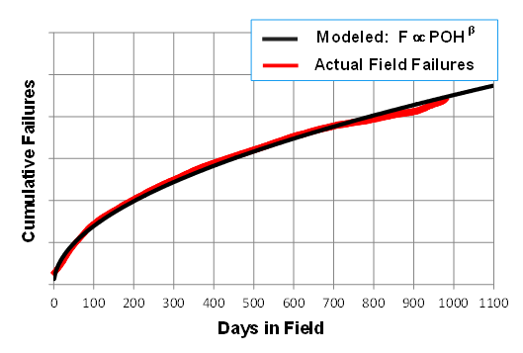
Classical reliability theory – time dependence
Standard Weibull Treatment
  Gives time dependence of unreliability, F(t)
  Where: t = time
  η = time constant
  β = shape parameter
In the limit of small failure rates (<10%) the failure rate vs time simplifies to a power function of time:
POH = power-on hrs
Since failure rate assumed to depend on time alone, MTTF has been used to quantify the intrinsic reliability of HDD’s
  MTTF defined by the time required for 63.2% of all drives in a given population to fail
But…..use of MTTF alone is meaningless
Reason behind the workload specs introduced by all HDD manufacturers
Field Reliability vs Time
3rd year
2nd year
1st year
β < 1: Failure rate decreases with time

Slide 18
Historical reliability model – impact of temp
Numerous studies conducted on HDD failure rates at elevated temperature
Consistent reports of HDD failure rates increasing exponentially with increasing temperature
  Arrhenius equation:
  E_{a} = activation energy
  A, R = constants
  T = Temperature (kelvin)
Rule of thumb:
  Failure rate doubles for approximately 15 C increase in temp
  Note: We make use of this acceleration by testing all products at the upper temp spec limit
Maxtor:
Ea = 51.9 kJ mole⁻¹
15C
Microsoft:
Ea = 44.4 kJ mole⁻¹
WD:
Ea = 39.3 kJ mole⁻¹
Seagate:
Ea = 36.4 kJ mole⁻¹
∼2X
Samsung:
Ea = 30.6 kJ mole⁻¹

Slide 19
Historical reliability model – duty cycle
A duty cycle term is typically added to general reliability expression
  Qualitatively accounts for the intuitive notion that HDD reliability should scale with how much the drive does
  Usually defined as a power law
Combination of all three effects, i.e. POH, DC and Temp, yields the classic reliability model
  This model has been used in the HDD industry for decades
How good is this at describing reality?
Usage Term
Thermal Term

Slide 20
Failure Rate vs Expanded Temp Range
  Failure rate dependence at cold shows inverse Arrhenius behavior
    Magnetic challenges due to higher media coercivity
    Stronger adhesive forces between heads and media/lube
  Failure rates are relatively independent of temp between 15 – 40C
Inverse Arrhenius
Conventional Behavior
-0.9 eV
E_{a} = activation energy
k = 8.62 x 10⁻⁵ eV/K
T = absolute temperature (Kelvin)
+0.4 eV
-5C +5C +15C +30C +40C +50C +60C +70C
Drive Basecast Temperature [C]

Slide 21
Duty Cycle
Usage
Thermal Term
Is the concept of “Duty Cycle” valid?
  DOE with same drives built at the same time
  Two tests with equivalent duty cycles (>95%)
  ……..but differing workloads (1.5:1)
Results clearly show that failure rates scale with workload…..not duty cycle
Standard (time-based) Weibull Analysis
Time to Failure Plot
182 GB/hr
Convex curvature
(β < 1)
β₁ = 0.8
Ln (cumulative failures)
180 GB/hr
β₂ = 0.8
Conclusions:
MTTF typically used to specify reliability of HDDs
Since MTTF is not uniquely defined……
MTTF alone is an insufficient measure of drive reliability!
MTTF₂
120 GB/hr
MTTF₁
Ln (test time)
Same drive / same DC / two workloads = different MTTFs

Slide 22
Historical Reliability Model – Duty Cycle
Functional duty cycle is a useless concept for predicting HDD failure rates
  Nebulous / ill-defined
  Every data center claims they run at 100% duty cycle, however, actually “usage” varies dramatically between data centers and within a given data center
  No quantitative data available
Workload is a much better measure for drive usage
  Defined as the total data transfer (sectors written + read)
  Tightly coupled to the dominate failure modes in test and field that are caused by close proximity between heads and media.
  Quantifiable from internal drive logs, thereby facilitating accurate field AFR predictions
  All HDD manufacturers now explicitly specify workload ratings
Usage Term
Thermal Term

Slide 23
Rough Drive Quality Scale
Reliability Landscape and Trends
15.3 XE
Introduced to allow comparison of basic quality requirements
Priority list for enablers
Reflective of
  Intrinsic quality spec: MTTF
  Workload
  Temperature
Normalized to Desktop
8.6 RE (Nearline Enterprise)
2.7 SE (Scaled Enterprise)
1 == Desktop; Cold Storage
0.6 Mobile

Slide 24
Reliability Landscape and Trends
AFR = Annualized Failure Rate
Typical Workloads for different market segments –
XE (800 TB/yr)
RE: Nearline Enterprise (550 TB/yr)
Cloud (180 TB/yr)
Desktop usage (55 TB/yr)
10x increase in usage from typical DT drive to Enterprise

Slide 25
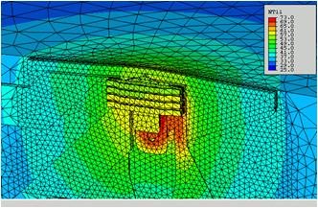

Minimization of time spent in close proximity
“Dynamic Fly Height” (DFH) concept
  Head-disk spacing is controlled by resistive heating of the pole tip region of the head
  Thermal actuation is only performed during read and write operations
  Head-disk interface failures → when flying at 10nm
DFH Off
DFH On
Thermal Expansion
Nominal FH
10nm
Element spacing
1.5nm
Disk

Slide 26
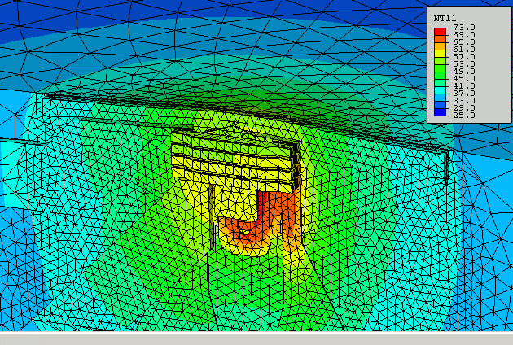
Minimization of time spent in close proximity
“Dynamic Fly Height” (DFH) concept
  Head-disk spacing is controlled by resistive heating of the pole tip region of the head
  Thermal actuation is only performed during read and write operations
  Head-disk interface failures → when flying at 10nm
DFH Off
DFH On
Thermal Expansion
Nominal FH
10nm
Element spacing
1.5nm
Disk

Slide 27
Minimization of time spent in close proximity
“Dynamic Fly Height” (DFH) concept
  Head-disk spacing is controlled by resistive heating of the pole tip region of the head
  Thermal actuation is only performed during read and write operations
  Head-disk interface failures → when flying at 10nm
  Head – disk interactions, if they occur, will be limited to times of DFH actuation
  Limits contact frequency
  Contact area decreased
  Much improved clearance sigma
Since contact only occurs during DFH actuation, and since DFH actuation only occurs during reads / writes, then workload will be critical to HDD reliability
Modification of our reliability prediction / testing methods needed
DFH Off
DFH On
Thermal Expansion
Nominal FH
10nm
Element spacing
1.5nm
Disk

Slide 28
Validation of Workload Impact on HDD reliability
Failure rates scale with the total TB transferred
Weibull Analysis
Standard (time-based) Treatment
Workload-based Treatment
120 GB/hr
Failure Rate (%)
Failure Rate (%)
180 GB/hr
180 GB/hr
MTTF₂
MPbF₁ = MPbF₂
120 GB/hr
120 GB/hr
MTTF₁
POH
TB Transferred (WL x POH)
Same drive + 100% DC / two workloads = different MTTFs
Same drive +100% DC / two workloads = unique MPbF
Results demonstrate that TB transferred is the critical reliability parameter….not time POH
Natural reliability metric: Mean Petabytes to Failure (MPbF)
➔ This naturally leads to a DWM (Drive Workload Monitor) (like an odometer)
Minimum requirement: Simultaneously define max workload spec and MTTF
  This is now done by all HDD manufacturers

Slide 29

Workload Specifications: An example
Weibull Projections
A workload Weibull analysis is performed on RDT data (1200 drives / 1000hrs / high workload script)
Cumulative failure rate vs total TB transferred is plotted
RDT Test

Slide 30

Workload Specifications: An example
Weibull Projections
A workload Weibull analysis is performed on RDT data (1200 drives / 1000hrs / high workload script)
Cumulative failure rate vs total TB transferred is plotted
Temperature derating from test → field is then applied
Resulting plot gives expected field reliability as a function of usage
RDT Test
Field

Slide 31
Workload Specifications: An example
Weibull Projections
A workload Weibull analysis is performed on RDT data (1200 drives / 1000hrs / high workload script)
Cumulative failure rate vs total TB transferred is plotted
Temperature derating from test → field is then applied
Resulting plot gives expected field reliability as a function of usage
Data validates that this drive can meet a 1.2M hr MTTF at a specified workload of 550TB/yr
RDT Test
MTTF spec = 1.2M hrs
Field
560TB/yr x 5yr
3.0 PB

Slide 32
Workload Specifications: An example
Weibull Projections
A workload Weibull analysis is performed on RDT data (1200 drives / 1000hrs / high workload script)
Cumulative failure rate vs total TB transferred is plotted
Temperature derating from test → field is then applied
Resulting plot gives expected field reliability as a function of usage
Data validates that this drive can meet a 1.2M hr MTTF at a specified workload of 550TB/yr
If HDD is used at lower workloads, a commensurate increase in MTTF (decrease in Failure Rate) will be realized
RDT Test
MTTF spec = 1.2M hrs
Field
MTTF = 3.0M hrs
120TB/yr x 5yr
560TB/yr x 5yr
3.0 PB

Slide 33
Reliability Test Enhancements (last few years)
Problem Statement
Testing Options
Field failure rates scale with usage / workload
RDT workloads can be insufficient to “see” the entire drive warranty period in many applications
  Leaves WD and customers vulnerable to late-in-life field excursions
Need existed to enhance our reliability testing to ensure future products display the required field quality?
RDT testing must be performed for longer times (brute force),
  Extended Lifetime Test (19 week)
or …….
  High workload test scripts
    Tribo RDT (highest WL script)
    Client (new version has 4X WL increase)
    Universal Enterprise (double workload of predecessor)
  Use of head parametric data to identify “virtual” failures
    Virtual failures = increased failure probability

Slide 34
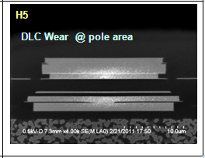
Are there precursors to HDD failure?
Degrading population
2.5nm
2.0nm
1.5nm
σ
μ =1.6nm
1.0nm
0.5nm
Head-disk Interaction
DISK
Controlling the clearance distribution is critical for long-term field reliability
Those heads in the low-clearance wing are far more prone to failure
Must maintain 3σ process
Degradation gets severe enough that the head can no longer function.
Failure (typically ECC) then results
Tear down confirms wear of carbon on pole tips due to occurrence of head-disk contacts

Slide 35
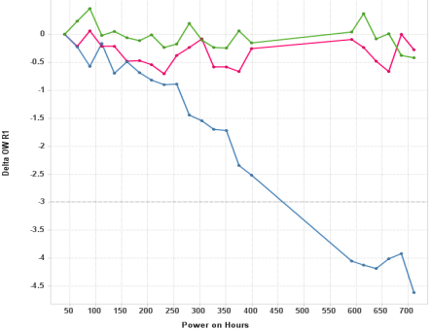
“Virtual” Failures
Overall Strategy:
  The TMR reader is the best sensor we have in the drive
  Use it to calibrate the head-media interface through magnetic ‘critical parameter’ degradation
  We use about 7 critical parameters to perform in-situ characterization during test
Degrading population
0
2.5nm
2.0nm
1
1.5nm
σ
μ =1.6nm
2
1.0nm
Critical Parameter A
0.5nm
Head-disk Interaction
3
4
Degradation vs time
DISK
5
RDT Run Hours
Controlling the clearance distribution is critical for long-term field reliability
Those heads in the low-clearance wing are far more prone to failure
Must maintain 3σ process
Contact between the head and disk leads to degradation of the magnetic / electrical propeties of the head
Monitoring degradation in the parametric data can be used to identify “virtual” failures
Degradation gets severe enough that the head can no longer function.
Failure (typcially ECC) then results
Tear down confirms wear of carbon on pole tips due to occurrence of head-disk contacts

Slide 36
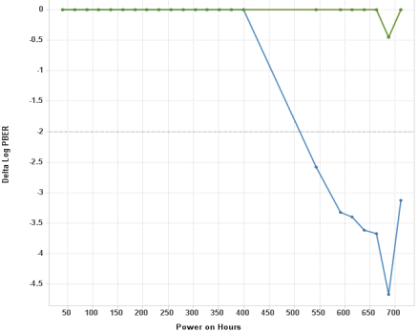

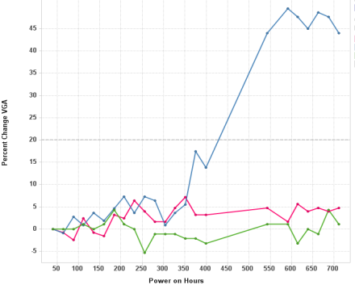
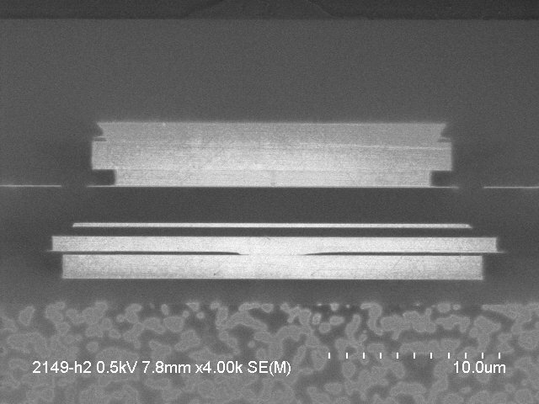
Degradation precedes vast majority of real failures
Drive triggered all three degradation limits at 400-500 hrs in factory RDT
Drive then failed for head-degradation at 933 hours
Parameter A
Parameter B
Parameter C
510hrs
Tribo-RDT trigger limit
400hrs
460hrs
4 order drop in BER
4.5 dB drop
2nd Level / Teardown FA
  Scope signal on failed head showed base line popping
  SEM on failed head showed DLC wear (others showed no wear).

Slide 37
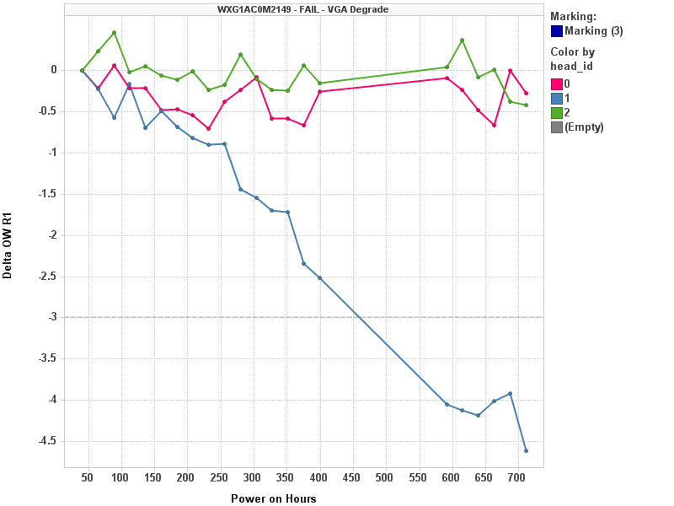
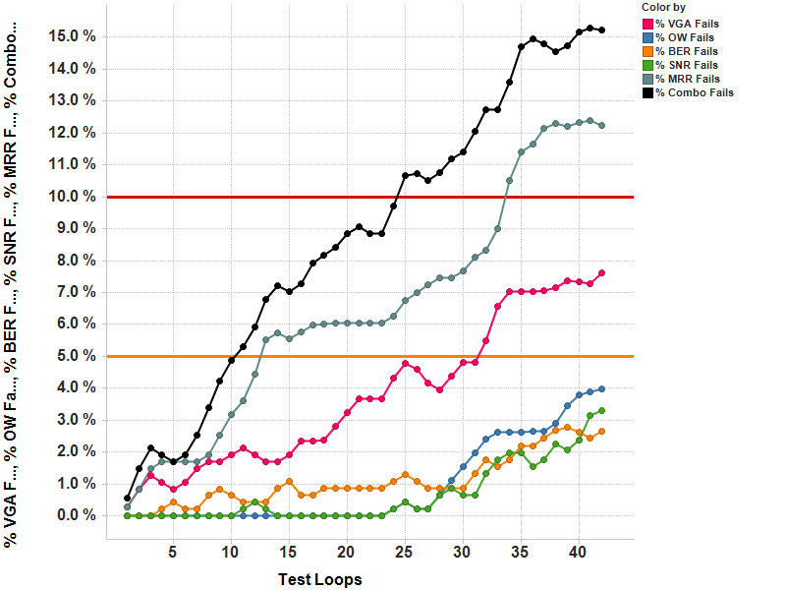
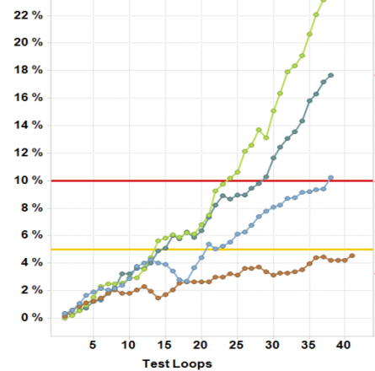
“Live” Parametric Monitoring During ORT/RDT
A web-based tool is available to monitor the progress of any drive running RDT/ORT in the factory in real time
  Gives temporal information on drive health that was previously unavailable
  Provides much clearer insight into nature of root cause leading to failure
  Allows tracking of: a) individual drives / parameters, b) entire drive population, or c) various drive configurations.
Representative Results
Individual Drive (any parameter)
Entire RDT Population
Comparison of RDTs
Total
Head A + Media A
A
Critical Parameter Degradation
Degradation Rate (%)
B
Trigger Level
C
Head A + Media B
D
E
Head B + Media B
RDT Test Time (hrs)
RDT Test Time (days)
RDT Test Time (days)

Slide 38
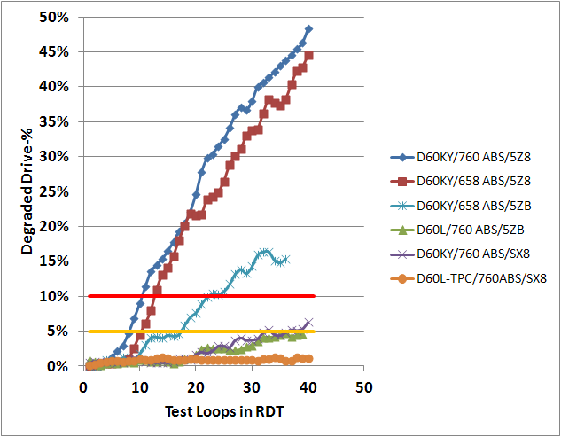
Product Improvements Driven by Parametric Measurements
  Parametric data provides far more granularity on product quality compared to “real” drive failures
  Quality team continually monitors Virtual Failures and uses this data to qualify any new component and / or design enhancement
  Engineering uses data to drive improvements into each HDD design
Head design
(new reader)
Improvement driven by Parametric measurement
Head design
Media design
Clearance

Slide 39
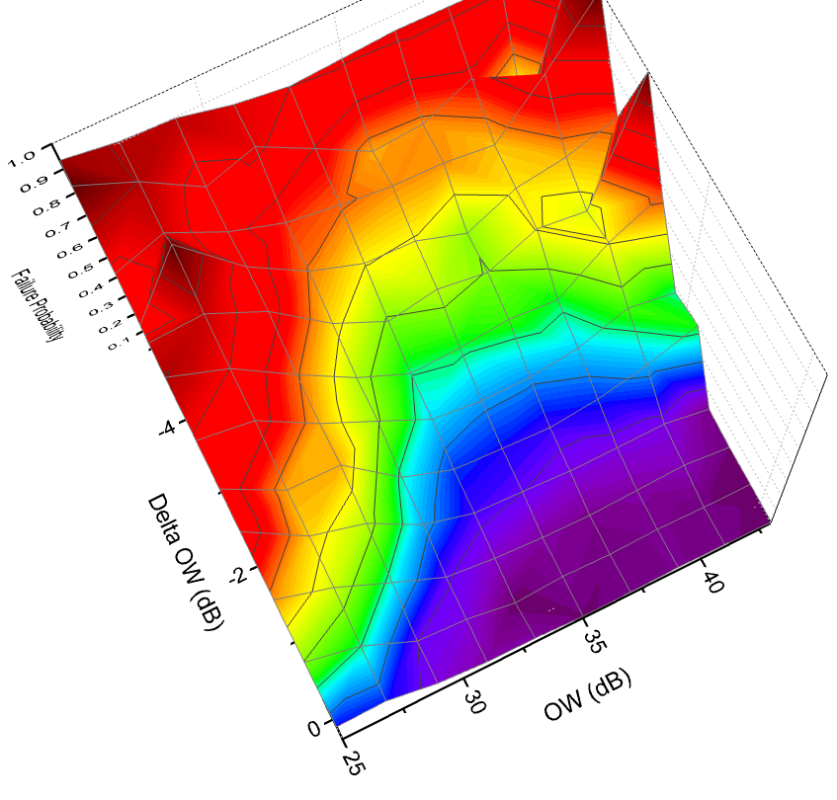
Failure probability contour plots
Field failure probability can be plotted as a function of both the critical parameter and the degradation in the critical parameter.
Both parameters are important
Failure Probability Contour Plot
For the vast majority of the population, degradation in critical parameter A is more important than the absolute value of A
This is not universally true for all parameters
  Degradation patterns are being used to perform virtual FA
  Some degradation scenarios are more serious than others
Methodology is being extended for WD’s “In-field Health Monitor”
10x
5x
1x
ΔCritical parameter A
ΔCritical parameter A
Critical parameter A

Slide 40
Evolution of Parametric Monitoring
Decreasing head-media clearance
➔More Head-Disk contact events
➔Higher levels of magnetic critical parameter degradation
➔Precursor to real failure of the drive
Internal Benchmarking: Measurement of critical parametric data now routinely performed in Reliability testing (2+ years experience)
Natural progression is to measure, and store critical parametrics at a regular interval during field operation
External dry-run: Partnership with Enterprise customers on small fleet sizes.

Slide 41
Why Extend parametric measurements to the field?
After nearly two decades, it is generally accepted that the SMART attributes are not strongly correlated to HDD failures
  “....models based on SMART parameters alone are unlikely to be useful for predicting individual drive failures”.
  (Google: Pinheiro et al., Proc. 5th USENIX Conf. on File and Storage Technologies, February 2007)
The obvious question arises…..“Can we use our parametric degradation approach to improve predictability of drive failures in the field”?
    In-field parametric monitoring (IFPM)
  WD is pursuing parametric data collection for data center fleet management
  Potential to identify poorly performing drives / heads before actual failure is the “Holy Grail” of HDD reliability
  Drives with the capability to perform critical parameter measurements (during drive idle time) have been developed and are just now becoming available
  Health monitor algorithms need to be optimized (6 – 9 months)

Slide 42
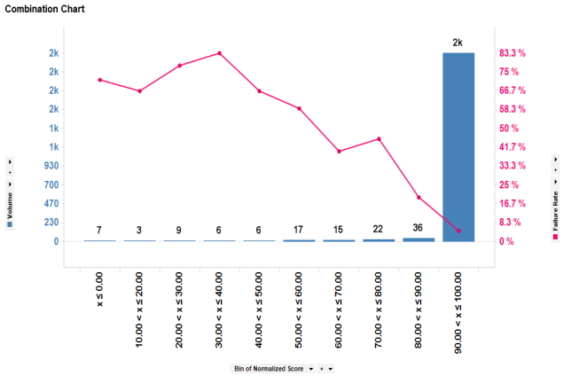
WD’s 1st fleet management system: IFPM
The In-Field Parametric Monitoring (IFPM) system will measure, and store, critical parameters periodically throughout the HDD lifetime, and output a relative health index.
A ‘Gas Gauge’ - Failure Probability Increases as ‘Health Index’ gets worse
Low Score (Bad)
High Score (good)
Drive Count
Real Failure Rate
IFPM Health Index
(derived from critical parameters)

Slide 43
WD’s 1st fleet management system: IFPM
Phase 1 – Drives equipped with initial parametric monitoring
  Subset of parameters available now
  Start field data collection with partners
Phase 2 – “Complete” set of critical parameters will become available shortly
Phase 3 – Algorithm development
  Data collected from select customers
  Refinement of failure probability algorithms
  Define a “relative health index”
Phase 4 – Ability to check relative health index of any drive on demand
Since the health index with change with usage, IFPM will be coupled to the DWM (Drive Workload Monitor)
WD Confidential

Slide 44
Meaningful Predictive Modeling
Powerful models that predict failures of individual drives need to make use of signals beyond SMART
One of the main motivators for SMART was to provide enough insight into disk drive behavior to enable such models to be built
IFPM + workload monitor + SMART may prove effective at overcoming our current inability to build predictive models.

Slide 45
Thank You

Slide 46
How does workload enter into the classical analysis?
All time is not equivalent in driving HDD failures
The critical time for is the time spent in close proximity to the disk
  Significant levels of head-disk interactions are limited to times of DFH actuation
  This relatively subtle modification / realization has significantly changed the way in which HDD reliability is viewed
  Since actuation only occurs during reads and writes….actuation time is directly proportion to the total data transferred
Failure rates will be dependent on the total data transferred
Overwhelming majority of failures occur when reading / writing / transferring data
Failure probability for HDI issues drops to near zero when pole tip is retracted
Failure probability for motor, PCBA, etc issues that depend on absolute POH time constitute only small percentage of total failures

Slide 47
Virtual Failure Rates - Definition
  Virtual failure rates (parametric degradation) are monitored in all WD reliability testing
        Very clearly defined pass / fail criteria
  Virtual failures defined in terms a number of critical parameters
  Critical parameters identified from analysis of field return data
      Writer health
      Reader health (magnetic and electrical measurements)
      Magnetic element spacing change
      Physical head-disk spacing change
      Bit error rate
VF
Writer Degradation
Writer Degradation

Slide 48
VF parameters = higher field failure probabilities
Field / test data used to identify parameters critical to HDD reliability
Δ Writer Health
Δ Error Rate
VFR Trigger
Increasing Degradation
ΔWriter Health
ΔError Rate
Δ Mag Spacing
Δ Physical Spacing
VFR Trigger
contamination
wear
Increase
Decrease
Increase
ΔMag Spacing
ΔPhysical Spacing

