Slide 1
Challenges and Overview
From Technical Coordination

Slide 2
Overview
Detector Installation
  CEDAR / GTK / CHANTI
  Completion of Vacuum Tank / LAV / STRAW
  RICH vessel installation and Al Beam pipe
  CHOD, LAV12, IRC
  LKR
  Installation of MUV to SAC area
Installation Schedule

Slide 3
How about the Beam ?
See Lau’s presentation.

Slide 4
CEDAR / GTK / CHANTI
CEDAR -> WG meeting
  Besides detector issues: Buffer Volume, Fast Valve (?), Gas System,….
GTK (CHIP fabrication/bonding contract/ test systems) -> WG meeting
  Overall schedule very tight.
  GTK cooling system / CERN in-house fabrication still not guarantied.
CHANTI: Need housing drawing (3D model) from Naples for GTK3 and CHANTI
!

Slide 5
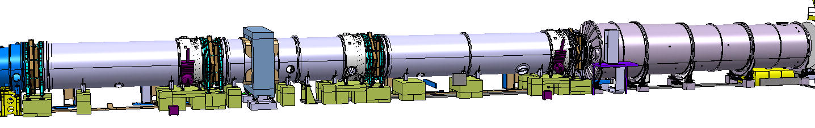
Completion of the Vacuum tank (1)
New Vacuum tanks #26 + #28 are tendered, order in Sept., delivery expected for Feb. 2014. (thanks to Flavio + Fabrizio).
LAV9, 10 + 11 will be at CERN in Sept. 2013
Challenge: STRAW schedule
!
LAV
9
10
11
#24
#26
#27
#28
Straw
I
II
III
IV

Slide 6
Straw Fabrication, Dressing + Stacking
Overall schedule still very tight
Straw | Module |  | Fabrication Ready | Electronics + Delivery | Stacking, Dressing Ready | Installation
I | 1 (u,v) | CERN | finished | FE cover Oct. 13 | Dec. 13 | Jan. 14
 | 2 (x,y) | CERN | finished | FE cover Oct. 13
II | 3 (u,v) | JINR | finished | Delivery Sept.13 FE cover Oct. 13 | Jan. 14 | Feb.14
 | 4 (x,y) | JINR | Oct. 13 | Delivery Dec. 13
III | 5 (u,v) | CERN | finished | FE cover Dec. 13 | Feb. 14 | Feb.14
 | 6 (x,y) | CERN | Dec. 13 | FE cover Dec. 13
IV | 7 (u,v) | JINR | Mar. 14 | Delivery Jul.14 | Aug. 14 | Aug. 14
 | 8 (x,y) | JINR | Jun. 14 | Delivery Jul. 14
We have made good progress in the last 6 months, but the remaining schedule remains tough!
(There is no time for respite).
The delivery schedule for Straw IV is a firm deadline, because otherwise we cannot close the vacuum tank.

Slide 7
Vacuum Tank Completion (2)
Summary
Install (position) LAV 9, 10 + 11 in Sept. or Oct. 2013. (the neighboring elements are incomplete)
Install Straw I, II + III between Jan. - Mar. 2014
  Vac. tank interface must be ordered in Sept. 2013
The New Vacuum tanks (#26, 28) are expected to arrive in February, and will be installed immediately.
In April 14, close vacuum tank (after LAV11) to do vacuum test of the full tank (except Straw IV).
!

Slide 8
RICH

Slide 9
RICH Vessel Delivery + Installation
Vessel delivery (contractual: 30/08/2013)
  Vacuum test in Spain was negotiated (+4 weeks)
  Realistically expect delivery not before end of November
RICH entrance window has been hydroformed
RICH – Straw Link is delivered and at CERN
Construction in Spain followed very close by Piet.

Slide 10
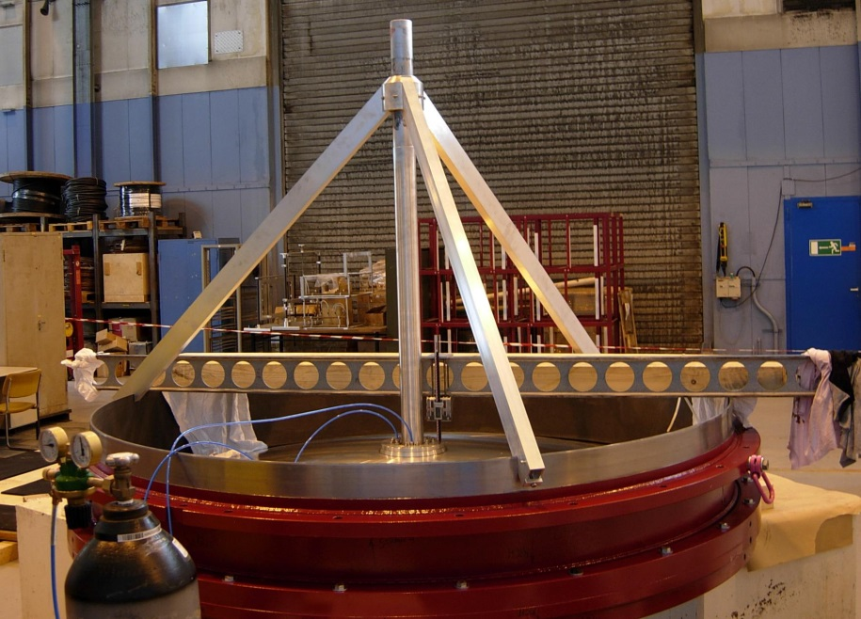
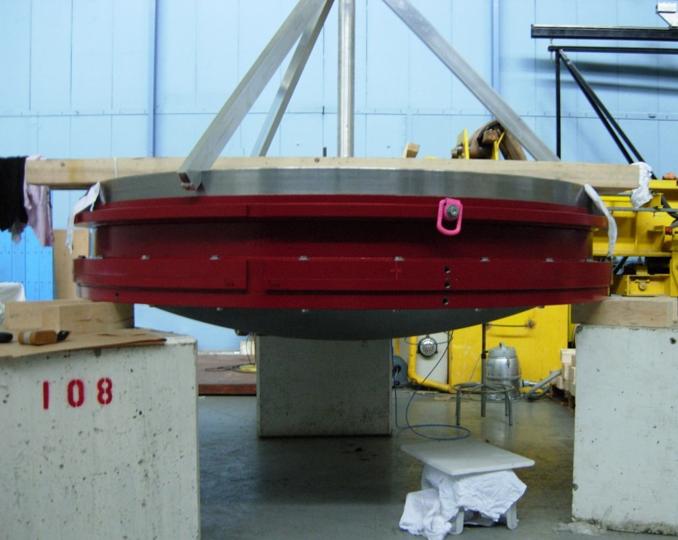
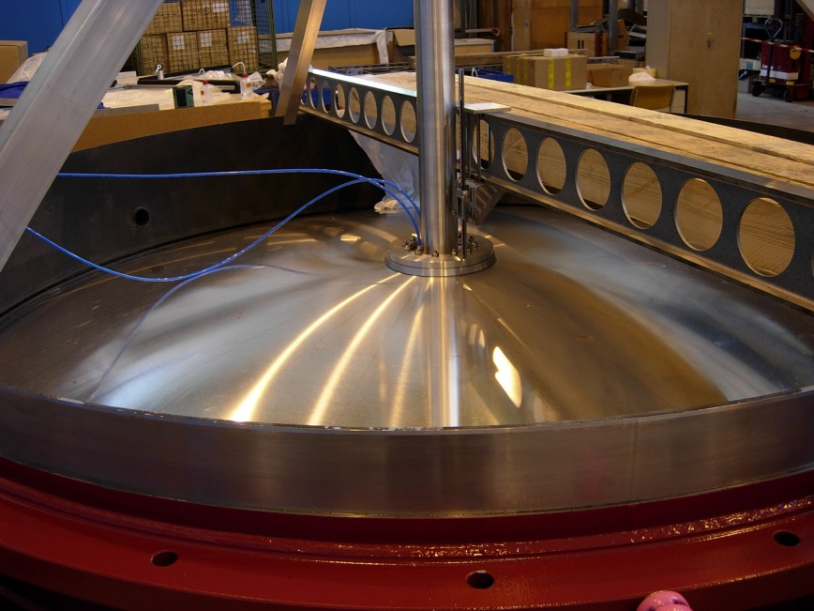
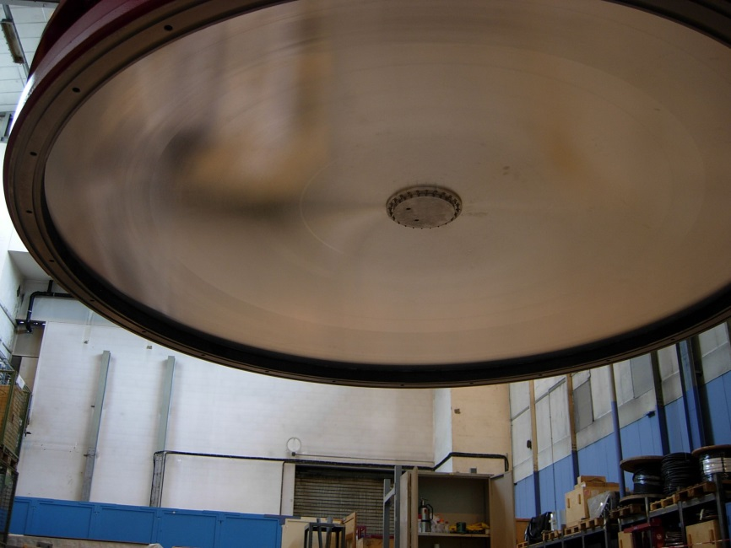
Al Window Hydroforming
Piet Wertelaers
Jerome Noel

Slide 11
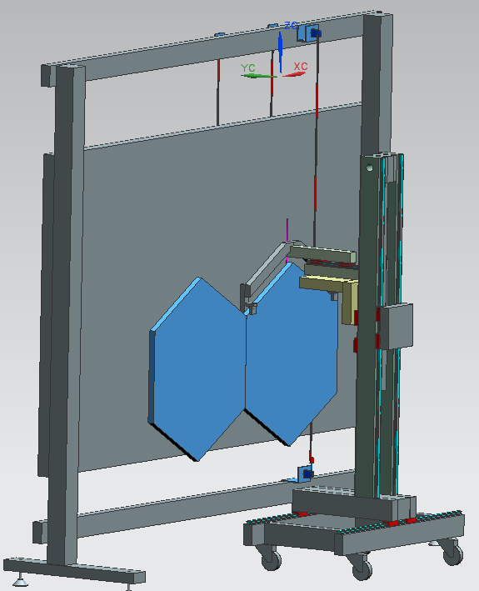
RICH Mirror Supports
Intensive design and prototype work for the mirror supports in Florence, Perugia, Ferrara and CERN. (good progress in last 6 months). -> WG
Mirror coating will be done in autumn
    Must start in September!
Next Challenge:
  Design and the fabrication of mirror support panel. (preparatory work from the Task-Force P.W. et al. exists)
  Expected delivery to CERN in < 6 months !
!
!
mirror positioning tool

Slide 12
Vessel Installation
Preparation: supports, etc.
Installation of Drums 1,2,3+4
Close vessel: upstream + downstream
2nd Vacuum test at CERN
Open both end caps again:
  Downstream window has to go for machining to the work-shop.
-> September
~8 -10 weeks
Finish by end January 2014 (1 month later than previously foreseen)

Slide 13
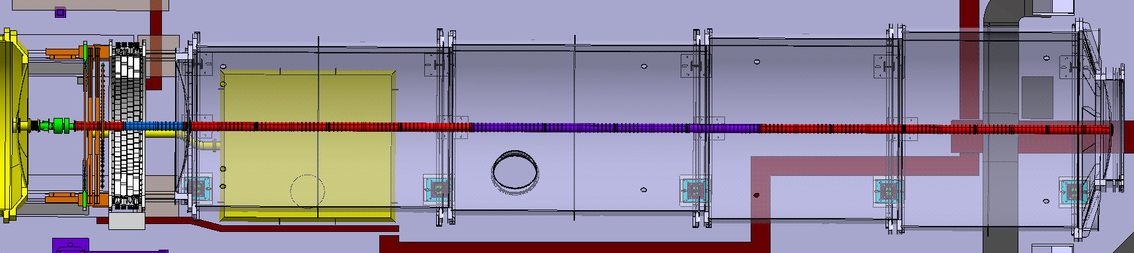
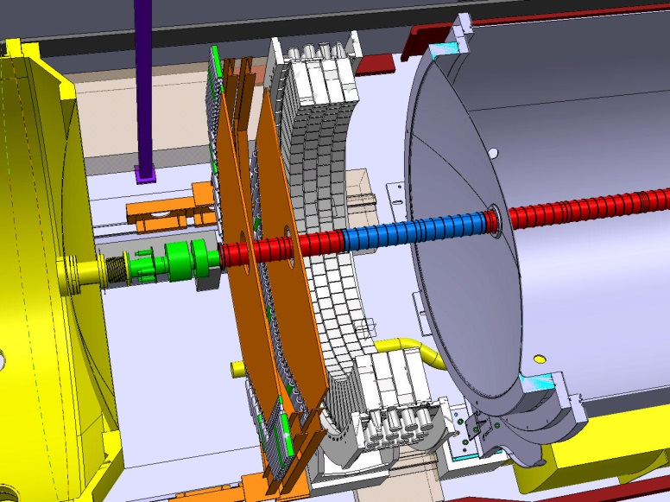
Al Beam Pipe
Piet Wertelaers
20 m of light Al Beam Pipe
Three section inside the RICH
Two short sections after the RICH

Slide 14
Status Report Al Beam Pipe
Raw tubes made in Industry
Precise machining in CERN work-shop
Managed by Piet Wertelaers
News from Piet (end of July):
17 tube "segments" needed for Experiment (L=1500mm).
Segments delivered as "hollow jet" (minimal order quantity).
At least 1 segment to be sacrificed to take test samples for welding.
All segments machined at inner bore (outside company) and measured (CERN).
A few slightly out of tolerance.
2 mandrels manufactured (for lathe machining at CERN)
First hot shuffling tests underway using the "worst" tubes.
Outer machining (CERN lathe) of segment to be sacrificed underway.
Final machining (CERN lathe) : start not before September 2013
Completion expected for end June 2014 (+ 2 months!)
Additional Challenge:
Inter Connections and “rolling seal” (for RICH exit window)
still in prototype phase -> PH-DT
!
Critical timing!

Slide 15
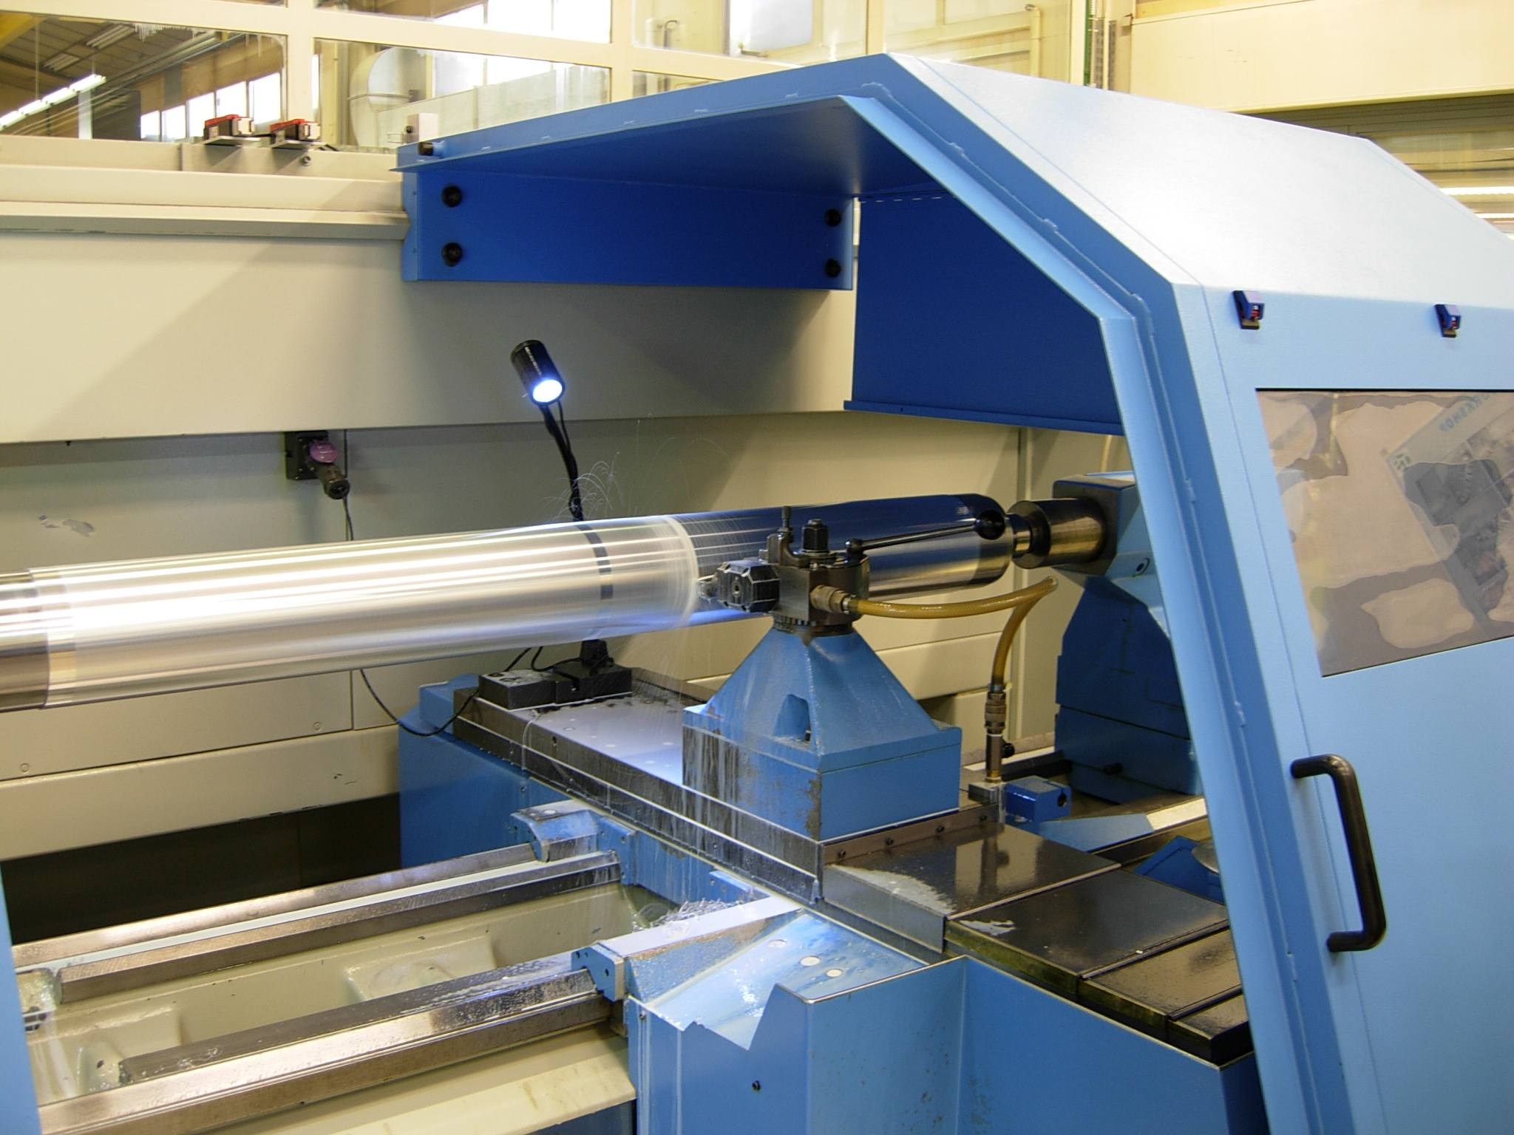

Slide 16
LAV12 / CHOD / IRC
LAV12 freeze design now -> WG meeting
NA48-CHOD: Do we have electronics and power supply for the operation?
IRC:
  ADC read out
  Beam tube 0.8mm thickness
  Detector fabrication and assembly
LAV12/IRC installation in Aug. - Sept. 14
!

Slide 17
LKR / CREAM Installation
Consolidation of Cooling system (ongoing)
Consolidation Electrical supplies (after cooling)
Warning: no cooling water from Oct. 13 to Mai 14
LKR Vacuum system should be protected by UPS (since July new leak on HV feed-throughs)
Challenges:
  CREAM hardware tests -> reports in WG meeting
  LKR L0 trigger -> first tests in Nov. Dry Run (update in TDAQ ?)

Slide 18
MUV installation (1)
Present Situation
LKr
MUV1
MUV2
Iron
wall
MUV3
MBPL
FISC
Monitor
Magnet

Slide 19
Muon Installation Sequence
From the Current Situation to the Final Installation
Magnet
LKr
MUV1
MUV2
Iron
wall
MUV3
MBPL
FISC

Slide 20
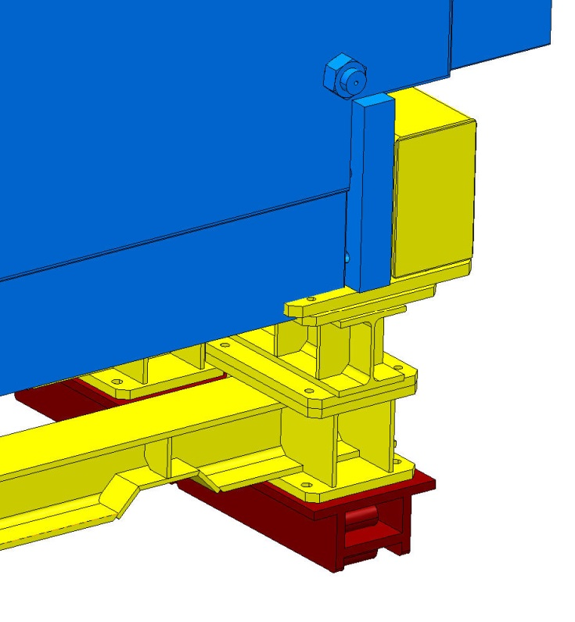
Muon Installation
MUV1 is critical element
MUV1 installation foreseen in March/April 2014.
Need urgently further drawings on MUV1:
  Support and adjustment details
  PMT cover / cabling details
!
!
3 Problem areas: support / beam tube / inner tube diameter
Challenge: is speed up manufacturing work on MUV1; target is delivery to CERN in March 2014

Slide 21
MBPL to SAC
From the Current Situation to the Final Installation
New below connection
Rotation angle changed
Platform and lifting tool
to be installed
MBPL
T1 (Ø = 320)
T2 (Ø = 600)
SAC
T3 (Ø = 600)
Dump
Cryo Control
Rack to be moved
HAC Support
and Detector

Slide 22
MBPL to SAC (2)
Nothing particular critical, except resources….
Work should be done in the shadow of other installation work, i.e.
  Modification beam pipe
  HAC Platform and lifting tool
  Cryo rack displacement
  HAC and SAC installation
Should be done this year
In 2014

Slide 23
How about TDAQ ?
See Marco’s presentation.

Slide 24
Installation Schedule (1)

Slide 25
Installation Schedule (2)

