Slide 1
“The PATTI board”
Gianluca Lamanna & Riccardo Fantechi
(Pisa - CERN)
NA62-Liverpool TDAQ 28.8.2013

Slide 2
The PATTI board
The PATTI board is a TELL1/TEL62 daughter board
  Same TDCB form factor
Main purpose: pulser for TDCB
  128 LVDS channels per board (512 channels per TELL1/TEL62)
  Same TDCB connectors
  Firmware, performance and primitive production stress test.
Additional features: standalone testbench
  LTU interface: you don’t need any L0TP to produce triggers
  Production of SOB/EOB: you don’t need any «SPS»
  Choke/error signals: test of readout perfomance
Versatility:
  All the functions are controlled with PP firmware

Slide 3

PATTI layout
I/O:
4 lemos (SOB, EOB, TRIGGER, SPARE)
LTU connector
8 LEDS
Choke/error receiver
TDC connectors
SAMTEC 200 pins – TEL62 connector
The logic will be done in the PP
Independent SOB,EOB production
Trigger and choke/error
Interface with LTU
LVTTL-LVDS translators
Power from Murata connectors: 3.3V and +5V,-5V

Slide 4
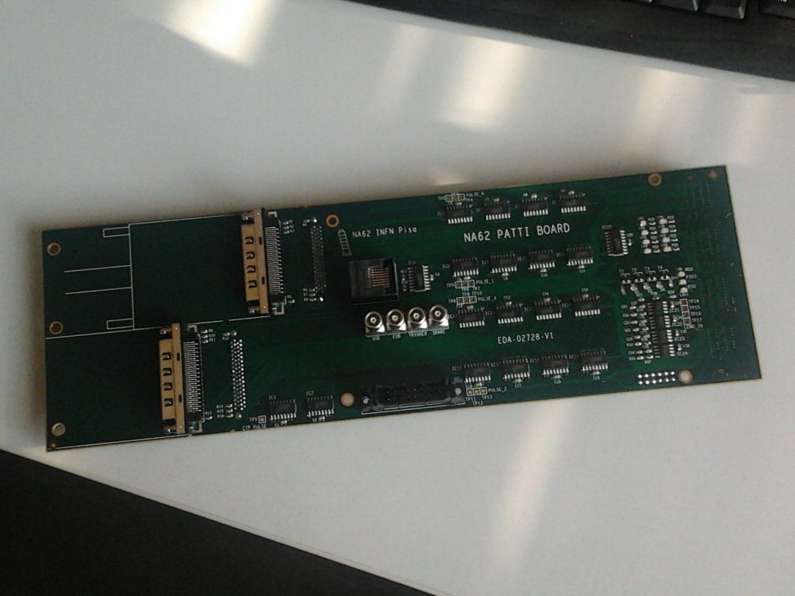
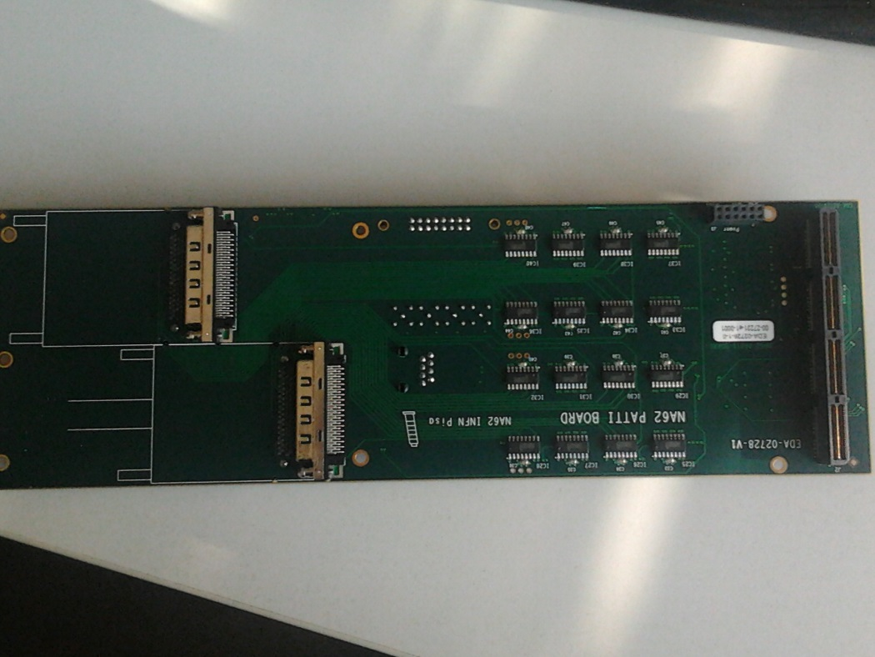
PATTI board
Power
TDCB connectors
Tell1 connector

Slide 5
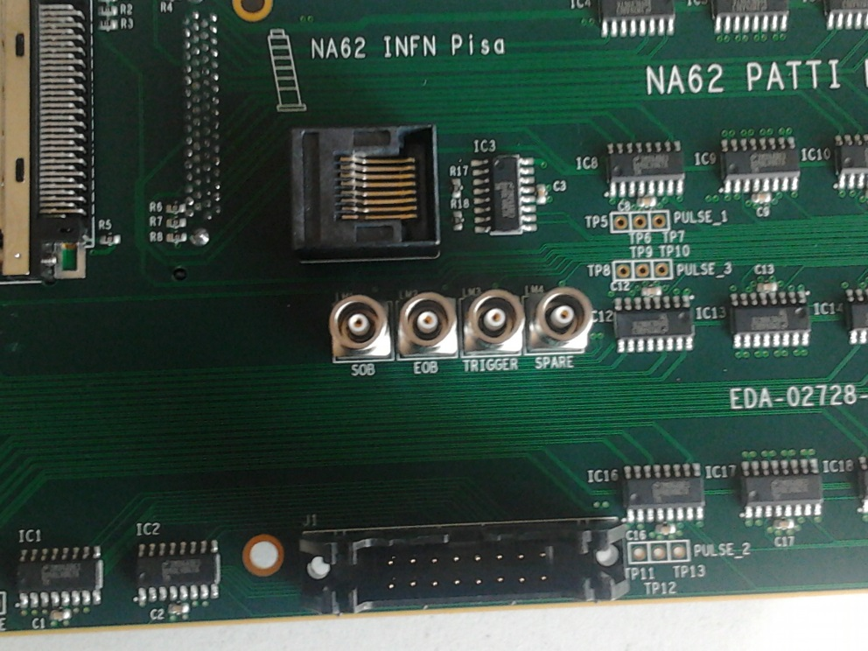
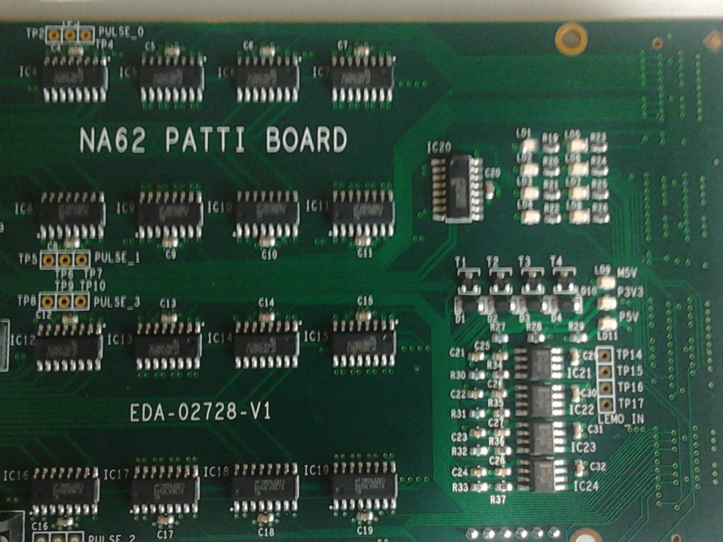
PATTI board
Choke & Error
LEDs
SOB, EOB, Trigger, Spare
LTU

Slide 6
Test Status
Preliminary test on HW @CERN:
  Basic firmware (some bugs in the fw)
  70% of the board tested (no choke/error, spare pair, TDCB connector,…)
  No major problems found
    Additional three boards in production
Next test @CERN & PISA:
  More advanced firmware
  Test missing HW part
  Connection with TDCB

Slide 7
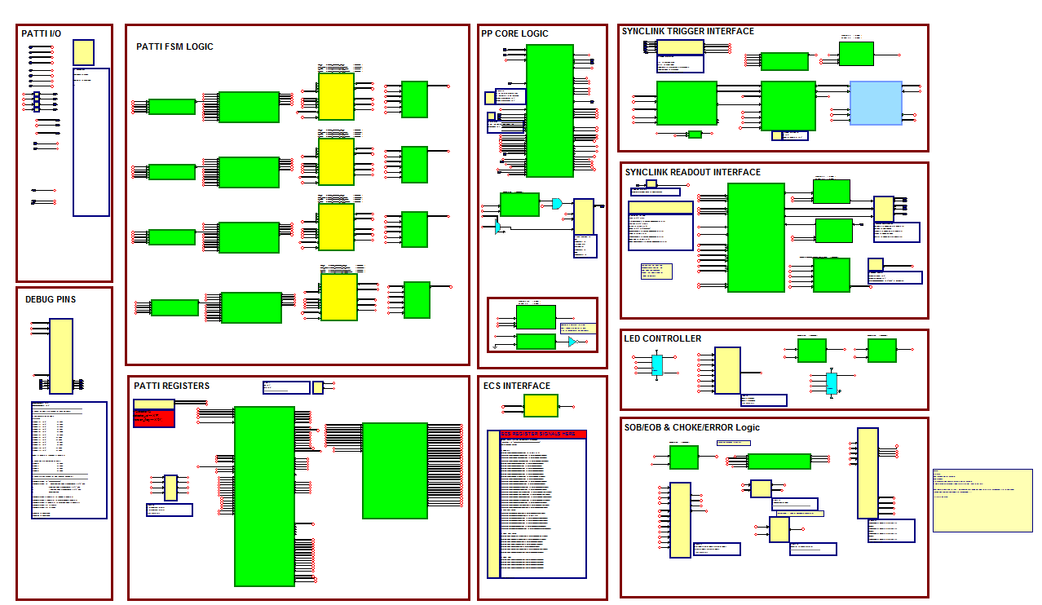
Firmware v.0

Slide 8
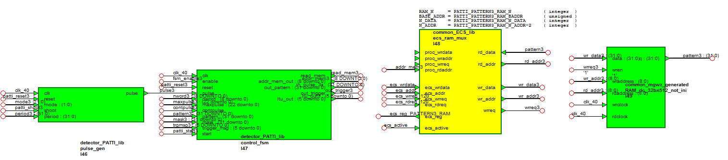
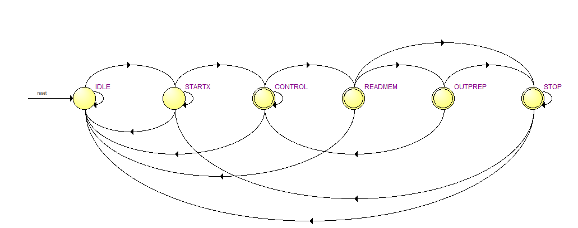
Firmware v.0

Slide 9
Firmware v.0

Slide 10
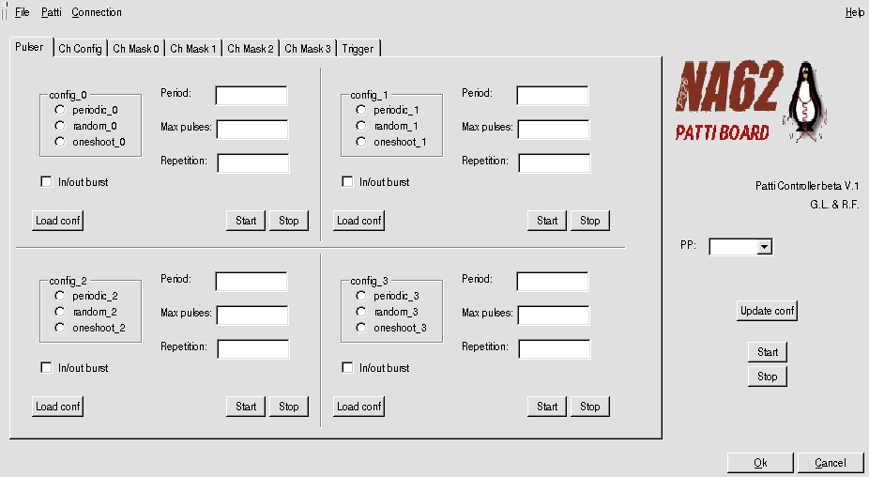
PATTI controller
Configure the frequency of the pulser independently for each connector

Slide 11
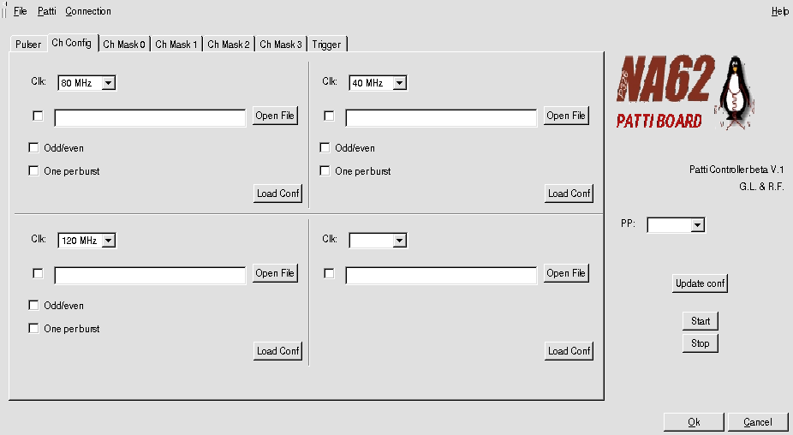
512 timeslots available for ch. Configuration
  Ex: 0x0000000F ch.#0,1,2,3 ON
  0x000000F0 ch.#4,5,6,7 ON
  0x0000000F ch.#0,1,2,3 ON
  ……….

Slide 12
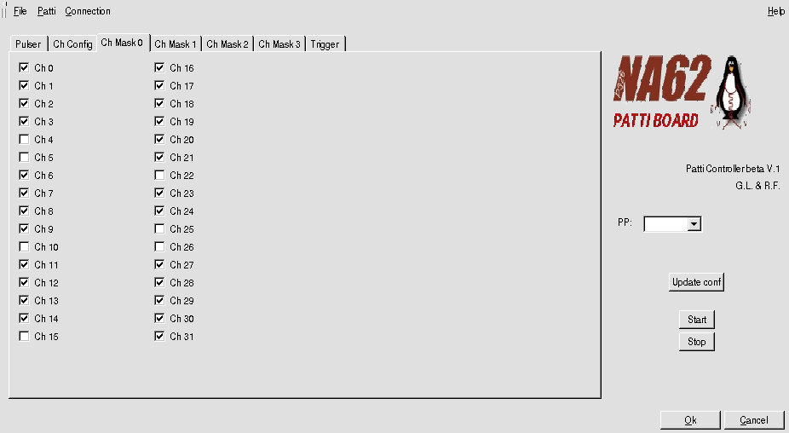
Individual channel masking

Slide 13
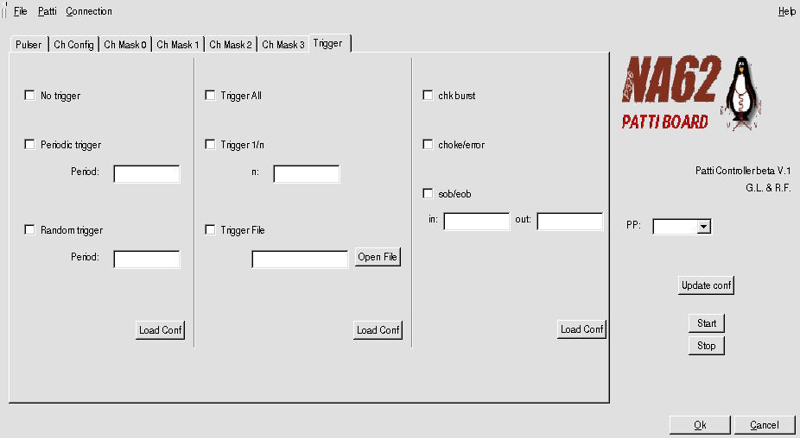
Trigger correlated/uncorrelated with the pulsers
Choke/error, programmable burst

Slide 14
Conclusions
Validation test will be completed in the next month (end of September)
Rise your hand (ask me and/or Riccardo) if you need PATTI boards
  CEDAR already is interested
What you need:
  TEL62+TDCB to test, LTU+TTCex (in any case PATTI can produce triggers on LEMO), TDCB cables, some lemo and… .
  …for the moment you need a TELL1
  Version for TEL62 foreseen (November/December)

