Slide 1
Straw Data during the Technical Run
Giuseppe Ruggiero (CERN)
Straw WG Meeting
Liverpool, 28/08/2013

Slide 2
Outline
Straw during the TR
Data merging
Time correlations
Conclusions.

Slide 3
Straw during the Technical Run
64 channels in U view and 64 channels in V view of Chamber1 readout.
Channels readout in triggerless mode:
  List of straw data for each burst.
  Each data provides timing information (leading and trailing) and location.
  List of the trigger timestamps for each burst.
Bug in the straw firmeware discovered after the run:
  Only the first few ms of each burst have been readout properly.
Thresholds set at minimum, but not properly monitored during the run.

Slide 4
Data merging
Matching between data and trigger timestamps
  Straw data within 16 μs around the trigger timestamps considered.
  Data written in the standard event format (proper header added).
  Run 390 considered.
  First 100 triggers/burst taken into account.
  Only half of the bursts working (about 200).
  Only straws in view U considered (view V was not usable during Run 390)
Straw data in the standard event format merged with the data from the other detectors (Run 390: trigger Q1 x NHOD).
  Merging done on the timestamp basis.
  Same procedure as for the LKr data merging used.
Data processed using NA62Reconstruction

Slide 5
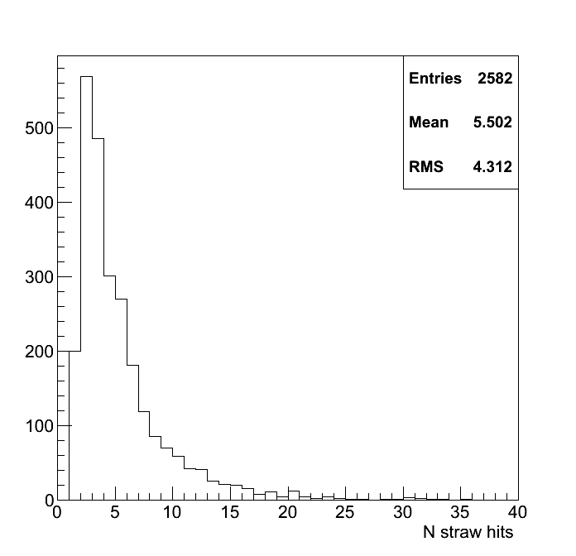
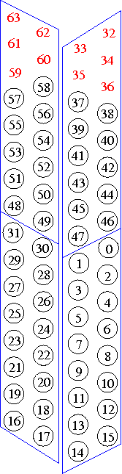
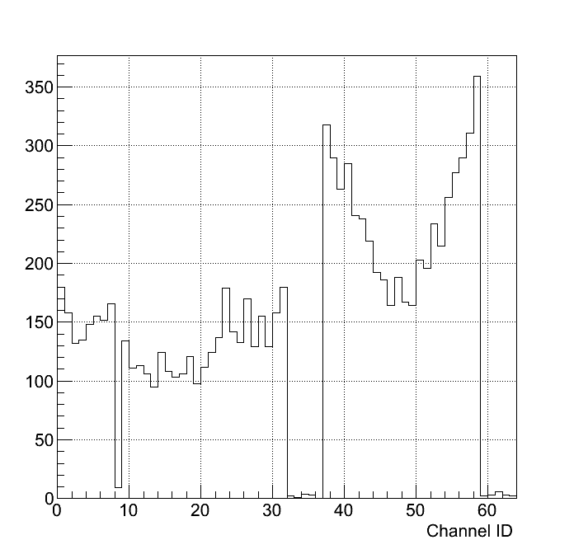
Straw Hits
Hole
Particle

Slide 6
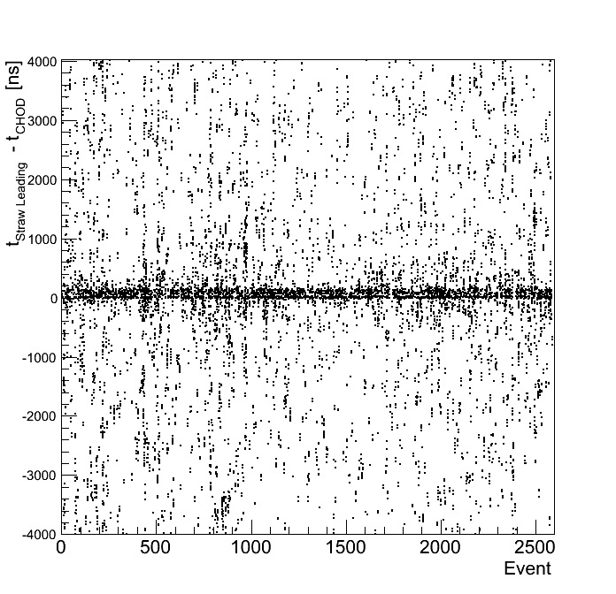
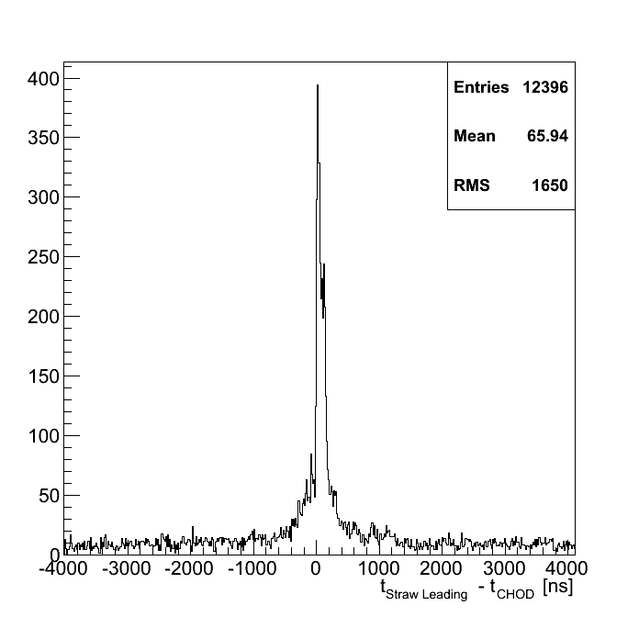
Timing
Events with 2 hits only in CHOD compatible with a Q1-like track considered
Corrections applied to the CHOD counters time
Only leading times in straws considered

Slide 7
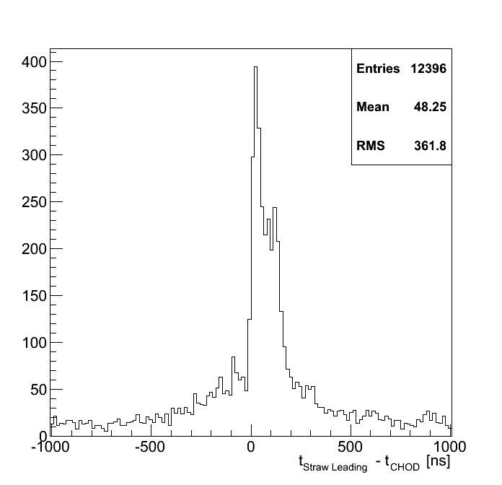
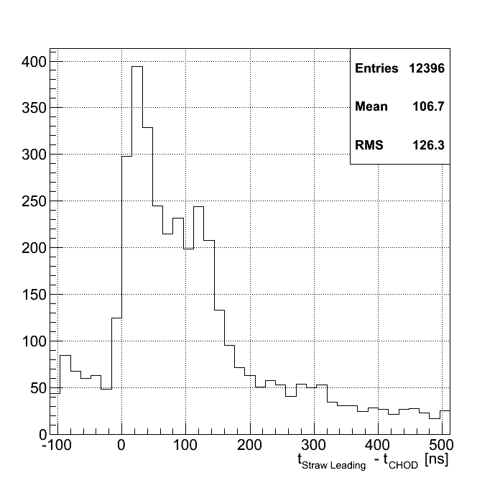
Straw – CHOD Timing
Drift time structure in time with CHOD clearly visible (< 200 ns).
Out-of-time structure within +-500 ns from the drift time not understood

Slide 8
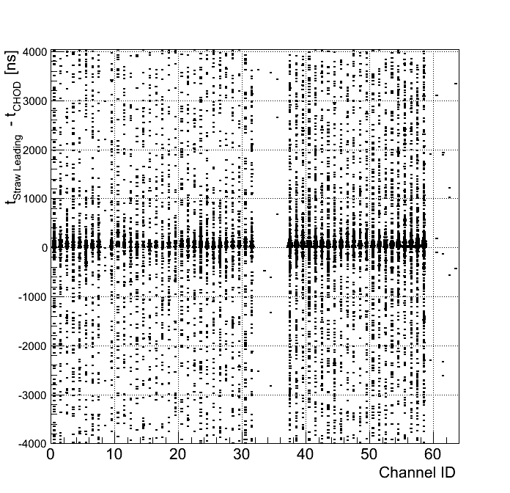
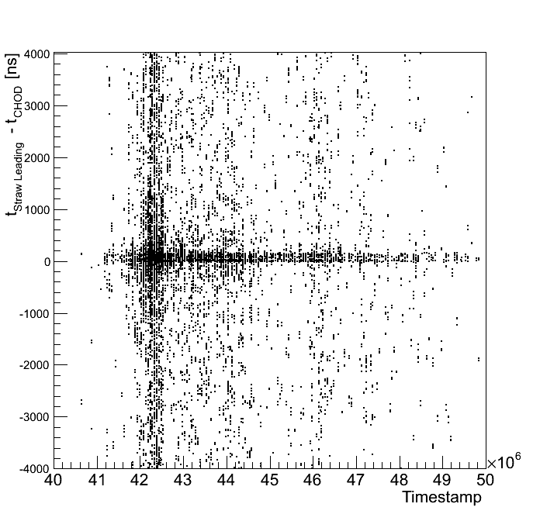
Straw – CHOD Timing
Channel by channel alignmenet should be investigated further
Few events in missing channels: firmeware bug not completely removed
Time stamp structure

Slide 9
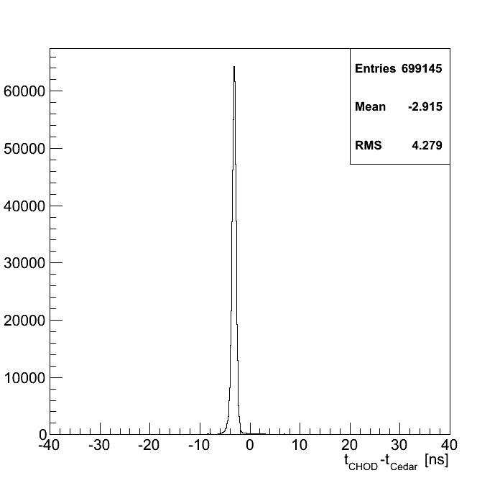
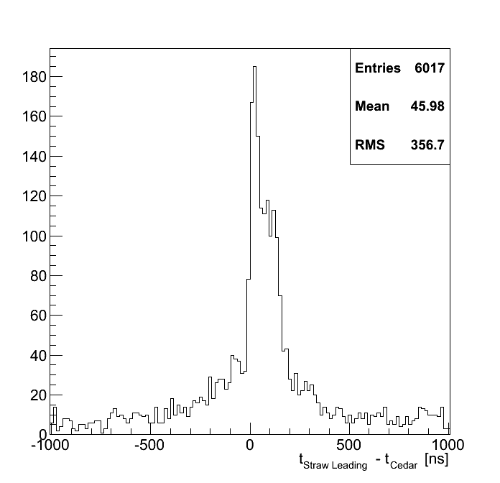
Straw-Cedar Timing
CHOD – Cedar time coincidence required
Same out-of-time structure around the drift time as in CHOD-Straw coincidence observed

Slide 10
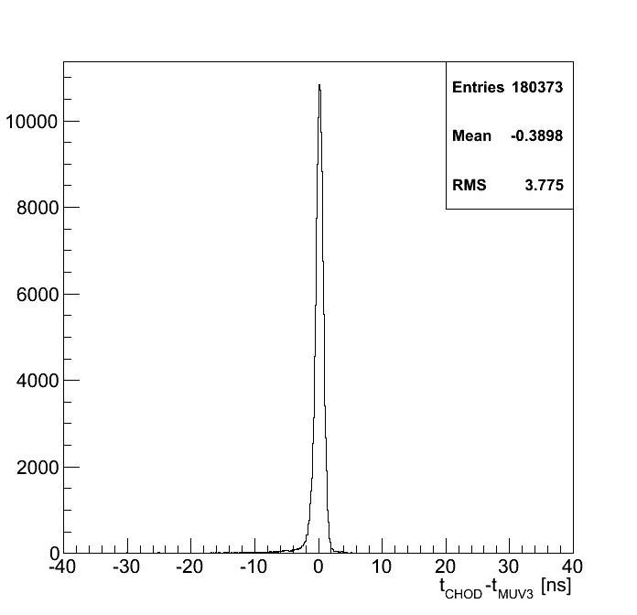
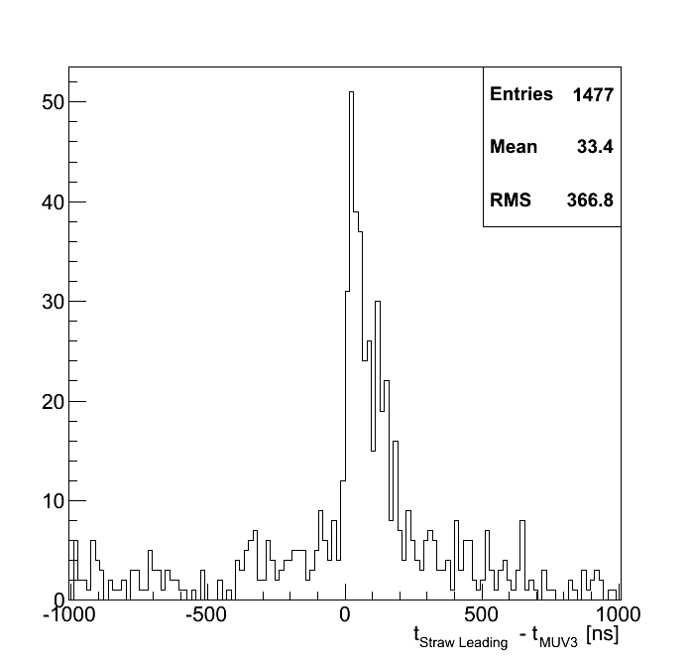
Straw-MUV3 Timing
CHOD – MUV3 time coincidence required
Same out-of-time structure around the drift time as in CHOD-Straw coincidence observed

Slide 11
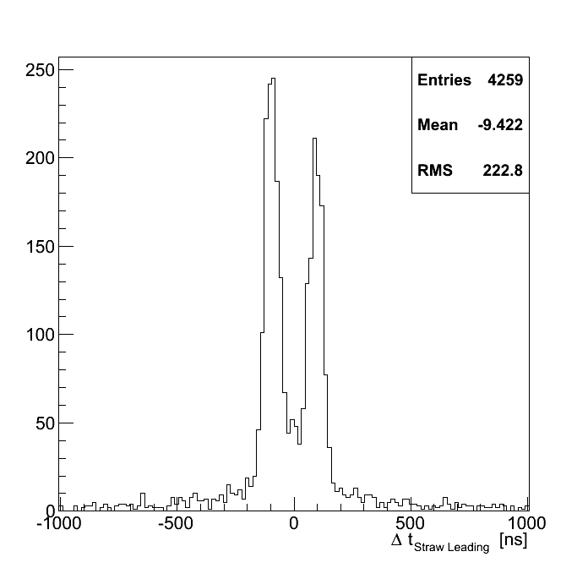
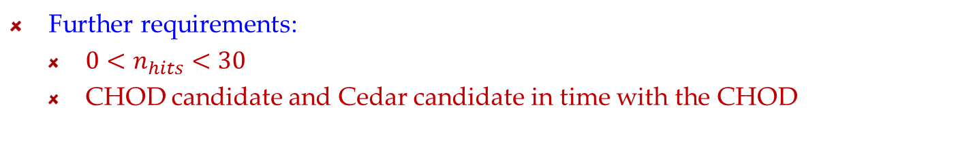
Multiple Straw-hits
Further requirements:
  $0<n_{hits}<30$
  CHOD candidate and Cedar candidate in time with the CHOD
40% of straws has more than 1 leading in the same event.
Time difference of the leadings belonging to the same Straw

Slide 12
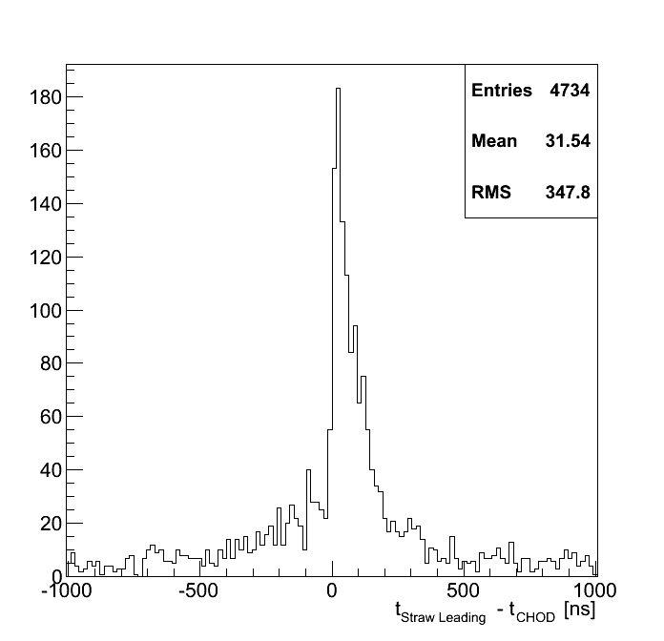
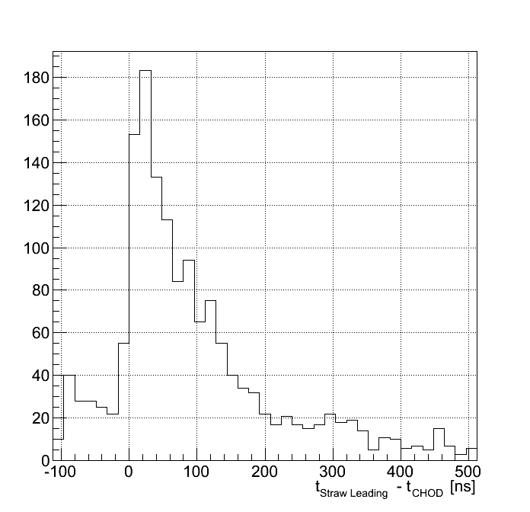
First Straw hit Timing
If >1 leading in the same straw within 200 ps the hit with the minimum time is considered.
No more shoulder in the second half of the drift time

Slide 13
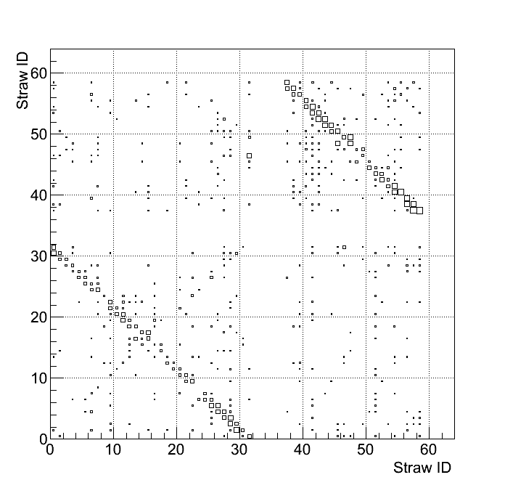
Plane correlations
Relative position of the hits belonging to different straws and within 200 ns
Pattern compatible with hits from one particle going straight

Slide 14
Conclusions
Method to handle triggerless data developed.
Timing correlation between Straws and other detectors evident.
View-planes correlation clearly visible.
Structure of the straw drift time to be investigated in detail.
Structure of the out-of-time event to be studied.
Straw multiple hit structure to be further investagated.

