Slide 1
Preparation for the installation of the CREAM readout
The LKr readout team

Slide 2
Cooling and power distribution
Decision taken to go to new heat exchangers
New exchangers to be bought now
Installation will follow
The old circuit has been already emptied
After the exchanger installation
Complete the installation of power plugs
2 long plug bars on each rack
4 crates + 4 switches
Not overload one single bar
Many power slots unaccessible because of equipment on the back/ exchangers

Slide 3
VME crates
All the ordered crates are at CERN
Connected to power
Keep them running to spot problems
Indeed:
A couple of fan trays had problems (fan failure) in the last delivery
To be reported to CAEN after their holidays
All the others on without failures for few months

Slide 4
Optical fibers
Installation completed
Fiber patch panels (both network and clock) will be on top of the racks EB01 and EB08 on the front face
Already being used by the CREAM setup in the dry run
Already discussed:
The path of the network fibers from the front panel to the internal back part of the racks 2-7
It is foreseen to install a complete crate (with all the services) to test the routing of cables and fibers

Slide 5
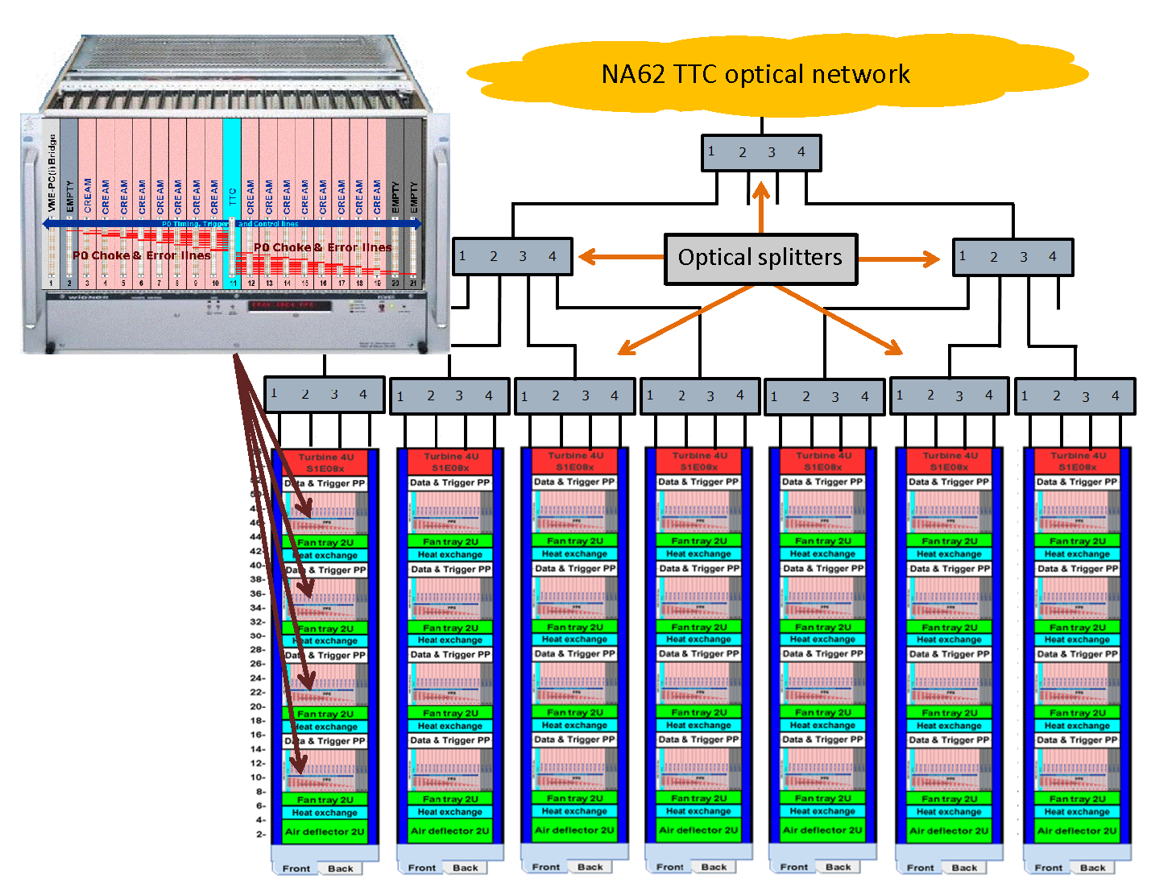

Slide 6
Broken regulator card
Reminder: during the control of the channels, a regulator board with a short circuit in input was found
Its removal with the standard procedure was failing, because one of the two screws was turning around
Eventually removed and a spare unit prepared for the substitution
For the removal, all the neighbouring cards where removed as well
Conservative approach to remount everything
Install the regulators one at the time
Check some of the corresponding channels to be sure the card is correctly installed
Go to the next one
During the tests, another board found faulty and replaced
Mechanical problem:
The initially faulty board was not fitting exactly in its position, because the hole in the brass box to the flange is too small
The board had to be grinded on one side to fit in

Slide 7
Channel checks
We have to complete the channel checks using calibration and scope.
About 3000 channels
Work started after the board repair
As of today, 1100 channels done
8 hours still needed
A refined investigation will be needed
To understand specific problems

Slide 8
Calibration driver hw/sw
Planned to upgrade the driver to new hardware
VME I/O registers instead of CAMAC
The TALK board to configure the pulse sequence
A patch panel PCB to match the old cables to the new connectors
New software as well
C++ code to handle the new hardware, run control and burst timing
Prototype setup by Christina Hughes (G. Mason Univ.)
TALK commands to be added
I plan to smoothly shift from the old system to the new one in the next months
In this way we can dismiss the last pieces of the NA48 LKr system

